Slide 1
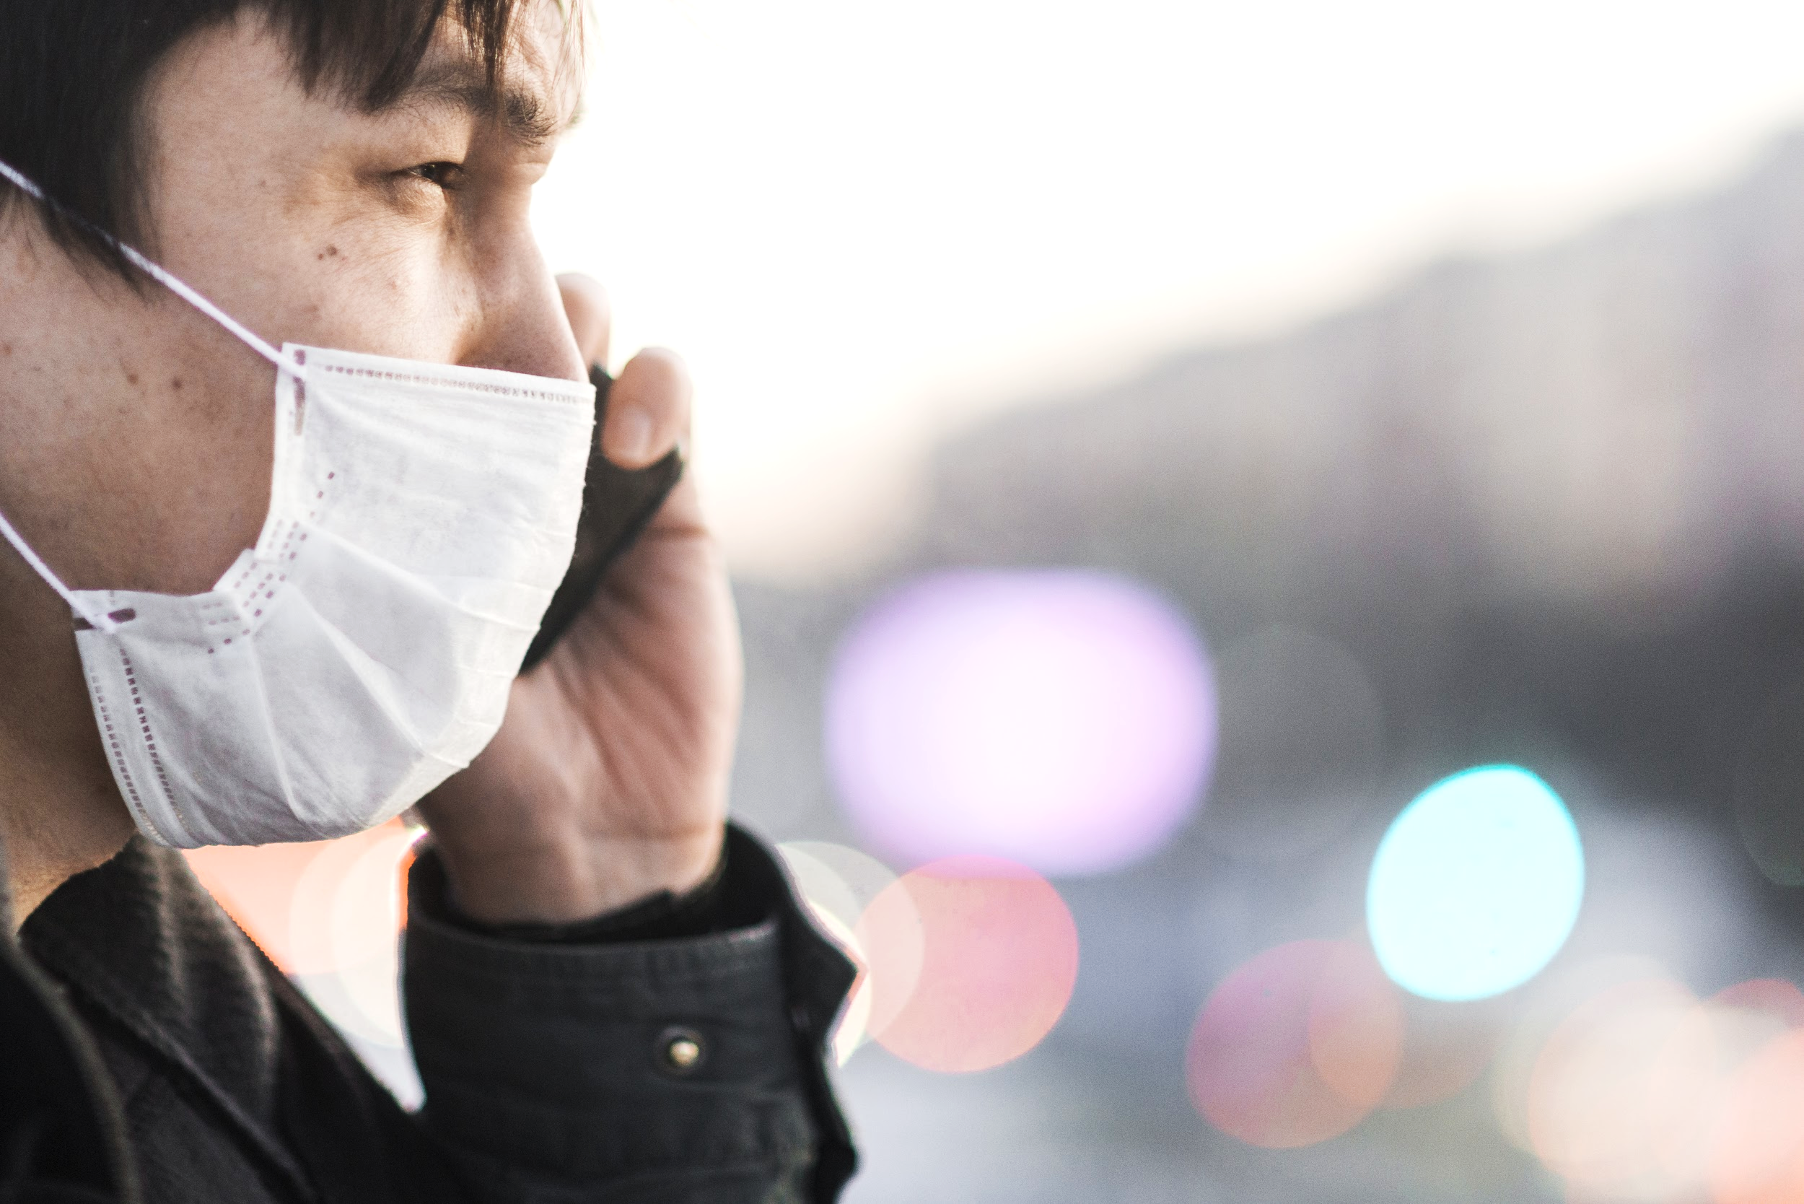
CORONAVIRUS CLINICAL CASE
Here is where the study begins

Slide 2
CONTENTS OF THIS TEMPLATE
Here’s what you’ll find in this Slidesgo template:
A slide structure based on a clinical case, which you can easily adapt to your needs. For more info on how to edit the template, please visit Slidesgo School or read our FAQs.
An assortment of pictures that are suitable for use in the presentation can be found in the alternative resources slide.
A thanks slide, which you must keep so that proper credits for our design are given.
A resources slide, where you’ll find links to all the elements used in the template.
Instructions for use.
Final slides with:
The fonts and colors used in the template.
More infographic resources, whose size and color can be edited.
Sets of customizable icons of the following themes: general, business, avatar, creative process, education, help & support, medical, nature, performing arts, SEO & marketing, and teamwork.
You can delete this slide when you’re done editing the presentation.

Slide 3
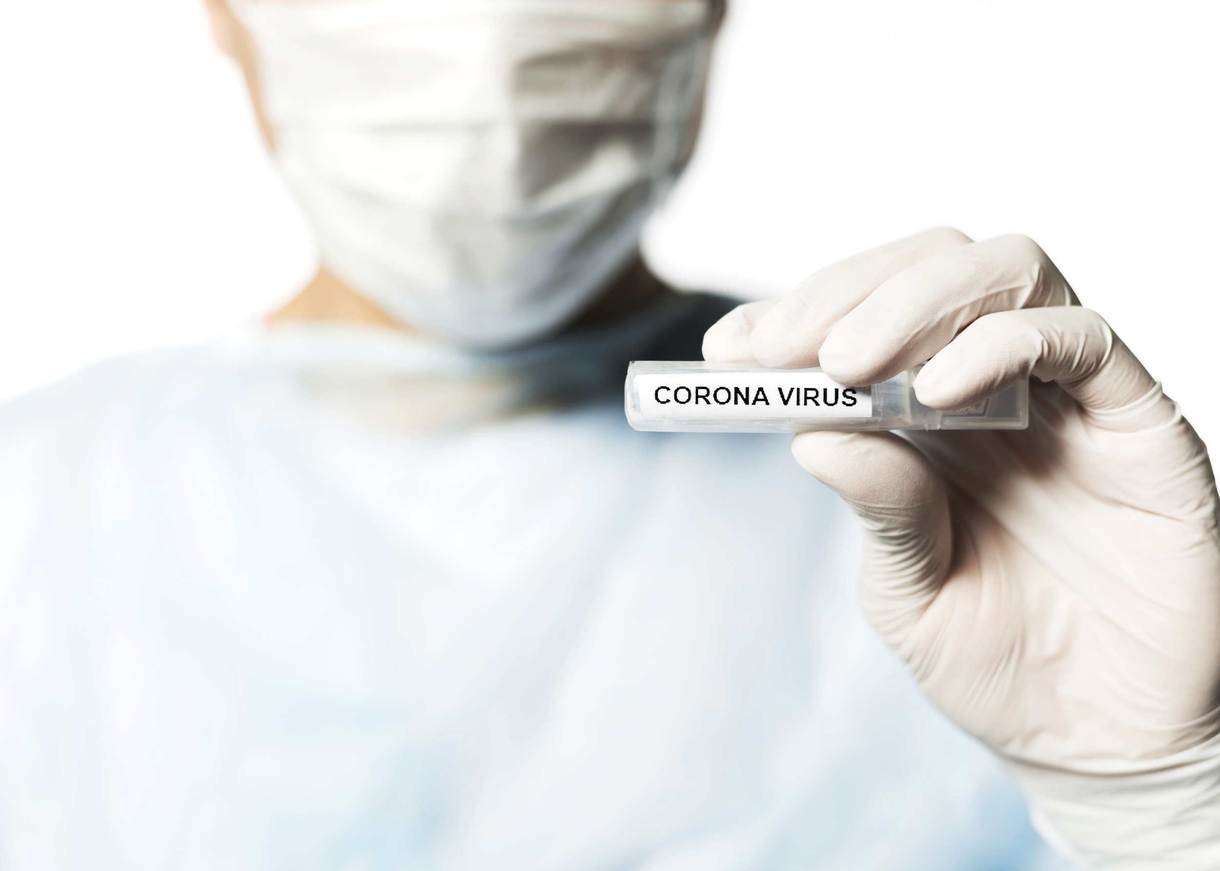
01.
ABOUT THE PATIENT
02.
DISCUSSION
03.
DIAGNOSIS
04.
TREATMENT
05.
PATIENT MONITORING
Describe here the topic of the section
Describe here the topic of the section
Describe here the topic of the section
Describe here the topic of the section
Describe here the topic of the section

Slide 4
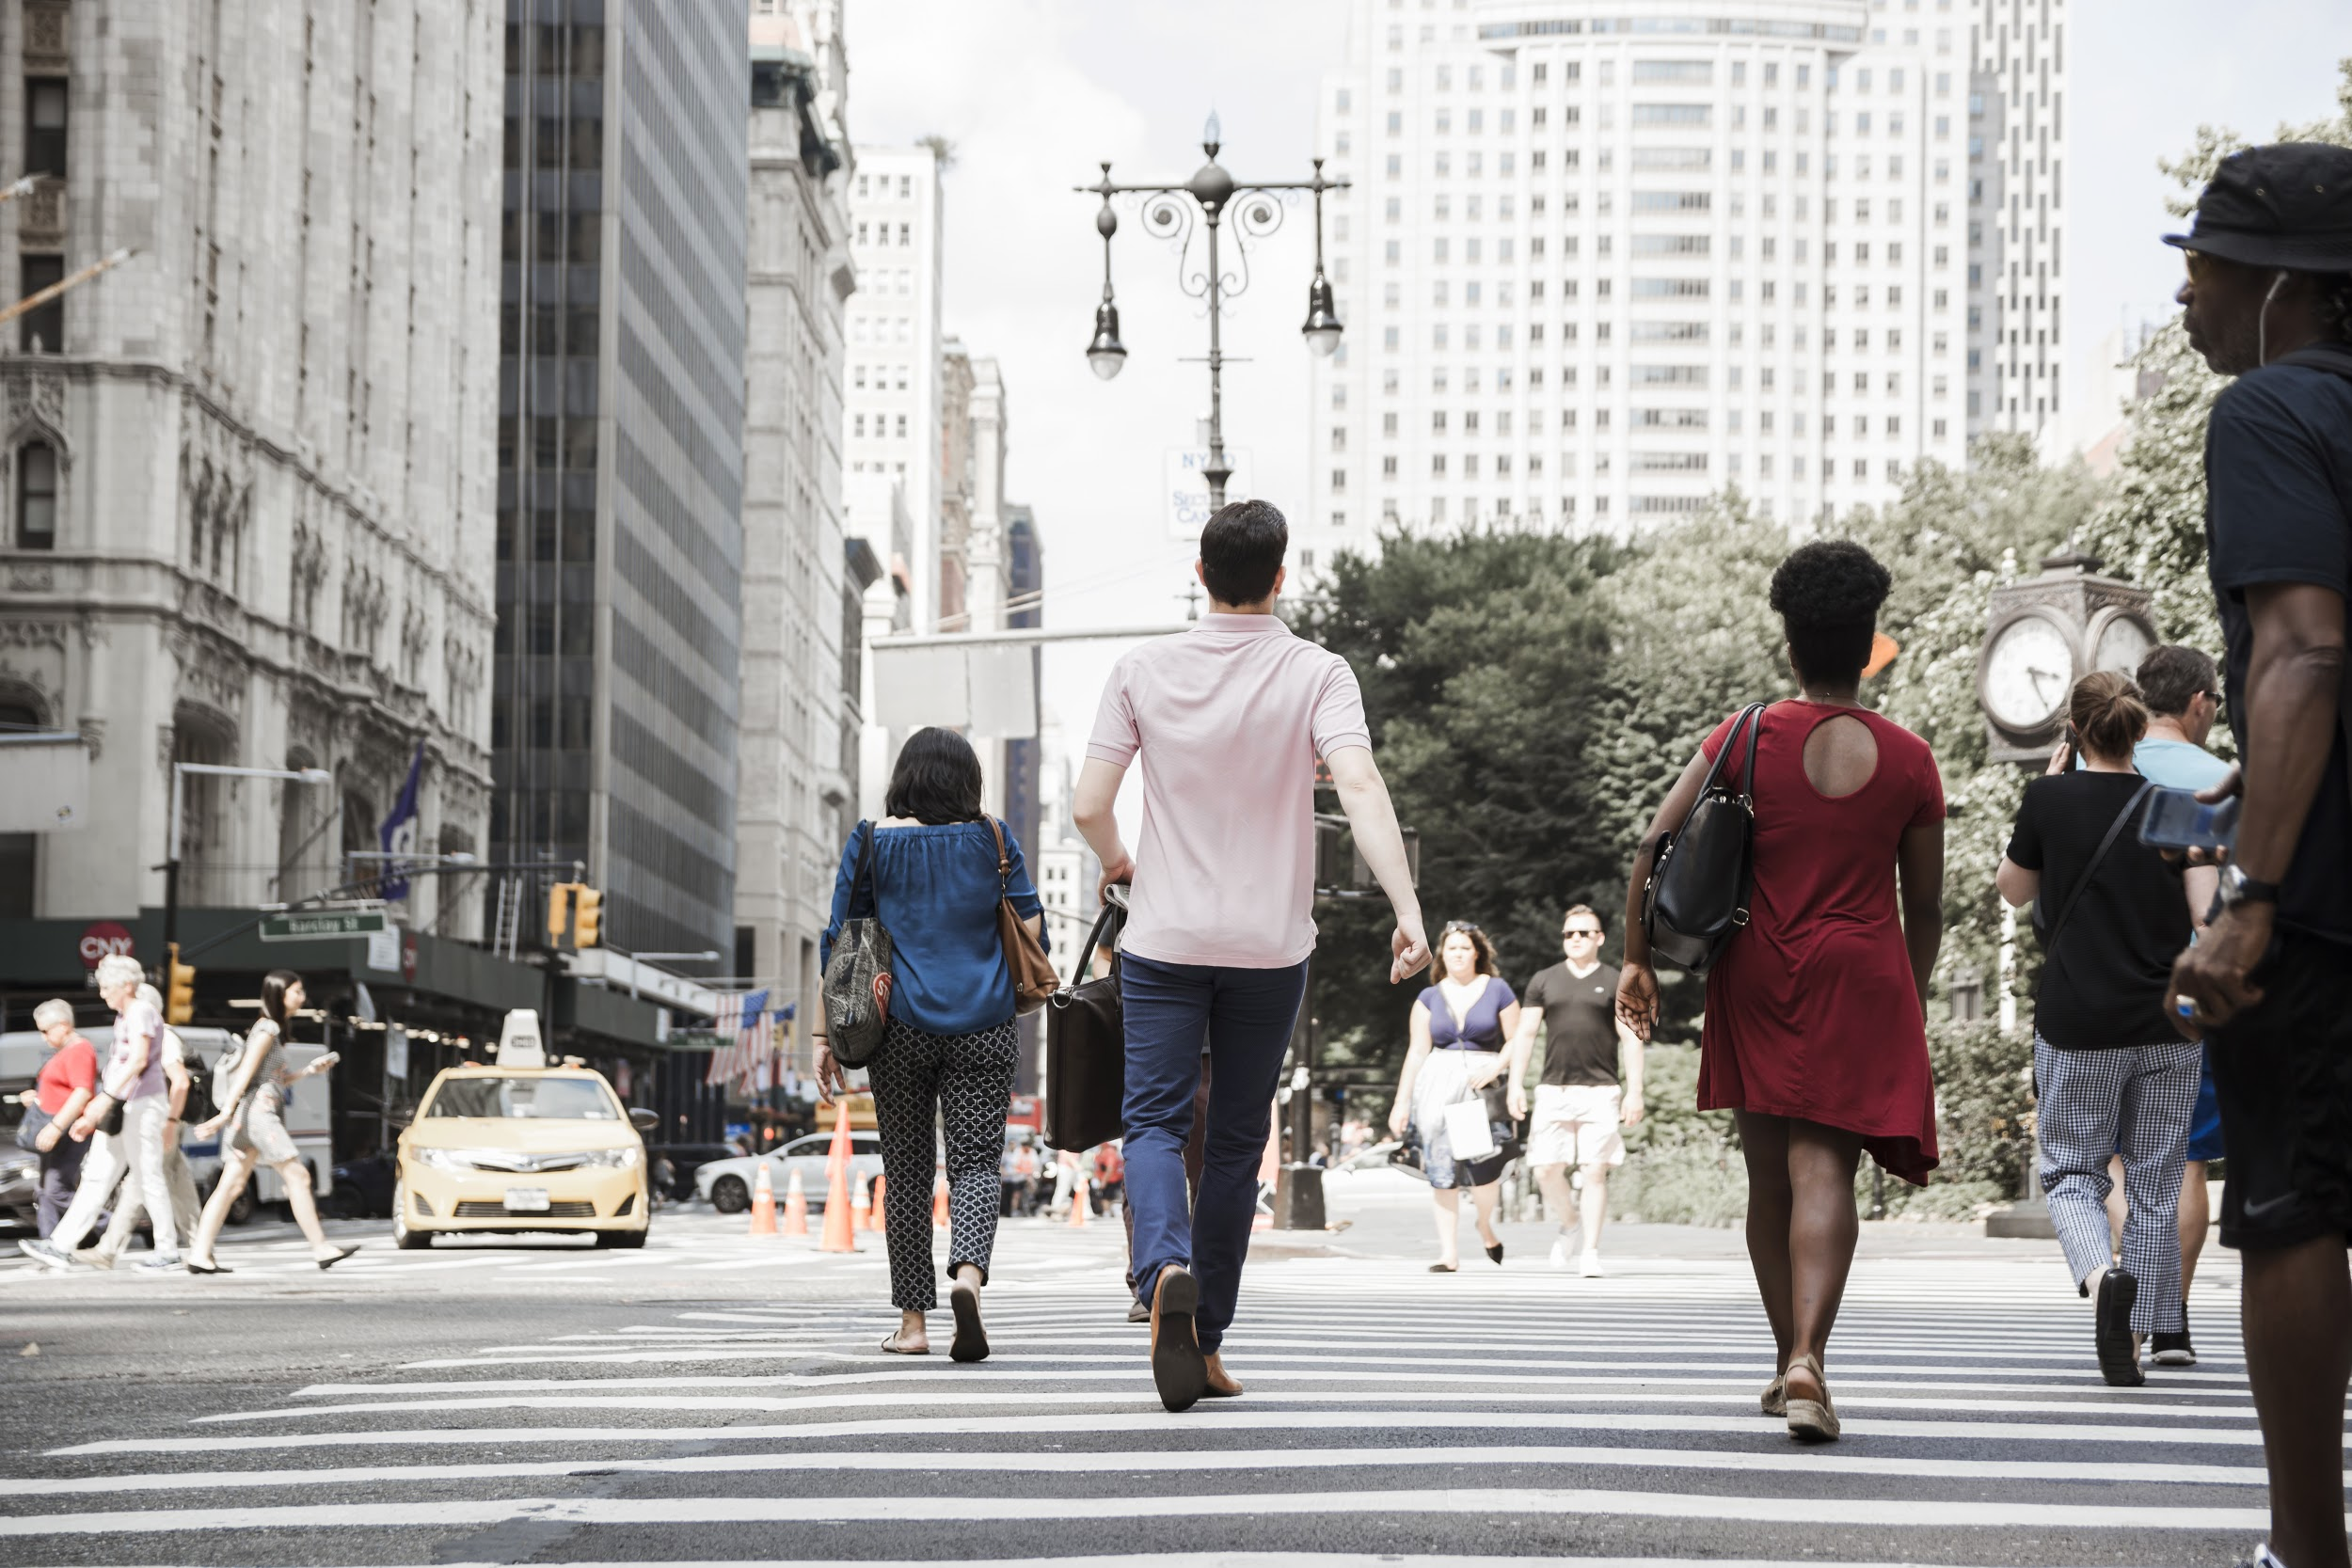
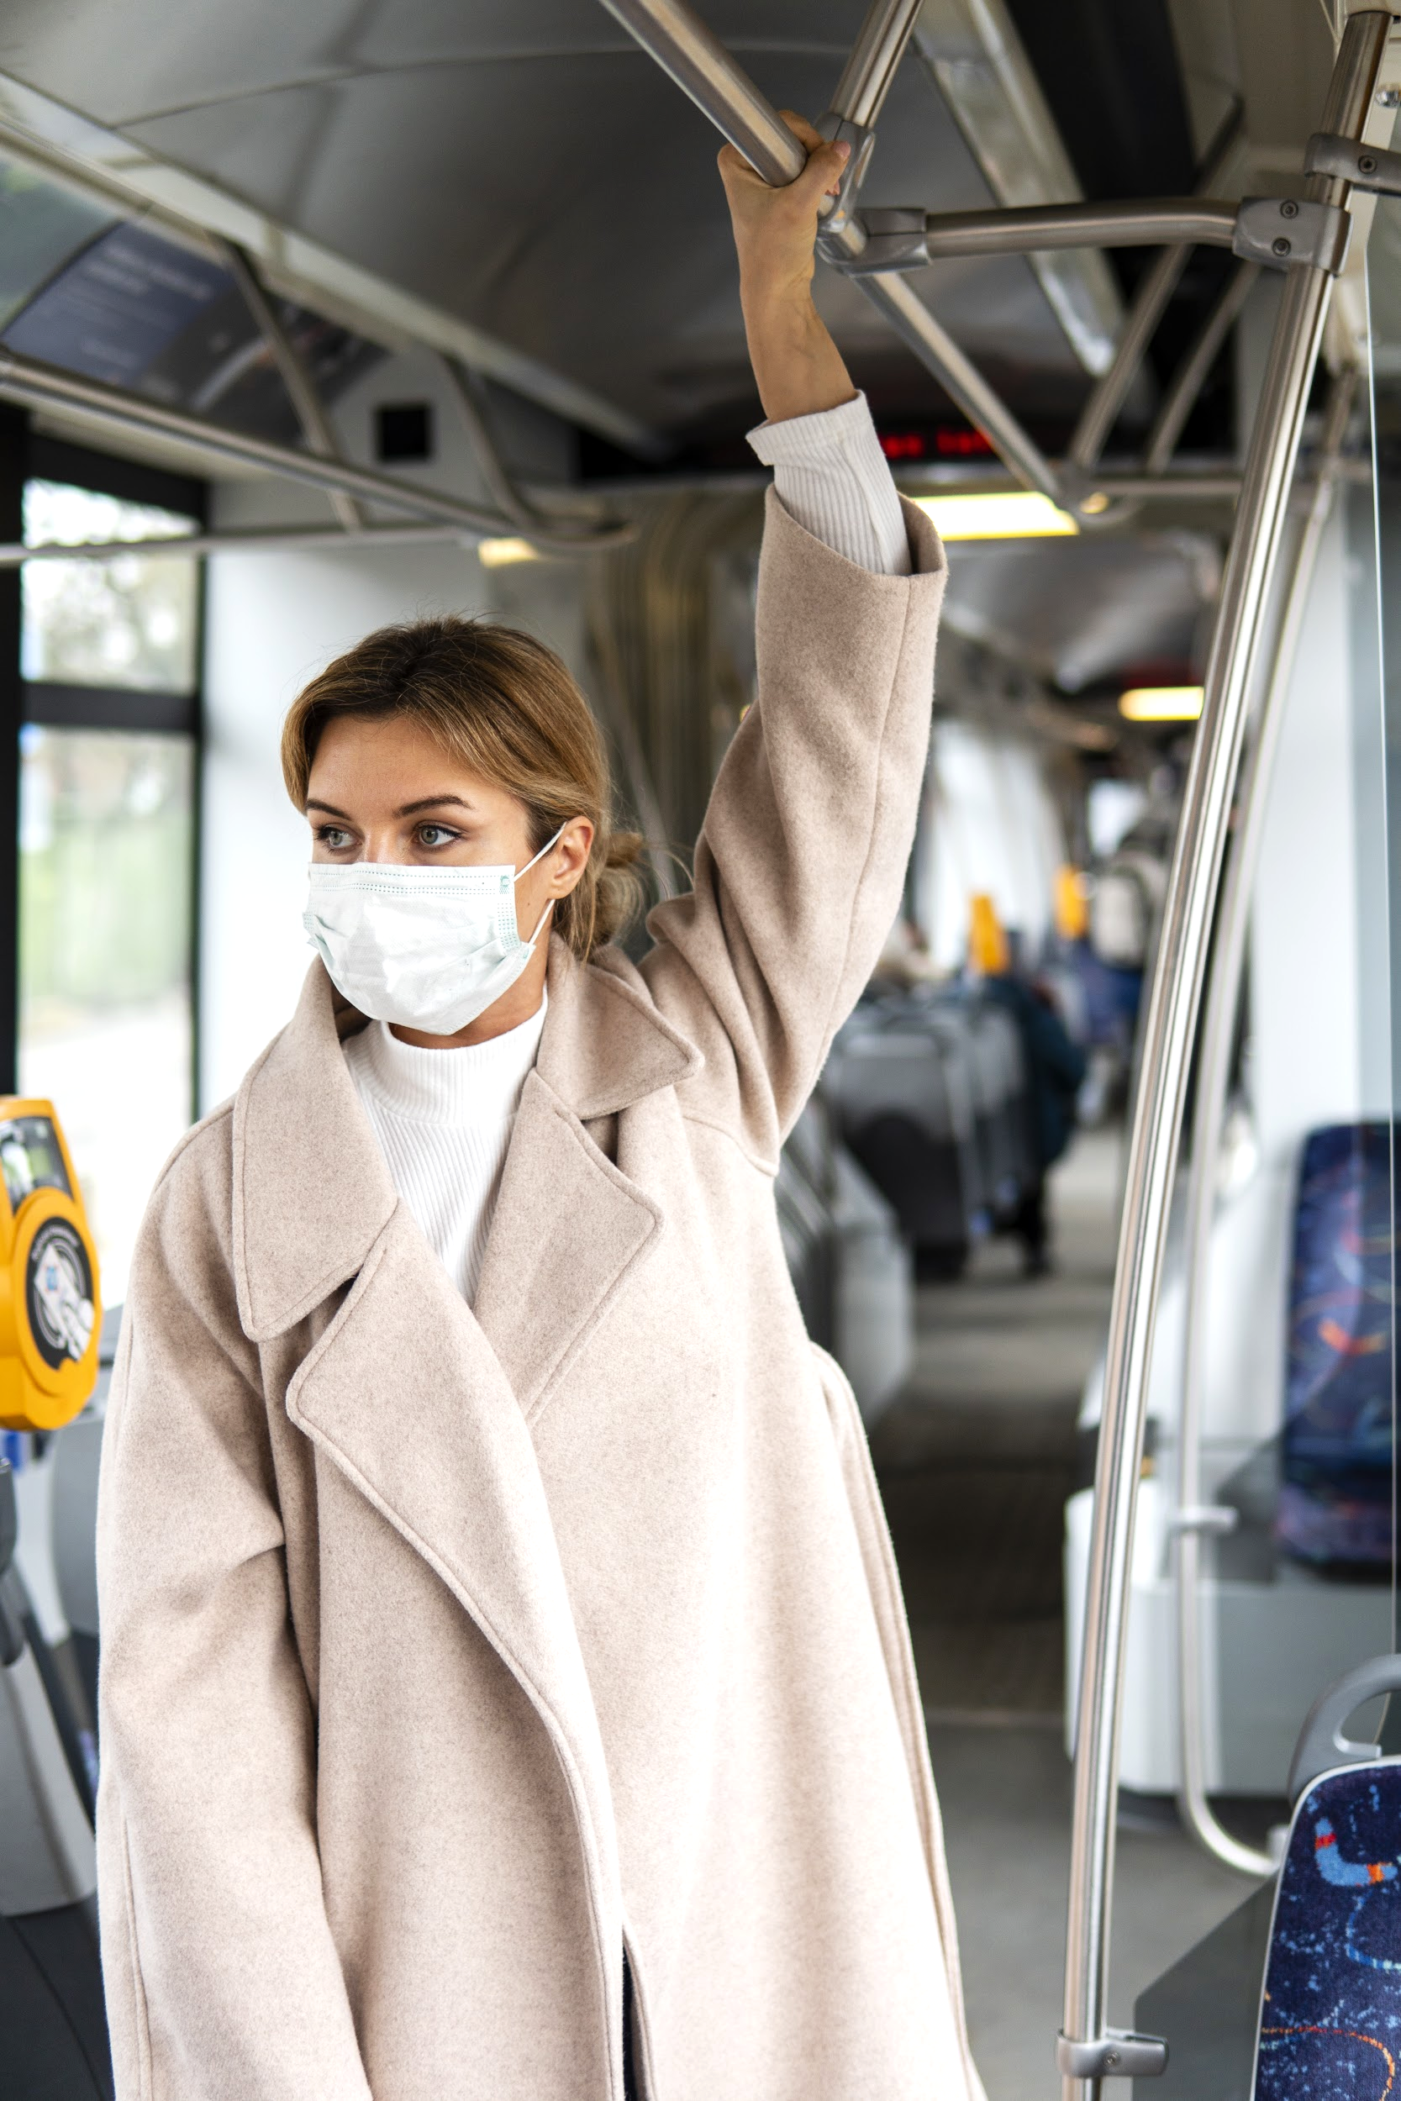
INTRODUCTION
COVID-19 is an infectious disease caused by the recently found virus known as SARS-CoV-2 (or coronavirus). Before the outbreak originated in Wuhan, China on December 2019, there was no information about this virus

Slide 5
IDENTIFYING INFORMATION
WHAT IS IT?
STATISTICS
PREVENTION
It’s an infectious disease caused by the recently found coronavirus
Coronavirus disease is having an impact on global economy and society
There are recommendations to follow in order to prevent the spread

Slide 6
01
ABOUT THE PATIENT
You can enter a subtitle here if you need it

Slide 7
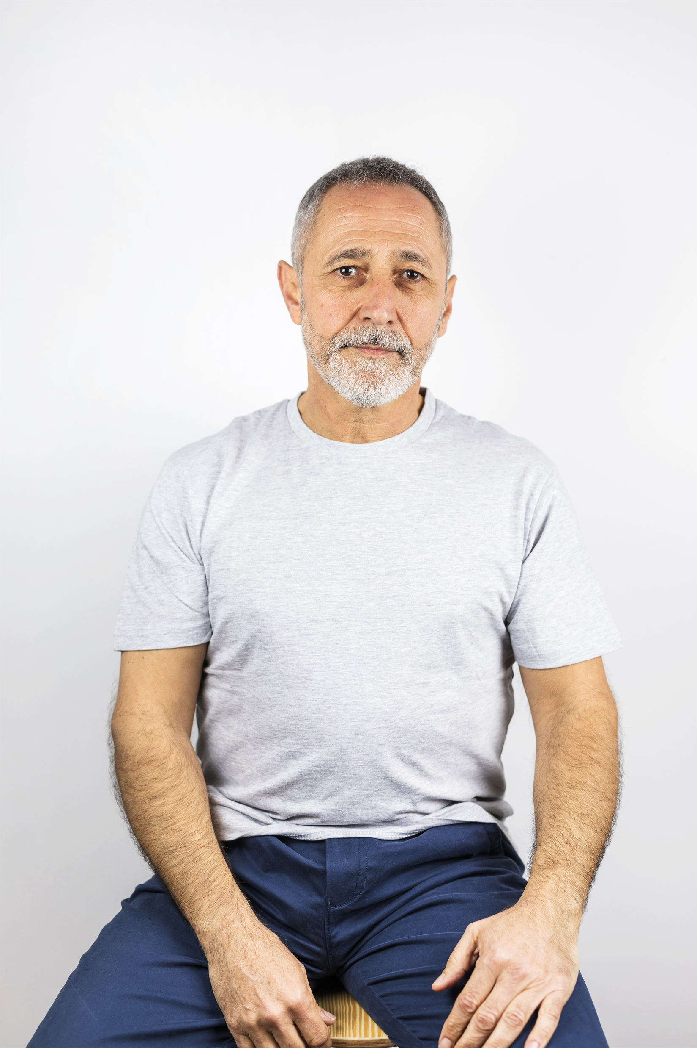
PATIENT MEDICAL HISTORY
AGE | 65
GENDER | Male
DISEASES | Cardiovascular Problems
LOCATION | Madrid, Spain
DAY 1
DAY 5
DAY 8
DAY 13
Visited an infected area
First symptoms started to appear
Needed hospitalization
Was fully cured and discharged

Slide 8
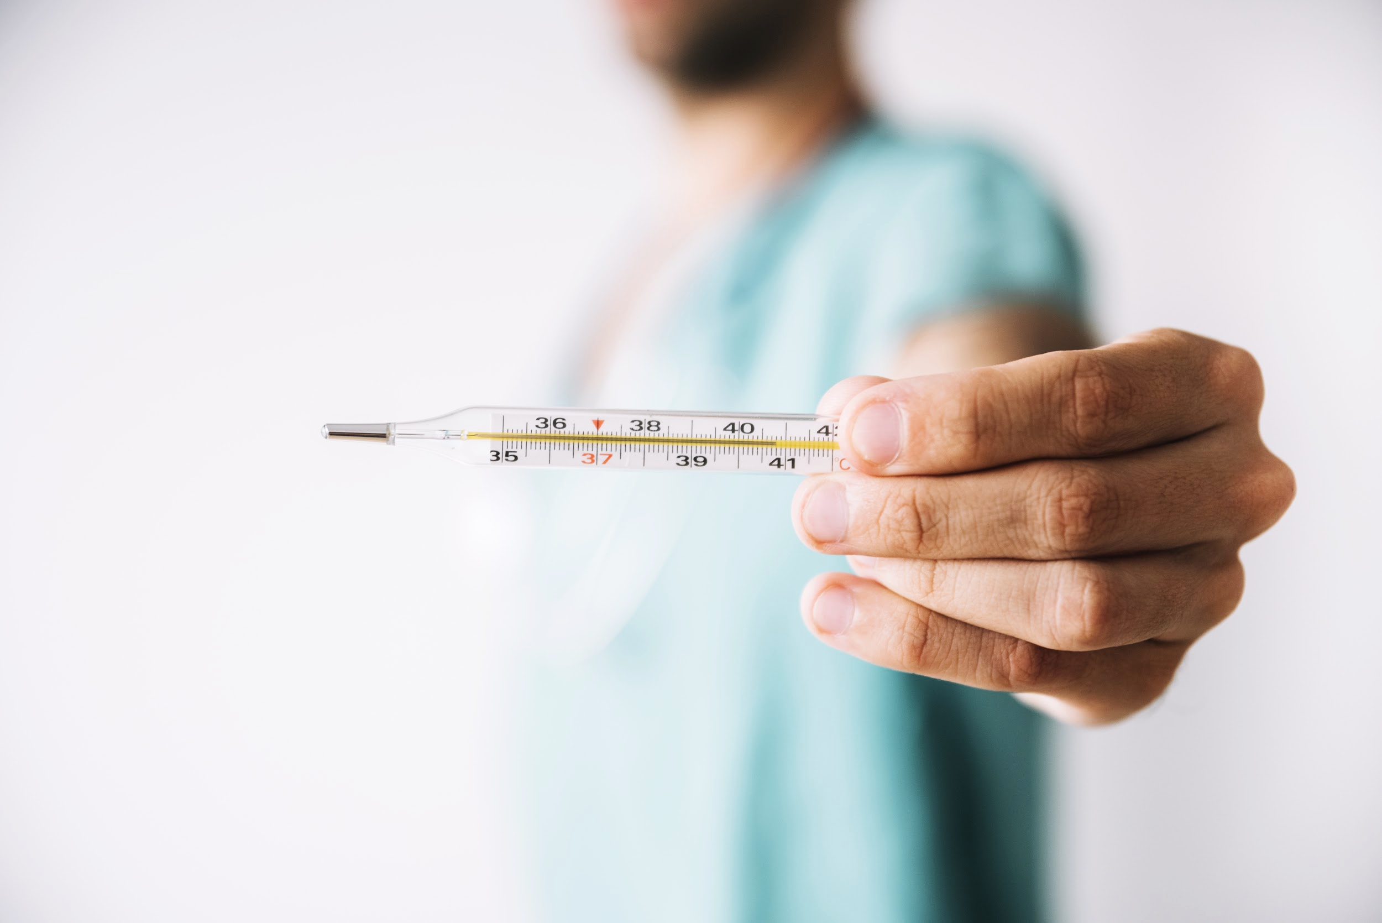
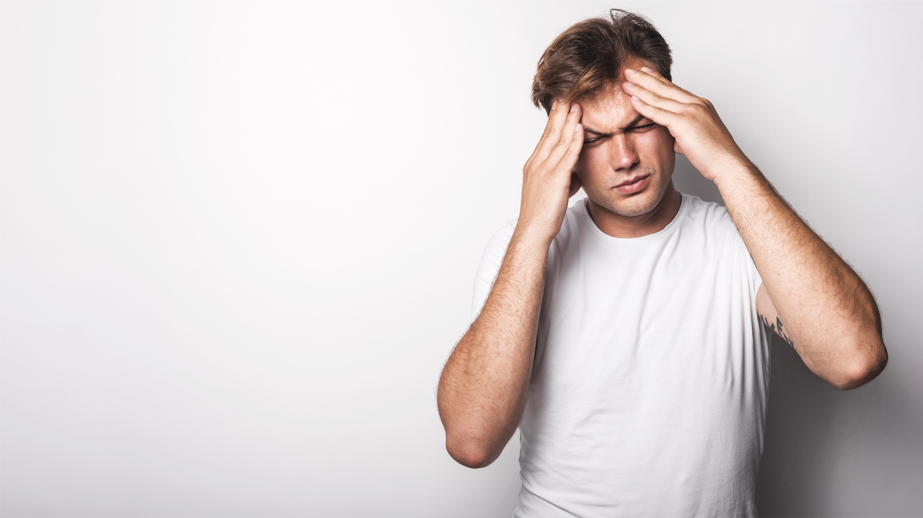
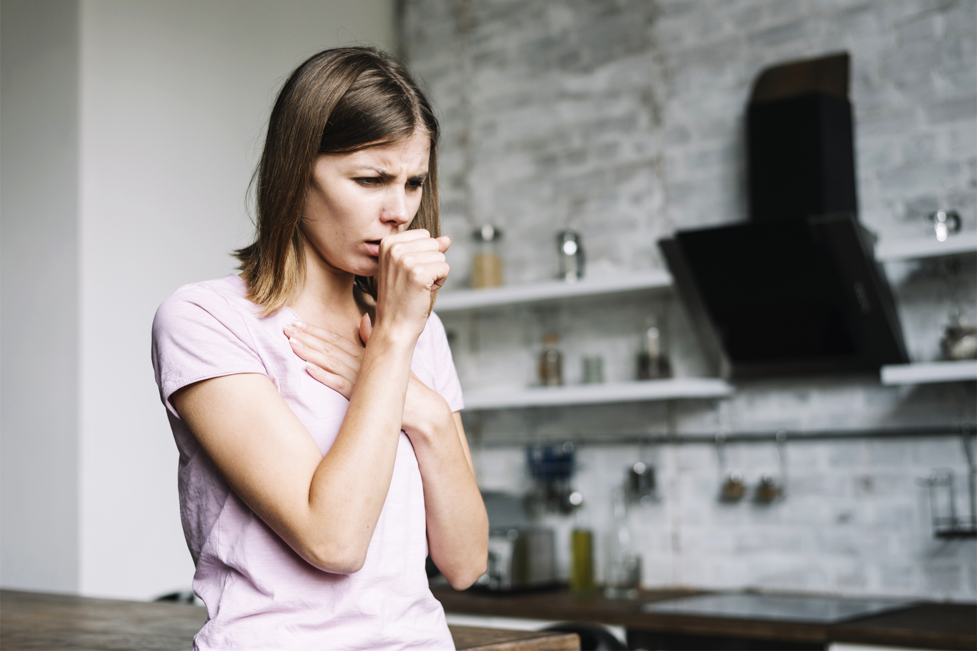
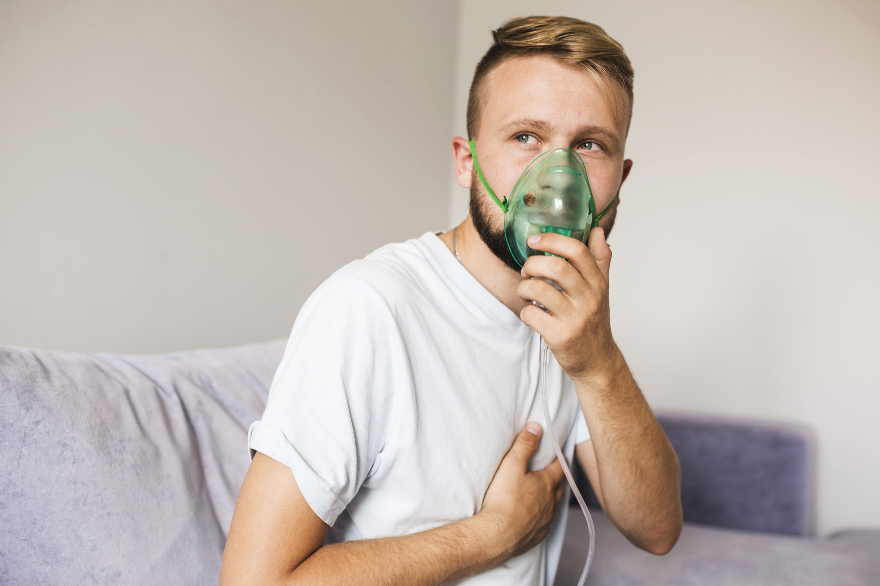
REVIEW OF SYMPTOMS
HIGH FEVER
HEADACHE
DRY COUGH
DYSPNOEA
The body temperature can exceed 37.3 ºC
The patient can suffer from headaches
Constant coughing without expelling mucus
Breathing actually feels more difficult

Slide 9
PHYSICAL EXAMINATION
COMMON SYMPTOMS
EVENTUAL SYMPTOMS
FEVER
PNEUMONIA
DRY COUGH
KIDNEY FAILURES
BAD BREATHING
GASTRO DISORDERS
The body temperature can exceed 37.3 ºC
Inflammation of both lungs
Constant coughing without expelling mucus
Kidney failures can result in vomiting
Breathing actually feels more difficult
The patient may suffer from diarrhea

Slide 10
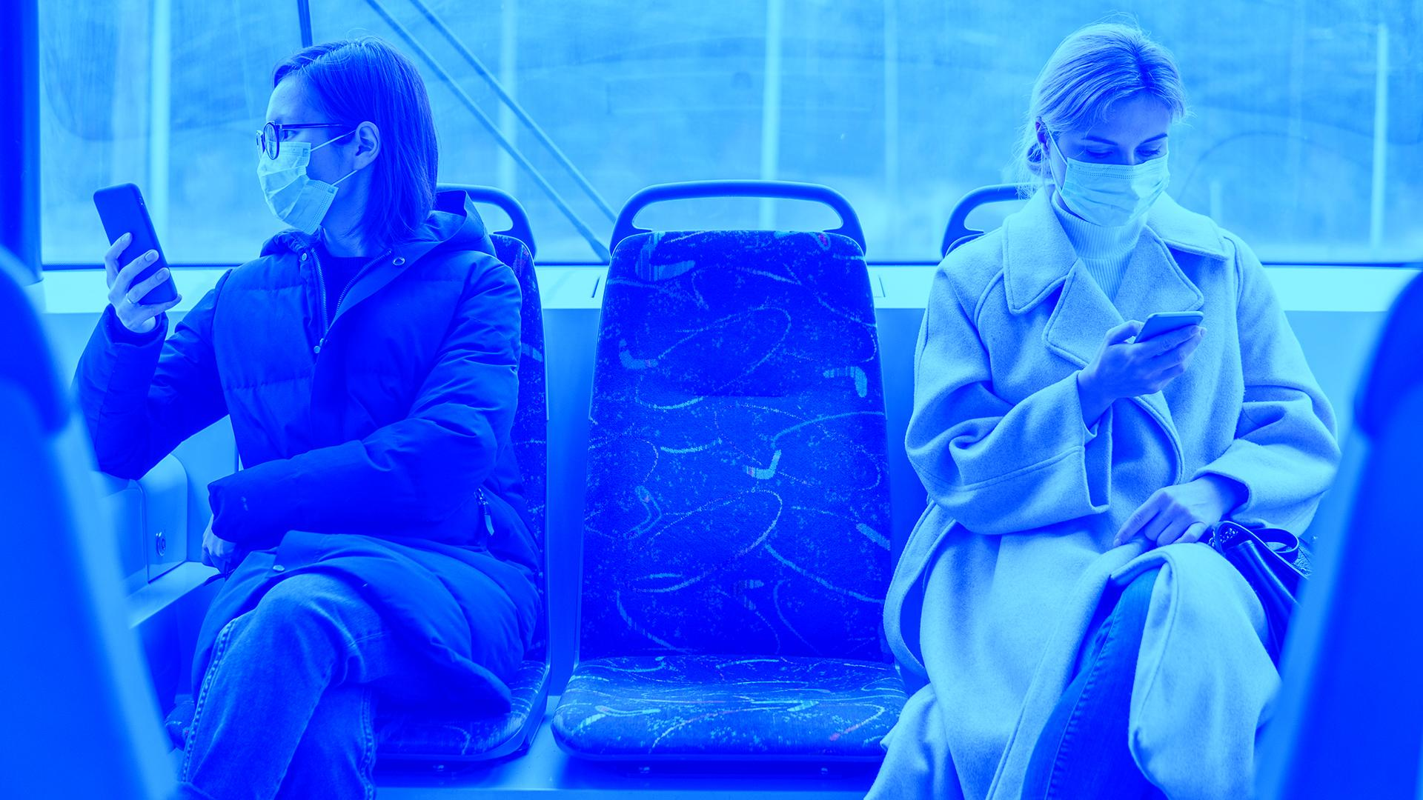
WORLD HEALTH ORGANIZATION ESTIMATES THE CONTAGION RATE IS 1.4 TO 2.5

Slide 11
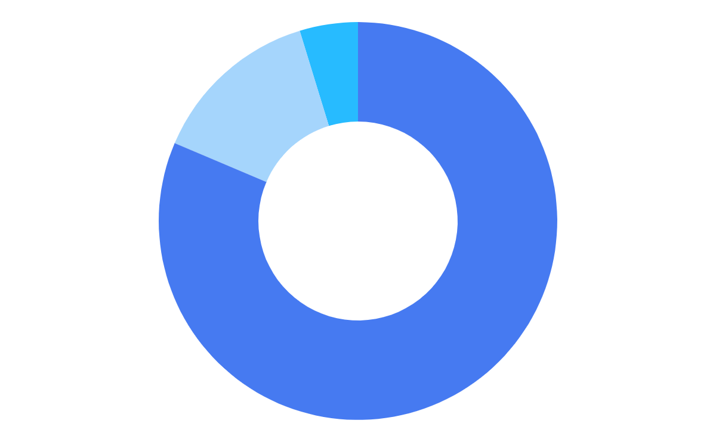
FINDINGS
SAMPLE
DEATH RATE
70.000
2.8%
1.7%
CASES SEVERITY
AGE
81%
13.8%
4.7%
infected people
Men
Women
10 - 49
50 - 59
Mild Cases
60 - 69
Serious Cases
Critical Cases
70+

Slide 12
CONFIRMED CASES
0-100 Cases
101-999 Cases
1000+ Cases
*Source: European Centre for Disease Prevention and Control (ECDC)
*Latest update: March 11, 2020

Slide 13
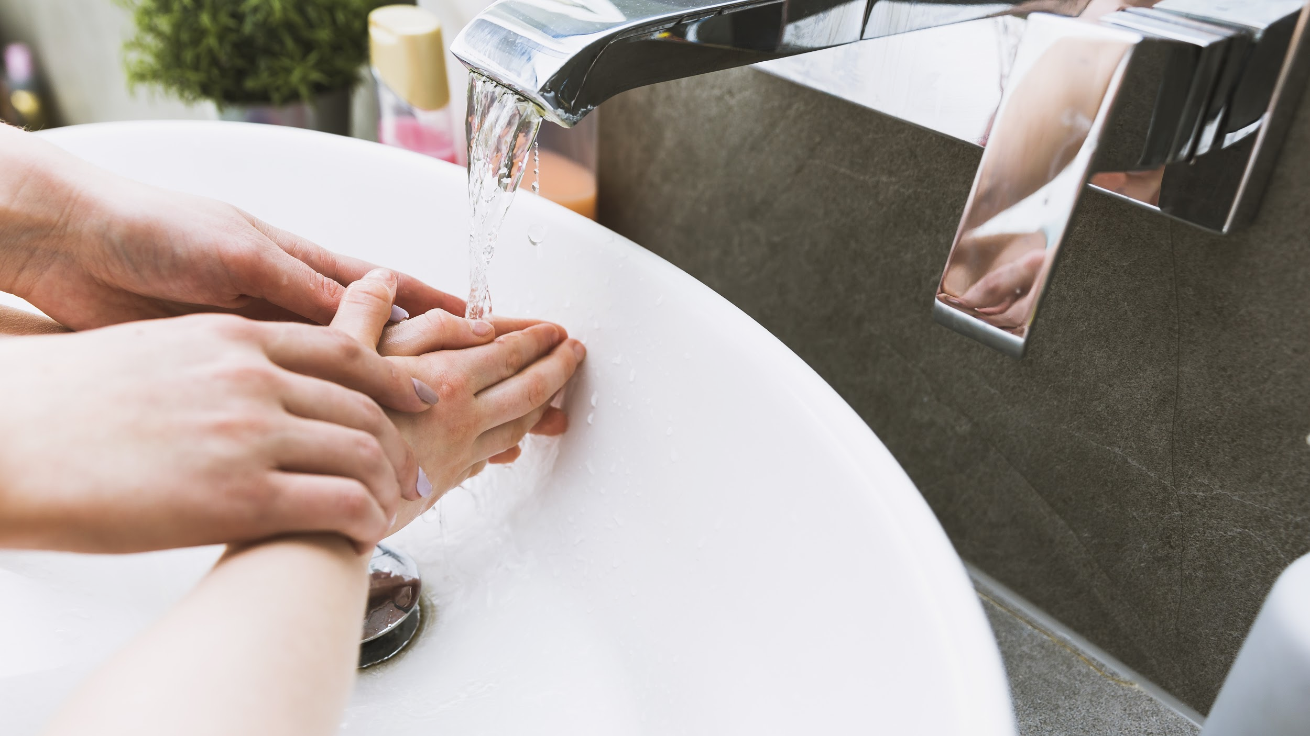
DISCUSSION
Dr. Tedros Adhanom Gebreyesus, WHO Director
Margarita del Val, virologist and immunologist
"We are following the epidemic and the levels of contagion. That is why COVID-19 is a pandemic"
"Quarantines, contact tracing, and any measures to reduce the spread of coronavirus are required"

Slide 14
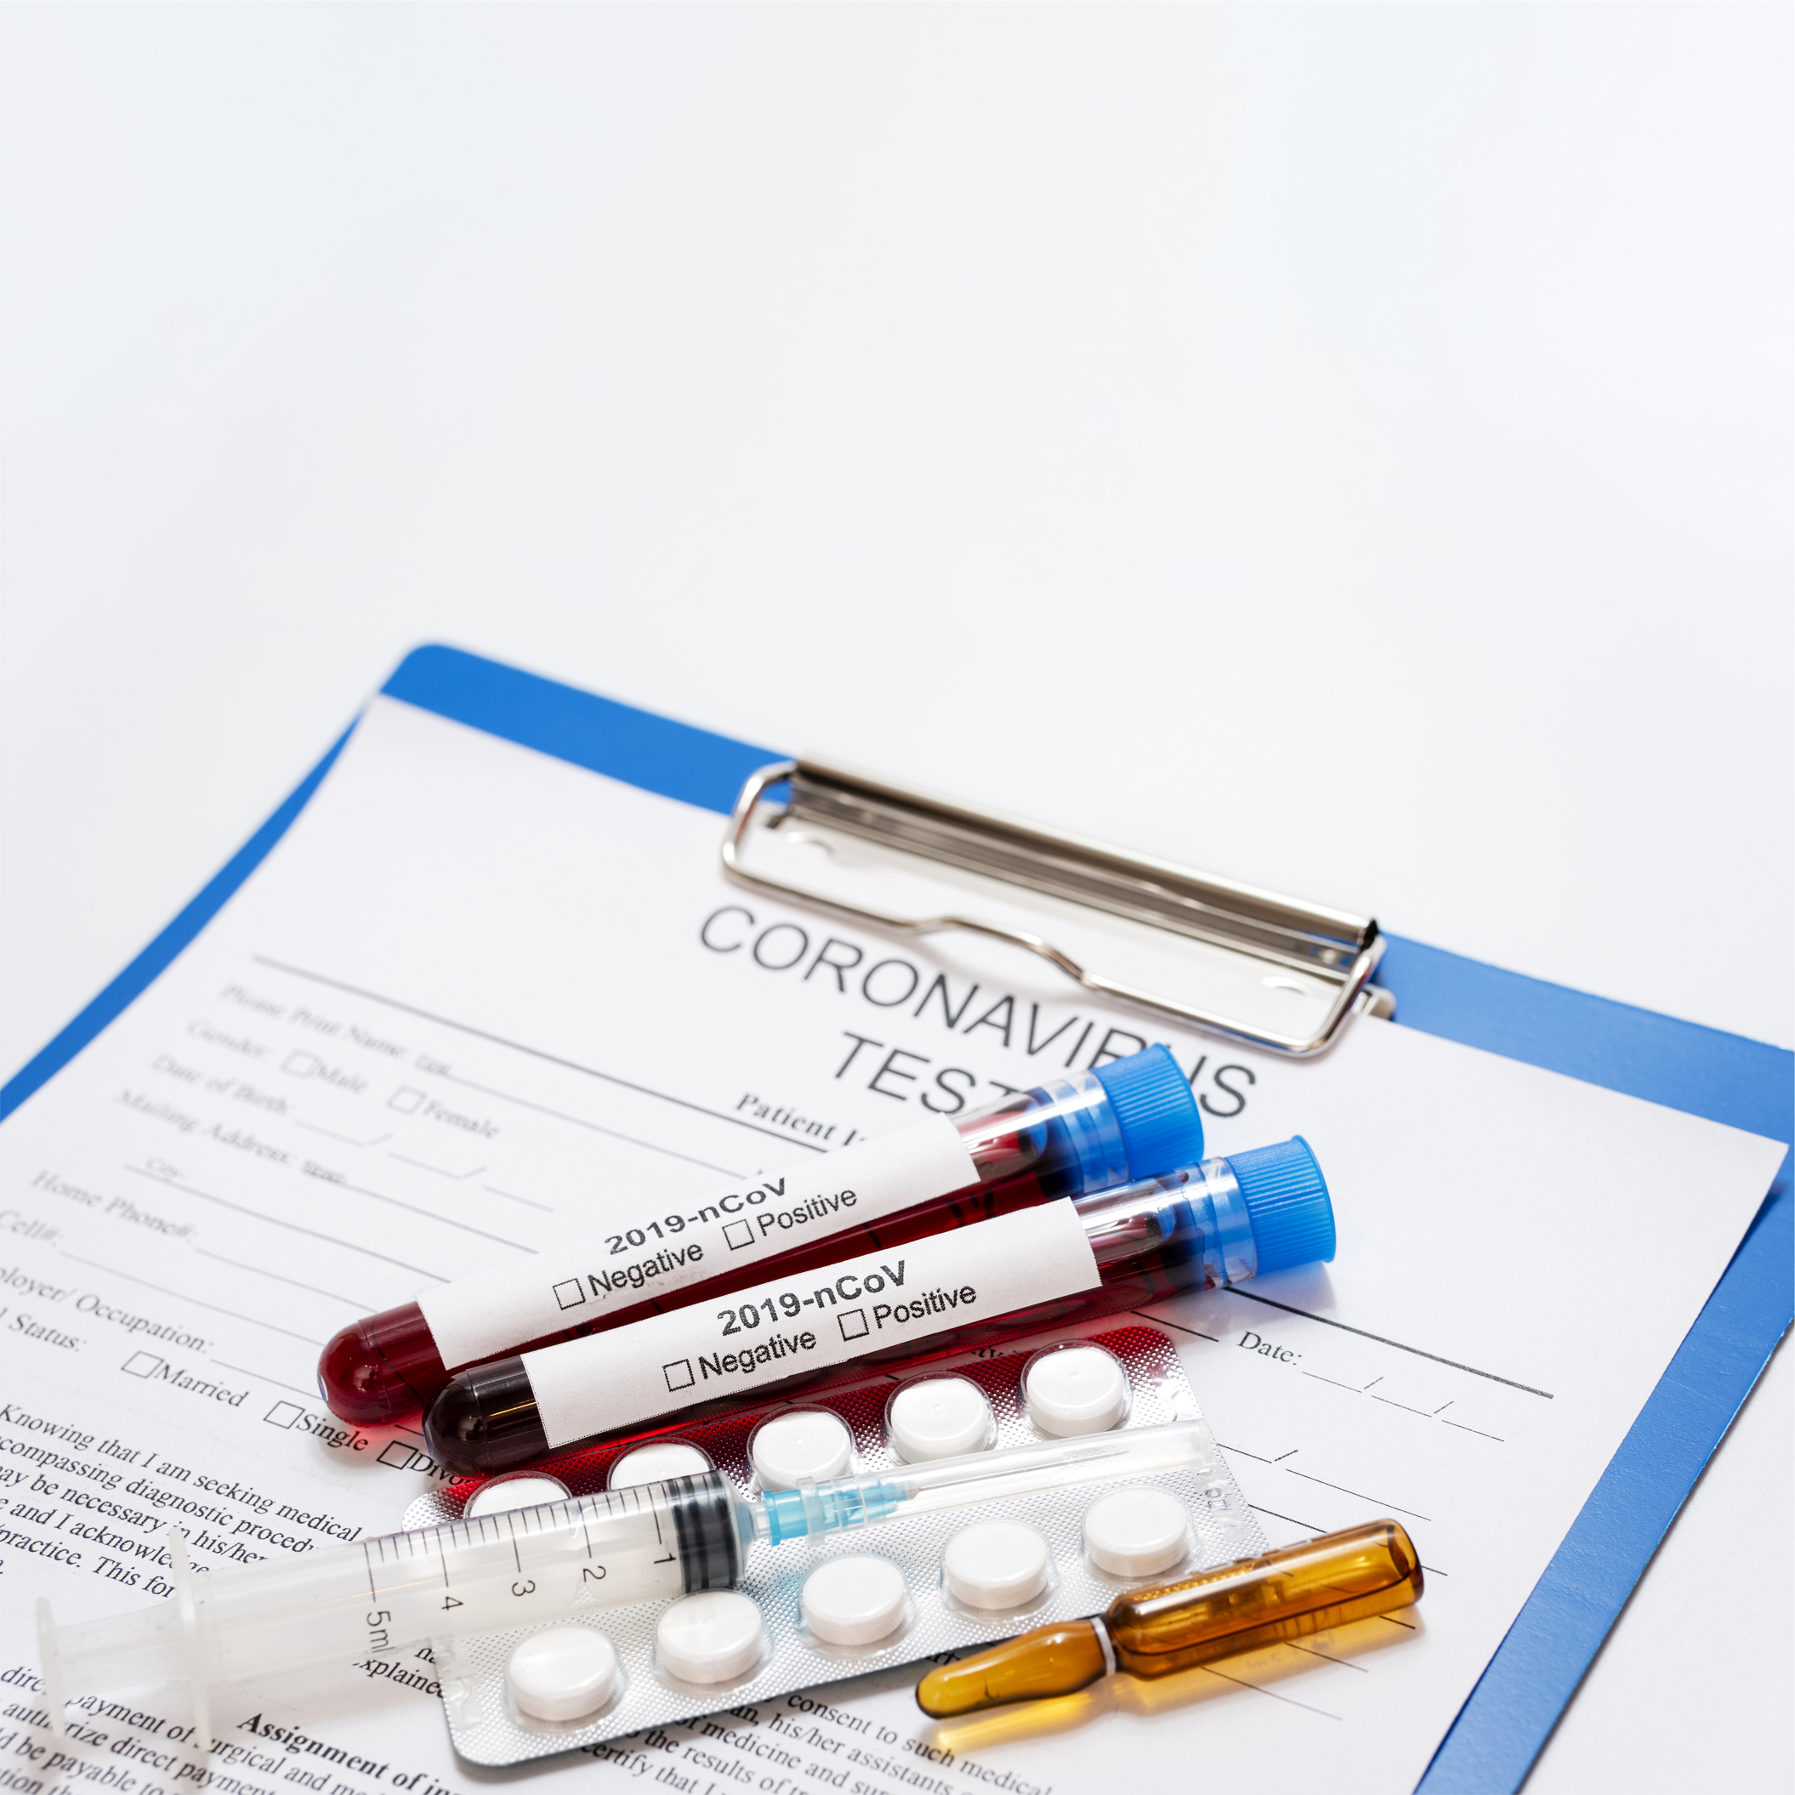
DISCUSSION SUMMARY
According to WHO, all countries can still change the course of this pandemic

Slide 15
118,629
Confirmed Cases*
* Updated on 03/11/2020. Data from the European Center for Disease Prevention and Control

Slide 16
COMPARISON
 | Iran | Korea | China | Italy
Factor 1
Factor 2
Factor 3
Factor 4

Slide 17
DIAGNOSIS
TRAVEL ABROAD
CONTACT
INFECTED AREAS
NOSE CULTURE
SALIVA SAMPLES
THORAX CHECK
People who travel abroad to infected countries
People who have been in contact with infected people
Especially big cities in those countries with reported cases
Samples are taken from the uppermost part of the throat
Samples are taken from the saliva in the tongue
Looking for presence of fluids in the lung spaces

Slide 18
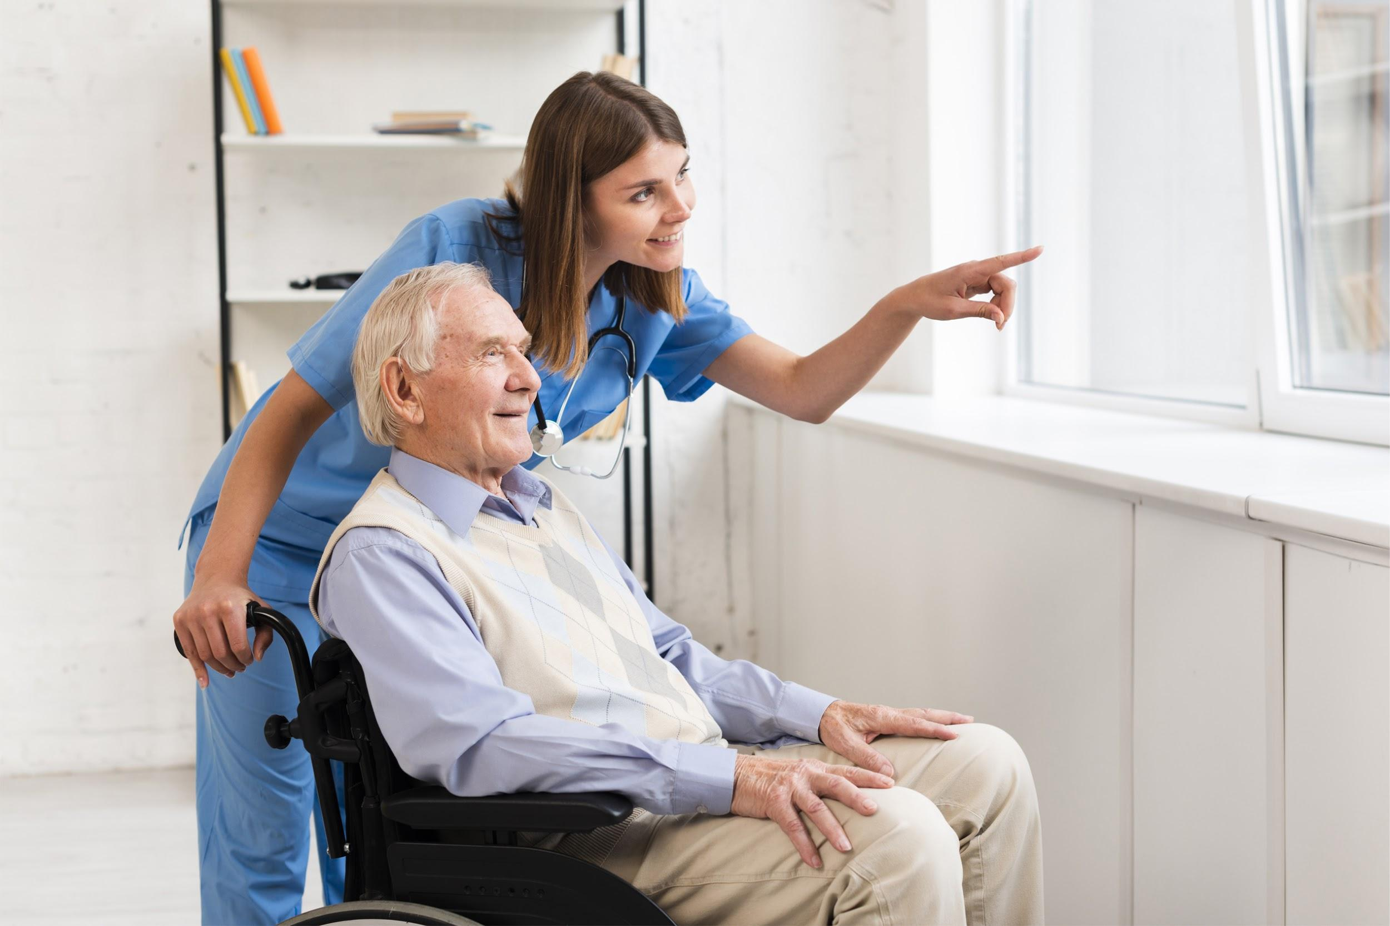
TREATMENT
At the moment there is no specific vaccine or treatment for COVID-19. No antiviral medication is currently recommended to treat the disease. Treatment focuses on relieving symptoms
Analgesics
Syrup or cough medication
Rest
Drink liquids

Slide 19
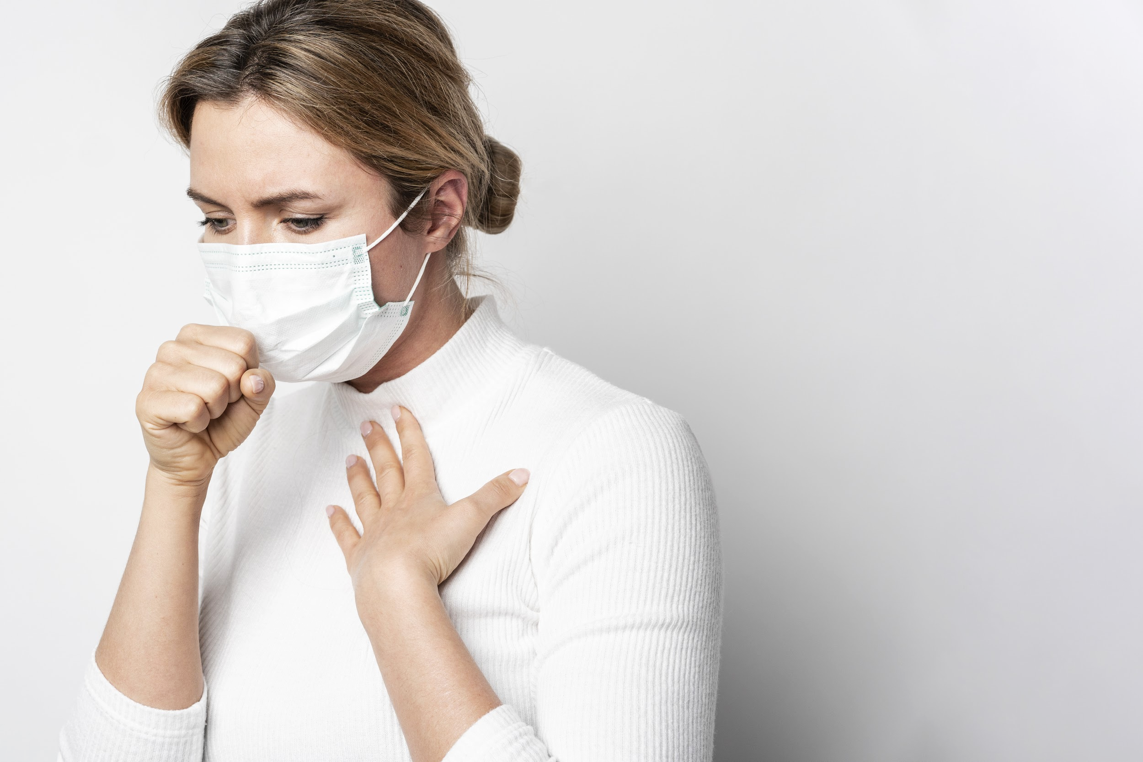
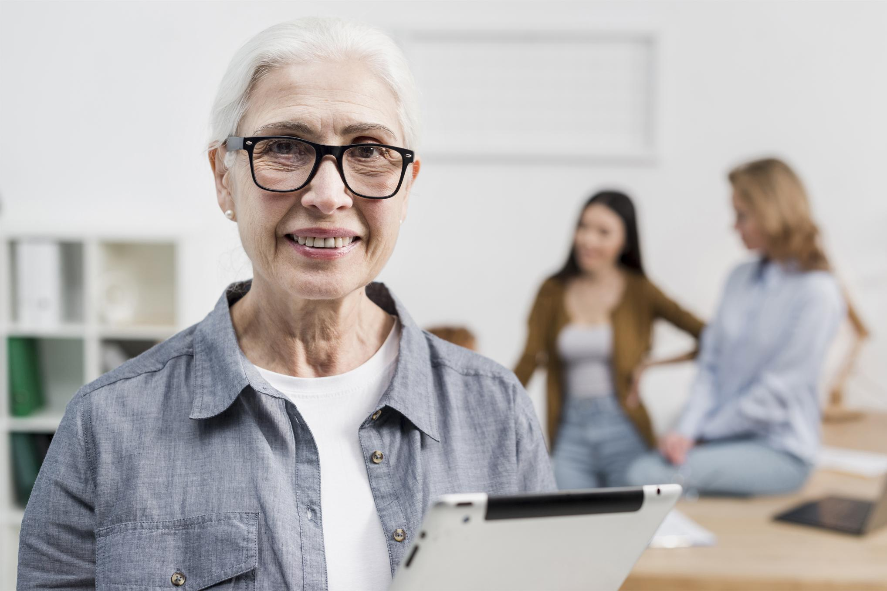
PATIENT MONITORING
WEEK 1
WEEK 3
WEEK 2
WEEK 4
Factor 1
Factor 1
Factor 2
Factor 2
Factor 1
Factor 1
Factor 2
Factor 2

Slide 20
CONTRAINDICATIONS & INDICATIONS
WHAT SHOULD YOU DO
WHAT TO AVOID
Wash your hands frequently
Greet others by waving or bowing
Inform as soon as you have symptoms
Stay home for as long as possible
Touching your mouth, eyes or nose
Traveling to risk areas unless strictly necessary
Going to closed and crowded places
Sharing news whose sources you don’t know

Slide 21
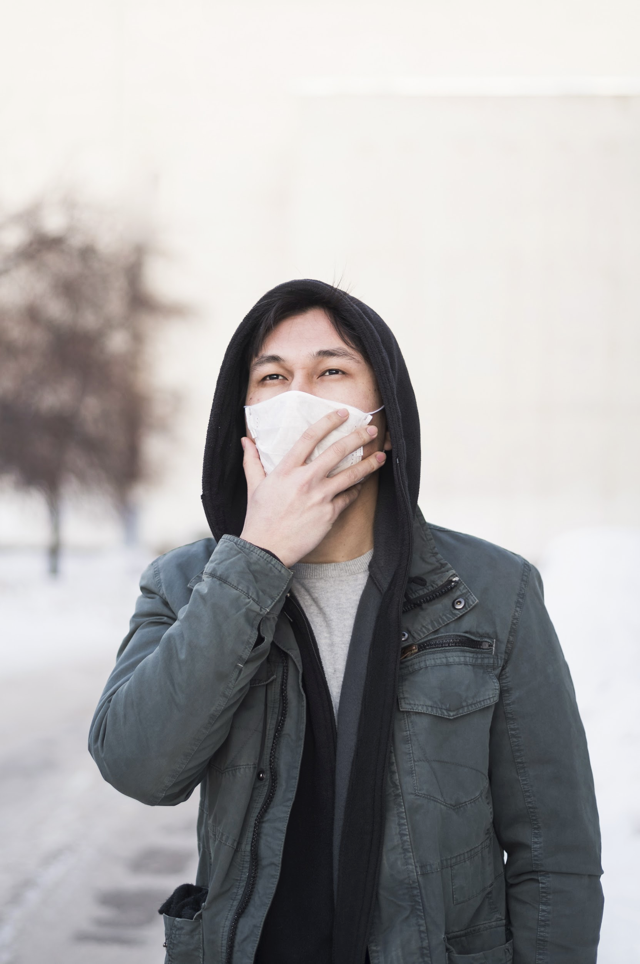

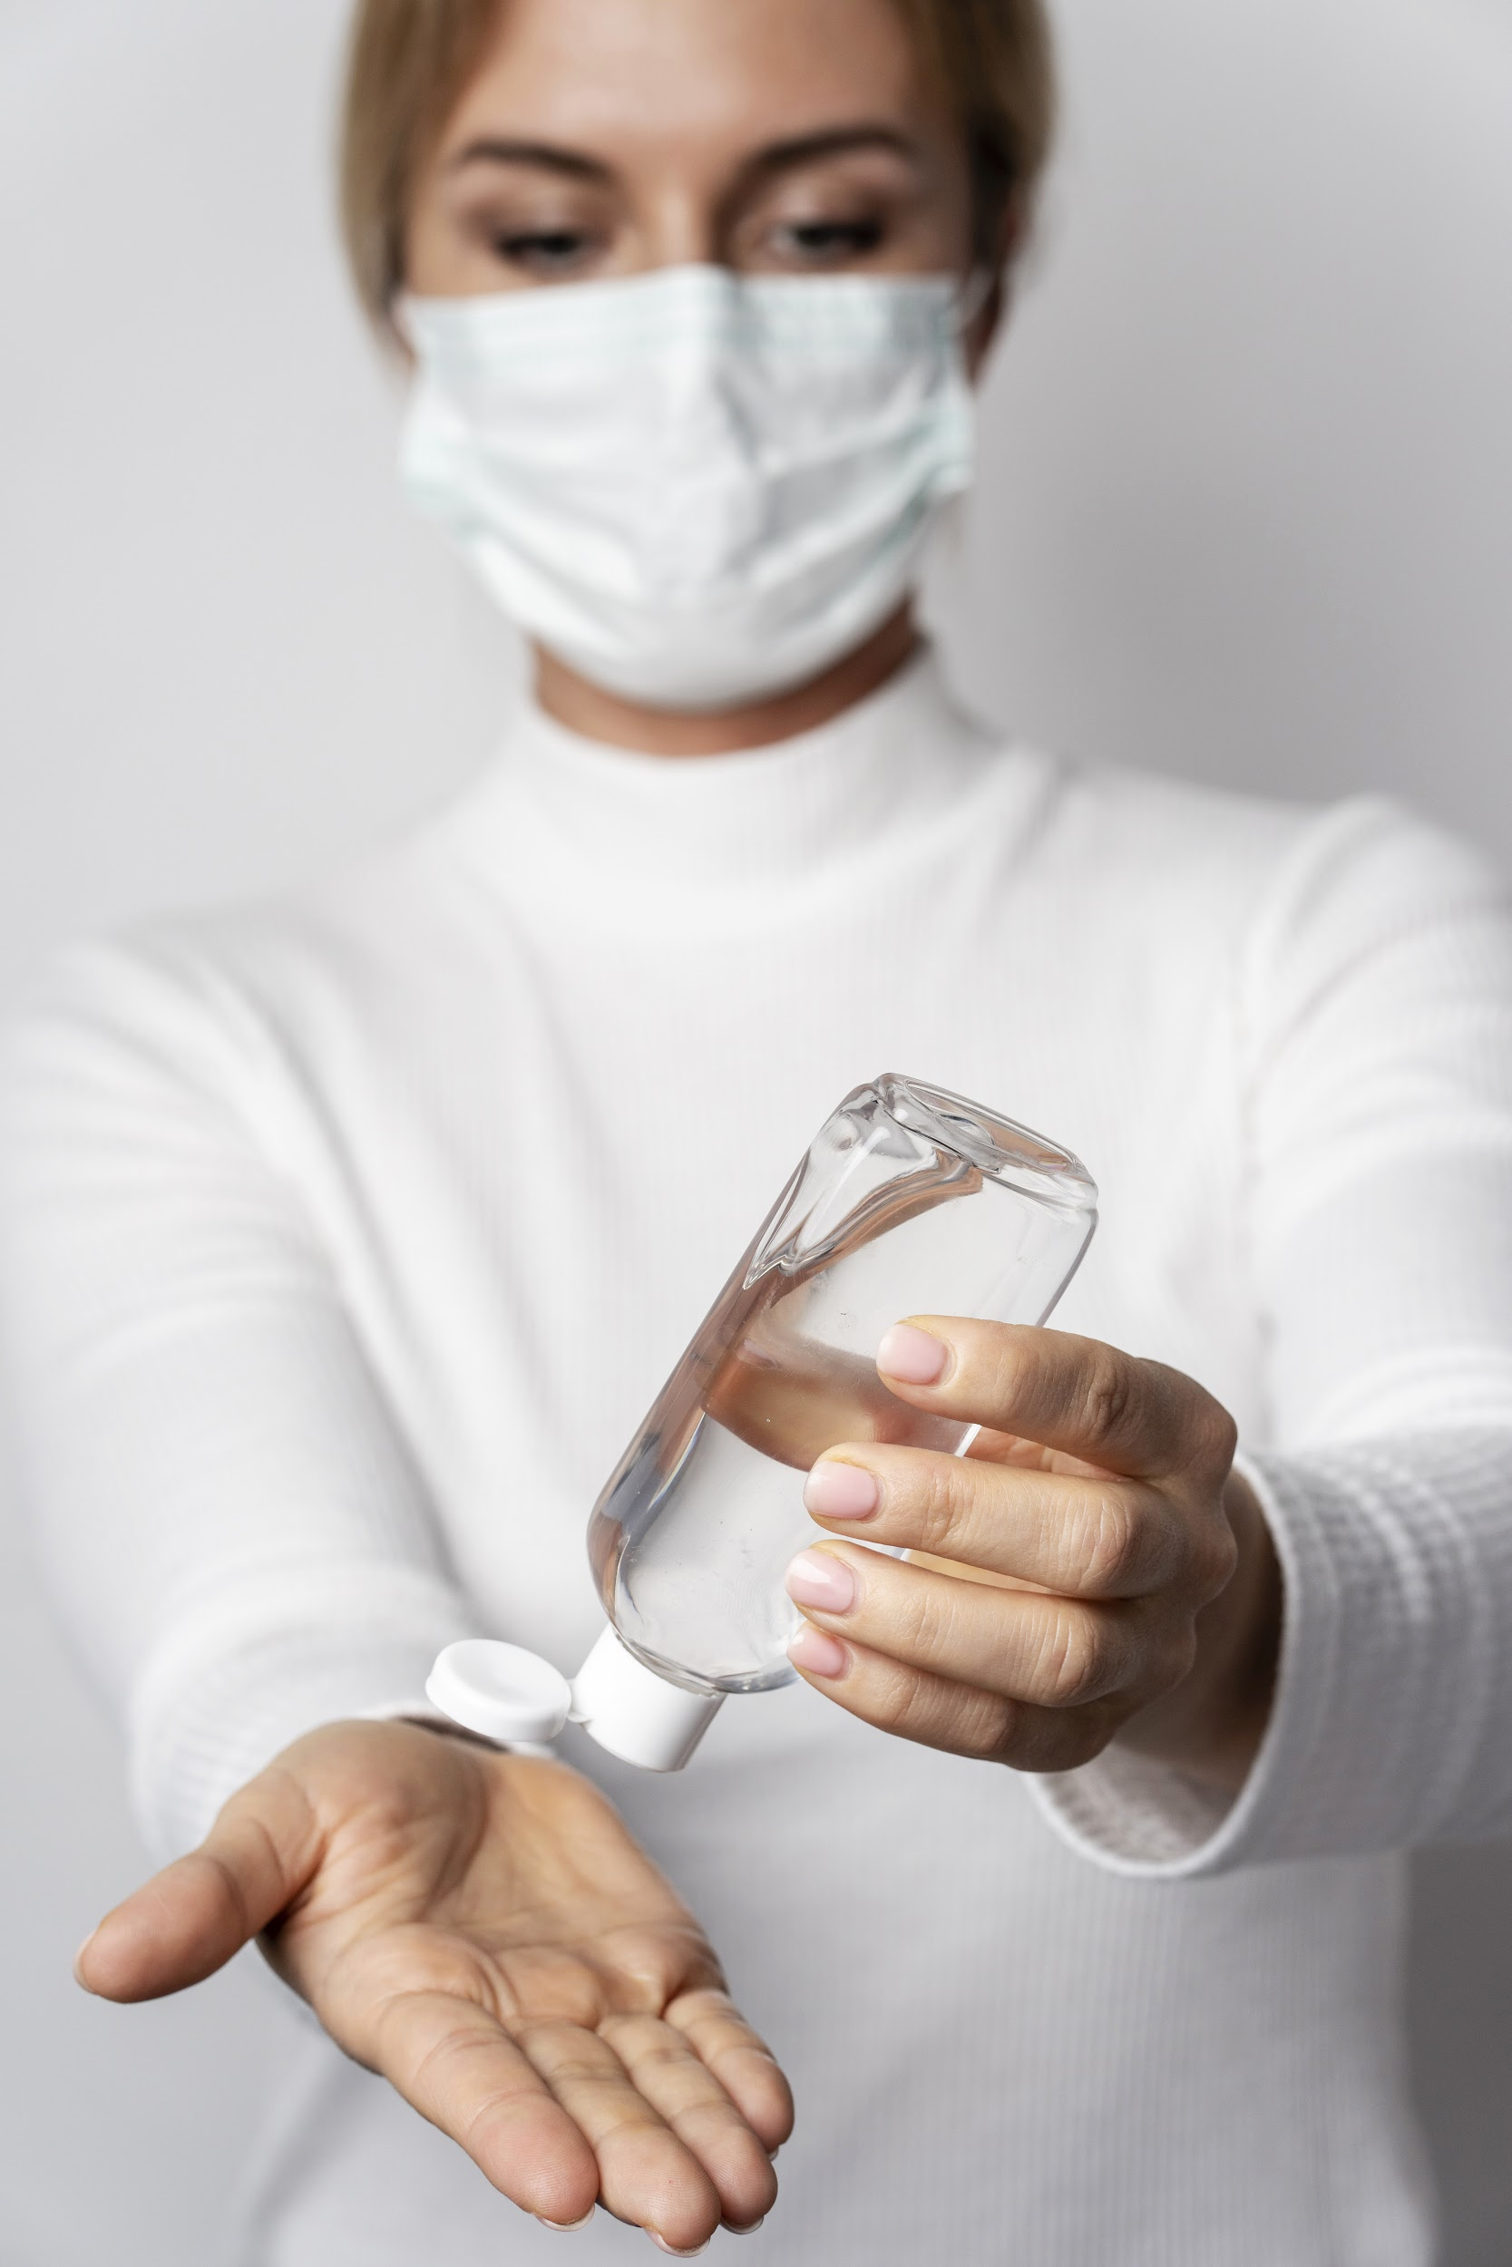
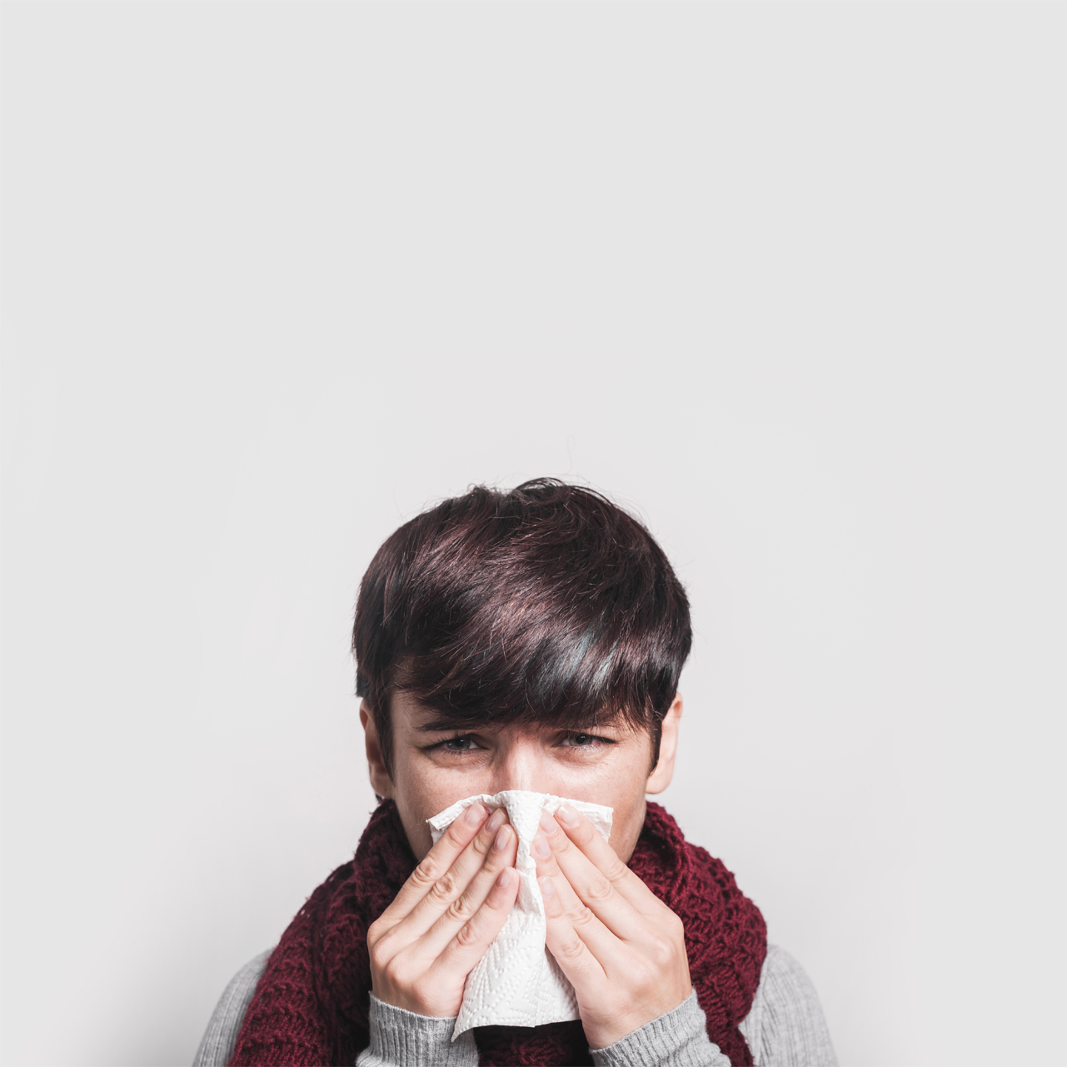
PREVENTION
WEAR MASKS
STAY AT HOME
WASH YOUR HANDS
COVER US WHEN SNEEZE
Cover nose and mouth, do not reuse disposable masks
Do not go out unless it is to buy food
Use alcohol-based disinfectants
Try to sneeze on your bent elbow or on a tissue

Slide 22
CASE TIMELINE
DAY 2
DAY 9
Samples were analyzed
Patient was cured and discharged
DAY 1
DAY 4
Patient reported having symptoms
Patient needed hospitalization

Slide 23
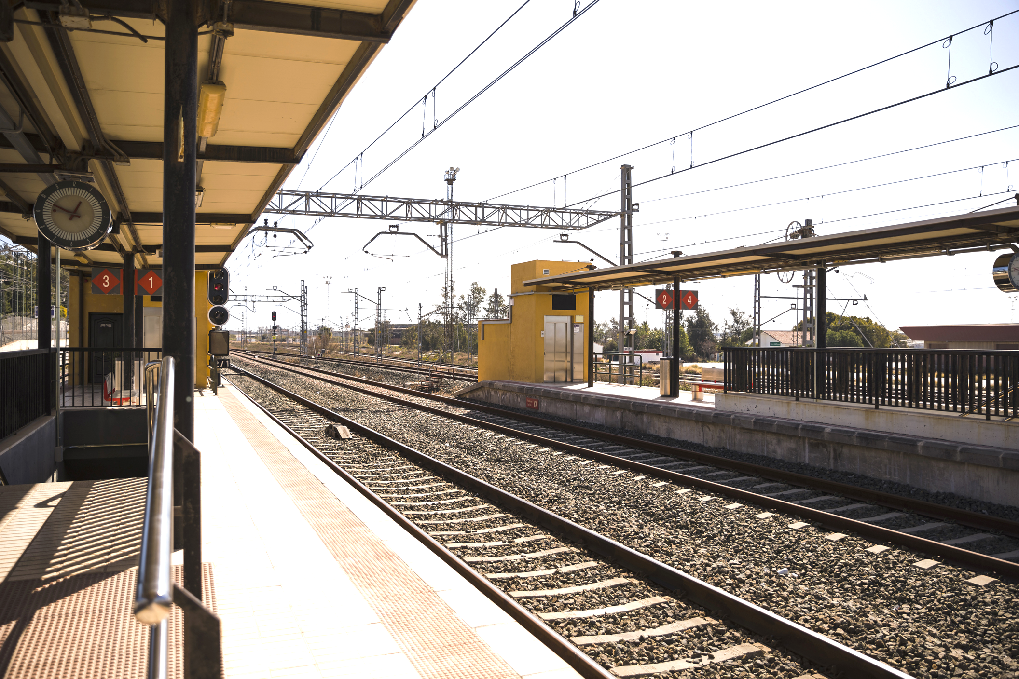
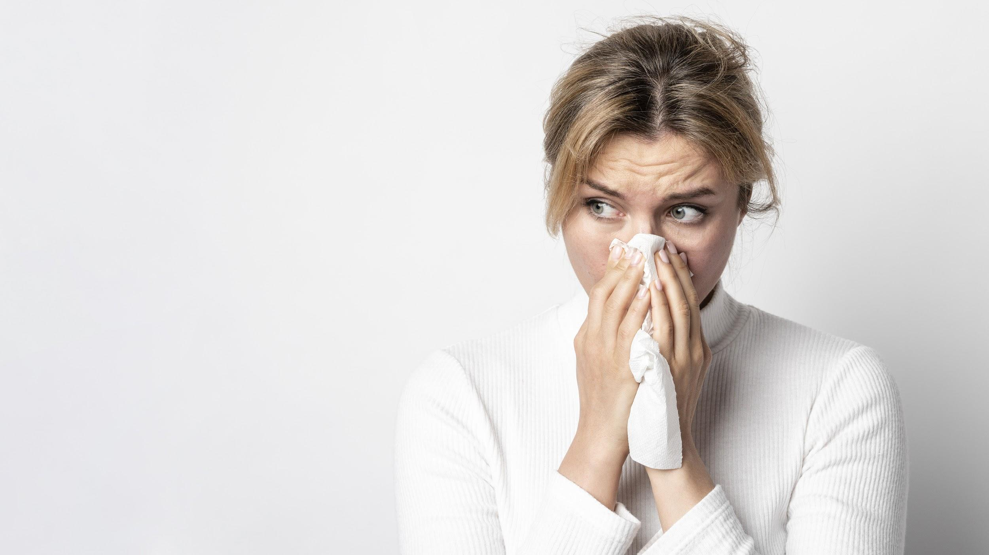
CONCLUSIONS
This disease can spread through small droplets from the nose or the mouth when the infected person coughs
People can still catch the disease from an infected person who only has a mere cough and does not feel ill

Slide 24
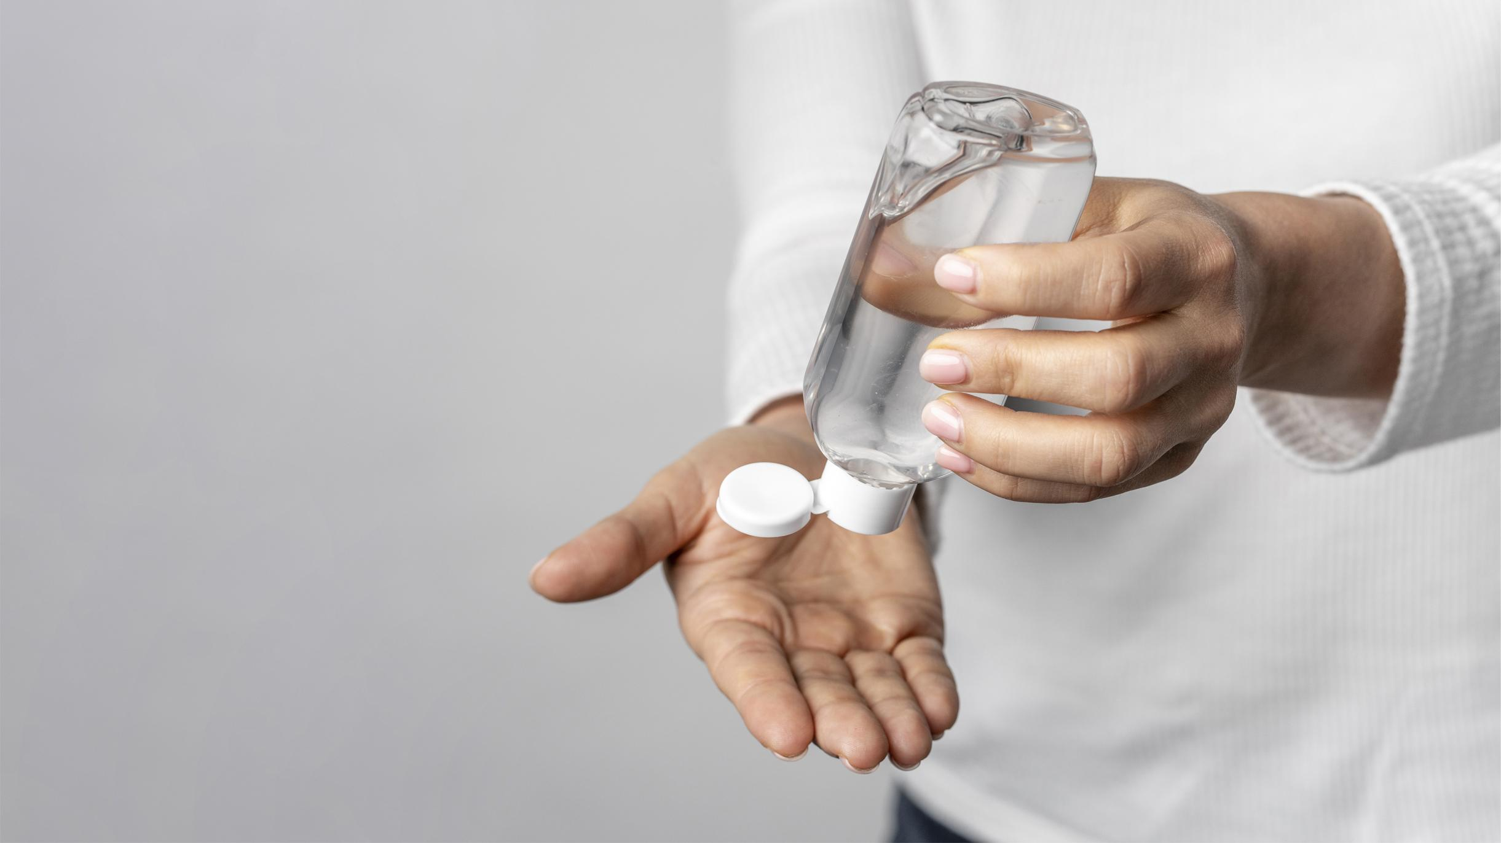
REFERENCES
AUTHOR (YEAR). Title of the publication. Publisher
AUTHOR (YEAR). Title of the publication. Publisher
AUTHOR (YEAR). Title of the publication. Publisher
AUTHOR (YEAR). Title of the publication. Publisher
AUTHOR (YEAR). Title of the publication. Publisher

Slide 25
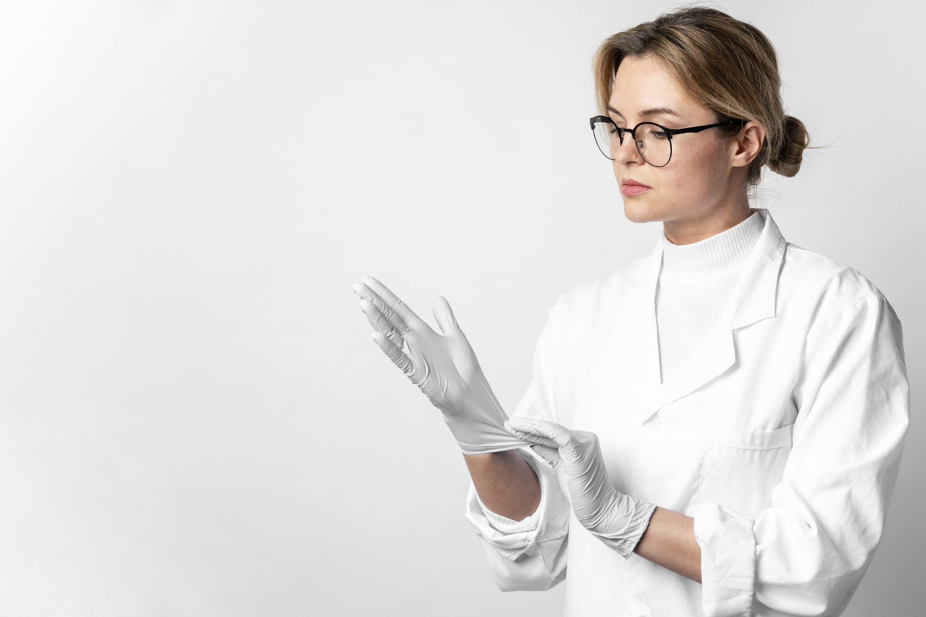
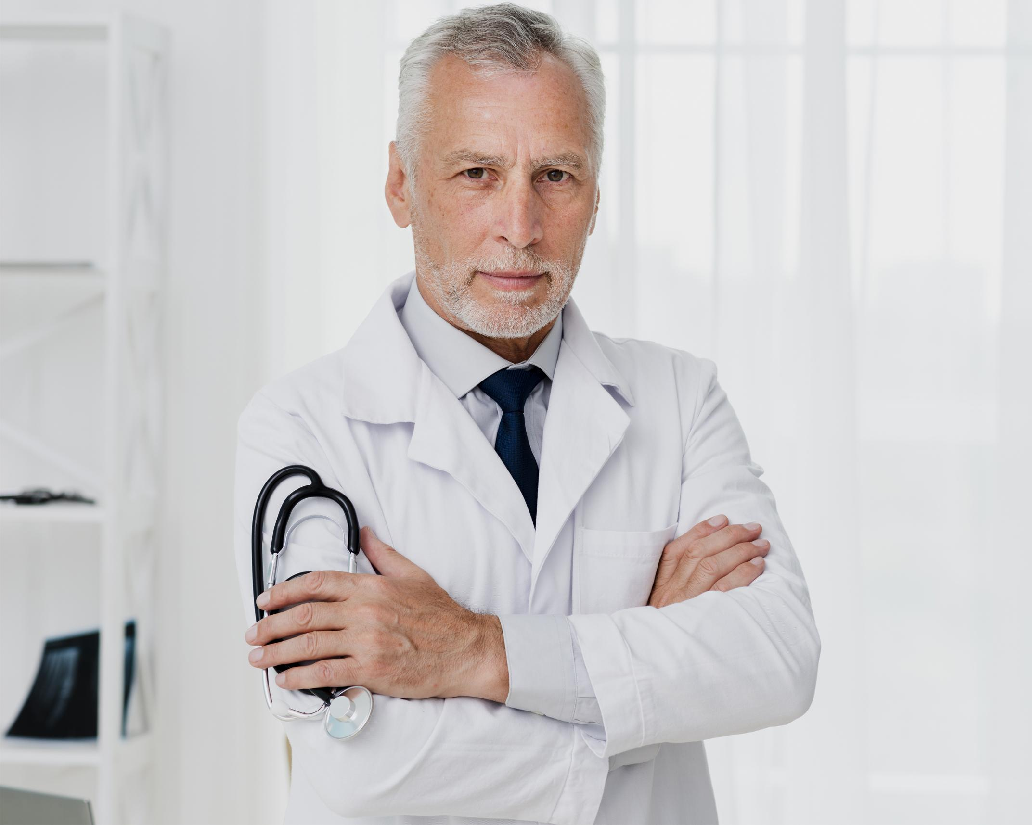
OUR TEAM
HELENA PATTERSON
JOHN DOE
You can replace the image on the screen with your own
You can replace the image on the screen with your own

Slide 26
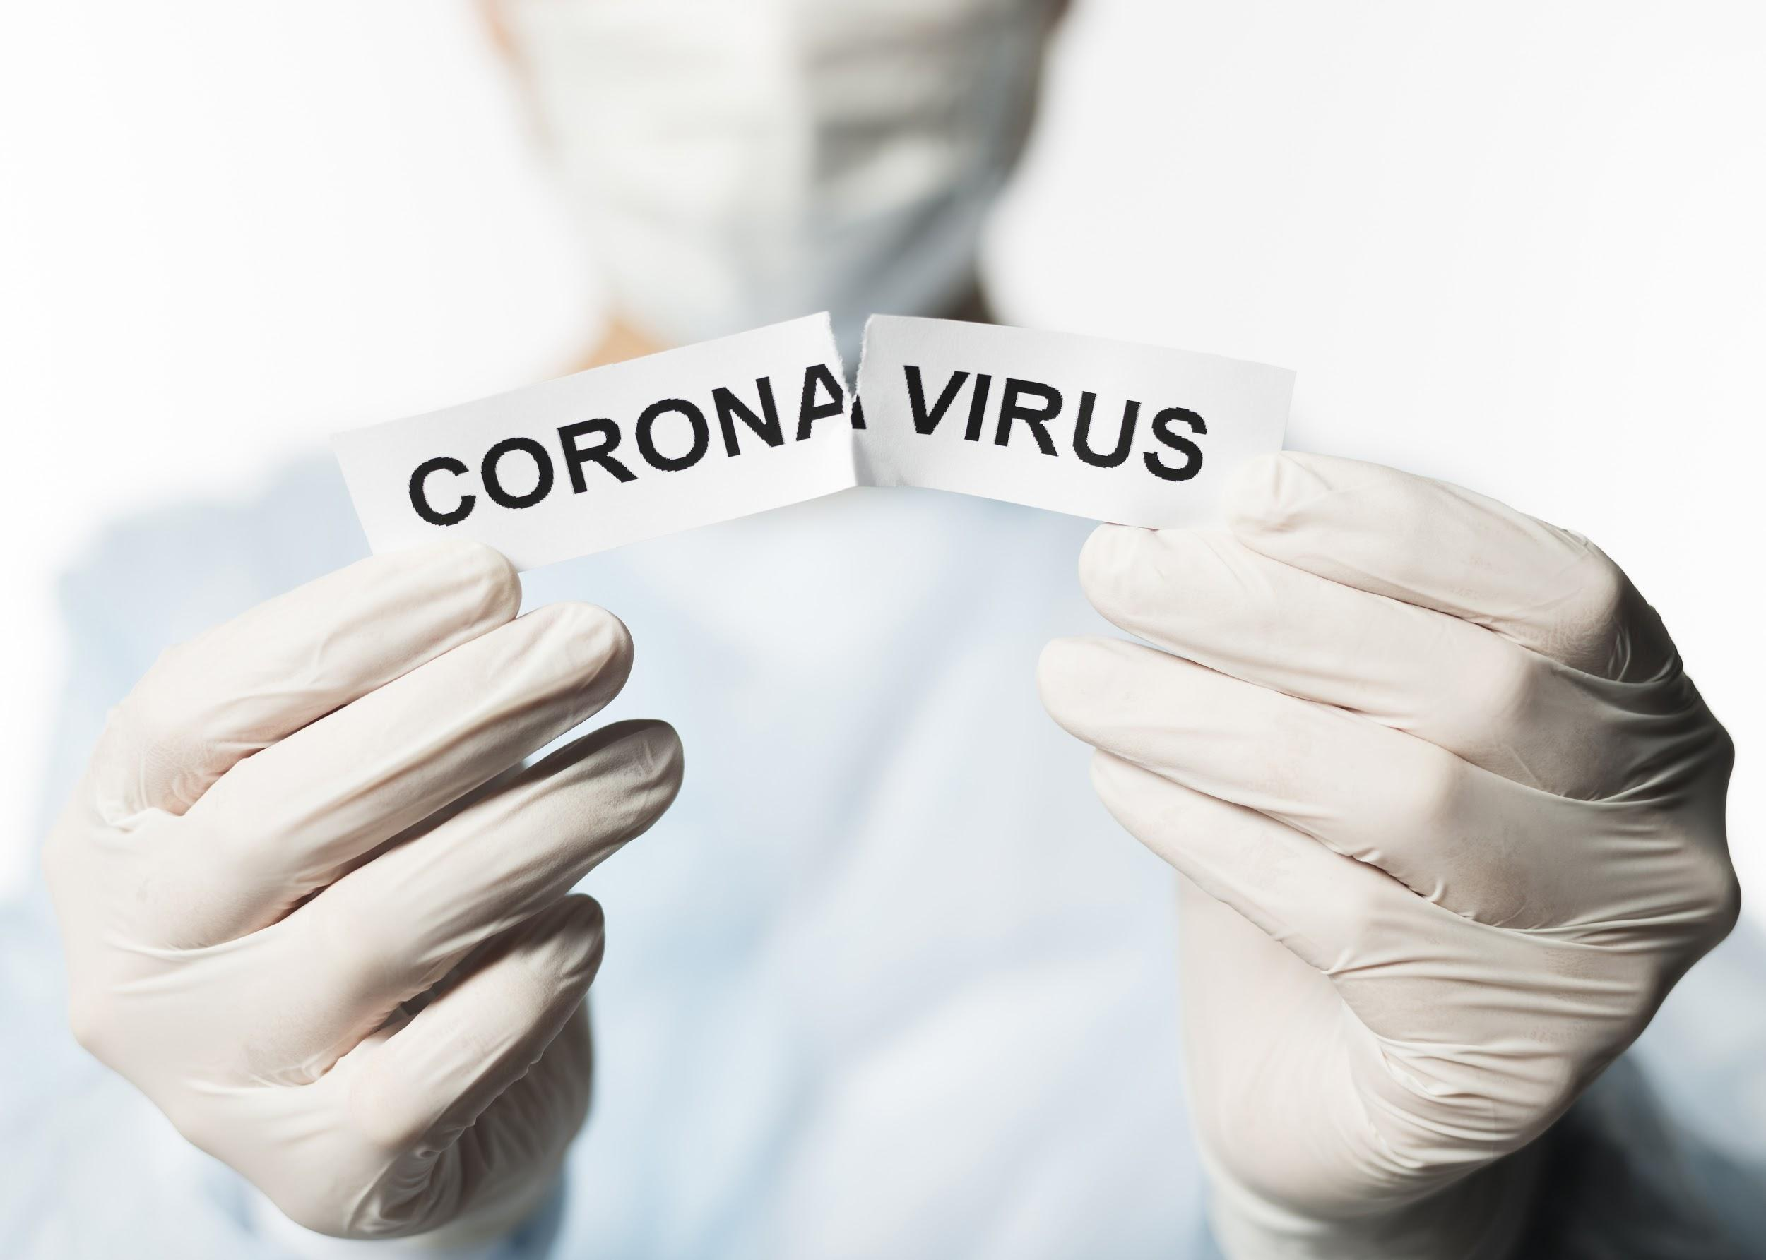
THANKS!
Do you have any questions?
youremail@freepik.com
+91 620 421 838
yourcompany.com
Please keep this slide for attribution.

Slide 27
ALTERNATIVE RESOURCES
Portrait of adult with face mask holding coronavirus sign
Front view of sick man coughing while wearing a medical mask
Portrait of adult woman wearing surgical mask outdoor
Front view of doctor wearing medical mask
Portrait of woman sanitizing hands with gel
Sick man coughing in medical mask
Coughing man posing on the stairs while wearing medical mask
Low angle of man coughing while wearing a medical mask

Slide 28
RESOURCES
Did you like the resources on this template? Get them for free at our other websites.
PHOTOS:
Front view of doctor holding torn paper with coronavirus
Front view of doctor holding stethoscope
Portrait of young doctor with surgical gloves
Young women using public transport with surgical mask
Couple in plaid watching tv
Close-up of woman sneezing with tissue against white background
Man wearing medical mask outside with copy space
Portrait of woman applying washing gel for hands
Close-up medical samples with syringe and tablets
Sick woman coughing at home
Close-up of young man suffering from headache

Slide 29
RESOURCES
Close-up of young man suffering from headache isolated over white background
Close-up of a doctor's hand showing thermometer
Man using nebulizer at home
Studio shot elder man with grey hair
Portrait of young woman wearing surgical mask
Front view of doctor holding tube with coronavirus
Side view of man with medical mask talking on the phone
Nurse pointing to the window while talking to old man
Close-up individual using cleaning gel for hands
View of empty railway station with railroad
Crop hands under water stream
Man crossing road on busy street
Portrait of beautiful senior woman with glasses
Portrait of adult woman with infection symptom

Slide 30
Instructions for use
In order to use this template, you must credit Slidesgo by keeping the Thanks slide.
You are allowed to:
- Modify this template.
- Use it for both personal and commercial projects.
You are not allowed to:
- Sublicense, sell or rent any of Slidesgo Content (or a modified version of Slidesgo Content).
- Distribute Slidesgo Content unless it has been expressly authorized by Slidesgo.
- Include Slidesgo Content in an online or offline database or file.
- Offer Slidesgo templates (or modified versions of Slidesgo templates) for download.
- Acquire the copyright of Slidesgo Content.
For more information about editing slides, please read our FAQs or visit Slidesgo School:
https://slidesgo.com/faqs and https://slidesgo.com/slidesgo-school

Slide 31
Fonts & colors used
This presentation has been made using the following fonts:
Montserrat
(https://fonts.google.com/specimen/Montserrat?query=MON)
#467af1
#000000
#ffffff

Slide 32
Use our editable graphic resources...
You can easily resize these resources without losing quality. To change the color, just ungroup the resource and click on the object you want to change. Then, click on the paint bucket and select the color you want. Group the resource again when you’re done.

Slide 35
JANUARY
FEBRUARY
MARCH
APRIL
MAY
JUNE
PHASE 1
Task 1
Task 2
PHASE 2
Task 1
Task 2
JANUARY
FEBRUARY
MARCH
APRIL
PHASE 1
Task 1
Task 2

Slide 38
Medical Infographics

Slide 41
...and our sets of editable icons
You can resize these icons without losing quality.
You can change the stroke and fill color; just select the icon and click on the paint bucket/pen.
In Google Slides, you can also use Flaticon’s extension, allowing you to customize and add even more icons.

Slide 42
Educational Icons
Medical Icons

Slide 43
Business Icons
Teamwork Icons

Slide 44
Help & Support Icons
Avatar Icons

Slide 45
Creative Process Icons
Performing Arts Icons

Slide 46
Nature Icons

Slide 47
SEO & Marketing Icons

Slide 48


