Slide 1
分布式共享日志研究
报告人：朱文喆 王孟
2019.11.01

Slide 2
01
Background
目录
02
CorfuDB analysis

Slide 3
01
Background

Slide 4

SSD is replacing HDD
Advantage
Space efficiency
Energy consumption
Performance
Maintenance cost
Data reduction
New system design problems
Appended writing is faster
Working life
10 cabinet, 1000 HDD, 420U space
56.62KW, 2 mantainer
1 cabinet, <100 HDD, 42U space
6.65KW, 1 mantainer

Slide 5

Log Structure
Design
Append-only
Random read
Suitable for SSD
Lower write latency
Less erasure
1
2
3
4
5
6
7
...
M
write
write
read
read

Slide 6
Consistency
Conventional
Paxos,Raft,Viewstamp-replication
Sort requests by a single node
Replicate state to other nodes
Cons
Single node bottleneck
[1] Paxos made simple.[ ACM Sigact News, 2001]
[2] Viewstamped replication revisited.[ 2012]
[3] In search of an understandable consensus algorithm.[ ATC, 2014]
clients
1.request
2.replicate
1
1
1
1
2
2
2
2
3
3
3
3
...
4
4
4
4
...
...
...
...
primary
backup
backup
backup

Slide 7
Consistency
Conventional
Partition requests
Each partition sort requests respectively
Replicate state to other nodes
Cons
No global order
clients
1.request
2.replicate
1
1
1
1
1
2
2
1
1
1
2
2
2
...
...
...
2
2
2
...
...
...
primary 1
primary 2
backup
backup
backup
1
2
3
4
1
2
3
4

Slide 8
Consistency
Corfu
Separate sorting from data writing
Auxiliary-driven reconfiguration protocol
Replicate by chain-replication
Pros
Remove single node bottleneck
[4] CORFU: A Shared Log Design for Flash Clusters. [NSDI ’12]
clients
1.request token
2.token reply
3.write and replicate
1
1
1
1
2
2
2
2
3
3
3
3
...
4
4
4
4
...
...
...
...
sequencer
node 1
node 2
node 3
node n

Slide 9
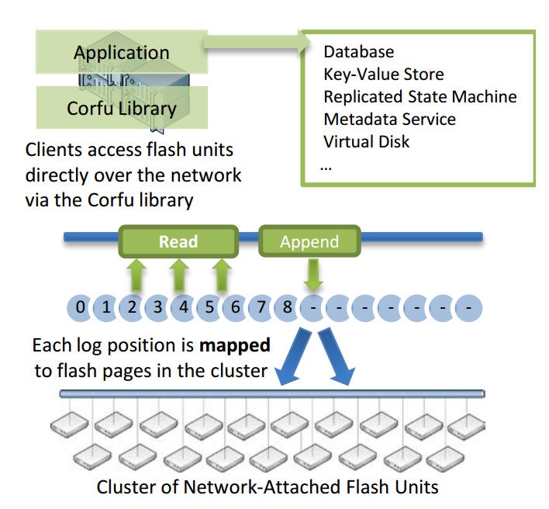
Corfu Design
Functions
Storage functions
Reads and writes on an address space of fixed-size pages.
‘Write-once’ semantics on the flash unit’s address space
‘Seal’ command
Client functions
A mapping function
A tail-finding mechanism
A replication protocol

Slide 10
Comparison
Design own fault tolerance protocols
High cost
Hard to get right
Implement SMR over a consensus protocol(eg. Paxos)
High programming costs
Highly available data structure(eg. Zookeeper)
Limited data structure, commonly inefficient
A mixture of the above options
Fragile system
Deployment nightmare
Distributed shared log
Lower programming costs
Flexible
Easy to use

Slide 11
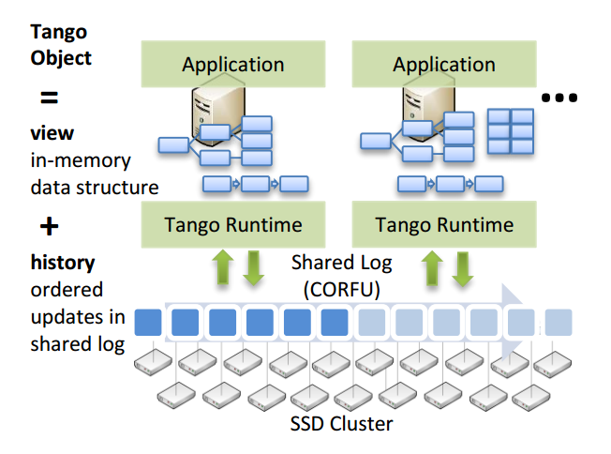
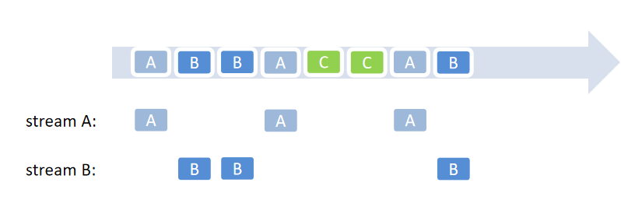
Object store
User-level abstraction
In-memory data structure
Backed by the shared log
[5] Tango: distributed data structures over a shared log. [SOSP ’13]
objects over shared log

Slide 12
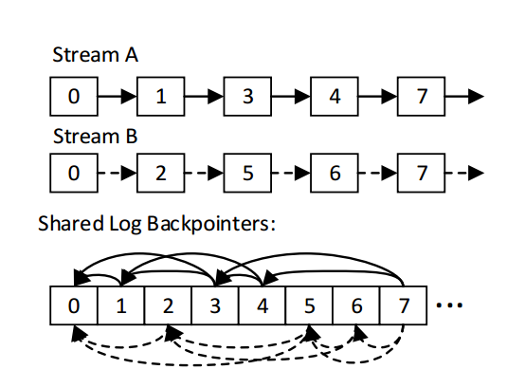
Stream Implementation
Metadata store
The library stores stream metadata as a linked list of offsets
Linked list construction
Each entry contains stream headers, which includes a stream id and K backpointers.
Backtrack entrys of a stream to construct or update metadata
SID | 1 | 2 | ... | k
Stream ID
K backpointers
stream header
time comsuming
streams in shared log

Slide 13
Shortcomings of Tango
Random stream reads require reading each stream from the tail in order and updating metadata
Backpointers pose performance, concurrency and recovery issues
Limitation
Limit the applicability: few clients or small global state, such as metadata services

Slide 14
V-Corfu Design
1
2
3
4
Metadata
Corresponding stream node
Write
Write to log node and stream node
Synchronization
No Synchronization
[6] vCorfu: A Cloud-Scale Object Store on a Shared Log. [NSDI ’17]
5
6
7
8
9
log node
node 1
node 2
node 3
node 4
1
2
6
3
5
7
4
8
9
stream node
node 1'
node 2'
node 3'
node 4'
Notes:
内容：
1.为了解决tango的缺点（同步开销大），v-corfu做了
a.新增加一组stream node,按照partition的方式进行放置
b.读写、同步流程
c.相比于tango，改进如何
d.新增加了什么问题（容易出现负载不均衡）

Slide 15
02
CorfuDB analysis

Slide 16
Impl: Overview
client
layout
objects
layout server
latest layout
sequencer server
latest layout
globalTail
addressSpaceMap
streamTail2GlobalTailMap
log unit server
latest layout
knownAddress

Slide 17
Impl: Layout Server
layoutServers:[ip_0:port_0, ..., ip_n:port_n]
sequencers: [ip_i0:port_i0, ..., ip_m:port_m]
segments: [segment_0, ..., segment_k]
segment_i: {start, end, stripes}
stripes: [node1, node2, node3, node4]
1
1
2
3
4
5
6
7
8
9
node 1
node 2
node 3
node 4
Object A: 1-> 3-> 4-> 9
Object B: 2-> 5-> 8
Object C: 6-> 7
Notes:
注：
1. 一个layout实例：
{
"layoutServers": [
"localhost:9000",
"localhost:9001",
"localhost:9002",
"localhost:9003",
"localhost:9004",
"localhost:9005",
"localhost:9006"
],
"sequencers": [
"localhost:9000",
"localhost:9001"
],
"segments": [
{
"replicationMode": "CHAIN_REPLICATION",
"start": 0,
"end": 20000,
"stripes": [
{
"logServers": [
"localhost:9002",
"localhost:9003"
]
},
{
"logServers": [
"localhost:9004"
]
}
]
},
{
"replicationMode": "CHAIN_REPLICATION",
"start": 20000,
"end": -1,
"stripes": [
{
"logServers": [
"localhost:9005"
]
},
{
"logServers": [
"localhost:9006"
]
}
]
}
],
"epoch": 775825
}
2. 每个Server上都存有一份上述形式的layout，发送给client的layout如上图所示。
3. segments项中，每个{}包围的部分是一个segment，其内容表示该segment的REPLICATION_MODE、地址区间[start, end)（end为-1表示正无穷）以及各stripe对应的logUnitServer的地址。
4. 同一个“logServers”中的不同地址表示同一日志的多份拷贝。

Slide 18
Impl: Sequencer Server
globalTail: 10
Address Space Map
Stream Tail to Global Tail Map
1
1
2
3
4
5
6
7
8
Object A:
1
3
4
9
9
Object B:
2
5
8
node 1
node 2
node 3
node 4
Object C:
6
7
Object A: 1-> 3-> 4-> 9
Object B: 2-> 5-> 8
Object A:
9
Object C: 6-> 7
Object B:
8
Object C:
7

Slide 19
Impl: Log Unit Server
knownAddress: Map<Long, AddressMetaData>
AddressMetaData:
offset
length
checksum
1
1
2
3
4
5
6
7
8
9
node 1
node 2
node 3
node 4
Object A: 1-> 3-> 4-> 9
Object B: 2-> 5-> 8
Object C: 6-> 7

Slide 20
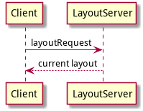
Impl: Write
1
1
2
3
4
5
6
7
8
9
node 1
node 2
node 3
node 4
Object A: 1-> 3-> 4-> 9
Object B: 2-> 5-> 8
Object C: 6-> 7

Slide 21
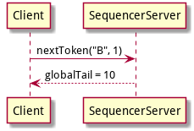
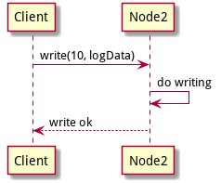
Impl: Write
1
1
2
3
4
5
6
7
8
9
node 1
node 2
node 3
node 4
Object A: 1-> 3-> 4-> 9
Object B: 2-> 5-> 8
Object C: 6-> 7
Notes:
注：
1. 10 mod 4 = 2，因此写在node2上。
2. 硬盘上记录存储形式就是普通二进制文件。每10000条记录创建一个新文件。

Slide 22
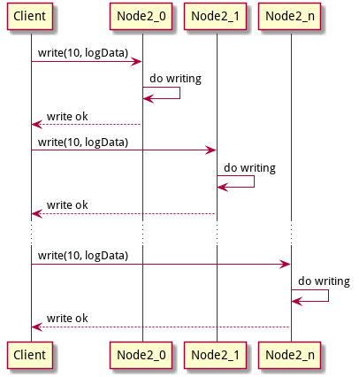
Impl: Write
Replica: Chain Replication Protocol
1
1
2
3
4
5
6
7
8
9
node 1
node 2
node 3
node 4
Object A: 1-> 3-> 4-> 9
Object B: 2-> 5-> 8
Object C: 6-> 7

Slide 23
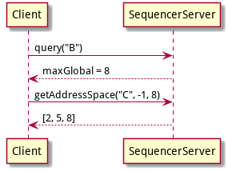
Impl: Read & Sync
Address Space Map
1
1
2
3
4
5
6
7
8
9
node 1
node 2
node 3
node 4
Object A: 1-> 3-> 4-> 9
Object B: 2-> 5-> 8
Object C: 6-> 7
Notes:
注：
1. -1 为stopAddress的默认值（因为实现中地址从0开始）。8为startAddress。
2. 若client有该对象的旧版本，则stopAddress为对应的旧版本号(即旧token)。
3. client向server查询的地址区间为(stopAddress, startAddress]。

Slide 24
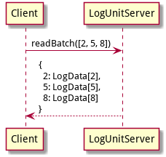
Impl: Read & Sync
Address Space Map
1
1
2
3
4
5
6
7
8
9
node 1
node 2
node 3
node 4
Object A: 1-> 3-> 4-> 9
Object B: 2-> 5-> 8
Object C: 6-> 7
Notes:
注：
1. 一个batch默认最多为10条记录。

Slide 25
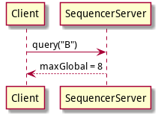
Impl: Read & Sync
Back Pointer
1
1
2
3
4
5
6
7
8
9
node 1
node 2
node 3
node 4
Object A: 1-> 3-> 4-> 9
Object B: 2-> 5-> 8
Object C: 6-> 7

Slide 26
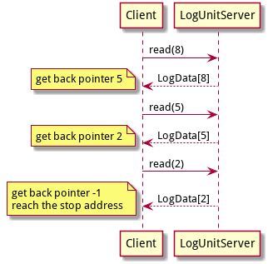
Impl: Read & Sync
Back Pointer
1
1
2
3
4
5
6
7
8
9
node 1
node 2
node 3
node 4
Object A: 1-> 3-> 4-> 9
Object B: 2-> 5-> 8
Object C: 6-> 7
Notes:
注：
1. back pointer存储在每条记录当中（硬盘上），因此需要多次向log unit server发起读请求，直到遇到stopAddress。
2. 此处stopAddress意义同P20备注。
3. 对比Address Space方式，sequencer的负担降低了，但是对log unit server的请求变多了。使用哪种可根据实际工作情况来进行调整。

Slide 27
Impl: Transaction
first read
or write
t2
TXEnd()
try to commit
TXBegin()
t1
in one transcation:
one single entry
one read object set
one write object set
Object A:
1
3
4
9
Object B:
2
5
8
for each read/write operation:
1. write operation stored in the entry
2. add object to corresponding set
3. sync object to t2
4. sync updates to local object
Object C:
6
7
some updates in log server by other clients
local state of objects
time
Notes:
注：
1. 上图为修改三个对象A B C的事务，TXBegin的时刻为t1。（时刻指server中log的globalTail，即token，下同）。
2. 第一次调用get或put等操作的时候，记录下时刻t2。
3. 事务过程中的操作会统一记录到本地的一个entry中（此时并不写给server），记录下读或写的对象，并将对象本地状态同步到t2，然后将该事务本身的修改应该到本地对象。
3. TXEnd会尝试进行commit。首先会向sequencer申请token，记作t3。
4. 上图是以optimistic transaction为例，其特点为事务的读集合中的对象不能在(t2, t3]被其他client写，否则不能commit。

Slide 28
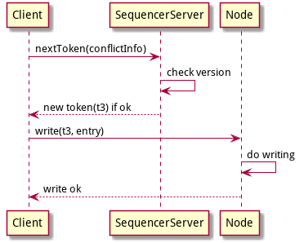
Impl: Transaction
Try To Commit
multi operations but only one entry in log files.(only one single I/O)
Notes:
注：
1. 对于optimistic trans，读集合作为conflict info，其中的对象不能在(t2, t3]中被修改，否则abort。
2. 对于write after write trans，写集合作为conflict info，其中的对象不能在(t2, t3]中被修改，否则abort。
3. 还有一类事务snapshot trans，为只读事务，此处不再赘述。
4. 一条事务只会被写成日志文件中的一条entry，不管操作多少。由于client的多次写只产生一次IO，相当于加快了写的速度。

Slide 29
Impl：Summary
CorfuDB contains only one group of log nodes, no stream nodes
Mapping : segmented round-robin
Client-centric:
Metadata is placed on the clients
Mapping from the global address to the physical address is done by the client
Storage unit index is a hash table

