Slide 1

Tango, vCorfu, CorfuDB对比
朱文喆

Slide 2

01
Corfu

Slide 3
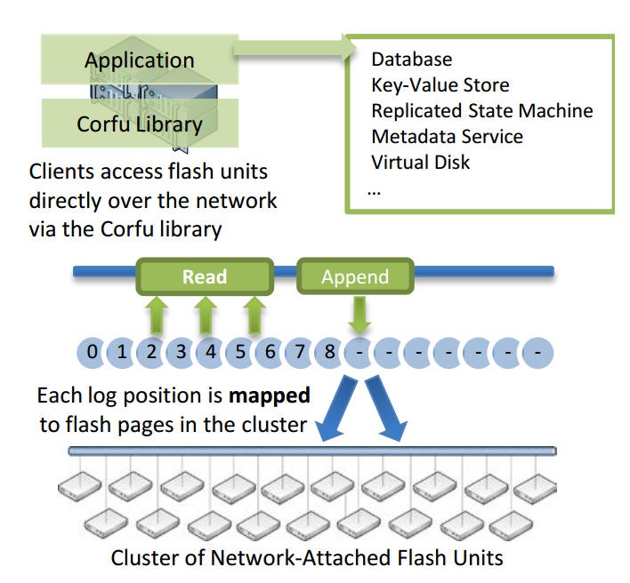
Corfu
Functions
Storage functions
Reads and writes on an address space of fixed-size pages.
‘Write-once’ semantics on the flash unit’s address space
‘Seal’ command
Client functions
A mapping function
A tail-finding mechanism
A replication protocol

Slide 4
02
Tango & vCorfu

Slide 5
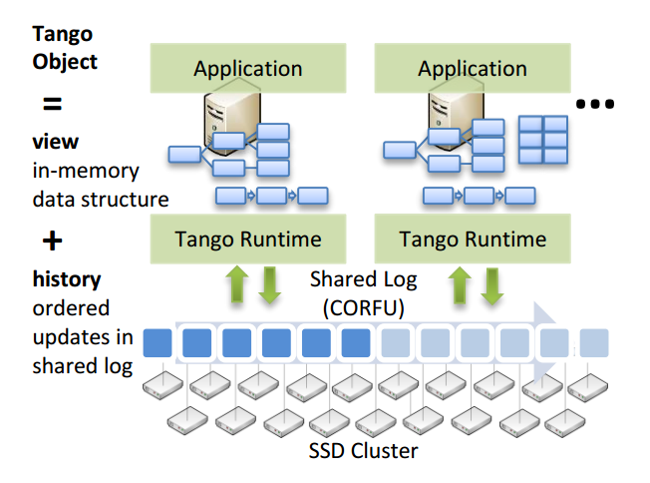
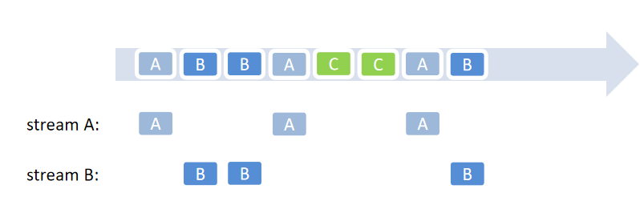
Tango Design
User-level abstraction
In-memory data structure
Backed by the shared log
Properties
Strong consistency
Scalability
History version
Availability
Transaction processing
objects over shared log

Slide 6
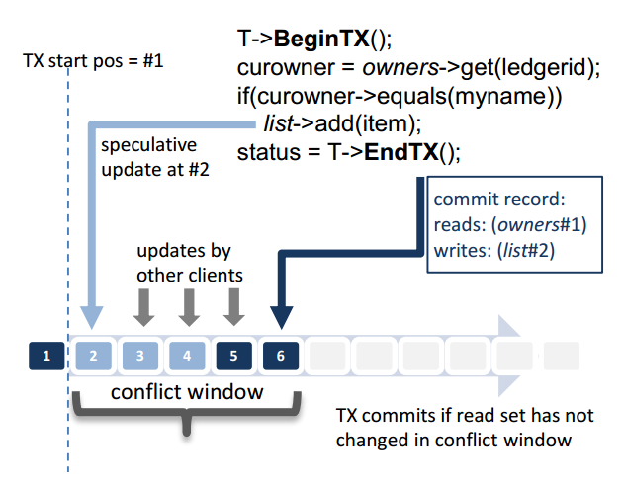
Transaction in Tango
Tango povide atomicity and isolation through the shared log.
Atomicity
Apply the updates in memory until making commit decision
Isolation
Abort transations when detecting read-write conflict.
Notes:
为什么只检测读-写冲突，写-写冲突？

Slide 7
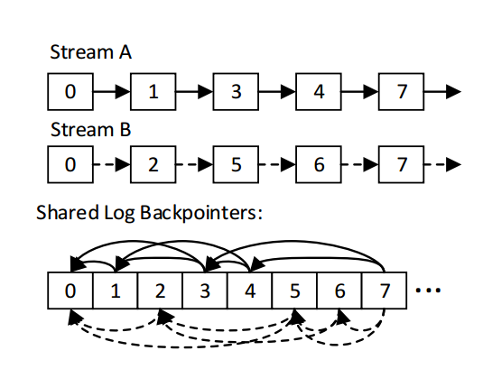
Stream Implementation
Metadata store
The library stores stream metadata as a linked list of offsets
Linked list construction
Each entry contains stream headers, which includes a stream id and K backpointers.
Backtrack entrys of a stream to construct or update metadata
SID | 1 | 2 | ... | k
Stream ID
K backpointers
stream header
time comsuming
streams in shared log

Slide 8
Shortcomings of Tango
Random stream reads require reading each stream from the tail in order and updating metadata
Backpointers pose performance, concurrency and recovery issues
Limitation
Limit the applicability: few clients or small global state, such as metadata services

Slide 9
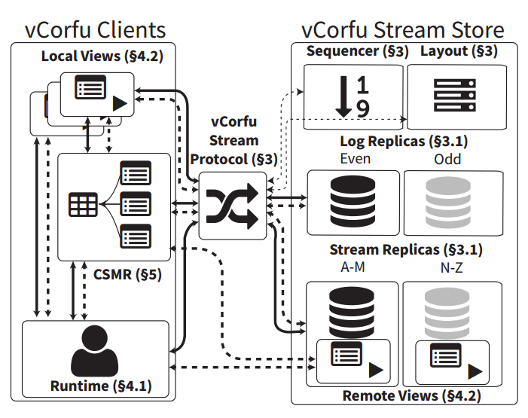
vCorfu Design
Improvements
Materialized stream
Composable state machine replication (CSMR)
Lightweight transaction manager
vCorfu overcomes tango's limitations and can be used as general object store

Slide 10
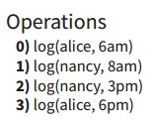
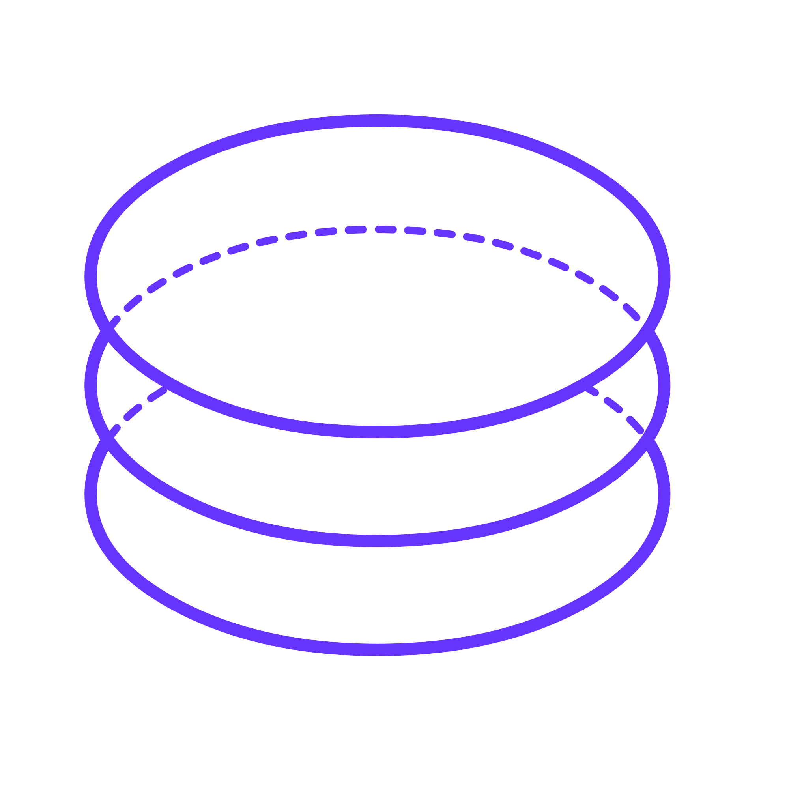
Materialized stream
vCorfu replicates the data and partitions it in two ways.
Log replicas
Store log entrys in the global order
A single source of scalability, consistency, durability and history
Stream replicas
Store a stream on a single replica
Avoids backpointers
Handle playback
0)alice, 6am
0)alice, 6am
1)nancy, 8am
1)nancy, 8am
2)nancy, 3pm
2)nancy, 3pm
3)alice, 6pm
3)alice, 6pm
0)alice, 6am
0)alice, 6am
1)nancy, 8am
1)nancy, 8am
2)nancy, 3pm
3)alice, 6pm
3)alice, 6pm
2)nancy, 3pm
vCorfu
Corfu/Tango

Slide 11
CSMR
CSMR divides the state of a single object
into several smaller objects
Reduces the size of each stream.
Reduce contention. providing for higher concurrency
Familiar data structure. Resembles how data structures are constructed in memory
class TreeNode{
int value;
int getChild( int partition ){
return open(getStreamID() + partition)
}
...
}

Slide 12
Transaction in vCorfu
vCorfu use the sequencer as a lightweight transaction manager.
Steps
Get log token. Get a snapshot
Buffer write operations
Commit/Abort decision. Check if impacted streams have changed
Write the write buffer. Write if the transaction is commited
Isolation
Opacity. Stronger guarantee than strict serializability

Slide 13
03
CorfuDB

Slide 14
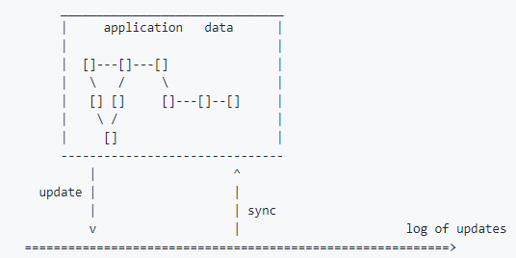
CorfuDB
Corfu object
In-memory
Highly available
Linearizable
Serializable
Trasaction
Snapshot Transactions
Optimistic Transactions
Locking Transactions

Slide 15
Sample
public static void main(String[] args) {
CorfuRuntime runtime = getRuntimeAndConnect(corfuConfigurationString);
Map<String, Integer> map = runtime.getObjectsView()
.build()
.setStreamName("A") // stream name
.setType(SMRMap.class) // object class backed by this stream
.open(); // instantiate the object!
Integer previous = map.get("a");
if (previous == null) {
System.out.println("This is the first time we were run!");
map.put("a", 1);
}
else {
map.put("a", ++previous);
System.out.println("This is the " + previous + " time we were run!");
}
}

Slide 16
04
Future plans

Slide 17
Future plans
Read CorfuDB source code
Analyze the flow of dataplacement, How to change?
Analyze the transaction process of CorfuDB and their Applicable scenario, test their performance.

