Slide 1

共享日志调研
朱文喆

Slide 2

01
Background
02
Corfu-A distributed shared log
目录
03
Summary & Future plans

Slide 3

01
Background

Slide 4
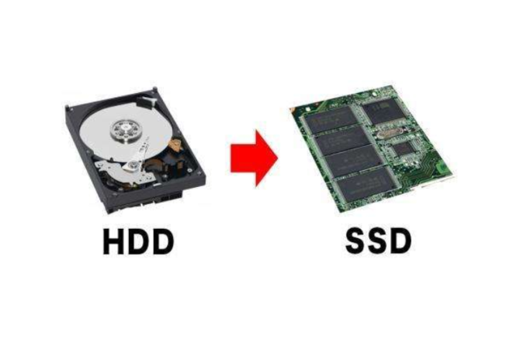
Flash Storage
Properties
Fast random read
Erased before overwriting
Wears out or ages
Non-Volatile

Slide 5
Log Structure
Design
Append-only
Good write performance
Limitation
Poor performance when dealing with random reads
Solution
Hash index
SSTable & LSM tree

Slide 6
Log Structure
1 | 2 | 3 | ...
Flash
Log
read
append
Append
Random read
Fast sequential write
Fast random read
Flash provides the most suitable hardware support for log

Slide 7
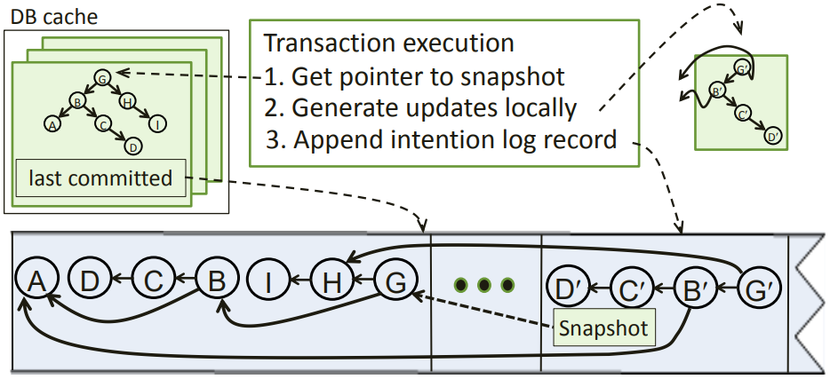
Why Shared Log?
Pros
Strong consistency
Shared log can be used for
Failure atomicity and node recovery
Consistent remote mirroring
Consensus engine

Slide 8
Why Distributed Log?
Partitioned Log
Multiple, independent logs
Pros
Scalability
Cons
A total order no longer exists
Strongly consistent operations are limited to a single partition
The age distribution of the drives depends on the workload
Distributed Log
A single log abstraction
Pros
Strong consistency
Better control
Cons
More complex data placement policy

Slide 9
02
Corfu-A distributed shared log

Slide 10
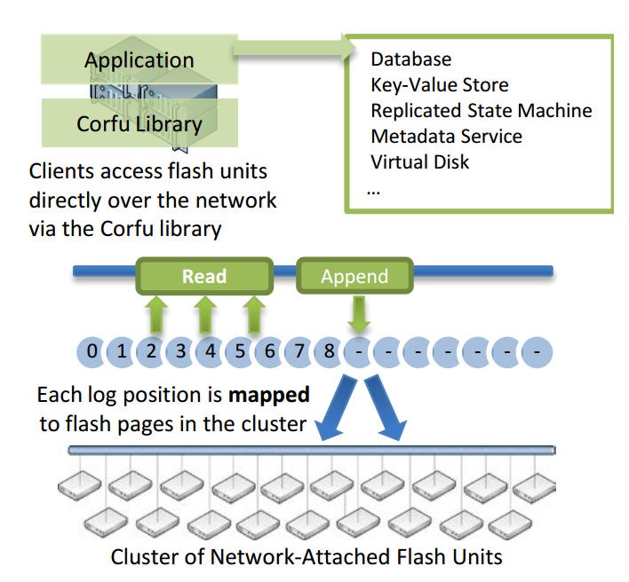
Corfu Design
Functions
Storage functions
Reads and writes on an address space of fixed-size pages.
‘Write-once’ semantics on the flash unit’s address space
‘Seal’ command
Client functions
A mapping function
A tail-finding mechanism
A replication protocol

Slide 11
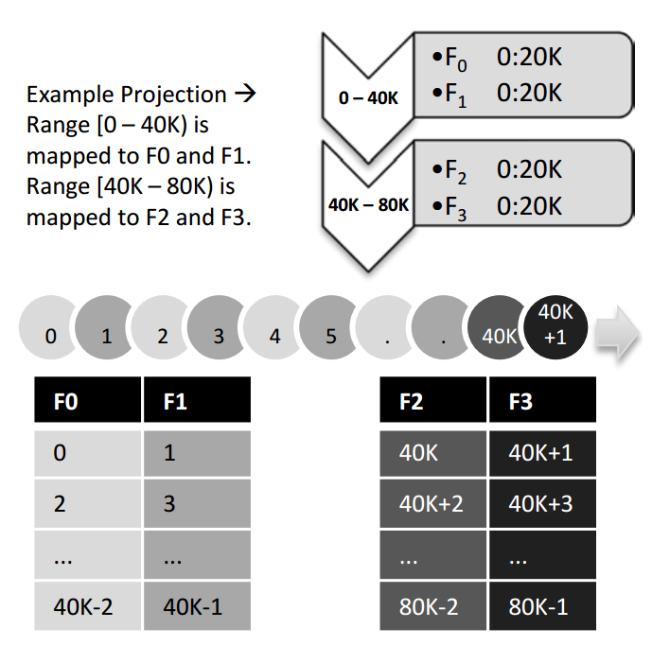
Mapping in Corfu
Projection
Data structure that carves the address space into disjoint ranges
Range
Each range is mapped to a list of extents within the address spaces of individual flash units
Notes:
默认是round robin,好处是可以直接通过计算得到物理位置，缺点是不够灵活，可以考虑动态调节，但是需要增加一步查找过程

Slide 12
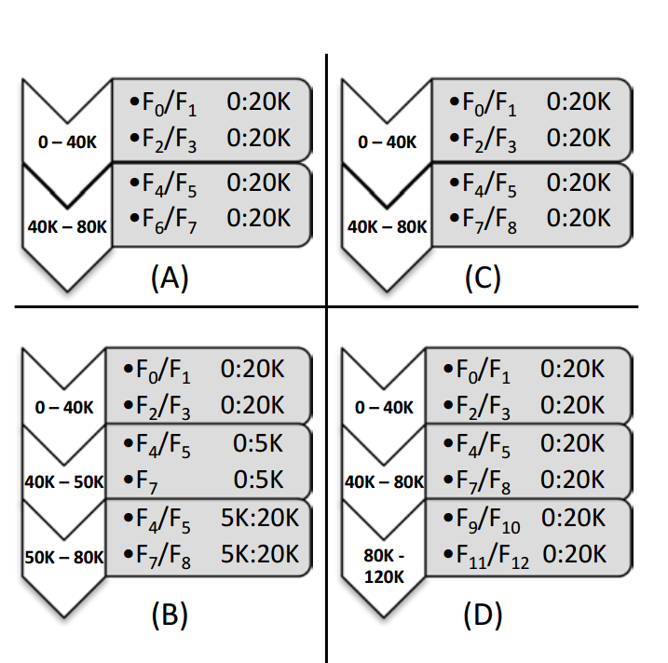
Changing the mapping
Reconfiguration protocol
When the mapping is changed,we need a method to reconfigure.
A auxiliary-driven protocol
two steps:
Sealing the current projection
Writing the new projection at the auxiliary

Slide 13

Finding the tail in Corfu
Contention method
Allowing clients to contend for positions
Sequencer
Using a dedicated sequencer that assigns clients ‘tokens’
better performance
step1
1 | 2 | 3 | ...
step1
Sequencer
getToken
write
write
write
step2
1 | 2 | 3 | ...
step2
1 | 2 | 3 | ...
write
write
write
write
fail
succeed
fail

Slide 14
Replication in Corfu
When writing to replicas of a log position, two requirements should be satisfied:
Safety-under-contention property Reading clients should observe a single value
Durability Written data must be visible to reads only after it has sufficient fault tolerance
1 | 2 | 3 | ... | ?
write( a )
write( b )
Contention in writing

Slide 15
Replication in Corfu
A chaining protocol
Updating replicas in a deterministic order
Waiting for each flash unit to respond before moving to the next one
Successfully completed when the last flash unit in the chain is updated
a
a
a
a
1
2
3
write(a)
succeed

Slide 16
03
Summary & Future plans

Slide 17
Summary & Future plans
Load balance in Corfu
The map is stored as projection
Each range is using it's own deterministic function
Projection is changed only when errors occur or a new range is needed
Projection is maintained using a consensus engine
Notes:
每个用户更新全局的projection是否有必要，是否会造成性能下降

Slide 18
Summary & Future plans
Some shortcomings
A simple deterministic function is efficient, but not flexible
Corfu maintains a static mapping, so it can't balance the load when access pattern changes
Ideas for improvement
Store mapping as metadata to improve the flexibility
Dynamicly adjust the mapping to fit specific access pattern

Slide 19
Summary & Future plans
Future plans
Deployment of Corfu in the cluster
Run some benchmarks to test the impact of different workloads on performance
Change mapping policy to test preformance
Analyze the impact of data migration

