Slide 1
Continuous Thought Machine
Pseudocode and formula mapping
4 code blocks
12 formulas
One slide per module
Layout principle: left side shows the algorithm step, right side shows the equations used by that step.
01

Slide 2
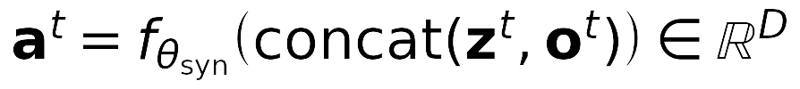

code1 updates neuron state from attention output
The first block shows how attention output and current state become pre-activations, memory, and next neuron activations.
PSEUDOCODE
CORRESPONDING FORMULAS
kv = KV(FeatureEncoder(inputs))
z, A = initialize learnable histories
post_acts_history = [z_init]
for t in thought_steps:
q = q_projector(synch_a)
o = Attention(q, kv, kv)
a = Synapses(concat(z, o))
A = FIFO(A, a)
z = NLM(A)
z = NLM(A)
append z to history
(1) Pre-activation from state and attention
(2) FIFO memory of pre-activations
(3) Neuron-level update
This is the cleanest place to explain the recurrent state update.
02

Slide 3


code2 summarizes state history for output
This slide uses the second formula group to explain how state history becomes an output synchronization.
PSEUDOCODE
CORRESPONDING FORMULAS
Z = collect post_acts_history
S = compute_synch(Z)
synch_o = compute_synch(
post_acts_history, type='output')
y = output_proj(synch_o)
(4) Stack post-activation history
(5) Synchronization matrix
(6) Output projection
The source code2 file is a neuron-level model, so replace this block if you want literal file fidelity.
03

Slide 4

code3 covers the action query path
This group shows how action synchronization queries the input features through attention.
PSEUDOCODE
CORRESPONDING FORMULAS
synch_a = compute_synch(
post_acts_history, type='action')
q = q_projector(synch_a)
kv = kv_projector(backbone(inputs))
o = Attention(q, kv, kv)
(7) Query from action synchronization
(8) Attention over extracted features
(9) Temporal decay weights
The file code3 currently duplicates code2; this slide reflects the intended third formula group.
04

Slide 5
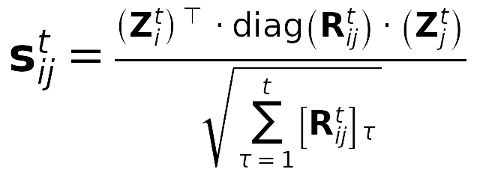

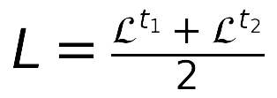
code4 selects thought steps for the final loss
The last group combines decay-weighted synchronization with cross-entropy over selected thought steps.
PSEUDOCODE
CORRESPONDING FORMULAS
p = softmax(logits)
certainty = 1 - entropy(p) / log(C)
losses = CrossEntropy(y_t, target)
t1 = argmin(losses)
t2 = argmax(certainty)
return mean((loss[t1] + loss[t2]) / 2)
(10) Decay-weighted synchronization
(11) Per-step classification loss
(12) Final averaged loss
Formula (12) corresponds to the two selected thought steps in code4.
05

