Slide 1


Management and Processing of Big Data Level-I
session-2

Slide 2
Recap
Data processing trend
Big Data and its characteristics
Applications of big data
Various computing technologies
History of Hadoop
Major components of Hadoop cluster
Unix commands
HDFS

Slide 3
Hadoop Cluster Overview
Submit Job
Namenode:
Job Tracker
Resource management
& Task tracking
Datanode:
Task Tracker
Datanode:
Task Tracker
Datanode:
Task Tracker
HDFS
HDFS
HDFS

Slide 4
HDFS
HDFS is a file system designed for storing very large files with streaming data access patterns, running on clusters of commodity hardware
Large Files
Streaming data access
Commodity hardware

Slide 5
HDFS Blocks
Single unit of storage
Default block size is 128MB
Size of block will drive the ratio of time to read a block to the seek for a block

Slide 6
Benefits of blocks
Files can be larger than a single disk
Simplicity at storage level as data node doesn’t store any metadata
Fault tolerance by replicating blocks

Slide 7
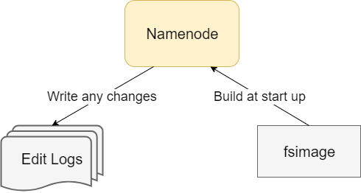
Filesystem metadata
Namenode stores
the metadata
Backup of metadata on
secondary namenode

Slide 8
Network Topology

Slide 9
Rack awareness

Slide 10
HDFS CLI Read Commands
Copy a file from local local file system to HDFS
hadoop fs –copyToLocal <source> <target>
Get merged file from HDFS to local file system
hadoop fs –getmerge <source> <target>
Cat a file from HDFS
hadoop fs –cat <filename>

Slide 11
HDFS Read operation

Slide 12
HDFS CLI Write Commands
Write a file from local file system to HDFS
hadoop fs –copyFromLocal <source> <target>
hadoop fs –put <source> <target>

Slide 13
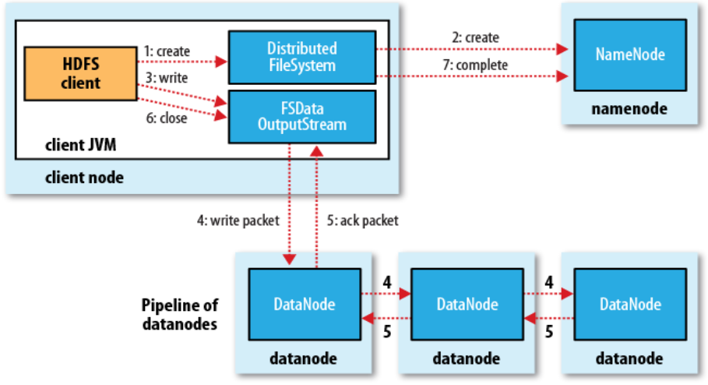
HDFS Write operation

Slide 14
HDFS not made for
Low-latency data access
Lots of small files
Each file|block|directory stores around 150 bytes of metadata. Hence 1 million files each of one block will consume 300 MB of storage on Namenode
Multiple writers, arbitrary file modifications

Slide 15
Agenda for today
MapReduce detailed discussion
Running your first MapReduce program
MapReduce Job Chaining
Hadoop 1 vs 2
YARN

Slide 16
MapReduce
Two major phases: Map and Reduce
Notion of <Key, Value> pairs
Divides job into multiple tasks
Map: extract important information from each record
Reduce: Aggregate, Summarize, Filter, Transform

Slide 17
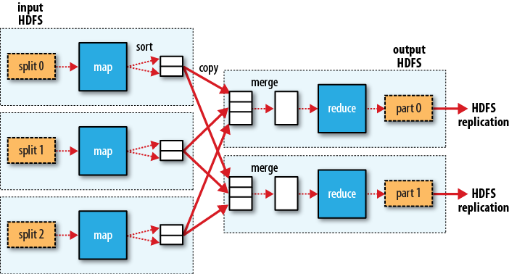
MapReduce Stages

Slide 18
Map Tasks
What is a good approach to decide how many map tasks a job should launch?
Less number of big tasks
vs
higher number of small tasks
Normally same as input data blocks

Slide 19
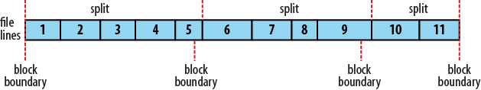
Input Splits
Blocks are of fixed size
Good chances of records being split between two block

Slide 20
Task to node mapping
Notion of data locality

Slide 21
Reduce Tasks
Can be configured by programmer
Normally same as #datanodes participating in execution
Input Key and Value type should be same as output type of mapper
One output file per reducer under output directory
Generates exception if output directory already exists.

Slide 22
MapReduce: Mapper code
public class WebHitCounterMapper extends
Mapper<Input Key, Input Value, Output Key, Output Value>
{
public void map(Input Key, Input Value, Context context) throws IOException, InterruptedException {
<MAP Logic goes here>
context.write(Output Key, Output Value) } }

Slide 23
MapReduce: Reducer code
public class WebHitCounterReducer extends
Reducer<Input Key, Input Value, Output Key, Output Value>
{ public void reduce(Input Key, Iterable<Value Data type> values,Context context) throws IOException, InterruptedException {
<REDUCE logic goes here>
context.write(Output Key, Output Value); } }

Slide 24
MapReduce: Driver Code
public class WebHitCounterMain { public static void main(String[] args) throws Exception { Configuration conf = new Configuration(); Job job = Job.getInstance(conf, "Daily Web Hit Counter");
} }

Slide 25
MapReduce: Driver Code
public class WebHitCounterMain { public static void main(String[] args) throws Exception { Configuration conf = new Configuration(); Job job = Job.getInstance(conf, "Daily Web Hit Counter");
job.setJarByClass(main.WebHitCounterMain.class); job.setMapperClass(mapper.WebHitCounterMapper.class); job.setReducerClass(reducer.WebHitCounterReducer.class); } }

Slide 26
MapReduce: Driver Code
public class WebHitCounterMain { public static void main(String[] args) throws Exception { Configuration conf = new Configuration(); Job job = Job.getInstance(conf, "Daily Web Hit Counter");
job.setJarByClass(main.WebHitCounterMain.class); job.setMapperClass(mapper.WebHitCounterMapper.class); job.setReducerClass(reducer.WebHitCounterReducer.class);
job.setOutputKeyClass(Text.class); job.setOutputValueClass(IntWritable.class); } }

Slide 27
MapReduce: Driver Code
public class WebHitCounterMain { public static void main(String[] args) throws Exception { Configuration conf = new Configuration(); Job job = Job.getInstance(conf, "Daily Web Hit Counter");
job.setJarByClass(main.WebHitCounterMain.class); job.setMapperClass(mapper.WebHitCounterMapper.class); job.setReducerClass(reducer.WebHitCounterReducer.class);
job.setOutputKeyClass(Text.class); job.setOutputValueClass(IntWritable.class);
FileInputFormat.addInputPath(job, new Path(args[0])); FileOutputFormat.setOutputPath(job, new Path(args[1])); } }

Slide 28
MapReduce: Driver Code
public class WebHitCounterMain { public static void main(String[] args) throws Exception { Configuration conf = new Configuration(); Job job = Job.getInstance(conf, "Daily Web Hit Counter");
job.setJarByClass(main.WebHitCounterMain.class); job.setMapperClass(mapper.WebHitCounterMapper.class); job.setReducerClass(reducer.WebHitCounterReducer.class);
job.setOutputKeyClass(Text.class); job.setOutputValueClass(IntWritable.class);
FileInputFormat.addInputPath(job, new Path(args[0])); FileOutputFormat.setOutputPath(job, new Path(args[1]));
System.exit(job.waitForCompletion(true) ? 0 : 1); } }

Slide 29
Additional Conf Properties
Configure maximum retries for failed tasks
setMaxMapAttempts(int n)
setMaxReduceAttempts(int n)
Configure reduce tasks explicitly
setNumReduceTasks(int tasks)

Slide 30
Input formats
Input format | Description
TextInputFormat | Read Text file line by line. Key is offset and value is record text
KeyValueTextInputFormat | Tab separated key values from a text file
SequenceFileInputFormat<K,V> | Hadoop’s file format

Slide 31
Output Formats
Output Format | Description
TextOutputFormat<K,V> | Tab separated key value pairs in plain text format. One record per key value pair
SequenceFileOutputFormat<K,V> | Hadoop’s Sequence file format
NullOutputFormat<K,V> | Nothing. Helps in map only job

Slide 32
Programming Exercise

Slide 33
Performance tuning
Cluster configuration
Use compression technique
Tuning # mappers and reducers
Use combiner
Appropriate data type
Reuse objects
Profiling

Slide 34
MapReduce Job chaining
Two separate jobs
Multiple mappers/reducers within same job

Slide 35
MapReduce Job chaining
Two separate jobs
Configure multiple job objects and run sequentially.
Job 3
Job 2
Job 1

Slide 36
MapReduce Job chaining
Multiple mappers/reducers within same job
ChainMapper API: to add multiple mappers
ChainReducer API: to add multiple reducers
Reduce
Map 2
Map 1

Slide 37
Challenges with Hadoop 1
Applications were limited to MapReduce implementations only
Namenode machine crash or maintenance activity
Namespace scaling
Backup and Recovery
Batch oriented architecture
Support for various file formats
Dual responsibilities of Job tracker

Slide 38
Hadoop 2
Support for other data processing engines
High Availability
HDFS Federation
HDFS Snapshot
Introduced Streaming and Interactive analysis
Support for various file formats
YARN

Slide 39
YARN
Yet Another Resource Negotiator
MapReduce 1 | YARN
Job Tracker | Resource Manager, Application Master and Timeline server
Task Tracker | Node Manager
Slot | Containers

Slide 40
YARN model
Image Ref: Hadoop definitive guide 4th edition

Slide 41
Pros of YARN
Scalability
4,000 node and 40,000 tasks to 10,000 nodes and 100,000 tasks
Availability
High Availability (HA) feature
Utilization
No fixed slots for map and reduce.
Multitenancy
Running other distributed system along Hadoop

Slide 42
References
Reference Book
Hadoop: The definitive guide by Tom White (Weblink)
MapReduce google paper
https://ai.google/research/pubs/pub62
Yahoo MapReduce Guide
https://developer.yahoo.com/hadoop/tutorial/module5.html?guccounter=1#fileformat
Filesystem metadata on Namenode
https://hortonworks.com/blog/hdfs-metadata-directories-explained/
Rack awareness
https://data-flair.training/blogs/rack-awareness-hadoop-hdfs/
https://community.hortonworks.com/articles/43057/rack-awareness-1.html
Concurrency vs Parallelism
https://stackoverflow.com/questions/1050222/what-is-the-difference-between-concurrency-and-parallelism
Latency vs Throughput
https://stackoverflow.com/questions/16718095/high-throughput-vs-low-latency-in-hdfs

Slide 43
References: Cont…
Modify input format in MapReduce Program
https://stackoverflow.com/questions/19624607/mapper-input-key-value-pair-in-hadoop
MapReduce job chaining
http://sadrzyatarkika.blogspot.com/2014/10/hadoop-chain-mapper-example.html
HDFS REST API
https://hadoop.apache.org/docs/r1.0.4/webhdfs.html#Document+Conventions
YARN Tuning Guide
https://www.cloudera.com/documentation/enterprise/5-8-x/topics/cdh_ig_yarn_tuning.html

