Slide 1
NEWA API Project Presentation March 7, 2019
Wang, Bianyu
Wang, Zhaolong
Huang, Jialing
Dadmehr, Mohammad

Slide 2
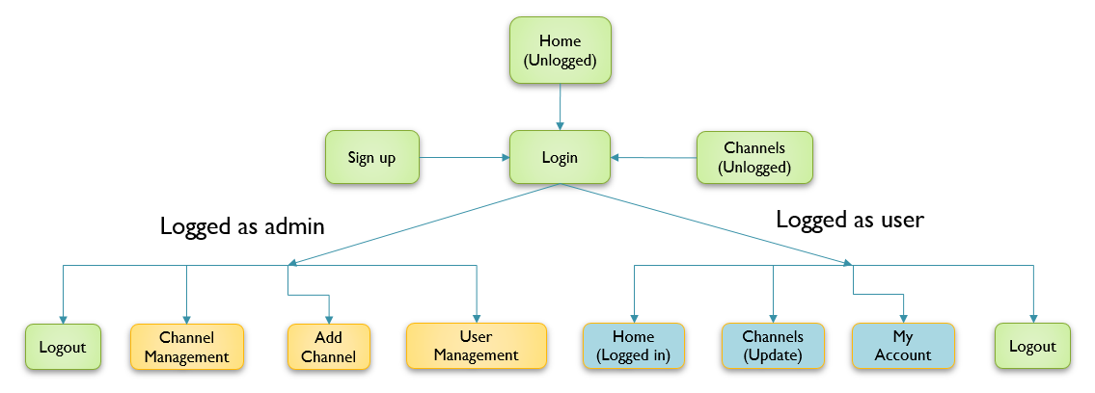
Overview
The project delivers a website to do:
To collect internet news channels resource
To let users to select preferred channels
To show news details to users
To allow admin to manage the website
Website Flowchart

Slide 3
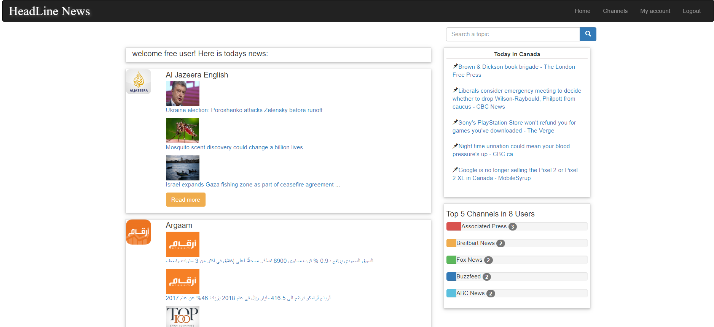
Page Layout ( User Pages )
Navigation Bar
Search Bar
Canada News Area
Main Info Area
Statistic Result Area

Slide 4
Highlights
Uses NEWS API to collect news resources.
NEWS API: https://newsapi.org/
Separates admin management pages and users pages.
Extra functions:
Search Function
Randomly showing news on Canada
Statistic result of recent news channel selection
Visual way to show news channels

Slide 5
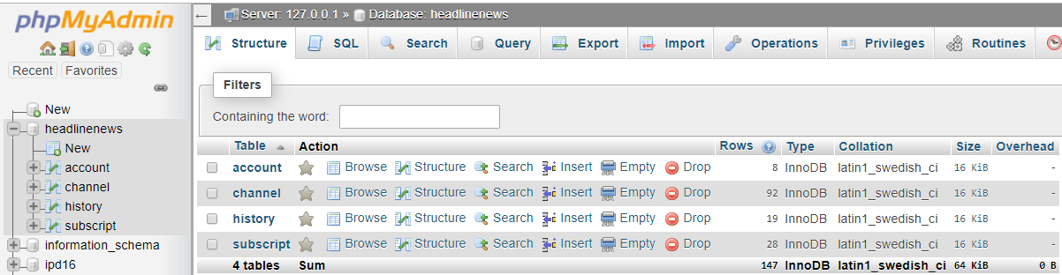
Database
Created a new database as “headlinenews” which convers 4 tables

Slide 6
Questions

