Slide 1



Augmentation with Projection:
Towards an Effective and Efficient Data Augmentation Paradigm for Distillation
Ziqi Wang, Yuexin Wu, Frederick Liu, Daogao Liu, Le Hou, Hongkun Yu, Jing Li, Heng Ji

Slide 2
Data augmentation in knowledge distillation
Token Replacement
Limited semantics
A sad , superior human comedy played out on the back roads of life.
A lamentable , superior human comedy played out on the backward roads of life.
A sad , superior human comedy played out on the back roads of life.

Slide 3
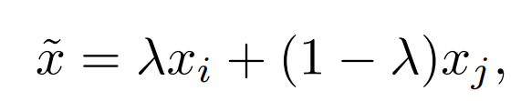
Data augmentation in knowledge distillation
Token Replacement Representation Interpolation
Limited semantics
Student Embedding
Student Embedding
watch on video at home
as good ,

Slide 4
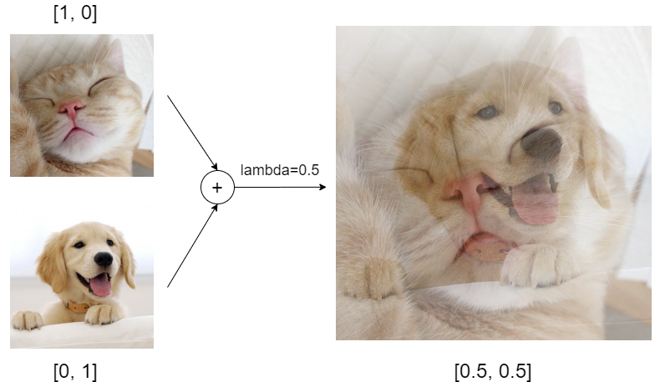
Data augmentation in knowledge distillation
Token Replacement Representation Interpolation
Limited semantics
https://medium.com/@wolframalphav1.0/easy-way-to-improve-image-classifier-performance-part-1-mixup-augmentation-with-codes-33288db92de5

Slide 5
Data augmentation in knowledge distillation
Token Replacement Representation Interpolation
Limited semantics
Teacher Embedding
Teacher Embedding
watch on video at home
as good ,

Slide 6
Data augmentation in knowledge distillation
Token Replacement Representation Interpolation
Limited semantics
Rich semantics
KLDiv
Student Model
Teacher Model

Slide 7
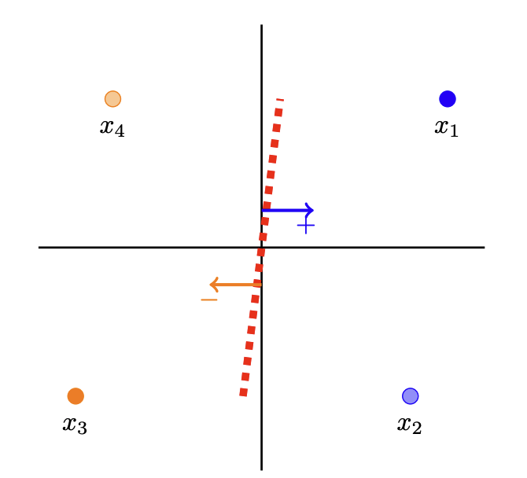
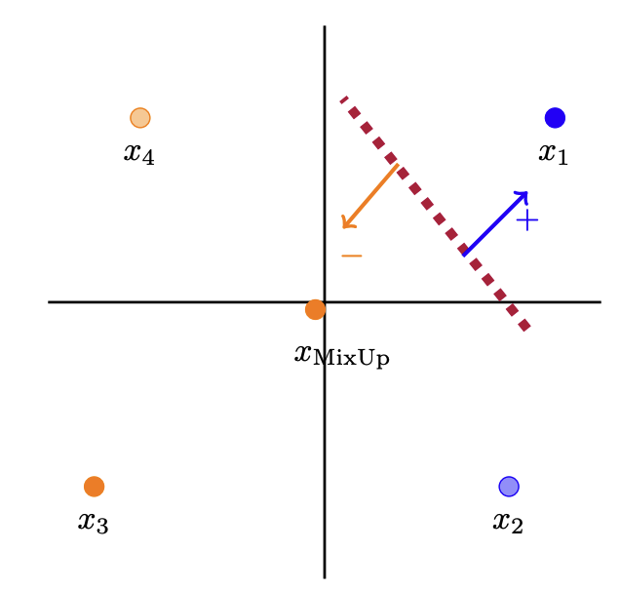
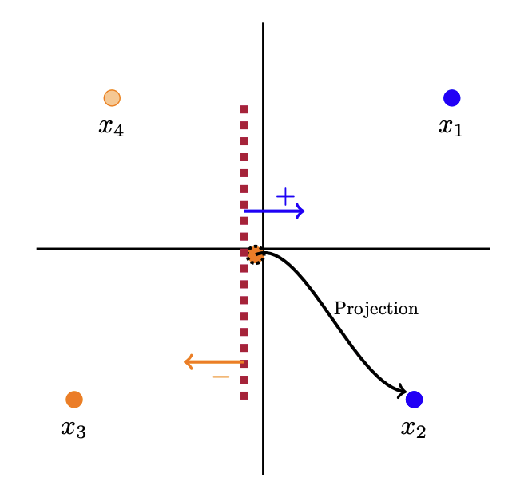
Data augmentation in knowledge distillation
The discrete nature of language makes representation interpolation sub-optimal
All data
Observed data and RI data
Observed / RI data with projection

Slide 8
Data augmentation in knowledge distillation
Representation inconsistency
KLDiv
Student Model
Teacher Model
Same?

Slide 9
Methodology
Token Replacement Representation Interpolation Our Method AugPro
Limited semantics
Rich semantics
Rich semantics + Discrete Nature
Teacher Embedding
Teacher Embedding
watch on video at home
as good ,

Slide 10
Methodology
Token Replacement Representation Interpolation Our Method AugPro
Limited semantics
Rich semantics
Rich semantics + Discrete Nature
Projection (e.g., Nearest neighbors)
Teacher Embedding
at
Watch
good
video
home
watch on video at home
as good ,

Slide 11
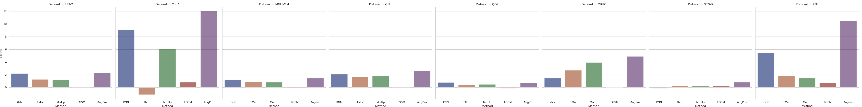
Our methods will significantly outperform other DA methods!

Slide 12
Conclusion
We propose a new effective data augmentation technique for knowledge distillation that considers the discrete nature of languages
Representation interpolation shows effectiveness in vision tasks
However, we need to consider the discreteness of languages when we use vision techniques for NLP tasks
This two observations motivate our research
Results have shown that our methods are effective compared to other methods

Slide 13
Thanks!

