Slide 1

Learning from Explanations with Neural Execution Tree
Ziqi Wang*, Yujia Qin*, Wenxuan Zhou, Jun Yan, Qinyuan Ye,
Leonardo Neves, Zhiyuan Liu, Xiang Ren
Notes:
Introduce myself (where I from), paper ideas + collaborators

Slide 2

Our Idea: High-level Human Supervisions
Traditional Training Method:
Training: instance ${\left\{x\right\}}_{i=1}^{n}→$ classifier $f$
Prediction: $\hat{y}=f(x)$
Our training method:
Training: instance ${\left\{x\right\}}_{i=1}^{n}+$ human knowledge ${\left\{e\right\}}_{i=1}^{n}→$ classifier $f$
Prediction: $\hat{y}=f(x)$

Slide 3
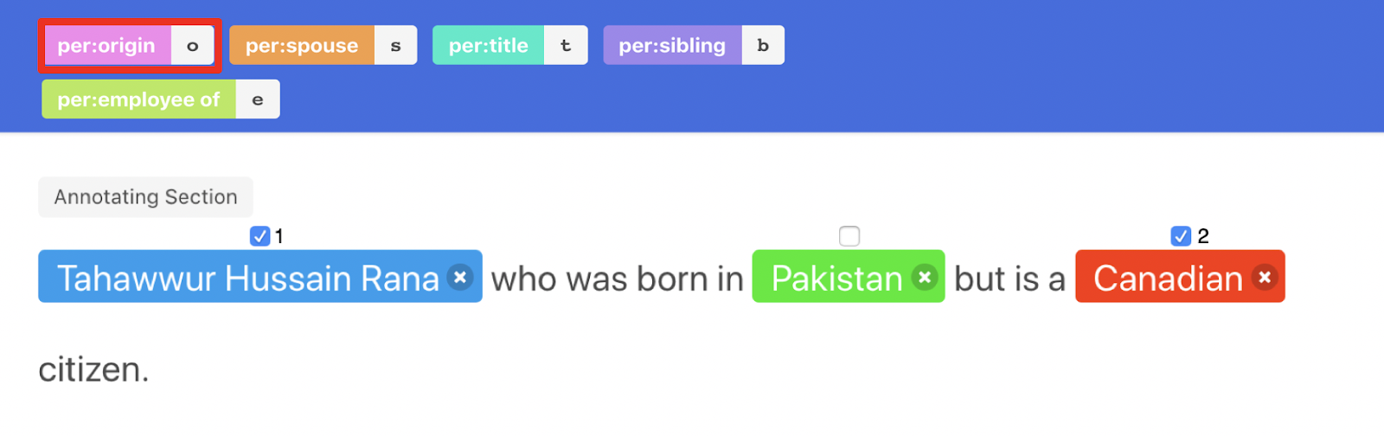
Our Idea: High-level Human Supervisions

Slide 4
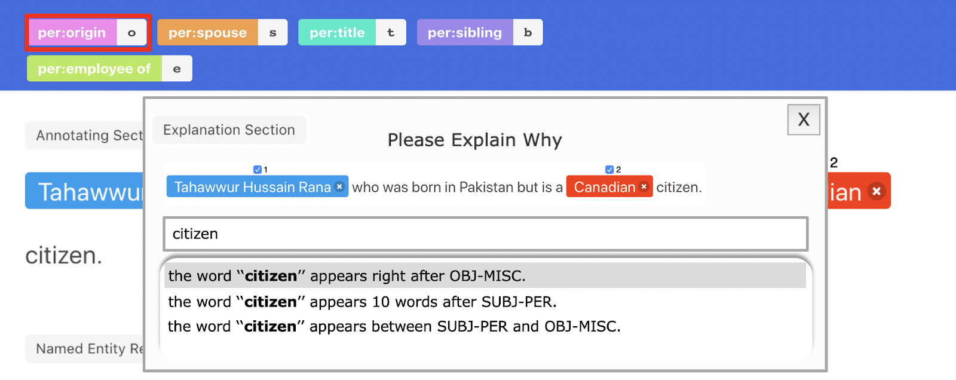

Our Idea: High-level Human Supervisions
Machine digests human rationale and learns how to make decisions

Slide 5

Standard pipeline for data annotation
Corpus
Labels
Microsoft was founded by Bill Gates in 1975.
Apple was founded by Steven Jobs in 1976.
Amazon was founded by Jeff Bezos in 1994.
ORG: FOUNDED_BY
ORG: FOUNDED_BY
ORG: FOUNDED_BY
Neural Classifier
Annotator
Slow, redundant annotation efforts on similar instances!

Slide 6


Problem Setting
explanation
$$U=\{x_{i}\}$$

Slide 7
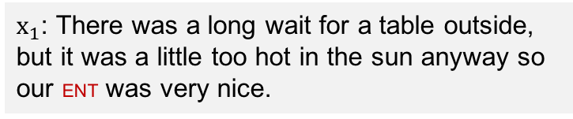
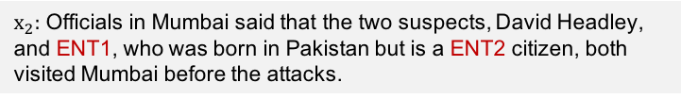
Natural Language Explanation
Sentiment on ENT is positive or negative?
Users' natural language explanations
$x_{1}$: There was a long wait for a table outside, but it was a little too hot in the sun anyway so our ENT was very nice.
Positive, because the words “very nice” is within 3 words after the ENT.
Relation between ENT1 and ENT2?
per: nationality, because the words ‘‘is a’’ appear right before ENT2 and the word ‘‘citizen’’ is right after ENT2.
$x_{2}:$ Officials in Mumbai said that the two suspects, David Headley, and ENT1, who was born in Pakistan but is a ENT2 citizen, both visited Mumbai before the attacks.

Slide 8
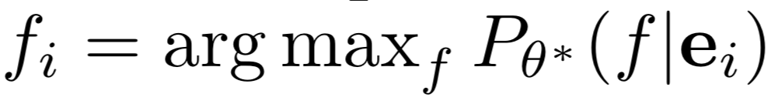
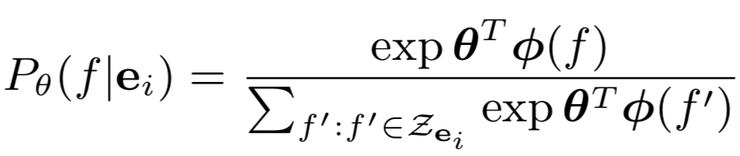
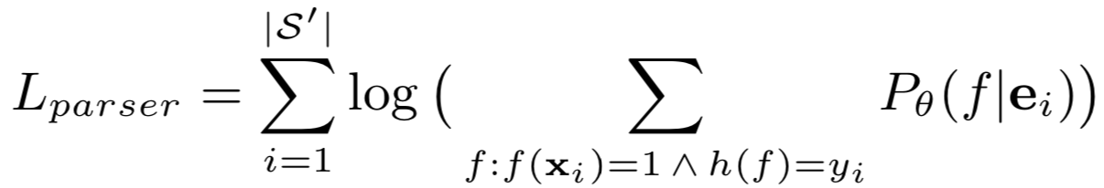
Explanations to “labeling functions”
Labeling function (most plausible)
Explanation
def LF (x) :
Return ( 1 if : And ( Is ( Word ( ‘who died’ ), AtMost ( Left ( OBJECT ), Num (3, tokens ) ) ), Is ( Word ( ‘who died’ ), Between ( SUBJECT , OBJECT) ) ); else 0 )
The words “who died” precede OBJECT by no more than three words and occur between SUBJECT and OBJECT
predicate assigning
function assigning
@Word @Quote(who died) @Left @OBJECT @AtMost @Num @Token @And @Is @Between @SUBJECT @And @OBJECT
CCG parsing
inference
Candidate logical forms
@And ( @Is ( @Quote ( ‘who died’ ), @AtMost ( @Left ( @OBJECT ), @Num ( @Token ) ) ), @Is ( @Word ( ‘who died’ ), @Between ( @SUBJECT , @OBJECT) ) )
Candidate scoring
..….
..….
(Srivastava et al., 2017; Zettlemoyer & Collins, 2012)

Slide 9
Hard matching for data augmentation
Instance
Sentence: quality ingredients preparation all around, and a very fair price for NYC.
Question: What is the sentiment polarity w.r.t. “price” ?
unlabeled instance
Sentence: it has delicious food with a fair price.
Human labeling
Label result
Label: Positive
Explanation: because the word “price” is directly preceded by fair.
Hard Matching

Slide 10
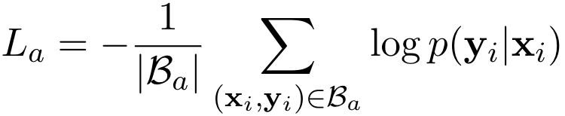
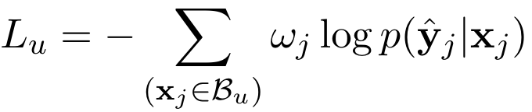



Proposed Model - Overview
hard matching
explanation
sample and annotate
$$B_{a}=\{{(x}_{i}, y_{i})\}$$
semantic parsing
feed all data to a
downstream classifier
logical form
$$U=\{x_{i}\}$$
soft matching
$$B_{u}=\{(x_{j},{\hat{y}}_{j},ω_{j})\}$$
annotate with a pseudo
label and a confidence score

Slide 11
matching score
max(p1+p2-1, 0)
argmax(p1*p2)
p1
0.8
p2
argmax(p1*p2)
0.9
0.9
p1
p2
And
p1
p2
SUBJECT was murdered on OBJECT
SUBJECT was murdered on OBJECT
SUBJECT was murdered on OBJECT
string
matching
soft
counting
SUBJECT was murdered on OBJECT
0.3, 0.2, 0.9, 0.2, 0.4
0.6, 1, 1, 1, 1
0, 1, 1, 1, 0
0.3, 0.2, 0.9, 0.2, 0.4
Is
Is
( Word ( who died ) )
Between(SUBJECT, OBJECT))
(Word(who died)
logic
calculation
deterministic
function
AtMost (Left(OBJECT), Num(3 Tokens))
Neural Execution Tree
Logical Form
Sentence
def LF (x) :
Return ( 1 if : And ( Is ( Word ( ‘who died’ ), AtMost ( Left ( OBJECT ), Num (3, tokens ) ) ), Is ( Word ( ‘who died’ ), Between ( SUBJECT , OBJECT) ) ); else 0 )
SUBJECT was murdered on OBJECT
SUBJECT was killed in OBJECT
Explanation
SUBJECT , who died on OBJECT
The words “who died” precede OBJECT by no more than
three words and occur between SUBJECT and OBJECT
..….

Slide 12
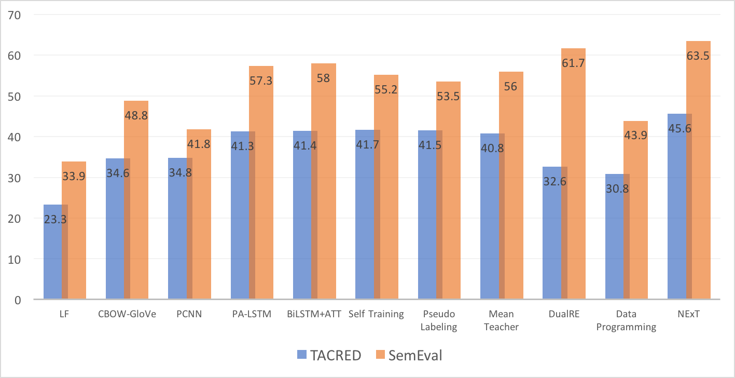
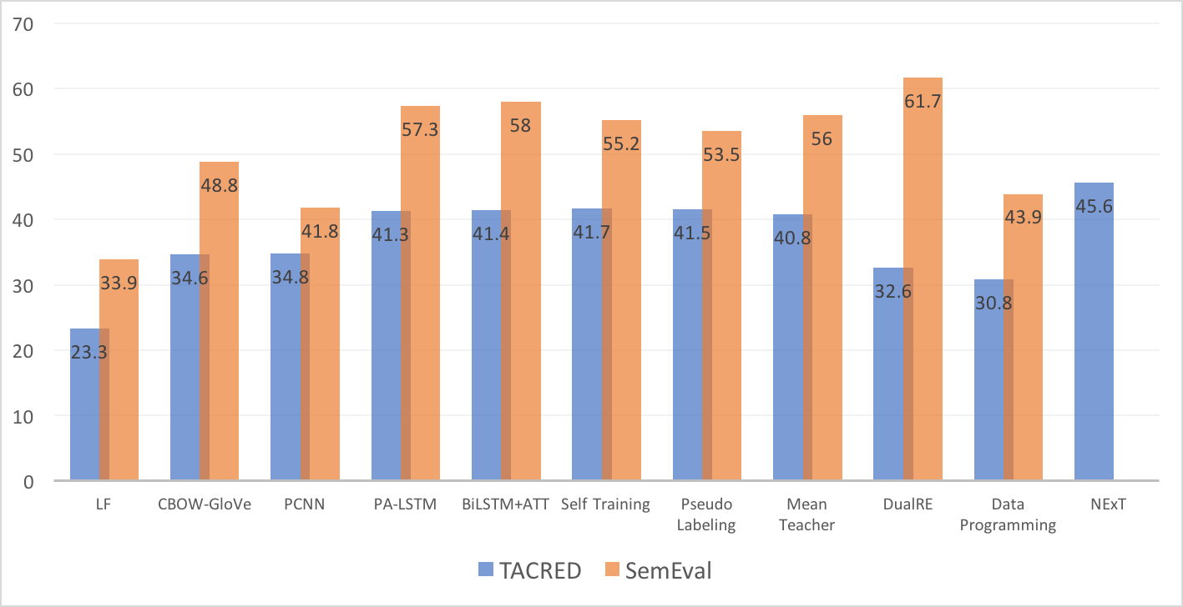
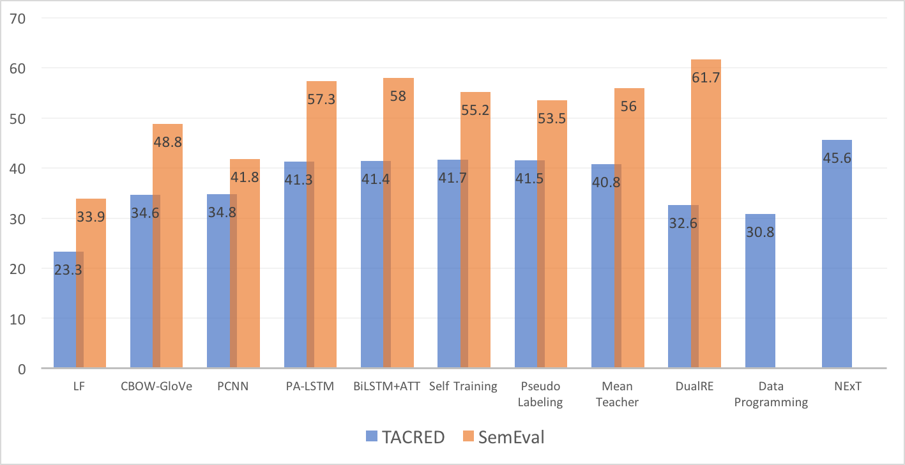
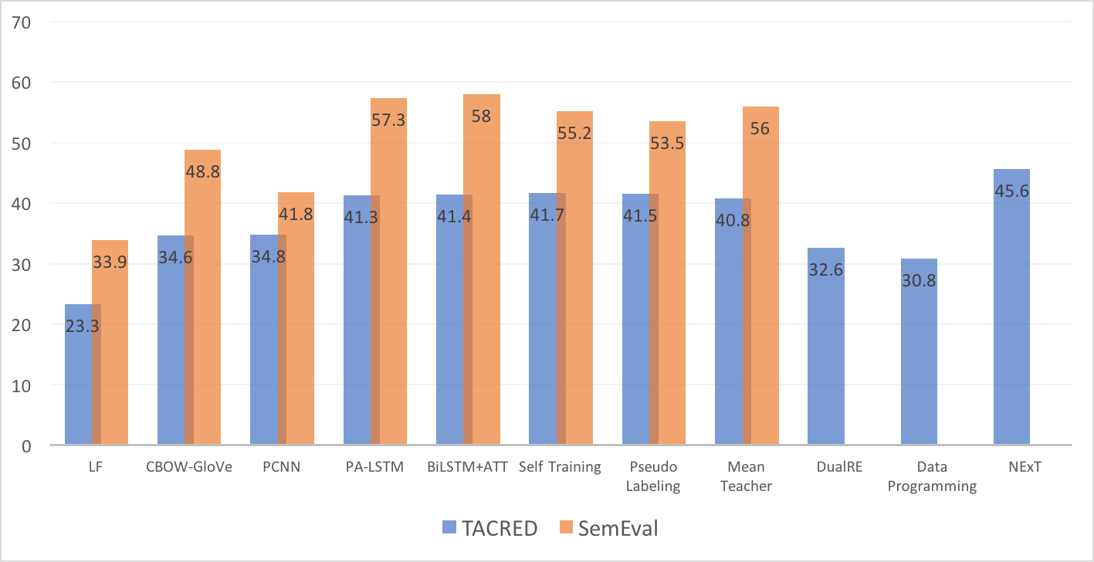
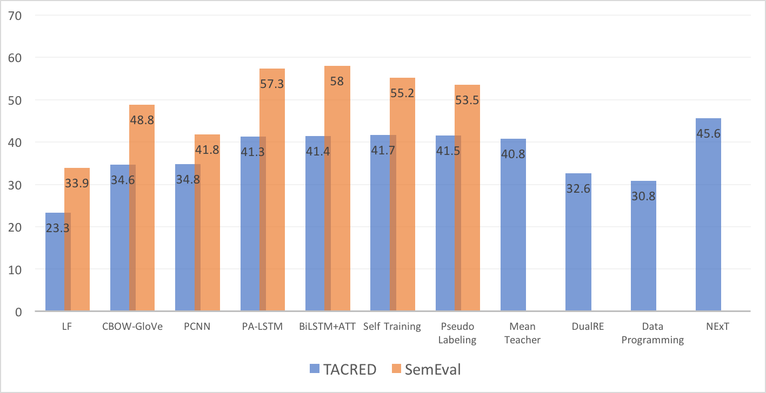
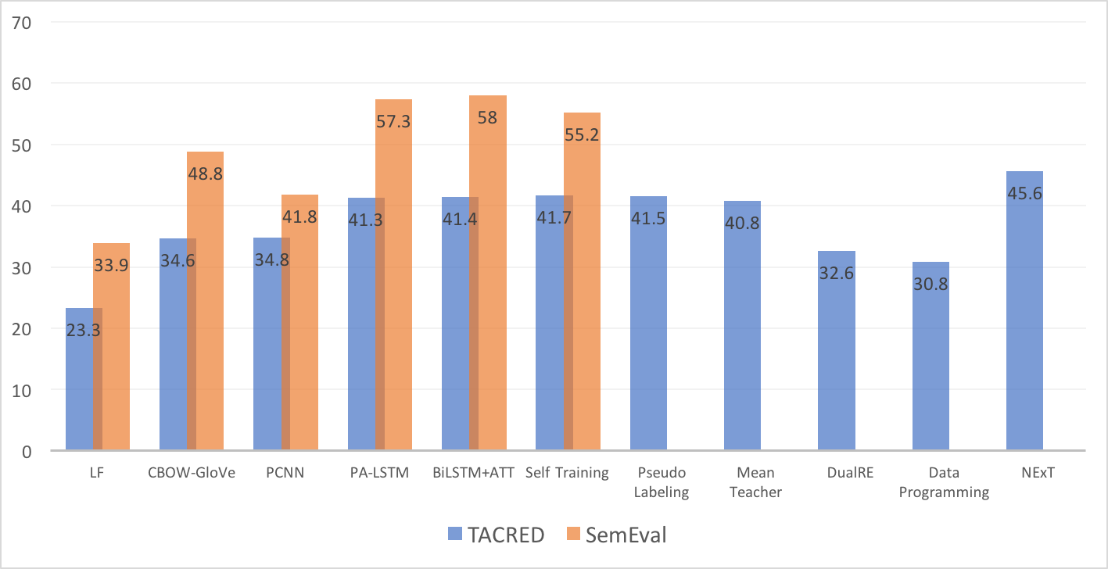
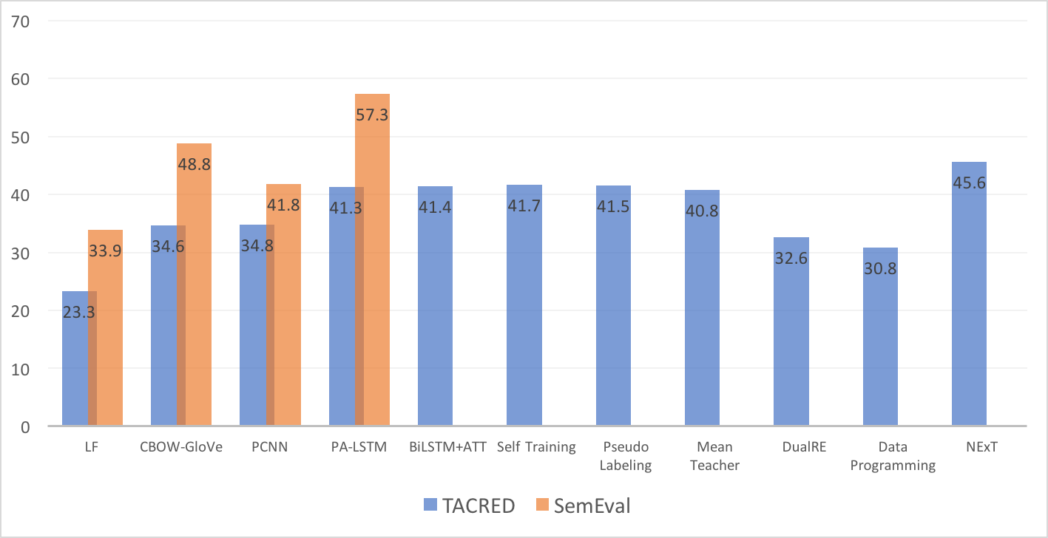
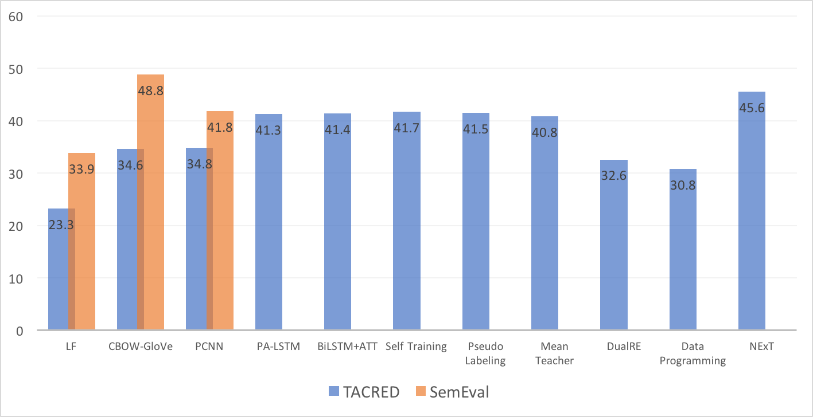
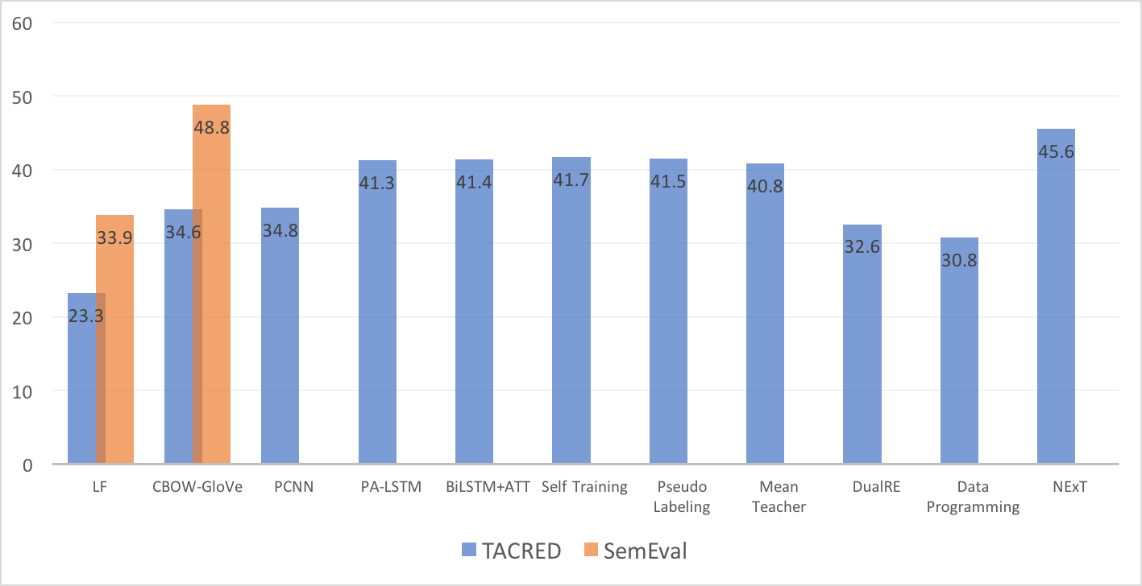
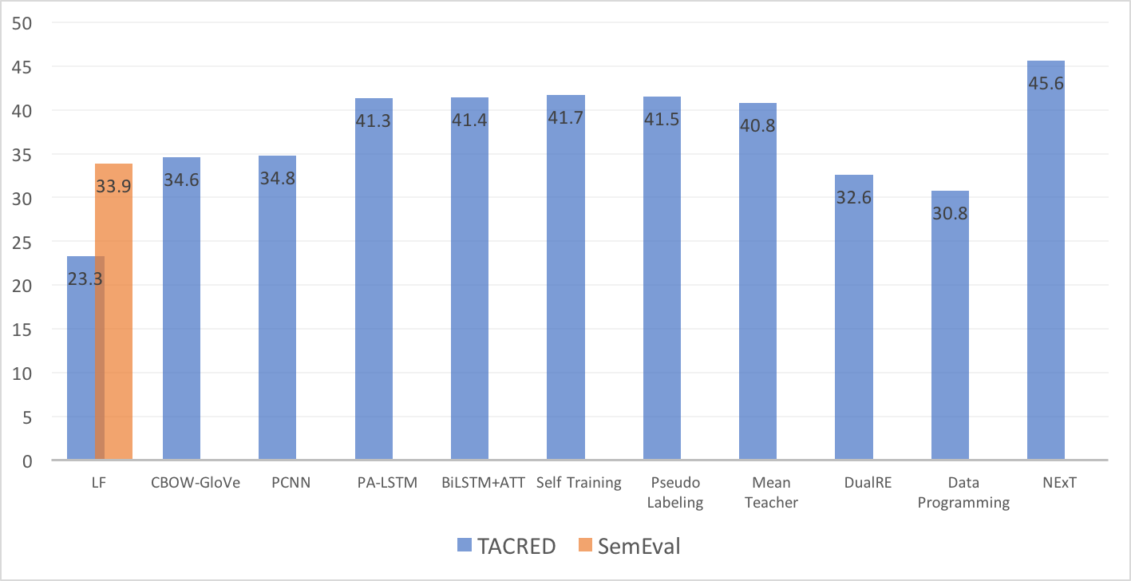
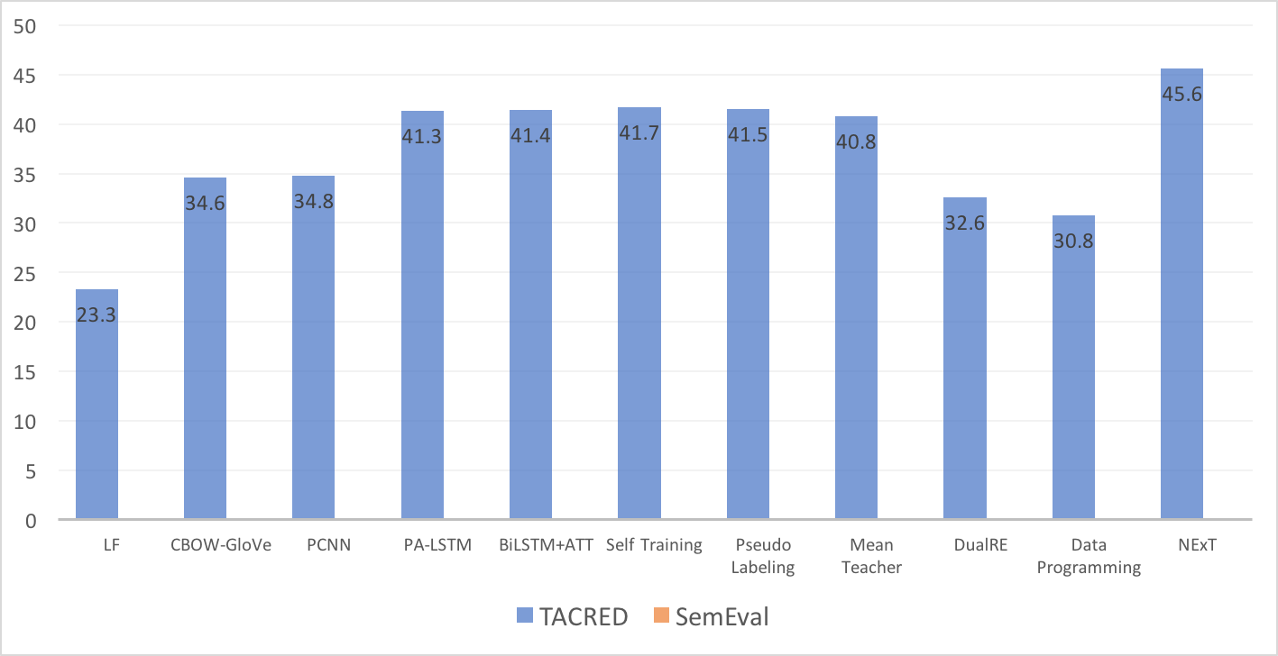
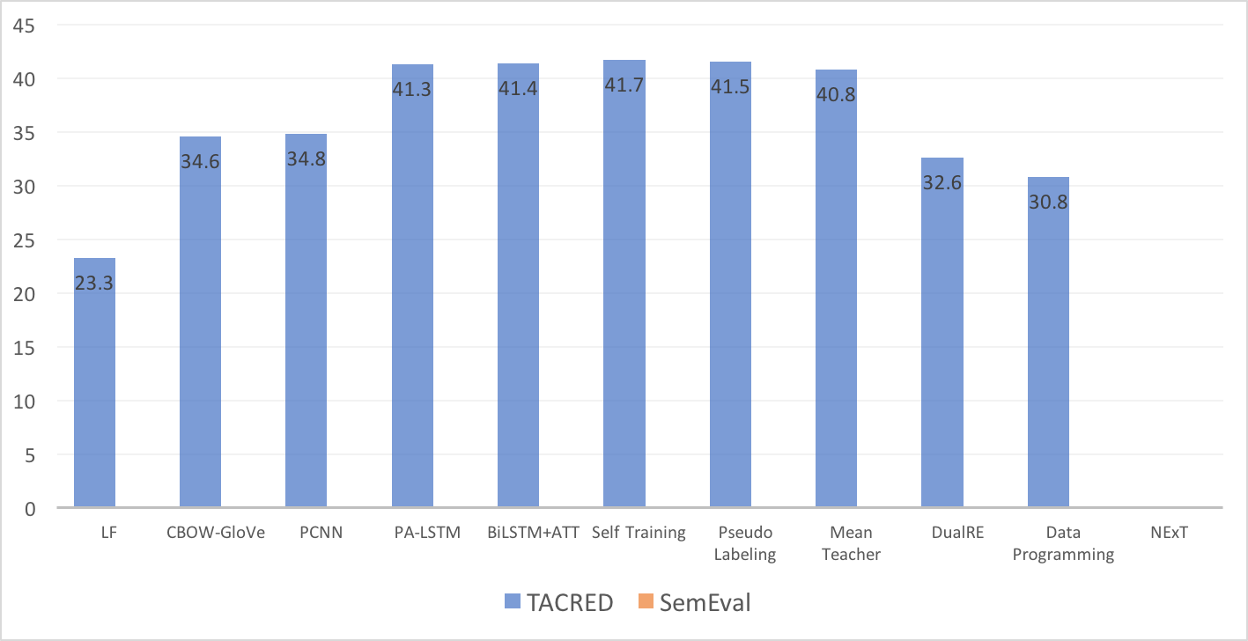
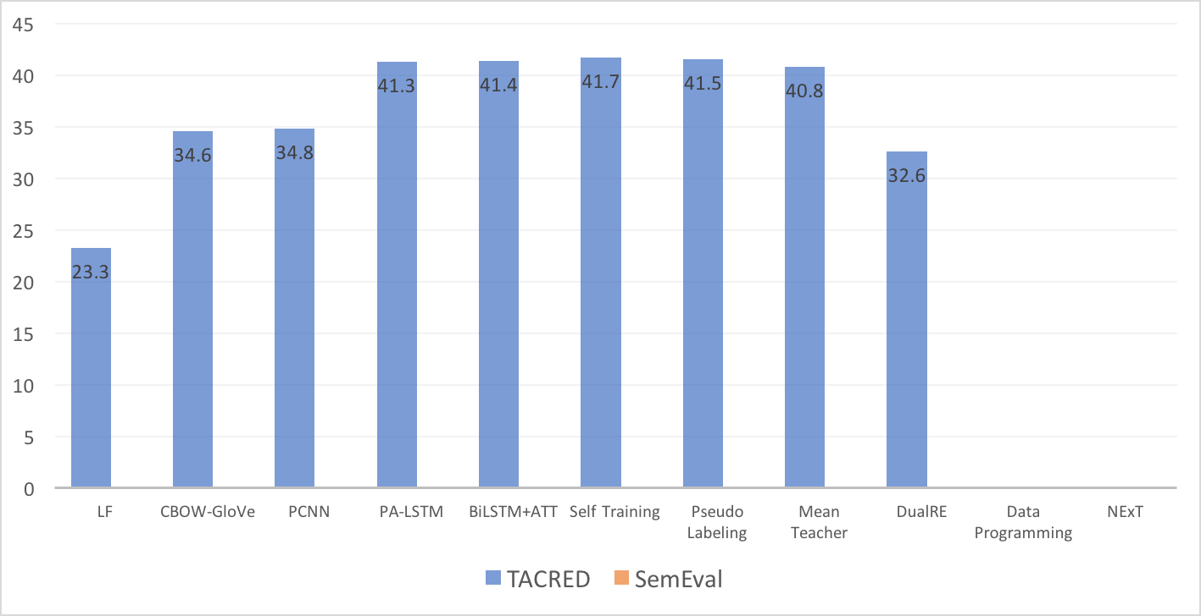
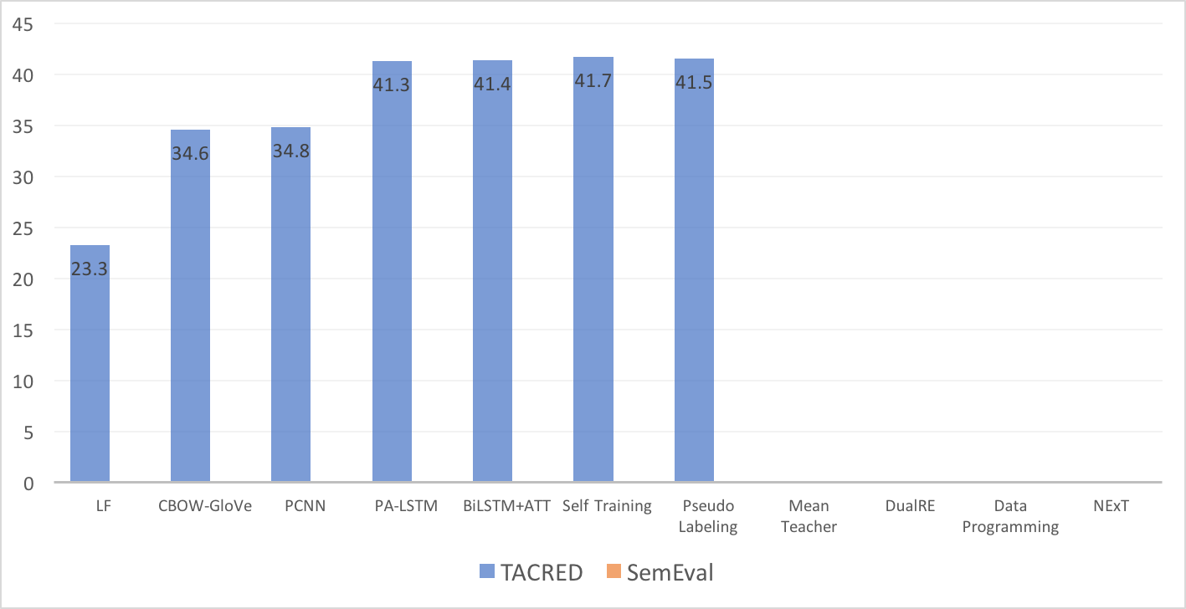
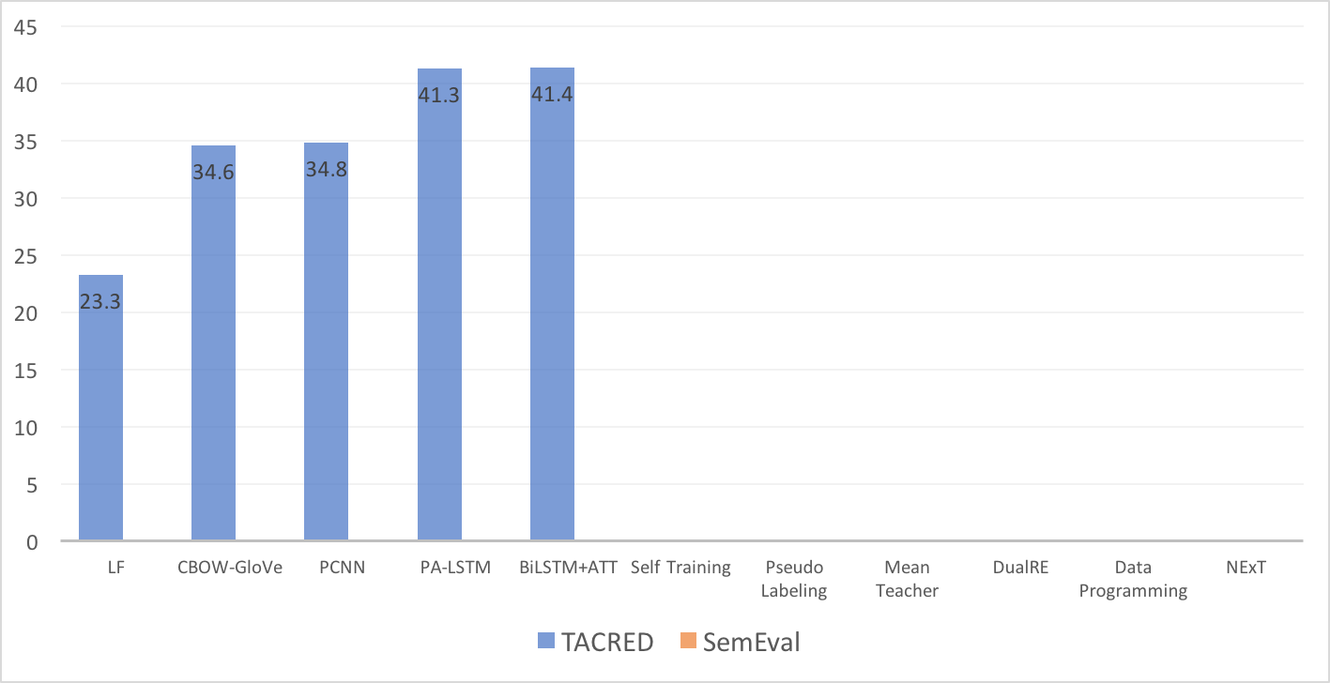
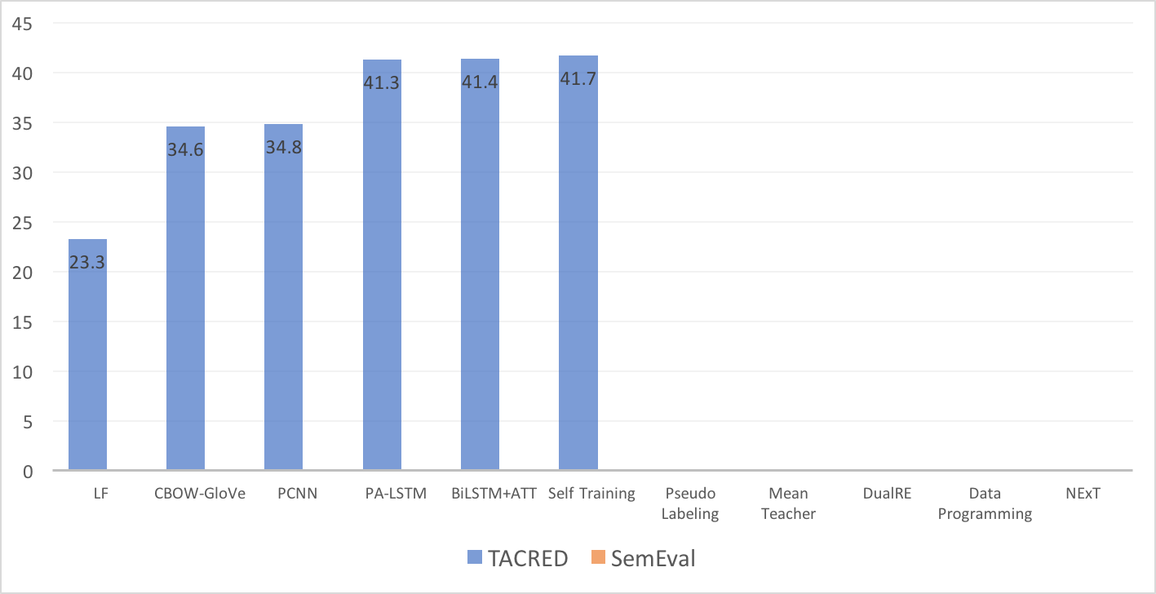
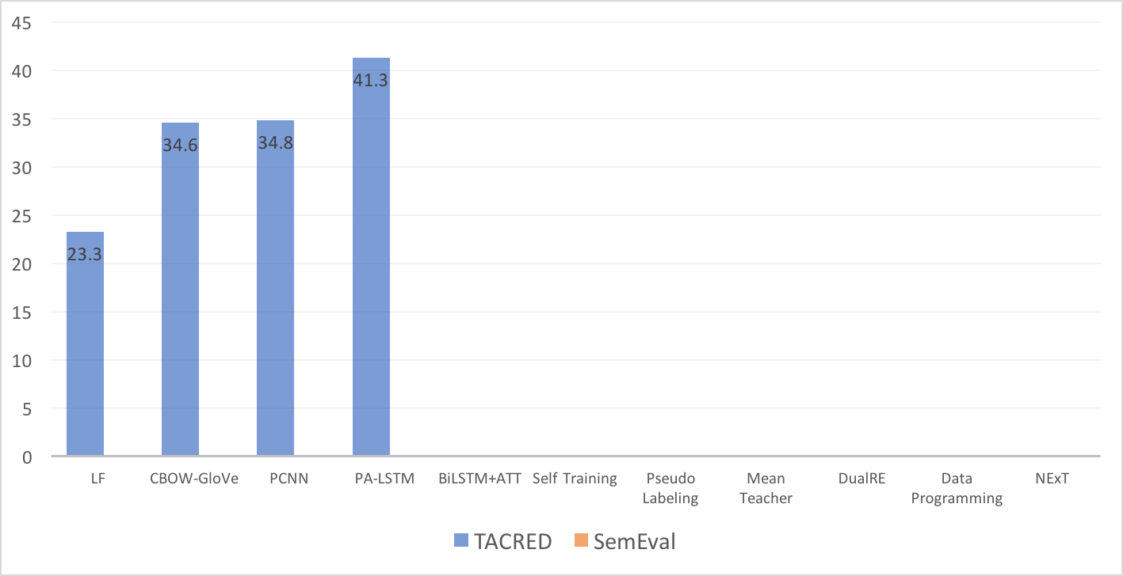
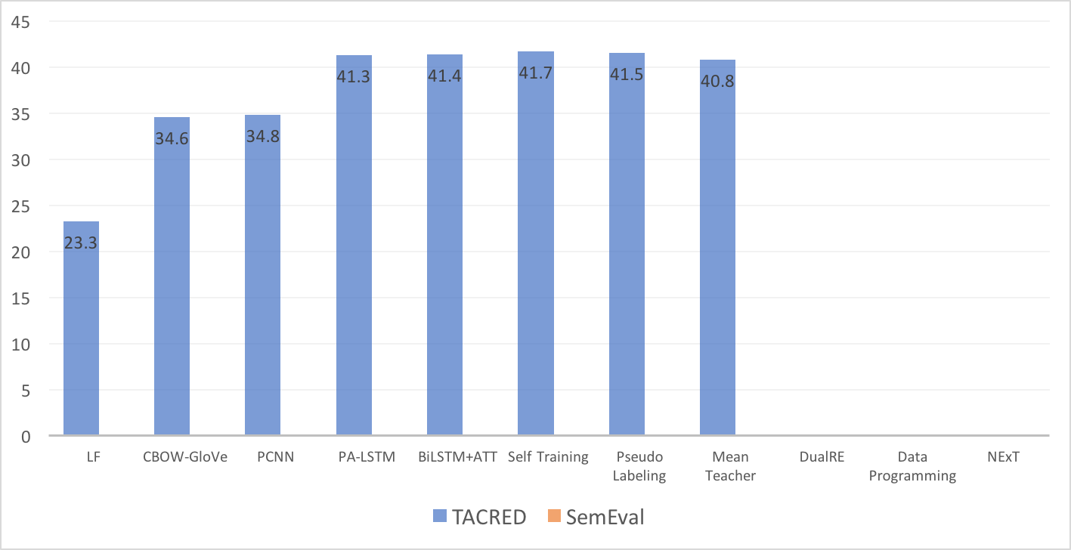
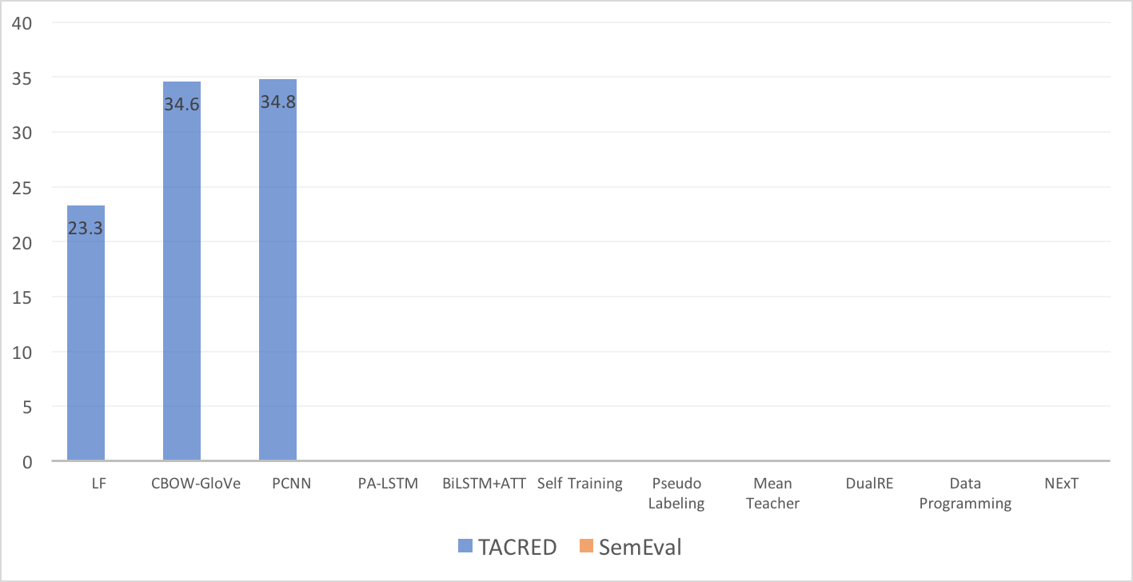
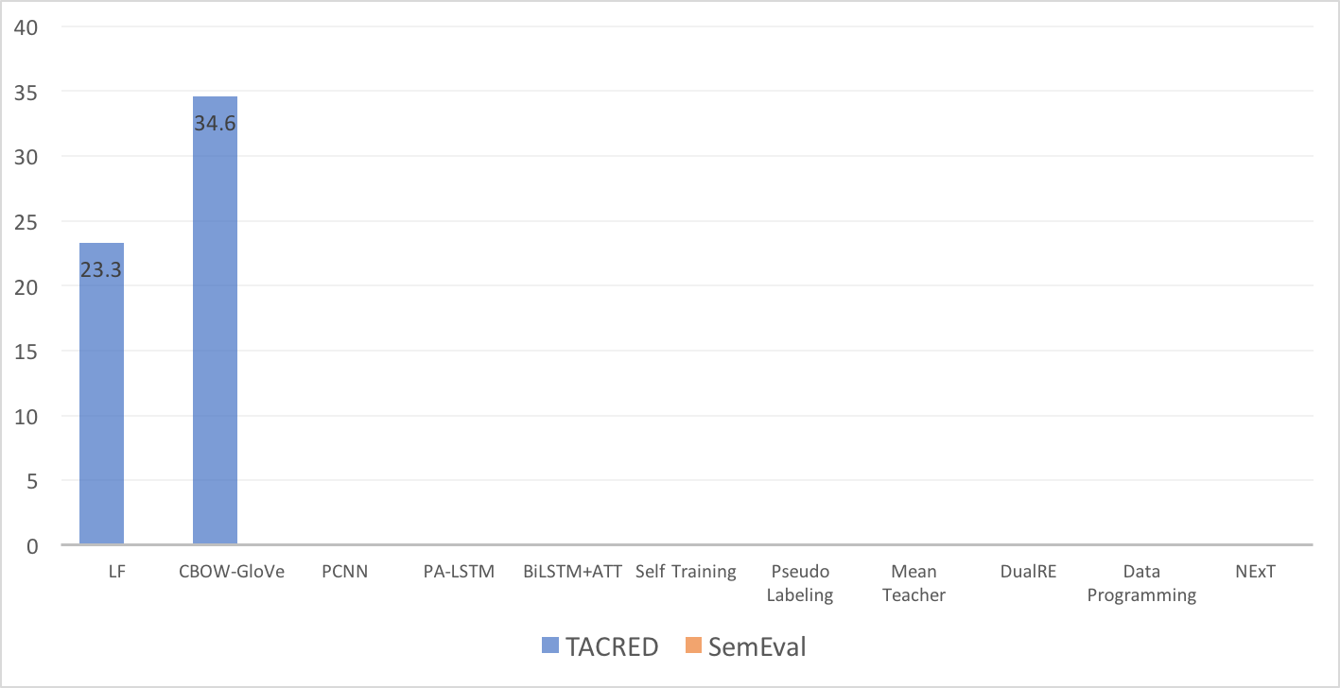
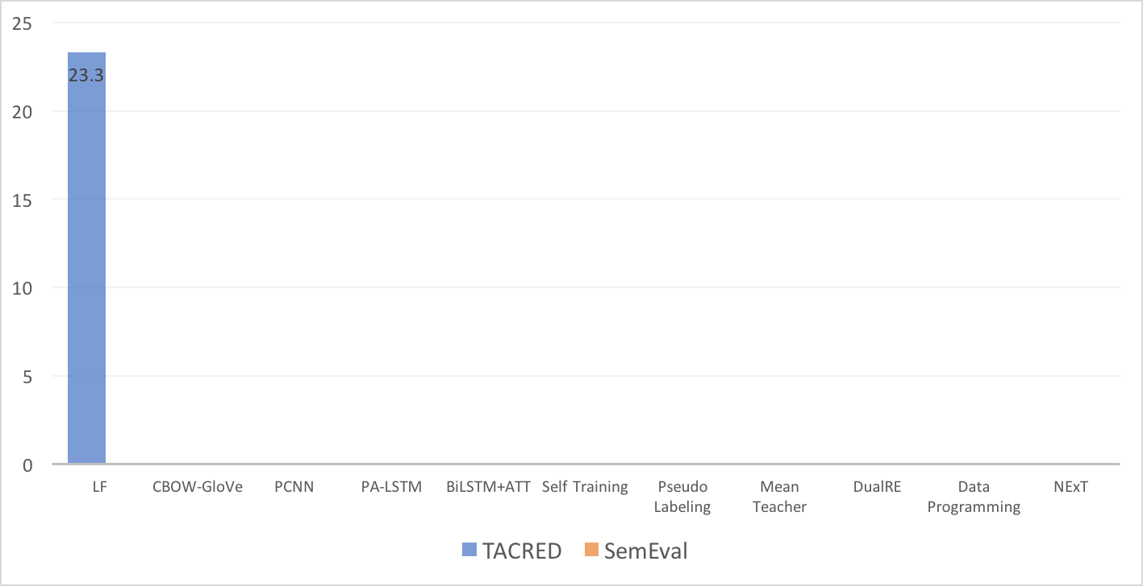
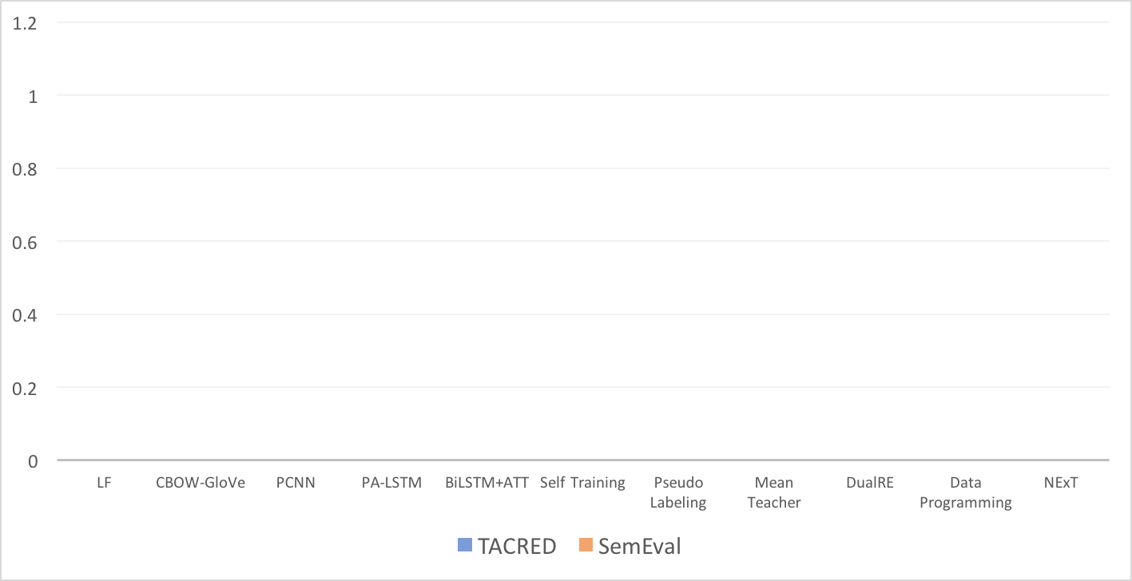
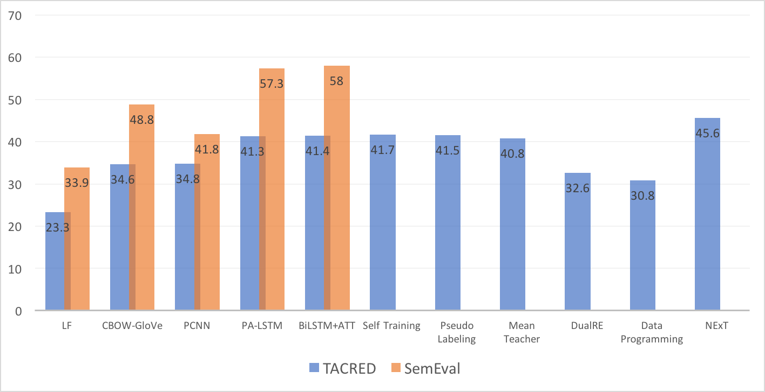
Performance Analysis – Relation Extraction
Notes:
Change to bar chat
Add lines on data settigs

Slide 13
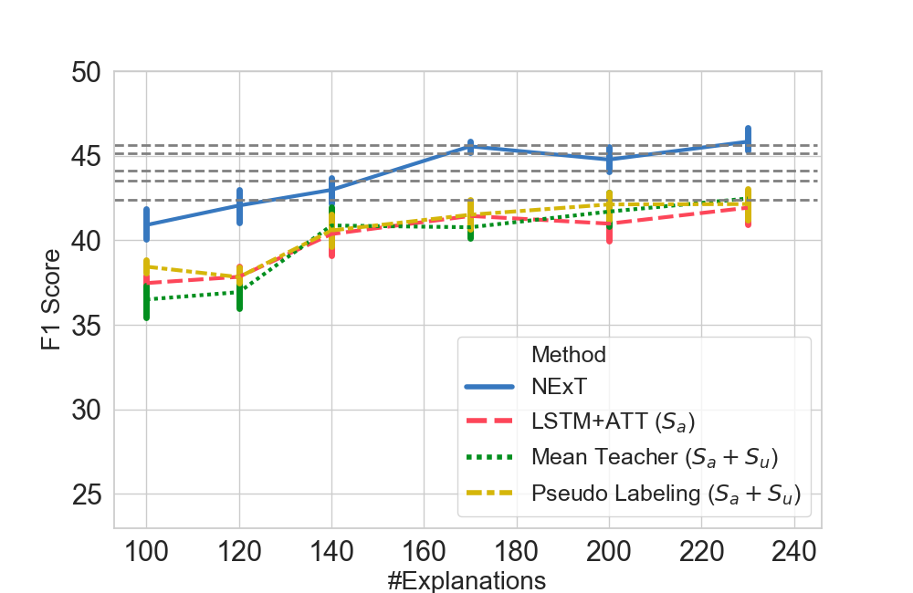


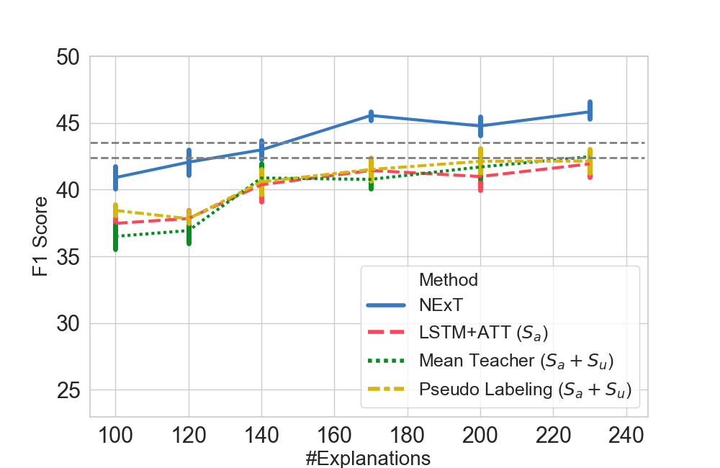
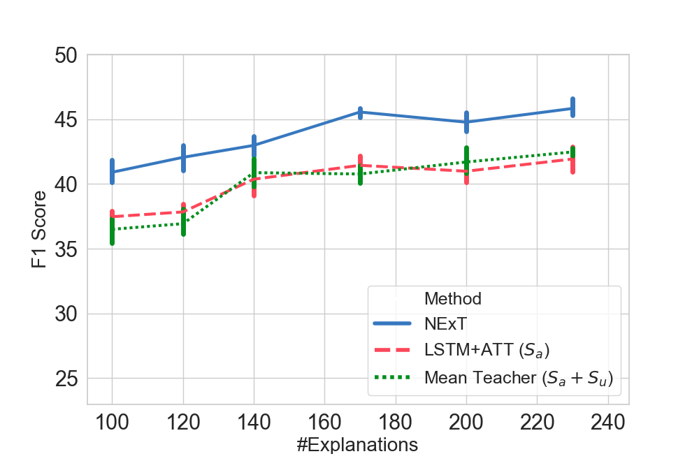
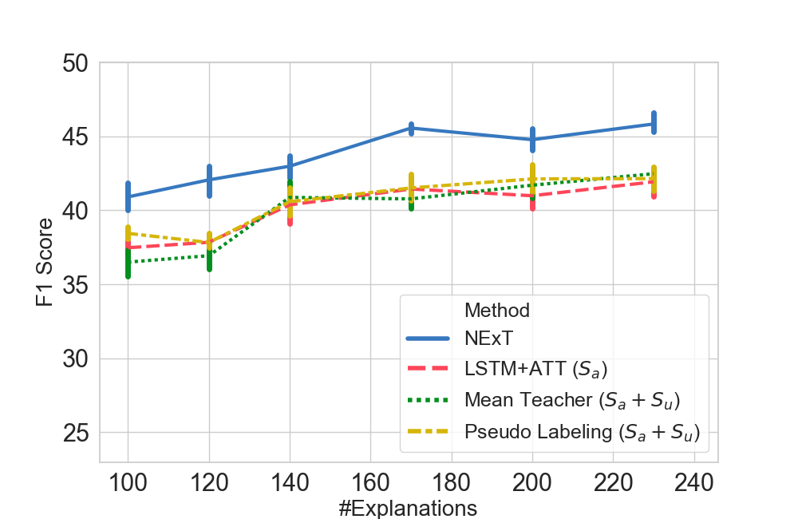
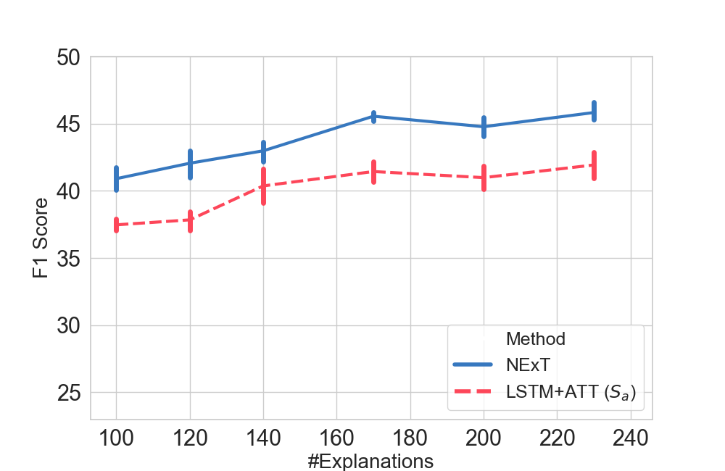
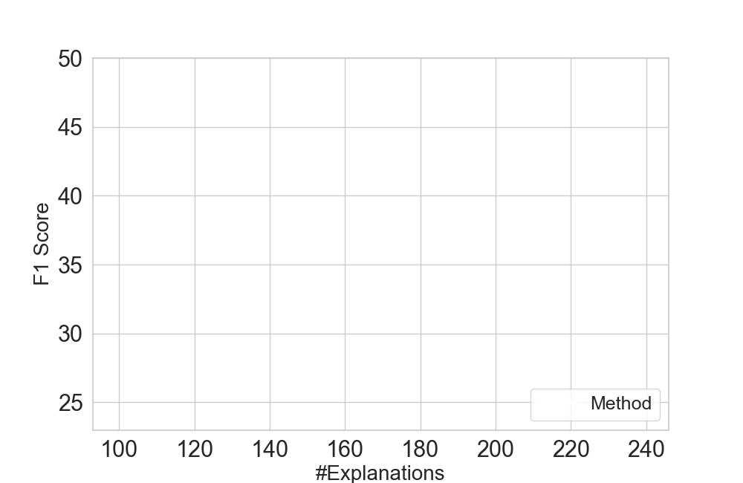
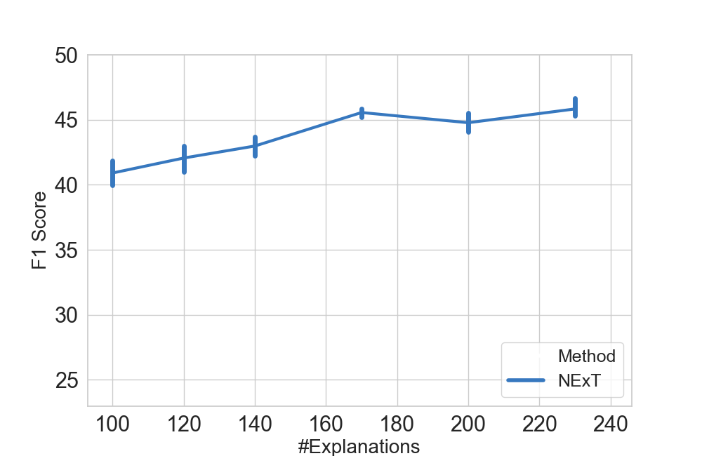

Study on Label Efficiency (TACRED)
# labels to achieve equal performance
2500
2000
1500
1000
500
Number of explanations
Annotation time cost:
giving a label + an explanation ~= 2x giving a label
Notes:
Change to bar chat
Add lines on data settigs

Slide 14
Thank you!
Paper: https://openreview.net/forum?id=rJlUt0EYwS
Project: http://inklab.usc.edu/project-NExT/
Code: https://github.com/INK-USC/NExT
Contact: ziqi-wan16@mails.tsinghua.edu.cn

