Slide 1

UNIT 4
Body
Language
Reading and Thinking
LISTENING TO HOW BODIES TALK
Before we speak,
our bodies already talk.
What can a smile say without words?
UNIT 4 / BODY LANGUAGE
01 / 21
Notes:
开场约45秒：微笑、挥手，先不说话。随后说：Before I say a word, you already know I am happy to see you. How did you know? Today, we will read a language without words—body language. Can the same gesture mean different things in different cultures? Let’s find out. 点击呈现开场句，再邀请学生解释你的动作。

Slide 2
OUR LEARNING JOURNEY
Learning objectives
By the end of this class, we will be able to:
01
Acquire
02
Recognize
03
Give advice
Acquire the information of some body language in different cultures.
Recognize the importance of respecting cultural differences in body language.
Give advice about using body language appropriately.
Read for meaning → Compare cultures → Communicate with respect
UNIT 4 / BODY LANGUAGE
02 / 21
Notes:
保留该页原教学要点，并优化视觉层级。点击时按顺序淡入重点或卡片；可先让学生作答，再呈现示例。第9页为完整信息表，直接用于核对答案。

Slide 3
LEAD-IN
How do we communicate?
What’s the function of language?
To communicate with each other.
How many ways do people use
to communicate?
Try it: say “hello” without speaking.
UNIT 4 / BODY LANGUAGE
03 / 21
Notes:
保留该页原教学要点，并优化视觉层级。点击时按顺序淡入重点或卡片；可先让学生作答，再呈现示例。第9页为完整信息表，直接用于核对答案。

Slide 4
LEAD-IN
Words are only one way
Ways of communication: verbal and nonverbal
Verbal communication
Nonverbal communication
Spoken language: face-to-face communication; phone calls.
Written language: letters; WeChat.
Body language: gestures, facial expressions and postures.
Suppose we are living in a silent world.
How will we communicate with each other?
UNIT 4 / BODY LANGUAGE
04 / 21
Notes:
保留该页原教学要点，并优化视觉层级。点击时按顺序淡入重点或卡片；可先让学生作答，再呈现示例。第9页为完整信息表，直接用于核对答案。

Slide 5
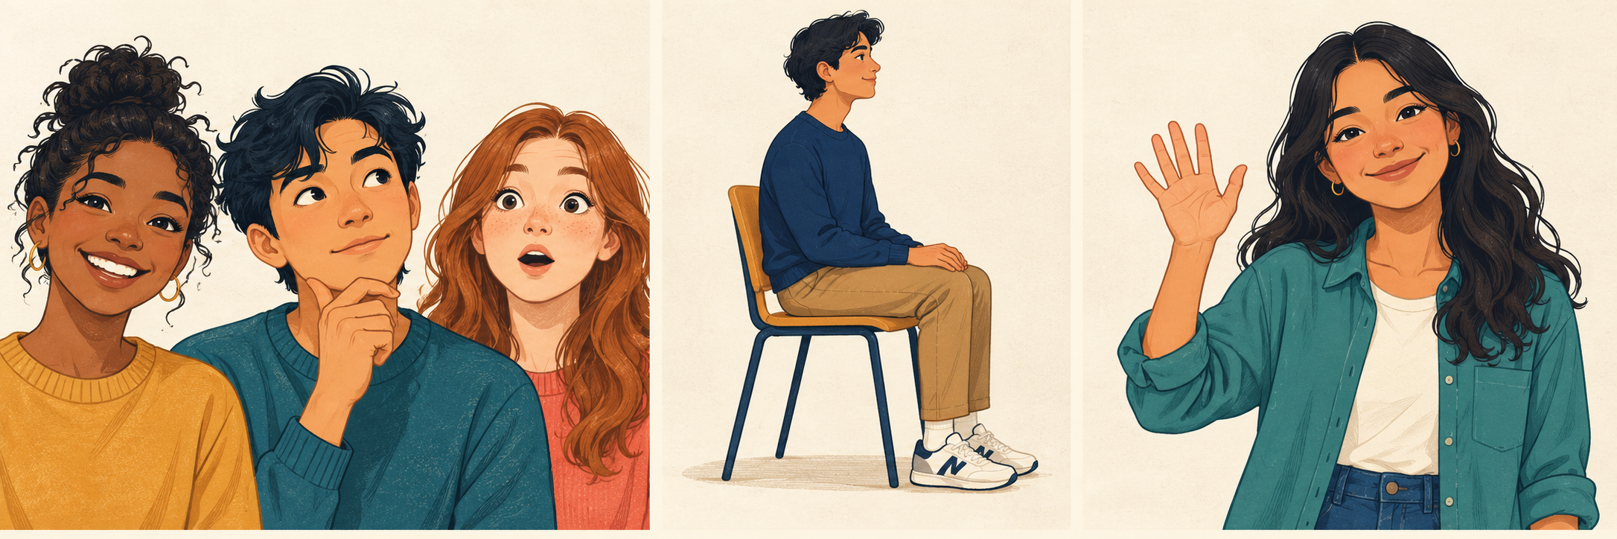
LEAD-IN
Three forms of body language
Forms of non-verbal communication / 非言语的沟通形式
Facial expressions
Postures
Gestures
面部表情
姿势
手势
What does a smile suggest?
What does your posture show?
Does “OK” always mean OK?
UNIT 4 / BODY LANGUAGE
05 / 21
Notes:
保留该页原教学要点，并优化视觉层级。点击时按顺序淡入重点或卡片；可先让学生作答，再呈现示例。第9页为完整信息表，直接用于核对答案。

Slide 6
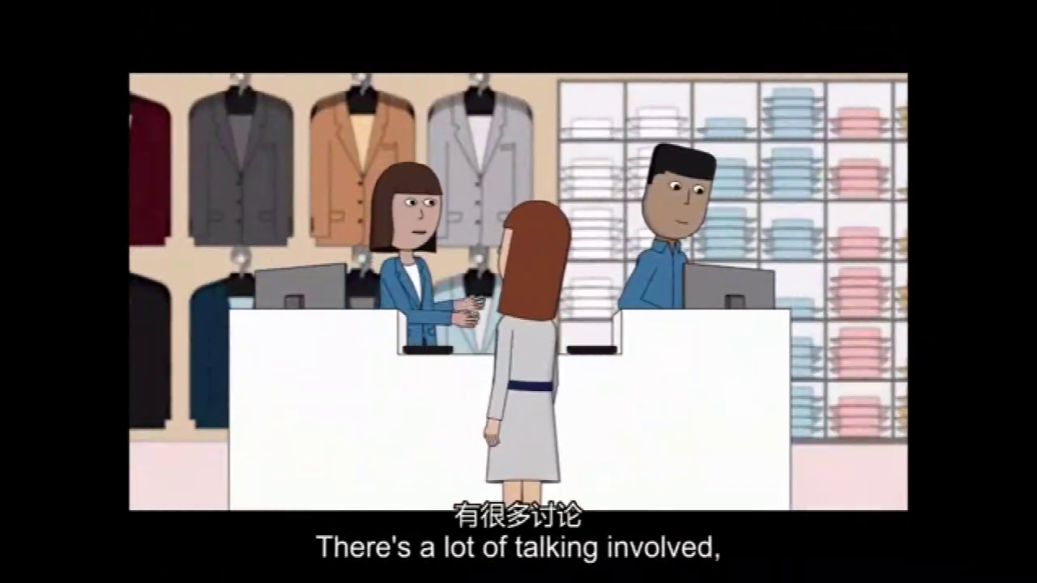
WATCH & NOTICE
Body language
Click the video image to open the original clip. Keep the media folder beside this PPT.
UNIT 4 / BODY LANGUAGE
06 / 21
Notes:
保留原视频、媒体关系及点击播放动作；视频对象位置和大小不变。点击视频播放。观看后可问：Which gestures did you notice? What did they communicate? 不要在此页添加自动播放或自动切页。
旧版PPT：点击媒体图片/音频图标打开原始文件。必须先解压完整配套包，保留media文件夹与PPT的相对位置。

Slide 7
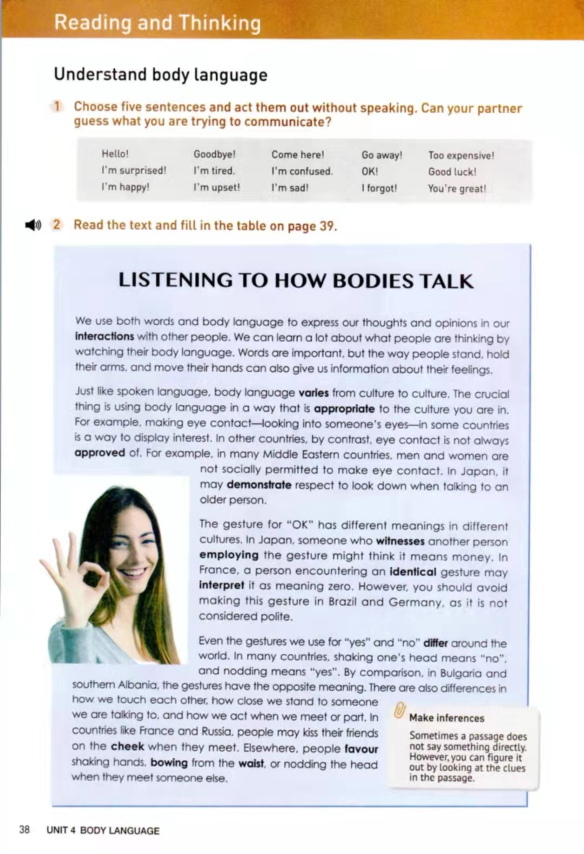
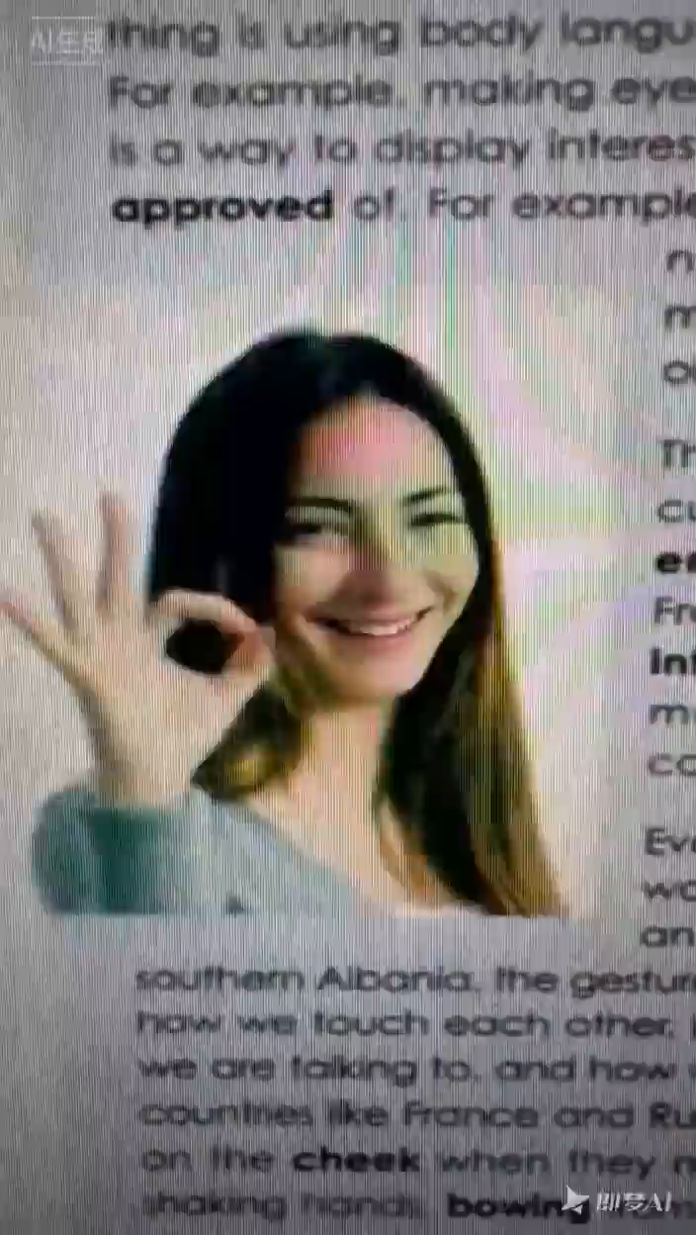
PRE-READING
Predict before you read
What’s the main idea
of the passage?
It’s about _______________________ .
the ways of body language
Tip 1: We can get the main idea of the
passage from the title and picture.
UNIT 4 / BODY LANGUAGE
07 / 21
Notes:
先引导观察标题与图片，收集预测，再点击显示原答案。保留原有第二段视频对象、媒体文件与点击播放动作；页面中的视频仍可点击播放。
旧版PPT：点击媒体图片/音频图标打开原始文件。必须先解压完整配套包，保留media文件夹与PPT的相对位置。

Slide 8

WHILE-READING · SKIMMING
LISTEN
Match the topic sentences
Match and underline the topic sentence of each paragraph.
Introduction
Para. 1
B
Body language plays an important role in daily communication.
The
differences
Para. 2
A
Just like spoken language, body language varies from culture to culture.
Para. 3
F
The gesture for “OK” has different meanings in different cultures.
Para. 4
C
Even the gestures we use for “yes” and “no” differ around the world.
The
similarities
Para. 5
D
Some gestures seem to have the same meaning everywhere.
Different uses
Para. 6
E
Some body language has many different uses.
Strategy: look for the central idea; use examples as supporting details.
UNIT 4 / BODY LANGUAGE
08 / 21
Notes:
音频与原播放图标完整保留，不做自动播放。保留原选项顺序：B、A、F、C、D、E。学生先自主匹配，再口头核对；参考：Para. 1–6 = B, A, F, C, D, E。结构：Introduction / Differences (2–4) / Similarities (5) / Different uses (6)。
旧版PPT：点击媒体图片/音频图标打开原始文件。必须先解压完整配套包，保留media文件夹与PPT的相对位置。

Slide 9
WHILE-READING · CLOSE READING
One gesture, different meanings
Compare the examples in the text. Context and culture matter.
Body language / Gesture
Meaning
Country / Region
Eye contact between men and women
display interest
in some countries
Eye contact between men and women
not polite
Middle East countries
Looking down when talking
respect
Japan
The “OK” gesture
money
Japan
The “OK” gesture
zero
France
The “OK” gesture
not polite
Brazil & Germany
Shake the head
yes
Bulgaria & southern Albania
Nod the head
no
Bulgaria & southern Albania
Kissing on the cheek
greeting
France & Russia
Shake hands / bowing / nodding
greeting
elsewhere
Hands together beside the head
sleep
everywhere
Move a hand over the stomach
I’m full
everywhere
Reading examples describe tendencies; individuals and situations may differ.
UNIT 4 / BODY LANGUAGE
09 / 21
Notes:
保留该页原教学要点，并优化视觉层级。点击时按顺序淡入重点或卡片；可先让学生作答，再呈现示例。第9页为完整信息表，直接用于核对答案。

Slide 10
WHILE-READING · THINK & RESPOND
Read again. Think beyond the text.
Read again and answer the following questions:
1
How is the body language mentioned in the text interpreted in China?
2
Can you think of an example of body language that is appropriate in China but might be misunderstood in another culture?
3
What advice on body language can you give a foreign friend on his/her first trip to China?
UNIT 4 / BODY LANGUAGE
10 / 21
Notes:
保留该页原教学要点，并优化视觉层级。点击时按顺序淡入重点或卡片；可先让学生作答，再呈现示例。第9页为完整信息表，直接用于核对答案。

Slide 11
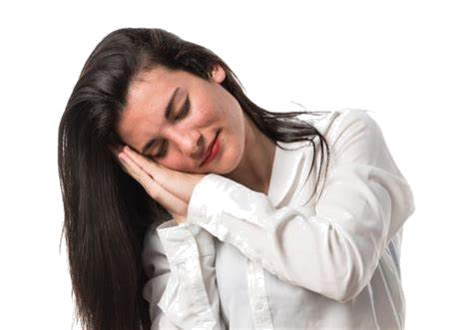
THINK & RESPOND · QUESTION 1
Same gesture, shared meaning
1. How is the body language mentioned in the text interpreted in China?
Some are the same in China. For example, the gesture for putting hands together and resting them on the side of your head means sleeping.
Act it out: show the gesture for “sleep”.
UNIT 4 / BODY LANGUAGE
11 / 21
Notes:
保留该页原教学要点，并优化视觉层级。点击时按顺序淡入重点或卡片；可先让学生作答，再呈现示例。第9页为完整信息表，直接用于核对答案。

Slide 12
THINK & RESPOND · QUESTION 2
Same action, different interpretations
2. Can you think of an example of body language that is appropriate in China but might be misunderstood in another culture?
Avoiding eye contact and lowering one’s head may mean respect and being shy in China, whereas in some other countries this body language may be interpreted as being rude.
One possible interpretation
Another possible interpretation
Respect / shyness
Rudeness / lack of interest
Avoid generalizing: consider the person, relationship and situation.
UNIT 4 / BODY LANGUAGE
12 / 21
Notes:
保留该页原教学要点，并优化视觉层级。点击时按顺序淡入重点或卡片；可先让学生作答，再呈现示例。第9页为完整信息表，直接用于核对答案。

Slide 13
THINK & RESPOND · QUESTION 3
Give advice with care
3. What advice on body language can you give a foreign friend on his/her first trip to China?
Please pay attention to the social distance, which is different in China and in the West.
Notice the context
Use a helpful sentence
Observe how close people stand.
“You can… / It is polite to…”
UNIT 4 / BODY LANGUAGE
13 / 21
Notes:
保留该页原教学要点，并优化视觉层级。点击时按顺序淡入重点或卡片；可先让学生作答，再呈现示例。第9页为完整信息表，直接用于核对答案。

Slide 14
POST-READING
Respect differences. Stay curious.
What should we do when we face cultural
or language differences?
1
Learn about the cultures.
When in Rome,
do as the Romans do.
2
Respect different cultures.
3
Observe local behaviour.
入乡随俗
4
Avoid improper gestures.
Be observant. Be respectful. Ask when you are unsure.
UNIT 4 / BODY LANGUAGE
14 / 21
Notes:
保留该页原教学要点，并优化视觉层级。点击时按顺序淡入重点或卡片；可先让学生作答，再呈现示例。第9页为完整信息表，直接用于核对答案。

Slide 15
POST-READING · DISCUSSION
Help Tom feel welcome in China
Discussion: What advice on body language would you give to your foreign friend Tom who is visiting China for the first time?
01
When greeting
02
When talking
03
When listening
How do people greet in China?
How do people talk to someone?
How do people behave when they listen?
Useful language: You can… / Please avoid… / This may show…
UNIT 4 / BODY LANGUAGE
15 / 21
Notes:
保留该页原教学要点，并优化视觉层级。点击时按顺序淡入重点或卡片；可先让学生作答，再呈现示例。第9页为完整信息表，直接用于核对答案。

Slide 16

POST-READING · SHARE YOUR WORK
Show your masterpiece
A guide for Tom
Share your advice on body language in China.
1
Give three practical tips.
2
Explain what each action may communicate.
3
Listen to one suggestion from a classmate.
UNIT 4 / BODY LANGUAGE
16 / 21
Notes:
保留该页原教学要点，并优化视觉层级。点击时按顺序淡入重点或卡片；可先让学生作答，再呈现示例。第9页为完整信息表，直接用于核对答案。

Slide 17
POST-READING · PEER ASSESSMENT
Assess your work by the criteria
Four criteria × 5 points = 20 points
Accuracy (5)
Standardization
(5)
Practical tip (5)
Design (5)
语言准确性
语言规范性
建议实用性
设计美观性
Correct vocabulary
and grammar.
Clear, well-formed
sentences.
Specific advice Tom
can actually use.
Readable, organized
and attractive.
Give one compliment + one specific suggestion for improvement.
UNIT 4 / BODY LANGUAGE
17 / 21
Notes:
保留该页原教学要点，并优化视觉层级。点击时按顺序淡入重点或卡片；可先让学生作答，再呈现示例。第9页为完整信息表，直接用于核对答案。

Slide 18
POST-READING · MODEL ANSWER
Advice on body language in China!
When you meet someone
You can shake hands with him/her and smile at him or her.
When you talk to someone
You can keep smiling and make eye contact with him/her. Don’t put your hands in pockets all the time while talking. It may seem rude.
When you listen
You can keep gentle eye contact instead of staring.
UNIT 4 / BODY LANGUAGE
18 / 21
Notes:
保留该页原教学要点，并优化视觉层级。点击时按顺序淡入重点或卡片；可先让学生作答，再呈现示例。第9页为完整信息表，直接用于核对答案。

Slide 19
REFLECTION · SMILE
A smile can open a conversation
S
Study
Learn about other cultures.
M
Mutual respect
Value different ways of communicating.
I
Inclusive
Welcome people and perspectives.
L
Listen
Notice words and nonverbal signals.
E
Empathy
Try to understand how others feel.
Start with a smile.
UNIT 4 / BODY LANGUAGE
19 / 21
Notes:
保留该页原教学要点，并优化视觉层级。点击时按顺序淡入重点或卡片；可先让学生作答，再呈现示例。第9页为完整信息表，直接用于核对答案。

Slide 20

AFTER CLASS
Assignment
Keep learning. Improve your work. Share your ideas.
1
Reflect
Reflect on what you have gained.
2
Polish
Polish your work with AI tools.
3
Share
Scan to share
Scan the QR code below and post your work.
(Big surprise is waiting for you!)
Use AI suggestions thoughtfully; check meaning and keep your own ideas.
UNIT 4 / BODY LANGUAGE
20 / 21
Notes:
保留原二维码原始图片，未重绘或改变链接。提醒学生：AI可帮助修改措辞，但必须核对语义、保留自己的观点。课堂内可先在手机上检查原二维码是否仍有效；原链接有效性不由课件文件决定。

Slide 21
THANKS
Listen with your eyes.
Speak with respect.
One gesture. Many meanings.
One smile. A new connection.
UNIT 4 / BODY LANGUAGE
21 / 21
Notes:
保留该页原教学要点，并优化视觉层级。点击时按顺序淡入重点或卡片；可先让学生作答，再呈现示例。第9页为完整信息表，直接用于核对答案。

