Slide 1
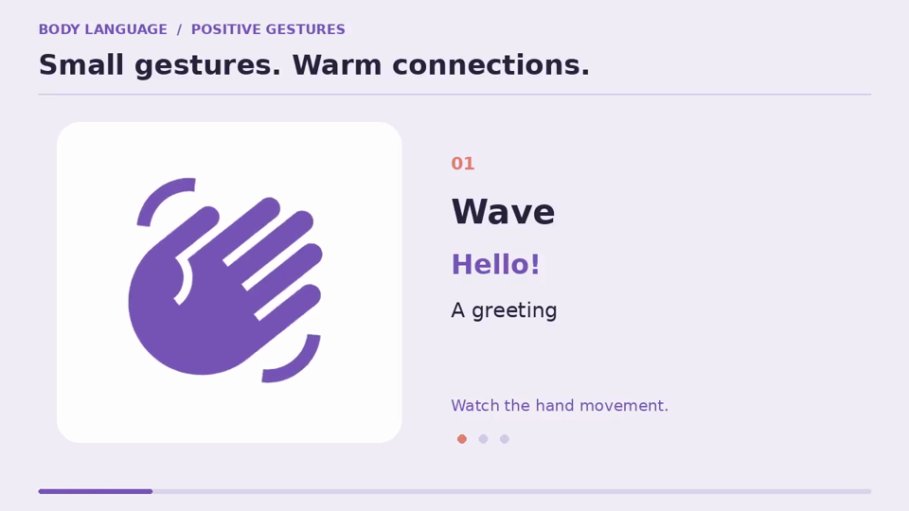
Let's enjoy a short video clip and answer the following questions.
03
01
Which gestures can you see ?
02
What do they have in common?
UNIT 04 / USING LANGUAGE
EXPLORE · LISTEN · CLARIFY · PERFORM

Slide 2


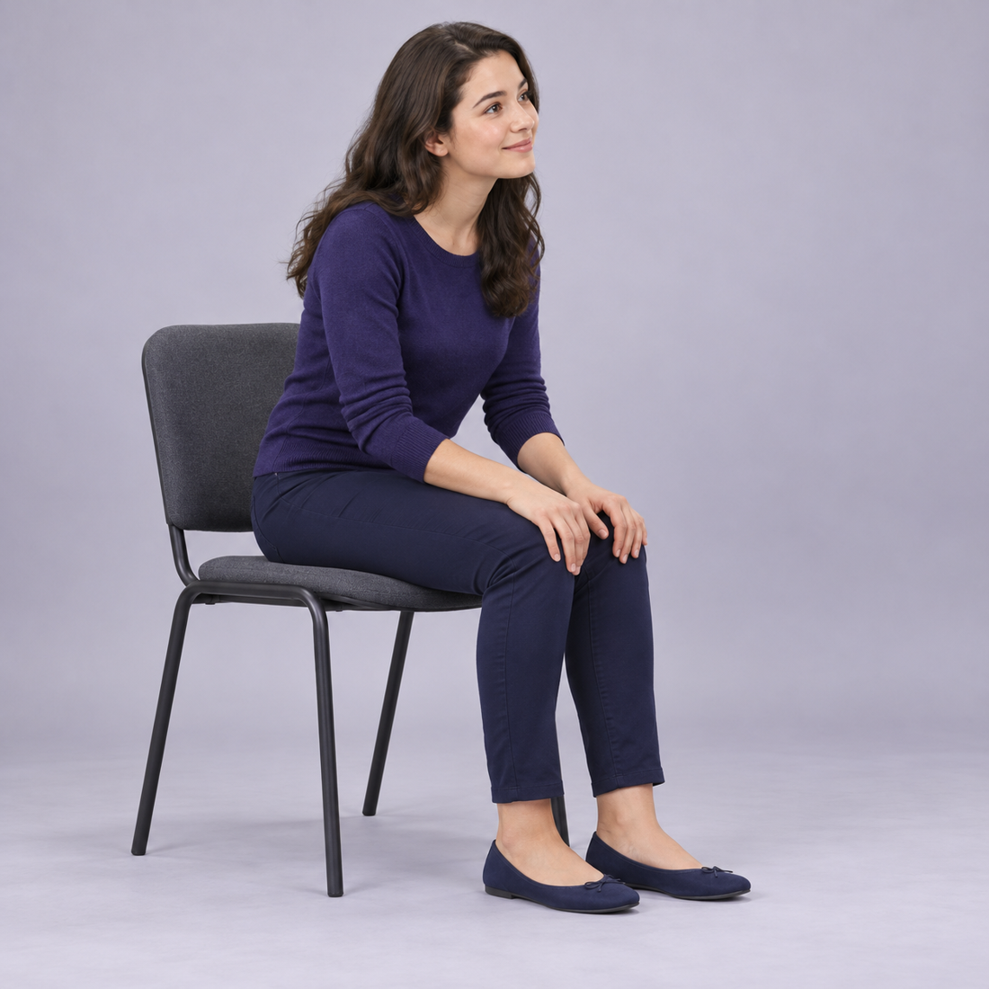
Step 1
Pre-listening
04
Gesture / hand signal
Facial expression
Body posture
Hands communicate a message.
Faces communicate an emotion.
The whole body communicates an attitude.
body language
UNIT 04 / USING LANGUAGE
EXPLORE · LISTEN · CLARIFY · PERFORM

Slide 3
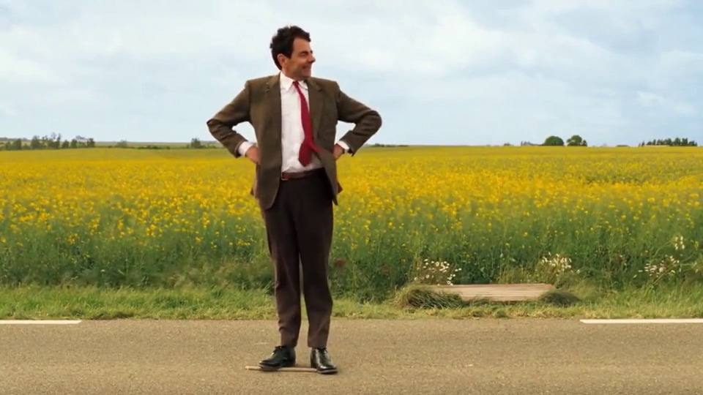
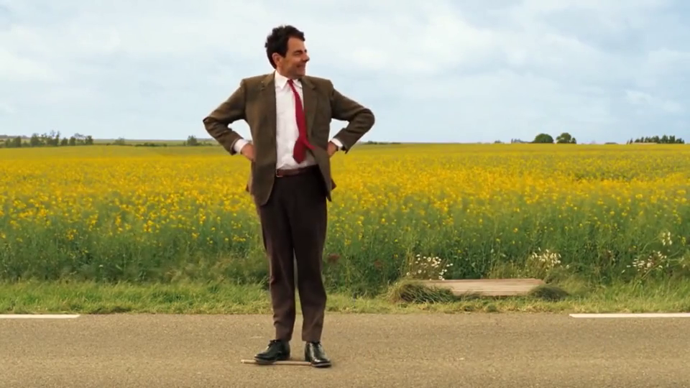
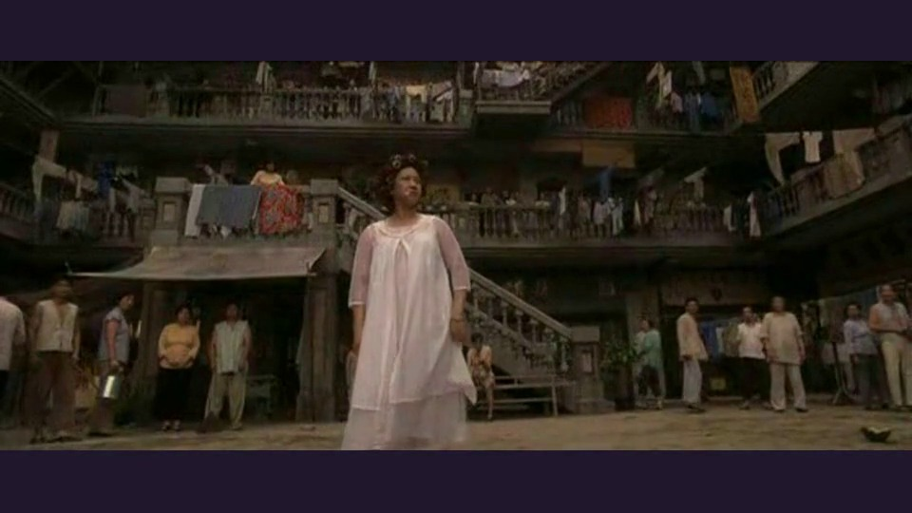

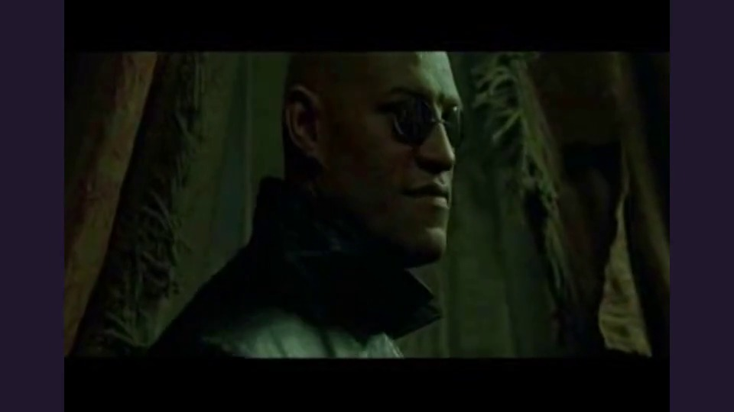
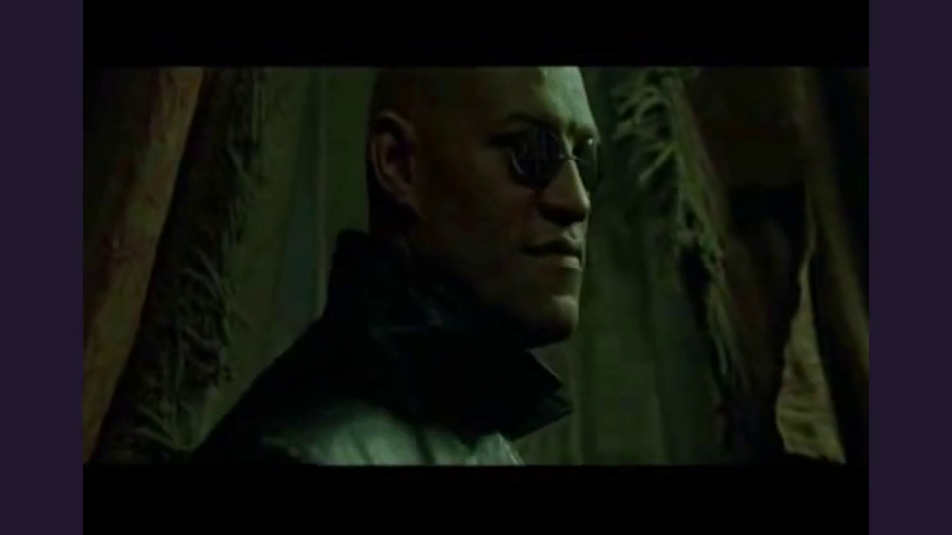
Step 1
Pre-listening
05
Discuss when and where people need to use body language to communicate.
Kung Fu Hustle · 6 s
The Matrix · 6 s
Mr Bean’s
physical comedy
Body language in classic action films
UNIT 04 / USING LANGUAGE
EXPLORE · LISTEN · CLARIFY · PERFORM

Slide 4
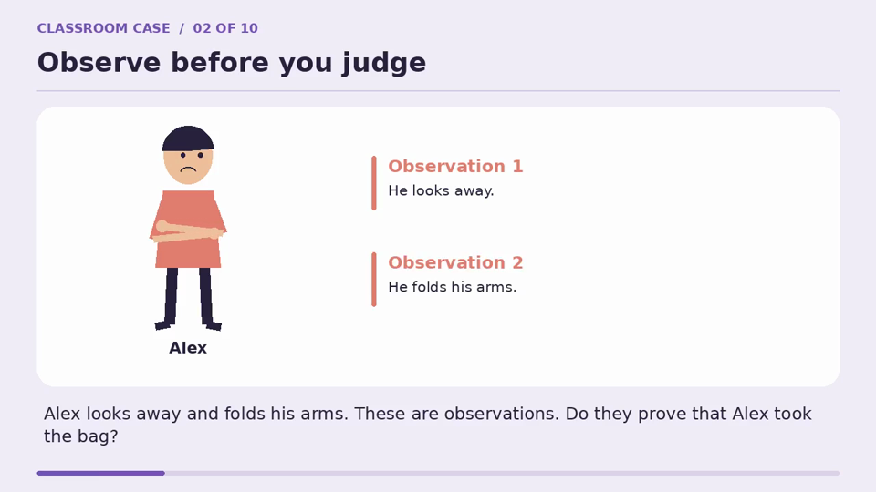
Step 2
While-listening
08
Read clues. Check your interpretation.
How can the investigator find out what happened?
What’s the function of body language in this process?
Function 2
To Seek Truth
UNIT 04 / USING LANGUAGE
EXPLORE · LISTEN · CLARIFY · PERFORM

