Slide 1
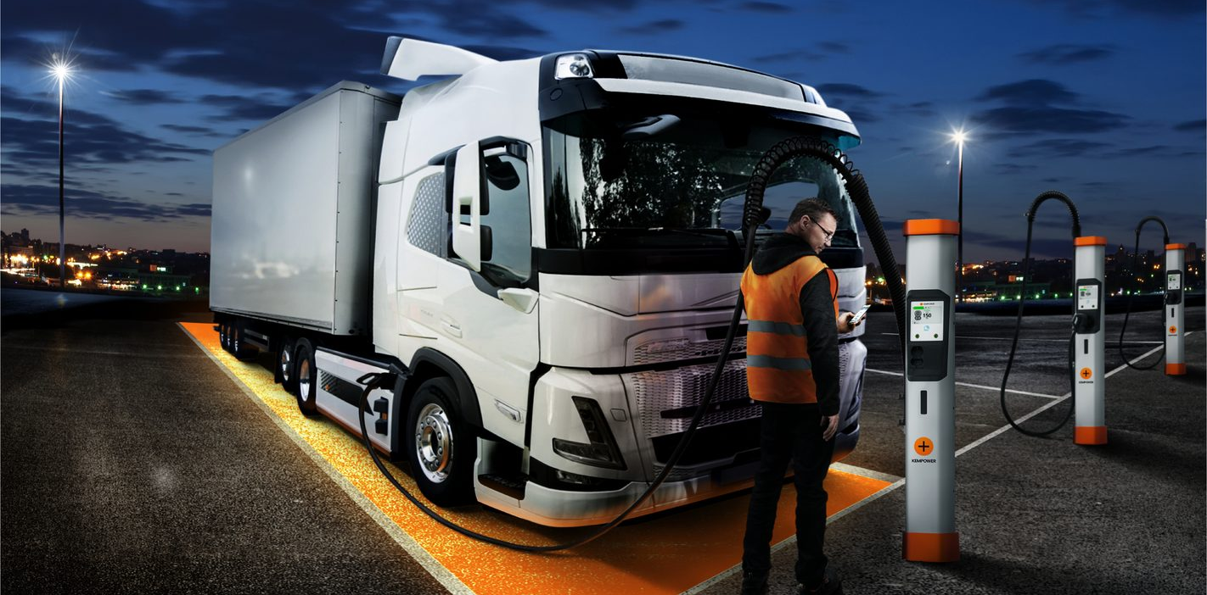
The self-operating charging network
Mats Mattsson
5.11.2026
Kempower challenge · LahtiES hackathon
Notes:
Don't introduce yourself yet.
Click → video.

Slide 2
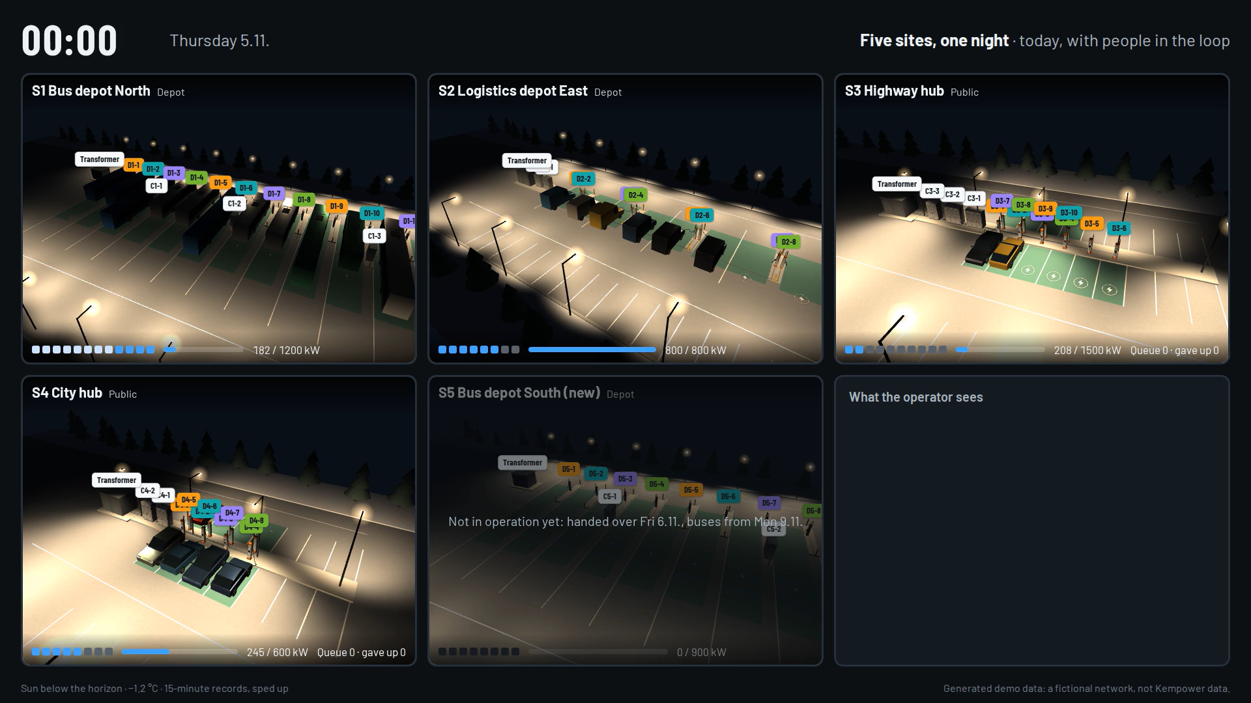
Notes:
Let it play (65 s). Say nothing.

Slide 3
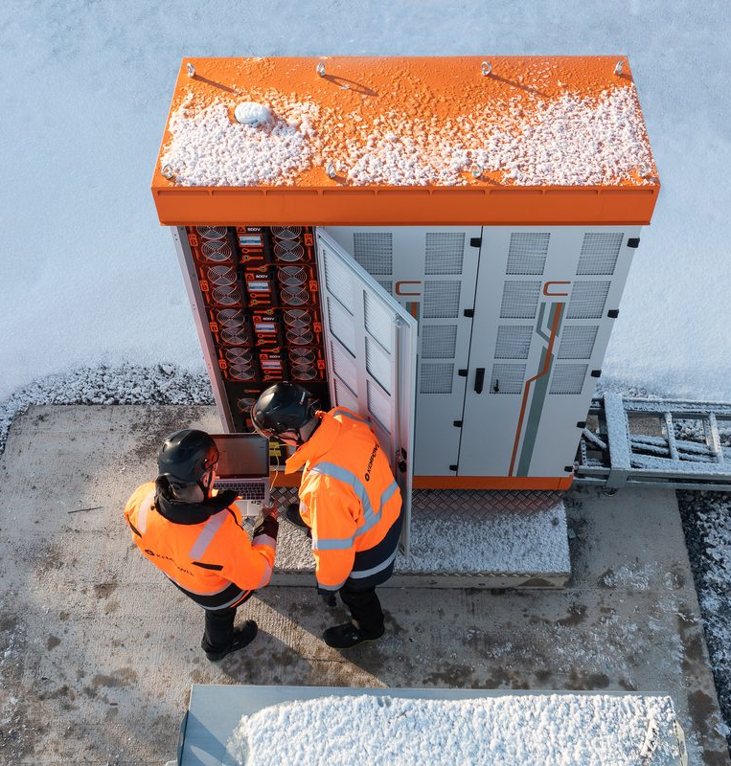
It's 10:00 on Thursday.
That's right now. And it's all in your data.
Generated demo data: a fictional network, not Kempower data.
Notes:
It's 10:00 on Thursday. That's right now.
00:25 a charger overheats. 09:00 the grid calls. 09:22 a module fails.
It's all in your data.

Slide 4
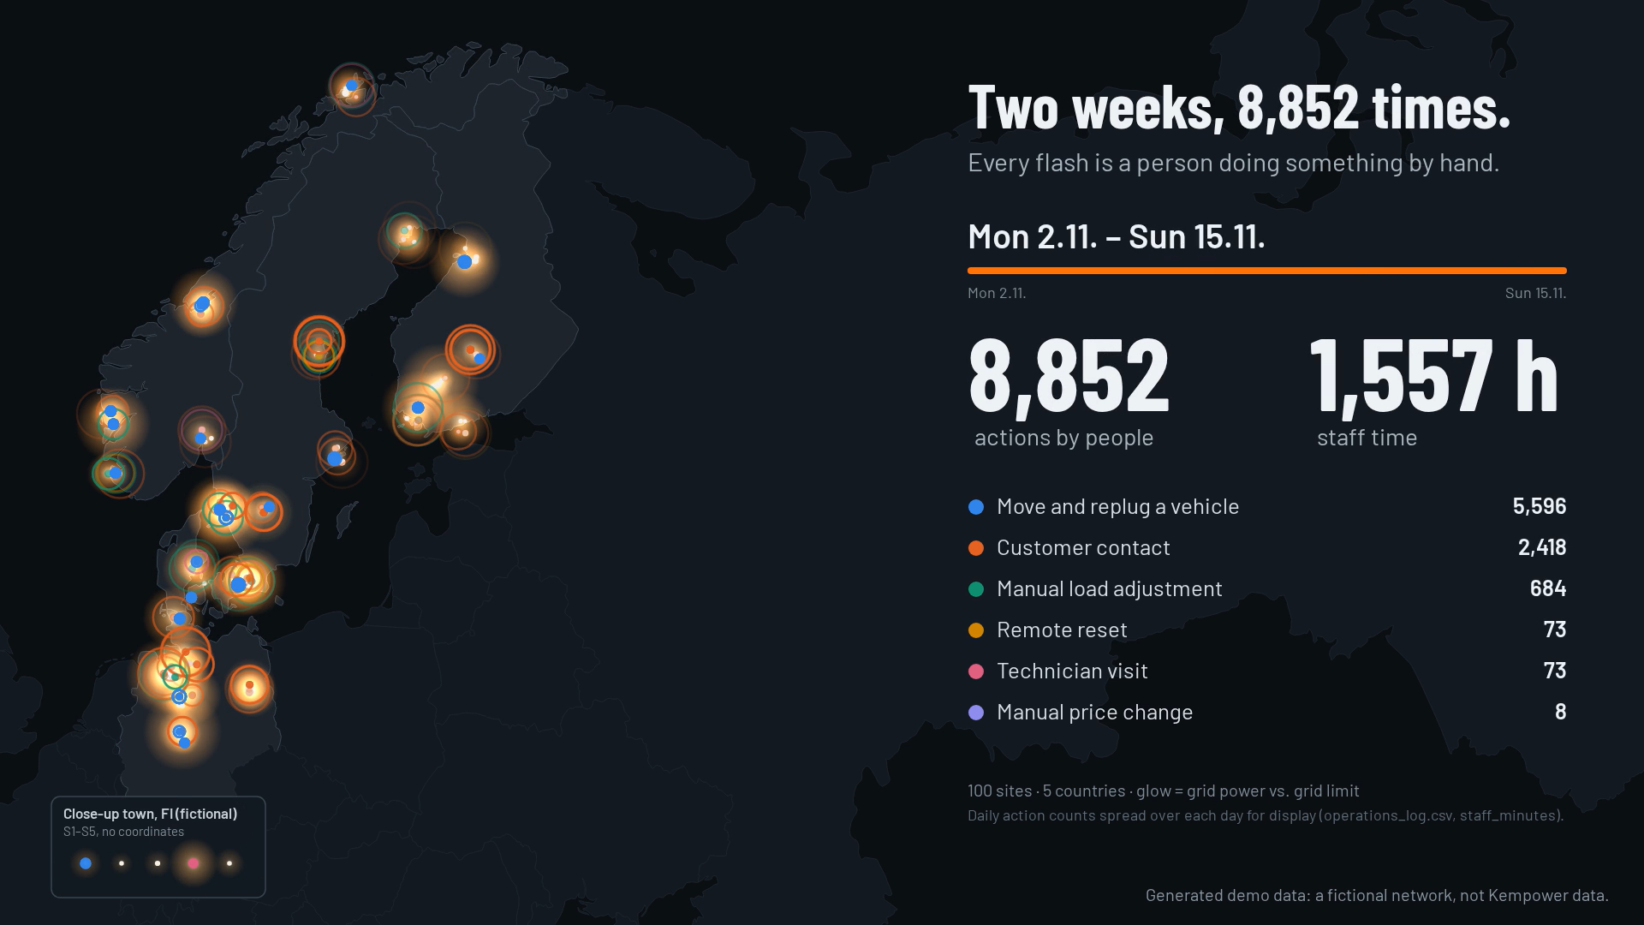
Notes:
Two weeks, 100 sites.
Every flash is a person doing it by hand.

Slide 5
21 people, full time.
Just to keep one network running.
Notes:
21 people, full time. Just to keep it running.
Pause.

Slide 6
If humans were no longer allowed to continuously operate and maintain a charging network, how would you redesign it?
The Kempower challenge.
Notes:
Read it slowly. Pause.
"This is our challenge to you."

Slide 7
Charging a better future
We are global
+ 60 countries with
Kempower chargers
14 subsidiaries
4 factories
Production and office
+ 800 employees,
+ 40 nationalities
Office
Kempower charging solutions delivered to the country
Notes:
I'm Mats. I lead Kempower's cloud software.
Founded in Lahti in 2017. Today in 60+ countries.

Slide 8
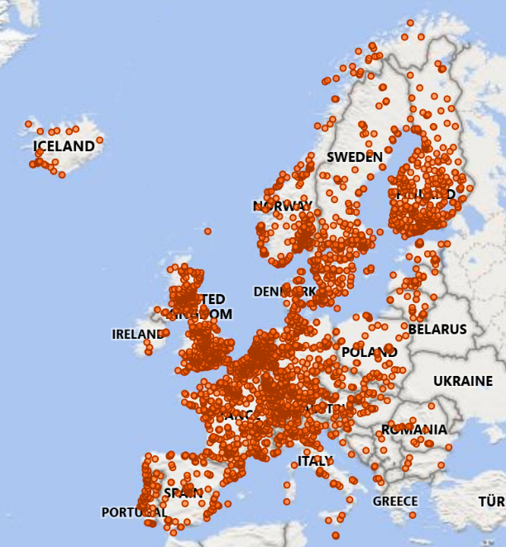
The electric evolution
in +60 countries
28,000
Kempower charging points
41,000,000
charging sessions with
Kempower chargers
1,6 billion+ kWh
of energy charged by
Kempower chargers
Data: ChargEye
Notes:
28,000 charge points. 41 million sessions.

Slide 9
Cars
Trucks
Buses
Our vision is to be
A top 3 global leader in DC fast charging – trusted by customers, built
to compound
Mining
Vessels
Vans
Agriculture
Harbor
machinery
Aviation
Construction machinery
Notes:
Top 3 in DC fast charging.
Cars, buses, trucks, mines, ports, ships.

Slide 10





Fast is better than slow
We focus on DC fast charging
2–22 kW AC charger
Typically > 50 kW DC charger
Kempower chargers are compatible with almost all electric vehicles
Battery
& car’s management system
Car’s own charger
<3.7 kW
Estimated charging time
is several hours
Estimated charging time is minutes, less than an hour
Notes:
Fast charging: minutes, not hours.

Slide 11
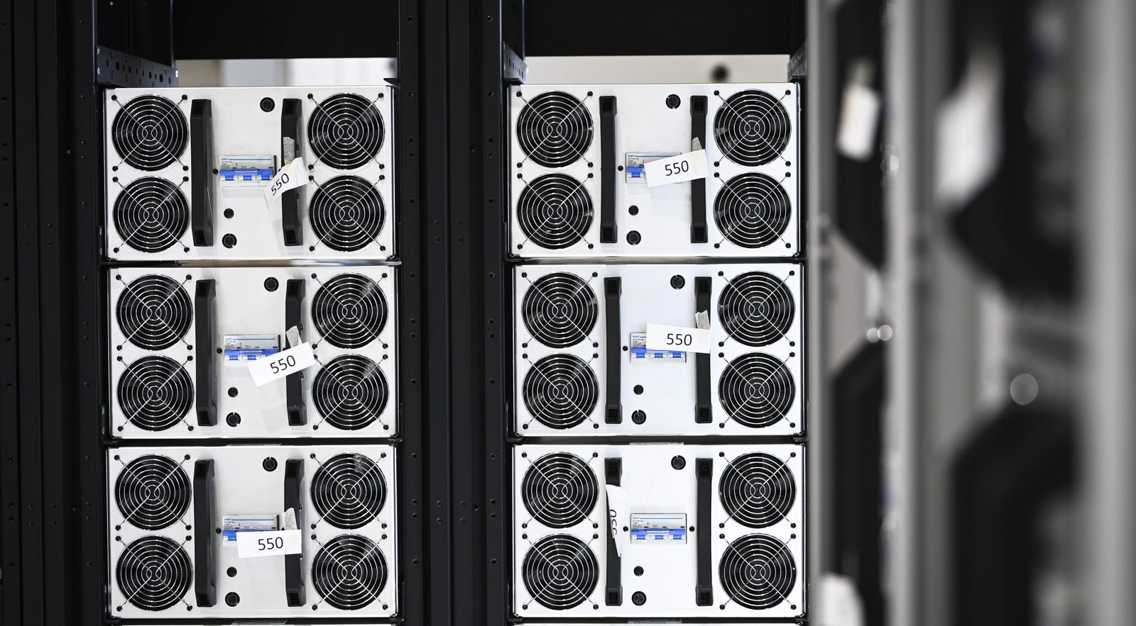
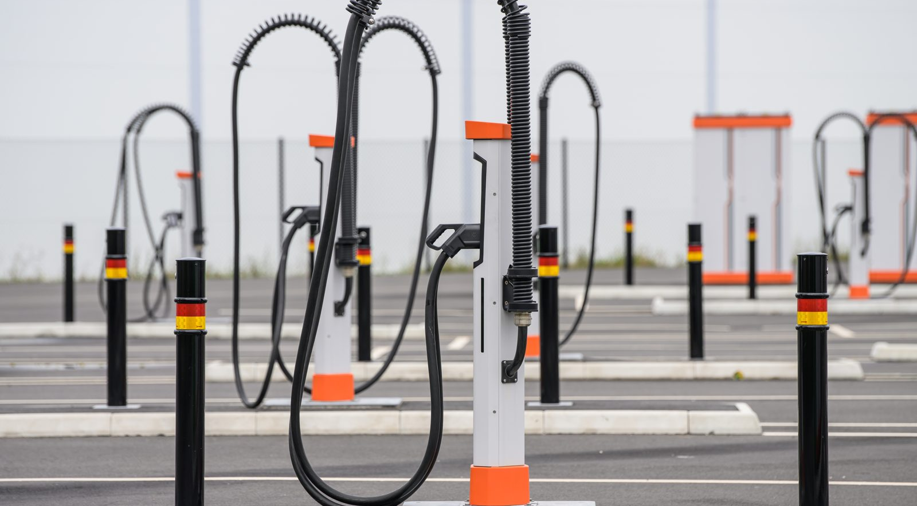
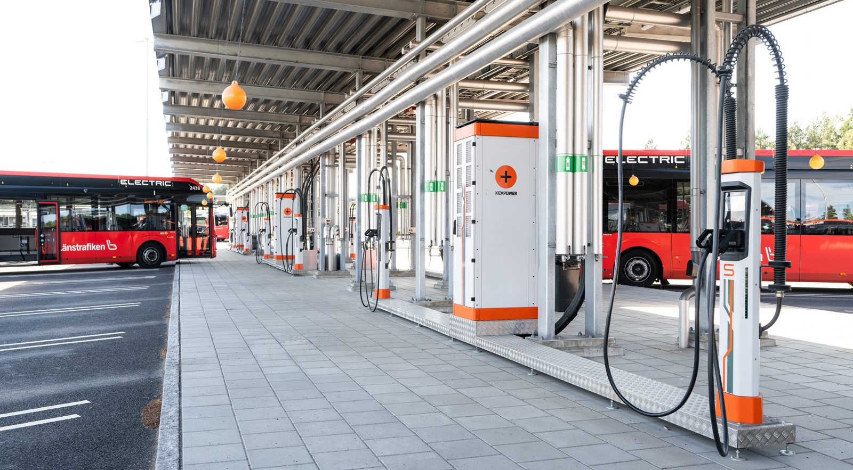
Power is shared, not fixed.
Power Unit
Satellites
ChargEye
Converts grid power to DC and shares it between the charging points.
Slim charging posts where drivers plug in. Several share one Power Unit.
The cloud that connects chargers: monitoring, settings and updates.
Key idea
Key idea
Key idea
Power modules in 25 kW steps
Moved where it is needed
No power conversion inside
Easy to add more
Sees every charger
Talks the OCPP standard
Notes:
Most chargers have fixed power. Ours share it.
Software decides who gets how much.
That's your playground.

Slide 12


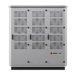
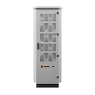
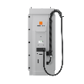

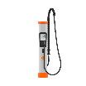
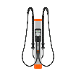
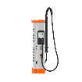





JYVÄSKYLÄ
Kempower facilities in Lahti
Kempower Lahti 1, 8 000m²
Headquarters
Ala-Okeroistentie 29
Production:
Power Units, MCS Satellites,
Station Chargers
Spare Parts
Laboratory
LAHTI 2
LAHTI
Kempower Lahti 2, 6 500m²
Mukkulankatu 19
Production:
Satellites, Liquid Cooled Satellites,
Control Units, Movables
Training
Service
Laboratory
LAHTI 1
TAMPERE
LAHTI 3
Kempower Lahti 3, 3 000m²
Ala-Okeroistentie 23
Production:
Power modules, Control modules,
Distribution modules, Power and distribution modules refurbishment
HELSINKI
Notes:
Lahti 2 is at Mukkulankatu 19: where you pitch on Saturday.
(Skip if short on time.)

Slide 13
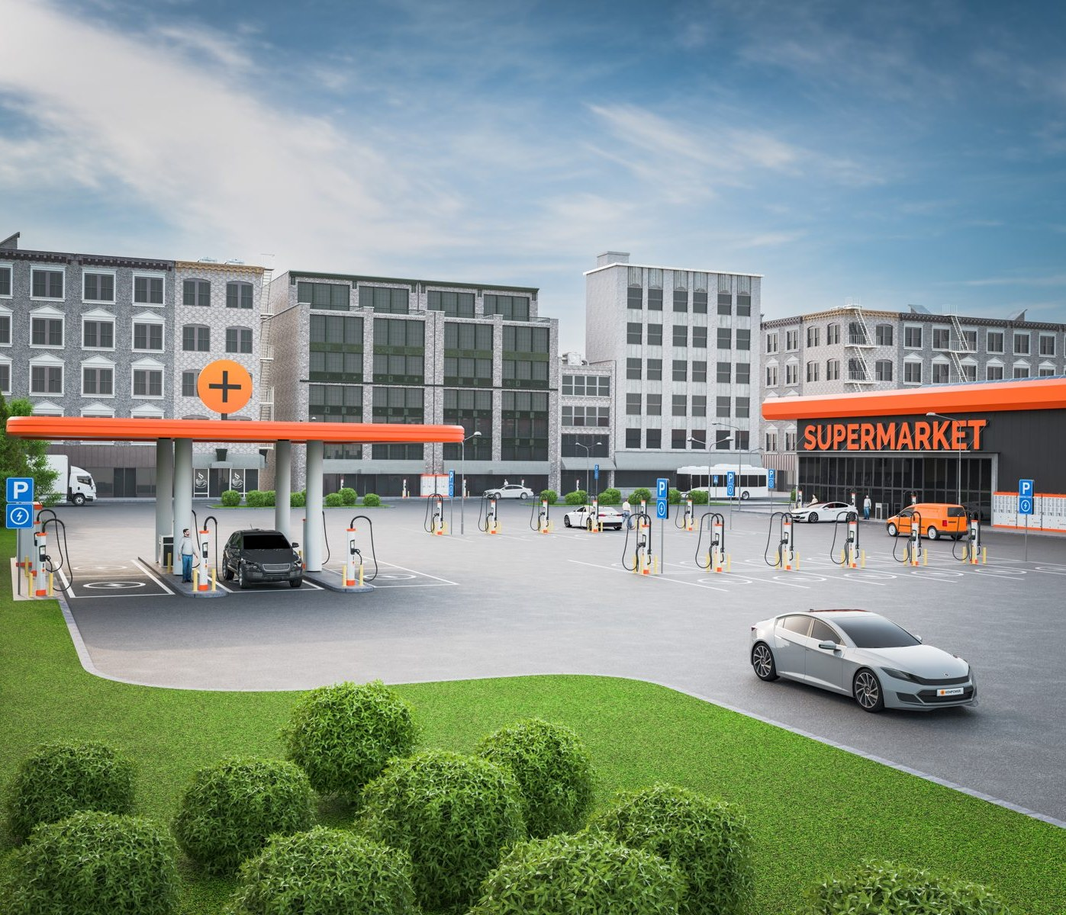
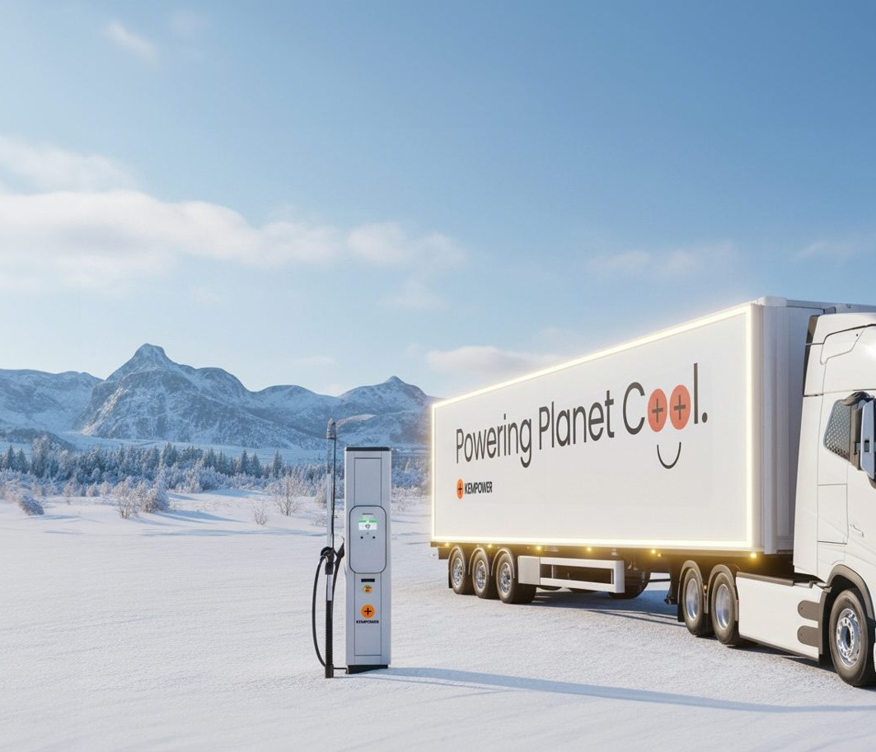
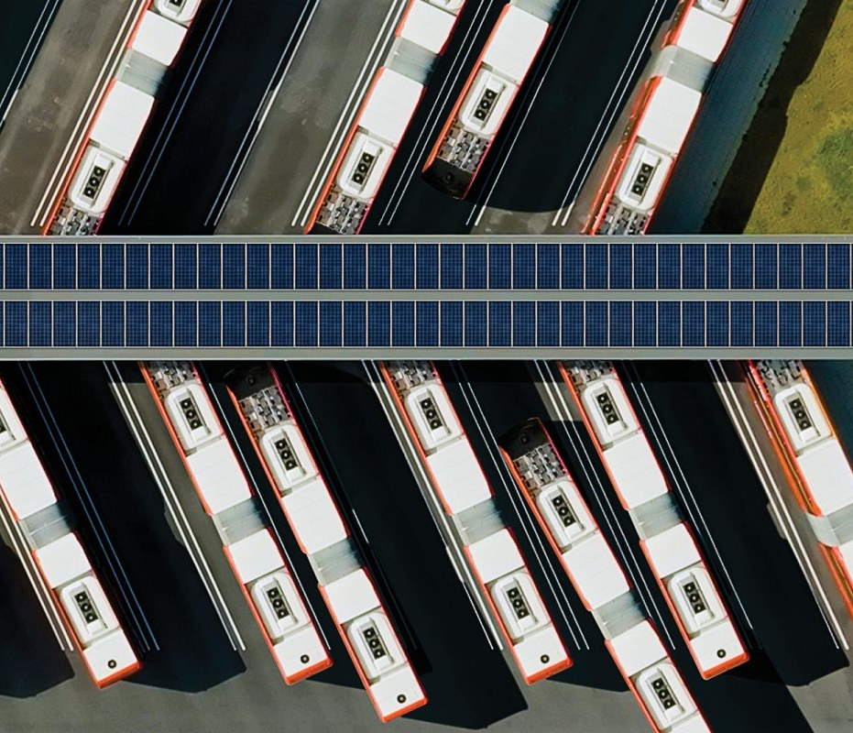
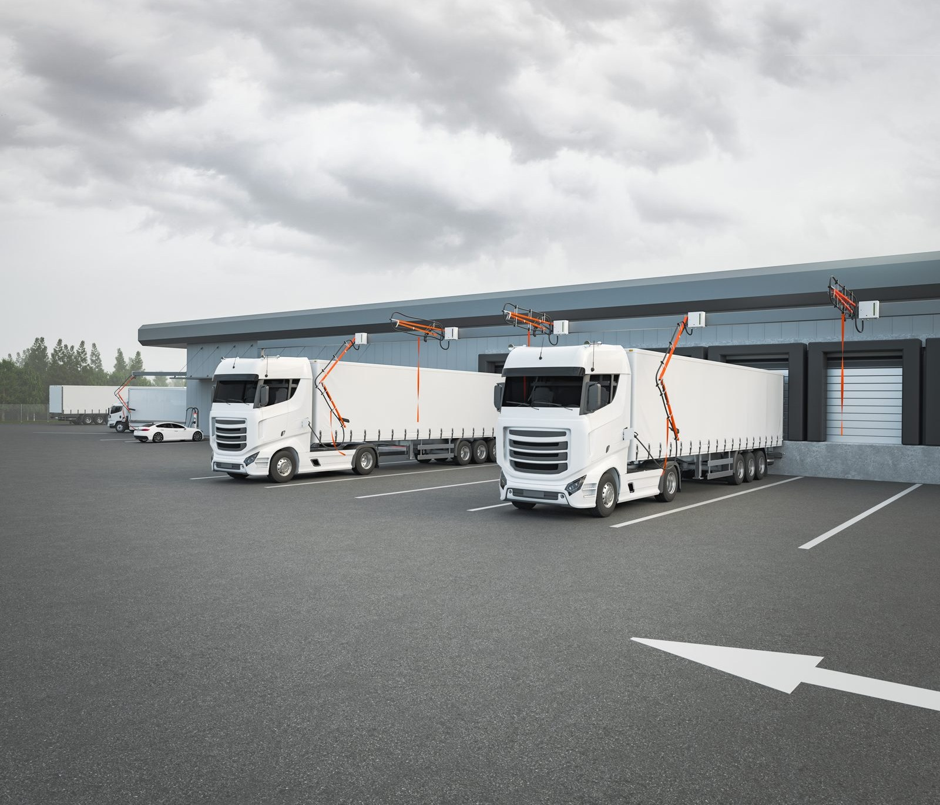
A charging network is an energy system.
Grid limits
Prices
Schedules
Failures
A hard cap per site
New price every 15 min
Leave on time, no queues
Someone has to notice
Notes:
Four forces: grid limits, prices, schedules, failures.
Today people juggle all four.

Slide 14
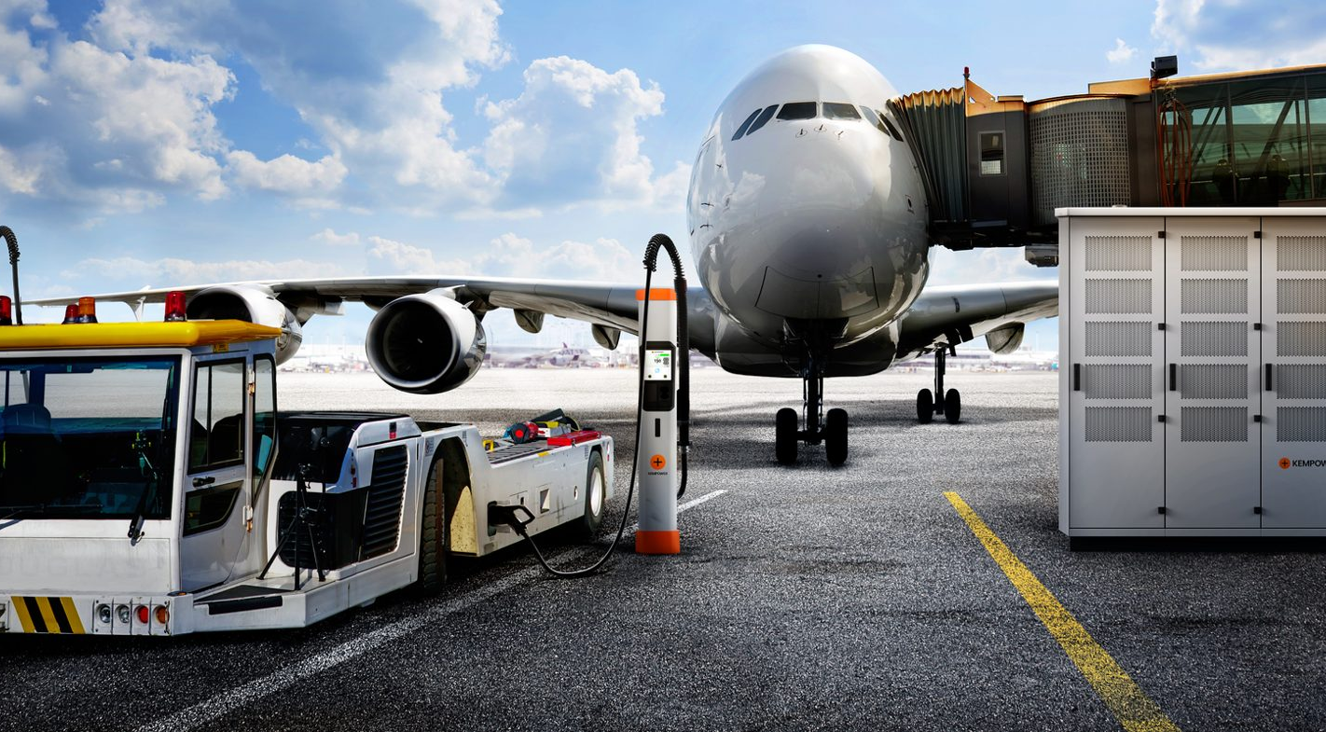
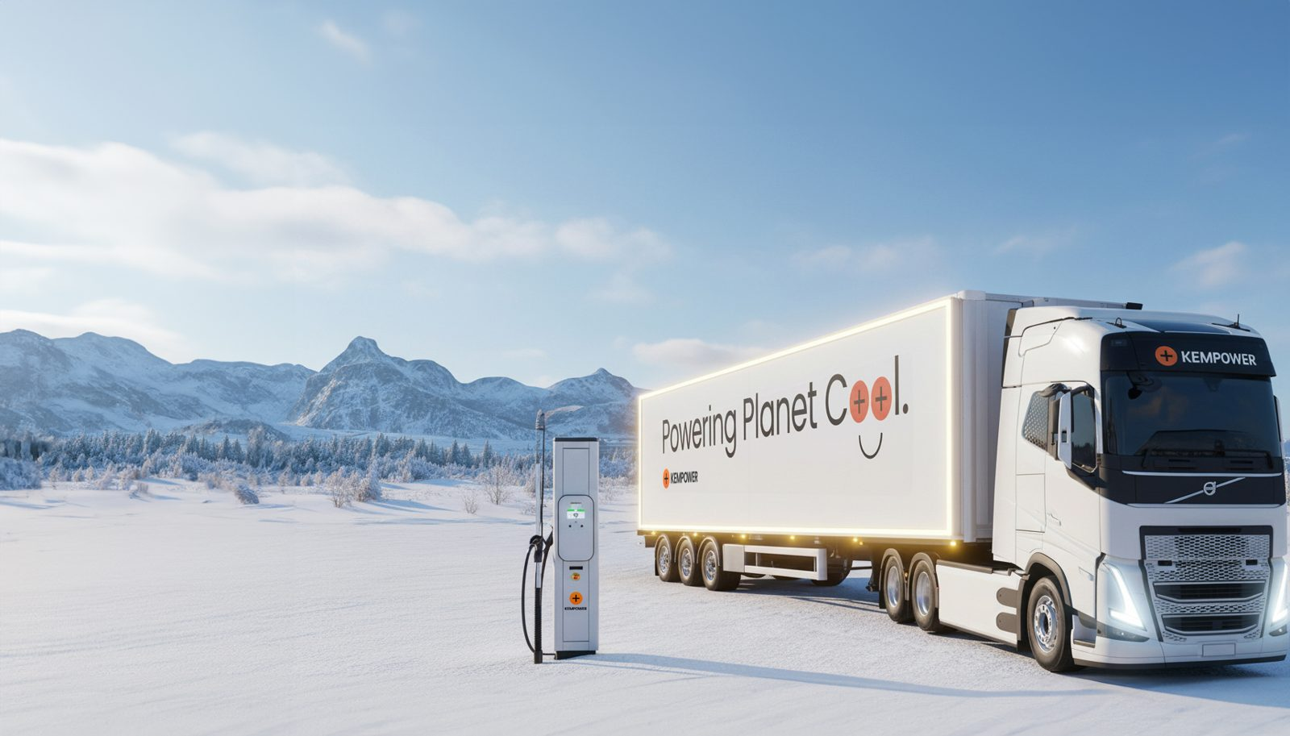
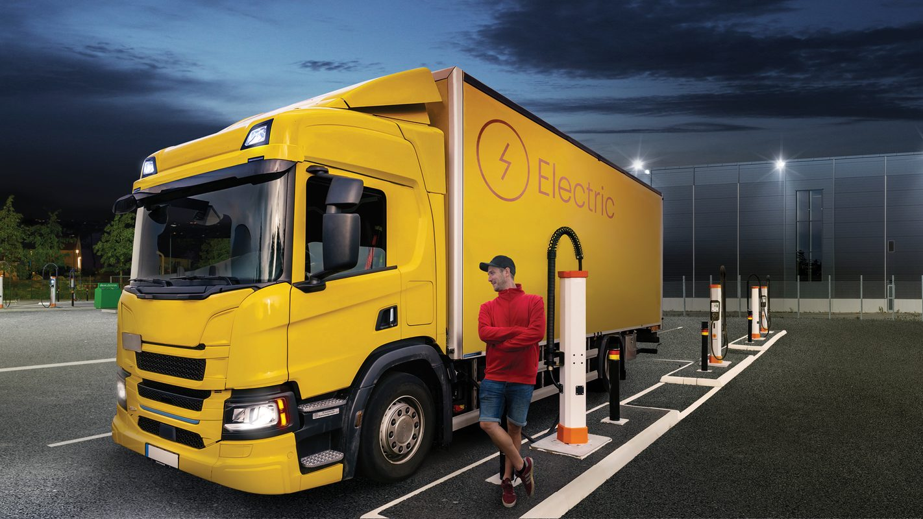
Three parts.
1 · Energy and control
2 · Show it
3 · The commercial side
Share power between chargers, sites and hours. Notice problems and recover alone.
Run the network through Fri 13.11. with no human, incl. a failure and a price event.
Who is the customer and what do they buy? Business model and a one-page service agreement.
Ask yourself
Format
Ask yourself
Where does the intelligence live?
Your choice of deliverable
Who is accountable when it's wrong?
Notes:
1 Energy and control. 2 Show it: Fri 13.11., no human. 3 Who pays, who's accountable.
Go deep, not wide.

Slide 15
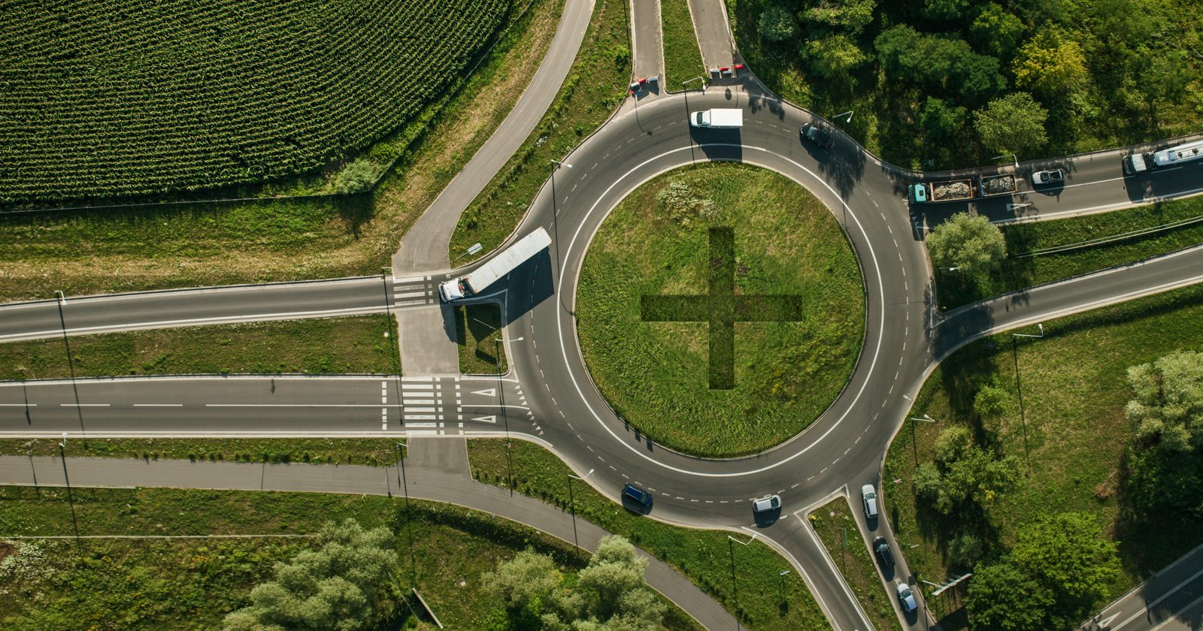





Whose network is it?
Don't try to cover all perspectives. Say which ones you take.
Manufacturer
Operator
Site owner
Drivers & fleets
Energy & grid
Builds the chargers
Often services them
Runs public charging
Sells it to drivers
Bus or logistics firm,
a shop or a port
Need to charge and
get going on time
Supplies the power
Sets the limits
Notes:
Many owners, many views.
Pick yours, and say which.

Slide 16
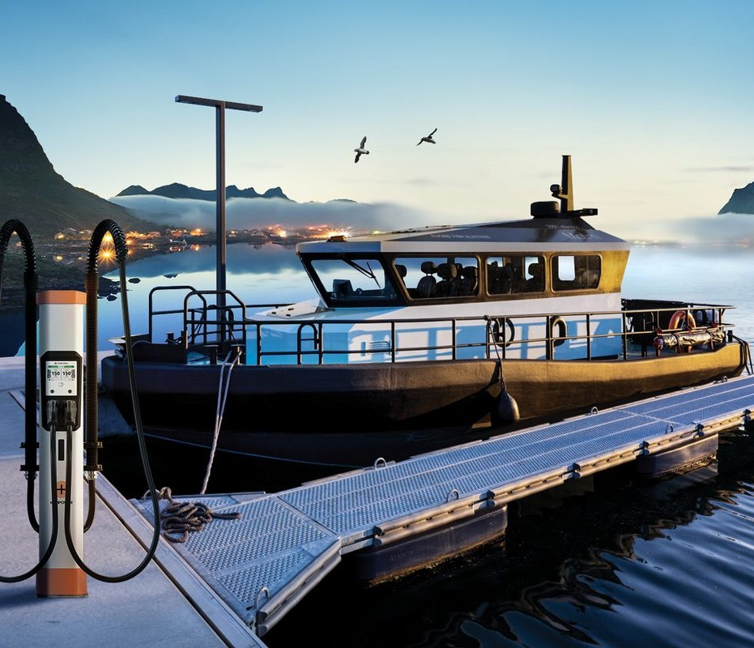
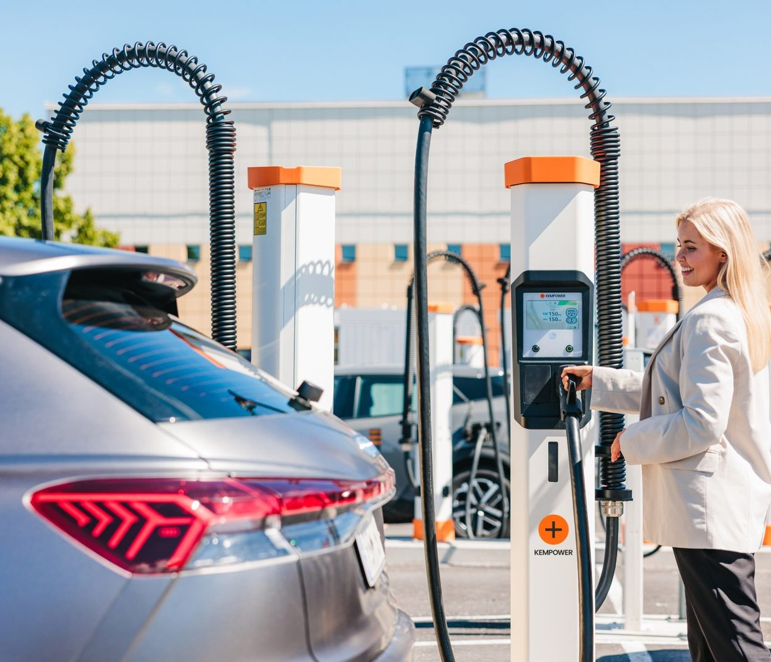
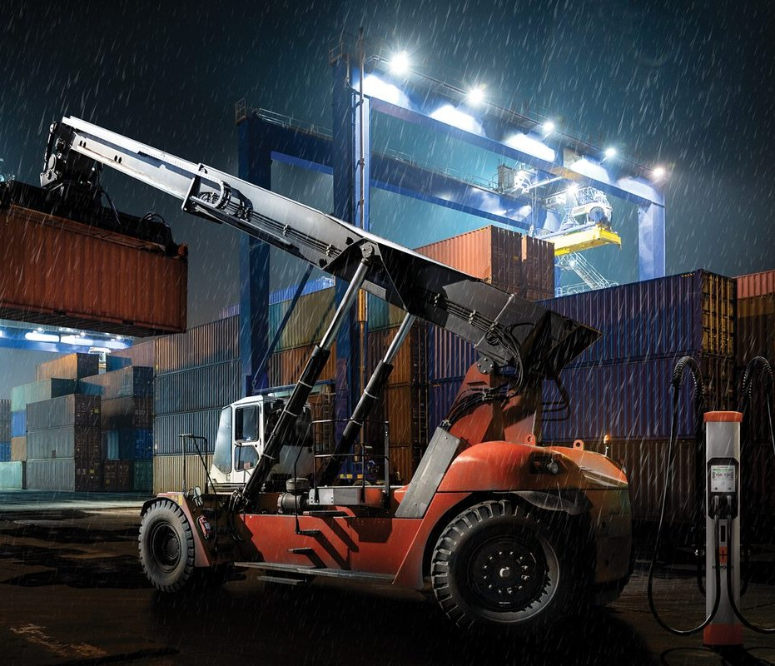
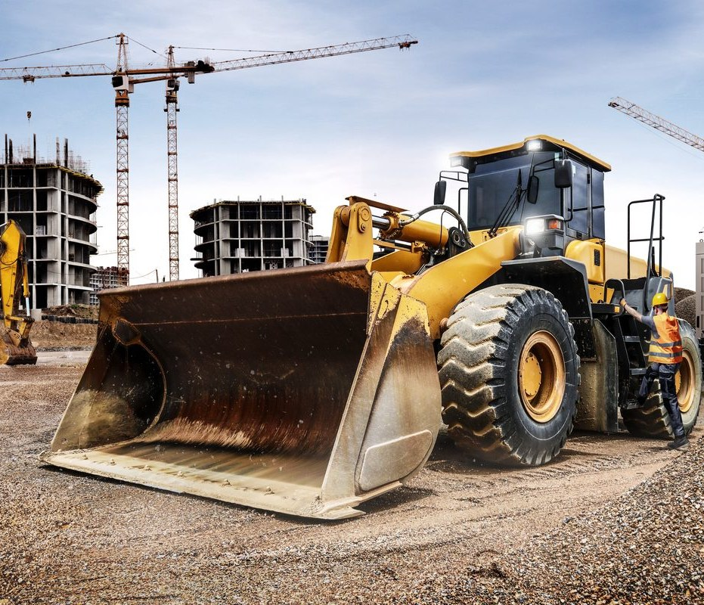
Your data.
Generated demo data: a fictional network, not Kempower data.
The network
Close-up
Two weeks
And more
100 sites, 5 countries
5 sites, every detail
2.–15.11., every 15 min
Prices, weather, costs
Notes:
All generated. Opens in Excel.
Start with README.md. This morning is in there.

Slide 17
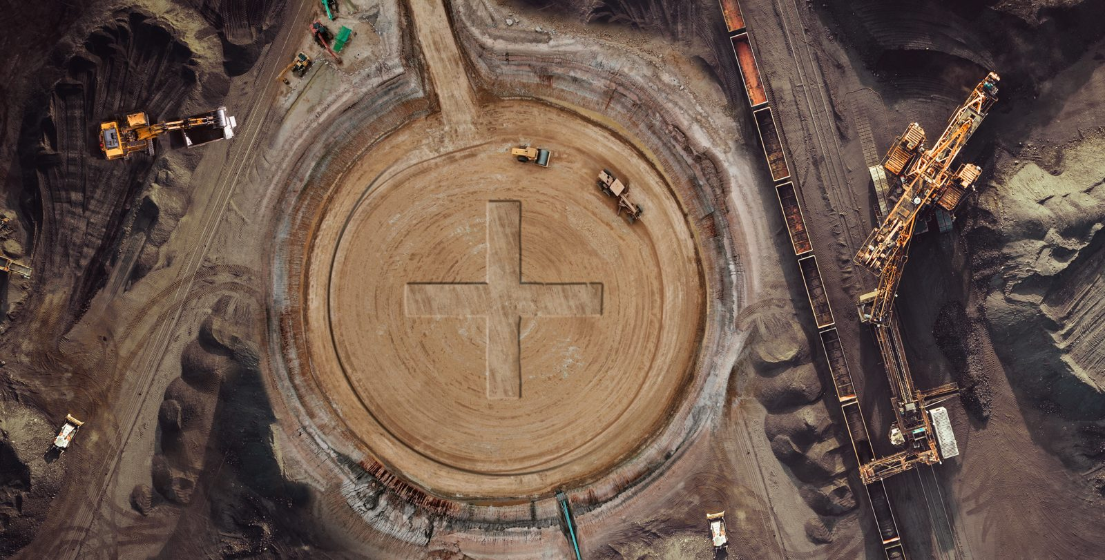





Missing something? Add it, and say so.
The data won't have everything. That's fine.
Add, not edit
Same baseline
Mark it
Keep it real
Count the cost
Generate data or use
public sources. Never
change the data we gave
Baseline and scenario
day are the same for
every team
Saturday: one list of
all you added and
every assumption
Use public sources
where you can. Start
with PUBLIC_SOURCES.md
New batteries or
chargers? Price them:
equipment_costs.csv
Notes:
Missing something? Add it. Never edit ours.
List every assumption on Saturday.

Slide 18
What you bring on Saturday.
Saturday 7.11. at LUT Lahti Campus.
Deliverables
How we evaluate
A 10-minute pitch
The demonstration
A one-page service agreement
Autonomy 25 %
Energy and grid 20 %
Technical credibility 20 %
Commercial viability 20 %
Clarity 15 %
Notes:
Pitch, demo, one-page agreement.
Autonomy weighs most.

Slide 19
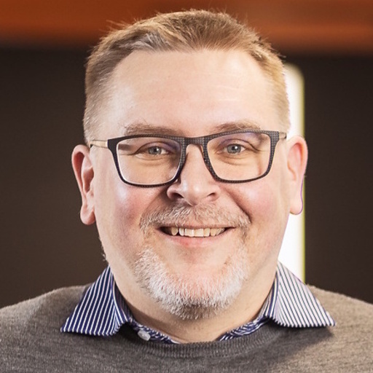
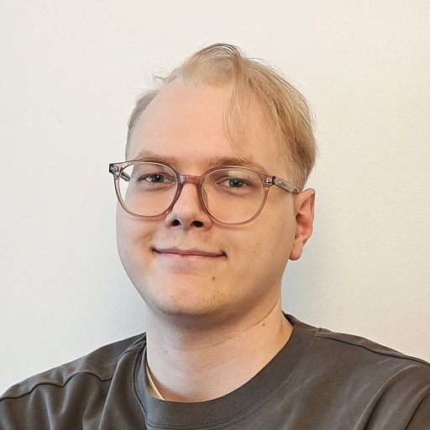
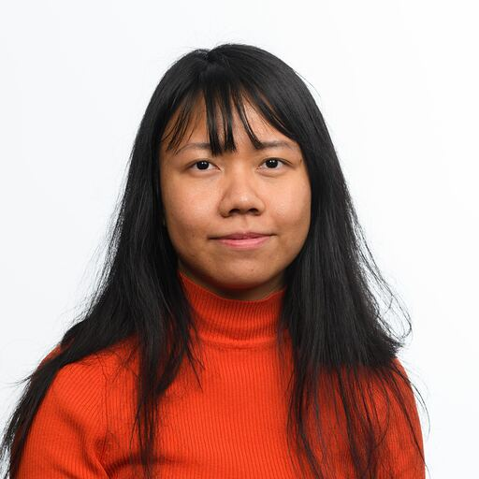
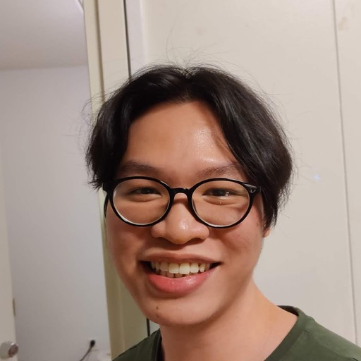
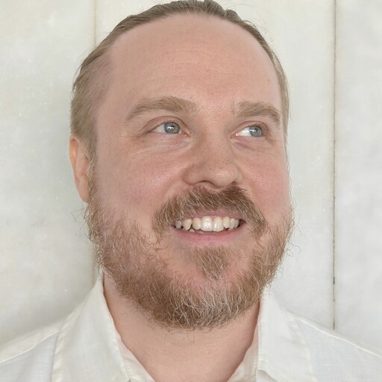
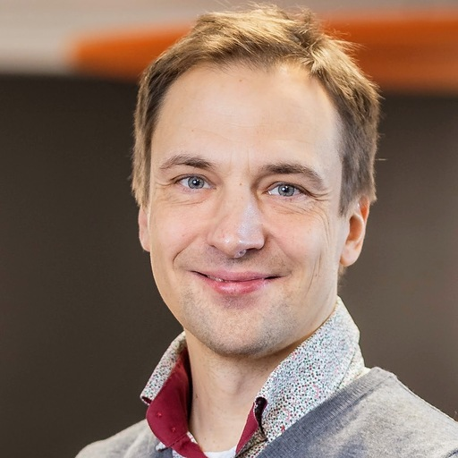
Your mentors.
Panu Vartiainen
Iiro Kinnunen
Thet Zin
Chuong Pham
Paul Carlson
Mats Mattsson
Notes:
Six of us. Stand up and wave.
We ask questions. The ideas are yours.

Slide 20
Book a mentor.
30-minute sessions. Book through LahtiES.
Thu 5.11.
Kickoff and team formation
21 slots
Fri 6.11.
42 slots
9:00
10:00
11:00
12:00
13:00
14:00
15:00
16:00
17:00
How to find us
1
Mukkulankatu 19
2
Isku entrance
3
3rd floor, Kempower
LUT campus, Mukkula.
The end of the building by the gym.
Meeting rooms 1, 2 and 3.
Each block is one 30-minute session with one of us. Lost? Ask in the hackathon Telegram chat.
Notes:
63 sessions, 30 min each. Book via LahtiES.
Thu from 12:30, Fri all day.
Mukkula, Isku entrance by the gym, 3rd floor.

Slide 21
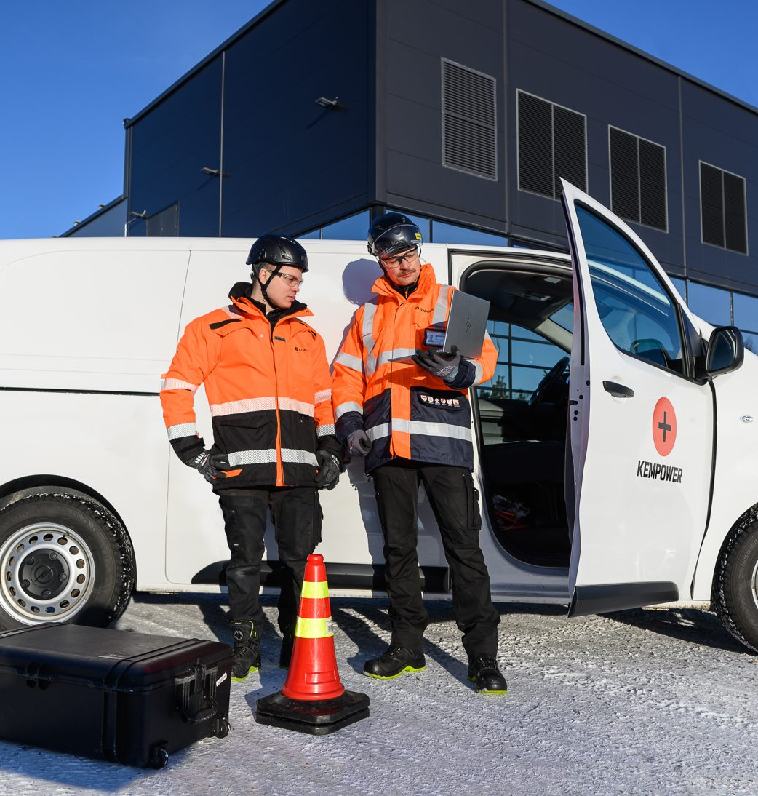
Join the movement.
Software, data, energy and engineering, right here in Lahti.
Summer jobs and traineeships. Real work in real teams.
Thesis work. Bachelor's and master's theses with our teams.
Careers. Open positions at kempower.com/careers.
Talk to us. Find any of your mentors during the hackathon.
Notes:
Summer jobs, theses, careers.
(Hand over to Ella if she's here.)

Slide 22
If humans were no longer allowed to continuously operate and maintain a charging network, how would you redesign it?
The ideas are yours.
Notes:
Read the question once more.
The ideas are yours. See you Saturday.
→ Questions.

Slide 23
www.kempower.com
Kempower and ChargEye are trademarks of Kempower Oyj,
registered in the U.S. and other countries and regions.

