Slide 1


Machine Learning 2. Numpy
Xueyuan Gong
School of Intelligent Systems Science and Engineering

Slide 2
Introduction
Select Numpy for matrix computation
Datasets used in Machine Learning are matrices
I suggest installing Anaconda as IDE
Anaconda automatically installs many necessary packages
Anaconda contains Spyder and Jupyter Notebook
Dataset
Model
Loss
Optimization

Slide 3
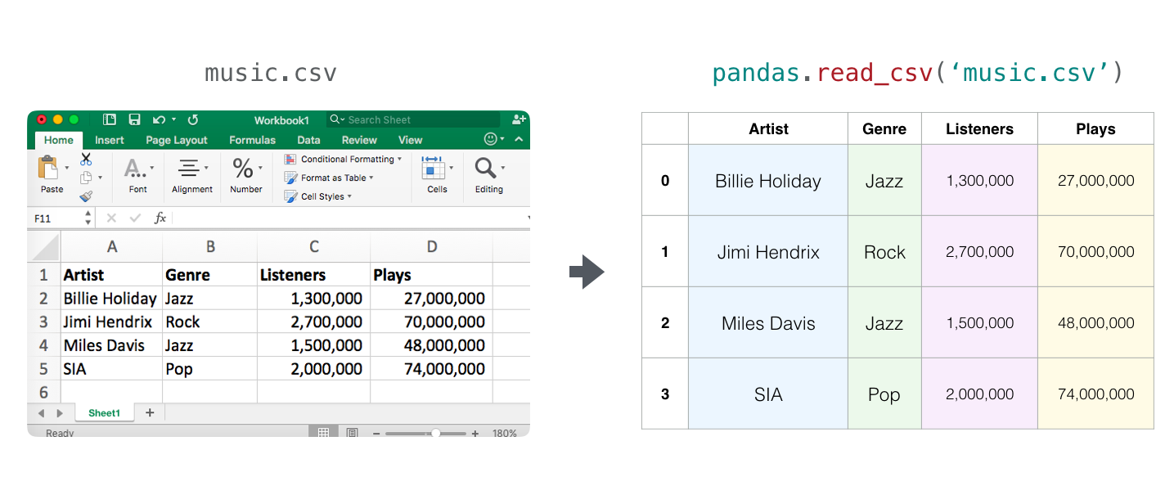
Tables and Spreadsheets

Slide 4
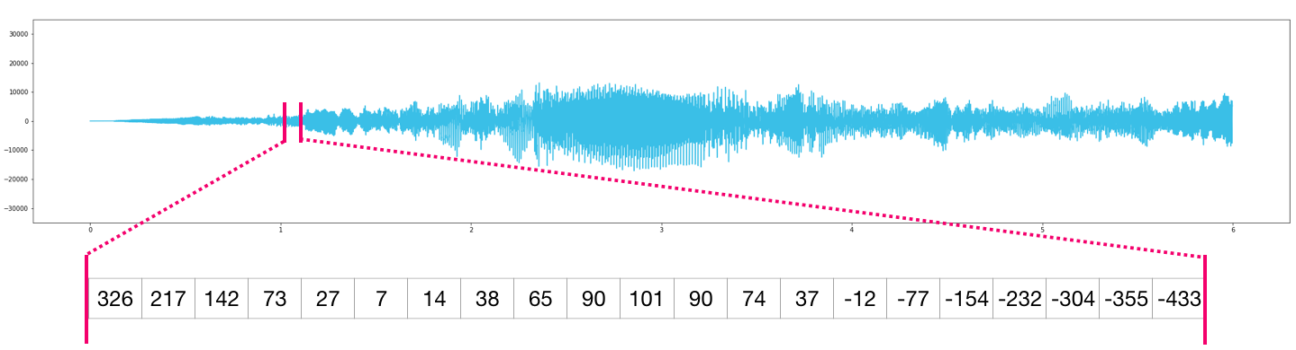
Audio and Timeseries

Slide 5
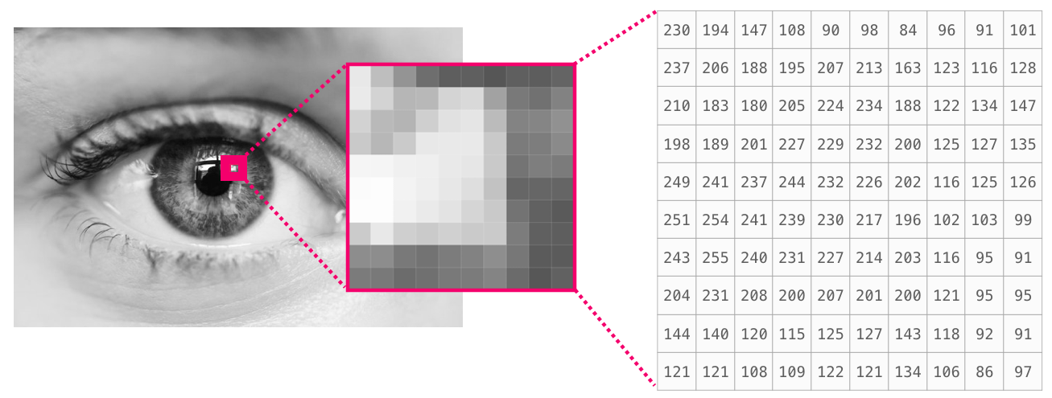
Images

Slide 6
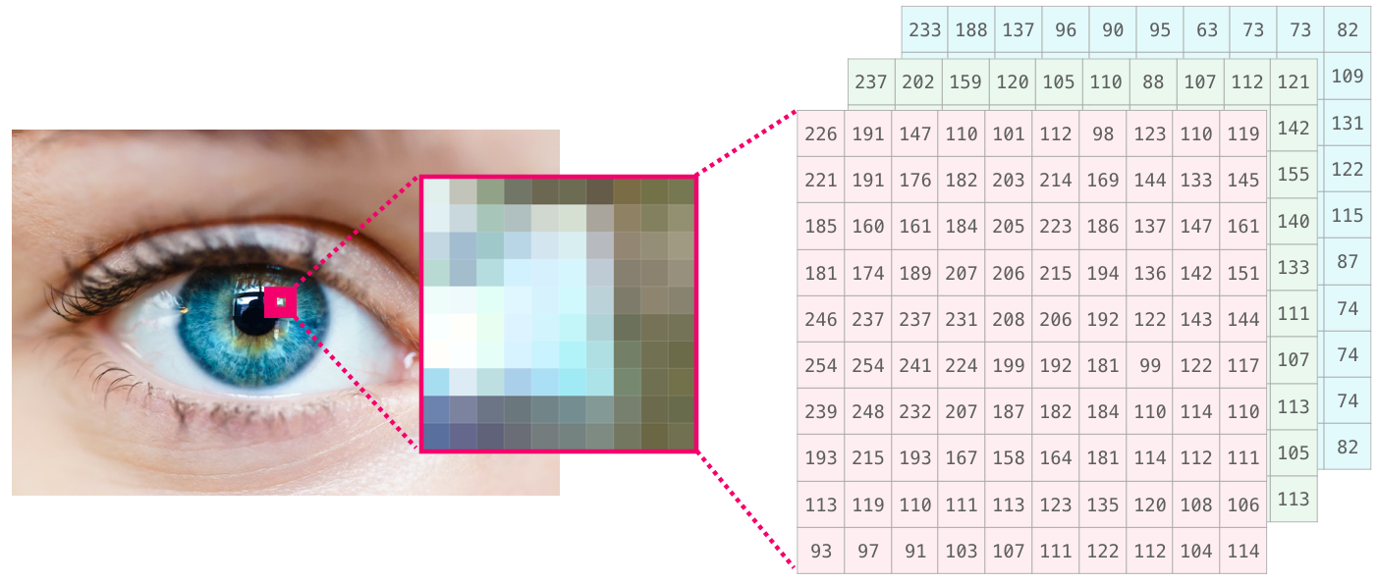
Images

Slide 7
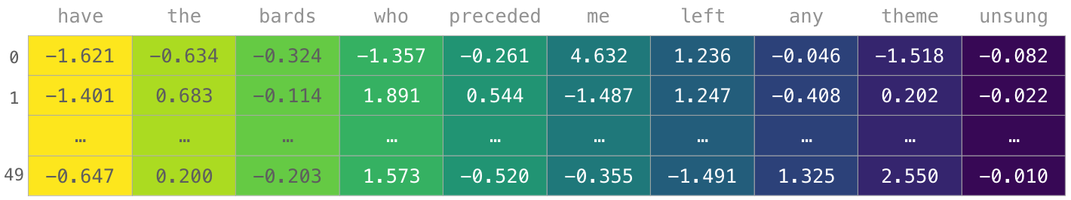
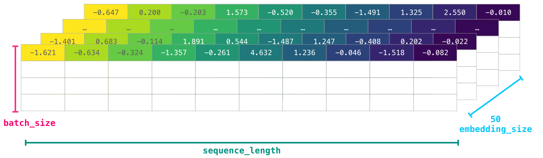
Language

Slide 8
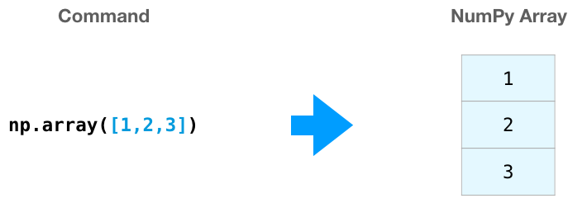
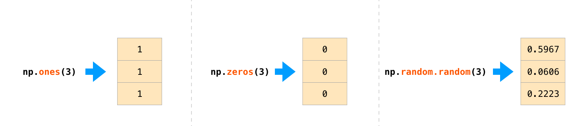
Creating Arrays

Slide 9
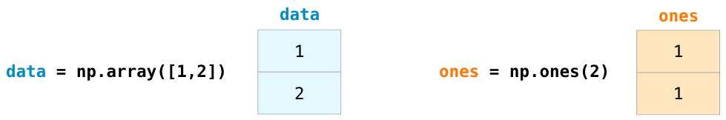
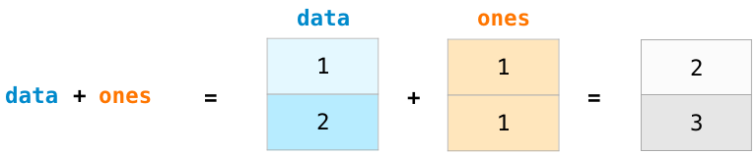
Array Arithmetic

Slide 10
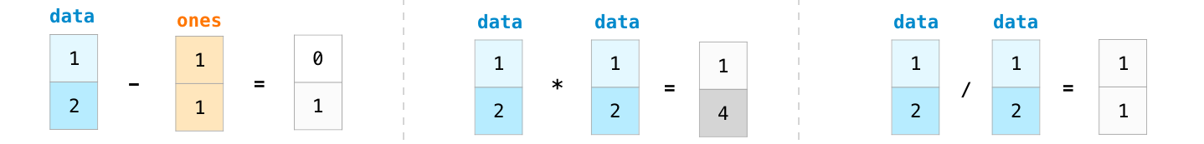
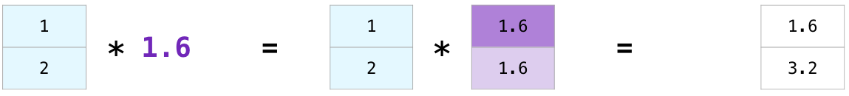
Array Arithmetic

Slide 11
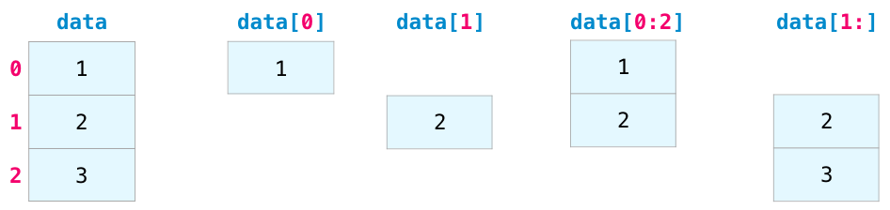
Indexing

Slide 12
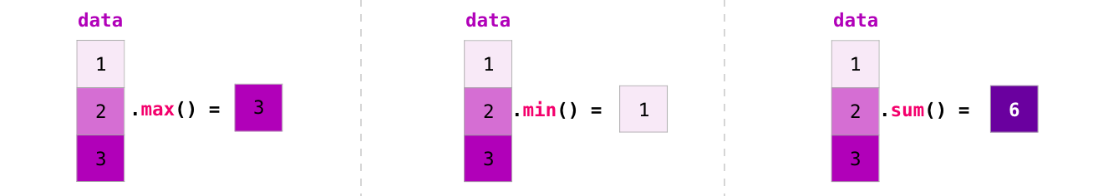
Aggregation

Slide 13
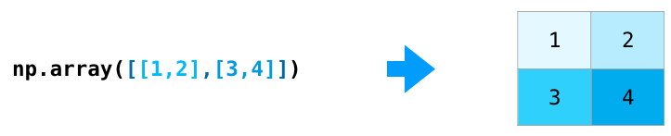
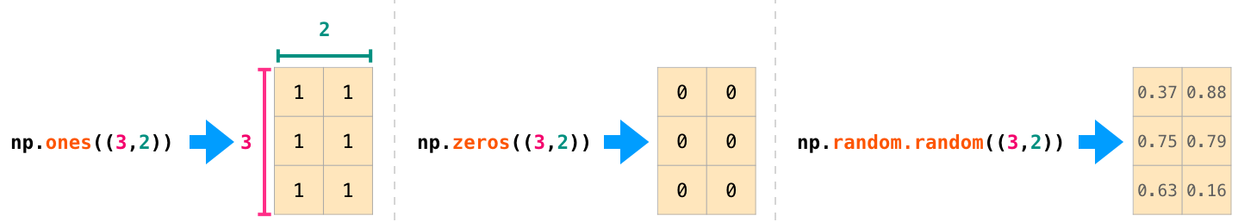
Creating Matrices

Slide 14
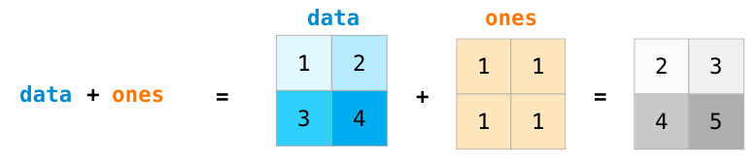
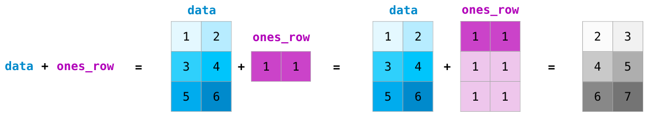
Matrix Arithmetic

Slide 15
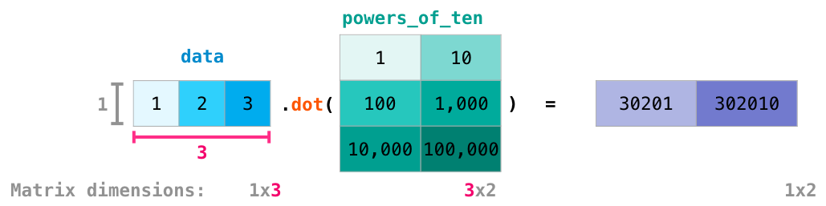
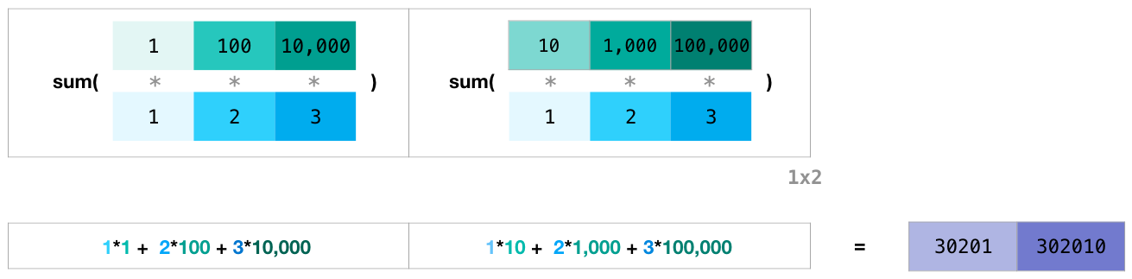
Matrix Arithmetic

Slide 16
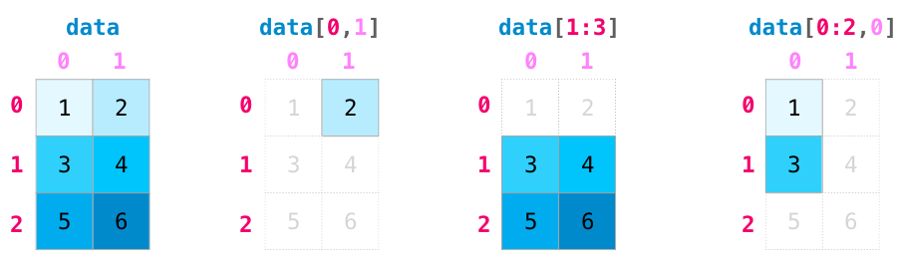
Matrix Indexing

Slide 17
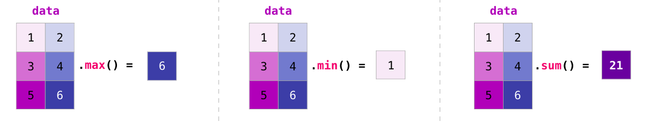
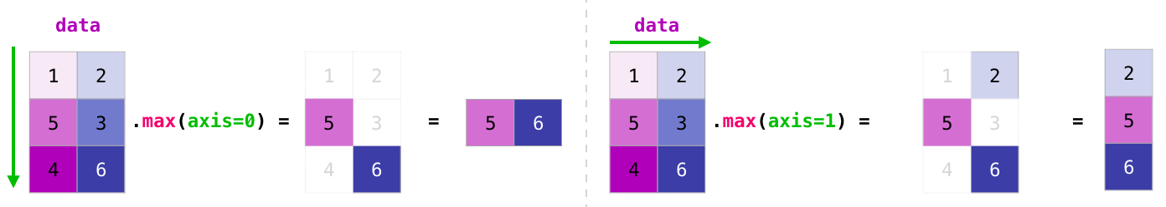
Matrix Aggregation

Slide 18
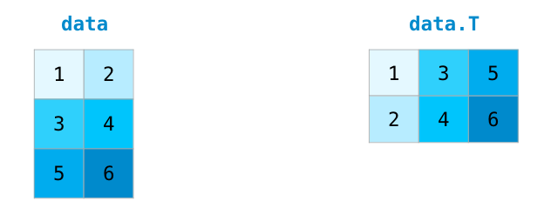
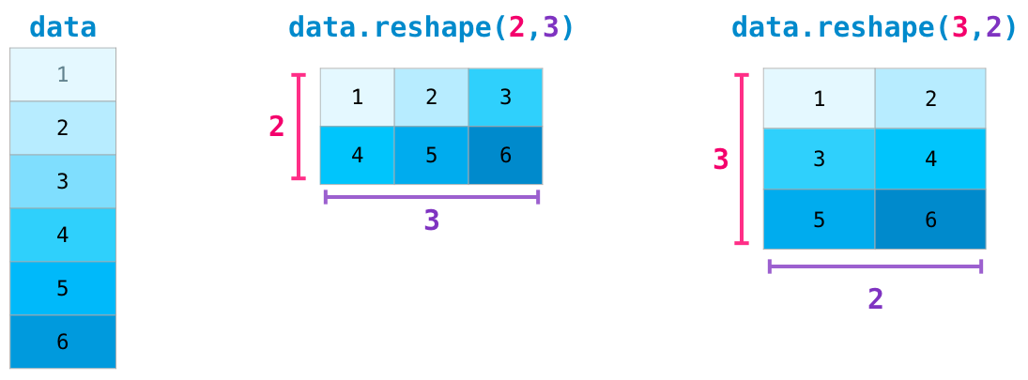
Transposing and Reshaping

Slide 19
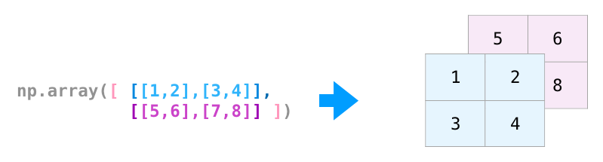
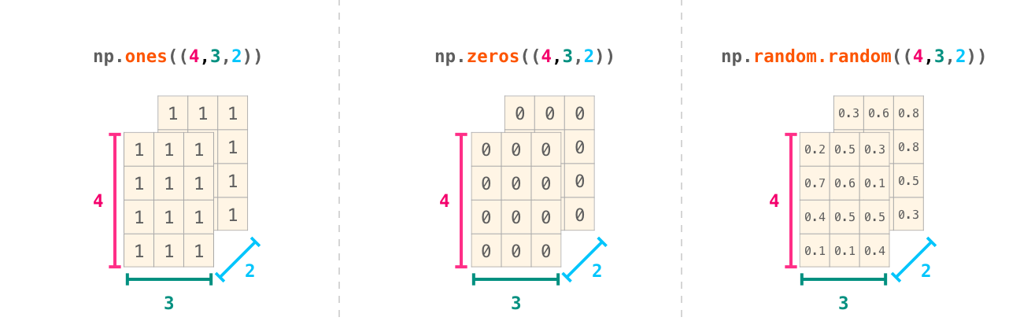
Yet More Dimensions

Slide 20
Thank you！

