Slide 1


Machine Learning 9. Optimization
Xueyuan Gong
School of Intelligent Systems Science and Engineering

Slide 2
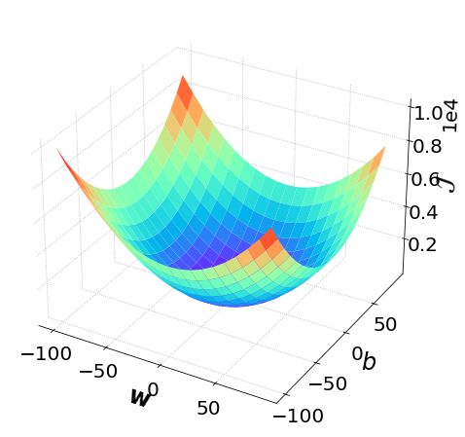
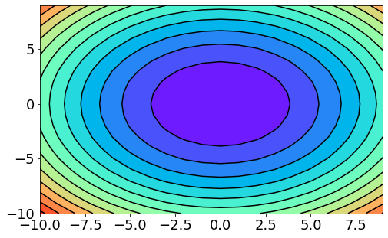
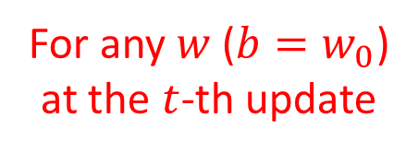
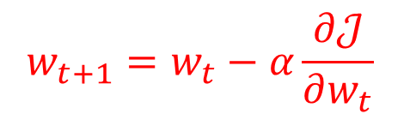
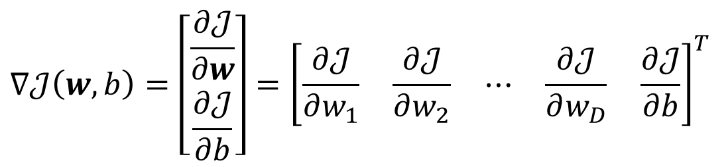
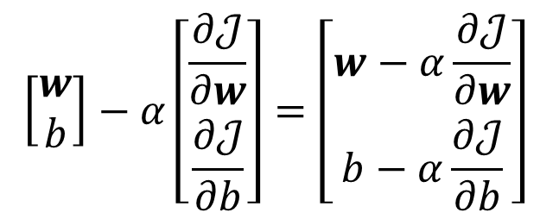
GD (Gradient Descent)
Gradient
$$∇𝒥\left(w,b\right)=\left[\begin{matrix}\frac{∂𝒥}{∂w} \\ \frac{∂𝒥}{∂b}\end{matrix}\right]={\left[\begin{matrix}\frac{∂𝒥}{∂w_{1}} & \frac{∂𝒥}{∂w_{2}} & ⋯ & \frac{∂𝒥}{∂w_{D}} & \frac{∂𝒥}{∂b}\end{matrix}\right]}^{T}$$
Gradient Descent
$$\left[\begin{matrix}w \\ b\end{matrix}\right]−α\left[\begin{matrix}\frac{∂𝒥}{∂w} \\ \frac{∂𝒥}{∂b}\end{matrix}\right]=\left[\begin{matrix}w−α\frac{∂𝒥}{∂w} \\ b−α\frac{∂𝒥}{∂b}\end{matrix}\right]$$
For any $w$($b=w_{0}$)
at the $t$-th update
$$w_{t+1}=w_{t}−α\frac{∂𝒥}{∂w_{t}}$$

Slide 3
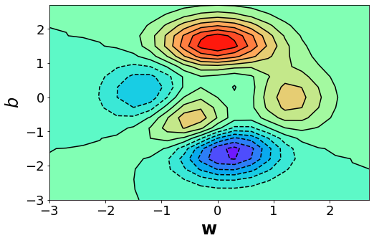
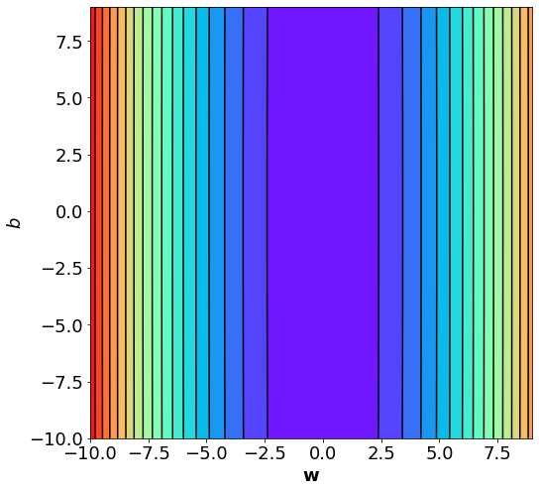
Problems of GD
Stuck at local minimum
Stuck at saddle point
Slow at the plateau
Same learning rate
Different scales of partial derivatives on different directions

Slide 4

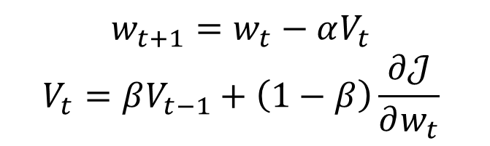
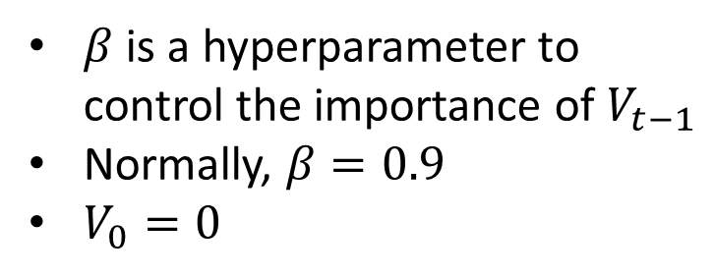


GDM (GD with Momentum)
$$w_{t+1}=w_{t}−αV_{t}$$
$$V_{t}=βV_{t−1}+\left(1−β\right)\frac{∂𝒥}{∂w_{t}}$$
$$−∂𝒥/∂w_{t}$$
$$V_{t−1}$$
$$V_{t}$$
$β$ is a hyperparameter to control the importance of $V_{t−1}$
Normally, $β=0.9$
$V_{0}=0$

Slide 5


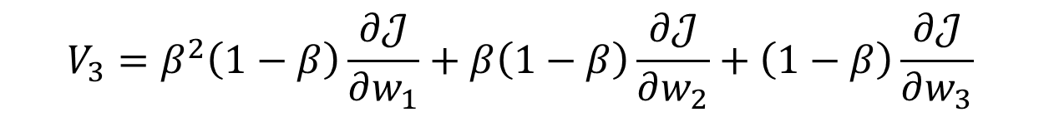
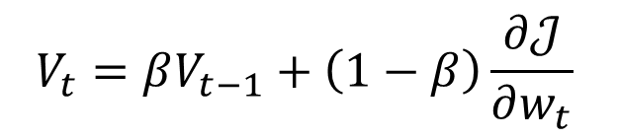
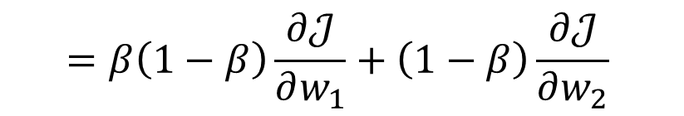
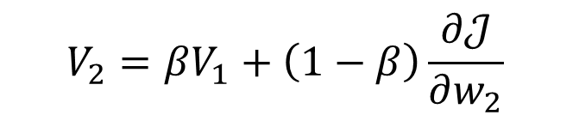
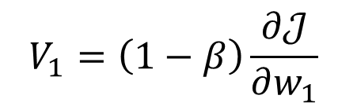
Exponential Moving Average
$$V_{t}=βV_{t−1}+\left(1−β\right)\frac{∂𝒥}{∂w_{t}}$$
$$V_{0}=0$$
$$V_{1}=\left(1−β\right)\frac{∂𝒥}{∂w_{1}}$$
$$V_{2}=βV_{1}+\left(1−β\right)\frac{∂𝒥}{∂w_{2}}$$
$$=β\left(1−β\right)\frac{∂𝒥}{∂w_{1}}+\left(1−β\right)\frac{∂𝒥}{∂w_{2}}$$
$$V_{3}=β^{2}\left(1−β\right)\frac{∂𝒥}{∂w_{1}}+β\left(1−β\right)\frac{∂𝒥}{∂w_{2}}+\left(1−β\right)\frac{∂𝒥}{∂w_{3}}$$
$$V_{4}=…$$

Slide 6
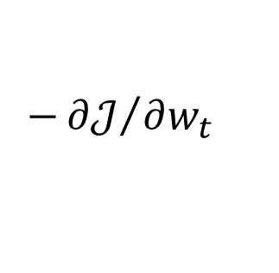
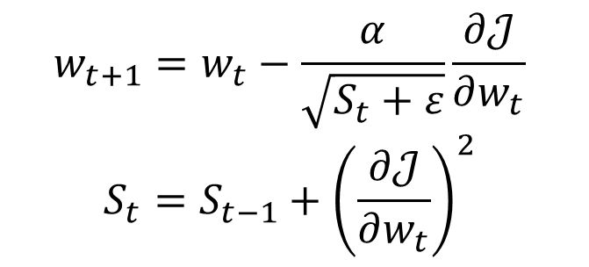
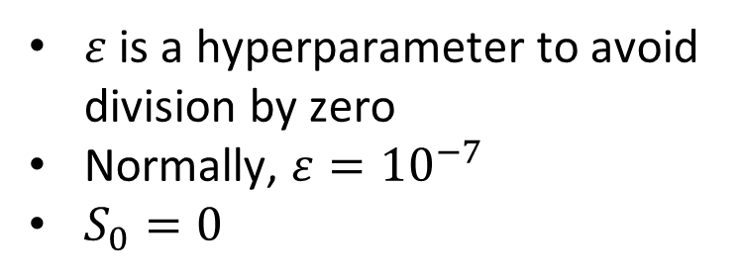
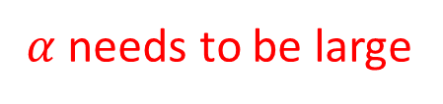

AdaGrad (Adaptive Gradient)
$α$ needs to be small
$$w_{t+1}=w_{t}−\frac{α}{\sqrt{S_{t}+ε}}\frac{∂𝒥}{∂w_{t}}$$
$$S_{t}=S_{t−1}+{\left(\frac{∂𝒥}{∂w_{t}}\right)}^{2}$$
$$−{∂𝒥}/{∂w_{t}}$$
$ε$ is a hyperparameter to avoid division by zero
Normally, $ε={10}^{−7}$
$S_{0}=0$
$α$ needs to be large

Slide 7
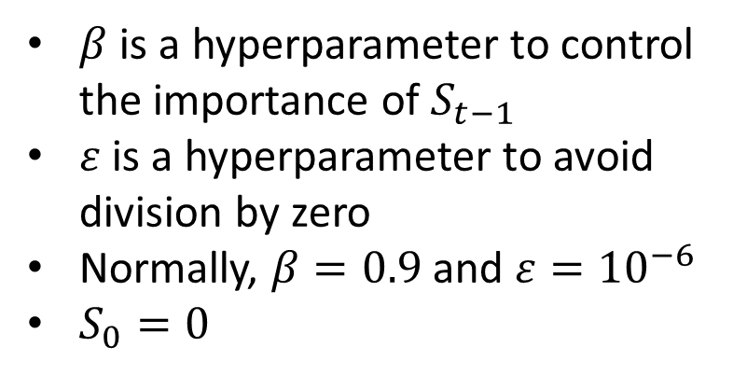
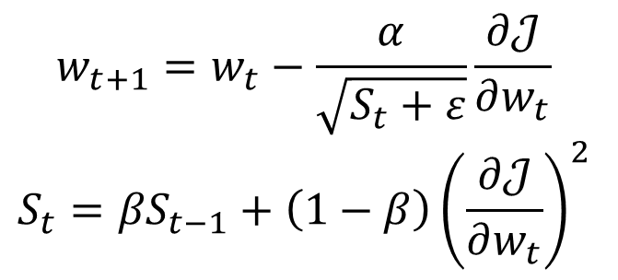
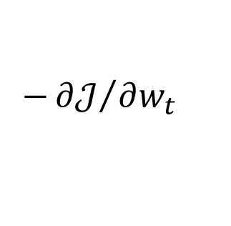
RMSProp (Root Mean Square Propagation)
$$w_{t+1}=w_{t}−\frac{α}{\sqrt{S_{t}+ε}}\frac{∂𝒥}{∂w_{t}}$$
$$S_{t}={βS}_{t−1}+\left(1−β\right){\left(\frac{∂𝒥}{∂w_{t}}\right)}^{2}$$
$$−{∂𝒥}/{∂w_{t}}$$
$β$ is a hyperparameter to control the importance of $S_{t−1}$
$ε$ is a hyperparameter to avoid division by zero
Normally, $β=0.9$ and $ε={10}^{−6}$
$S_{0}=0$
AdaGrad does not fit this situation

Slide 8
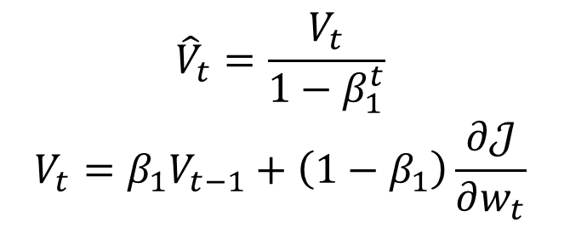
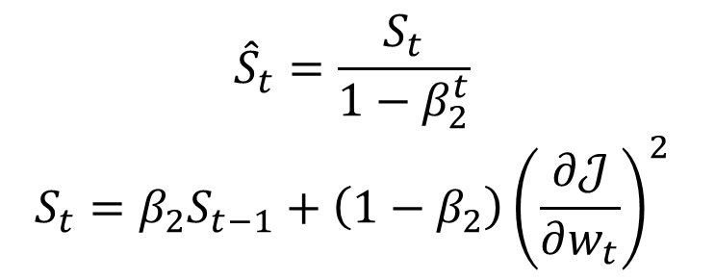
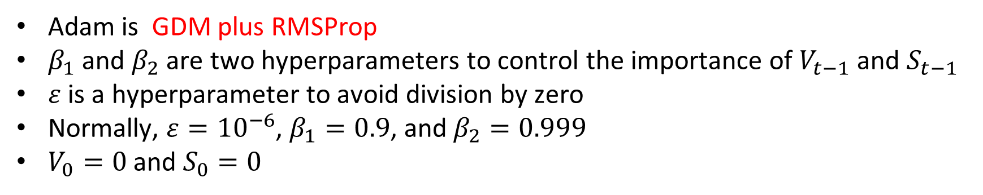
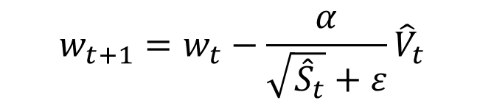
Adam (Adaptive Moment Estimation)
$$w_{t+1}=w_{t}−\frac{α}{\sqrt{{\hat{S}}_{t}}+ε}{\hat{V}}_{t}$$
GDM
RMSProp
$${\hat{V}}_{t}=\frac{V_{t}}{1−β_{1}^{t}}$$
$$V_{t}=β_{1}V_{t−1}+\left(1−β_{1}\right)\frac{∂𝒥}{∂w_{t}}$$
$${\hat{S}}_{t}=\frac{S_{t}}{1−β_{2}^{t}}$$
$$S_{t}={β_{2}S}_{t−1}+\left(1−β_{2}\right){\left(\frac{∂𝒥}{∂w_{t}}\right)}^{2}$$
Adam is GDM plus RMSProp
$β_{1}$ and $β_{2}$ are two hyperparameters to control the importance of $V_{t−1}$ and $S_{t−1}$
$ε$ is a hyperparameter to avoid division by zero
Normally, $ε={10}^{−6}$, $β_{1}=0.9$, and $β_{2}=0.999$
$V_{0}=0$ and $S_{0}=0$

Slide 9
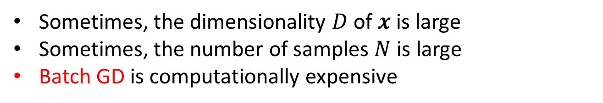
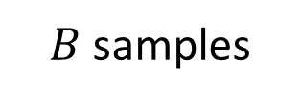
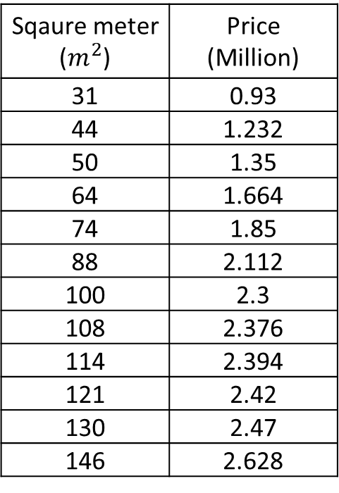
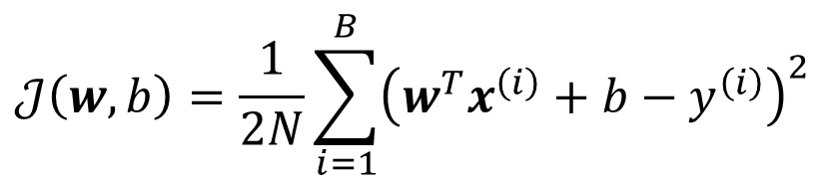
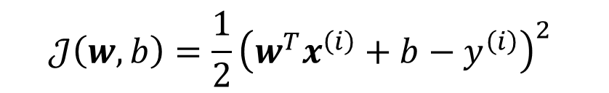
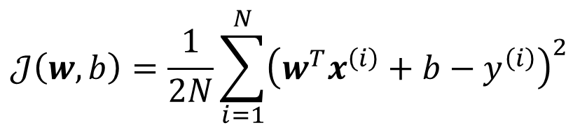
Other Gradient Descents
Sometimes, the dimensionality $D$ of $x$ is large
Sometimes, the number of samples $N$ is large
Batch GD is computationally expensive
Dataset
Sqaure meter ($m^{2}$) | Price (Million)
31 | 0.93
44 | 1.232
50 | 1.35
64 | 1.664
74 | 1.85
88 | 2.112
100 | 2.3
108 | 2.376
114 | 2.394
121 | 2.42
130 | 2.47
146 | 2.628
$$𝒥\left(w,b\right)=\frac{1}{2N}\sum_{i=1}^{N}{{\left(w^{T}x^{\left(i\right)}+b−y^{\left(i\right)}\right)}^{2}}$$
$B$ samples
Stochastic GD
$$𝒥\left(w,b\right)=\frac{1}{2}{\left(w^{T}x^{\left(i\right)}+b−y^{\left(i\right)}\right)}^{2}$$
Always used in Deep Learning
Mini-batch GD
$$𝒥\left(w,b\right)=\frac{1}{2N}\sum_{i=1}^{B}{{\left(w^{T}x^{\left(i\right)}+b−y^{\left(i\right)}\right)}^{2}}$$

Slide 10
Thank you！

