Slide 1









Slide 2


Slide 3
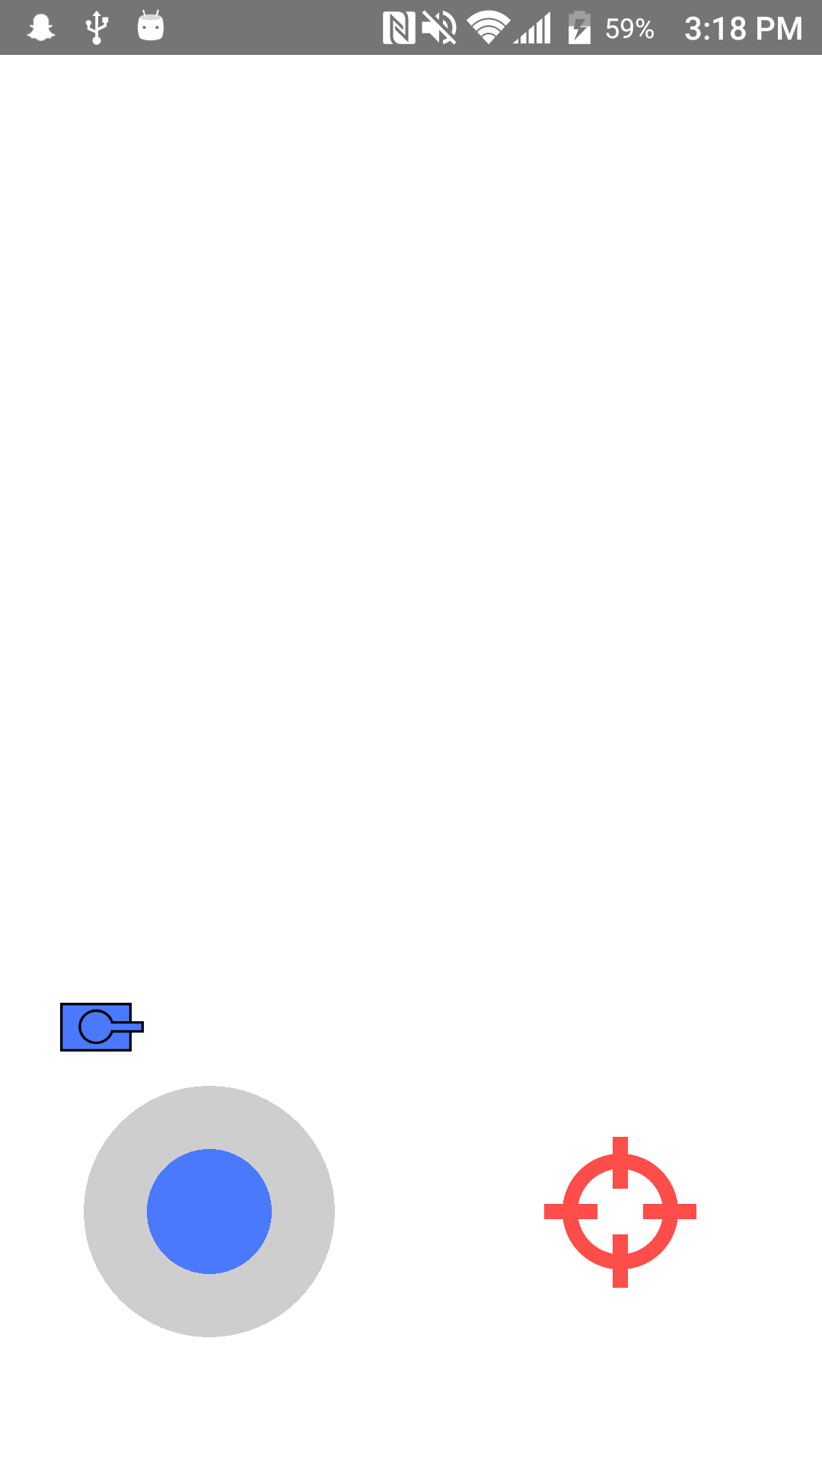

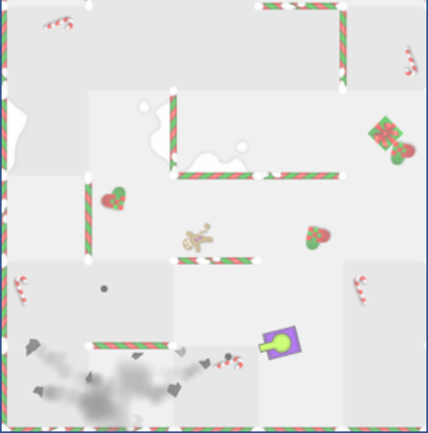

Slide 4
SINGLE BATTLE
Add entering tanks
MULTIPLAYER
BATTLE
Remove exiting tanks
Player dies
Player respawns
Only one left alive
Players respawn
SINGLE INTERMISSION
Add entering tanks
MULTIPLAYER
INTERMISSION
Remove exiting tanks

