Slide 1
Client Issue Prediction
Final Presentation
Team Members: Zhuoyou Wang, Zhenkai Liu, Xuexun Xiao, Benjamin Chen

Slide 2
Content
Project overview
Background and goal
Dataset and evaluation
Exploratory data analysis & Feature engineering
Behavior related features
Profile related features
Modeling and feature importance
Modeling result
Model ensembling

Slide 3
Background and Goals
Paychex has over 600,000 clients to which it provides HR software. During usage of Paychex systems and services, some clients will report having issues. To provide better service and prevent issues, Paychex is looking for the underlying causes. Paychex has gathered a sample containing one month of client transactions, and marked whether or not each client has indicated an issue.
Objective 1: Predict whether or not a client will have an issue
Objective 2: Through the prediction, identify root causes and problematic events, and provide insight into what can be improved

Slide 4
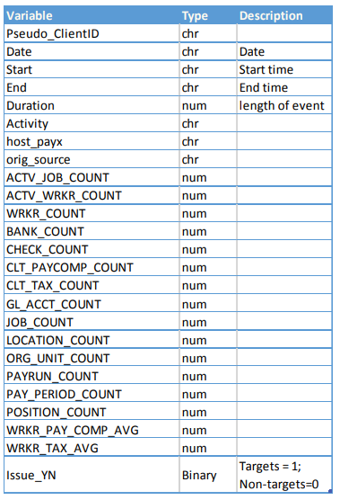
Dataset Has 2,399,917 Rows and 25 Columns (over 700mb)
ClientID
 | Clients | Transactions
No Issue (Issue_YN = 0) | 35,441 (94.47%) | 1,749,197 (72.89%)
Has Issue (Issue_YN = 1) | 2074 (5.53%) | 650,720 (27.11%)
Total | 37,515 | 2,399,917
Behavior Features
25 Columns
Profile Features

Slide 5
Profile-related Features and Behavior Related Features
Transaction 1
Behavior Related Features
(recorded by system)
Client 1
Transaction 2
Transaction 3...
Profile Related Features
(filled in by clients)
Transaction 1
Client 2…
Transaction 2
Transaction 3...

Slide 6
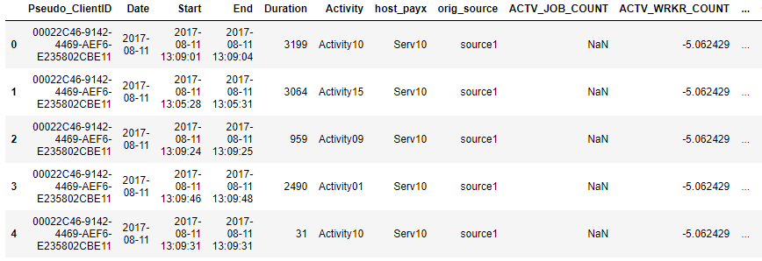
Data Before Processing:
2399917 rows (Transactions), 25 columns (Features)

Slide 7
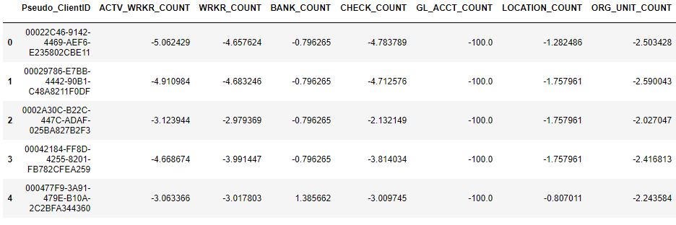
Data After Processing:
37515 rows (Clients), 2708 columns (Features)

Slide 8
Evaluation of Models
Because of the imbalance in our dataset, we use the F1 score (harmonic mean) alongside precision and recall to evaluate the performance of our models.
F1 = 2*(Precision*Recall)/(Precision+Recall)
Precision = TP/(TN+FP)
Recall = TP/(TP+FN)

Slide 9
Content
Project overview
Background and goal
Dataset and evaluation
Exploratory data analysis & Feature engineering
Behavior related features
Profile related features
Modeling and feature importance
Modeling result
Model ensembling

Slide 10
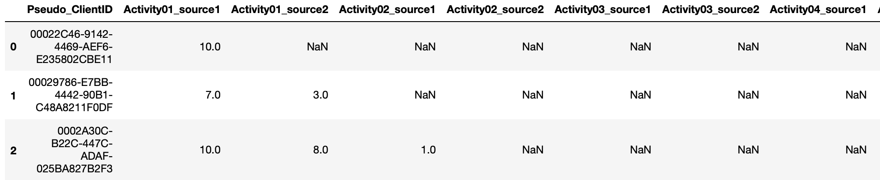
What We Did to Behavior Features
Transaction 1
Group by Client ID and aggregate behavior related features, then determine distribution of behavior features and combine these features e.g. the percentage of Activity 1 among all activities, the maximum value of transaction time, the count of Activity 1 hosted by Source 1
Client 1
Transaction 2
Transaction 3..

Slide 11
Key Findings from Behavior Related Features
Clients with a larger amount of transactions have a higher chance of having issues.
There is no strong evidence indicating that having issues is related to the source or server.
Activities 2, 3, 4, 8, 9 and 10 have a higher percentage of issues, with activity 8 at a 60% issue rate.
Based on behavioral features we can separate data in to two clusters, one with a 50.6% issue rate and another with a 4.3% issue rate.

Slide 12
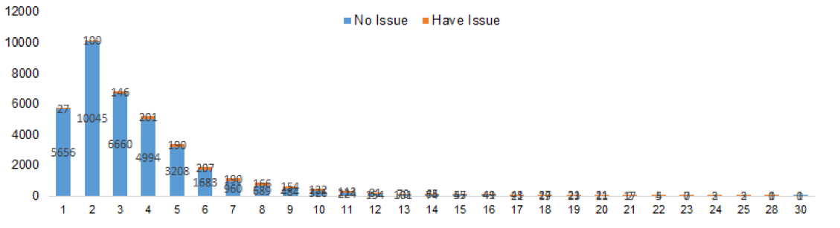
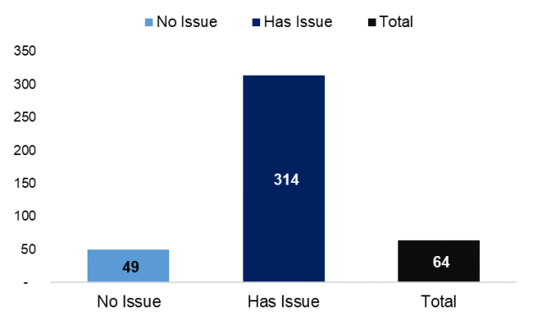
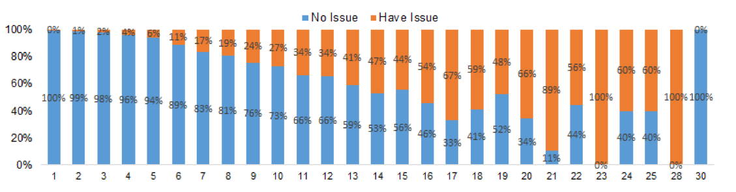
Transaction Analysis I
Number of days clients use the Paychex platform
Average Amount of Transactions
Majority of clients use the platform 1-6 days a month

Slide 13
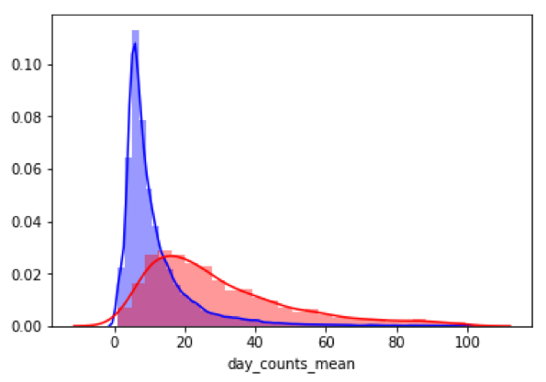
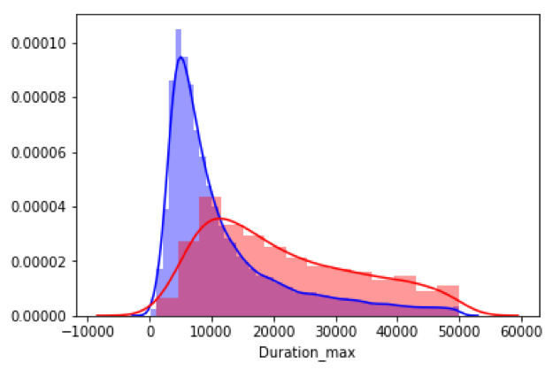
Transaction Analysis II
Distribution of mean transactions per day
Distribution of maximum duration
Don’t have issues
Don’t have issues
Have issues
Have issues
In addition to the previous findings, clients having issues not only use the platform many days per month, but also many times per day. Moreover, clients having issues tend to have a larger maximum duration.

Slide 14
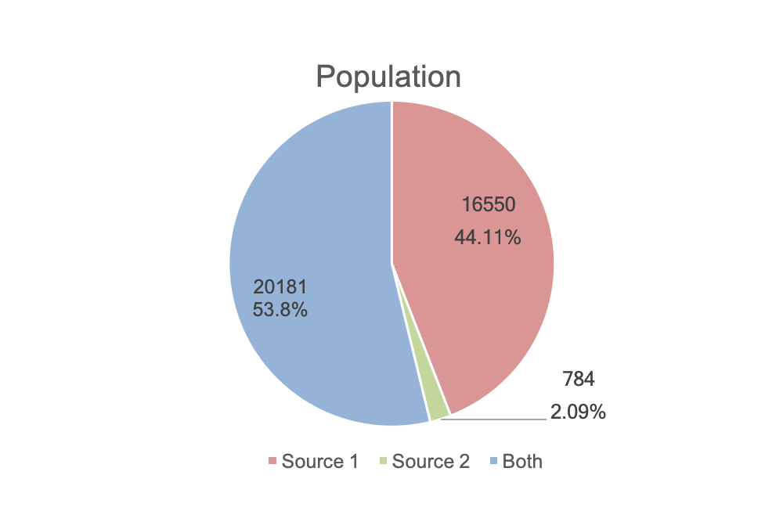
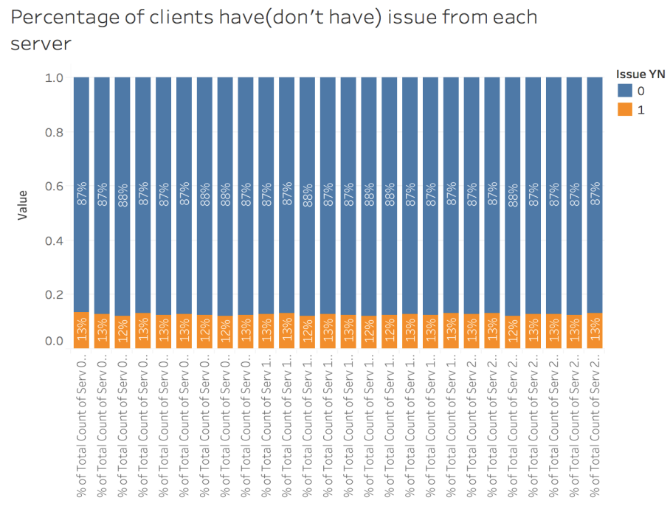
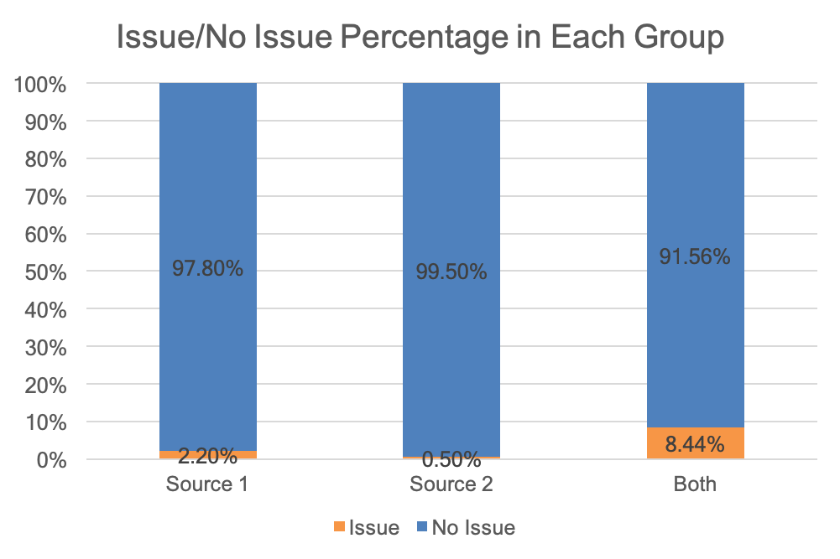
Source and Server Analysis

Slide 15
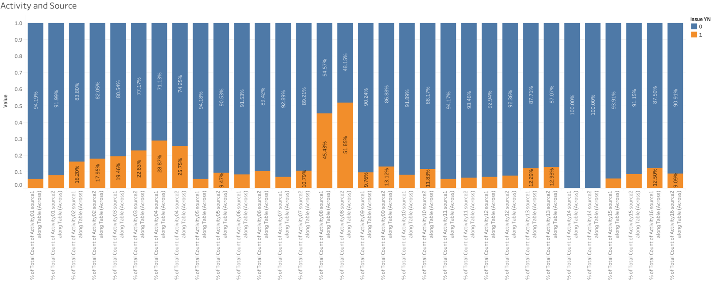
Activity Analysis
Activity 2
Activity 3
Activity 4
Activity 8
Source 1
Source 2

Slide 16
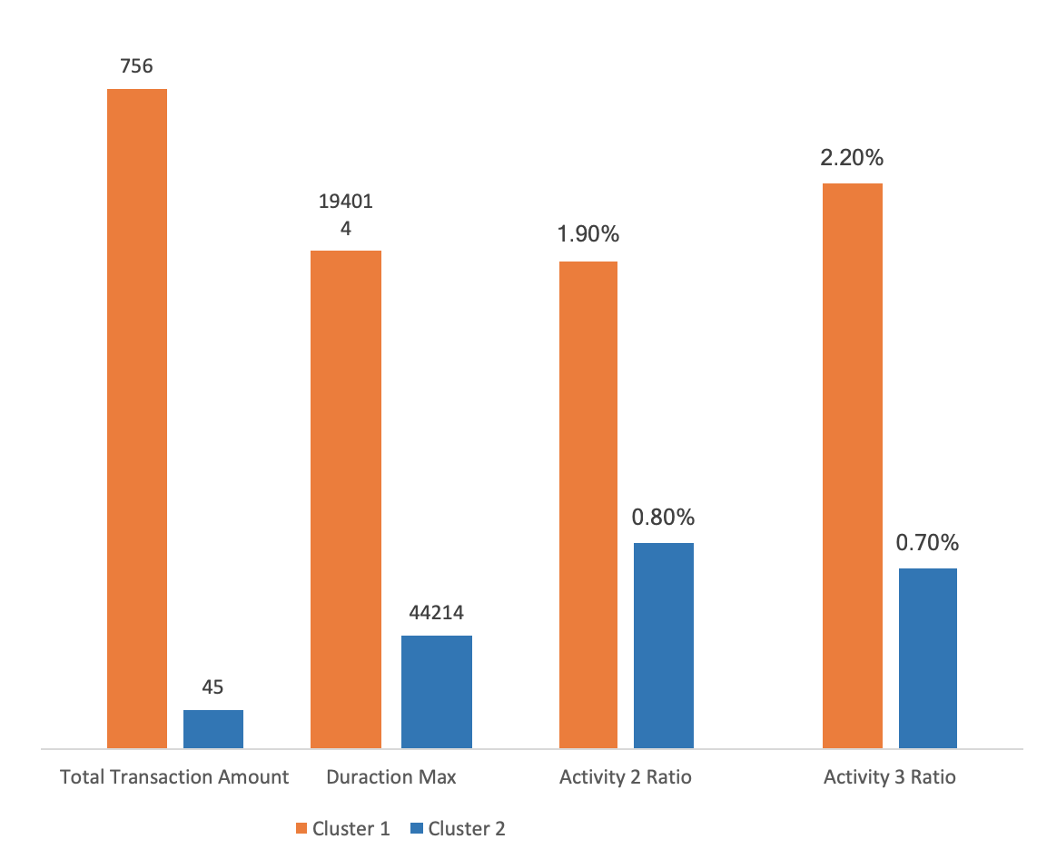
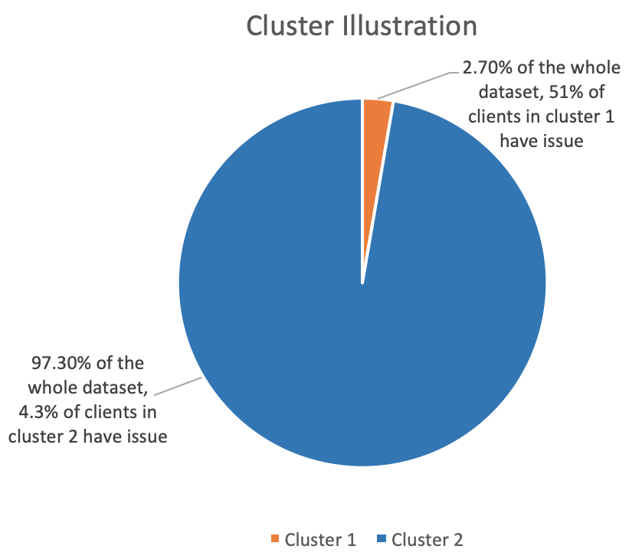
Cluster Analysis
Cluster Attributes

Slide 17
Content
Project overview
Background and goal
Dataset and evaluation
Exploratory data analysis & Feature engineering
Behavior related features
Profile related features
Modeling and feature importance
Modeling result
Model ensembling

Slide 18
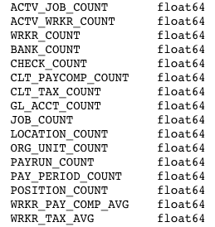
Profile-related Features
MAIN FINDING
The more complex the client’s company is, The more likely the company will have issue.
16 Original Profile-related Features
Manually Filled by clients
Contain missing values
Some features’ values changed through transactions （CHECK_COUNT, WRKR_COUNT..）
Notes:
(massive transaction, large # of checks be sending, large # of employers)

Slide 19
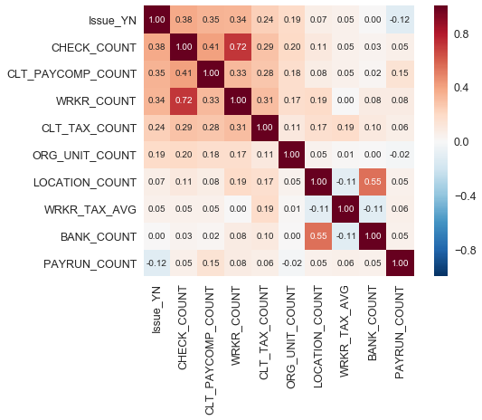
Correlation Matrix v1 (Original Features)
Ordered by absolute correlation coefficient value between features and Issue_YN
Dropped the missing value
The highest value is between CHECK_COUNT and Issue_YN, which is 0.38

Slide 20
Feature Engineering - Step 1
16 Original Features
17 Basic Features with 37515 records
Generate new feature “NULL_COUNT”
LightGBM regressor predict and fill missing value
Collect each client’s last transaction
ACTV_JOB_COUNT
ACTV_WRKR_COUNT
…
…
NULL_COUNT
(# of features with Nah value)

Slide 21
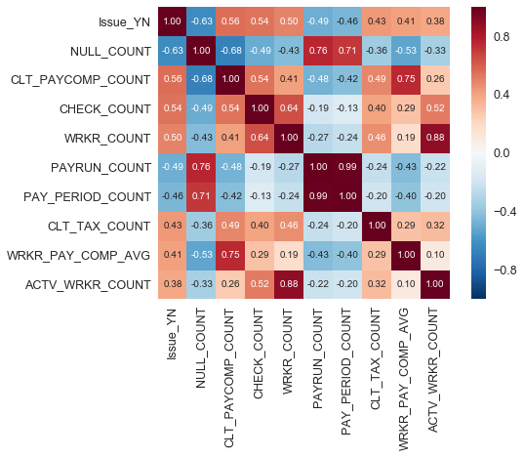
Correlation Matrix v2 (Basic Features)
Ordered by absolute correlation coefficient value between features and Issue_YN
1096 clients are all-feature-missed, only 8 clients have issue

Slide 22
Feature Engineering - Step 2
16 original features
601 features with 37515 Clients
ACTV_JOB_COUNT x ACTV_WRKR_COUNT
ACTV_JOB_COUNT
Basic arithmetic
(+, -, X, /)
ACTV_JOB_COUNT - ACTV_WRKR_COUNT
ACTV_WRKR_COUNT
ACTV_JOB_COUNT / ACTV_WRKR_COUNT
ACTV_WRKR_COUNT / ACTV_ JOB _COUNT
…
ACTV_JOB_COUNT + ACTV_WRKR_COUNT
…

Slide 23
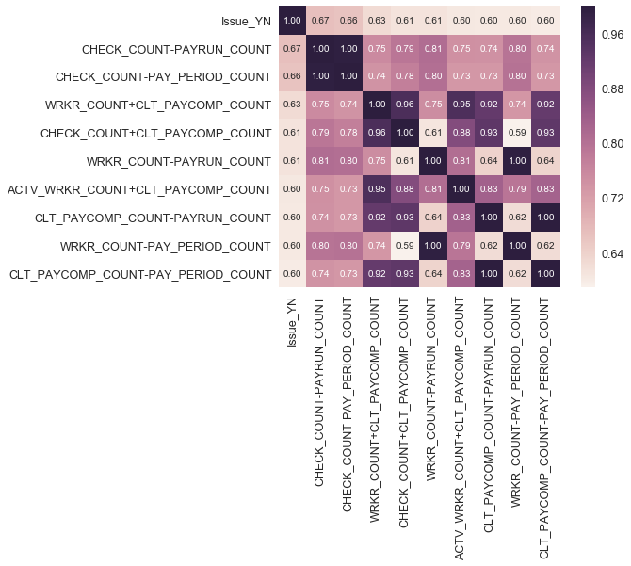
Correlation Matrix (combinations)
Top 10 features’ coefficients (with Issue_YN) > 0.6

Slide 24
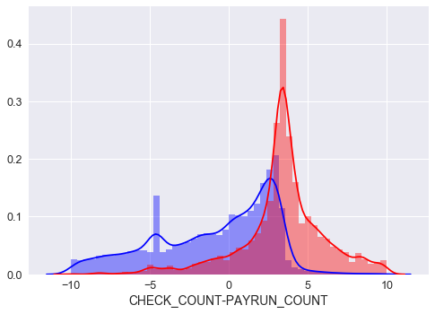
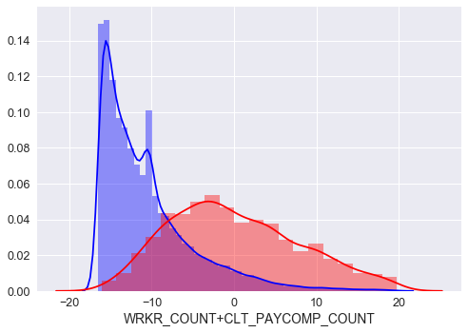
Features’ Detail
Don’t have issue
Mean = -10.38
Std=6.5
Median = -12.14
Don’t have issue
Mean = -4.6
Std=8.4
Median = -1.75
Have issue
Mean = 4.17
Std = 8.95
Median = 3.51
Have issue
Mean = 3.94
Std = 15.04
Median = 0.33

Slide 25
Feature Engineering - Step 3
16 original features +601 combination features with all transactions
3087 features with 37515 Clients
Aggregating stats
(mean, max, min, # of unique value, std)
through each client’s every transaction
ACTV_JOB_COUNT Mean
ACTV_JOB_COUNT
ACTV_JOB_COUNT Std.
ACTV_WRKR_COUNT
ACTV_JOB_COUNT Max
ACTV_JOB_COUNT x ACTV_WRKR_COUNT
ACTV_JOB_COUNT x ACTV_WRKR_COUNT Mean
ACTV_JOB_COUNT - ACTV_WRKR_COUNT
ACTV_JOB_COUNT x ACTV_WRKR_COUNT Std.
…
…

Slide 26
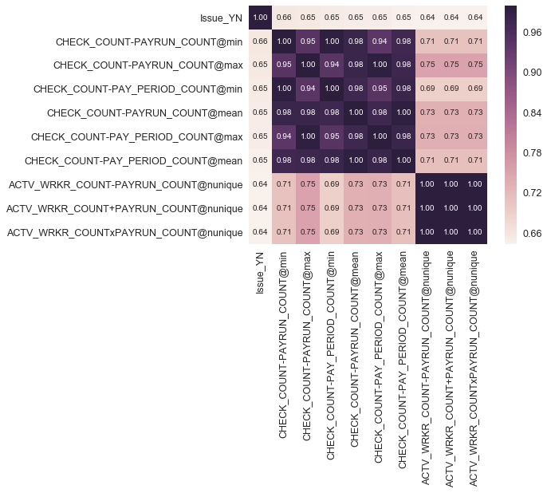
Correlation Matrix (apply stats on features)
Compare to issue clients, no issue clients has small values on features, less changes on features, and just change a little for every change on features
Top 10 features’ coefficients (with Issue_YN) > 0.6

Slide 27
Content
Project overview
Background and goal
Dataset and evaluation
Exploratory data analysis & Feature engineering
Behavior related features
Profile related features
Modeling and feature importance
Modeling result
Model ensembling

Slide 28
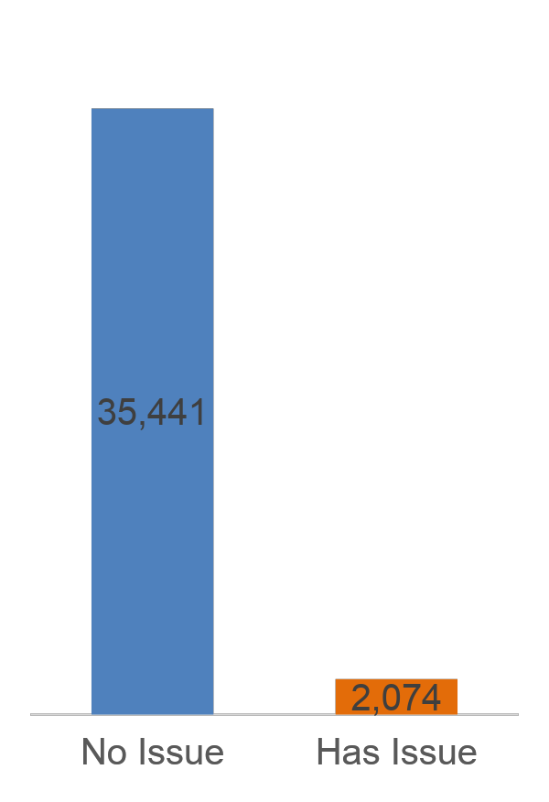
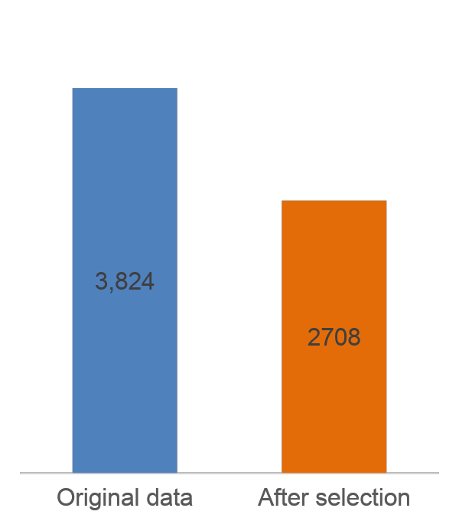
Feature Selection and Upsampling Before Training Model
Feature Selection
Upsampling
Duplicate data of clients who have issues
To avoid information leaks, we first split the dataset into a training dataset and test dataset, then upsample in the training set and keep the test set at the original size
1,116

Slide 29
Model Results
 | Random Forest | Lightgbm | Xgboost | Neural Network
Accuracy | 95% | 94.6% | 96% | 90.6%
F1 | 49.7% | 59.4% | 54% | 51.5%
Recall | 43.8% | 79.3% | 47% | 89.1%

Slide 30
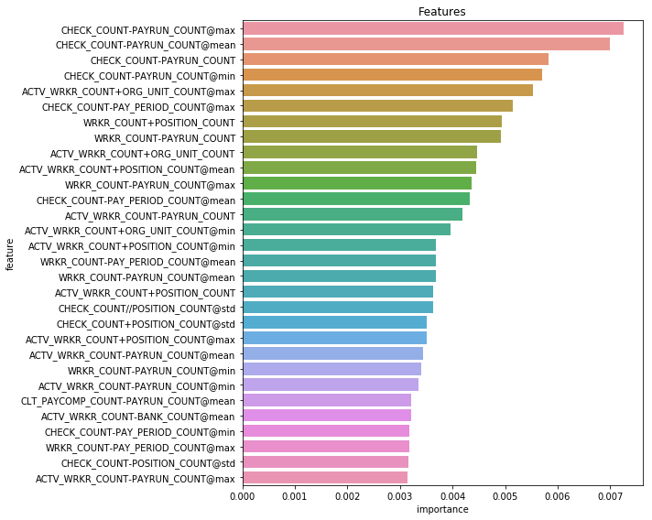
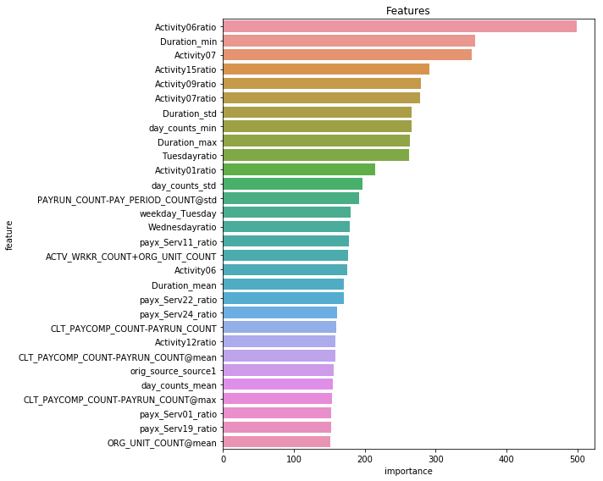
Random Forest vs Lightgbm
Profile related
Random forest
Behavior related
Lightgbm

Slide 31
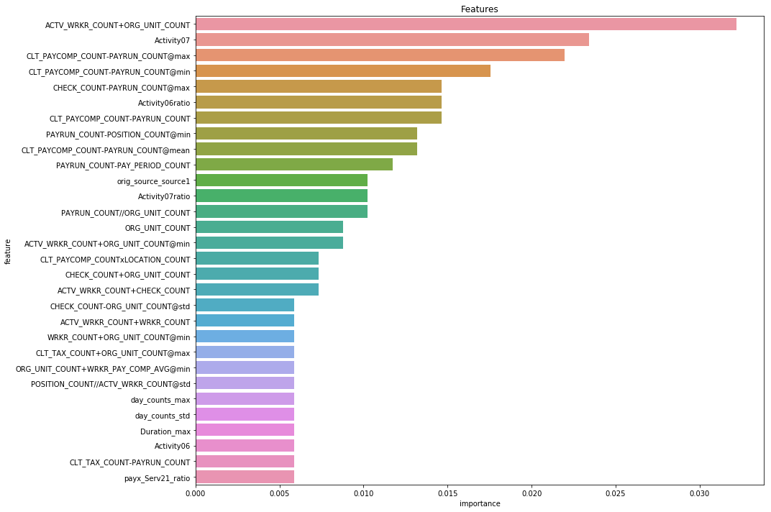
Xgboost vs Lightgbm
Mixture
Behavior related
Lightgbm
Xgboost

Slide 32
Content
Project overview
Background and goal
Dataset and evaluation
Exploratory data analysis & Feature engineering
Behavior related features
Profile related features
Modeling and feature importance
Modeling result
Model ensembling

Slide 33
Model Ensembling Results
 | 4 Model Ensemble |  | 3 Model Ensemble (lightgbm, xgboost, neural network)
 | Mean | Majority Vote | Mean | Majority Vote
Accuracy | 93.8% | 94% | 93.0% | 93.2%
F1 | 59.3% | 59.4% | 57.2% | 57.9%
Recall | 81.1% | 78% | 85.1% | 83.9%

Slide 34
Conclusions and Next Steps
Conclusions
Next Steps
Key features
Amount of transactions, frequent usage, maximum duration of transactions
Frequently changing profile, complex business structures
Modeling
Different models predict from different perspectives
Through model ensembling, we can identify 85% clients who might have issues
Key features
Involve new data such as new clients, count of users on a single account
Industry of clients
Modeling
Improve model ensembling method
Trade off between precision and recall
Adjusting threshold

Slide 35
Thank you!

