Slide 1
MLE&MAP

Slide 2
True or False(20 pts) and why(20 pts)
Given the joint probability distribution P(X₁ ,...,X_{n}) over a set of random variables, it is possible in principle to compute any joint or conditional probability defined over any subset of these variables
If we can get many training samples, then MLE method would perform well
In some cases, MLE can be converted into MAP
In MAP, we are going to find one or more parameters $θ$to make our data be observed as much as possible in the real world

Slide 3
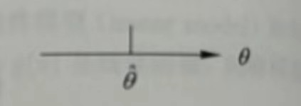
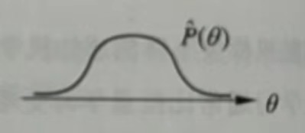
Multiple choice question (10 pts) and why (10 pts)
MAP
MLE

Slide 4
Short answer question(40 pts)
Why we rarely predict P(Y|X) in reality by learning the joint probability distribution ?
Under what condition, MLE algorithm perform well? And when would it perform really bad? How about MAP?
What’s the relationship between MLE and MAP?
When we use MAP to estimate the probability of throwing a coin up, what kind of probability distribution would you use to make assumption about it? Why?

Slide 5
Introduction
Many machine learning methods depend on probabilistic approaches. The reason is simple: when we are interested in learning some target function f : X → Y, we can more generally learn the probabilistic function P(Y|X)
This lecture describes joint probability distributions over many variables, and shows how they can be used to calculate a target P(Y|X).
We presenting the two most common approaches: maximum likelihood estimation and maximum a posteriori estimation.

Slide 6
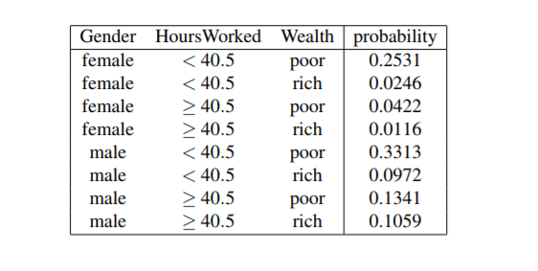
Joint Probability Distributions
The key to building probabilistic models is to define a set of random variables, and to consider the joint probability distribution over them.
The joint probability distribution is central to probabilistic inference, because once we know the joint distribution we can answer every possible probabilistic question that can be asked about these variables.
We can calculate conditional or joint probabilities over any subset of the variables, given their joint distribution

Slide 7
Joint Probability Distributions
To summarize,if we know the joint probability distribution over an arbitrary set of random variables {X₁ ...X_{n}}, then we can calculate the conditional and joint probability distributions for arbitrary subsets of these variables (e.g., P(X_{n}|X₁ ...X_{n−1})).

Slide 8
Joint Probability Distributions
How can we learn joint distributions from observed training data?
In the example of Table it will be easy if we begin with a large database containing, say, descriptions of a million people in terms of their values for our three variables
To successfully address the issue of learning probabilities from available training data, we must
be smart about how we estimate probability parameters from available data
be smart about how we represent joint probability distributions

Slide 9
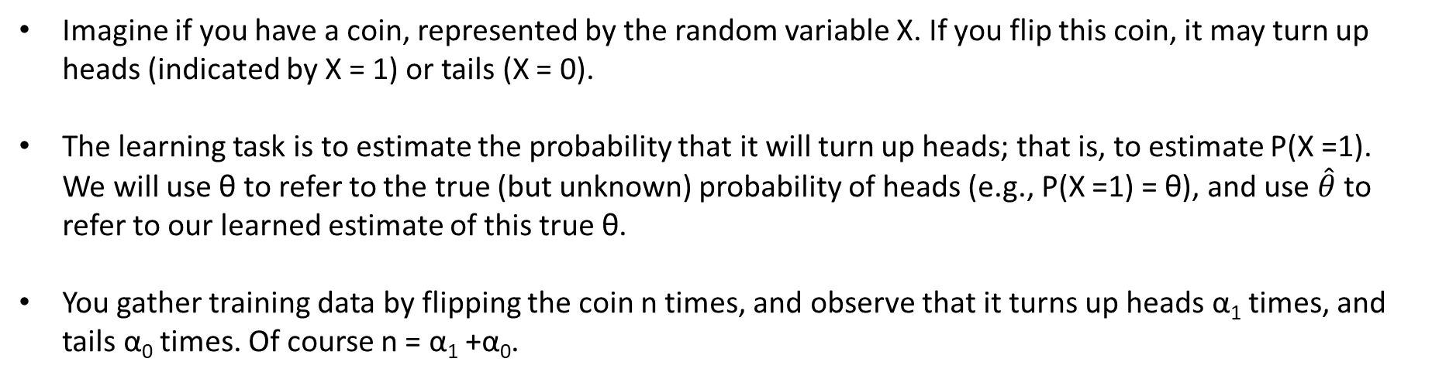
Example: flipping a coin
Imagine if you have a coin, represented by the random variable X. If you flip this coin, it may turn up heads (indicated by X = 1) or tails (X = 0).
The learning task is to estimate the probability that it will turn up heads; that is, to estimate P(X =1). We will use θ to refer to the true (but unknown) probability of heads (e.g., P(X =1) = θ), and use $\hat{θ}$ to refer to our learned estimate of this true θ.
You gather training data by flipping the coin n times, and observe that it turns up heads α₁ times, and tails α₀ times. Of course n = α₁ +α₀.

Slide 10
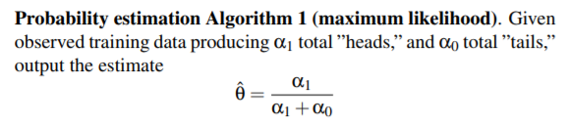
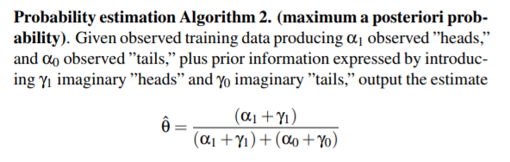
Methods
MLE
MAP

Slide 11
More about MAP
MAP
It is easy to incorporate our prior assumptions about the value of θ by adjusting the ratio of γ₁ to γ₀
It is easy to express our degree of certainty about our prior knowledge, by adjusting the total volume of imaginary coin flips
Asymptotically, as the volume of actual observed data grows toward infinity, the influence of our imaginary data goes to zero.
In other words, Algorithm 2 behaves so that priors have the strongest influence when observations are scarce, and their influence gradually reduces as observations become more plentiful

Slide 12

MLE
Maximum Likelihood Estimation, often abbreviated MLE, estimates one or more probability parameters θ based on the principle that if we observe training data D, we should choose the value of θ that makes D most probable
If we summarize D by the total number of observed times α₁ when X =1 and the number of times α₀ that X =0, we have in general
P(D = <α₁,α₀>|θ) = θ ^{α1} (1−θ) ^{α0}

Slide 13


MAP
Maximum a Posteriori Estimation, often abbreviated to MAP estimation, estimates one or more probability parameters θ based on the principle that we should choose the value of θ that is most probable, given the observed data D and our prior assumptions summarized by P(θ).
Using Bayes rule, we can rewrite the MAP principle as:

Slide 14
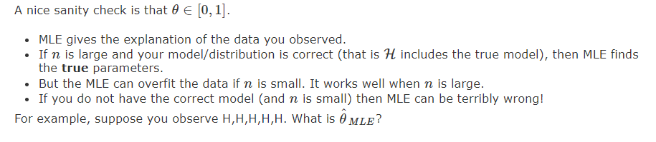
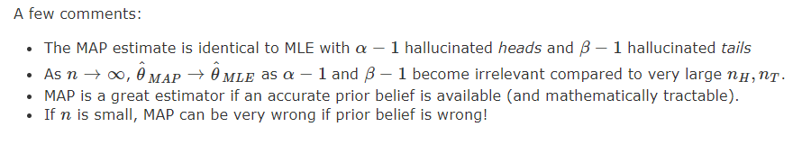
MLE VS MAP
MLE
MAP

Slide 15
Conclusion
Joint probability distributions lie at the core of probabilistic machine learning approaches. Given the joint probability distribution P(X₁ ,...,X_{n}) over a set of random variables, it is possible in principle to compute any joint or conditional probability defined over any subset of these variables.
Learning, or estimating, the joint probability distribution from training data can be easy if the data set is large compared to the number of distinct probability terms we must estimate. But in many practical problems the data is more sparse, requiring methods that rely on prior knowledge or assumptions, in addition to observed data

Slide 16
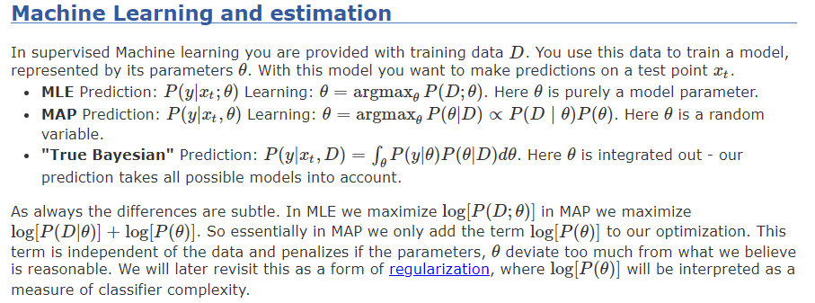
Conclusion

Slide 17
Thanks!

Slide 18

Categorical distribution
Given a sample of data drawn from a particular Categorical distribution for a random variable that can take on n possible values, the maximum likelihood estimate for θ_{i} is given by
MLE is simply the fraction of times the particular value was observed in the data!

Slide 19
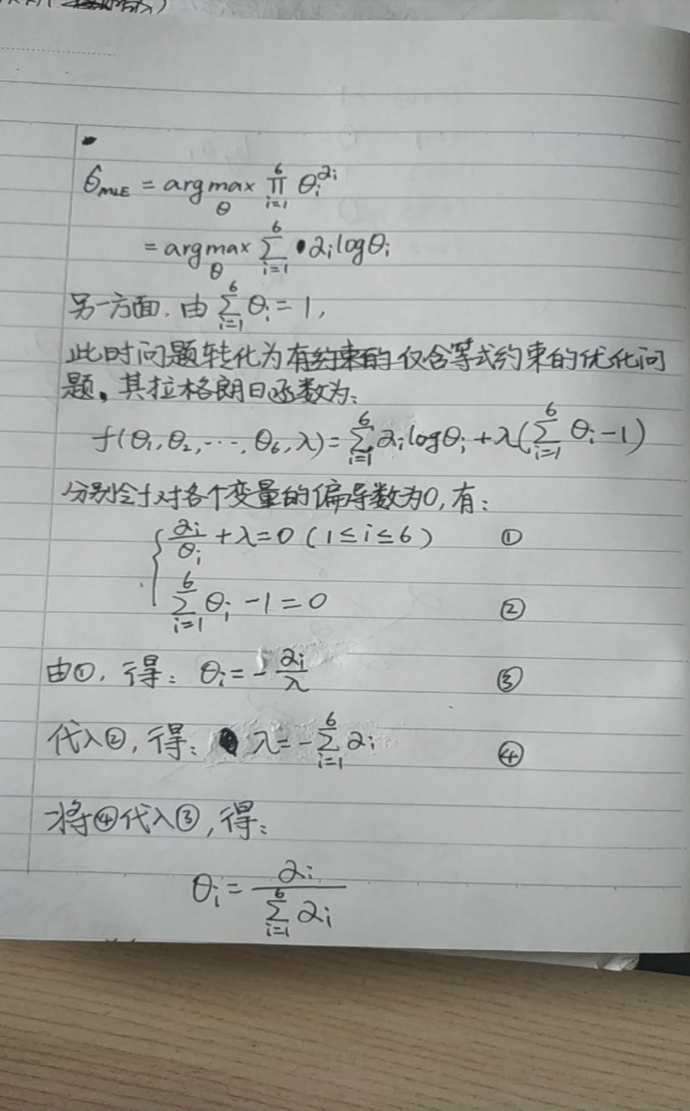
Categorical distribution
Given a sample of data drawn from a particular Categorical distribution for a random variable that can take on n possible values, the maximum likelihood estimate for θ_{i} is given by
证明：

Slide 20


Categorical distribution
If we prefer a MAP estimate for an n-valued random variable governed by a Categorical distribution, we use the conjugate prior for the Categorical distribution, which is called the Dirichlet distribution.
The Dirichlet distribution is a generalization of the Beta distribution, and has the form:
The MAP estimate for each θ_{i} for a Categorial distribution is given by

