Slide 1
EPO专利数据格式

Slide 2
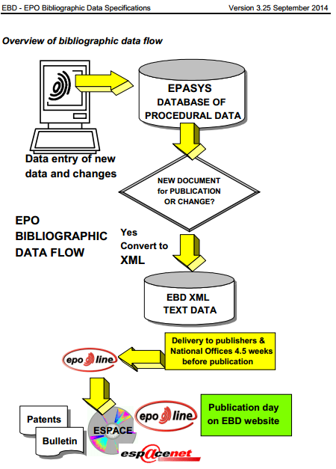
EPO数据处理流程

Slide 3
EP专利文献种类
A1 Application published with search report 包含检索文件的申请
A2 Application published without search report 未包含检索文件的申请
A3 Search report 检索报告
A4 Supplementary search report 补充检索报告
A8 Modified first page 被修改的第一页
A9 Modified complete specification 被修改的完整文件
B1 Patent specification 授权专利文件
B2 New patent specification 新授权专利文件
B3 After limitation procedure 被限制后的(授权专利文件)
B8 Modified first page granted patent 修改后的授权专利首页
B9 Corrected complete granted patent 更正后的完整授权专利
A系列的是普通的公开文件。如果能找到相对应的B结尾的文件，通常情况下专利已经被授权了。 不过在异议期实际上还是不完整(这个时间内专利虽然受保护，但是法院不受理侵权诉讼)
来自：https://bbs.mysipo.com/thread-7674-1-1.html

Slide 4
SDOBI
Sub-DOcument for BIbliographic data
<B100>: Document identification
<B200>: Domestic filing data
<B400>: Public availability dates
<B500>: Technical Data
<B700>: Parties concerned with the document
来源：ebdv3-25_en.pdf

Slide 5
B100
Document identification

Slide 6
B100
<B110>: Publication number of the document (EPO or WIPO) <B110>1118543</B110> - EPO number <B110>2003043537</B110> - WIPO number

Slide 7
B100
<B130>: Kind of document The values used by the EPO are: A1 Application published with search report A2 Application published without search report A3 Separate publication of the search report A8 Correction - reprint of the title page of an A-document A9 Correction - complete reprint of an A-document B1 Granted patent B2 Amended granted patent after opposition procedure B3 Amended granted patent after limitation procedure B8 Correction - reprint of the title page of a B-document B9 Correction - complete reprint of a B-document

Slide 8
B100
<B190>: Publishing country or organisation Country or organisation which actually publishes the document. The values used by EPO are: EP European Patent Office WO WIPO

Slide 9
B200
Document identification

Slide 10
B200
<B210>: Application number Number assigned by the EPO or National Office when the application is first filed.
'YYXXNNNN.P' where: YY = Year of application XX = Place of application NNNN = Number P = Check digit
<ep-bulletin id="EP03789660A1" file="03789660.2" lang="en" country="EP" doc-number="1826796" kind="A1" date-publ="20070829" status="n" dtd version="ep-bulletin-v1-3">

Slide 11
B200
<B220>: Application filing date <B220> <date>20000417</date> </B220>

Slide 12
B200
<B250>: Filing language It contains the language code in which the application was originally filed e.g: de German en English fr French ja Japanese etc.

Slide 13
B200
<B251EP>: Procedure language Content: en, fr or de

Slide 14
B200
<B260>: Publication language Language in which the Application/Patent has to be published. Currently, EPO uses the following languages: · fr French · en English · de German

Slide 15
B400
Public availability dates

Slide 16
B400
<B405>: Patent Bulletin / Gazette information <B405> <date>Publication date</date> <bnum>Issue number of the Bulletin</bnum> </B405>
Date when the EPO Bulletin is actually published and the corresponding issue number.

Slide 17
B400
<B430>: Unexamined document without grant (first publication) <B430> <date>Publication date</date> <bnum>Issue number of the Bulletin</bnum> </B430>
Date of publication of application (A1, A2) and issue number of the EPO Bulletin in which the first publication of the application is mentioned.

Slide 18
B400
<B450>: Document with grant (second publication) <B450> <date>Publication date</date> <bnum>Issue number of the Bulletin</bnum> </B450>
Date of publication of specification (B1) and the issue of the EPO Bulletin in which the mention of the grant is published.

Slide 19
B500
Technical Data

Slide 20
B500
<B510>: International Patent Classification (IPC) Note: This coding will no longer be used in the XML files after publication week 52-2005 but instead the IPC coding will be stored in tag B510EP <B510> <B516>8 <B511> 8B 60R 13/08 A <B512> 8C 08J 9/00 B <B512> 8C 08J 9/10 B <B513> 8C 08L 51/06 - </B510>

Slide 21
B500
<B510EP>: International Patent Classification (IPCR – in force 01-2006) <!ELEMENT B510EP (classification-ipcr+)> <!ELEMENT classification-ipcr ((section , class , subclass , main-group? , subgroup? , ipc-version-indicator , classification-level? , symbol position? , classification-value? , action-date? , classification-status? , classification-data-source?, generating-office?) | text)>

Slide 22
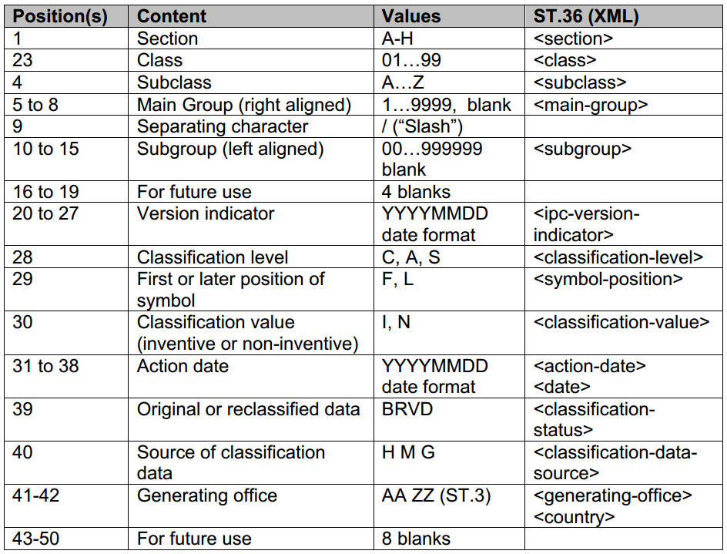
B500
<B510EP>: International Patent Classification (IPCR – in force 01-2006)
第8版IPC分类md参考：https://github.com/wzyjerry/ipcr-taxonomy

Slide 23
B500
<B510EP>: International Patent Classification (IPCR – in force 01-2006)
<B510EP> <classification-ipcr sequence="1"> <section>C</section> <class>22</class> <subclass>C</subclass> <main-group>1</main-group> <subgroup>02</subgroup> <ipc-version-indicator>20050101</ipc-version-indicator> <classification-level>A</classification-level> <symbol-position>F</symbol-position> <classification-value>I</classification-value> <action-date>20050105</action-date> <classification-status>B</classification-status> <classification-data-source>H</classification-data-source> <generating-office>EP</generating-office> </classification-ipcr> </B510EP>

Slide 24
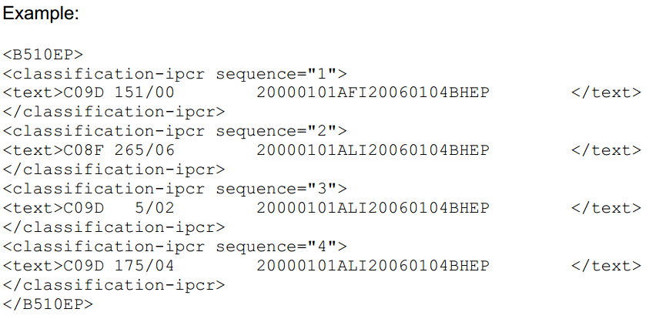
B500
<B510EP>: International Patent Classification (IPCR – in force 01-2006)
capture the new IPC as one fixed length field of 50 positions conforming to the new IPC (see above);

Slide 25
B500
<B540>: Title <B540> <B541>de</B541> <B542>German title</B542> <B541>en</B541> <B542>English title</B542> <B541>fr</B541> <B542>French title</B452 </B540>

Slide 26
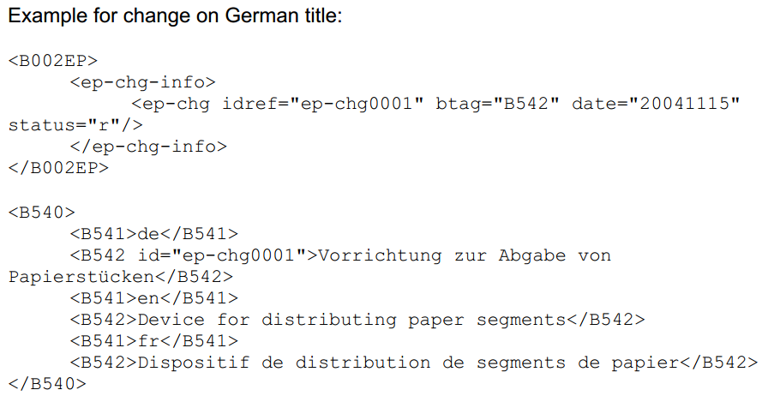
B500
<B540>: Title

Slide 27
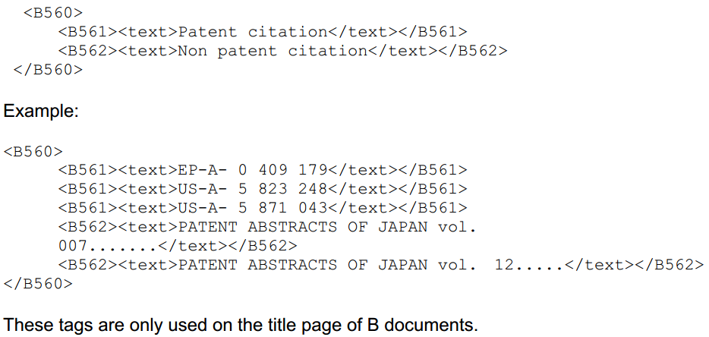
B500
<B560>: List of prior art documents

Slide 28
B500
<B560>: List of prior art documents

Slide 29
B700
Parties concerned with the document

Slide 30
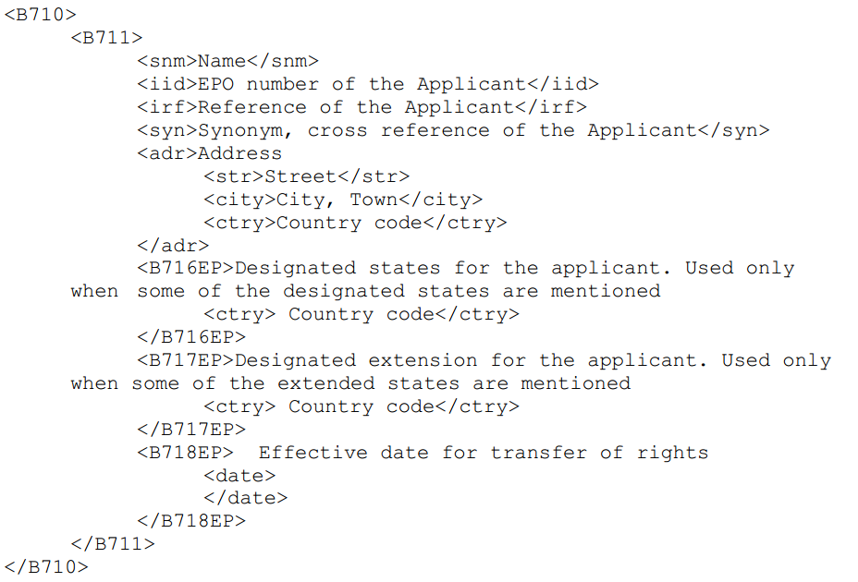
B700
<B710>: Applicants

Slide 31
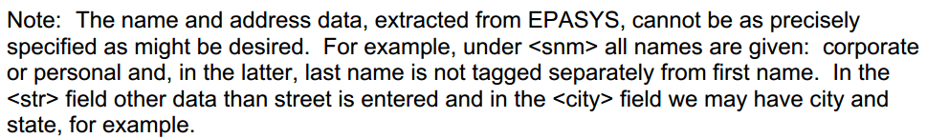
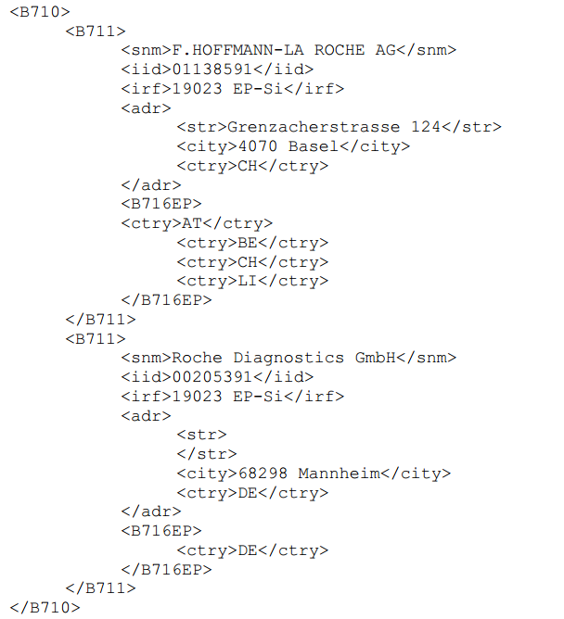
B700
<B710>: Applicants

Slide 32
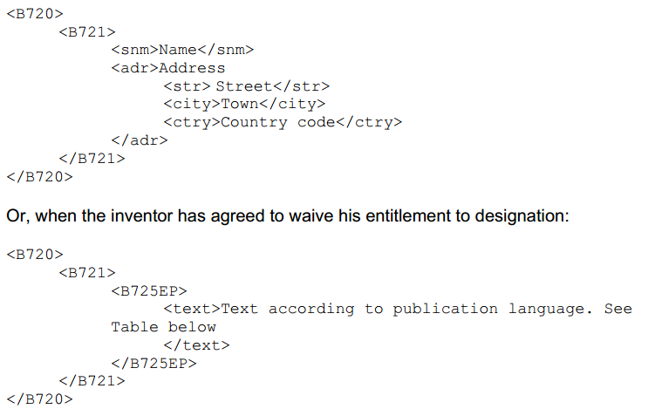
B700
<B720>: Inventors

Slide 33
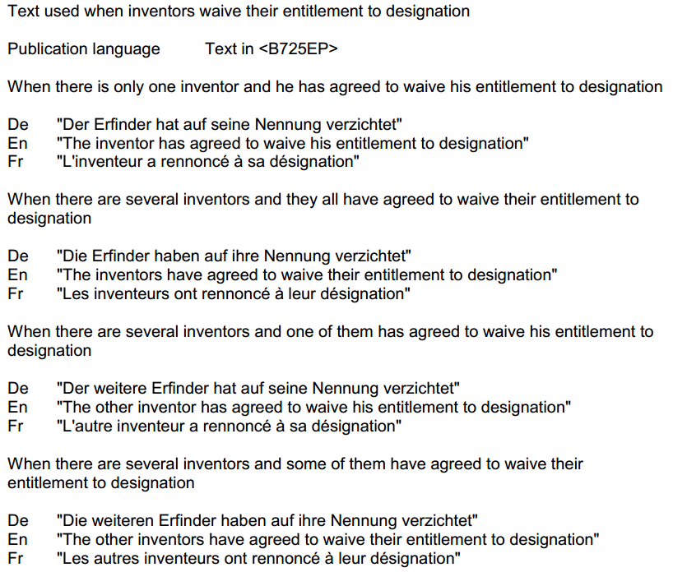
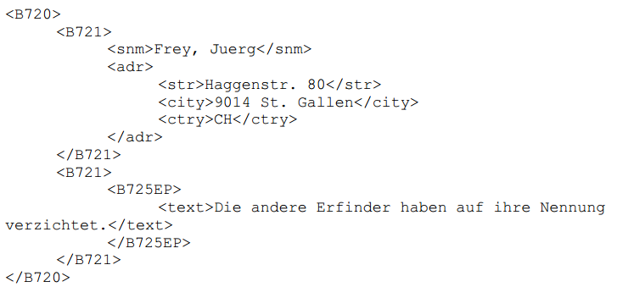
B700
<B720>: Inventors

Slide 34
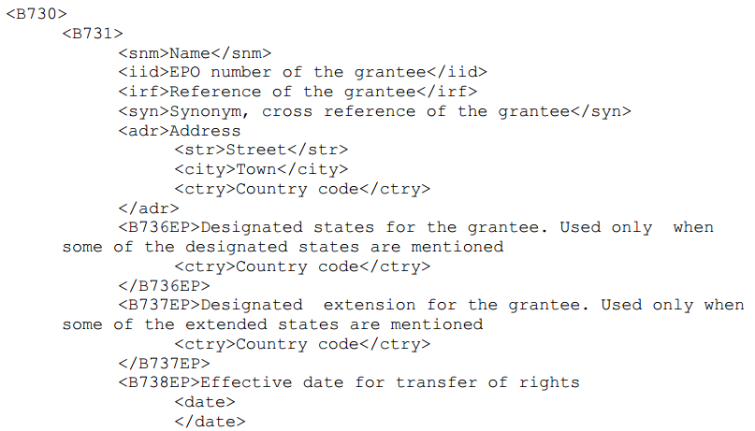

B700
<B730>: Grantees

Slide 35
description
<!ELEMENT description (invention-title?,(technical-field | background-art |
disclosure | summary-of-invention | description-of-drawings |
description-of-embodiments | best-mode | mode-for-invention |
industrial-applicability | reference-signs-list |
reference-to-deposited-biological-material | sequence-list-text |
citation-list | (heading*,p+)+)+) >
<!ATTLIST description
id ID #IMPLIED
lang CDATA #IMPLIED
status CDATA #IMPLIED >
来源：ep-patent-document-v1-5.dtd

Slide 36
claims
<!ELEMENT claims (claim+) >
<!ATTLIST claims
id ID #IMPLIED
lang CDATA #IMPLIED
claim-type CDATA #IMPLIED
status CDATA #IMPLIED >
来源：ep-patent-document-v1-5.dtd

