Slide 1




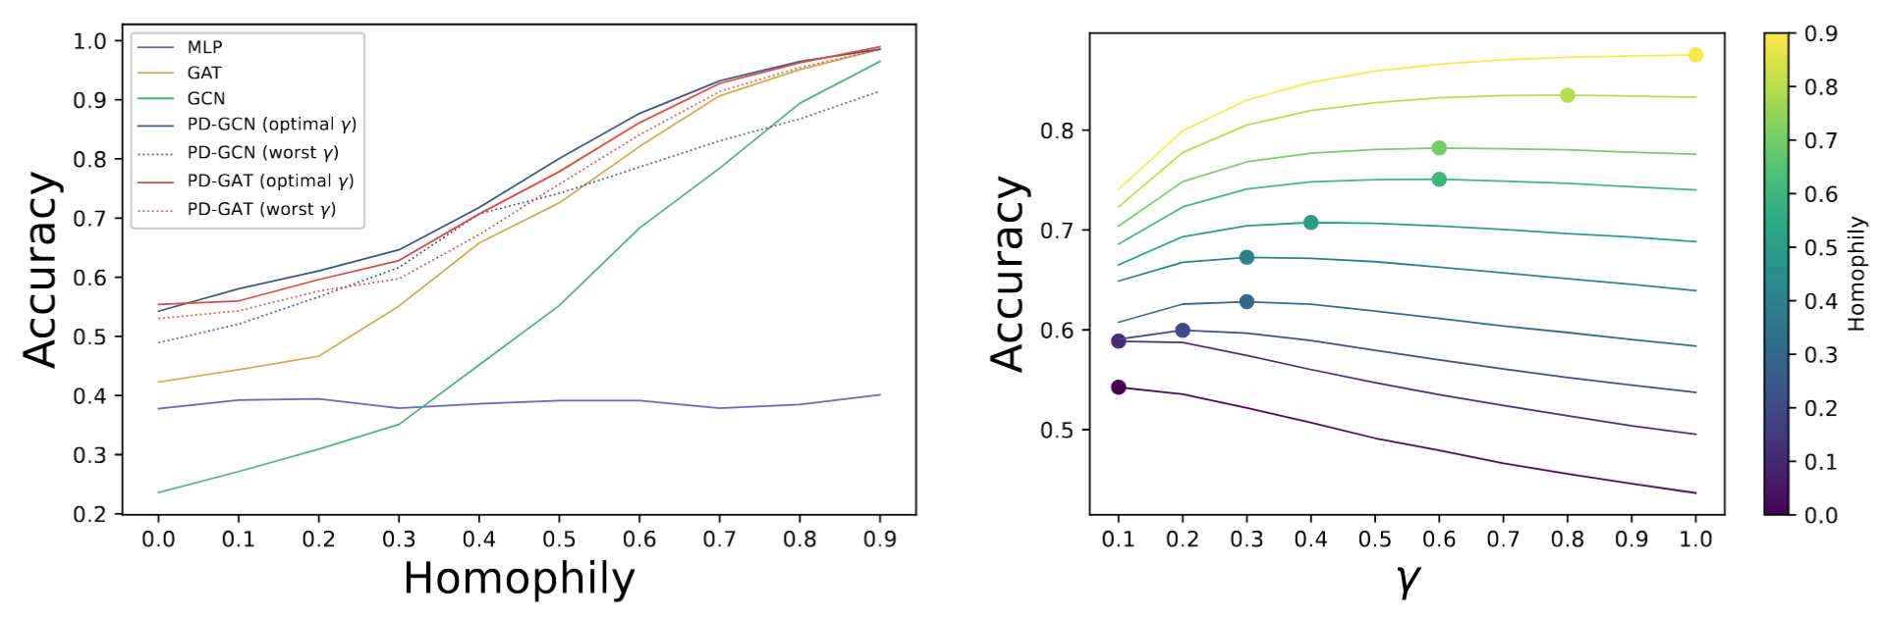
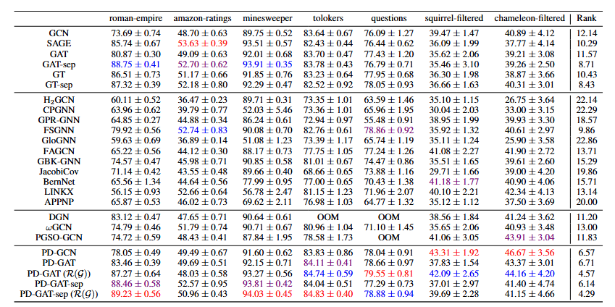
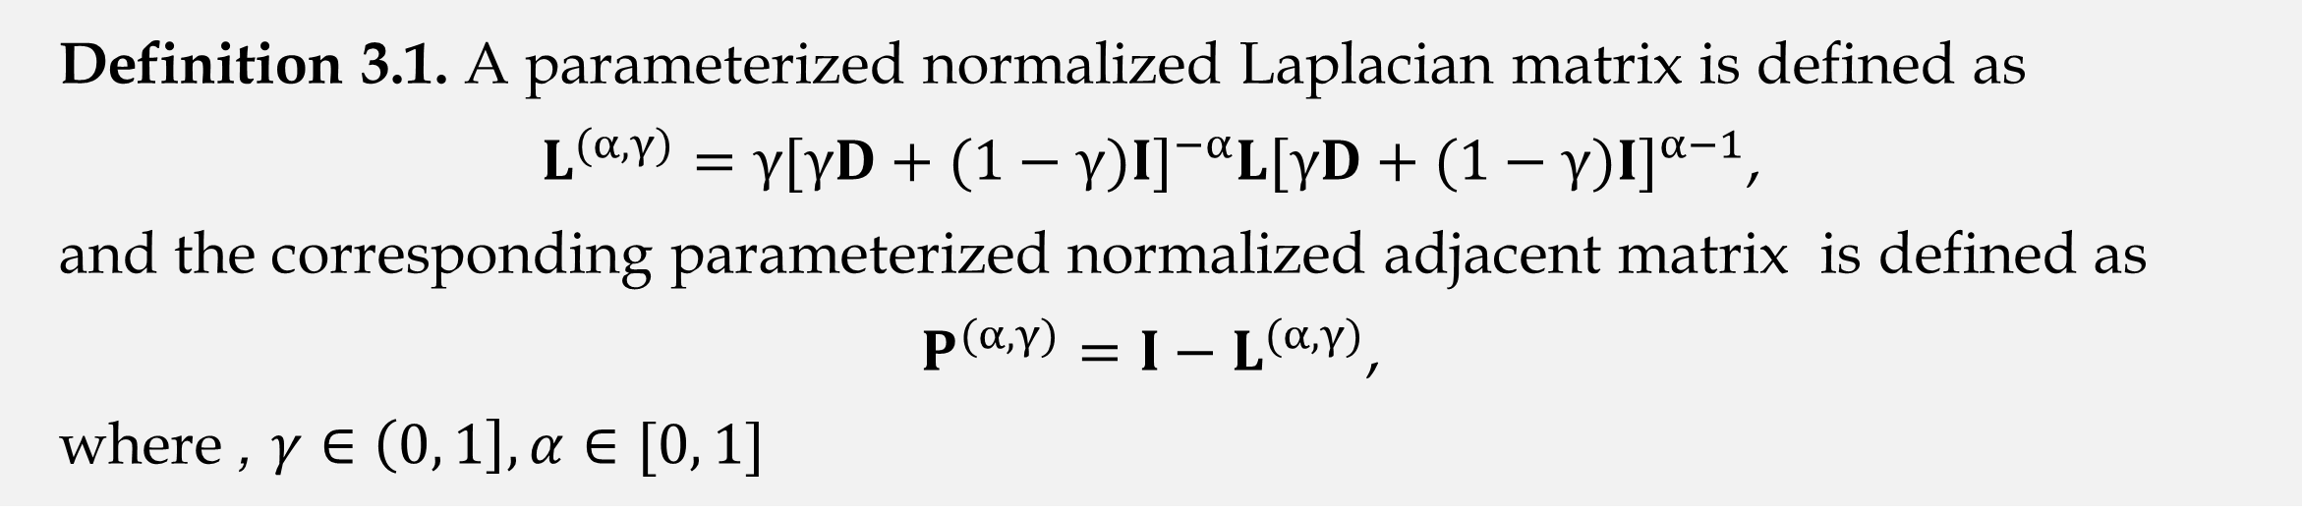
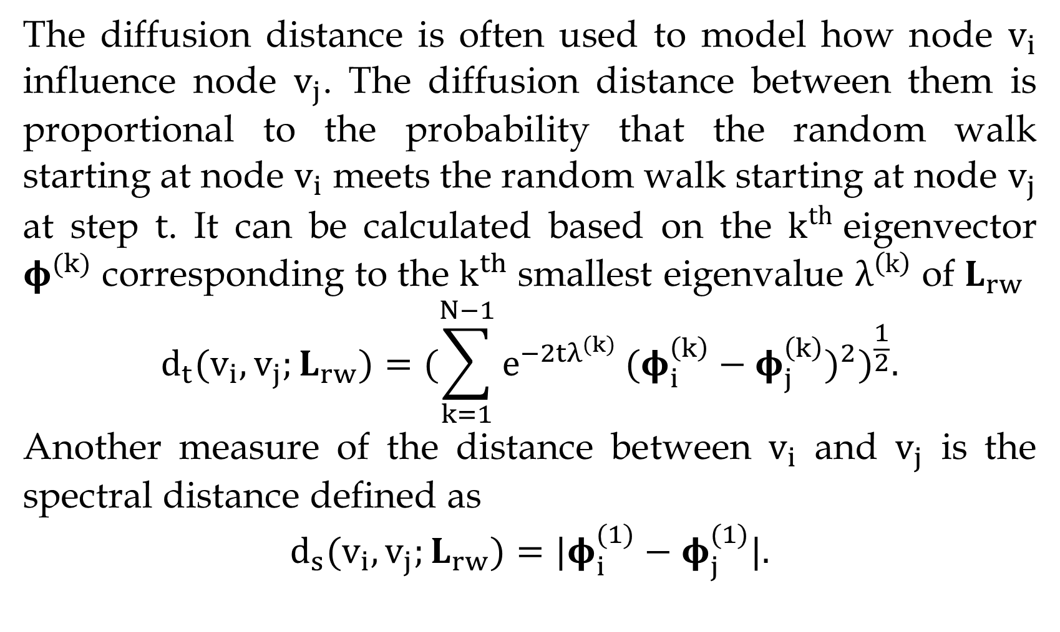
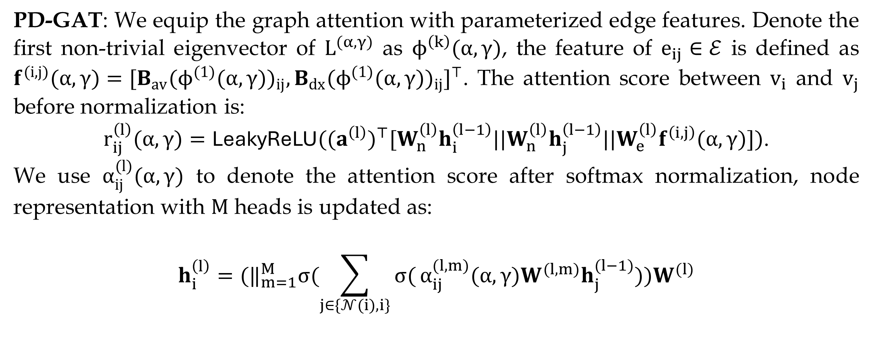
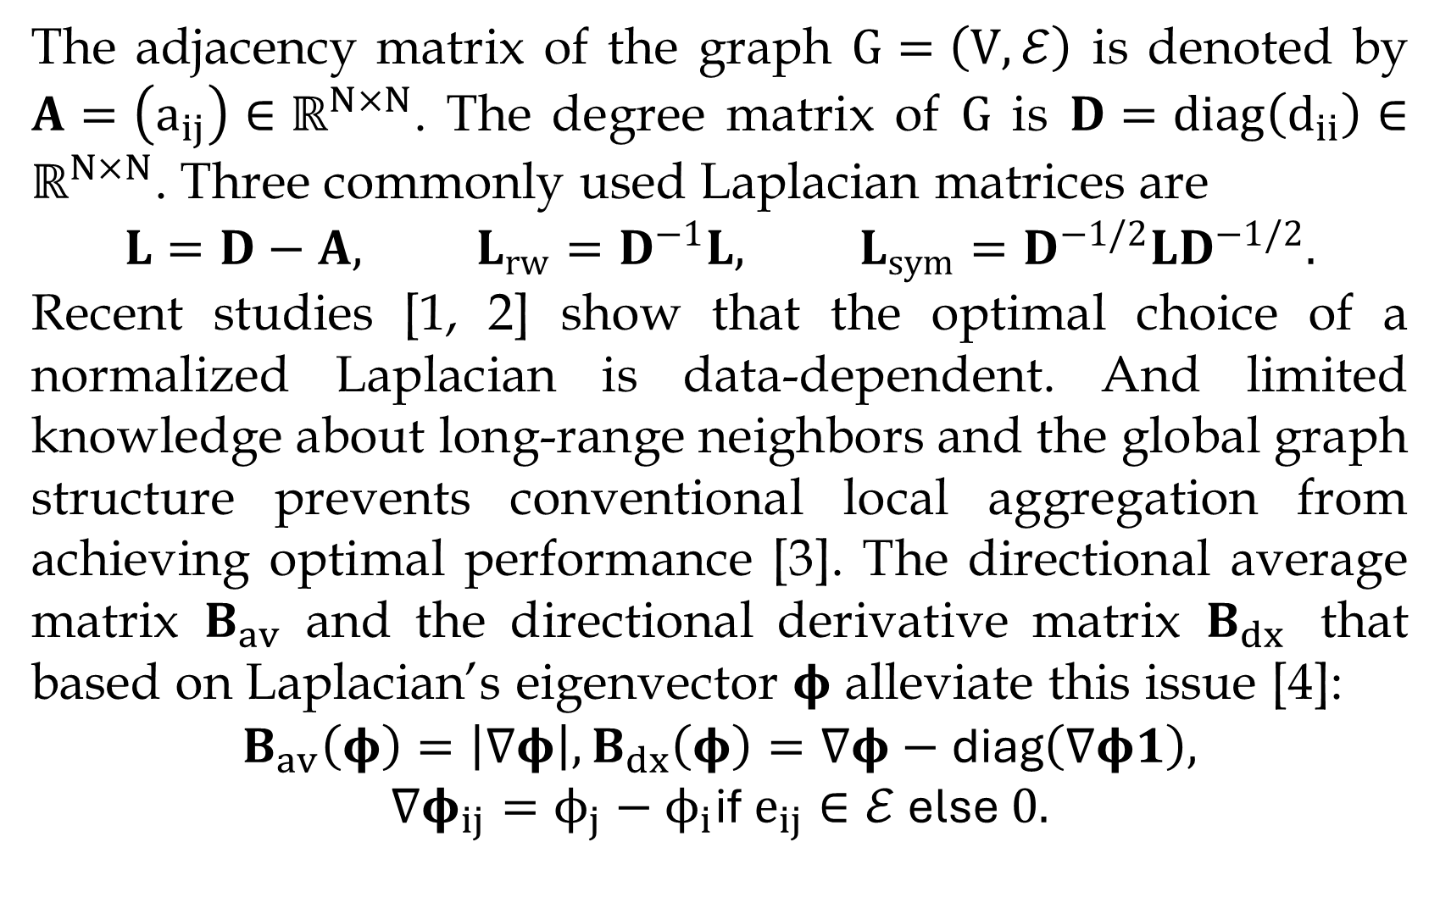
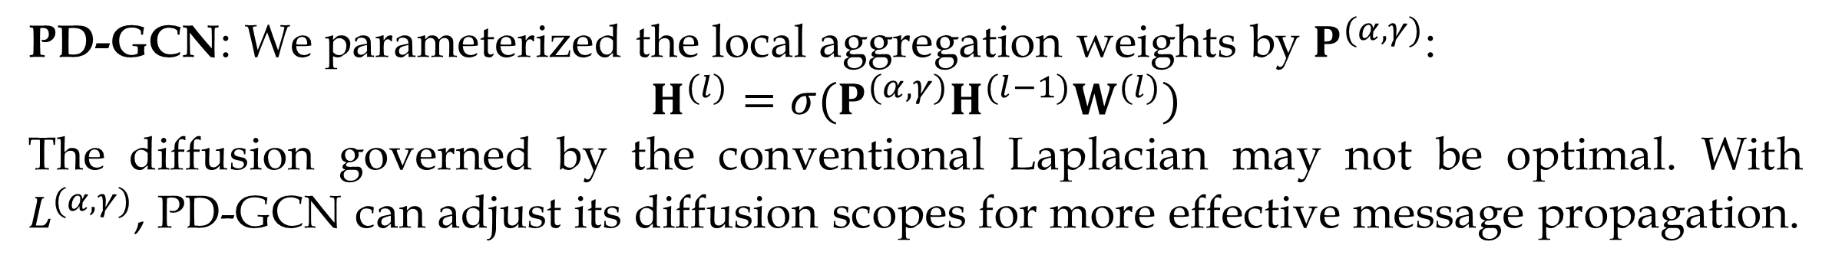
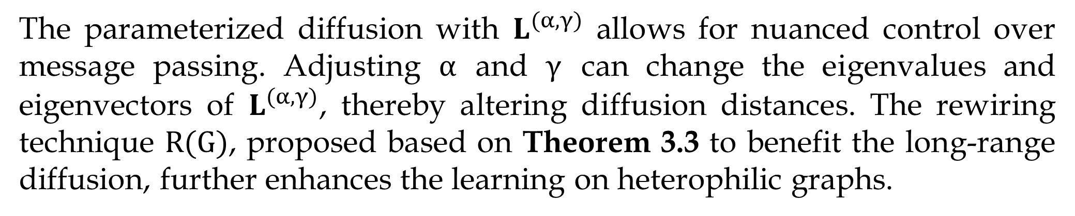
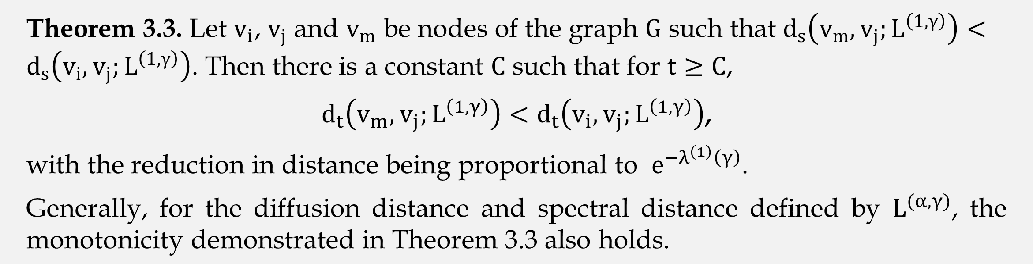
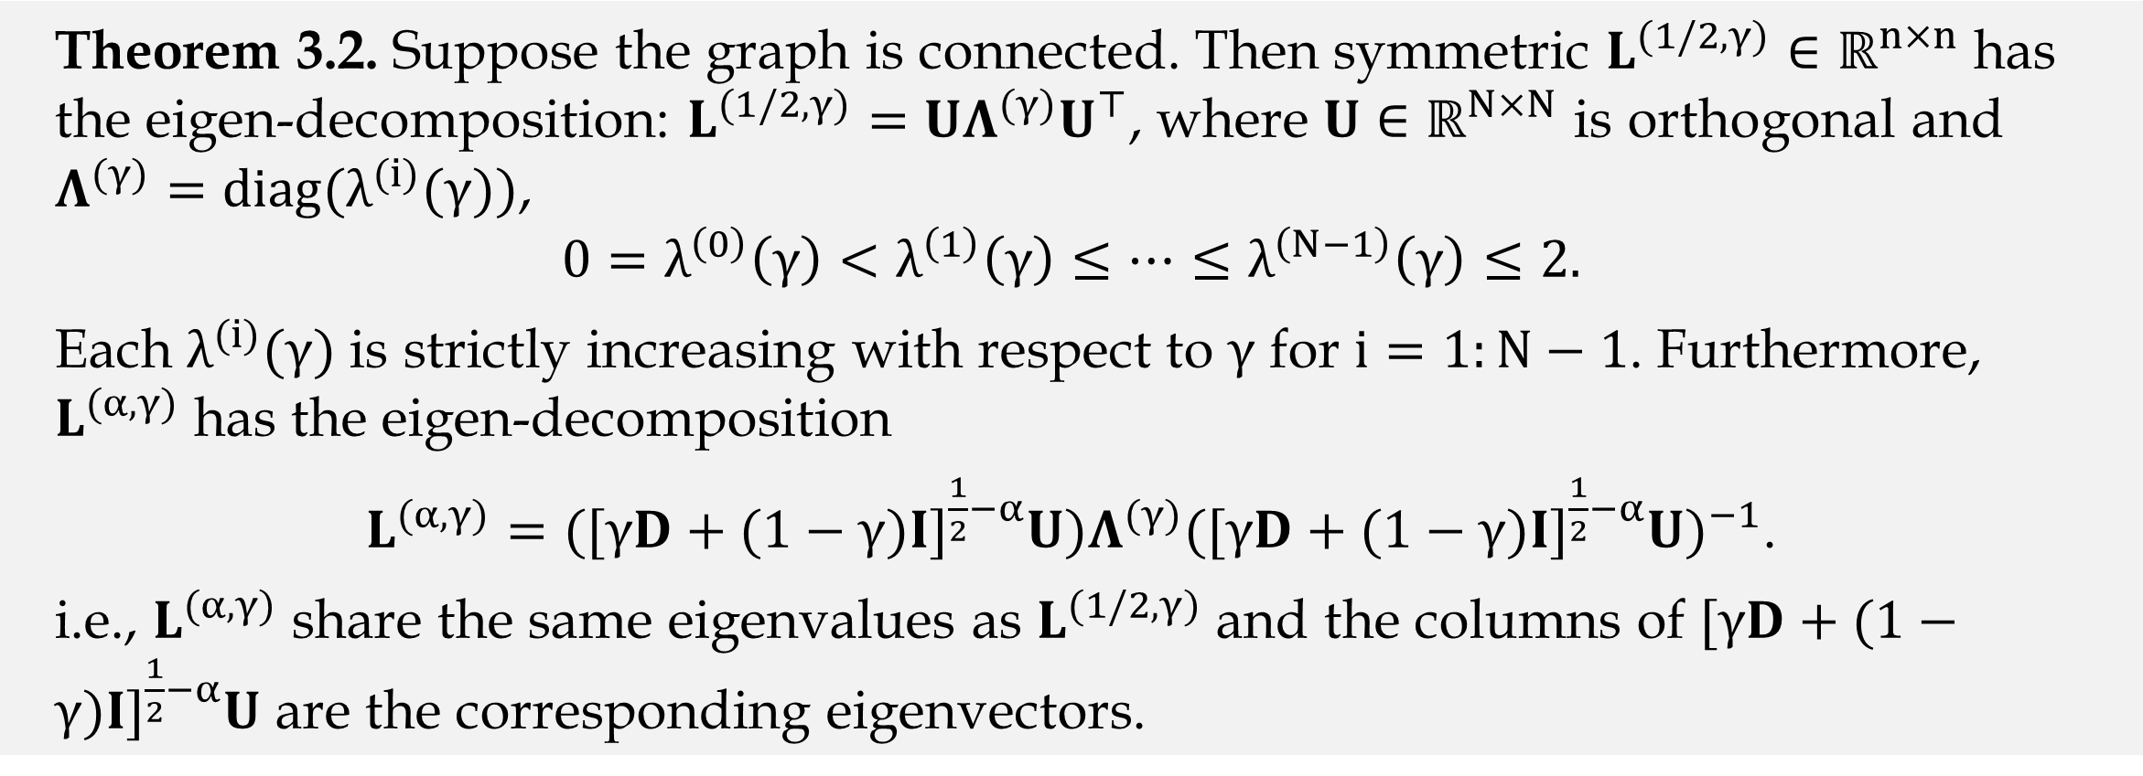
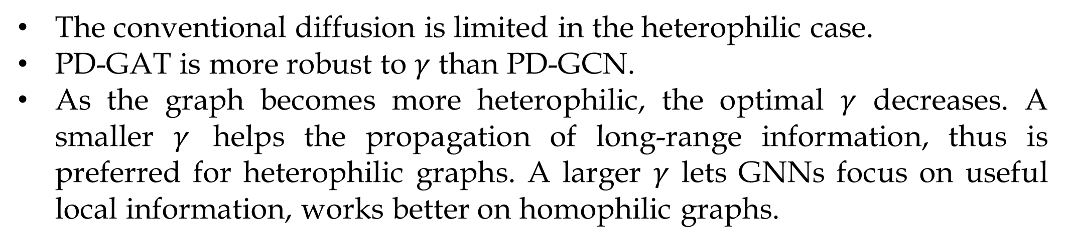
Flexible Diffusion Scopes with Parameterized Laplacian for Heterophilic Graph Learning
Qincheng Lu, Jiaqi Zhu, Sitao Luan, Xiao-Wen Chang
Abstract
Parameterized Normalized Laplacian
Experiments on Synthetic Graphs: Explainability
We propose a new class of parameterized Laplacian matrices, which provably offers more flexibility in controlling the diffusion distance between nodes than the conventional graph Laplacian, allowing long-range information to be adaptively captured through diffusion on graph. We prove that the diffusion distance and spectral distance on graph have an order-preserving relationship. Based on the theoretical results, two GNNs with flexible diffusion scopes: namely the Parameterized Diffusion based Graph Convolutional Networks (PD-GCN) and Graph Attention Networks (PD-GAT), and a topology-guided rewiring mechanism to capture helpful long-range neighborhood information, are proposed. Synthetic experiments reveal the high correlations between the parameters of the new Laplacian and the performance of parameterized GNNs under various graph homophily levels. The proposed methods achieve SOTA performance on 6 out of 7 real-world datasets.
Definition 3.1. A parameterized normalized Laplacian matrix is defined as
$L^{(α,γ)}=γ[γD+(1−γ)I]^{−α}L[γD+(1−γ)I]^{α−1}$,
and the corresponding parameterized normalized adjacent matrix is defined as
$P^{(α,γ)}=I−L^{(α,γ)}$,
where , $γ∈\left(0, 1\right], α∈[0, 1]$
Theorem 3.1. The${ P}^{(α,γ)}$ is non-negative, and when $α=1\text{, }\text{and} P^{(α,γ)}1=1$
Theorem 3.2. Suppose the graph is connected. Then symmetric $L^{(1/2,γ)}∈ℝ^{n×n}$ has the eigen-decomposition: $L^{(1/2,γ)}=UΛ^{(γ)}U^{⊤}$, where $U∈ℝ^{N×N}$ is orthogonal and $Λ^{(γ)}=diag(λ^{(i)}(γ))$,
$$0=λ^{\left(0\right)}\left(γ\right)<λ^{\left(1\right)}\left(γ\right)≤⋯≤λ^{\left(N−1\right)}\left(γ\right)≤2.$$
Each $λ^{(i)}(γ)$ is strictly increasing with respect to $γ$ for $i=1:N−1$. Furthermore, $L^{(α,γ)}$ has the eigen-decomposition
$L^{(α,γ)}=([γD+(1−γ)I]^{\frac{1}{2}−α}U)Λ^{(γ)}{([γD+(1−γ)I]^{\frac{1}{2}−α}U)}^{−1}$.
i.e., $L^{(α,γ)}$ share the same eigenvalues as $L^{(1/2,γ)}$ and the columns of $[γD+(1−γ)I]^{\frac{1}{2}−α}U$ are the corresponding eigenvectors.
The conventional diffusion is limited in the heterophilic case.
PD-GAT is more robust to $γ$ than PD-GCN.
As the graph becomes more heterophilic, the optimal $γ$ decreases. A smaller $γ$ helps the propagation of long-range information, thus is preferred for heterophilic graphs. A larger $γ$ lets GNNs focus on useful local information, works better on homophilic graphs.
Benchmarks on Node Classification
Conventional Graph Laplacians
Conventional Laplacians are special cases of $L^{(α,γ)}$:${ L}^{(1, 1)}=L_{rw}; { L}^{(1/2, 1)}=L_{sym}$.
The adjacency matrix of the graph $G=\left(V,ℰ\right)$ is denoted by $A=\left(a_{ij}\right)∈ℝ^{N×N}$. The degree matrix of $G$ is $D=diag\left(d_{ii}\right)∈ℝ^{N×N}$. Three commonly used Laplacian matrices are
$$L=D−A, L_{rw}=D^{−1}L, L_{sym}=D^{−1/2}LD^{−1/2}.$$
Recent studies [1, 2] show that the optimal choice of a normalized Laplacian is data-dependent. And limited knowledge about long-range neighbors and the global graph structure prevents conventional local aggregation from achieving optimal performance [3]. The directional average matrix $B_{av}$ and the directional derivative matrix $B_{dx}$ that based on Laplacian’s eigenvector $φ$ alleviate this issue [4]:
$$B_{av}\left(φ\right)=\left|∇φ\right|,B_{dx}\left(φ\right)=∇φ−\text{diag}\left(∇φ1\right),$$
$$∇φ_{ij}=ϕ_{j}−ϕ_{i}\text{if}{ e}_{ij}∈ℰ \text{else} 0.$$
Theorem 3.3. Let $v_{i}$, $v_{j}$ and $v_{m}$ be nodes of the graph $G$ such that $d_{s}\left(v_{m},v_{j};L^{\left(1,γ\right)}\right)<d_{s}\left(v_{i},v_{j};L^{\left(1,γ\right)}\right)$. Then there is a constant $C$ such that for $t≥C$,
$d_{t}\left(v_{m},v_{j};L^{\left(1,γ\right)}\right)<d_{t}\left(v_{i},v_{j};L^{\left(1,γ\right)}\right)$,
with the reduction in distance being proportional to $e^{−λ^{\left(1\right)}\left(γ\right)}$.
Generally, for the diffusion distance and spectral distance defined by $L^{(α,γ)}$, the monotonicity demonstrated in Theorem 3.3 also holds.
We can easily compute the spectral distance in $O(|ℰ|)$ and use it as a surrogate function of diffusion distance whose computational complexity is $O(N|ℰ|)$ .
Parameterized Diffusion Augmented GNNs
The parameterized diffusion with $L^{(α,γ)}$ allows for nuanced control over message passing. Adjusting $α$ and $γ$ can change the eigenvalues and eigenvectors of $L^{(α,γ)}$, thereby altering diffusion distances. The rewiring technique $R(G)$, proposed based on Theorem 3.3 to benefit the long-range diffusion, further enhances the learning on heterophilic graphs.
Spectral-based Nodes Relative Distances
PD-GCN: We parameterized the local aggregation weights by $P^{(α,γ)}$:
$$H^{(l)}=σ(P^{(α,γ)}H^{(l−1)}W^{(l)})$$
The diffusion governed by the conventional Laplacian may not be optimal. With $L^{(α,γ)}$, PD-GCN can adjust its diffusion scopes for more effective message propagation.
The diffusion distance is often used to model how node $v_{i}$ influence node $v_{j}$. The diffusion distance between them is proportional to the probability that the random walk starting at node $v_{i}$ meets the random walk starting at node $v_{j}$ at step $t$. It can be calculated based on the $k^{th}$eigenvector $φ^{(k)}$ corresponding to the $k^{th}$smallest eigenvalue $λ^{\left(k\right)}$ of $L_{rw}$
$$d_{t}(v_{i},v_{j};L_{rw})=(\sum_{k=1}^{N−1}{e^{−2tλ^{\left(k\right)}}}(φ_{i}^{\left(k\right)}−φ_{j}^{\left(k\right)})^{2})^{\frac{1}{2}}.$$
Another measure of the distance between $v_{i}$ and $v_{j}$ is the spectral distance defined as
$$d_{s}(v_{i},v_{j};L_{rw})=|φ_{i}^{(1)}−φ_{j}^{(1)}|.$$
See our paper for the rewiring technique and ablation study.
PD-GAT: We equip the graph attention with parameterized edge features. Denote the first non-trivial eigenvector of $L^{(α,γ)}$ as $ϕ^{\left(k\right)}(α, γ)$, the feature of $e_{ij}∈ℰ$ is defined as $f^{(i,j)}(α,γ)=[B_{av}(ϕ^{(1)}(α,γ))_{ij},B_{dx}(ϕ^{(1)}(α,γ))_{ij}]^{⊤}$. The attention score between $v_{i}$ and $v_{j}$ before normalization is:
$r_{ij}^{\left(l\right)}(α,γ)=\text{LeakyReLU}((a^{\left(l\right)})^{⊤}[W_{n}^{\left(l\right)}h_{i}^{\left(l−1\right)}||W_{n}^{\left(l\right)}h_{j}^{\left(l−1\right)}||W_{e}^{\left(l\right)}f^{\left(i,j\right)}(α,γ)])$.
We use $α_{ij}^{(l)}(α,γ)$ to denote the attention score after softmax normalization, node representation with $M$ heads is updated as:
$$h_{i}^{\left(l\right)}=(‖_{m=1}^{M}σ(\sum_{j∈\{𝒩(i),i\}}{σ(}α_{ij}^{(l,m)}(α,γ)W^{(l,m)}h_{j}^{(l−1)}))W^{(l)}$$
References
[1] Dasoulas, G., Lutzeyer, J. F., & Vazirgiannis, M.. Learning parametrized graph shift operators. ICLR, 2021.
[2] Dall’Amico, L., Couillet, R., & Tremblay, N.. Optimal laplacian regularization for sparse spectral community detection. ICASSP, 2020
[3] Gasteiger, J., Weißenberger, S., & Günnemann, S.. Diffusion improves graph learning. NeurIPS, 2019.
[4] Beaini, D., Passaro, S., Létourneau, V., Hamilton, W., Corso, G., & Liò, P.. Directional graph networks. ICML, 2021.

