Slide 1
SAHAY - सहाय
“ Sampoorna Aarogya & Humari Assistance Yojana “
" One Nation, One Health Platform – For Every Mind, Every Body, Every Village "
What is SAHAY?
India's first AI-powered, offline-first, inclusive public health intelligence network that provides
universal healthcare access, daily wellness tracking, neurodiverse support, blockchain accountability, and real-time
government intelligence – all on ONE platform.
Team: ZerOne (Chandigarh University)
Sahil Dhillon | Armaan Alam | Millee Kesarwani | Kumar Utkarsh
Domain: AI/ML • Healthcare • IoT • Blockchain • Accessibility
1

Slide 2
PROBLEM STATEMENT
"Imagine you're a mother in a remote village. Your child has had fever for 3 days. The nearest doctor is 40 km
away. You have no smartphone, no internet, and no money for private care. What do you do?"
The Triple Exclusion Problem
1️⃣ Geographic Exclusion
  Rural areas lack hospitals and specialists
  70% of rural people travel 30+ km for basic care
  Mobile network is weak or unavailable
2️⃣ Economic Exclusion
  Smartphones (₹10,000+) are unaffordable
  Mobile data (₹200–500/month) is costly
  Private healthcare is out of reach
3️⃣ Cognitive Exclusion
  30 crore illiterate Indians can’t use text-based apps
  Neurodiverse users find current apps overwhelming
  No tools designed for varied cognitive abilities
⚠️ Intersection: A neurodiverse child in a poor rural family has zero access to diagnosis, therapy, or support.
What’s Missing Today — The Core Gaps
  No single platform covering physical, mental, and developmental health
  No offline-capable system for zero-connectivity regions
  No voice-first access for 30 crore illiterate citizens
  No neurodiverse-friendly health technology
  No daily wellness tracking linked with medical care
  No real-time health data for government decisions
  No predictive systems for outbreaks or developmental trends
  No integration across Anganwadi, ASHA, PHCs, and hospitals
  No employment pathways for persons with disabilities
  No tamper-proof complaint system—grievances get lost
Insight: India spends ₹89,000 crore on health, yet decisions rely on 5-year-old, 60% incomplete data (NITI Aayog).
India’s Healthcare Crisis — Key Numbers
  40 crore without healthcare access → 1 in 3 Indians can’t see a doctor when sick
  Rural doctor–patient ratio: 1:25,000 → WHO standard is 1:1,000 (25× worse)
  3 crore children with undiagnosed developmental delays → Miss early therapy window
  Autism diagnosis delay: 7 years → 90% brain development completes by age 5
  90% districts lack mental health professionals → Mental illnesses go untreated
  ₹4.5 lakh crore annual economic loss → Ill health reduces productivity and income
  24 lakh preventable deaths/year → Basic care could save these lives
  65% can’t use telemedicine → No smartphone or stable internet
2

Slide 3
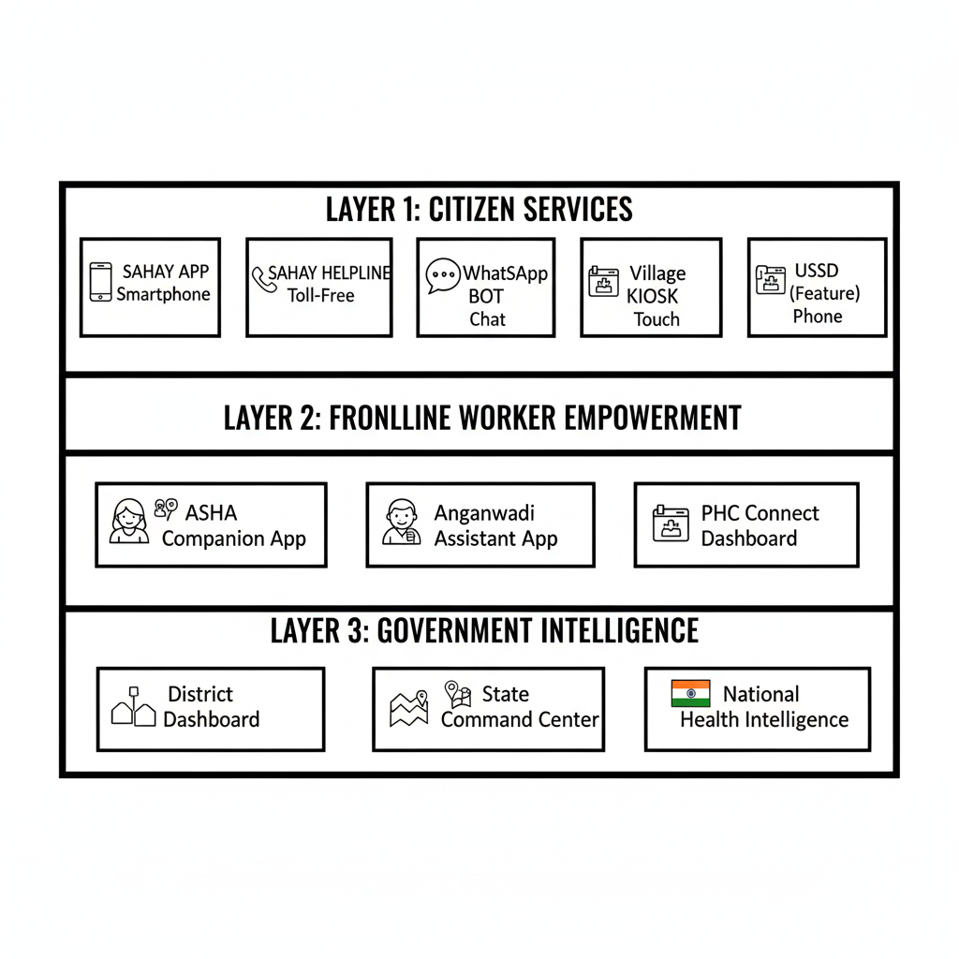
PROPOSED SOLUTION
DESIGNED FOR EVERYONE
  No smartphone - Works on basic feature phone via toll-free IVR call
  No internet - Fully offline-first – AI works locally, syncs when connected
  Can't read/write - Voice-first interface in 22 Indian languages
  Different cognitive abilities - Adaptive UI that adjusts to user's needs
  No health records - Blockchain-secured profile that travels with you
KEY DIFFERENTIATORS
📴 Offline-First - AI works completely without internet – syncs when available
🗣️ Voice-First - Just call and speak – no typing, no reading required
🧠 Adaptive UI - Interface changes based on user's cognitive abilities
🔮 Predictive AI - Predicts health risks and outbreaks before they happen
🔗 Blockchain Secured - Tamper-proof health records and complaints
🏛️ Govt Integrated - Native integration with ABDM, ICDS, NHM, UDID
WHAT IS SAHAY?
SAHAY is India's first AI-powered, offline-first, inclusive public health intelligence network.
It's not just an app – it's a complete health ecosystem that:
• Provides universal healthcare access for underserved communities
• Offers daily wellness tracking for preventive health
• Delivers specialized support for neurodiverse individuals
• Enables blockchain-based accountability for complaints
• Gives real-time intelligence to government for data-driven policy
THREE-LAYER ECOSYSTEM
3

Slide 4
KEY FEATURES
HEALTHCARE ACCESS FEATURES
How SAHAY Solves Access
  Voice-first, offline care in 22 Indian languages
  AI triage → self-care / PHC / emergency
  Doctor connect via call, prescription by SMS
  Early detection & prevention through daily tracking
  40% cases resolved locally, reducing hospital overload
  Outbreak prediction 2–3 weeks in advance
Core Modules (Ultra-Short):
  🗣️ VoiceSahay: Toll-free AI health helpline
  🏥 TeleSahay: Phone/video consults + SMS prescriptions
  👩‍⚕️ ASHASahay: Offline AI tools for health workers
  💉 VaxTrack: Vaccine schedules, reminders, certificates
  🔗 HealthChain: Portable, tamper-proof digital health records
  🚑 SOS: One-tap emergency with location & medical history
  📍 Locator: Nearby hospitals, PHCs, pharmacies, labs
  🔮 OutbreakSense: Predictive alerts for diseases & resources
Result: Healthcare reaches anyone, anywhere, instantly.
Daily Health Tracking
DailySahay – Everyday Health Companion
Keeps you healthy daily with continuous tracking + smart alerts.
Key Modules :
  💓 VitalTrack: BP, sugar, heart rate, SpO₂, weight → trends & risk alerts
  🍎 AaharSahay: Voice/photo food logging, Indian diet plans, nutrition tracking
  🚶 FitSahay: Steps, workouts, yoga, reminders, challenges
  😴 NeendSahay: Sleep tracking, smart alarm, habit insights
  💧 JalSahay: Water goals, reminders, activity & weather-based alerts
  🧠 MannSahay: Mood, stress, meditation, anxiety checks, SOS
  👩 NaariSahay: Period, pregnancy, menopause, women’s health care
  👴 VriddhSahay: Medicines, fall detection, SOS, family monitoring
  👶 BalVikas: Growth, milestones, vaccines, child development alerts
  💊 DawaiSahay: Medicine reminders, interactions, refills, generics
  👨‍👩‍👧‍👦 ParivarSahay: One app for family health & shared care
  🩺 ChronicCare: Diabetes, BP, asthma, thyroid, heart management
Outcome: Early detection, better habits, doctor-ready reports, healthier families.
3

Slide 5
SHIKAYATCHAIN – Blockchain Complaint System
Why ShikayatChain
  Immutable blockchain records – no complaint can be lost or altered
  Anonymous & safe – zero retaliation risk
  Auto-escalation – smart contracts enforce deadlines
  Full accountability – every action logged with officer ID
What You Can Report
  Healthcare failures, bribery, negligence
  Medicine stockouts or overcharging
  Neurodiverse discrimination or denial of services
  Insurance fraud, platform issues
How It Works
  File via app, call, WhatsApp, or ASHA (voice supported)
  Register on blockchain + SMS receipt
  Auto-route to authority with SLA timer
  Track actions in real time
  Auto-escalate (District → State → National) if delayed
Key Features
  Tamper-proof evidence (IPFS)
  Voice-based filing in any language
  Mandatory user feedback before closure
  Public facility & officer performance scores
Outcome: Transparent, unstoppable complaints → real action, real justice.
Neurodiversity Support
How SAHAY Helps
  Early AI screening via ASHA/Anganwadi (months, not 7 years)
  Affordable at-home therapy with voice/video guidance
  Simple, sensory-safe, adaptive design
  Tele-specialists for diagnosis and therapy
  Skills → jobs with inclusive employers
  Awareness & stigma reduction in schools and communities
Core Modules (Ultra-Short):
  🧒 NeuroScreen: 5-min AI screening (autism, ADHD, dyslexia)
  🎯 AdaptLearn: Personalized learning styles & pace
  🏠 TherapyHome: Speech, OT, behavior therapy at home
  🗣️ CommBridge: AAC communication (symbols, TTS, offline)
  🛡️ SensoryShield: Calm UI, overload detection, coping tools
  📅 RoutineBuilder: Visual schedules & transitions
  ⚠️ MeltdownPredict: Early warnings & caregiver alerts
  💼 RozgarSahay: Skills assessment, job matching, coaching
  🤝 NeuroNetwork: Parent groups, mentors, resources
  🎓 EmpathyTrainer: Training for schools, employers, families
Result: Early diagnosis, continuous support, independent and dignified lives.
3

Slide 6
Government Intelligence Dashboard
GovSahay – Real-Time Health Intelligence
First system to deliver live village-level health data, not outdated surveys.
🏛️ Three-Level View
  District: Block data, local actions, ASHA & PHC performance
  State: District comparisons, resource & policy tracking
  National: Pan-India trends, SDG progress, budget usage
📈 What It Shows
  Health heatmaps: diseases, vaccination gaps, maternal/child health, mental health
  Disability mapping: autism, ADHD, physical disabilities
  Complaint hotspots: facilities with high grievances
🔮 Predictive Analytics
  Outbreak warnings 2–3 weeks early
  Seasonal disease forecasts
  Demand prediction for beds, medicines, staff
🎯 Action & Accountability
  Smart resource allocation (mobile clinics, ASHAs, specialists)
  Officer & facility performance tracking with SLAs
  Scheme integration: ABDM, PM-JAY, ICDS, NHM, UDID, CoWIN
Result: Faster decisions, targeted action, and real accountability—powered by live data.
3

Slide 7
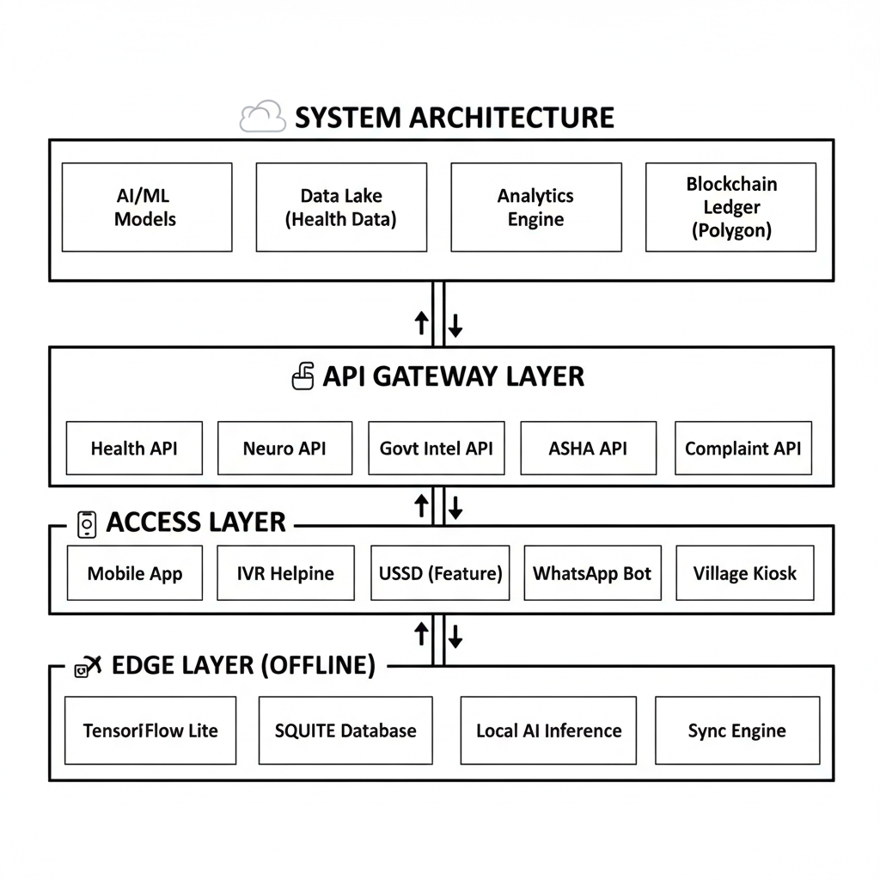
TECHNICAL APPROACH
Tech Stack
  Frontend: React Native (mobile), Next.js PWA (web), WCAG 2.1 AAA UI
  Voice/IVR: Twilio/Exotel, Whisper (STT), Google TTS (regional voices)
  AI/ML: GPT-4/LLaMA (chat), custom health triage, screening AI, outbreak prediction
  Backend: FastAPI, Node.js (real-time), Kafka, Redis, Celery, Kubernetes
  Databases: PostgreSQL, MongoDB, TimescaleDB, Pinecone, ClickHouse
  Blockchain: Polygon, Solidity smart contracts, IPFS, verifiable IDs
  Edge/Offline: TensorFlow Lite, SQLite, optimized on-device models, smart sync
  Govt Integrations: ABDM, DigiLocker, ICDS, UDID, PM-JAY
  Analytics: Superset, Grafana, Mapbox, D3.js
  Security: AES-256, TLS 1.3, JWT/OAuth, RBAC, DPDP-compliant audits
  Accessibility: 22 Indian languages, OpenDyslexic, screen readers, AAC, calm mode
Result: Scalable, offline-first, voice-first, secure, and fully inclusive.
4

Slide 8
FEASIBILITY ANALYSIS and IMPACTS
✅ Technical Feasibility
  All technologies are production-ready and proven
  Voice AI in 22+ Indian languages, offline AI supported
  Blockchain (Polygon) enables fast, low-cost, tamper-proof systems
  Existing government APIs readily integrable
  Scales easily using Kubernetes infrastructure
✅ Operational Feasibility
  Voice-first design → no literacy or training barrier
  ASHAs onboarded with 2-hour in-app training
  Uses existing health infrastructure and works fully offline
  Low maintenance via self-learning AI models
✅ Economic Feasibility
  MVP cost ₹50–80 lakhs (mostly open-source)
  Very low operating costs (₹<1 blockchain txn, ₹0.50/min IVR)
  No extra hardware required for users or field workers
📈 Revenue & ROI
  Revenue via government licensing, hospitals, freemium users, CSR
  Government saves ~₹35,000 Cr/year through prevention and efficiency
⏱️ Timeline & Risk
  MVP in 3 months, state pilot in 9 months, national scale in 24 months
  Risks handled via IVR, offline-first design, blockchain security
Verdict: Feasible, scalable, cost-effective, and implementation-ready.
👥 For General Public
  40+ crore gain healthcare access
  70% less travel for consultations
  24 lakh lives/year saved via early detection
  Nationwide daily health tracking
  60% fewer chronic complications
  ₹5,000/year saved per family
🧠 For Neurodiverse Community
  3 crore children screened early
  Diagnosis delay cut 7 years → 7 months
  70% lower therapy costs
  10+ lakh neurodiverse adults employed
  1+ crore families supported, 5+ lakh schools trained
🏛️ For Government
  100% real-time village health data
  2–3 weeks early outbreak warnings
  Accurate disability mapping
  ₹35,000 Cr budget savings
  Lower corruption, real-time SDG-3 tracking
💰 For Economy
  ₹50,000 Cr GDP boost from healthier workforce
  ₹15,000 Cr saved via prevention
  ₹5,000 Cr from neurodiverse employment
  ₹10,000 Cr efficiency gains
6

Slide 9
Unique Selling Points (USPs)
  India’s First truly unified health platform – physical, mental, developmental & daily wellness
  📴 Offline-first – works even without internet
  🗣️ Voice-first (22 languages) – includes 30 crore illiterate citizens
  🧠 Neurodiverse-native design – built for them, not adapted later
  🔗 Blockchain accountability – complaints can’t be deleted or ignored
  🔮 Predictive AI – detects outbreaks and risks in advance
  👶➡️💼 Lifelong support – from birth to employment
  🏛️ Government-ready – integrates with ABDM, ICDS, NHM, UDID
  👩‍⚕️ Frontline empowerment – ASHAs & Anganwadis become AI-enabled
  📊 Daily engagement – wellness every day, not just on sick days
7

