Slide 1


Design and implement a small office network
Names
Abduallah elsayed mahmoud alghandour
Ziad wael faiz abdelgaber
Amira salah elasyed elnoby
Asmaa samir abo sabaa elsayed
Yara magdy samih abdelaziz

Slide 2
the purpose of this project
This project simulates the design and implementation of a small office network on one floor with three departments: Technical, Sales, and Financial. Additionally, there are separate LANs for the manager and their secretary.
Goals : we focused on what the office need in easy way in implementing and not in expensive way and we want ensuring reliable communication, secure data transfer, and scalability.

Slide 3
Network Devices and Setup
Devices that we use
Router: the role of the router in connecting all the LANs and providing internet access and run as DHCP.
Switches: switches are used to create individual LANs for each department .
Access Points: If using Wi-Fi, access points provide wireless coverage across the office.
Printer
Labtop
PCs
IP Phones
Smart phone
Ip addressing
All PCs & printers in the topology take ip by DHCP
All VLANs has its network and its gateway

Slide 4
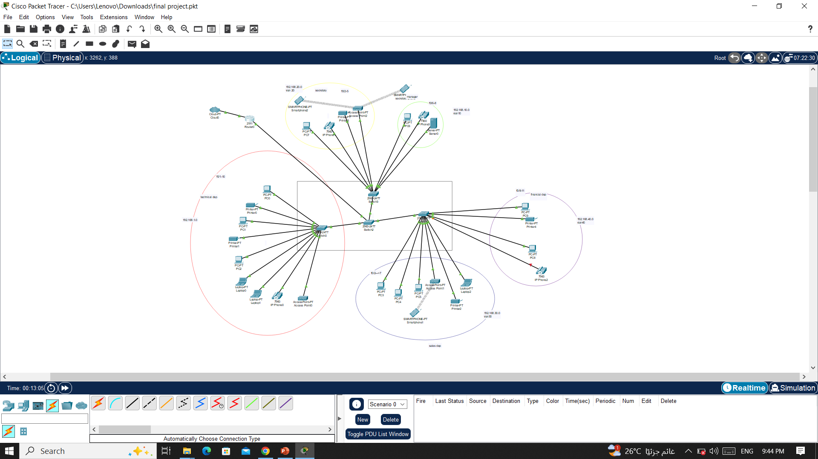
The topology

Slide 5
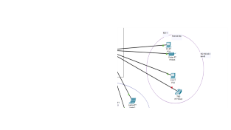
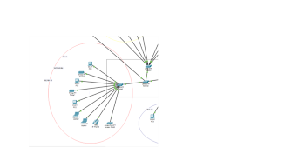
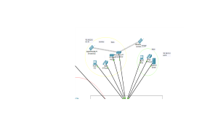
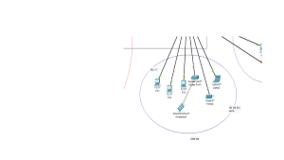
Network Layout and Devices
office is divided into three departments:
Technical department
Sales department
Financial department
A private section for the manager and secretary

Slide 6
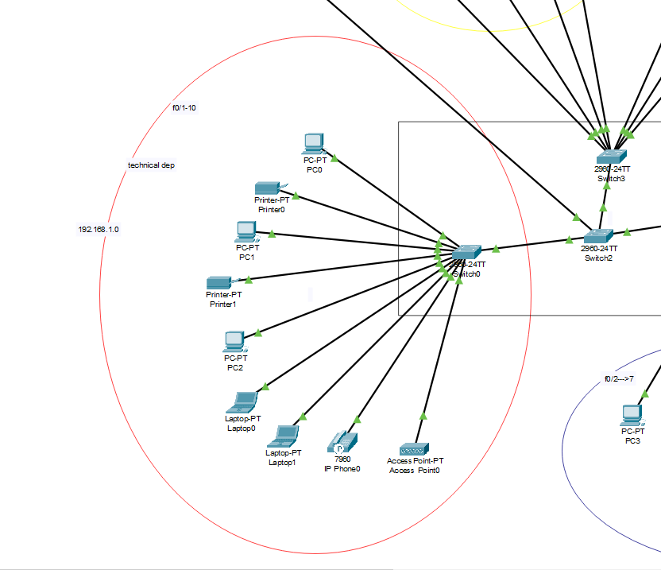

Slide 7
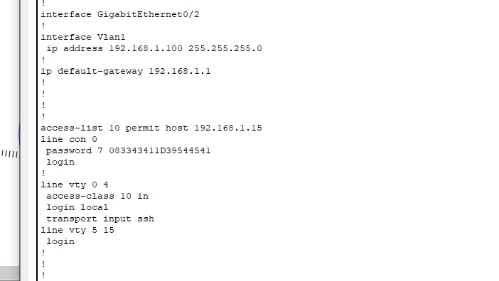
Technical department
This is technical department :
It contain PCs and printers and access point
All together in one switch

Slide 8
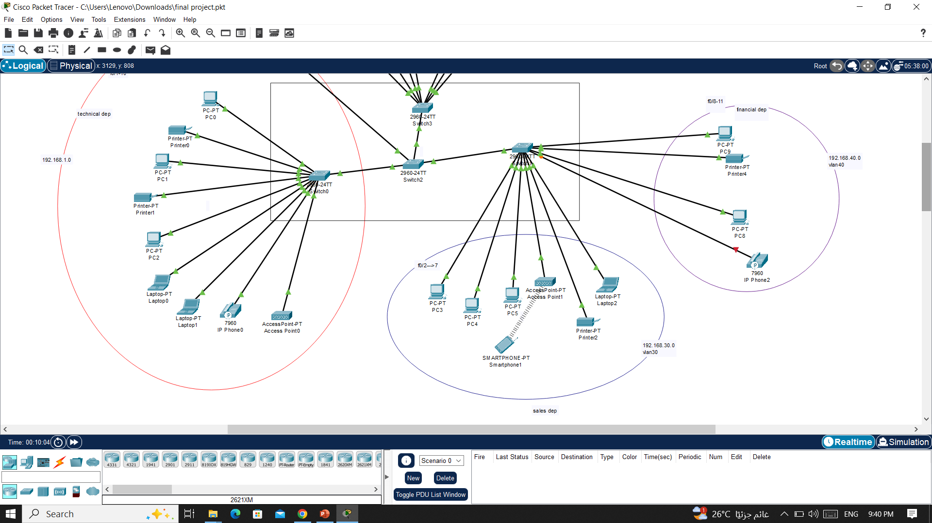

Slide 9
Financial department
This department in separate LAN (LAN 40)
The pc take the Ips from DHCP
Each device in VLAN can ping to other

Slide 11
Sales department
This department in different VLAN also
Has access point

Slide 13
This separate part
This part for The manager and secretary
Each of them in separate VLAN for
more security and handling.

Slide 15
The end

Slide 16
The end

Slide 17
The end

