Slide 1

Social Engineering - Is it Phishing? -
Cyber Crime Survey
Lab #7
Alex MacIntyre

Slide 2
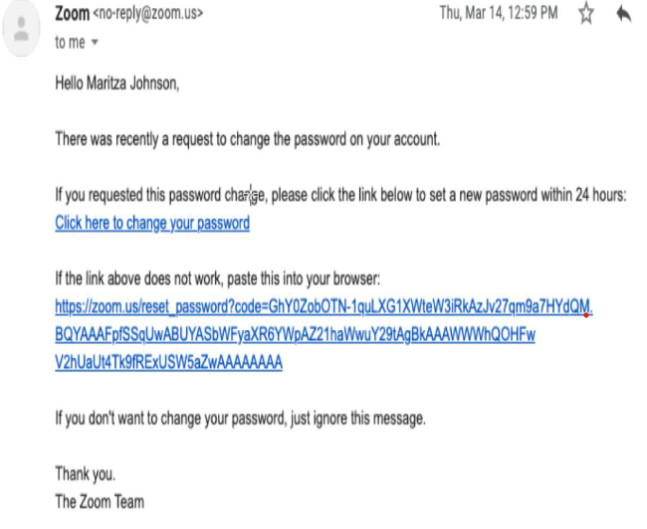
Example 1: Zoom Password Change
Ensure that the email was sent from a legitimate address.
Zoom uses no-reply@zoom.us for account purposes.
By clicking the down arrow next to “to me”, you can see
more details.
Assuming Maritza Johnson is indeed the addressee, this could point towards legitimacy, given account details.
If that is not their name, it could serve as an indicator that it is phishing.
Zoom.us is a legitimate address, and since the address is asked to be pasted into the browser, there is little chance that there is a phishing hyperlink hidden here.
To verify a link, hover the mouse over it.
No notable errors or typos can help indicate that the email is legitimate, given other legitimizing factors.
Designation: Real

Slide 3
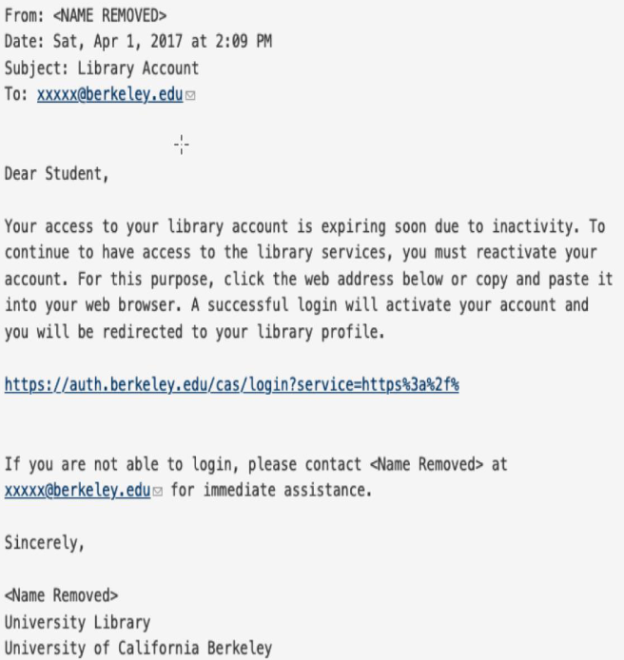
Example 2: : Library Account Access
A lack of identifying information such as the name or email address of the sender can indicate a fraudulent email. If the information was removed for the purpose of the example, it could still be seen as legitimate.
Many real institutions such as universities may have automated systems that don’t personalize addressee information. This could be seen as a delegitimizing factor if combined with other red flags.
The provided link seems to direct towards a login page under the university's domain, which offers credence to legitimacy. To verify that there is no redirection, hover over the link. To further verify, visit the website independently of the email and log into the affected account.
The contact email is associated with the organization and offers legitimacy, as there is somebody to contact regarding the email.
This is a professionally written email with no typos, which works in favor of it being legitimate.
Designation: Real

Slide 4
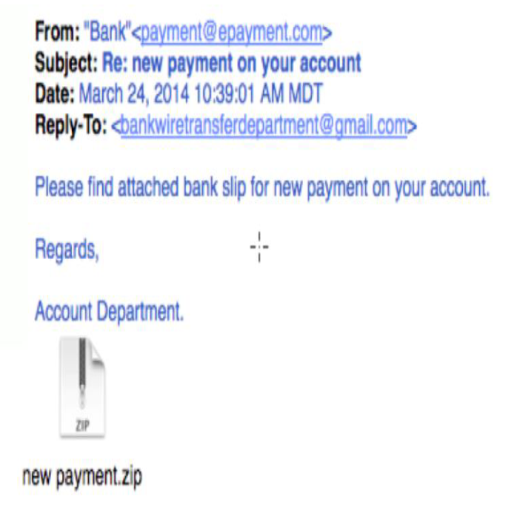
Example 3: Bank Slip and ZIP
If the sender is a real financial institution, any official communications would be sent from the organization’s domain, and a bank wouldn’t simply call themselves “Bank”.
There is a reply-to address that uses Gmail, which a legitimate organization would never do, as they could be using their own email domain.
No personalized information is a potential indicator of a phishing email. This sentence should say “Please find THE attached bank slip…”, a typo which indicates a potential phishing attempt.
This is an extremely suspicious attachment. Rather than a .doc/.pdf/.xml file, or any other file type that would indicate a document, the attachment is a ZIP file, which could contain malware if opened. The lowercase lettering rather than discernable information about a bank slip is another indicator of fraud.
Designation: Phishing
Banking information should only be trusted or accessed either on the bank’s official website or in-person.

Slide 5
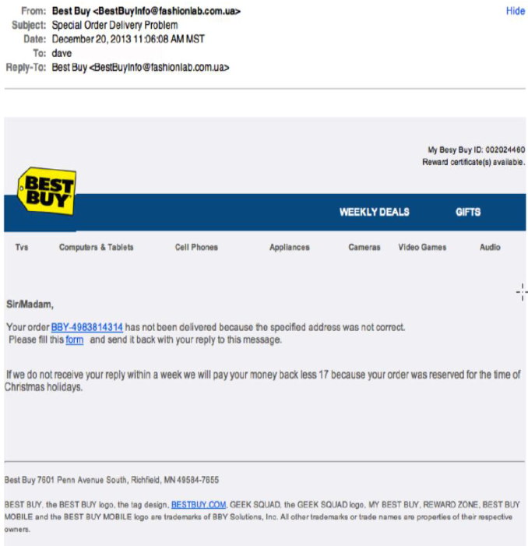
Example 4: Best Buy Delivery Problem
The email comes from the domain “fashionlab.com.us” rather than the official Best Buy domain address and is its own reply-to recipient. This is very suspicious.
If this ID doesn’t match the user’s account number, which can be verified on the official website, it is likely a false email.
Numerous typos and formatting errors such as “Tvs” instead of “TVs” and extra spaces in the text body indicates phishing.
There is no user information given to verify that the sender is associated with people who have that information and “SirMadam” rather than one of the two is highly suspicious.
No commerce organization such as Best Buy would demand an email reply, as it would likely be referred to a customer service department.
While time may be limited when dealing with delivery problems, this sense of urgency, paired with typos such as “we will pay your money back less 17” indicates a phishing attempt.
Designation: Phishing

Slide 6
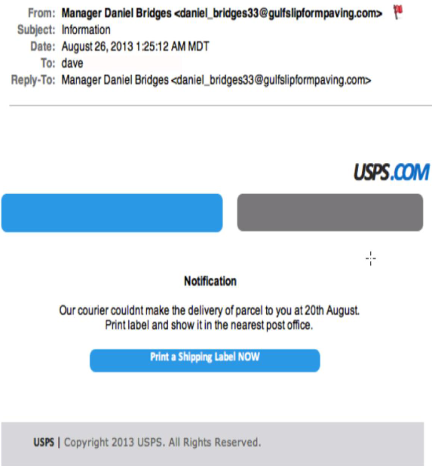
Example 5: USPS but also… Paving.
This email does not come from the official USPS domain. Coupled with the vague subject line and red flag marking importance, this is an immediate red flag.
Broken or removed resource links indicates a phishing attempt.
For a delivery on August 20th, the email was sent on August 26th. If this were legit, it would have been sent sooner.
There are plenty of typos and language errors in this text, such as “…couldnt make the delivery of (the) parcel to you at (should be “on”, not “at”) 20th August. (should be “August 20th”)
“Print a Shipping Label NOW” provides a suspicious call of urgency that would not be seen in an official communication.
If the user is expecting a package, they should refer to the vendor or postal service themselves to verify tracking information.
Designation: Phishing

