Slide 1

Ghost Emperor
Also known as SaltTyphoon, FamousSparrow, or UNC2286
A Chinese affiliated APT

Slide 2
What is Ghost Emperor?
This is a Chinese hacking organization responsible for devastating rootkit based attacks.
They are known for their mysterious positioning and have been given several different names by cybersecurity groups.
They are known as:
GhostEmperor (by Kapersky Labs)
Salt Typhoon (by Microsoft)
FamousSparrow
UNC2286

Slide 3
Who are members of Ghost Emperor?

Slide 4
History of Ghost Emperor

Slide 5
Country of Operation

Slide 6
How are they connected to China?

Slide 7
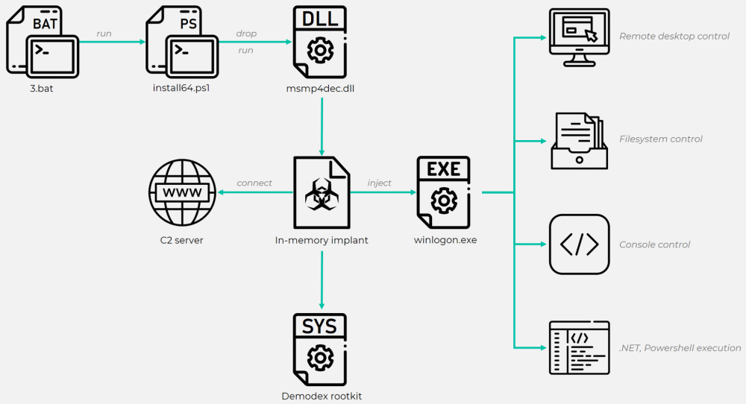
Methods of Attack

Slide 8
Current Status

Slide 9
References
Opening Image: Crayion: Ghost Wearing Crown
Malpedia: GhostEmperor
Kapersky: GhostEmperor APT targets high-profile victims using unknown rootkit (July 29 2021)
We Live Security: FamousSparrow: A suspicious hotel guest
DarkReading: Notorious Chinese Hacker Gang GhostEmperor Re-Emerges After 2 Years (July 19 2024)
Sygnia: The Return of Ghost Emperor’s Demodex (17 July 2024)

Slide 10
References
ComputerWeekly: Zero-day that forced Barracuda users to bin kit was exploited by China (29 Aug 2023)
Vulnera: Chinese Hacking Group Breaches Major U.S. Broadband Providers (7 Oct 2024)
TechCrunch: The 30-year-old internet backdoor law that came back to bite (7 Oct 2024)
Washington Post: China hacked AT&T, Verizon, and Lumen in apparent counterspy operation

