Slide 1
Tabular Q-Learning for
Reaction-Yield Optimization in a Simulated
Self-Driving Lab
A simulation study: 11 × 11 grid, 5 actions, 30-step episodes
Course: REINFORCEMENT LEARNING
Presented by: 1. Nikitha V 100523729060
2. Satwika G 100523729019
3. Sahithi V 100523729057
4. Susritha K 100523729035

Slide 2
Can a minimal RL agent find high-yield reaction conditions in a simulator?
Self-driving labs choose experiments sequentially; experiments are costly and noisy.
Question: Can a minimal RL agent find high-yield conditions?
Compared against Random, FixedRecipe, and HillClimb baselines.
Setting: a simulated reaction, not real chemistry.
Propose conditions
Run experiment
Update agent
Measure noisy yield
Simulation only — not real chemistry.

Slide 3
A small, fully discrete lab with an agent that learns a 121 × 5 value table.
11 × 11 temperature-concentration grid: 121 states and 5 actions.
Temperature: 20–100 °C; concentration: 0.1–2.0 mol/L.
Actions: increase/decrease temperature, increase/decrease concentration, or hold.
Reward: noisy yield, minus 0.2 if temperature > 90 °C; episodes last 30 steps.
Tabular Q-learning: alpha = 0.1, gamma = 0.95, epsilon decays from 1.0 to 0.05, 3,000 episodes, 5 seeds.
Concentration
11 × 11 grid
121 states
Dark cell = one state (one temperature–concentration pair)
Temperature
Two different optima:
Grid maximum: 0.9059 at 68 °C and 1.24 mol/L
Continuous optimum: 0.95 at 65 °C and 1.2 mol/L
Note: The grid maximum is the best value available on the discretized 11 × 11 grid. It is not the continuous optimum.
Q-table: 121 × 5 (one row per state, one column per action)
state / action | T↑ | T↓ | C↑ | C↓ | hold
state 1 | Q(s,a) | Q(s,a) | Q(s,a) | Q(s,a) | Q(s,a)
state 2 | Q(s,a) | Q(s,a) | Q(s,a) | Q(s,a) | Q(s,a)
⋮ | ⋮ | ⋮ | ⋮ | ⋮ | ⋮
state 121 | Q(s,a) | Q(s,a) | Q(s,a) | Q(s,a) | Q(s,a)
T = temperature, C = concentration; ↑/↓ = increase/decrease

Slide 4
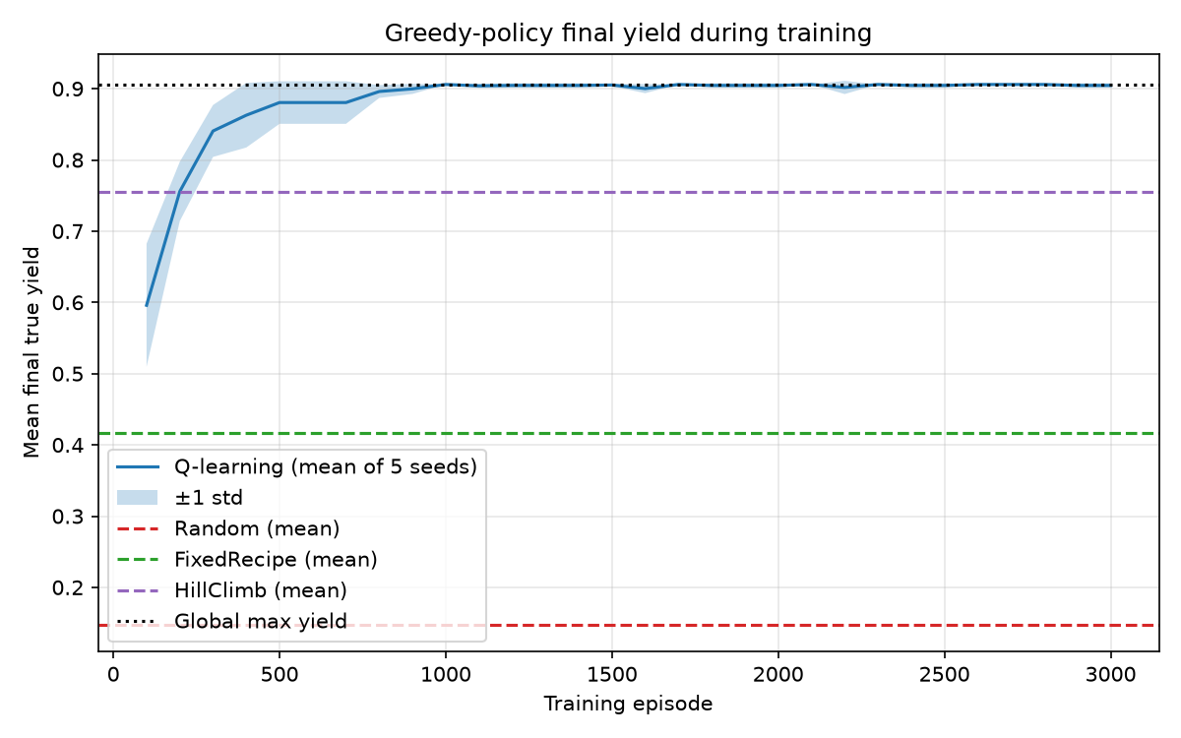
On this simulator, the seed-0 Q-table reaches the grid-maximum yield fastest and most safely.
QAgent final yield: 0.9059, equal to the grid maximum.
QAgent reached 90% of the grid maximum in 5.085 steps on average.
HillClimb reached 90% of the grid maximum in 14.67 steps on average.
HillClimb achieved 0.7549 final yield and 63% of QAgent’s return.
Learning curve rises during training and plateaus near 0.906.
Policy | Final yield [95% CI] | Steps to 90%* | Unsafe
QAgent | 0.9059 | 5.085 | 0.37%
HillClimb | 0.7549 [0.7212, 0.7886] | 14.67 | 9.82%
FixedRecipe | 0.4162 | 30 (never reached) | 0%
Random | 0.1479 [0.1146, 0.1812] | 25.525 | 18.15%
[INSERT BAR CHART HERE: results/bar.png]
.
[INSERT HEATMAP HERE: results/heatmap.png]
*“90%” means 90% of the grid maximum, 0.9059. QAgent uses the seed-0 Q-table; zero-width confidence intervals reflect deterministic policies.
Greedy evaluation yield versus training episode, with baseline comparisons.

Slide 5
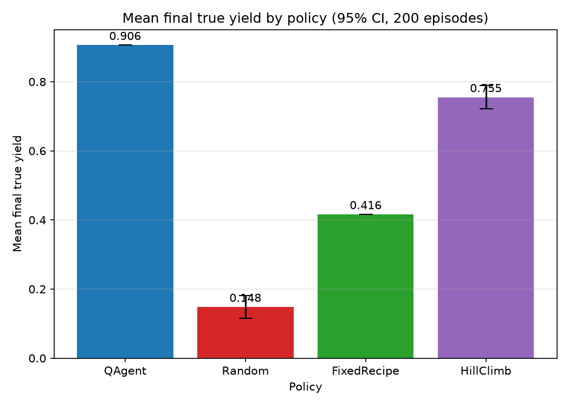
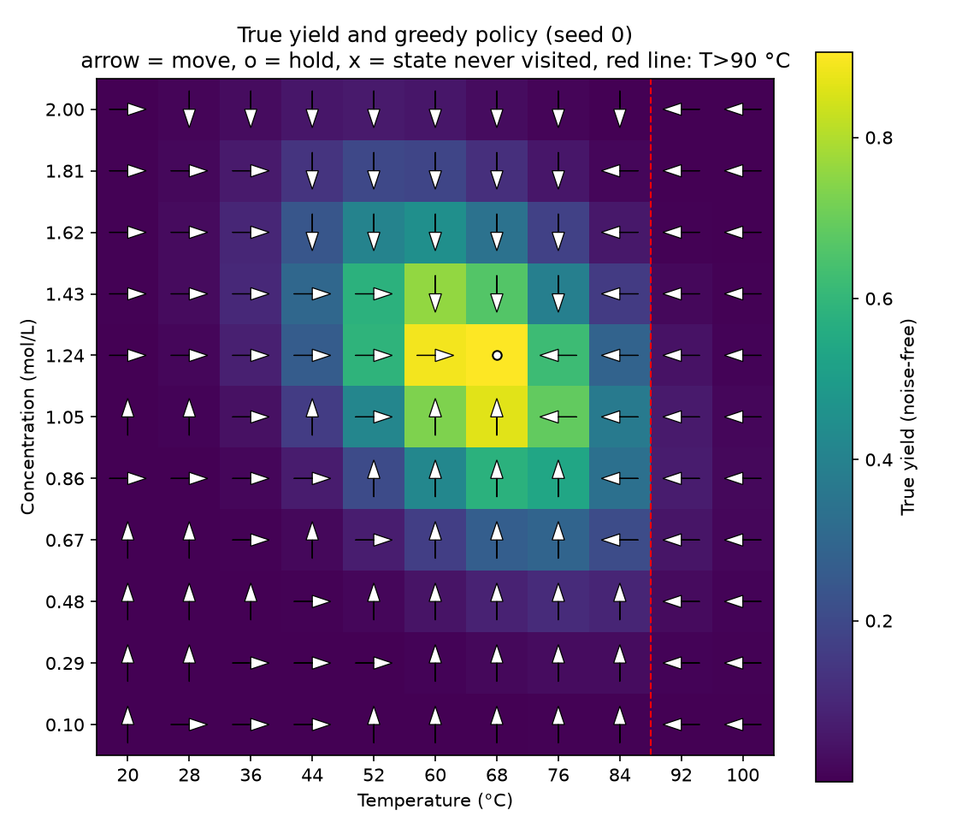
Final noise-free yield by policy across 200 test episodes
Yield landscape on the 11 × 11 grid with the seed-0 learned policy. Temperature is on the x-axis; concentration is on the y-axis.

Slide 6
These results show learning on a known toy landscape, not discovery in a real lab.
Fixed, known yield function: the agent memorizes the landscape and does not generalize.
Coarse discrete grid: the 0.9059 grid maximum is below the continuous optimum of 0.95.
Only the seed-0 Q-table was evaluated; zero-width confidence intervals reflect deterministic policies, not certainty.
No confidence intervals were reported for return, steps to 90%, or unsafe fraction.
FixedRecipe starts from a different cell, so its comparison is not perfectly matched.
90,000 training steps per seed would be unrealistic in many real experiments.
Grid maximum vs. continuous optimum
The gap comes from the coarse grid.

Slide 7
Optimizing a simulated number is not the same as running a safe, responsible lab.
1. Safety
The temperature > 90 °C penalty is soft; real systems need hard constraints and human oversight.
2. Reward
Optimizing yield alone ignores cost, waste, and by-products.
3. Claims
Simulated gains are not evidence of real-world chemistry.
4. Dual use
Autonomous optimization can accelerate harmful as well as beneficial synthesis.
5. Transparency
Fixed seeds, shared code, and a clearly stated single-Q-table evaluation.

