Slide 1
Group 14 Computational Modelling and AI Coursework 2
Members:
Abdul-Wahab Mahmood
Hasan ALI
Matheus Shimizu Felisberto
Mohammed Jumail Hussain
Yufei Zhang

Slide 2
Roles:
Best-First Search: Hasan Ali and Yufei Zhang
Iterative Deepening: Mohammed Jumail Hussain
Uniform Cost: Abdul-Wahab Mahmood and Matheus Shimizu Felisberto

Slide 3
Iterative Deepening: Explanation
Iterative deepening depth-first search is a state space/graph searching strategy in which a limited version of the DFS is run over and over again while increasing the depth limits until the eventual goal is found.

Slide 4
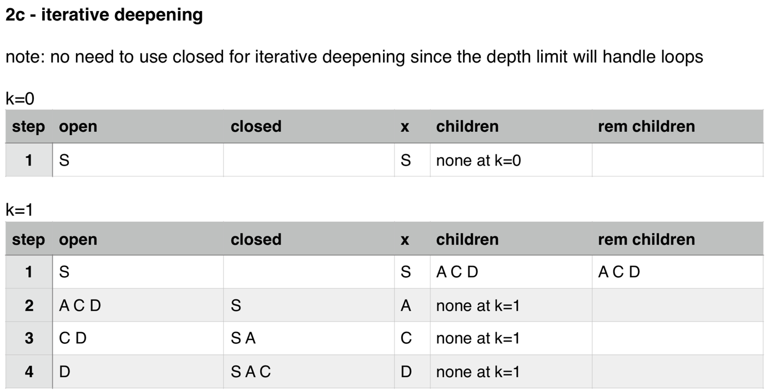
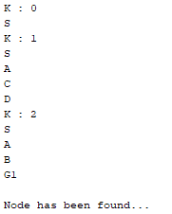
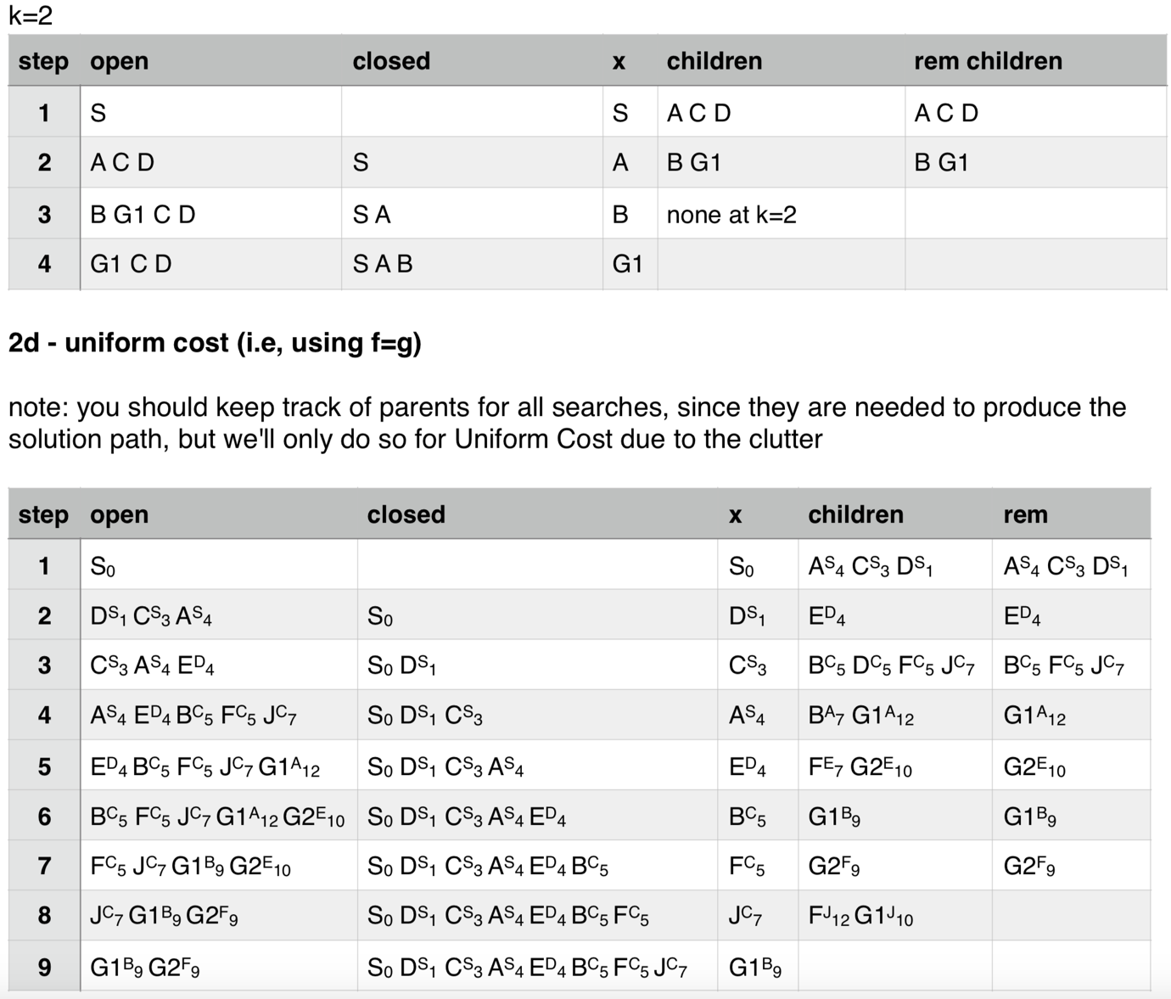
Iterative Deepening: Results

Slide 5
Uniform Cost: Explanation
Uniform Cost Search is the best algorithm for a search problem, which does not involve the use of heuristics. It can solve any general graph for optimal cost. It uses priority queues such as DFS and BFS which means it does not work through layers, but it works through nodes using the above searching algorithms. In simple terms, it doesn’t look through all nodes, it just chooses the shortest path every time.

Slide 6
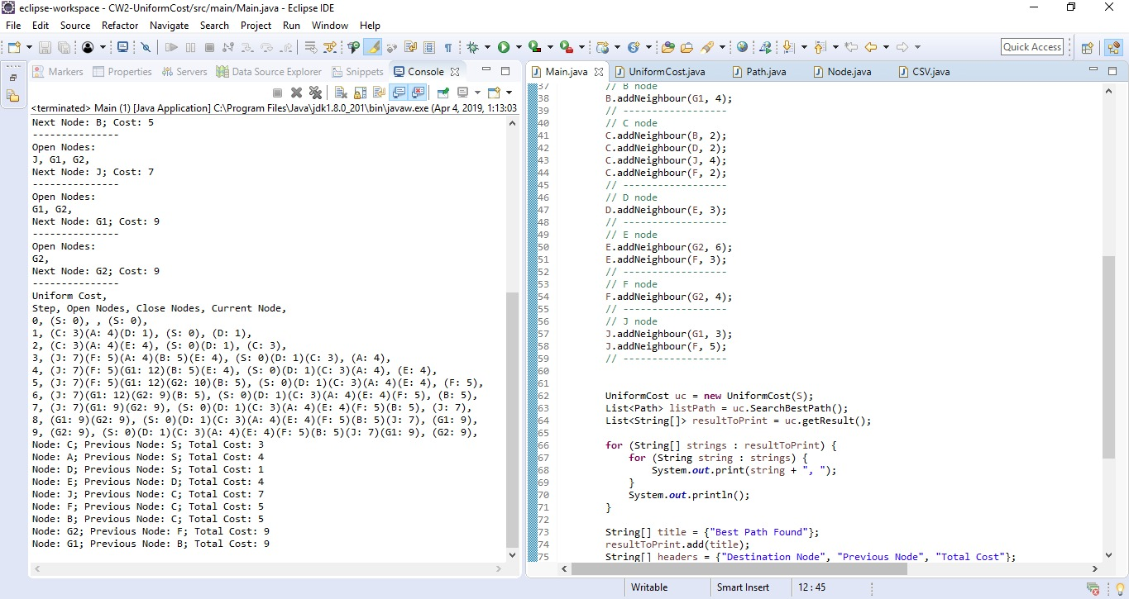
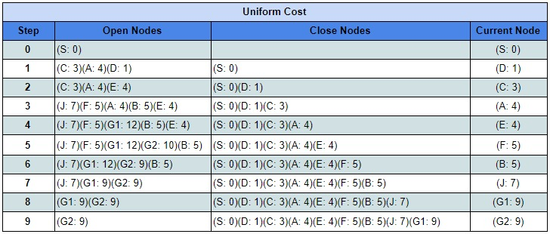
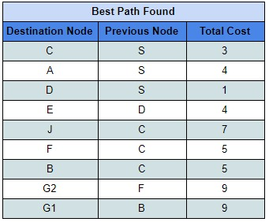
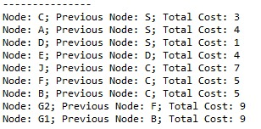
Uniform Cost: Results

Slide 7
Best-First: Explanation
Best-first search is a search algorithm which explores a graph by expanding the most promising node chosen according to a specified rule. As shown in our implementation, it starts from the node S and it ends at the node G1. The first node that is searched for is the smallest value which in this case ‘C’ and then it moves to the next value which is ‘J’ and the last value is ‘G1’ and then the searching stops here.

Slide 8
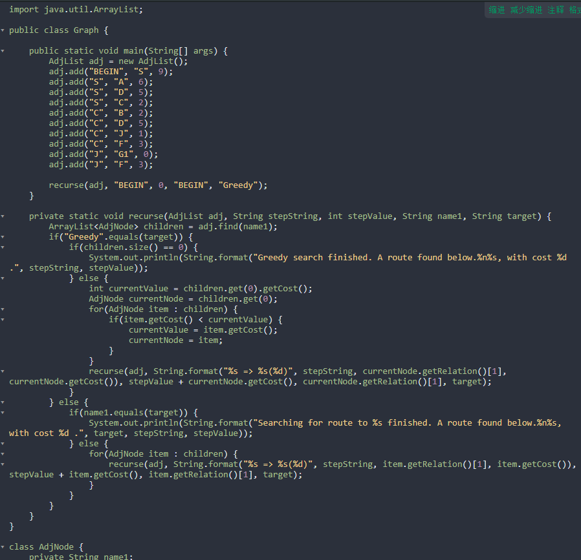
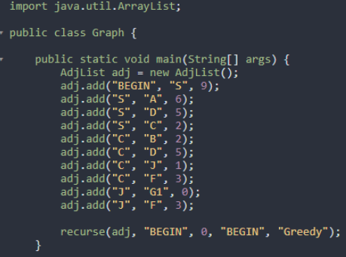
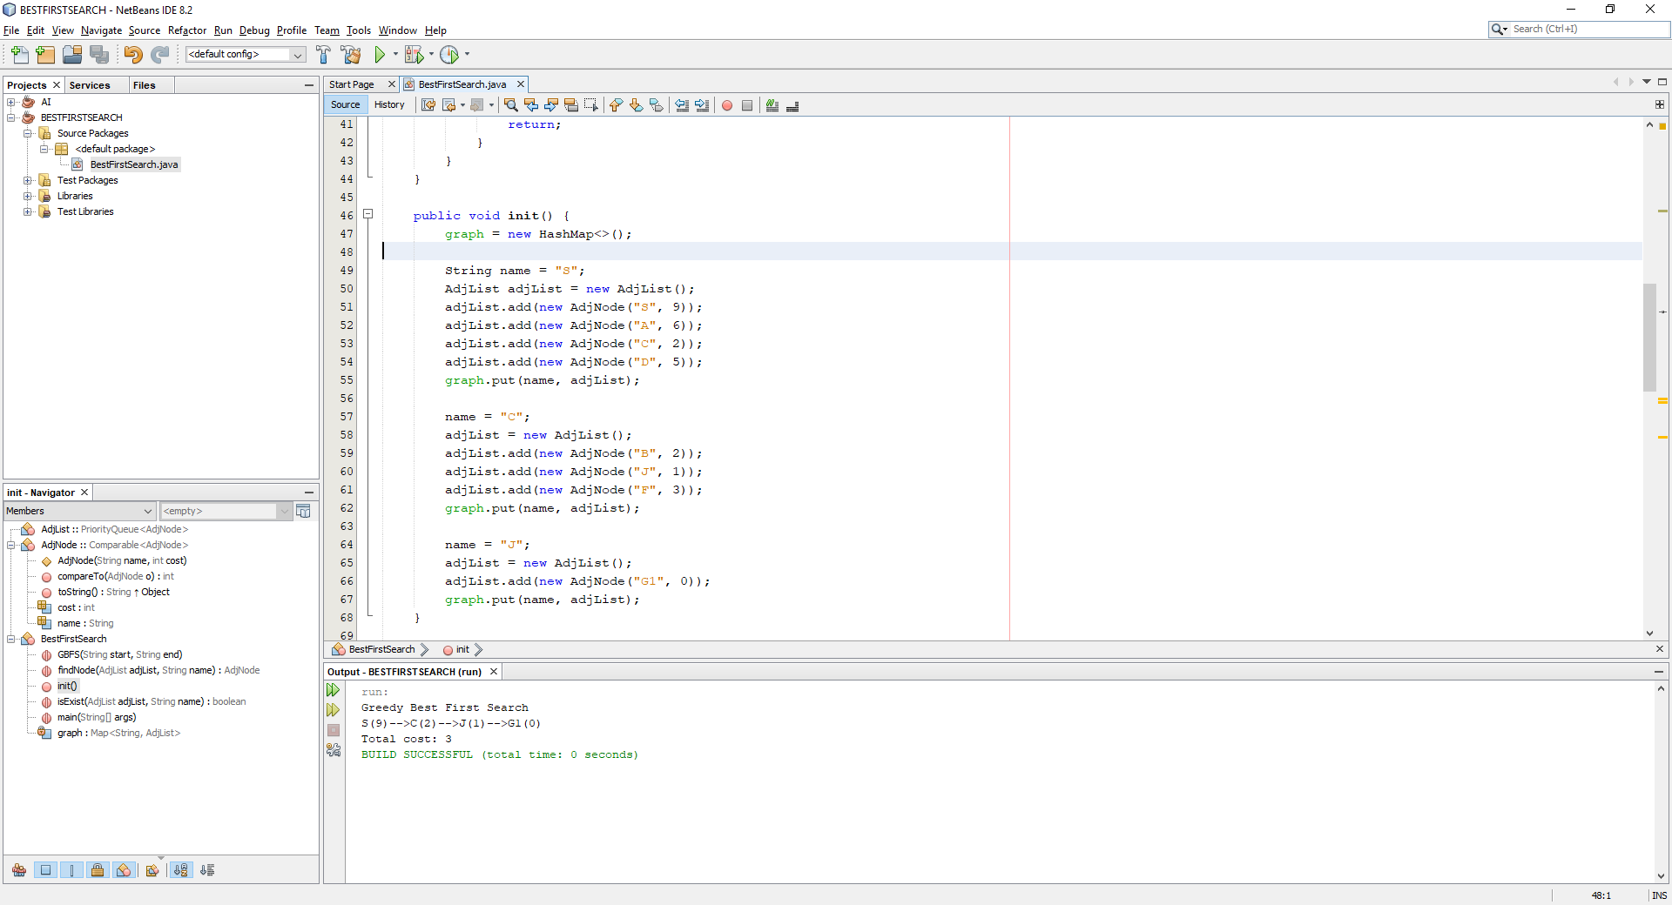
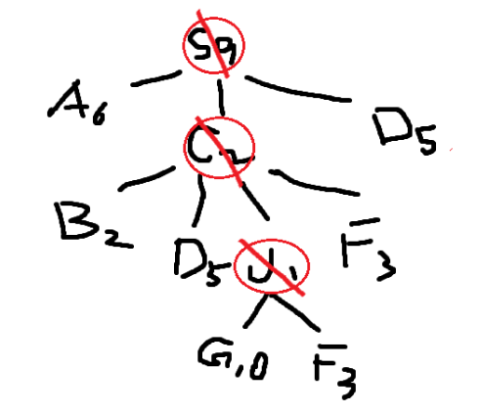
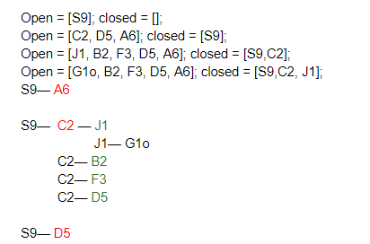

Best-First: Results
Result of Greedy
Best-First search

Slide 9
Comparison / Analysis
Best-first search takes the children of any node selected meaning you cannot go back up a branch that has been discovered or used.
Uniform Cost takes a look at all the nodes and selects the smallest node to use but allows going back up nodes to check the path from parent node to the child.
Iterative Deepening is the slowest strategy of the three as it works in iterations but it very accurate as all paths are checked.
So BFS is the quickest strategy, ID is the most accurate but lengthy and UC is a combination of the two meaning it is the quickest with the best possible results.

Slide 10
Evidence of Group Work
A WhatsApp group chat was created to discuss the timing and location of our meetings, which was confirmed to be 12-1 on Thursday and Friday. We had a couple meetings and in each we discussed the strategies, the implementation and anything else that was on our mind.
During our 1st meeting as a team, a GitHub Repository was set up so we could upload all our individual work and work on another members tasks if we had completed our own, this helped us complete the work on time for the deadline and also gave us time to improve.

Slide 11
Questions?

