Slide 1
CS6543: Computer Networks
Part II
Wireless and Mobile Ad Hoc Networks
Introductions
Turgay Korkmaz
http://www.cs.utsa.edu/~korkmaz/teaching/cs6543/
When preparing these slides, I used the books listed in the class web pages and many slides provided by others. Specially, I would like to acknowledge and thank Professor Jochen Schiller http://www.jochenschiller.de/ and Professors Luiz DaSilva and Scott Midkiff http://www.intel.com/education/highered/Wireless/lectures2.htm

Slide 2
Objectives
Wireless and Mobile Applications
The impact of the wireless environment on networks
An overview of mobile wireless technologies
Reference layer model
Research in Wireless and Mobile Communications

Slide 3
Wireless and Mobile Applications
Wireless vs. Mobile
Applications
Location dependent services
Mobile devices
Effects of device portability

Slide 4
Wireless vs. Mobile
Two aspects of mobility:
  user mobility: users communicate (wireless) “anytime, anywhere, with anyone”
  device portability: devices can be connected anytime, anywhere to the network
Wireless vs. mobile Examples
✗ ✗ stationary computer
✗ ✓ notebook in a hotel
✓ ✗ wireless LANs in historic buildings
✓ ✓ Personal Digital Assistant (PDA)
Integration of wireless networks into existing fixed networks is needed:
  local area networks: IEEE 802.11, ETSI (HIPERLAN)
  Internet: Mobile IP extension of the internet protocol IP
  wide area networks: e.g., internetworking of GSM and ISDN

Slide 5
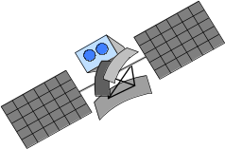




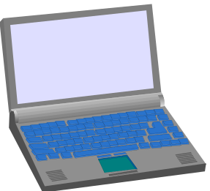

The global goal
integration of heterogeneous fixed and
mobile networks with varying
transmission characteristics
regional
vertical
handover
metropolitan area
campus-based
horizontal
handover
in-house

Slide 6
Applications I
Vehicles
  transmission of news, road condition, weather, music via DAB
  personal communication using GSM
  position via GPS
  local ad-hoc network with vehicles close-by to prevent accidents, guidance system, redundancy
  vehicle data (e.g., from busses, high-speed trains) can be transmitted in advance for maintenance
Emergencies
  early transmission of patient data to the hospital, current status, first diagnosis
  replacement of a fixed infrastructure in case of earthquakes, hurricanes, fire etc.
  Crisis, war, etc.

Slide 7

Applications II
Traveling salesmen
  direct access to customer files stored in a central location
  consistent databases for all agents
  mobile office
Replacement of fixed networks
  LANs in historic buildings
Entertainment, education, ...
  outdoor Internet access
  intelligent travel guide with up-to-date
  location dependent information
  ad-hoc networks for multi user games
Distributed computing, mesh, sensor...
History
Info

Slide 8
Typical application: road traffic
UMTS, WLAN,
DAB, DVB, GSM,
cdma2000, TETRA, ...
ad hoc
Personal Travel Assistant,
PDA, Laptop,
GSM, UMTS, WLAN,
Bluetooth, ...

Slide 9
Location dependent services
Location aware services
  what services (e.g., printer, fax, phone) exist in the local environment
Follow-on services
  automatic call-forwarding, transmission of the actual workspace to the current location
Information services
  “push”: e.g., current special offers in the supermarket
  “pull”: e.g., where is the Black Forrest Cherry Cake?
Support services
  caches, intermediate results, state information etc. “follow” the mobile device through the fixed network
Privacy
  who should gain knowledge about the location

Slide 10



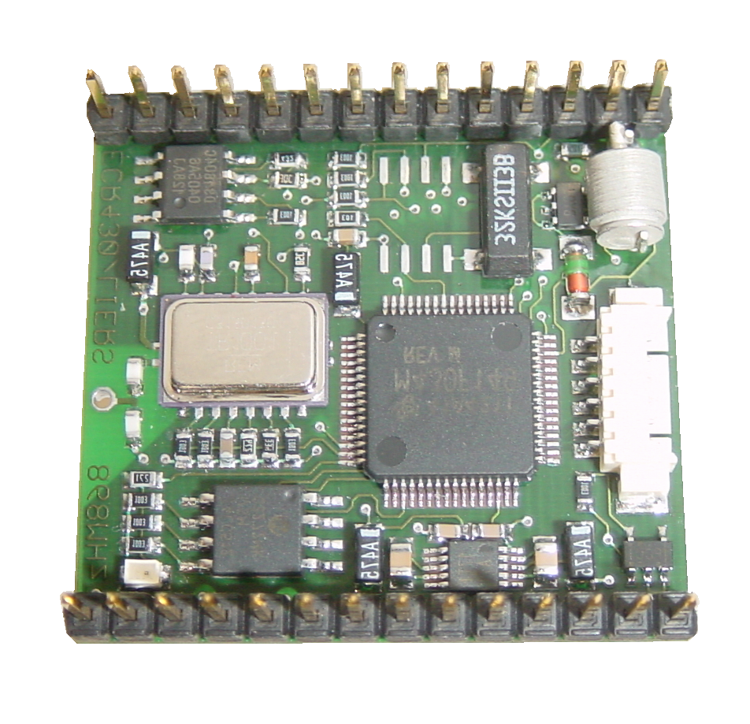
Mobile devices
Pager
receive only
tiny displays
simple text
messages
PDA
graphical displays
character recognition
simplified WWW
Laptop/Notebook
fully functional
standard applications
Sensors,
embedded
controllers
Mobile phones
voice, data
simple graphical displays
Palmtop
tiny keyboard
simple versions
of standard applications
www.scatterweb.net
performance

Slide 11
Effects of device portability
Power consumption
  limited computing power, low quality displays, small disks due to limited battery capacity
  CPU: power consumption ~ CV²f
    C: internal capacity, V: supply voltage, f: clock frequency
Loss of data
  higher probability, has to be included in advance into the design (e.g., defects, theft)
Limited user interfaces
  compromise between size of fingers and portability
  integration of character/voice recognition, abstract symbols
Limited memory
  limited value of mass memories with moving parts
  flash-memory or ? as alternative
Notes:
C: internal capacity, reduced by integration,
V: supply voltage, can be reduced to a certain limit,
f: clock frequency, can be reduced temporally

Slide 12
Impact of Wireless Environment on Networks
Wireless vs. fixed networks
Wireless transmission
  The wireless spectrum
  Signals, antennas
  Signal propagation and
  Physical impairments
  Spread spectrum
Contention for the shared medium
Effects of mobility
Restrictions on terminal equipment
Security

Slide 13
Wireless vs. fixed networks
Restrictive regulations of frequencies
  frequencies have to be coordinated, useful frequencies are almost all occupied
Low transmission rates
  local some Mbit/s, regional currently, e.g., 53kbit/s with GSM/GPRS
Higher loss-rates due to interference
  emissions of, e.g., engines, lightning
Higher delays, higher jitter
  connection setup time with GSM in the second range, contention
Lower security, simpler active attacking
  radio interface accessible for everyone, base station can be simulated, thus attracting calls from mobile phones
Always shared medium
  Performance guarantees and secure access mechanisms important

Slide 14
Wireless transmission
  The wireless spectrum
  Signals, antennas
  Signal propagation and
  Physical impairments
  Spread spectrum

Slide 15



Wireless Spectrum (1)
Broadcast TV
VHF: 54 to 88 MHz, 174 to 216 MHz
UHF: 470 to 806 MHz
30 MHz
300 MHz
3 GHz
30 GHz
FM Radio
88 to 108 MHz
Digital TV
54 to 88 MHz, 174 to 216 MHz, 470 to 806 MHz

Slide 16
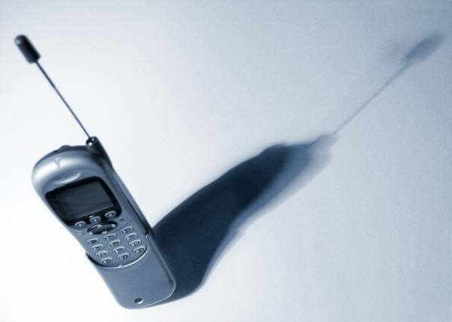
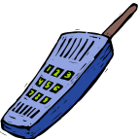
Wireless Spectrum (2)
3G Broadband Wireless
746-794 MHz, 1.7-1.85 GHz, 2.5-2.7 GHz
30 MHz
300 MHz
3 GHz
30 GHz
Cellular Phone
800-900 MHz
Personal Communication Service (PCS)
1.85-1.99 GHz

Slide 17



Wireless Spectrum (3)
Wireless LAN (IEEE 802.11b/g)
2.4 GHz
Wireless LAN (IEEE 802.11a)
5 GHz
30 MHz
300 MHz
3 GHz
30 GHz
Bluetooth
2.45 GHz
Local Multipoint Distribution Services (LMDS)
27.5-31.3 GHz

Slide 18
Signals (1)
Physical representation of data
Function of time and location
Classification
  continuous time/discrete time
  continuous values/discrete values
  analog signal = continuous time and continuous values
  digital signal = discrete time and discrete values
Signal parameters of periodic signals:
  Period T, Frequency f=1/T, Amplitude A, Phase shift ϕ
    Sine wave as special periodic signal for a carrier:
  s(t) = A_{t} sin(2 π f_{t} t + ϕ_{t})
  Wave length: λ = c/f, where c is the speed of light c ≅ 3x10⁸m/s
Notes:
Signal parameters: parameters representing the value of data

Slide 19
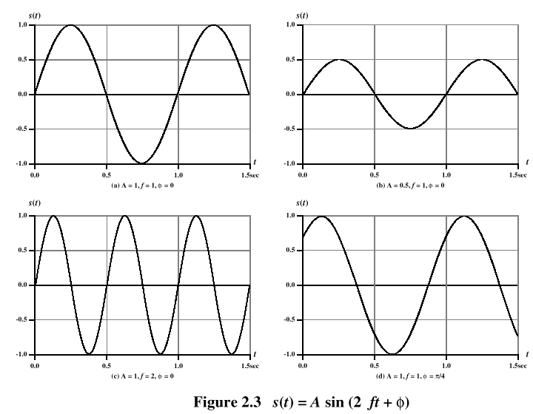
Signals (2)

Slide 20
Signals (3)
Different representations of signals
  amplitude (amplitude domain)
  frequency spectrum (frequency domain)
  phase state diagram (amplitude M and phase ϕ in polar coordinates)
Digital signals need
  infinite frequencies for perfect transmission
  modulation with a carrier frequency for transmission (analog signal!)
A [V]
A [V]
Q = M sin ϕ
t[s]
ϕ
I= M cos ϕ
ϕ
f [Hz]
Notes:
Composed signals transferred into frequency domain using Fourier transformation

Slide 21
Digital Modulation
Digital data is translated into an analog signal (baseband)
Amplitude Shift Keying (ASK):
  very simple
  low bandwidth requirements
  very susceptible to interference
Frequency Shift Keying (FSK):
  needs larger bandwidth
Phase Shift Keying (PSK):
  more complex
  robust against interference
1
0
1
t
1
0
1
t
1
0
1
t

Slide 22
Analog Modulation
Analog data or signal (e.g., voice) is translated into another analog signal (carrier signal)
Motivation
  Smaller antennas (e.g., λ/4),
  Frequency Division Multiplexing.
  Medium characteristics
Basic schemes
  Amplitude Modulation (AM)
  Frequency Modulation (FM)
  Phase Modulation (PM)

Slide 23
Modulation and demodulation
analog
baseband
signal
antenna
digital
data
digital
modulation
analog
modulation
101101001
radio transmitter
radio
carrier
antenna
analog
baseband
signal
digital
data
analog
demodulation
synchronization
decision
101101001
radio receiver
radio
carrier

Slide 24
Antennas: isotropic radiator
Radiation and reception of electromagnetic waves, coupling of wires to space for radio transmission
Isotropic radiator: equal radiation in all directions (three dimensional) - only a theoretical reference antenna
Real antennas always have directive effects (vertically and/or horizontally)
Radiation pattern: measurement of radiation around an antenna
z
y
z
y
x
ideal
isotropic
radiator
x

Slide 25
Antennas: simple dipoles
Real antennas are not isotropic radiators but, e.g., dipoles with lengths λ/4 on car roofs or λ/2 as Hertzian dipole
➔ shape of antenna proportional to wavelength
Example: Radiation pattern of a simple Hertzian dipole
λ/4
λ/2
y
y
z
simple
dipole
x
z
x
side view (xy-plane)
side view (yz-plane)
top view (xz-plane)
Notes:
Gain: maximum power in the direction of the main lobe compared to the power of an isotropic radiator (with the same average power)

Slide 26
Antennas: directed and sectorized
Often used for microwave connections or base stations for mobile phones (e.g., radio coverage of a valley)
y
y
z
directed
antenna
x
z
x
side view (xy-plane)
side view (yz-plane)
top view (xz-plane)
z
z
sectorized
antenna
x
x
top view, 3 sector
top view, 6 sector
Notes:
Multiple antennas can also be used for better performance…

Slide 27
Signal propagation ranges
Transmission range
  communication possible
  low error rate
Detection range
  detection of the signal
  possible
  no communication
  possible
Interference range
  signal may not be
  detected
  signal adds to the
  background noise
sender
transmission
distance
detection
interference

Slide 28




Signal propagation
Propagation in free space always like light (straight line)
Receiving power proportional to 1/d² in vacuum – much more in real environments (d = distance between sender and receiver)
Receiving power additionally influenced by
  fading (frequency dependent)
  shadowing
  reflection at large obstacles
  refraction depending on the density of a medium
  scattering at small obstacles
  diffraction at edges
shadowing
reflection
refraction
scattering
diffraction

Slide 29
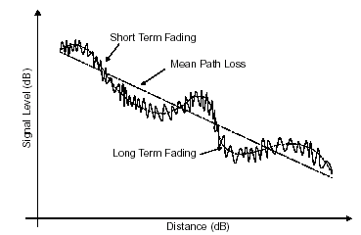
Physical impairments: Fading (1)
power
long term
fading
t
short term fading

Slide 30
Physical impairments: Fading (2)
Strength of the signal decreases with distance between transmitter and receiver: path loss
  Usually assumed inversely proportional to distance to the power of 2.5 to 5
Channel characteristics change over time and location (e.g., due to mobility)
long term (slow) fading: slow changes in the average power
received (e.g., due to distance to sender, obstacles between transmitter and receiver)
Short term (fast) fading: quick changes in the power received (e.g., due to scatterers in the vicinity of the transmitter)
  signal paths change
  different delay variations of different signal parts
  different phases of signal parts

Slide 31
Physical Impairments: Noise
Unwanted signals added to the message signal
May be due to signals generated by natural phenomena such as lightning or man-made sources, including transmitting and receiving equipment as well as spark plugs in passing cars, wiring in thermostats, etc.
Sometimes modeled in the aggregate as a random signal in which power is distributed uniformly across all frequencies (white noise)
Signal-to-noise ratio (SNR) often used as a metric in the assessment of channel quality

Slide 32
Physical Impairments: Interference
Signals generated by communications devices operating at roughly the same frequencies may interfere with one another
  Example: IEEE 802.11b and Bluetooth devices, microwave ovens, some cordless phones
  CDMA systems (many of today’s mobile wireless systems) are typically interference-constrained
Signal to interference and noise ratio (SINR) is another metric used in assessment of channel quality

Slide 33

Multipath propagation
Signal can take many different paths between sender and receiver due to reflection, scattering, diffraction
Time dispersion: signal is dispersed over time
  interference with “neighbor” symbols, Inter Symbol Interf. (ISI)
The signal reaches a receiver directly and phase shifted
  distorted signal depending on the phases of the different parts
multipath
pulses
LOS pulses
signal at sender
signal at receiver

Slide 34
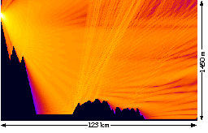
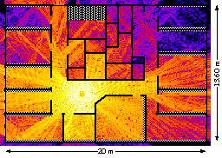
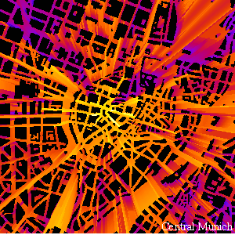
Signal propagation: Real world example
sender
transmission
distance
detection

Slide 35
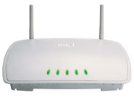
Diversity
A diversity scheme extracts information from multiple signals transmitted over different fading paths
Appropriate combination of these signals will reduce severity of fading and improve reliability of transmission
In space diversity, antennas are separated by at least half a wavelength
Other forms of diversity also possible
  Frequency diversity – techniques where the signal is spread out over a larger frequency bandwidth or carried on multiple frequency carriers (spread spectrum – next)
  Time diversity – techniques aimed at spreading the data out over time

Slide 36
Spread Spectrum
Problem of radio transmission: frequency dependent fading can wipe out narrow band signals for duration of the interference
Solution: spread the narrow band signal into a broad band signal using a special code protection against narrow band interference
Spread spectrum signals are distributed over a wide range of frequencies and then collected back at the receiver
  These wideband signals are noise-like and hence difficult to detect or interfere with
Initially adopted in military applications, for its resistance to jamming and difficulty of interception
channel
quality
channel
quality
2
2
1
5
6
2
2
2
3
2
1
4
frequency
frequency
spread
spectrum
narrow band
signal
guard space

Slide 37
Frequency Hopping Spread Spectrum (FHSS)
Data signal is modulated with a narrowband signal that hops from frequency band to frequency band, over time
The transmission frequencies are determined by a spreading, or hopping code (a pseudo-random sequence)
t_{b}
user data
0
1
0
1
1
t
f
t_{d}
f₃
slow
hopping
(3 bits/hop)
f₂
f₁
f
t_{d}
t
f₃
fast
hopping
(3 hops/bit)
f₂
f₁
t
t_{b}: bit period t_{d}: dwell time

Slide 38
Direct Sequence Spread Spectrum (DSSS)
11010111010100100001101010010011111010100100111
Spreading code
11010111010100100001101010010011111010100100111 (…)
User data
Information after spreading
1101010010011
Data signal is multiplied by a spreading code, and resulting signal occupies a much higher frequency band
Spreading code is a pseudo-random sequence

Slide 39
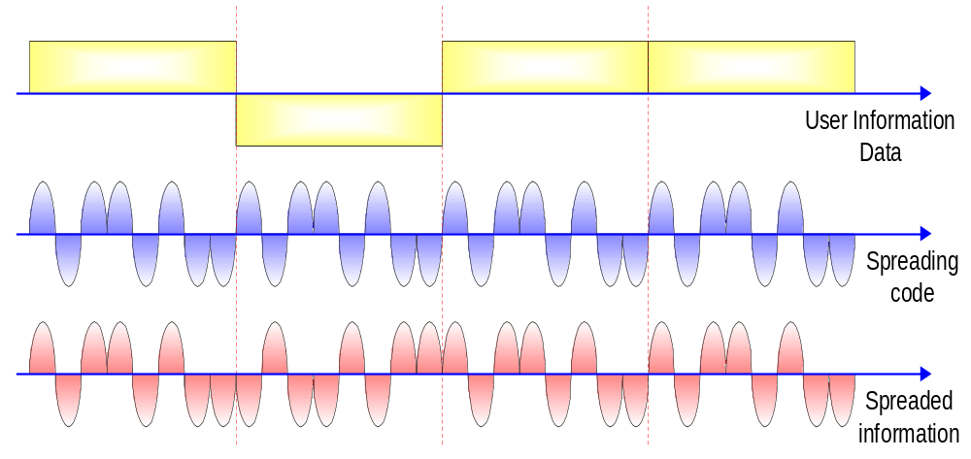
DSSS Example

Slide 40
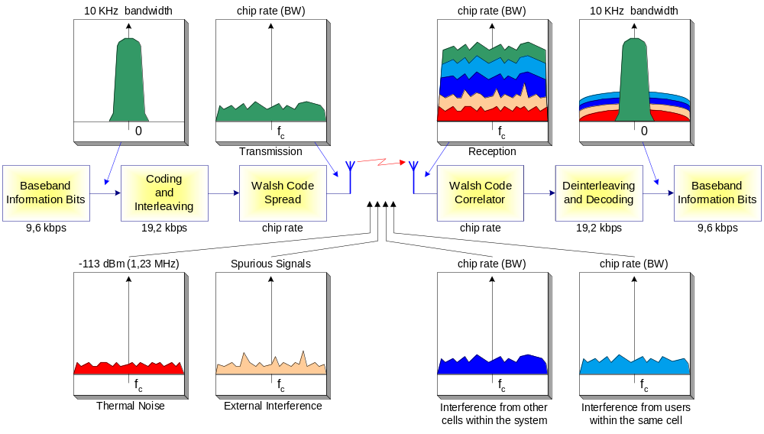
Spreading and De-spreading DSSS
End of Wireless Transmission Part

Slide 41

Contention for the Medium
C
packets
A
B
If A and B simultaneously transmit to C over the same channel, C will not be able to correctly decode received information: a collision will occur
Need for medium access control mechanisms to establish what to do in this case (also, to maximize aggregate utilization of available capacity)

Slide 42


Effects of Mobility
home network
wide area network
visited network
1
2
mobile contacts foreign agent on entering visited network
Figure from Kurose & Ross
foreign agent contacts home agent home: “this mobile is resident in my network”
Destination address not equal to destination location
Addressing and routing must be taken care of to enable mobility
Can be done automatically through handoff or may require explicit registration by the mobile in the visited network
Resource management and QoS are directly affected by route changes

Slide 43
Form Factors
Form factors (size, power dissipation, ergonomics, etc.) play an important part in mobility and nomadicity
  Mobile computing: implies the possibility of seamless mobility
  Nomadic computing: connections are torn down and re-established at new location
Battery life imposes additional restrictions on the complexity of processing required of the mobiles units

Slide 44

Security
Safeguards for physical security must be even greater in wireless communications
Encryption: intercepted communications must not be easily interpreted
Authentication: is the node who it claims to be?

Slide 45
An Overview of Mobile Wireless Technologies
Mobile wireless (Cellular Phones)
Fixed wireless (satellites, cordless phones)
Local wireless networks WLAN 802.11 (WiFi)
Personal wireless networks WPAN 802.15 (Bluetooth, ZigBee)
More standards (e.g., WMAN 802.16 (WiMAX))

Slide 46
Generations in Mobile Wireless Service
(Cellular Phones)
First Generation (1G)
  Mobile voice services
Second Generation (2G)
  Primarily voice, some low-speed data (circuit switched)
Generation 2½ (2.5G)
  Higher data rates than 2G
  A bridge (for GSM) to 3G
Third Generation (3G)
  Seamless integration of voice and data
  High data rates, full support for packet switched data

Slide 47
Evolution of Mobile Wireless (1)
Advance Mobile Phone Service (AMPS)
FDMA
824-849 MHz (UL), 869-894 MHz (DL)
U.S. (1983), So. America, Australia, China
1G
2G
2.5G
3G
NG
European Total Access Communication System (E-TACS)
FDMA
872-905 MHz (UL), 917-950 MHz (DL)
Deployed throughout Europe

Slide 48
Evolution of Mobile Wireless (2)
Global System for Mobile communications (GSM)
TDMA
Different frequency bands for cellular and PCS
Developed in 1990, expected >1B subscriber by end of 2003
1G
2G
2.5G
3G
NG
IS-95
CDMA
800/1900 MHz – Cellular/PCS
U.S., Europe, Asia

Slide 49
Evolution of Mobile Wireless (3)
General Packet Radio Services (GPRS)
Introduces packet switched data services for GSM
Transmission rate up to 170 kbps
Some support for QoS
1G
2G
2.5G
3G
NG
Enhanced Data rates for GSM Evolution (EDGE)
Circuit-switched voice (at up to 43.5 kbps/slot)
Packet-switched data (at up to 59.2 kbps/slot)
Can achieve on the order of 475 kbps on the downlink, by combining multiple slots

Slide 50
Evolution of Mobile Wireless (4)
Universal Mobile Telecommunication Systems (UMTS)
Wideband DS-CDMA
Bandwidth-on-demand, up to 2 Mbps
Supports handoff from GSM/GPRS
1G
2G
2.5G
3G
NG
IS2000
CDMA2000: Multicarrier DS-CDMA
Bandwidth on demand (different flavors, up to a few Mbps)
Supports handoff from/to IS-95

Slide 51
Fixed Wireless
Microwave
  Traditionally used in point-to-point communications
  Initially, 1 GHz range, more recently in the 40 GHz region
Local Multipoint Distribution Service (LMDS)
  Operates around 30 GHz
  Point-to-multipoint, with applications including Internet access and telephony
  Virginia Tech owns spectrum in SW VA and surroundings
Multichannel Multipoint Distribution Service (MMDS)
  Operates around 2.5 GHz
  Initially, for TV distribution
  More recently, wireless residential Internet service
Notes:
satellites, cordless phones

Slide 52
WLANs: IEEE 802.11 Family
802.11 working group
  Specify an open-air interface between a wireless client and a base station or access point, as well as among wireless clients
IEEE 802.11a
  Up to 54 Mbps in the 5 GHz band
  Uses orthogonal frequency division multiplexing (OFDM)
IEEE 802.11b (Wi-Fi)
  11 Mbps (with fallback to 5.5, 2 and 1 Mbps) in the 2.4 GHz band
  Uses DSSS
IEEE 802.11g
  20+ Mbps in the 2.4 GHz band

Slide 53
WLANs/WPANs: Bluetooth
Cable replacement technology
Short-range radio links
Small, inexpensive radio chip to be plugged into computers, phones, palmtops, printers, etc.
Bluetooth was invented in 1994
Bluetooth Special Interest Group (SIG) founded in 1998 by Ericsson, IBM, Intel, Nokia and Toshiba to develop an open specification
  Now joined by > 2500 companies

Slide 54
Some more IEEE standards for mobile communications
IEEE 802.16: Broadband Wireless Access: WMAN, WiMax
  Wireless distribution system for the last mile, alternative to DSL
  75 Mbit/s up to 50 km LOS, up to 10 km NLOS; 2-66 GHz band
  Initial standards without roaming or mobility support
  802.16e adds mobility support, allows for roaming at 150 km/h
IEEE 802.20: Mobile Broadband Wireless Access (MBWA)
  Licensed bands < 3.5 GHz, optimized for IP traffic
  Peak rate > 1 Mbit/s per user
  Different mobility classes up to 250 km/h and ranges up to 15 km
IEEE 802.21: Media Independent Handover Interoperability
  Standardize handover between different 802.x and/or non 802 networks
IEEE 802.22: Wireless Regional Area Networks (WRAN)
  Radio-based PHY/MAC for use by license-exempt devices on a non-interfering basis in spectrum that is allocated to the TV Broadcast Service

Slide 55
Wireless systems: overview of the development
cellular phones
satellites
cordless
phones
wireless LAN
1980:
CT0
1981:
NMT 450
1982:
Inmarsat-A
1983:
AMPS
1984:
CT1
1986:
NMT 900
1987:
CT1+
1988:
Inmarsat-C
1989:
CT 2
1991:
CDMA
1991:
D-AMPS
1991:
DECT
1992:
GSM
1992:
Inmarsat-B
Inmarsat-M
199x:
proprietary
1993:
PDC
1994:
DCS 1800
1997:
IEEE 802.11
1998:
Iridium
1999:
802.11b, Bluetooth
analogue
2000:
GPRS
2000:
IEEE 802.11a
2001:
IMT-2000
digital
200?:
Fourth Generation
(Internet based)
4G – fourth generation: when and how?

Slide 56
Reference layer model
Application
Application
Transport
Transport
Network
Network
Network
Network
Data Link
Data Link
Data Link
Data Link
Physical
Physical
Physical
Physical
Radio
Medium

Slide 57
Layer model
Application layer
Transport layer
Network layer
Data link layer
Physical layer
  service location
  new applications, multimedia
  adaptive applications
  congestion and flow control
  quality of service
  addressing, routing,
  device location
  hand-over
  authentication
  media access
  multiplexing
  media access control
  encryption
  modulation
  interference
  attenuation
  frequency

Slide 58
Areas of research in wireless and mobile networks
Wireless Communication
  transmission quality (bandwidth, error rate, delay)
  modulation, coding, interference, media access, regulations .
Mobility
  location dependent services
  location transparency
  quality of service support (delay, jitter, security) ...
Portability
  power consumption
  limited computing power, sizes of display, ...
Cross-layer design
Energy-efficiency

Slide 59
Future mobile and wireless networks
Improved radio technology and antennas
  smart antennas, beam forming, multiple-input multiple-output (MIMO)
    space division multiplex to increase capacity, benefit from multipath
  software defined radios (SDR)
    use of different air interfaces, download new modulation/coding/...
    requires a lot of processing power (UMTS RF 10000 GIPS)
  dynamic spectrum allocation
    spectrum on demand results in higher overall capacity
Core network convergence
  IP-based, quality of service, mobile IP
Ad-hoc technologies
  spontaneous communication, power saving, redundancy
Simple and open service platform
  intelligence at the edge, not in the network (as with IN)
  more service providers, not network operators only

Slide 60
Future Computers
Computers are integrated
  small, cheap, portable, replaceable - networked devices
Technology is in the background
  computers are aware of their environment and adapt (“location awareness”)
  computers recognize the location of the user and react appropriately (e.g., call forwarding, fax forwarding, “context awareness”))
Advances in technology
  more computing power in smaller devices
  flat, lightweight displays with low power consumption
  new user interfaces due to small dimensions
  more bandwidth per cubic meter
  multiple wireless interfaces: wireless LANs, wireless WANs, regional wireless telecommunication networks etc.

