Slide 1
A Survey and Tutorial of RFID Anti-Collision Protocol
Author: Dheeraj K. Klair, Kwan-Wu Chin, and Raad Raad
Presenter: Zi Yan

Slide 2
Outline
Introduction
Background
Anti-collision protocols
Framed Slotted Aloha Protocols
RFID anti-collision standards
Future work
Conclusion

Slide 3
Introduction
Radio Frequency IDentification (RFID)
A reader
One or more tags

Slide 4
Background
RFID system communication types
Operating Frequency: 100KHz to 5.8GHz
Tag types: passive, active, and semi-passive

Slide 5
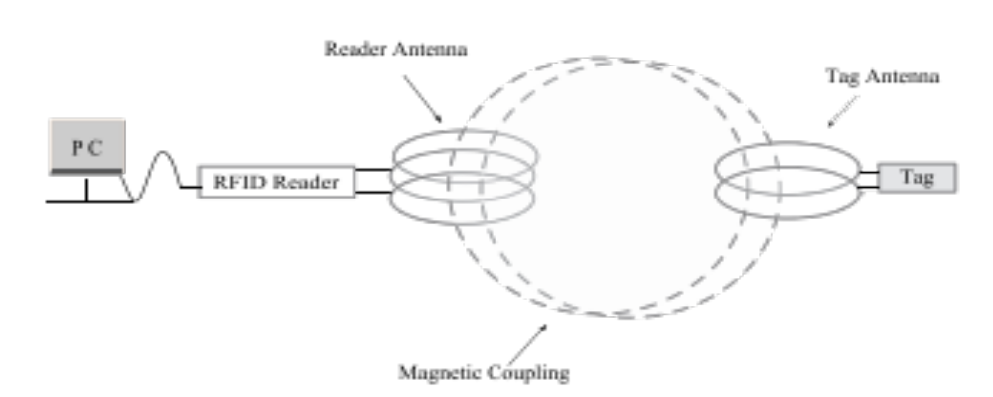
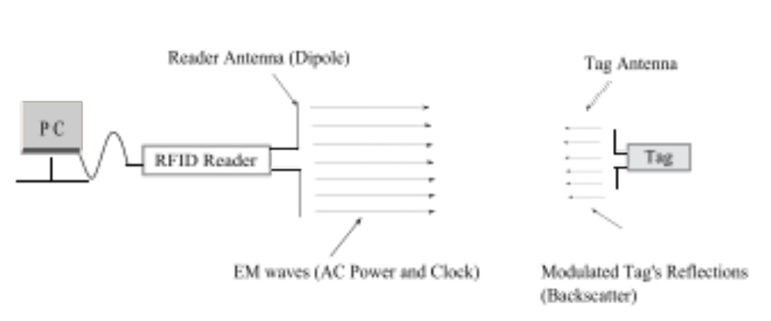
Two coupling types
Magnetically Coupled Systems
  Near field
  Passively in LF or HF bands
Electromagnetically Coupled Systems
  Far field
  UHF and microwave bands

Slide 6



Anti-collision Protocols
Directional antennas: expensive and require intricate design
Space division multiple access (SDMA)
Frequency division multiple access (FDMA)
Code division multiple access (CDMA)
Time division multiple access (TDMA)
In different frequencies: require a complex receiver at the reader
Different codings: expensive and power hungry
Easy, simple, most chosen

Slide 7
Anti-collision Protocols
Aloha Based Protocols
Tree Based Protocols
Hybrid Protocols

Slide 8
Aloha based protocols
Pure Aloha (PA)
Slotted Aloha (SA)
Framed Slotted Aloha (FSA)
Notes:
Pure aloha: randomly respond after being energized
Slotted aloha: transmit in sync time slots
Framed slotted aloha: transmit once in a give frame, which is consisted of several slots.

Slide 9
tree based protocols
Tree splitting (TS)
Query tree (QT)
Binary search (BS)
Bitwise arbitration (BTA)

Slide 10
hybrid protocols
Tree Slotted Aloha
Hybrid Query Tree
Hybrid Randomized Protocol
Hash-Tree Protocol

Slide 11
Frame slotted aloha
Passive and Active systems
Mathematical Model
Capture effect

Slide 12
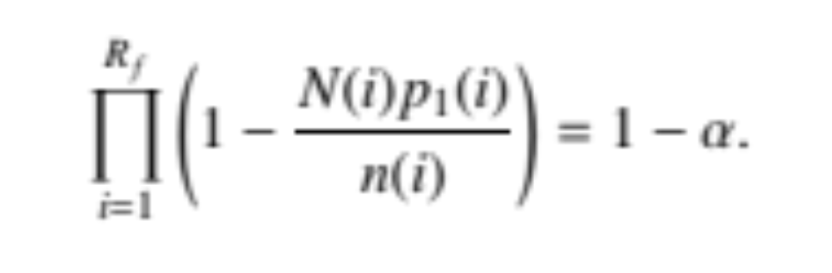
Passive and Active Systems
Active Systems: store identification info
Passive Systems: memoryless, use a confidence level to ensure
Notes:
Active system will store the identification info, but passive can’t. So for passive system, there is a confidence level for identifying all tags

Slide 13
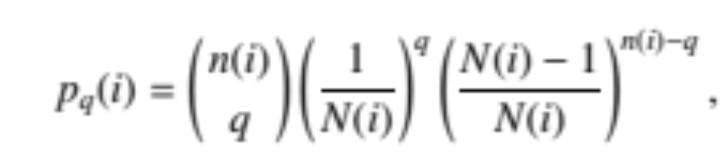
Mathematical Models
Static frame size
Dynamic frame size
Frame size is N(i),
n(i) tags to be read
Tag estimation functions:
static or statistical

Slide 14
Capture Effect
Can still identify tags, when there is a collision
Method: amplify stronger or earlier signals

Slide 15
Frame slotted aloha
  Basic framed slotted Aloha (BFSA)
    A variant: 4-bit sized slot to reserve
  Dynamic framed slotted Aloha (DFSA)
  Enhanced Dynamic framed slotted Aloha (EDFSA)

Slide 16
Variants of Aloha
Muting: silence identified tags
Slow Down: reduce the identified tag’s transmission rate
Fast Mode: silence other tags
Early End (for slotted): end a slot early, if idle

Slide 17
RFID Anti-collision Standards
EPCglobal: industry-driven standards for international supply chain network.
International Organization for Standardization (ISO): specifies interface specifications for tracking cattle, payment systems, contact less smart cards, and vicinity cards.

Slide 18
Future Work
Goal: To reduce computational cost and memory requirements
Tree protocols: use pseudo IDs
Hybrid protocols
Integration with sensor nodes to create RFID-enhanced WSN: multi-hop
Anti-collision protocols for mobile tags

Slide 19
Conclusion
Aloha and Tree Protocols
Aloha Protocols: dynamic adaptability to varying loads and low reader-to-tag commands
Tree Protocols: promise deterministic identifications, but require more reader-to-tag commands

Slide 20
Thanks
Questions?

