Slide 1
Evaluation
Data source
Clustering and Classification
“New” Spammers

Slide 2
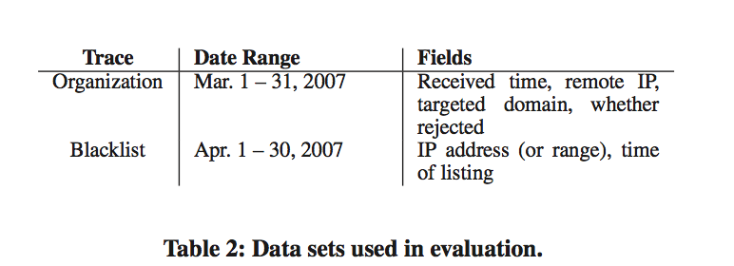
Organization: provides a set of email logs as the primary data
Blacklist: the full database of Spamhaus, as a performance counterpart
Process: clustering and classification, Δt = 6 hours.

Slide 3
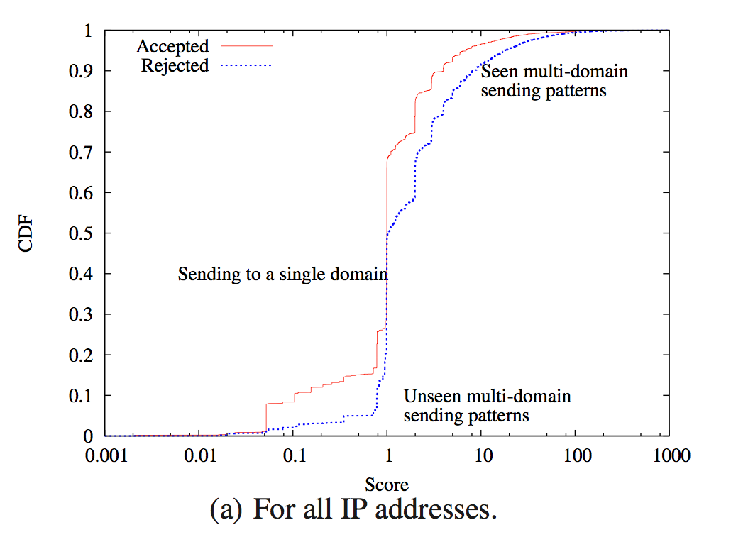
Accept a email or reject it based on sending pattern
High score: a known spamming pattern
Low score: unknown to the classifier
A single threshold is not easy to choose
Notes:
Most of mails are for one domain. This is not the place in which SpamTracker do well.

Slide 4
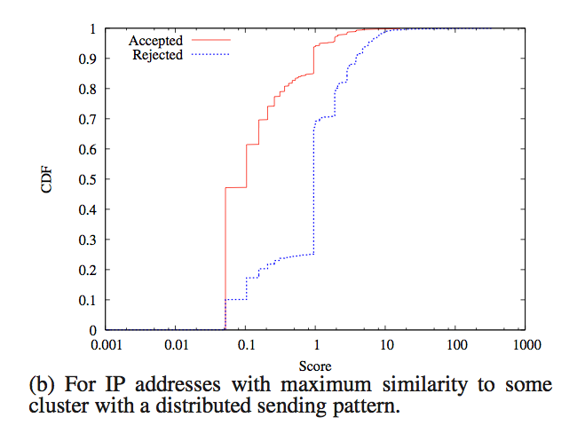
IP addresses that have maximum similarity with a single cluster whose C_{avg} is not dominated by a single column
Notes:
This implies spamming mails concentrate in more than one domain

Slide 5
“New” spammers
A subset of the email with highest spam scores is re-examinated
15% is false positive
620 emails
65 emails (about 10%) had a spam score S(r)>5

Slide 6
Discussion
Improvements
Incorporating with Existing Systems
Deployment
Evasion
Sensor Placement

Slide 7
Improvements
Using more features for clustering
Improved similarity computation
Notes:
Originally use target domain, other temporal patterns like time interval between successive emails received from an IP, or sending frequency of the IP. The bot often gets templates and mailing list from one botmaster, so they may have similar temporal behavior
In Equation 1, all columns of IP’s vector r are weighted equally. Differentiation between those “fingerprints” may improve the performance, like country-specific domains.

Slide 8
Incorporating with Existing Systems
With existing infrastructure, providing a simple interface
“On the wire”, anywhere in the network
Notes:
Add as a filtering criterion.
Bad: does not stop email traffic close to the source
Because it is based on source IP and dest. Domain
Bad: need to maintain up-to-date information about clusters and sending IP address, in a distributed, dynamic setting

Slide 9
Deployment and Sensor Placement
Better Scalability with data compression
Better Reliability with replication and anycast
A more distribution of sensors
Notes:
many servers (possibly the same ones who manage mail for various domains) report sender behavior to a centralized location that performs the clustering.
Scalability:SpamTracker requires the full I P × domain matrix from each source to perform clustering, but requires only the average row vectors for each cluster (i.e., the output of the algorithm) for classification.
we observe is received by only 84 of the 115 domains from which we observe email, and that only about 15% of the senders in our traces target more than one of the domains from which we can ob- serve sending patterns at the email hosting provider.

Slide 10
Evasion
Robustness: Forming clusters from a smaller number of trusted email recipients
Adjustment on the time window used for clustering
Notes:
the fraction of spam does not change much over short timeframes, and a decrease in the fraction of flagged email indicates that the window is too small to cluster similar IPs together.

