Slide 1

Nimble Page Management for Tiered Memory Systems
Zi Yan*
Daniel Lustig*, David Nellans*
Abhishek Bhattacharjee✥
*NVIDIA Research, ✥Yale University

Slide 2
Heterogeneous Memory system
CPU
GPU
TLB
Accelerator
Accelerator
TLB
TLB
TLB
MCDRAM
HBM
Interconnect Network
DRAM
Non-Volatile Memory

Slide 3
Heterogeneous memory Management
OS page management
Placing pages in memory initially
Relocating pages to other memory
Two key components
Policy: where to place/move pages
e.g., Thermostat¹, HeteroOS²
Mechanism: Page migration process
Execute policy decisions
CPU
GPU
Acc
Acc
TLB
TLB
TLB
TLB
Mechanism is as important as policy
MCDRAM
HBM
Page
Interconnect Network
DRAM
Page
Non-Volatile Memory
Page
N. Agarwal et al. Thermostat: Application-transparent Page Management for Two-tiered Main Memory. ASPLOS 2017
S. Kannan et al. HeteroOS: OS Design for Heterogeneous Memory Management in Datacenter. ISCA 2017

Slide 4
Faster Page Migration = Better PERF
Performance boost over stock Linux
Disaggregated memory system
Standard Linux page replacement policy
Optimizing page migration mechanism in OS
32GB workloads
CPU
40% Runtime Improvement
TLB
Fast memory
16GB
Slow memory
40GB

Slide 5
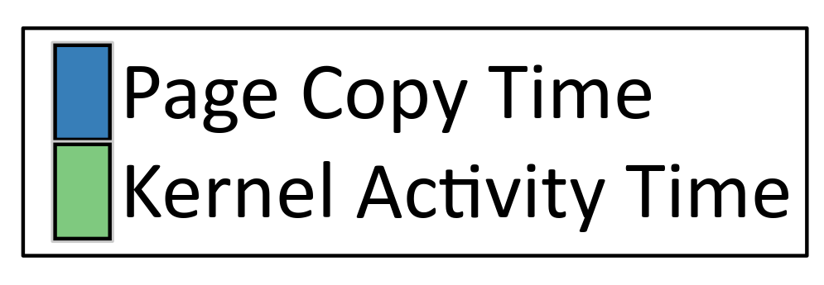
Page Migration Throughput Is LOW
4KB
2MB
2MB
Page migration profiling
Three common manners
Between two mem nodes
19.2 GB/s hardware BW
Observations
Low throughput (4%)
High kernel overhead

Slide 6
Page Migration Problems
High kernel overhead
Locks on shared data structures, e.g. page lists
Virtual memory maintenance, e.g. page table modification
Split huge pages before migration
Kernel operation serialization
Migration process serialization
Low throughput
19.2GB/s available hardware bandwidth
 | Base Page (4KB) | 512 Base Pages (2MB) | Split THP (2MB) | Max Copy Throughput
X86_64 | 0.04 GB/s (0.3%) | 0.75 GB/s (5.0%) | 0.75 GB/s (5.0%) | 15.05 GB/s

Slide 7
The Goals of Improving Page Migration
High performance
Achieve throughput as high as possible
Significantly reduce page migration overheads
Ease of implementation
Implemented in Linux
Reuse most of existing code
Generality
Not rely on special hardware
Applicable to other uses, memory offlining, hot add/remove

Slide 8
Improve Page Migration System
Policies
Auto NUMA
Program Controlled
Device Drivers
Policies decide which pages to move
In Linux, move_pages() system call connects policies with the mechanism
The mechanism helps move pages
My work improves the mechanism
System Call move_pages()
Mechanism
Allocate new pages
Unmap old pages & TLB invalidation
Copy data from old pages to new pages
Map new pages
Free old pages

Slide 9
Page Migration Optimizations
Transparent huge page (THP) migration
Reduce kernel overhead
4KB Data Copy
2MB
Data Copy
4KB Data Copy
Time
…
4KB Data Copy
4KB Data Copy
512 migrations
1 migration

Slide 10
Page Migration Optimizations
Transparent huge page (THP) migration
Reduce kernel overhead
Parallel page migration
Improve data copy throughput
Single-threaded
Data Copy
Multi-threaded
Data Copy
Time

Slide 11
Page Migration Optimizations
Transparent huge page (THP) migration
Reduce kernel overhead
Parallel page migration
Improve data copy throughput
Concurrent page migration
Parallelize kernel operations
Data Copy
Data Copy
N Concurrent
Data Copies
Time
…
Data Copy
Data Copy
Serialized
Concurrent

Slide 12
Page Migration Optimizations
Transparent huge page (THP) migration
Reduce kernel overhead
Parallel page migration
Improve data copy throughput
Concurrent page migration
Parallelize kernel operations
Exchange pages
Reduce migration process overhead
All optimizations can be combined
Data Copy 1
Node 0
(Full)
Step 1
Node 1 (Not Full)
Step 2
Data Copy 2
Time
Data Exchange
Node 0
(Full)
Node 1 (Not Full)
Step 1 & 2

Slide 13
Page Migration Improvement
Max achievable data copy throughput: 15GB/s
14.6x improvement

Slide 14
Methodology
Disaggregated memory in real hardware
A two-socket NUMA machine
Fast memory has 2x bandwidth and 1/2 access latency over Slow memory
Experiments run on modified Linux
Integrate all page migration mechanism optimizations
Adapt Linux page replacement algorithm as the page migration policy
Benchmarks
SpecACCEL and graph500
32GB footprint for each benchmark

Slide 15
Results
16GB fast memory
Worse than All Slow
as page migration throughput is low
40% Runtime Improvement

Slide 16
Broad Applicability Results
Fast memory size (4GB to 28GB) versus benchmark footprint (32GB)
45% Runtime Improvement
Performance Degradation

Slide 17
Summary
Existing page migration mechanism is inefficient
It utilizes only 4% hardware bandwidth
It can lead to performance degradation in heterogeneous memory management
Our optimizations improve page migration throughput
14.6x page migration throughput improvement
Up to 45% end-to-end runtime speedup
High-performance page migration is essential to heterogeneous memory management

Slide 18
Questions?

