Slide 1

AI based career prediction
Smart India Hackathon

Slide 2
Problem Description
Ministry: Ministry of Education
PS Code: SIH1434 Problem Statement: Making career choices and AI based counselling accessible to every child at secondary level along with aptitude tests and detailed career paths. Team Name : EduXperts
Team Leader Name: Vijesh Pethuram K
Institute Code : 9517
Institute Name: Mepco Schlenk Engineering College
Theme: Education

Slide 3
Team Members Details
Team Member Name | Branch | Stream
Vijesh Pethuram K (Leader) | Bachelor Of Technology | Information Technology
Prabhu R | Bachelor Of Technology | Information Technology
Vignesh S | Bachelor Of Technology | Information Technology
Sanchith R S | Bachelor Of Technology | Information Technology
Abinaya S M | Bachelor Of Technology | Information Technology
Deepalakhsmi N J S | Bachelor Of Technology | Information Technology
Team Mentor Name | Category | Expertise Domain | Domain Experience
Dr.G.Yogarajan | Academic | Networking | 18 years

Slide 4
Proposed Ideas
To Recommend a suitable career for the students based on Aptitude Tests and previous marks.
The student will then be allowed to chat with a Chatbot through which his careers are predicted and refined.
It is planned to have real-time career insights and providing career suggestions based on it.
Speech-to-text is used for people with disabilities to access the application and Text-to-speech is used to access the application in audio format.

Slide 5
Use case

Slide 6
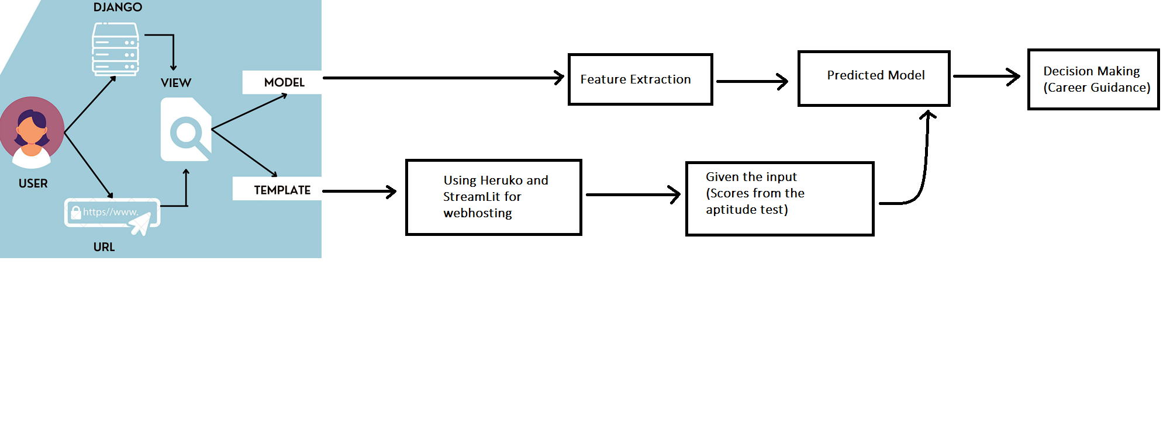
System Design

Slide 7
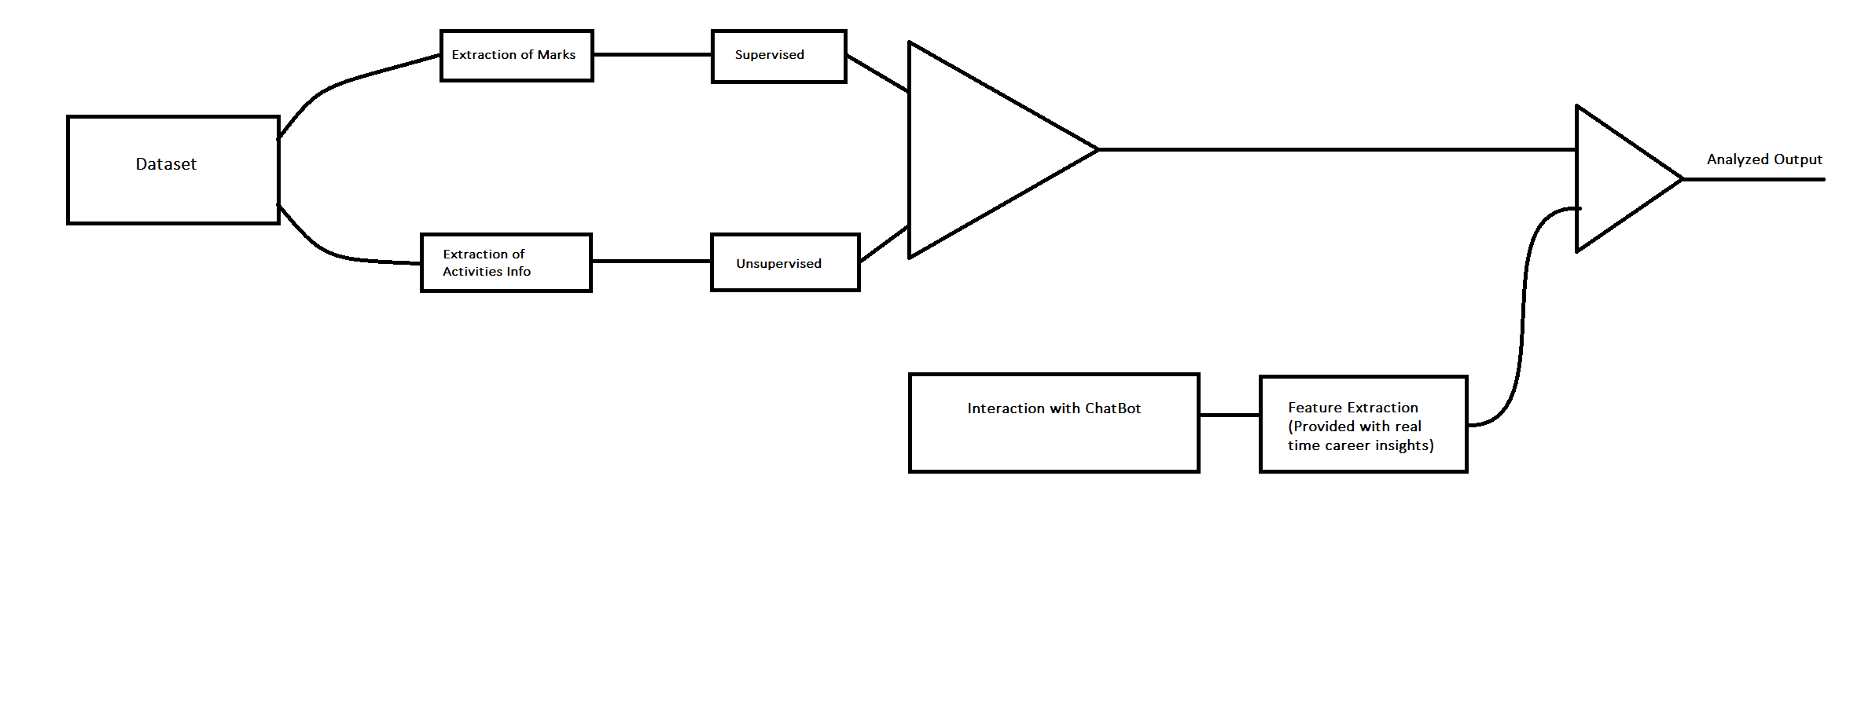
System Design(contd.)

Slide 8
System Design(contd.)
As from the given criteria, we are going to implement the model as web application.
Django and Humalect is considered to implement the model for web application.
REST Framework is a flexible toolkit for building Web APIs which can be used to machine learning model deployment by calling an API endpoint.

Slide 9
System Design(contd.)
As we are analyzing their career based on their marks in aptitude tests and previous marks, we are going to to implement them by classification through supervised learning.
For the other miscellaneous activities like hobbies and area of interest, we are going to implement through clustering through unsupervised learning.
This results will be further processed and analysed and followed by the student will be interacted with ChatBot

Slide 10
Prototype
The scores will be calculated and it is analyzed by the trained model, the further career guidance will be taken.
The front end development is done using StreamLit and Humalect. StreamLit is a framework for creating interactive web apps. is a platform for deploying and hosting web apps
The prototype model is a good starting point for out model. It is able to achieve a high classification accuracy and it is relatively considered easy to implement. However, the prototype model can be improved by using a larger dataset of labelled career choice and thus improving a more sophisticated environment for career guidance system.

Slide 11
Technologies
Machine Learning and Data Analytics:
Machine learning libraries and frameworks like TensorFlow, PyTorch, or scikit-learn for building recommendation models.
Data analytics tools to process and analyze user data, such as Python's pandas and NumPy libraries.
Natural Language Processing (NLP):
NLP libraries and frameworks, like spaCy, NLTK, or Hugging Face Transformers, for text analysis and understanding user input.
Pretrained language models for text generation, sentiment analysis, and entity recognition.

