Slide 1

BASIC DETAILS OF THE TEAM AND THE PROBLEM STATEMENT
Ministry: Department of School Education & Literacy (DoSEL), Ministry of Education.
PS Code: RK790
Problem Statement: Access to Education - education delivery for specially-abled students Innovations in improving the delivery of education to students with special needs to improve the learning outcome.
Team Name : Techie Phoenix
Team Leader Name: Sheron S
Institute Code (AISHE): 1-3516234145
Institute Name: Mepco Schlenk Engineering College
Theme Name: Miscellaneous

Slide 2
IDEA / APPROACH DETAILS
Different User Interface’s (UI) are created so that people with different disorder can access and learn from the application independently.
Speech-to-text is used for blind people to access the application and Text-to-speech is used for blind people to access the book in audio format (Visual User Interface).
Eye ball movement is detected to control the cursor on the UI, so that paralyzed people (who cannot use voice and hand to control UI) can access the application.
Interactive quizzes are provided to assess the Intelligent Quotient (IQ) of dyslexia or low IQ people in order to provide learning units customized to their level.
Application is loaded with learning units of different cognitive levels which can be accessed easier by dyslexia/disabled students.
The students are also continuously monitored of their progress and provided with modified and updated learning units to increase learning outcomes.

Slide 3


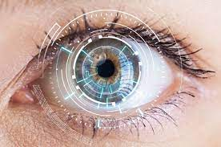

USECASE
Deaf can access through normal UI (touching). The learning units will be in the form of pictorial representation.
Blind can access through speech recognition. The learning units will be available in the form of audio.
Physically disabled people can access through eye ball movement. The learning units will be in the normal form.
People having learning difficulty can access the through normal UI. They have an IQ based quiz to assess them and provide learning units accordingly.

Slide 4
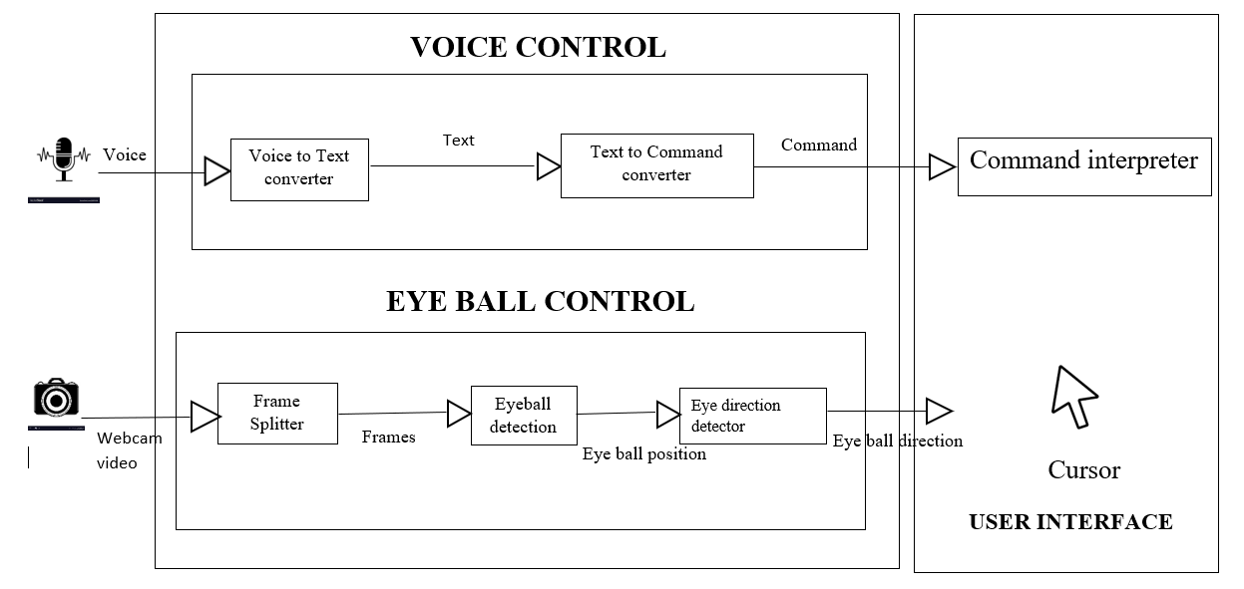
SYSTEM DESIGN
TECHNOLOGIES AND DEPENDENCIES
1. Libraries:
a. Open CV
b. Natural Language Processing
c. Front End - React JS
d. Back End - Nodejs , MongoDB
2. Dependencies:
a. React : Speech Recognition
b. React : Text - Speech

Slide 5
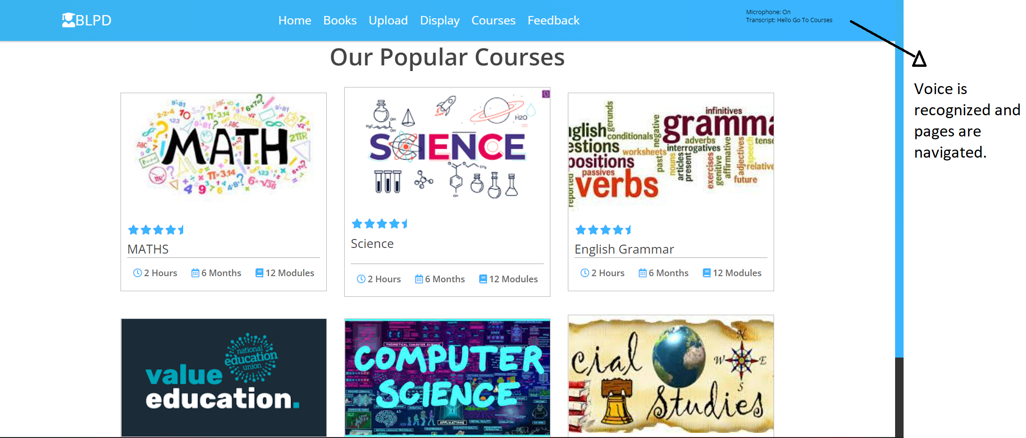
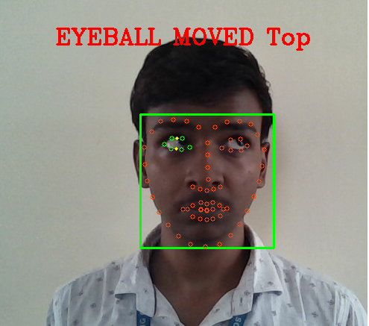
IMPLEMENTATION SCREENSHOTS
Navigating the UI using voice commands
Controlling the cursor using eye ball movement

Slide 6
TEAM MEMBERS DETAILS
Team Member Name | Branch | Stream
Sheron S (Leader) | Bachelor of Engineering | Computer Science Engineering
Aadith Thillai Arasu S | Bachelor Of Engineering | Computer Science Engineering
Stalin Raj A | Bachelor Of Engineering | Computer Science Engineering
Mohammed Umar M | Bachelor Of Engineering | Computer Science Engineering
Smitha Rajini T | Bachelor Of Engineering | Computer Science Engineering
Praveen S | Bachelor Of Engineering | Computer Science Engineering
Team Mentor Name | Category | Expertise Domain | Domain Experience
Dr.G.Yogarajan | Academic | Networking | 17 years
Dr.S.Priyadharsini | Academic | Image Processing, Deep Learning | 10 years

