Slide 1
★ AMIHACKS 2026 · TRACK C: CYBERSECURITY & API SECURITY
SentinelAPI
Autonomous Differential API Security Testing
While 200 teams build generic AI wrappers or test basic SQLi/XSS, SentinelAPI solves the #1 blindspot in modern cloud software: Broken Object Level Authorization (BOLA/IDOR).
WHAT TRACK C DEMANDS · OWASP API #1 Focus
Automated detection of authorization logic flaws across multi-tenant boundaries that traditional scanners miss completely.
HOW WE SOLVE IT · Ground-Truth Matrix
Learns real resource ownership without guessing IDs, then compares cross-user responses using weighted Jaccard differential distance.
WHY WE WIN · Zero False Positives
Empirical live re-probes verify 100% reproducibility, generating shell-safe copy-paste cURL PoCs with zero cleartext token leaks.
Lead Security Architect: Tanuj | Full-Stack & Security Engineering | GitHub: https://github.com/x03tanuj/sentinel-api

Slide 2
● WHAT IT IS SOLVING (PROBLEM STATEMENT)
The Multi-Billion Dollar API Authorization Blindspot
⚠️ OWASP API Security #1 Threat (API1:2023): Over 40% of cloud API breaches stem from Broken Object Level Authorization (BOLA/IDOR) — yet 99% of automated security scanners cannot detect it.
THE CORE FLAW
Changing id=101 to id=102
An authenticated user simply changes an ID parameter in an API request and directly reads, modifies, or deletes another customer's private invoices, patient medical charts, or banking records.
TRADITIONAL TOOLS FAIL
DAST & SAST Are Blind to Auth
Conventional scanners only test for syntax injection like SQLi or XSS. Operating in single-user isolation, they have zero understanding of multi-tenant ownership, role privileges, or cross-account access boundaries.
SILENT EXPLOITATION
Flaws Evade Firewalls & WAFs
Because BOLA requests use valid JWT tokens and legitimate JSON formats, target APIs respond with standard 200 OK payloads. WAFs see completely normal traffic, leaving breaches undetected for months.
SentinelAPI · AmiHacks 2026 (Track C: Cybersecurity) Slide 2 of 10

Slide 3
● HOW IT IS SOLVING IT (PROPOSED SOLUTION)
The 4-Step Autonomous Differential Security Pipeline
STEP 1
Spec Ingestion & Mapping
Ingests OpenAPI 3.x contracts from URLs or files. Validates schemas, dereferences circular $ref pointers, and prioritizes endpoints by state-changing methods and authorization requirements.
STEP 2
Ownership Discovery
Authenticates multiple distinct personas (userA, userB, admin). Automatically queries legitimate profile & collection endpoints to discover owned resources without guessing IDs.
STEP 3
Differential Analysis
Compiles a ground-truth Allow/Deny expectation matrix. Dispatches rate-limited cross-user probes and mathematically measures response divergence using weighted Jaccard distance and schema shifts.
STEP 4
Empirical Proof & cURL
Actively re-probes live findings to prove reproducibility (boosting confidence to 100%). Generates copy-paste shell-safe cURL PoCs with masked $TOKEN placeholders for instant remediation.
Core Advantage: Entirely autonomous from spec to PoC. No manual test scripting, no synthetic dummy payloads, and zero secrets leaked.
SentinelAPI · AmiHacks 2026 (Track C: Cybersecurity) Slide 3 of 10

Slide 4
● WHAT IS UNIQUE ABOUT THIS
Why SentinelAPI Wins: Standing Out Against 200 Teams
EVALUATION CRITERIA
TYPICAL HACKATHON TEAMS (200 TEAMS)
SENTINELAPI (OUR SOLUTION)
Vulnerability Focus
Generic SQLi, XSS, or syntax input fuzzing
Complex Multi-User Authorization (BOLA, BFLA, Data Exposure)
Detection Engine
Asks an LLM 'is this vulnerable?' (Hallucinations & Flaky)
100% Deterministic Differential Engine (Weighted Jaccard Distance)
Ownership Knowledge
Random ID guessing or hardcoded IDs in test scripts
Autonomous Resource Ownership Discovery from Legitimate APIs
Accuracy & Evidence
Vague warnings with high false positive rates
Empirically Proven Live Reproduction + Copy-Paste cURL PoCs
Safety & Egress
Unrestricted flood requests; sends raw tokens to AI
Scope Guard, 20 RPS Rate Cap, Budget Cap, Zero Egress PII Guard
Production Readiness
Mock scripts or static Figma UI concept
FastAPI Backend + React 19 HUD + Headless CI Gate + Docker Stack
SentinelAPI · AmiHacks 2026 (Track C: Cybersecurity) Slide 4 of 10

Slide 5
● KEY FEATURES (PROPRIETARY IP)
The Core Security Engine: 6 Proprietary Deep-Tech Engines
ENGINE 1 · Attack Surface Mapper
Parses OpenAPI 3.x specifications with circular $ref resolution. Extracts query/path parameters and scores initial endpoint risk based on state-changing methods.
ENGINE 2 · Identity & HTTP Executor
Multi-persona JWT session manager enforcing 20 RPS token-bucket rate limits, 1,000 req budgets, and strict host allowlists (assert_in_scope).
ENGINE 3 · Matrix Compiler
Discovers legitimate resource ownership per user and compiles a mathematical Allow/Deny expectation matrix for every endpoint and object ID.
ENGINE 4 · Differential Analyzer
Computes weighted Jaccard payload similarity, HTTP status divergence, and detects leaked sensitive PII fields outside the documented schema.
ENGINE 5 · 6 Security Checks
Dedicated detection suites for BOLA/IDOR (API1), Broken Auth (API2), Data Exposure (API3), Rate Limiting (API4), BFLA Privileges (API5), and Input Anomalies (API8).
ENGINE 6 · Explainable Risk Scorer
Replaces CVSS guesswork with a 4-part score: Impact (40) + Exploitability (25) + Sensitivity (30) + Evidence (15) with live empirical reproduction.
SentinelAPI · AmiHacks 2026 (Track C: Cybersecurity) Slide 5 of 10

Slide 6
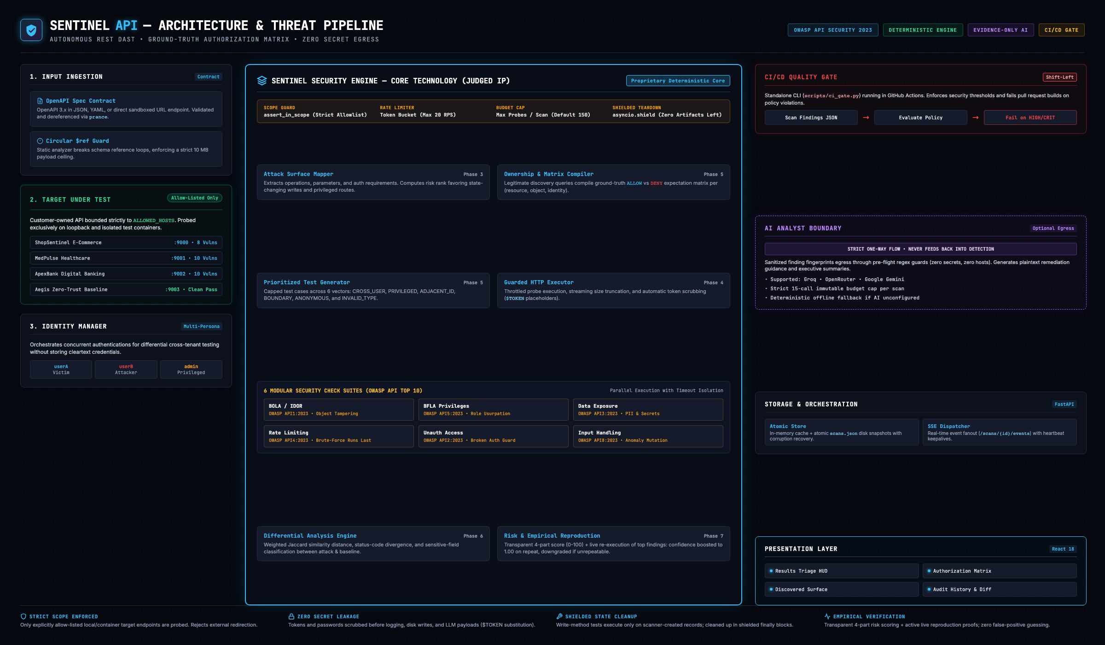
● SYSTEM ARCHITECTURE
Decoupled Architecture & Enforced Safety Boundaries
Core Safety Invariant: The deterministic security engine runs 100% offline. Zero credentials or tokens are ever persisted or exposed. The AI Analyst is strictly an evidence-only side-branch with zero raw data egress.
SentinelAPI · AmiHacks 2026 (Track C: Cybersecurity) Slide 6 of 10

Slide 7
● KEY FEATURES (DEVSECOPS INTEGRATION)
Shift-Left Automated Security Quality Gate for CI/CD
HEADLESS CI GATE CLI
Fails Builds on Violations
Integrates directly into GitHub Actions or GitLab CI. Breaks pull request builds with exit code 1 when CRITICAL or HIGH authorization vulnerabilities are detected.
SARIF CODE SCANNING
Native GitHub Security Alerts
Exports deterministic SARIF, Markdown, and JSON audit reports. Findings appear directly inside GitHub PR code review diffs with line-level remediation hints.
HERMETIC TEST SANDBOX
Verified Zero-Trust Baseline
Ships with realistic vulnerable sandboxes (Retail Store, Healthcare, FinTech). When SECURE_MODE=true is enabled, SentinelAPI verifies 100% controls pass.
GITHUB ACTIONS WORKFLOW INTEGRATION (.github/workflows/ci.yml):
# 1. Trigger automated security scan against PR environment
python -m app.cli scan --spec http://api:8000/openapi.json --base-url http://api:8000 --json-out findings.json
# 2. Enforce quality gate (fails build on CRITICAL / HIGH findings with confidence >= 0.70)
python scripts/ci_gate.py --findings findings.json --fail-on CRITICAL,HIGH --min-confidence 0.70
SentinelAPI · AmiHacks 2026 (Track C: Cybersecurity) Slide 7 of 10

Slide 8
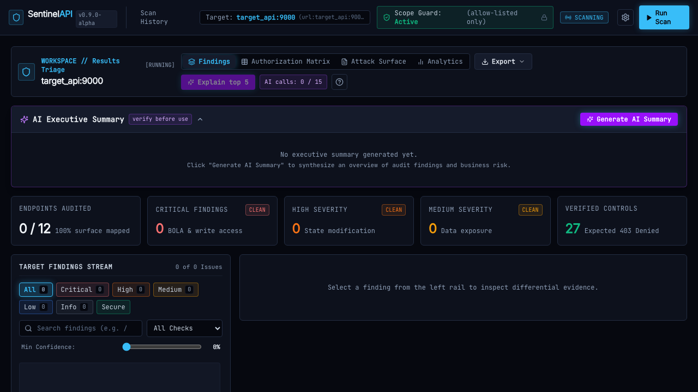
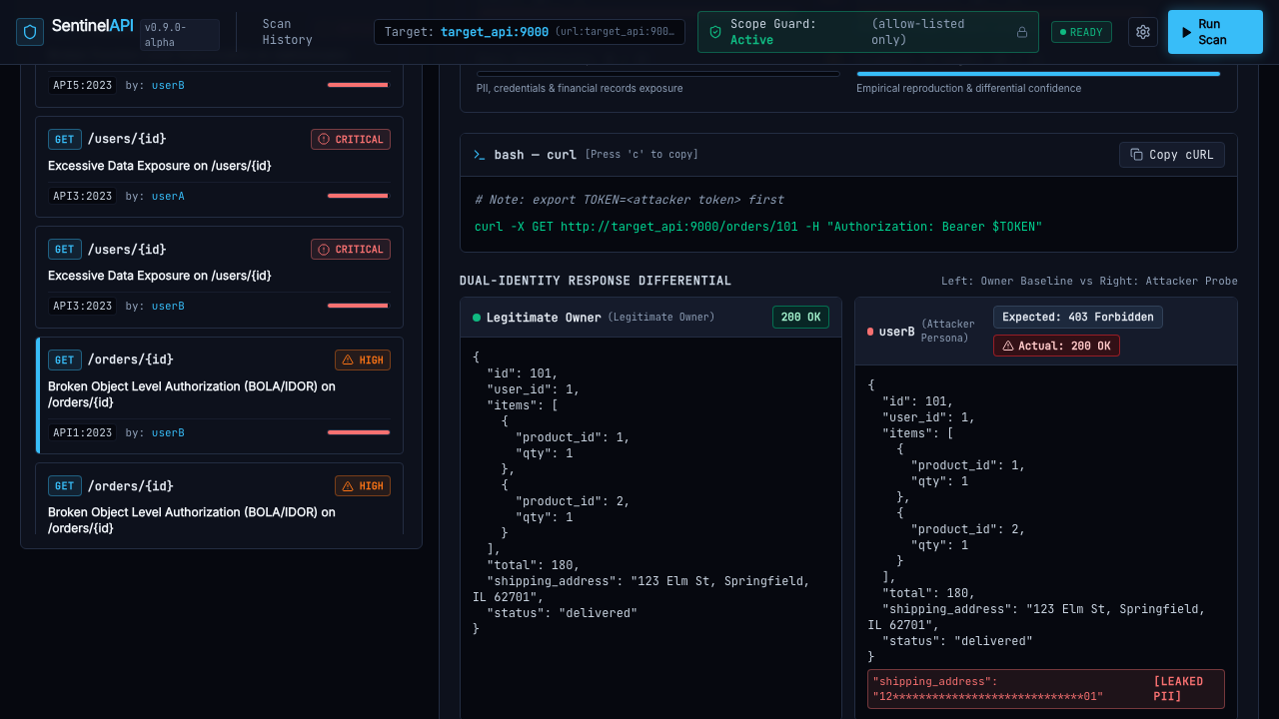
● DEMO SCREENSHOTS (WORKING PROTOTYPE)
Live Tactical Dashboard & Mathematical Differential Inspector
Results Triage Workspace: Real-Time Stream
Live telemetry HUD with verified control counts, severity badges, and one-click filtering across OWASP categories, status codes, and paths.
Differential Inspector: Side-by-Side Proof
Side-by-side baseline vs attack diff showing BOLA breach (200 OK vs 403), leaked PII fields, 4-factor risk breakdown, and copy-paste cURL PoC.
Empirical Evidence: Zero guesswork. Developers receive exact response diffs, 100% verified reproduction badges, and copy-paste shell commands.
SentinelAPI · AmiHacks 2026 (Track C: Cybersecurity) Slide 8 of 10

Slide 9
● FUTURE SCOPE (COMMERCIAL ROADMAP)
Beyond the Hackathon: Path to an Enterprise SaaS Platform
PHASE A · COMMERCIAL SAAS
Open-Source CLI + Paid Cloud Dashboard
Maintain open-source CLI runner for individual developers and CI gates. Commercialize a hosted, multi-tenant SaaS dashboard for engineering organizations with centralized RBAC, historical risk trending, team collaboration, and vulnerability triage workflows.
PHASE B · ENTERPRISE AUTH
Enterprise OAuth2 & SSO Negotiation
Extend beyond static JWTs to automated OAuth2 / OIDC PKCE flow negotiation, SAML handshakes, and mTLS client-certificate authentication for complex enterprise banking, fintech, and healthcare environments.
PHASE C · COMPLIANCE MAPPINGS
Custom Regulatory Policy Engines
Provide declarative YAML policy mappings translating authorization findings directly into HIPAA, PCI-DSS, SOC 2, and ISO 27001 audit deliverables with automated executive PDF sign-off reports.
PHASE D · DISTRIBUTED MESH
Distributed Scanner Mesh & Persistence
Deploy distributed Kubernetes scanner workers capable of concurrently auditing large microservice meshes, backed by MongoDB and PostgreSQL persistence adapters for multi-year enterprise audit archiving.
SentinelAPI · AmiHacks 2026 (Track C: Cybersecurity) Slide 9 of 10

Slide 10
● CONCLUSION & Q&A
Team & Project Summary — Questions & Live Demo
CORE TEAM & ARCHITECTURAL CONTRIBUTIONS
Tanuj — Lead Security Architect & Full-Stack Engineer
• Core Security Engine: Differential response analyzer, ground-truth authorization matrix compiler, and 6 modular OWASP security checks.
• Execution & Safety Infrastructure: Token-bucket HTTP executor, strict immutable scope guard, rate/budget caps, and multi-persona JWT orchestrator.
• Backend & Storage: FastAPI async orchestrator, real-time SSE telemetry stream, and atomic JSON store with secret leak guards.
• Tactical Web UI: React 19/Vite dashboard, Results Triage Workspace, Authorization Heatmap, and Differential Inspector.
• CI Quality Gate: Headless ci_gate.py, Docker Compose testbed, live empirical reproduction, and zero-egress AI analyst boundary.
PROJECT SUMMARY & LIVE ACCESS
“SentinelAPI stops API authorization breaches before code hits production — fully autonomous, mathematically verified, with reproducible evidence and zero secrets leaked.”
GitHub Repository: https://github.com/x03tanuj/sentinel-api
Live Web Dashboard: http://localhost:8080
Automated Demo Script: bash scripts/demo.sh
Architecture Diagram: docs/architecture.png (2400×1400)
Thank You! We are now open for Q&A and Live Demo.
SentinelAPI · AmiHacks 2026 (Track C: Cybersecurity) Slide 10 of 10

