Slide 1
INTRODUCTION TO OS AND ITS FUNCTIONS

Slide 2
Definition
An operating system is a program that manages the computer hardware. It also provides a basis for application programs.
Acts as an intermediary between the computer user and the computer hardware.
Operating system goals:
Execute user programs and make solving user problems easier
Make the computer system convenient to use
Use the computer hardware in an efficient manner

Slide 3
OS is a resource allocator
Manages all resources
Decides between conflicting requests for efficient and fair resource use
OS is a control program
Controls execution of programs to prevent errors and improper use of the computer
“The one program running at all times on the computer” is the kernel.
Everything else is either
a system program (ships with the operating system) , or
an application program.

Slide 4
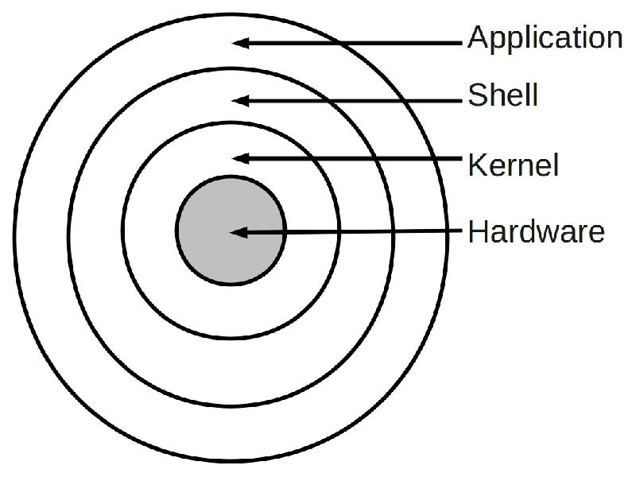
OS ARCHITECTURE

Slide 5
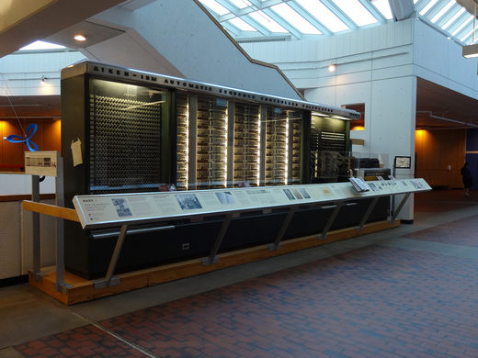
First generation (1945-1955)
The first generation of computer were huge, slow, expensive and often unreliable. In 1946, two Americans, Presper Eckert and Willian Mauchly build the ENIAC (Electronic Numerical Integrator and Computer).
It use vacuum tube instead of mechanical switches of the MARK
MARK I Features:
It could perform five basic arithmetic operations: addition, subtraction, multiplication, division and table reference
It took approximately 0.3 seconds to add two numbers and 4.5 seconds for multiplication of two numbers
MARK I Disadvantages :
It was huge in size
Complex in design.
Very slow

Slide 6
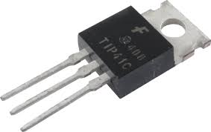
SECOND GENERATION & BATCH system (1955-1965)
Features :
Vacuum tubes were replaced by transistors.
Works on Batch System
Transistor is a small device that transfers electronic signals through resistors.
The creation of transistor spark the production of a wave of second generation computer. Transistor was small devices use to transfer electronic signals across a resister. Transistors had many advantages compared to other hardware technology.
transistors were smaller than vacuum tubes
they needed no warm up time
consumed less energy
generated much less heat
faster and more reliable

Slide 7
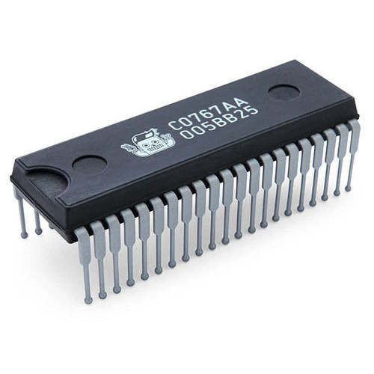
THIRD GENERATION & MultiProgramming(1965-1980)
Features :
In this generation microelectronics technology was introduced that made it possible to integrate large number of circuit elements into very small surface of silicon known as chips. This new technology was called INTEGRATED CIRCUIT.
Multiprogramming Introduced Advantages A new concept in this generation was that of a family of computer which allowed computer to be upgraded and expanded as necessary.
Silicone chips were reliable, compact and cheaper.
Sold hardware and software separately which created the software industry.
customer service industry flourished (reservation and credit checks)

Slide 8
FOURTH GENERATION (1980-PRESENT)
With the development of LSI (Large Scale Integration) circuits, chips containing thousands of transistors on a square centimeter of silicon, the age of the personal computer dawned.
In terms of architecture, personal computers (initially called microcomputers) were not all that different from minicomputers of the PDP-11 class, but in terms of price they certainly were different.
Where the minicomputer made it possible for a department in a company or university to have its own computer, the microprocessor chip made it possible for a single individual to have his or her own personal computer.
Advantages
· Computers became 100 times smaller than ENIAC (Electronic Numerical Integrator and Computer) the first computer
· Gain in speed, reliability and storage capacity

Slide 9
Fifth GENERATION (1990-PRESENT)
Mobile Computers
Mobile Phone OS eg. Symbian, Blackberry, iphone, Android

Slide 10
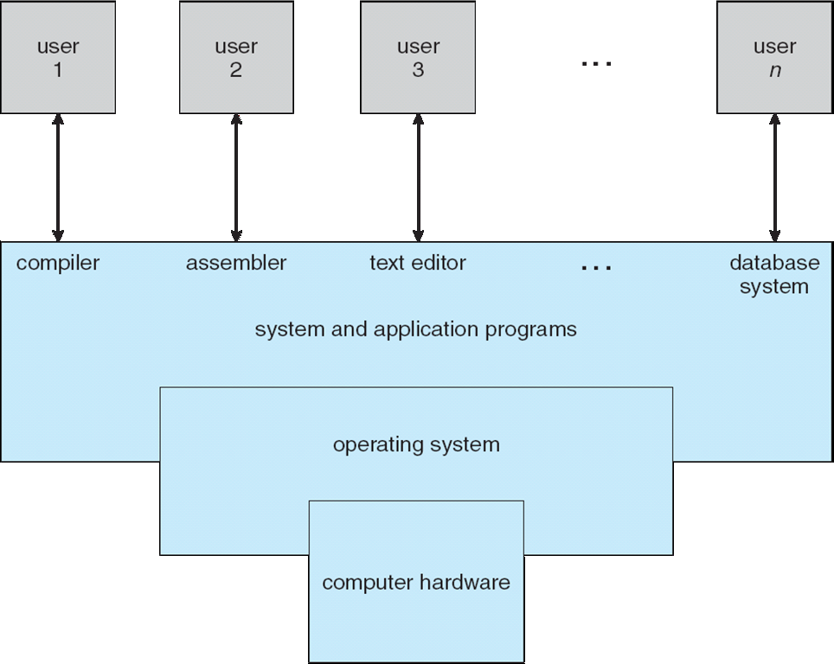
Components of computer system
1.User View 2.System View

Slide 11
Computer system can be divided into four components:
Hardware – provides basic computing resources
CPU, memory, I/O devices
Operating system
Controls and coordinates use of hardware among various applications and users
Application programs – define the ways in which the system resources are used to solve the computing problems of the users
Word processors, compilers, web browsers, database systems, video games
Users
People, machines, other computers

Slide 12
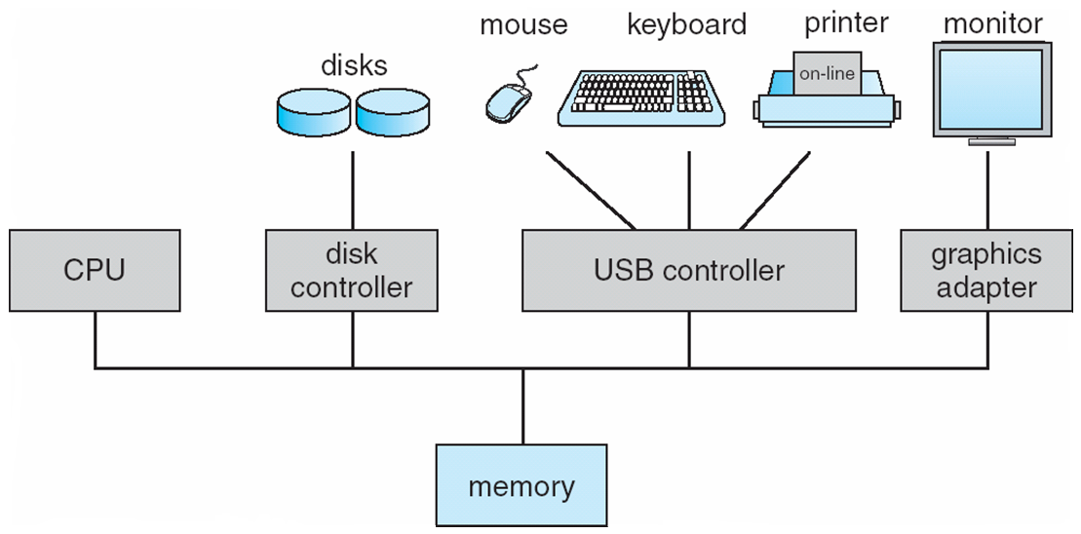
Computer System Organization
Computer-system operation
One or more CPUs, device controllers connect through common bus providing access to shared memory
Concurrent execution of CPUs and devices competing for memory cycles

Slide 13
Storage Structure
Main memory – only large storage media that the CPU can access directly
Random access
Typically volatile
Secondary storage – extension of main memory that provides large nonvolatile storage capacity
Hard disks – rigid metal or glass platters covered with magnetic recording material
Disk surface is logically divided into tracks, which are subdivided into sectors
The disk controller determines the logical interaction between the device and the computer
Solid-state disks – faster than hard disks, nonvolatile
Various technologies
Becoming more popular

Slide 14
Computer-System Architecture
Most systems use a single general-purpose processor
Most systems have special-purpose processors as well
Multiprocessors systems growing in use and importance
Also known as parallel systems, tightly-coupled systems
Advantages include:
Increased throughput
Economy of scale
Increased reliability – graceful degradation or fault tolerance
Two types:
Asymmetric Multiprocessing – each processor is assigned a specie task.
Symmetric Multiprocessing – each processor performs all tasks

Slide 15
Functions/services of Operating system
User interface
Program execution
I/O operations
File-system manipulation
Communications
Error detection
Resource allocation
Accounting
Protection and security

Slide 16
Kernel in OS
Kernel is central component of an operating system that manages operations of computer and hardware.
It basically manages operations of memory and CPU time.
It is core component of an operating system.
Kernel acts as a bridge between applications and data processing performed at hardware level using inter-process communication and system calls.
kernel loads first into memory when an operating system is loaded and remains into memory until operating system is shut down again. It is responsible for various tasks such as disk management, task management, and memory management.

Slide 17
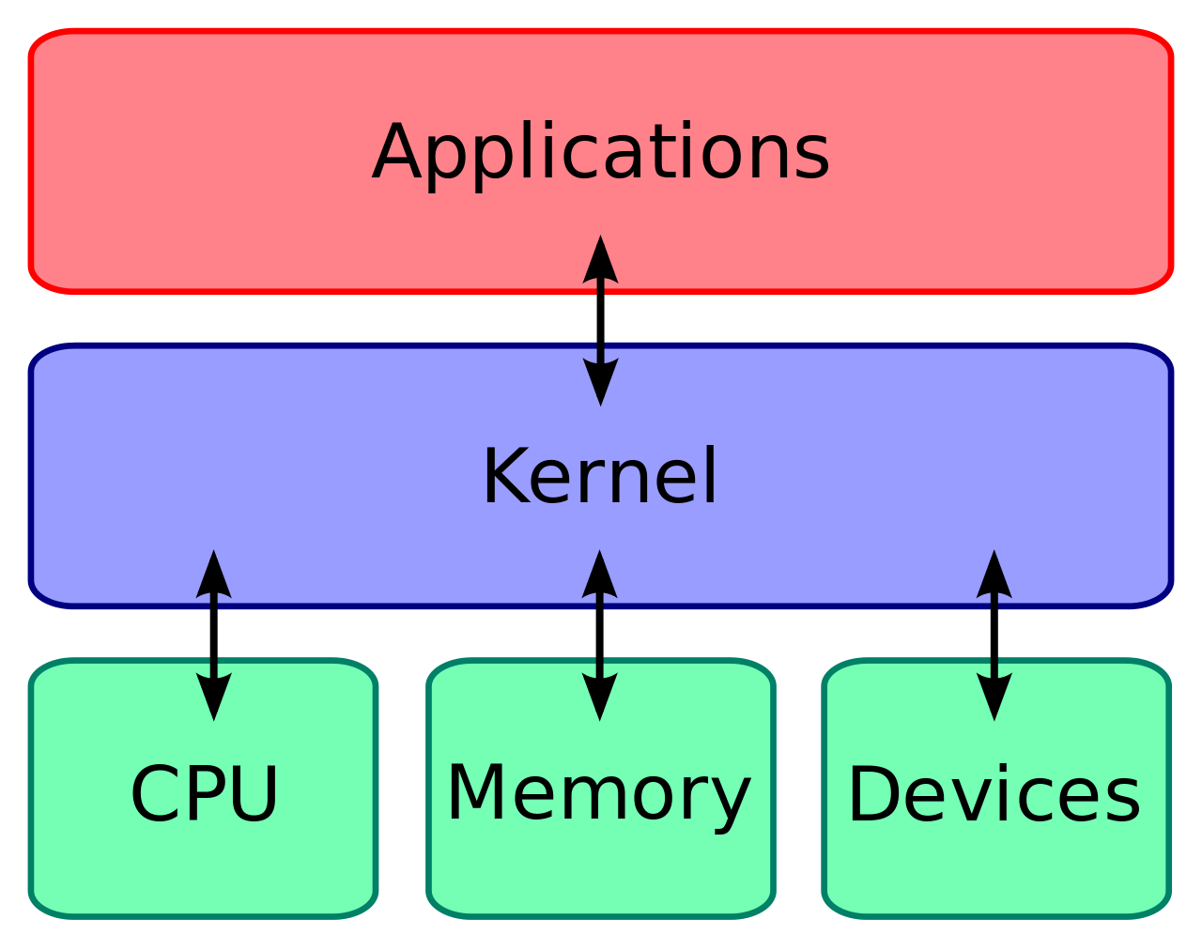

Slide 18
Types of Kernel:
Monolithic Kernels
Microkernel
Hybrid Kernel
Nanokernel
Exokernel

Slide 19
Monolithic Kernels:
In a monolithic kernel, the same memory space is used to implement user services and kernel services.
In this type of kernel, there is no different memory used for user services and kernel services.
As it uses the same memory space, the size of the kernel increases, increasing the overall size of the OS.
The execution of processes is also faster than other kernel types as it does not use separate user and kernel space.
Examples of Monolithic Kernels are Unix, Linux

Slide 20
Advantages:
The execution of processes is also faster as there is no separate user space and kernel space and less software involved.
As it is a single piece of software hence, it's both sources and compiled forms are smaller
Disadvantages:
If any service generates any error, it may crash down the whole system
Large in size and hence become difficult to manage.
To add a new service, the complete operating system needs to be modified.

Slide 21
b) Microkernel
A microkernel is also referred to as μK, and it is different from a traditional kernel or Monolithic Kernel.
In this, user services and kernel services are implemented into two different address spaces: user space and kernel space.
Since it uses different spaces for both the services, so, the size of the microkernel is decreased, and which also reduces the size of the OS.
Examples of Microkernel are L4, AmigaOS, Minix, K42, etc.

Slide 22
Advantages:
Microkernels are easier to manage and maintain as compared to monolithic kernels.
As in a microkernel, if a kernel process crashes, the crashing of the whole system can still be prevented by restarting the error-caused services.
A new service can be easily added without modifying the whole OS.
Disadvantages:
Process management is very complicated.

