Slide 1
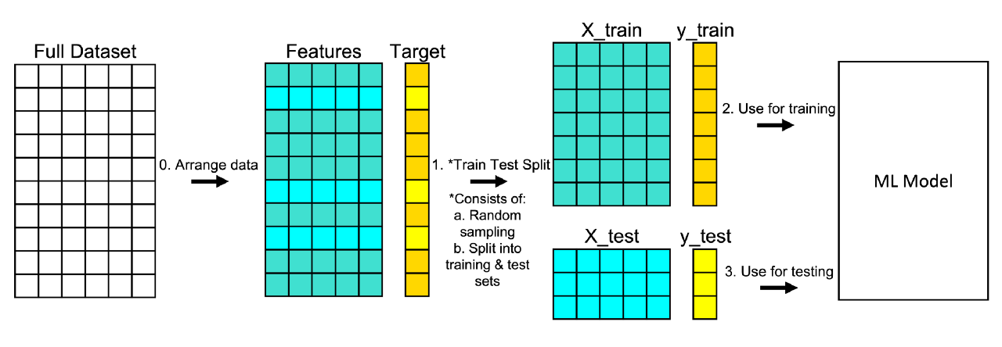
Change hyperparameters

Slide 2
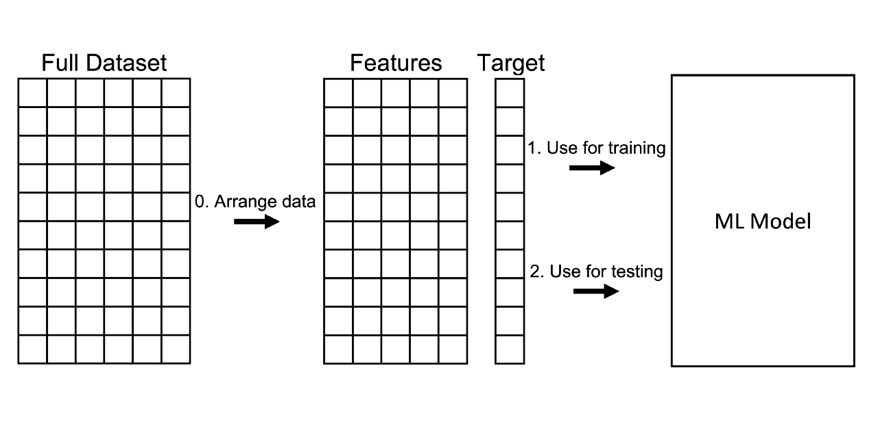
You can train and test your model on the same data, but this doesn’t simulate how a model would perform on new/unseen data and it tends to reward overly complex models that overfit on the dataset.

Slide 3
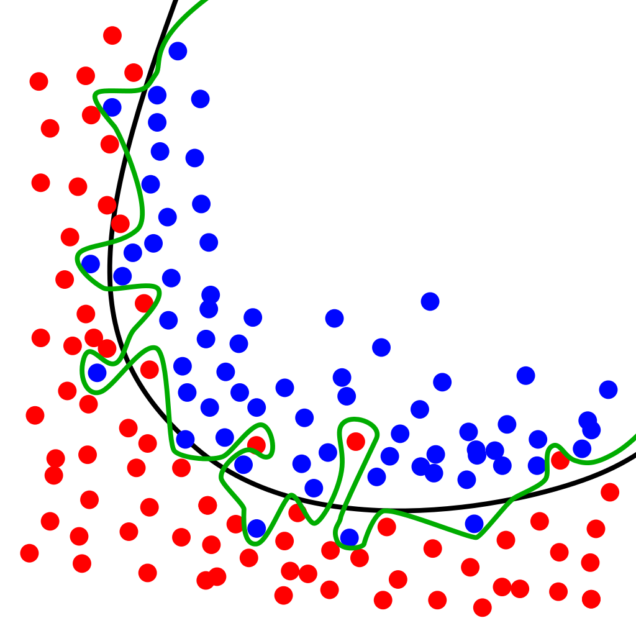

Slide 4
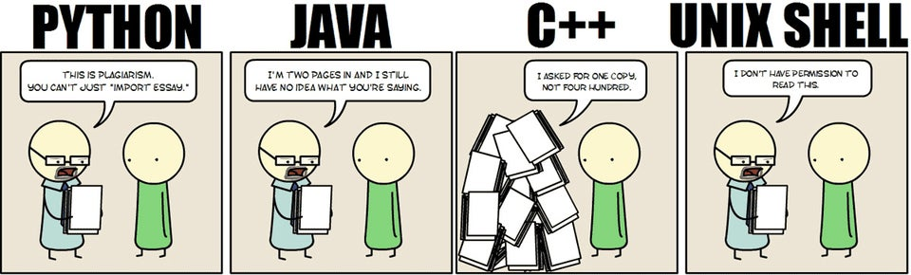

Slide 5
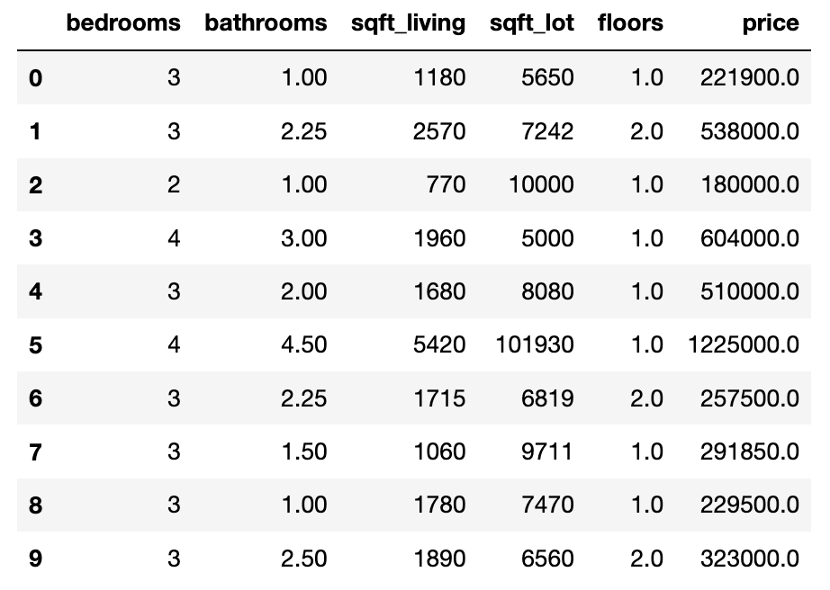

Slide 6
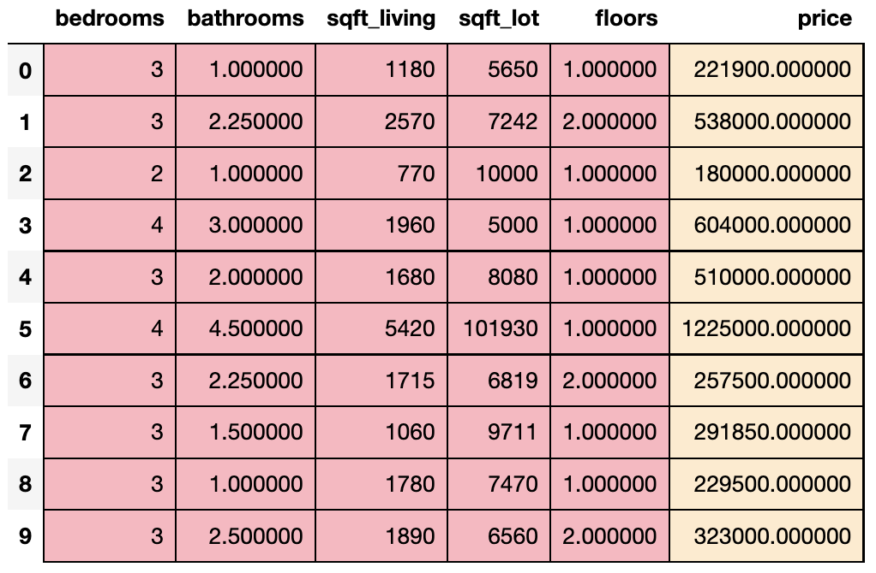
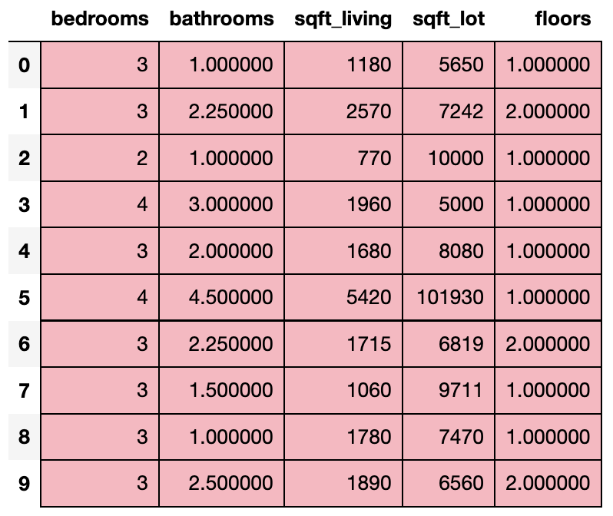
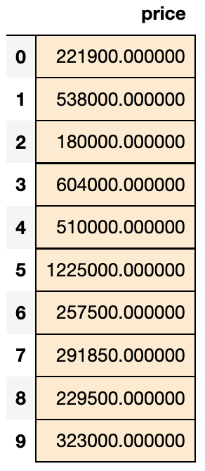
X = df.loc[:, features]]
y = df.loc[:, ‘price’]
df
X
y

Slide 7
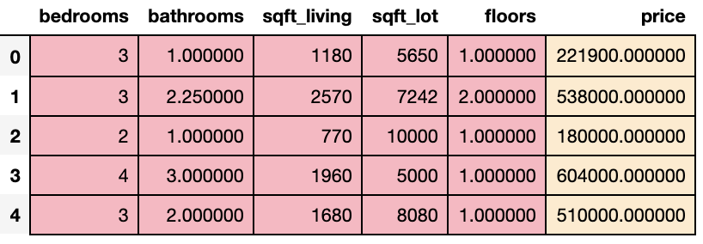
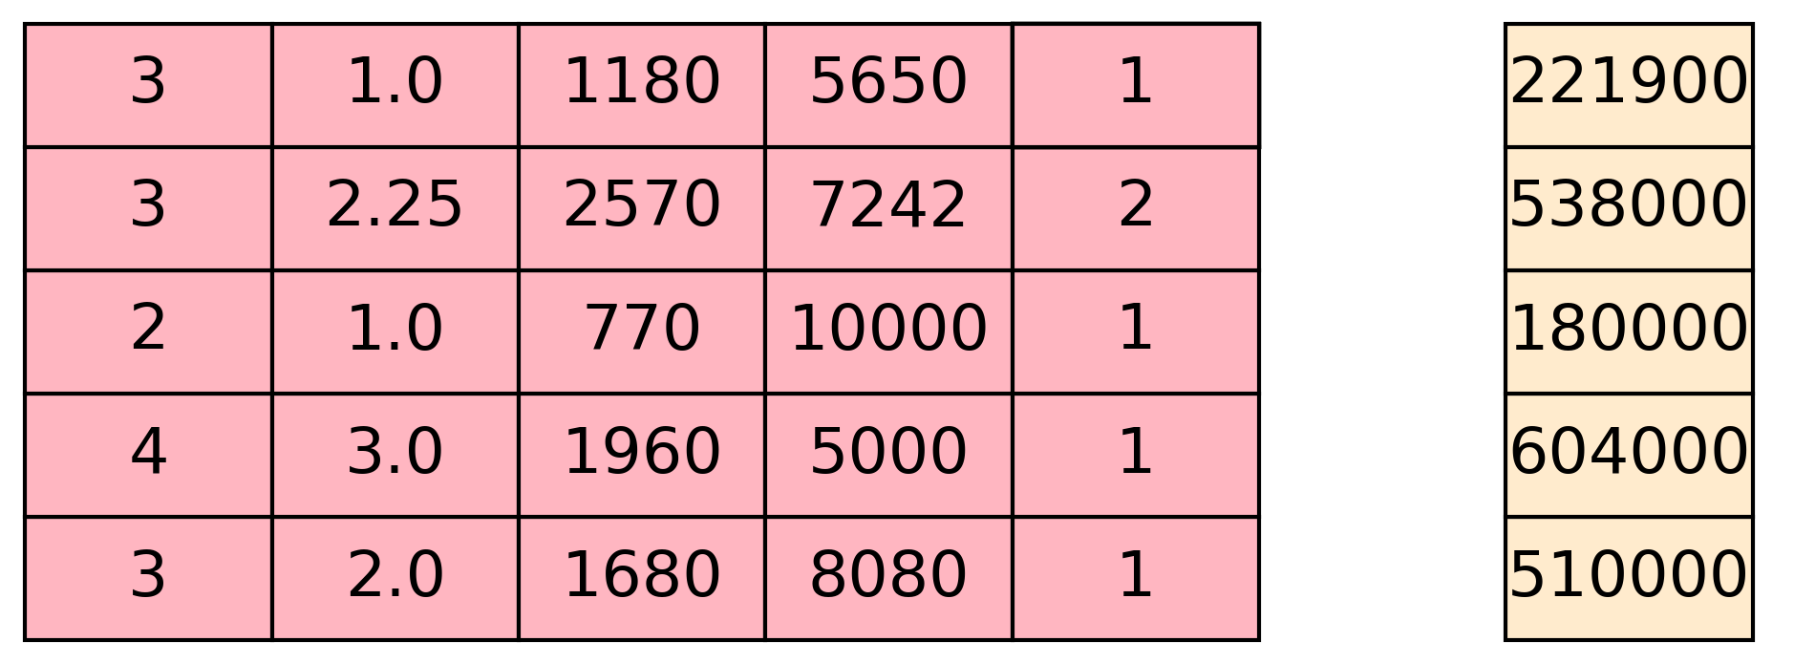
X = df.loc[:, features]].values
y = df.loc[:, ‘price’].values
df
X
y

Slide 8
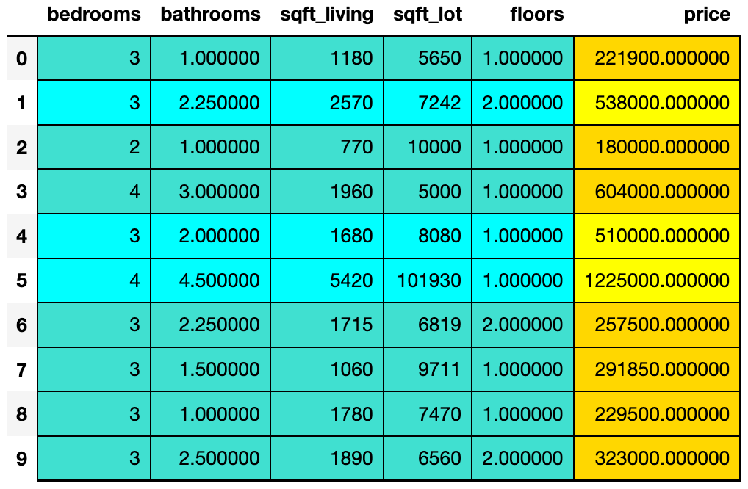
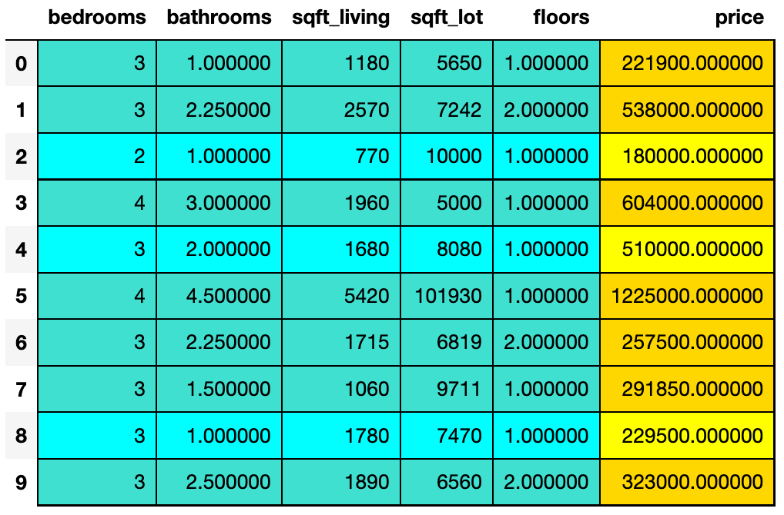
variable data will go to
X_train
X_test
y_train
y_test

Slide 9
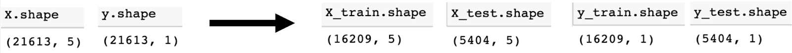

Slide 10
variable data will go to
X_train
X_test
y_train
y_test
random_state = 0
random_state = 2

Slide 11
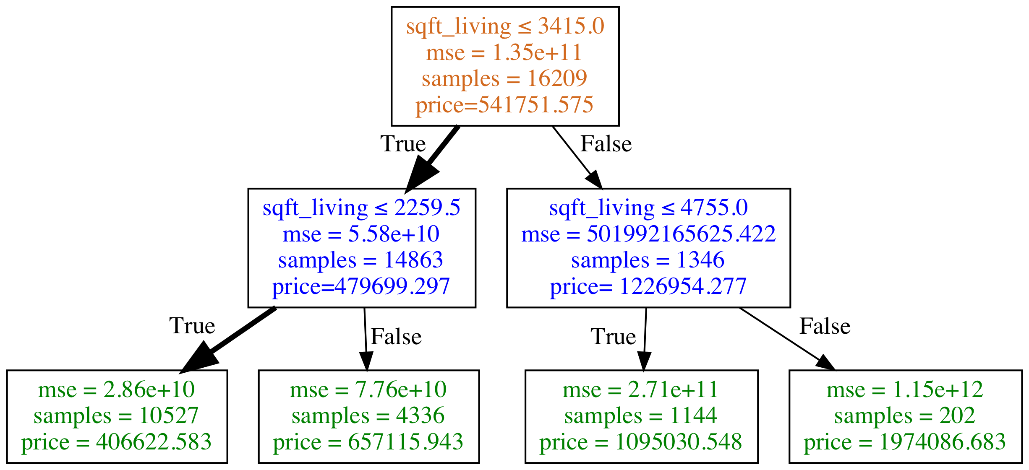
What is the price of a house with the following features?
bedrooms: 2
bathrooms: 1.5
sqft_living: 1430
sqft_lot: 1650
floors: 3
Type of Node
Root + Decision Node
Decision Node
Leaf/Terminal Node
The price prediction is 406622.583 which was based on the average price of 10527 houses (samples) contained in the leaf node.

Slide 12
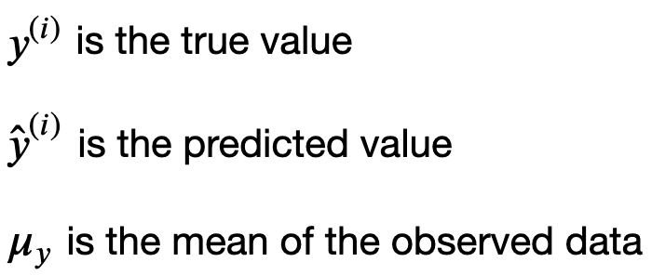
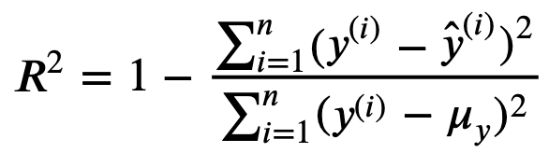
where

Slide 13
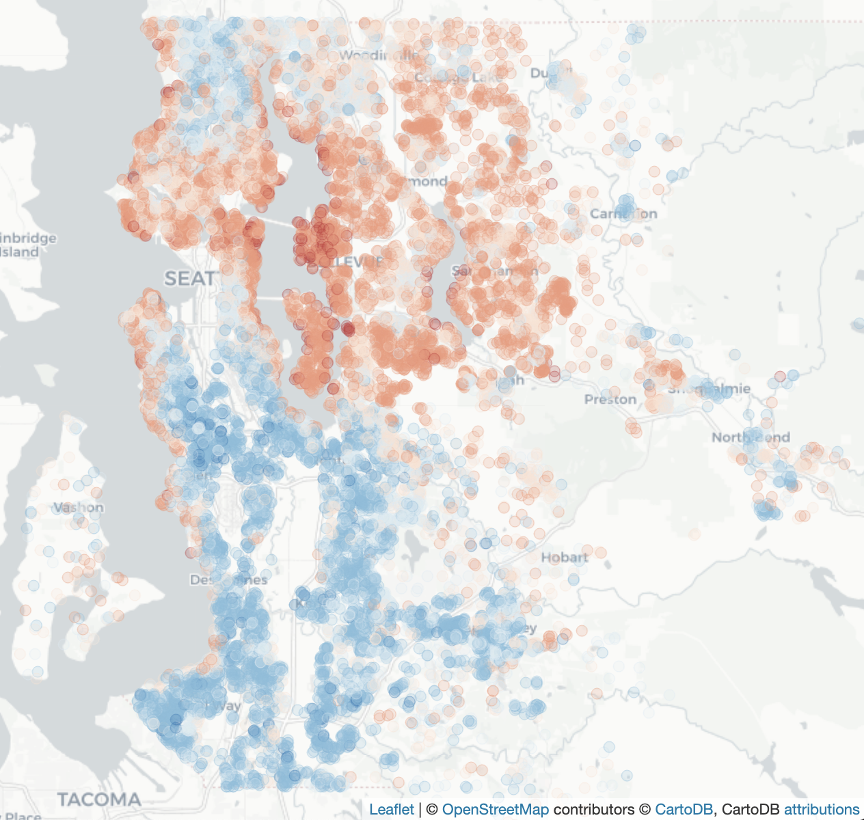
House Price
(0%) 75,000
(1%) 153,500
(25%) 321,950
(50%) 450,000
(75%) 645,000
(99%) 1,964,000+

Slide 14
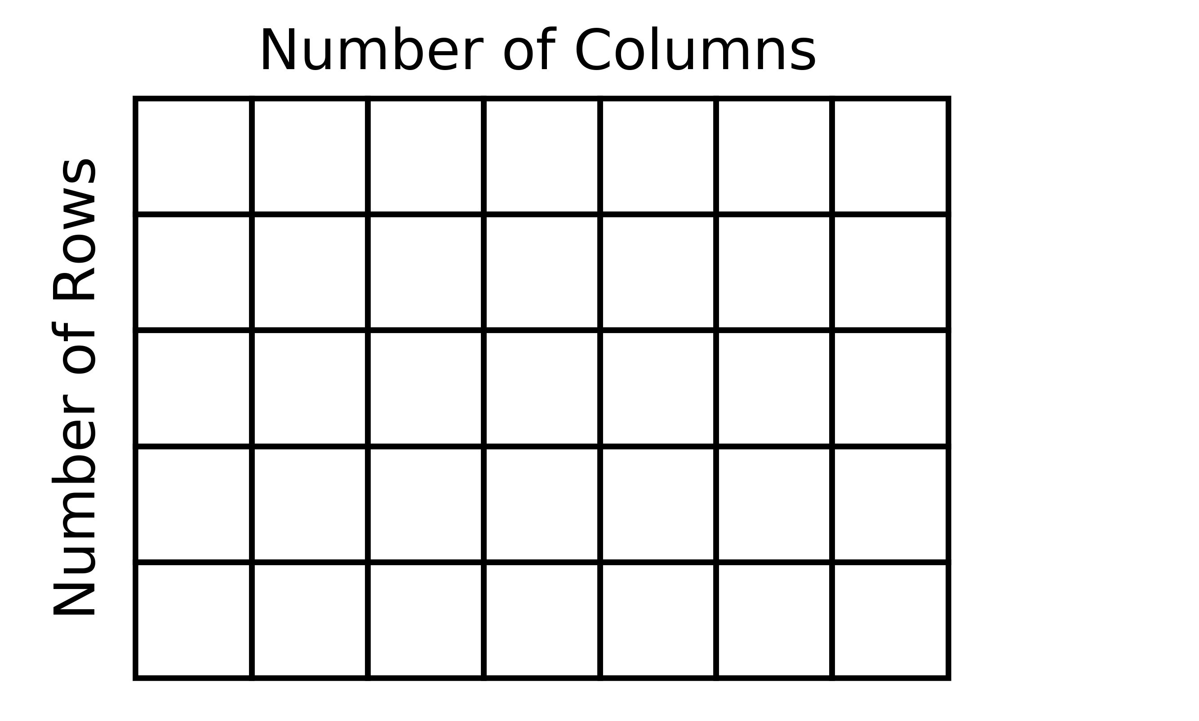
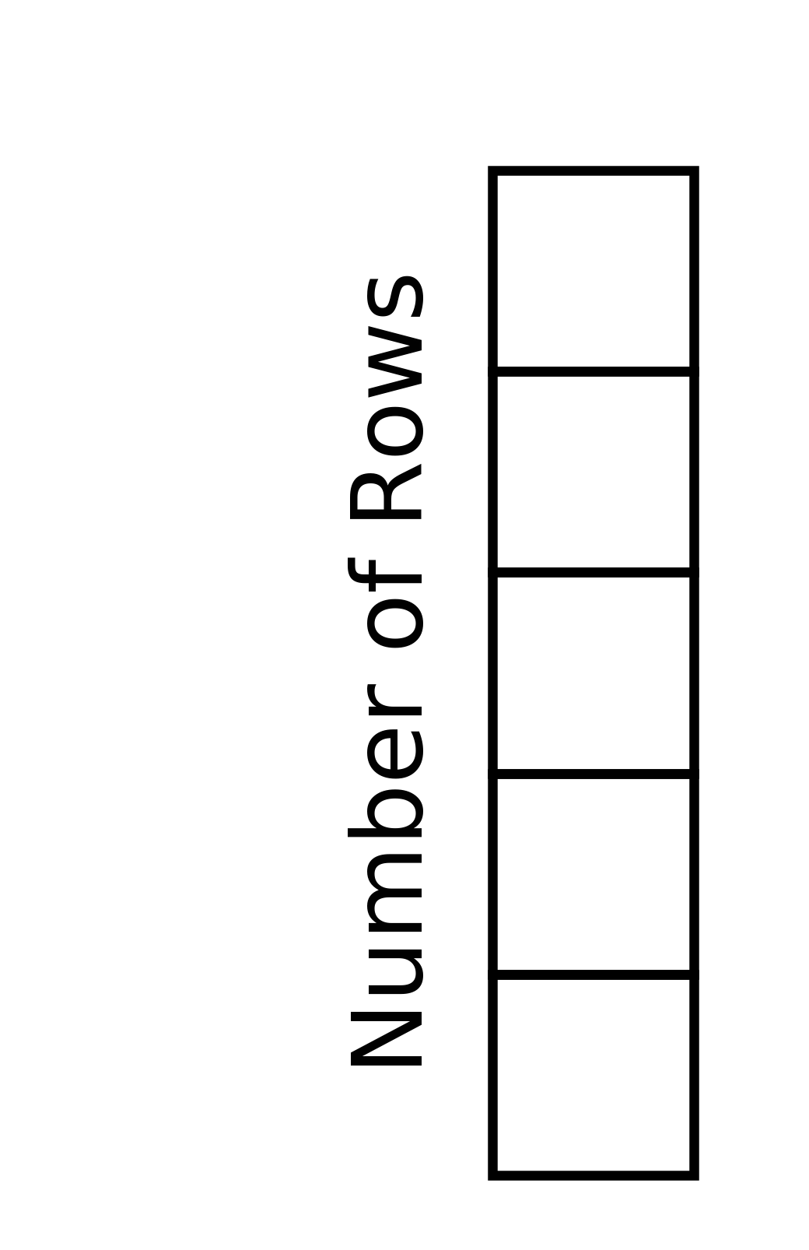
Features Matrix
Target Vector

Slide 15
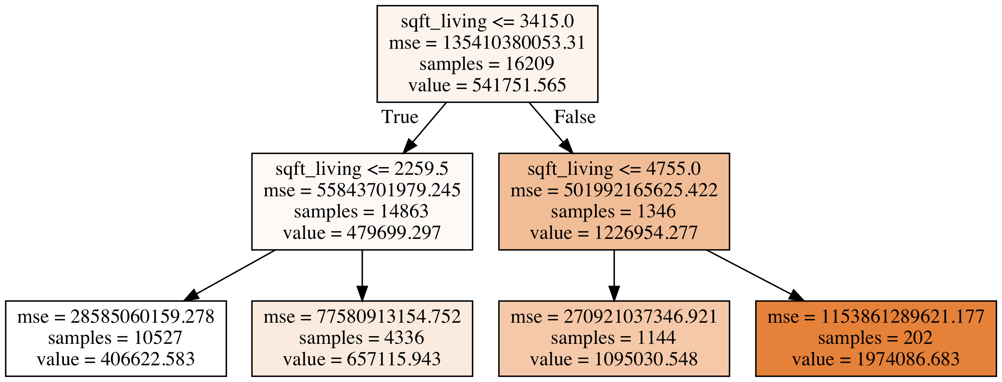
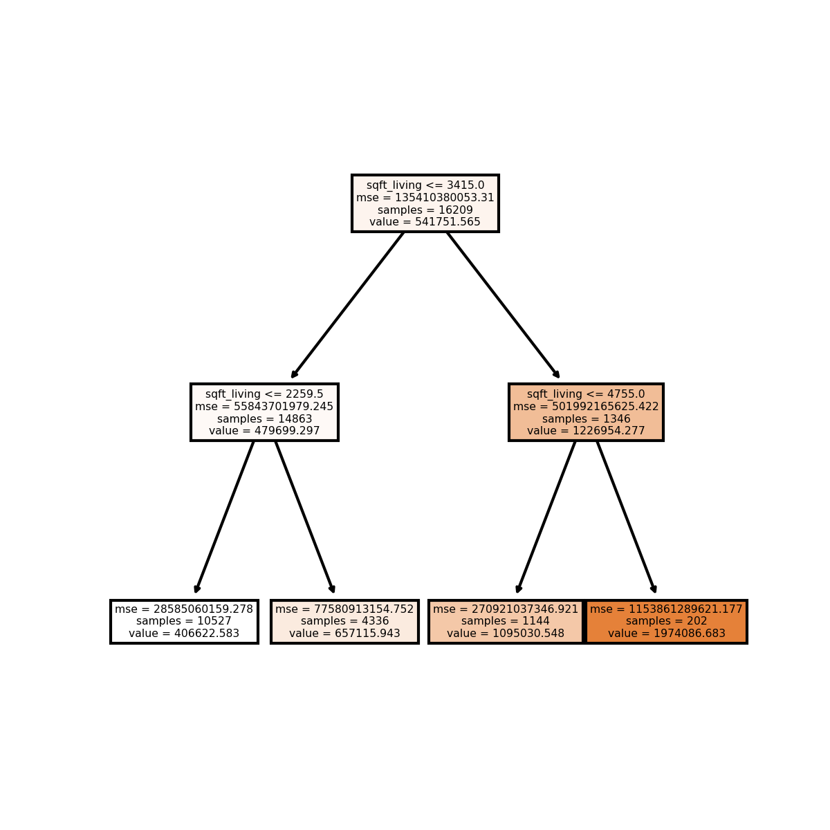
What is the price of a house with the following features?
bedrooms: 2
bathrooms: 1.5
sqft_living: 1430
sqft_lot: 1650
floors: 3
Type of Node
Root + Decision Node
Decision Node
Leaf/Terminal Node
The price prediction is 406622.583 which was based on the average price of 10527 houses (samples) contained in the leaf node.

