Slide 1
X10-based Agent Simulation on Distributed Infrastructure (XASDI) Application Development Guide
v0.9.0
IBM Research – Tokyo 2016/03/08

Slide 2
What is X10-based Agent Simulation on Distributed Infrastructure (XASDI)?
A multi-agent agent simulation platform on top of the X10 language
Java applications connected to ZASE can also attach to this base.

Slide 3
XASDI
X10-based Distributed Agent Simulation Platform
X10 is the state-of-the-art PGAS (Partitioned Global Address Space) language that brings high productivity when implementing highly parallel and distributed applications on post-peta or exascale machines
X10 provides the functionality that can seamlessly integrate with legacy applications written in Java or C++.
Programming Model
The agent programming model of XASDI is derived from our ZASE [Yamamoto, AAMAS2007] simulation platform
XASDI provides compatible API interface of ZASE to developers.
Gaku Yamamoto, et.al, “A Platform for Massive Agent-based Simulation and its Evaluation” , AAMAS 2007

Slide 4
XASDI Software Stack
The following diagram illustrates the software stack of XASDI and its applications.
Social Simulation(Java)(e.g. Traffic, CO2 Emission, Auction, Marketing)
XASDI API
Java Bridge
XASDI Runtime
X10 (Java, C++)

Slide 5
Directories
You can see the following sub directories under the “xasdi” directory.
api (API Javadoc)
doc (Contains this file)
jar (Simulation base jar file)
MySample (Eclipse project directory of tiny sample program)
src (XASDI source code)

Slide 6
Installation
Setup X10
Download pre-built binary of X10 2.5.4 for selected platform from http://x10-lang.org/releases/x10-release-254
After downloading, untar and see the INSTALL file for further instructions.

Slide 7
XASDI API CLASSES
Class information for developing applications on XASDI

Slide 8
Overview
World
World
Region
Region
Place
Place
CitizenProxy
CitizenProxy
CitizenProxy
CitizenProxy
Citizen
Citizen
Citizen
Citizen
Place
Place
CitizenProxy
CitizenProxy
CitizenProxy
CitizenProxy
Citizen
Citizen
Citizen
Citizen
Driver
Driver
Driver
Driver
X10 Place (X10 Runtime)
X10 Place (X10 Runtime)

Slide 9
Mapping to Traffic Simulation for example
World
World
Area
Area
Road
Road
VehicleProxy
VehicleProxy
VehicleProxy
VehicleProxy
Vehicle
Vehicle
Vehicle
Vehicle
Road
Road
VehicleProxy
VehicleProxy
VehicleProxy
VehicleProxy
Vehicle
Vehicle
Vehicle
Vehicle
CrossPoint
CrossPoint
CrossPoint
CrossPoint
X10 Place (X10 Runtime)
X10 Place (X10 Runtime)

Slide 10
Important Classes
Running simulation
Managing messages
LauncherProxy
Region
Driver
Place
CitizenProxy・Citizen
World
Message
MessageList
MessageQueue
MessageRepository
MessageResolver

Slide 11
LauncherProxy
A class for launching an agent simulation itself after creating relevant Regions, Drivers, Places, Citizens, World etc.
The first Java object to be created.
Assign agent ID to agent objects.
Create important objects (Launcher and Region).
The created agents and message objects are provided to the runtime of XASDI through Java APIs (xasdi_bridge).

Slide 12
Region
Possess agents (CitizenProxy and Driver), groups of agents (Place), mapping about objects and these IDs.
These objects are added, removed, and referenced at this class.
Region
Place
CitizenProxy
CitizenProxy
Citizen
Citizen
Place
CitizenProxy
CitizenProxy
Citizen
Citizen

Slide 13
Driver
Region
A Driver class triggers the behaviors of CitizenProxies and Places
Handle and execute Citizen objects.
At first handle Place objects, and then move CitizenProxy objects.
Driver objects can send and receive messages between other Driver and CitizenProxy objects.
Place
CitizenProxy
CitizenProxy
Citizen
Citizen
Place
CitizenProxy
CitizenProxy
Citizen
Citizen
Driver
Driver

Slide 14
Place
Group of CitizenProxy objects (Not X10 Place).
They have CitizenID and manage CitizenProxy objects.
CitizenID needs not to be a contiguous identifier.
CitizenID | CitizenProxy
0 | obj1
1 | obj2
… | …
N | objN

Slide 15
CitizenProxy
An agent class for sending and receiving messages.
A list of messages with source and destination identifiers sent from this class will delivered to MessageResolver
Behavior when receiving messages is defined at subclass (It can ignore received messages).
Each CitizenProxy object has one Citizen object handling their agent behavior or business logic.
Region
Place
CitizenProxy
CitizenProxy
Citizen
Citizen
Place
CitizenProxy
CitizenProxy
Citizen
Citizen

Slide 16
Citizen
A CitizenProxy object passes messages to the corresponding Citizen object that executes their agent behavior via the “execute” method.
The “execute” method returns a “Message” as a response.
Region
Place
CitizenProxy
CitizenProxy
Citizen
Citizen
Place
CitizenProxy
CitizenProxy
Citizen
Citizen

Slide 17
World
It is used for maintaining global variables such as .. .
Set of log writers, simulation step counter, phase counter, mapping about agent and X10 Place ID...
Most variables can be referred using static methods.
e.g. World.world().getLogger();

Slide 18
DEVELOPING SAMPLE APPLICATION WITH XASDI

Slide 19
Sample Program : MySample
Overview of Sample Simulation Program
10 agents send messages to other agents with unicast (10x10 messages in total ) or broadcast (10 messages) style.
Simulation steps is 4
Step 0: Each agent sends an attribute message to the agent itself in order to change the attribute of the agent.
Step 1: Each agent sends an individual message to the agent itself in order to output the attribute value.
Step 2: The region sends broadcast messages to 10 agents (citizens).
Step 3: Each agent sends mutual messages to all the agents in an N to N manner.
Project directory can be found at xasdi/MySample

Slide 20
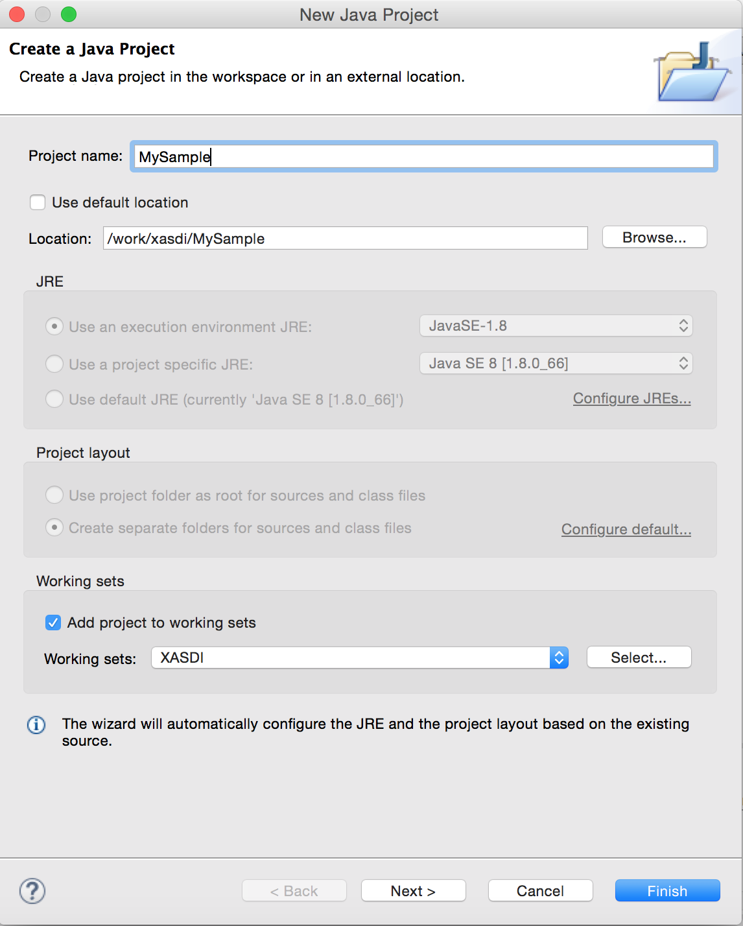
Create Eclipse Project
Launch Eclipse
Locate the project directory to “xasdi” directory.
You should set work directory “xasdi” as well

Slide 21
Required jar files
(X10-2.5.4 install directory)/stdlib/x10.jar
X10 standard library for Java
xasdi/jar/xasdi.jar
Base library of XASDI

Slide 22
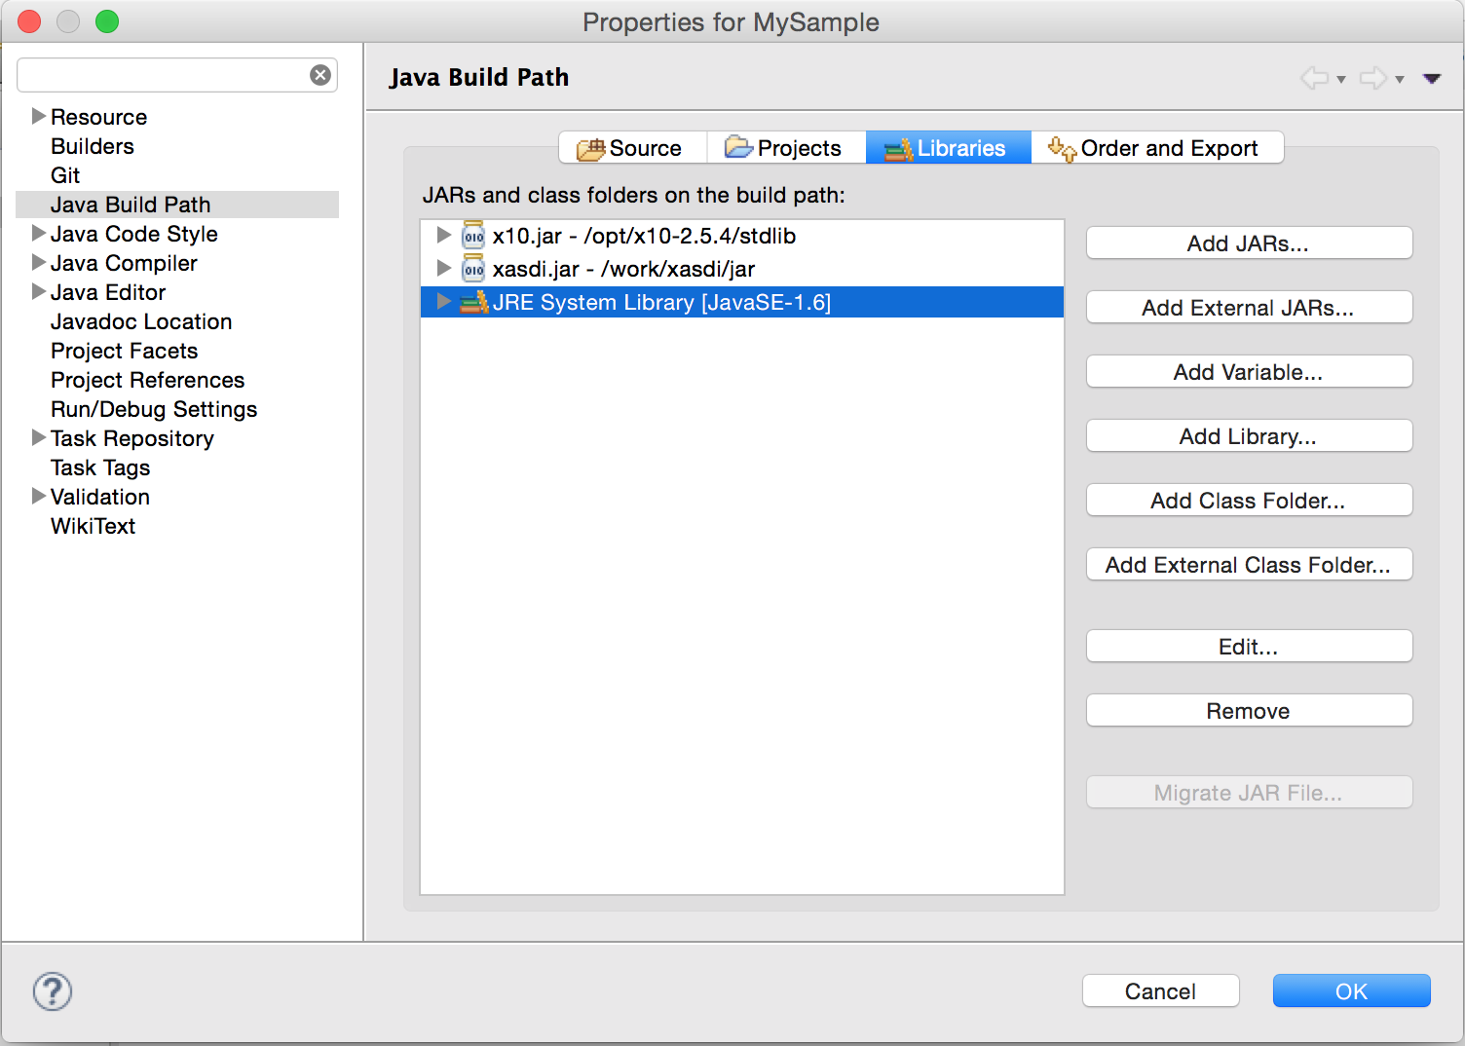
Import jar files
Add required jar files into class path.
”Properties” → “Java Build Path” → ”Add External JARs ...”
Add two jars in the previous slide.

Slide 23
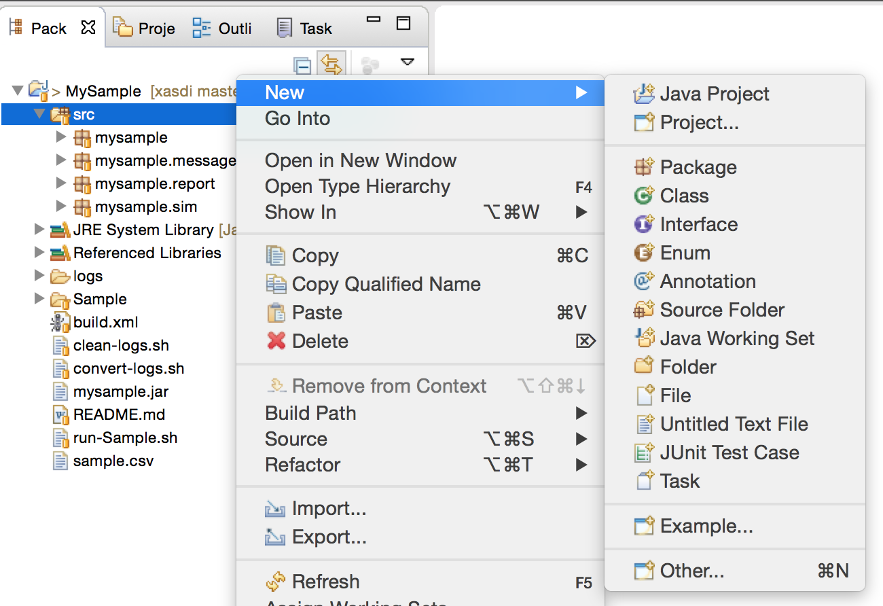
Add Java packages
Select “src” directory.
“new” → “Package”
Create 4 packages.
mysample
mysample.message
mysample.report
mysample.sim

Slide 24
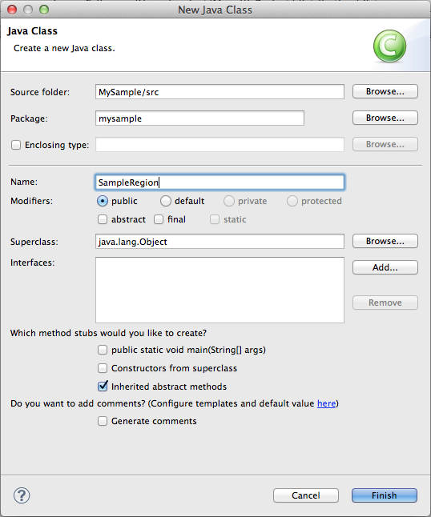
Add Java classes listed in p.27-p.29
Add Java classes listed in p.27-p.29 into packages.
Select a package → “new” → “Class”
Input class name.

Slide 25
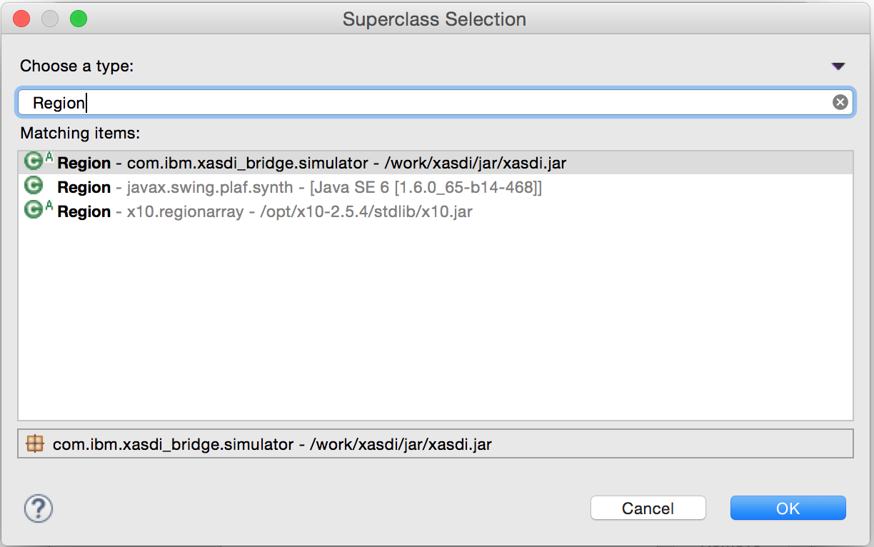
Selecting appropriate Inheritance classes
Some classes inherit parent class in XASDI.
Click “Browse...“ button, input super class and select proper class.

Slide 26
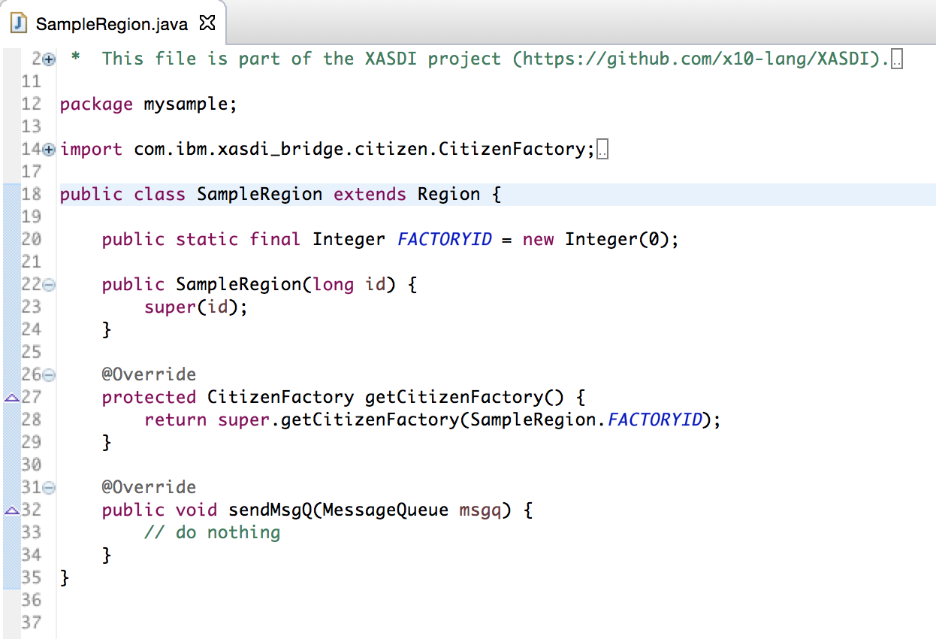
Write class content
After clicking the “Finish” button, a constructor and methods are automatically shown.
You have to add your source codes to these methods.
After adding all Java classes, complement, add, and modify source code.
* You can remove error marks alerted in Eclipse by importing classes in the simulation base (xasdi.jar and x10.jar).

Slide 27
Classes for MySample Application
SampleRegion extends Region
SampleDriver implements Driver
SamplePlace extends Place
SampleCitizen extends Citizen
SampleCitizenProxy extends CitizenProxy
SampleCitizenFactory implements CitizenFactory
SampleCitizenProxyFactory implements CitizenProxyFactory
SampleResolver implements MessageResolver

Slide 28
Classes (mysample.message)
SampleMessage extends Message
SetAttributeMessage extends SampleMessage
IndividualMessage extends SampleMessage
BroadCastMessage extends SampleMessage
DirectionMessage extends SampleMessage
MutualMessage extends SampleMessage

Slide 29
Classes (mysample.report, sim)
package mysample.report
SampleLogConverter
package mysample.sim
SampleLauncher implements Launcher

Slide 30
Sample Code

Slide 31
Code Structure
World
World
Region
SampleRegion
Place
CitizenProxy
CitizenProxy
SamplePlace
Citizen
Citizen
SampleCitizenProxy
CitizenProxy
SampleCitizen
SampleCitizen
Place
CitizenProxy
CitizenProxy
Citizen
Citizen
SampleDriver
Driver
Driver
X10 Place (X10 Runtime)
X10 Place (X10 Runtime)

Slide 32
SampleRegion
package mysample;
import com.ibm.xasdi_bridge.citizen.CitizenFactory;
import com.ibm.xasdi_bridge.message.MessageQueue;
import com.ibm.xasdi_bridge.simulator.Region;
public class SampleRegion extends Region {
public static final Integer FACTORYID = new Integer(0);
public SampleRegion(long id) {
super(id);
}
@Override
protected CitizenFactory getCitizenFactory() {
return super.getCitizenFactory(SampleRegion.FACTORYID);
}
@Override
public void sendMsgQ(MessageQueue msgq) {
// do nothing
}
}
You have only to define a constructor and CitizenFactory.
Parent class (Region) will manage all Citizen, Place and Driver agents.

Slide 33
SampleDriver
package mysample;
import java.util.HashMap;
import mysample.message.*;
import com.ibm.xasdi_bridge.CitizenID;
import com.ibm.xasdi_bridge.message.MessageList;
import com.ibm.xasdi_bridge.simulator.CitizenProxy;
import com.ibm.xasdi_bridge.simulator.Driver;
import com.ibm.xasdi_bridge.simulator.Region;
public class SampleDriver implements Driver {
SamplePlace place;
SampleRegion region ;
public SampleDriver(SamplePlace place, SampleRegion region) {
this.place = place;
this.region = region;
for(int i=0; i<10; i++){
int args = 0;
CitizenID cid = new CitizenID(i);
SampleCitizenProxy proxy = (SampleCitizenProxy)region.createCitizen(SampleRegion.FACTORYID, cid, args);
if(proxy != null){
Region.getCitizenSet(0).add(cid);
}
}
}
The SampleDriver is responsible for creating 10 agent (SampleCitizenProxy) objects in a constructor.
Agent ID is from 0 to 9.
In the execute method, the SampleDriver object kick offs the behavior of the CitizenProxy object.

Slide 34
SampleDriver
@Override
public void execute(long time) {
HashMap<Long, CitizenProxy> proxies = region.getCitizenProxies();
if(time == 0){
for(long i=0; i<proxies.size(); i++){
SampleCitizenProxy proxy = ((SampleCitizenProxy)proxies.get(i));
proxy.setAttribute(proxy.getID() , (int) i);
}
}else if(time == 1){
for(long i=0; i<proxies.size(); i++){
SampleCitizenProxy proxy = (SampleCitizenProxy)proxies.get(i);
proxy.individual(proxy.getID());
}
}else if(time == 2){
BroadCastMessage msg = new BroadCastMessage(place.getID());
region.sendMessage(msg);
}else if(time == 3){
for(long i=0; i<proxies.size(); i++){
SampleCitizenProxy from = (SampleCitizenProxy)proxies.get(i);
for(long j=0; j<proxies.size(); j++){
SampleCitizenProxy to = (SampleCitizenProxy)proxies.get(j);
MutualMessage msg = new MutualMessage(from.getID(), to.getID());
from.mutual(msg);
}
}
}
}

Slide 35
The “execute” method in SampleDriver
Each agent (CitizenProxy) sends 4 types of messages at the “execute” method.
Step 0: Sends a message to itself and changes its attribute.
Step 1: Sends a message to itself, but only writes log file without changing its attribute.
Step 2: Broadcasts one message to all agents.
Step 3: Send different messages to each agent.
(Tips) It is not required to change other methods than the “execute” method.

Slide 36
SamplePlace
package mysample;
import com.ibm.xasdi_bridge.simulator.Place;
import com.ibm.xasdi_bridge.simulator.Region;
public class SamplePlace extends Place {
private static final long serialVersionUID = 1L;
public SamplePlace(Region region, long id) {
super(region, id);
}
}
In this sample application, all agent are grouped into one Place so that the Place class is not used.
If you would like to use a Place class for grouping multiple places, you can have variables in the Place class.

Slide 37
SampleCitizen
package mysample;
import mysample.message.*;
import com.ibm.xasdi_bridge.CitizenID;
import com.ibm.xasdi_bridge.citizen.Citizen;
import com.ibm.xasdi_bridge.citizen.CitizenSet;
import com.ibm.xasdi_bridge.log.Log;
import com.ibm.xasdi_bridge.log.Logger;
import com.ibm.xasdi_bridge.Message;
import com.ibm.xasdi_bridge.simulator.Region;
import com.ibm.xasdi_bridge.simulator.World;
public class SampleCitizen extends Citizen {
int attribute;
public SampleCitizen(CitizenID cid) {
super(cid);
}
@Override
public void onCreation(Object arg) {
attribute = 0;
CitizenSet set = Region.getCitizenSet(0);
set.add(getID());
}
@Override -→ Obsolete
public void onExecute(long time, int phase) {
// do nothing
}
SampleCitizen objects execute its core agent behavior methods according to received messages’ types.
Create reply message
Write Log
(Tips) The “onExecute” method is now obsolete, instead you can write your agent behavior in the onMessage method.

Slide 38
SampleCitizen
@Override
public Message onMessage(Message msg) {
SampleMessage reply = (SampleMessage)msg;
switch(msg.getType()){
case SampleMessage.INDIVIDUAL:
reply = individual((IndividualMessage)msg); break;
case SampleMessage.BROADCAST:
reply = broadCast((BroadCastMessage)msg); break;
case SampleMessage.ATTRIBUTE:
reply = null; attribute((SetAttributeMessage)msg); break;
case SampleMessage.DIRECTION:
reply = null; direction((DirectionMessage)msg); break;
case SampleMessage.MUTUAL:
reply = mutual((MutualMessage)msg); break;
}
return reply;
}
When a message is arrived, “onMessage” method is called.
This method is create a reply message (if any) and return.

Slide 39
SampleCitizen
private IndividualMessage individual(IndividualMessage msg){
IndividualMessage reply = new IndividualMessage(1);
int value = attribute;
reply.selected = value;
this.writeLog("I have received an individual message", value);
return reply;
}
private BroadCastMessage broadCast(BroadCastMessage msg){
BroadCastMessage reply = new BroadCastMessage(msg.getGroupID());
int value = BroadCastMessage.VALUE;
this.writeLog("I have received a broadcast message", value);
return reply;
}
private void attribute(SetAttributeMessage msg){
this.attribute = msg.attribute;
this.writeLog("I have received a setattribute message", attribute);
}
The methods - listed in the left hand demonstrate 3 different agent behaviors, unicast (individual), broadcast, and changing the agent attribute.
You can use the proprietary logging methods, but it is optional.

Slide 40
SampleCitizen
private void direction(DirectionMessage msg){
int cid = (int)msg.getReceiverID().getLocalID();
this.writeLog("I have received a direction message", cid);
}
private DirectionMessage mutual(MutualMessage msg){
int value = MutualMessage.VALUE;
this.attribute = value;
this.writeLog("I have received a mutual message", value);
CitizenID dest = msg.getSenderID();
DirectionMessage reply = new DirectionMessage(dest);
return reply;
}
private void writeLog(String str, int value){
try{
Logger logger = World.world().getLogger();
Log log = logger.getFreeLog(0);
log.setInt(0, value);
log.setString(1, str);
log.write();
} catch(Exception e){
e.printStackTrace();
}
}
When a message is received, message information is written to common log files.

Slide 41
SampleCitizenProxy
package mysample;
import mysample.message.*;
import com.ibm.xasdi_bridge.CitizenID;
import com.ibm.xasdi_bridge.Message;
import com.ibm.xasdi_bridge.simulator.CitizenProxy;
import com.ibm.xasdi_bridge.simulator.Region;
public class SampleCitizenProxy extends CitizenProxy {
public SampleCitizenProxy(Region region) {
super(region);
}
SampleCitizenProxy can send messages to SampleRegion class.
These objects has a pointer of Region object.

Slide 42
SampleCitizenProxy
public void individual(CitizenID id){
IndividualMessage msg =
new IndividualMessage(0);
msg.setSenderID(id);
sendMessage(msg);
}
public void setAttribute(CitizenID id ,int i){
SetAttributeMessage msg =
new SetAttributeMessage(i);
msg.setSenderID(id);
sendMessage(msg);
}
public void direct(CitizenID dest, DirectionMessage msg){
msg.setReceiverID(dest);
sendMessage(msg);
}
public void mutual(MutualMessage msg){
sendMessage(msg);
}
It has “sendMessage” method to send a message.
These 4 methods are called according to the message type.

Slide 43
SampleCitizenProxy
@Override
public void receiveMessage(Message msg) {
Message reply = citizen.onMessage(msg);
sendMessage(reply);
}
This class instance invokes the Citizen object in order to send a reply message after receiving an incoming message.

Slide 44
SampleCitizenFactory
package mysample;
import com.ibm.xasdi_bridge.CitizenID;
import com.ibm.xasdi_bridge.citizen.Citizen;
import com.ibm.xasdi_bridge.citizen.CitizenFactory;
public class SampleCitizenFactory implements CitizenFactory {
@Override
public Citizen newInstance(CitizenID id) {
return new SampleCitizen(id);
}
}
When “newInstance” method is called, one SampleCitizen object is instantiated.

Slide 45
SampleCitizenProxyFactory
package mysample;
import com.ibm.xasdi_bridge.simulator.CitizenProxy;
import com.ibm.xasdi_bridge.simulator.CitizenProxyFactory;
import com.ibm.xasdi_bridge.simulator.Region;
public class SampleCitizenProxyFactory implements CitizenProxyFactory {
@Override
public CitizenProxy newInstance(Region region) {
return new SampleCitizenProxy(region);
}
}
When “newInstance” method is called, one SampleCitizenProxy object is instantiated.
SampleCitizen and SampleCitizenProxy should be created at the same time.

Slide 46
SampleResolver
package mysample;
import java.util.ArrayList;
import java.util.Collection;
import java.util.List;
import mysample.message.BroadCastMessage;
import mysample.message.DirectionMessage;
import mysample.message.IndividualMessage;
import mysample.message.MutualMessage;
import mysample.message.SetAttributeMessage;
import com.ibm.xasdi_bridge.CitizenID;
import com.ibm.xasdi_bridge.Message;
import com.ibm.xasdi_bridge.citizen.CitizenSet;
import com.ibm.xasdi_bridge.citizen.MessageResolver;
import com.ibm.xasdi_bridge.simulator.Region;
A message resolver is in charge of resolving a list of destination agents (CitizenProxy) from a given message
Import all message classes and some parent classes.

Slide 47
SampleResolver
public class SampleResolver implements MessageResolver {
@Override
public Collection<CitizenID> resolve(Message msg) {
if(msg instanceof BroadCastMessage){
BroadCastMessage bmsg = (BroadCastMessage)msg;
long pid = bmsg.getGroupID().getLocalID();
CitizenSet cset = Region.getCitizenSet(pid);
if(cset == null){
System.err.println
("CitizenSet is null: placeid="+pid);
return null;
}else{
return cset.getCollection();
}
}else if(msg instanceof IndividualMessage){
List<CitizenID> cset = new ArrayList<CitizenID>();
cset.add(msg.getSenderID());
return cset;
}
You have only to implement the “resolve” method.
The return type is a list of destination agent identifiers (CitizenID).

Slide 48
SampleResolver
else if(msg instanceof DirectionMessage){
List<CitizenID> citizenSet
= new ArrayList<CitizenID>(); citizenSet.add(((DirectionMessage)msg).getReceiverID());
return citizenSet;
}else if(msg instanceof SetAttributeMessage){
List<CitizenID> cset = new ArrayList<CitizenID>();
cset.add(msg.getSenderID());
return cset;
}else if(msg instanceof MutualMessage){
List<CitizenID> citizenSet
= new ArrayList<CitizenID>();
citizenSet.add(((MutualMessage)msg).getReceiverID());
return citizenSet;
}else{
System.err.println
("Message is null or unsupported.");
return null;
}
}
}
Destination of messages are determined by their types

Slide 49
SampleMessage
package mysample.message;
import com.ibm.xasdi_bridge.Message;
public class SampleMessage extends Message {
private static final long serialVersionUID = 1L;
public static final int INDIVIDUAL = 1;
public static final int BROADCAST = 2;
public static final int ATTRIBUTE = 3;
public static final int DIRECTION = 4;
public static final int MUTUAL = 5;
public SampleMessage(int type) {
super(type);
}
}
A message class – extending the Message class - used for this application.
5 constant values are represented as message types – each of which is used at a constructor method.

Slide 50
IndividualMessage
package mysample.message;
public class IndividualMessage extends SampleMessage {
private static final long serialVersionUID = 1L;
public int selected = 0;
public IndividualMessage(int selected) {
super(INDIVIDUAL);
this.selected = selected;
}
}
Each agent sends this message only to itself.
If selected is 0, it is an original message
If selected is 1, it is a reply message.

Slide 51
BroadCastMessage
package mysample.message;
import com.ibm.xasdi_bridge.PlaceID;
public class BroadCastMessage extends SampleMessage {
private static final long serialVersionUID = 1L;
public static final int VALUE = 3141;
private PlaceID id;
public BroadCastMessage(PlaceID id) {
super(BROADCAST);
this.id = id;
}
public PlaceID getGroupID(){
return id;
}
}
An agent sends this message to all agents.
It has PlaceID, but no agents belong to any Place in this application. Therefore, it will be sent to all agents in the same Place.

Slide 52
SetAttributeMessage
package mysample.message;
public class SetAttributeMessage extends SampleMessage {
private static final long serialVersionUID = 1L;
public int attribute;
public SetAttributeMessage(int attribute) {
super(ATTRIBUTE);
this.attribute = attribute;
}
}
Set the agent attribute
When an agent receives this message, it change its attribute to that variable.

Slide 53
DirectionMessage
package mysample.message;
import com.ibm.xasdi_bridge.CitizenID;
public class DirectionMessage extends SampleMessage {
private static final long serialVersionUID = 1L;
public DirectionMessage(CitizenID dest) {
super(DIRECTION);
this.setReceiverID(dest);
}
}
A Message class could have a list of CitizenIDs. to specify origin and destination ids.
The destination id is set in this sample application.

Slide 54
MutualMessage
package mysample.message;
import com.ibm.xasdi_bridge.CitizenID;
public class MutualMessage extends SampleMessage {
private static final long serialVersionUID = 1L;
public static final int VALUE = 1732;
public MutualMessage(CitizenID orig, CitizenID dest) {
super(MUTUAL);
this.setSenderID(orig);
this.setReceiverID(dest);
}
}
Two CitizenIDs represent an origin and destination identifiers in this sample.
A destination object can create a reply message.

Slide 55
SampleLogConverter
package mysample.report;
import java.io.*;
import com.ibm.xasdi_bridge.log.*;
public class SampleLogConverter {
public static void main(String[] args) {
System.out.println
("now converting");
This class is used for converting binary log to text data format.

Slide 56
SampleLogConverter
try {
PrintWriter pw = new PrintWriter(new FileWriter("sample.csv"));
File dir = new File(args[0]);
File[] logs = dir.listFiles();
for(int i=0;i<logs.length;i++) {
try {
if(logs[i].isDirectory())continue;
LogSet set = LogSet.read(logs[i].getAbsolutePath());
while(set.hasNext()) {
Log log = set.next();
LogDefinition def = log.getLogDefinition();
switch(def.getID()) {
case 0: convert(pw,log);break;
default:
System.out.println("unknown”);
break;
}
}
} catch(Exception e) {
e.printStackTrace();
}
}
pw.close();
} catch(Exception ee) {
ee.printStackTrace();
}
}
Convert binary Log files into a CSV text file.

Slide 57
SampleLogConverter
static void convert(PrintWriter w, Log log) throws Exception {
int value = log.getInt(0);
String message = log.getString(1);
w.println(message + "," + value);
}
}
The “convert” method converts binary data to text (ASCII) data.

Slide 58
SampleLauncher
package mysample.sim;
import java.io.File;
import java.util.Properties;
import mysample.SampleCitizenFactory;
import mysample.SampleCitizenProxyFactory;
import mysample.SampleDriver;
import mysample.SamplePlace;
import mysample.SampleRegion;
import mysample.SampleResolver;
import com.ibm.xasdi_bridge.log.ColumnType;
import com.ibm.xasdi_bridge.log.DefaultLogger;
import com.ibm.xasdi_bridge.log.LogDefinition;
import com.ibm.xasdi_bridge.log.Logger;
import com.ibm.xasdi_bridge.message.MessageRepository;
import com.ibm.xasdi_bridge.simulator.Launcher;
import com.ibm.xasdi_bridge.simulator.Region;
import com.ibm.xasdi_bridge.simulator.World;
public class SampleLauncher implements Launcher {
static final String LOGFILE = "logFile";
private SampleRegion sampleRegion = new SampleRegion(0);
private SampleResolver sampleResolver =
new SampleResolver();
Simulation starts from this SampleLauncher class that implements the Launcher interface.
It creates most of objects such as CitizenProxy, Driver, Place, and so forth.

Slide 59
SampleLauncher
@Override
public void prepare(Properties prop) {
// defines Log
String filename = prop.getProperty(LOGFILE, "sample");
Logger logger = World.world().setLogger(new DefaultLogger());
logger.setFile(new File(filename));
LogDefinition def = new LogDefinition(0,0);
def.addColumn(ColumnType.INT);
def.addColumn(ColumnType.STRING);
logger.addLogDefinition(def);
logger.enableLog(0);
// defines SampleCitizen(Proxy)Factory, SampleRegion
SampleCitizenProxyFactory sampleCitizenProxyFactory = new SampleCitizenProxyFactory();
sampleRegion.addCitizenProxyFactory
(SampleRegion.FACTORYID, sampleCitizenProxyFactory);
sampleRegion.setNumberOfPhases(1);
sampleRegion.setMessageRepository(new MessageRepository()); sampleRegion.getMessageRepository().setResolver(sampleResolver);
SampleCitizenFactory sampleCitizenFactory =
new SampleCitizenFactory(); sampleRegion.addCitizenFactory
(SampleRegion.FACTORYID, sampleCitizenFactory);
sampleRegion.createCitizenSet(0);
The “prepare” method creates a set of principal objects.
Region, Log, Citizen, CitizenProxy, Factory...

Slide 60
SampleLauncher
// defines a place, a driver, a simulator
SamplePlace samplePlace =
new SamplePlace(sampleRegion, 0);
sampleRegion.addPlace(samplePlace);
SampleDriver sampleDriver =
new SampleDriver(samplePlace, sampleRegion);
sampleRegion.addDriver(sampleDriver);
World.world().setDeltaTime(1);
World.world().setSimulationTime(0, 4);
World.world().addRegion(0, sampleRegion);
}
Create objects about Place and Driver.
Set simulation time and Region object to the World class.

Slide 61
SampleLauncher
@Override
public void start(Properties prop) {
System.out.println("start...");
World.world().start();
}
@Override
public Region getRegion() {
return sampleRegion;
}
@Override
public MessageRepository getMessageRepository() {
return sampleRegion.getMessageRepository();
}
}
An application will start from the “start” method.
Overided methods such as “getRegion” and “getMessageRepository” so that the underlying runtime of X10-based Agents Executive Infrastructure for Simulation can refer variables in Region and MessageRepository.

Slide 62
DebugGING sample application

Slide 63
Copy property XML file
First, create directories “Sample” and “logs”.
Simulation program on X10-based Agent Simulation on Distributed Infrastructure (XASDI) needs property XML file and CSV files.
The easiest way is to copy these files from extracted archive directory MySample/Sample/ to MySample/Sample/.

Slide 64
Setting up Projects in Eclipse
Use a debugger in Eclipse (4.2.x or later).
Confirm two jar files named “xasdi.jar” and “x10.jar” are in the class path of the MySample project.

Slide 65
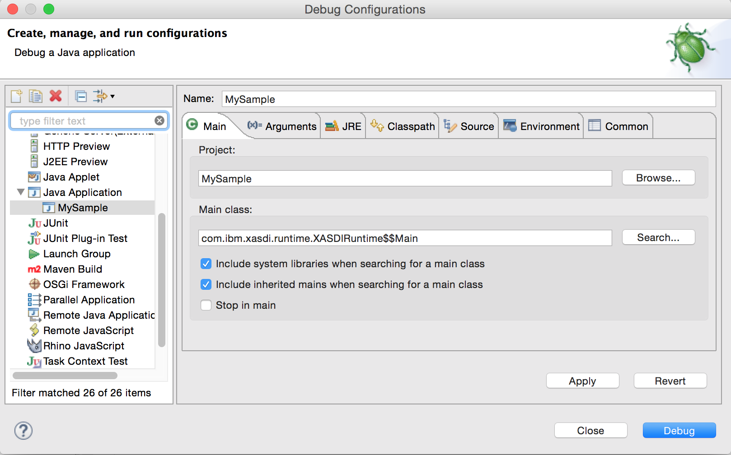
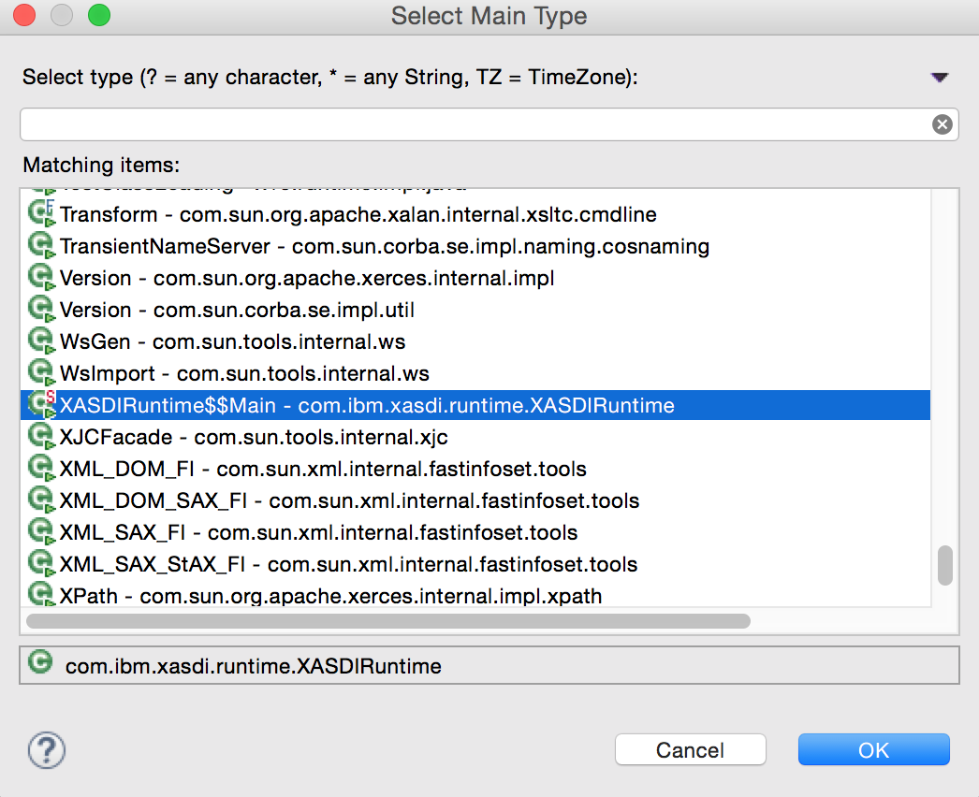
Debug configurations in Eclipse
Run → Debug Configurations…
Select the Main class
Project: MySample
Main class : com.ibm.xasdi.runtime.XASDIRuntime$$Main

Slide 66
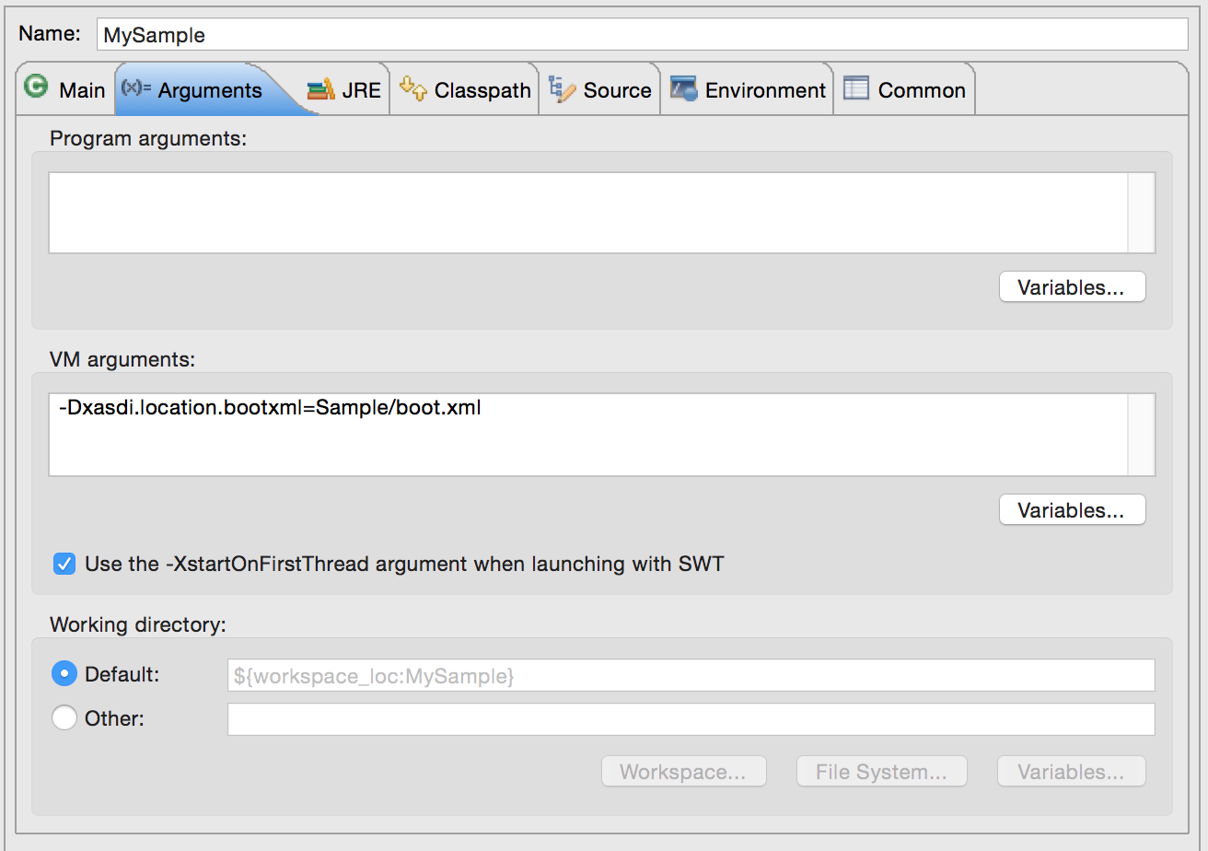
VM arguments
Set the Java VM arguments
-Dxasdi.location.bootxml=Sample/boot.xml
Java VM
Arguments

Slide 67
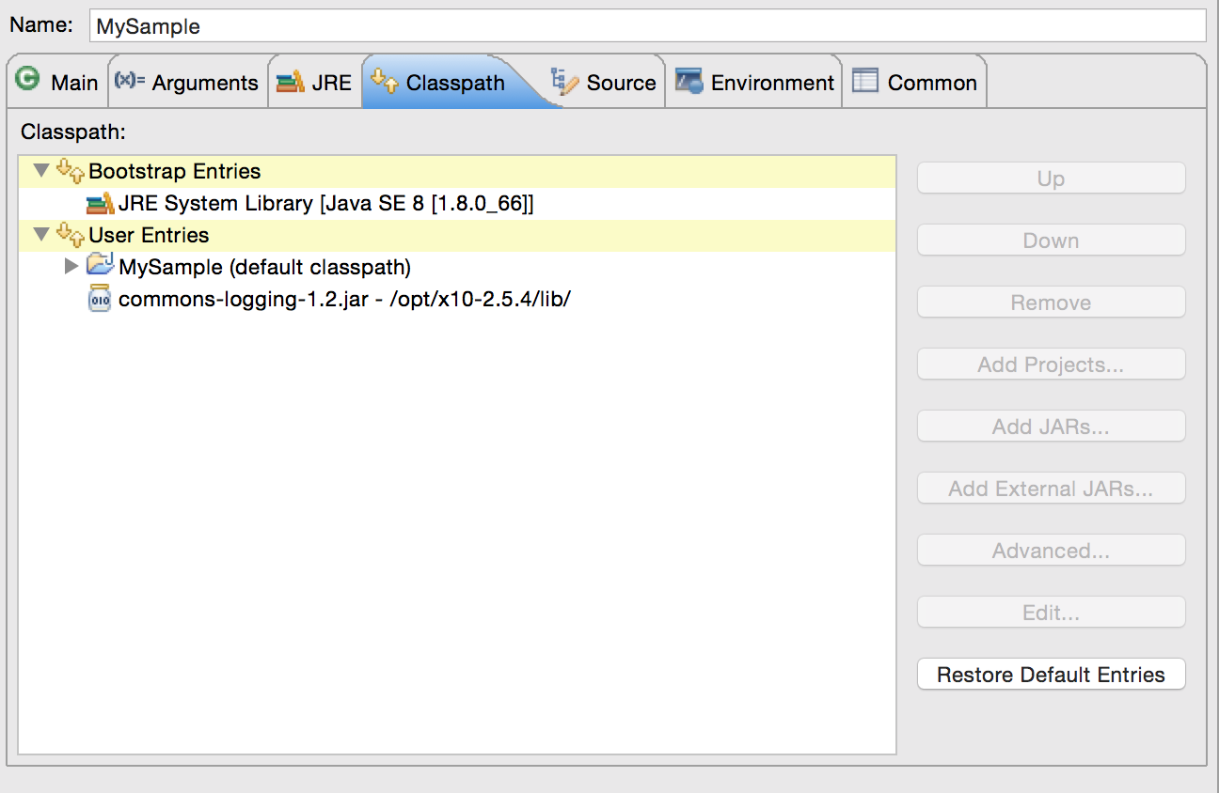
VM arguments
Add a required jar from x10 lib directory
(X10-2.5.4 install directory)/lib/commons-logging-1.2..jar
External JAR

Slide 68
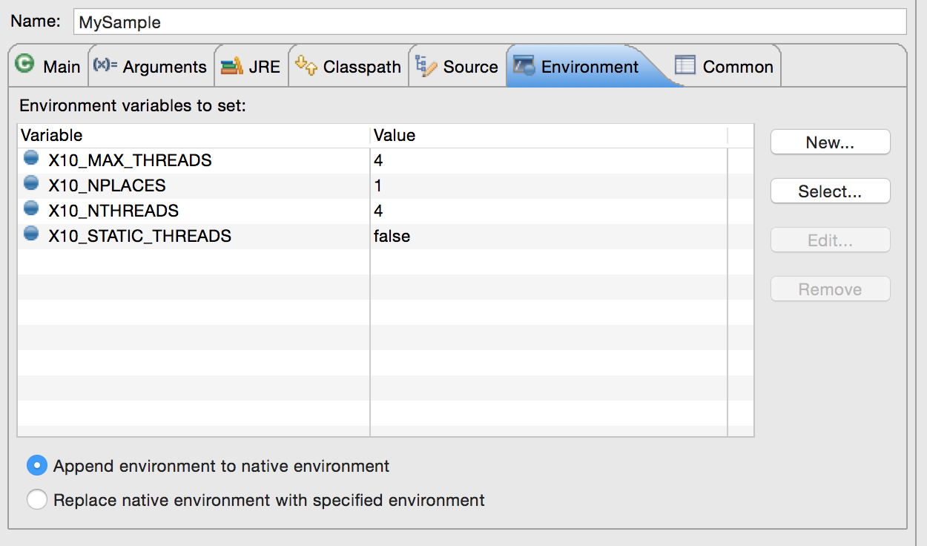
Environment variables
Set the environment variables (* $TH: the number of CPU cores)
X10_MAX_THREADS: $TH
X10_NPLACES: no need to specify (default is 1)
X10_NTHREADS: no need to specify (default is the number of CPU cores)
X10_STATIC_THREADS: no need to specify (default is false)

Slide 69
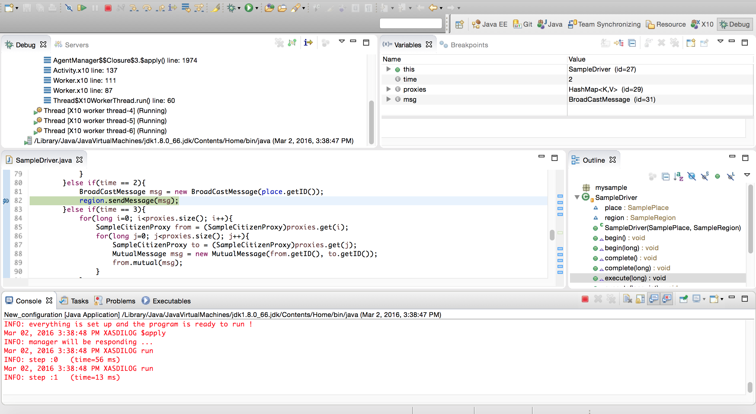
Debugging with Eclipse
Control Processing
(Run, Stop, Step in, over, out)
Break Point
Start the debugging by setting breakpoints in the Java source codes.

Slide 70
Debugging with Eclipse
At the end of simulation, log files are generated at MySample/logs

Slide 71
runNING sample Application

Slide 72
Copy shell script
First, copy a shell script “run-Sample.sh” from extracted archive directory MySample/ to MySample/ directory.

Slide 73
Setting simulation properties with boot.xml
<?xml version="1.0"?>
<!DOCTYPE properties SYSTEM "http://java.sun.com/dtd/properties.dtd">
<properties>
<entry key="directory">./</entry>
<entry key="simTime">4</entry> <!-- setting the simulation steps -->
<entry key="simName">MySample</entry>
<entry key="nThreads">2</entry>
<entry key="nPlaces">1</entry>
<entry key=“nPhase”>1</entry>
<entry key="launcherName">mysample.sim.SampleLauncher</entry>
<entry key="workFile">Sample/citizenPlaceMap.csv</entry> <!-- mapping file -->
<entry key="driverFile">Sample/driverPlaceMap.csv</entry> <!-- mapping file -->
<entry key="logFile">logs/sample</entry>
</properties>

Slide 74
Mapping file for multi-nodes
Two files, citizenPlaceMap.csv and and driverPlaceMap.csv, are needed.
The first column indicates the agent identifier and the second column indicates the identifier of the X10 place.
If you would like to run your simulation on multiple nodes, you can specify the identifier greater than 0 for some set of agents.
0,0
1,0
2,0
3,0
4,0
5,0
6,0
7,0
8,0
9,0

Slide 75
Running simulation script
Then, execute this script.
./run-Sample.sh
* Tips: If you would like to run your simulation on multi-nodes, please specify the environmental variable, X10_NPLACES to the number greater than 1.
After running this program, a set of log files can be found in logs/ directory.

