Slide 1
X10: Computing at Scale, productively
Vijay Saraswat
Research Staff Member
Vivek Sarkar
Research Staff Member and Senior Manager

Slide 2
Acknowledgements
X10 core team*
  Raj Barik
  Philippe Charles
  Chris Donawa (IBM Toronto)
  Kemal Ebcioglu (emeritus)
  Christian Grothoff (UCLA)
  Allan Kielstra (IBM Toronto)
  Douglas Lovell
  Igor Peshansky
  Christoph von Praun
  Vijay Saraswat
  Vivek Sarkar
Additional contributors to X10 ideas:
David Bacon, Bob Blainey, Perry Cheng, Julian Dolby, Guang Gao (U Delaware), Robert O'Callahan, Filip Pizlo (Purdue), Lawrence Rauchwerger (Texas A&M), Mandana Vaziri, Jan Vitek (Purdue), V.T. Rajan, Radha Jagadeesan (DePaul), Maged Michael, Armando Solar-Lezama (UC Berkeley)
X10 Tools
Julian Dolby, Steve Fink, Robert Fuhrer, Matthias Hauswirth, Peter Sweeney, Frank Tip, Mandana Vaziri
X10 Static Analysis
Julian Dolby, Ras Bodik, Satish Chandra
University partners:
MIT (StreamIt), Purdue University (X10), UC Berkeley (StreamBit), U. Delaware (Atomic sections), U. Illinois (Fortran plug-in, HTA), Vanderbilt University (Productivity metrics), DePaul U (Semantics)
X10 PM+Tools Team Lead: Vivek Sarkar
PERCS Software Lead: Rama Govindaraju
PERCS Principal Investigator: Mootaz Elnozahy

Slide 3
X10 Axioms: Mainstream → HPC
Support for productivity
  Leverage OO’s proven baseline productivity, maintenance, portability benefits, mainstream talent pool. (Java=Cleaner C++)
  Rule out large classes of errors
    Type safe, Memory safe, Pointer safe, Lock safe, Place safe, Clock safe.
  Support incremental introduction of explicit place types/remote operations.
  Integrate with Eclipse -- flag performance problems, refactor code, detect races.
  Support automatic static and dynamic optimization (CPO).
Support for scalability
  Reify non-uniformity of access.
    Primitive synchronous access only to local memory
  Use asynchrony to overlap communication with computation.
  Use scalable synchronization constructs.
  Provide collective operations through a library
To support a large eco-system an HPC language should be more than “an HPC language”.

Slide 4
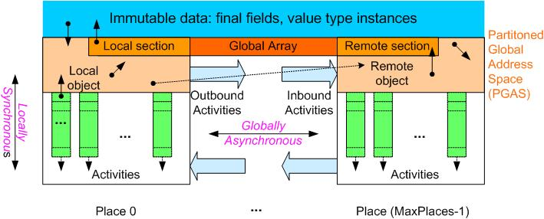
The X10 Programming Model
Place = collection of resident
(non-mobile) activities & objects
Storage classes
Immutable Data
PGAS
  Local Heap
  Remote Heap
Activity Local
Locality Rule
Any access to a mutable
datum must be performed by a
local activity ➔ remote data
accesses can be performed by
creating remote activities
Ordering Constraints (Memory Model)
Locally Synchronous:
Guaranteed coherence for local heap ➔
Sequential consistency
Globally Asynchronous:
No ordering of inter-place activities ➔
use explicit synchronization for coherence
Few concepts, done right.

Slide 5
X10 realization in Java
async (P) [clocked(c…)]Stm
  Run s asynchronously at p
finish Stm
  Execute s, wait for all asyncs to terminate
foreach ( point P : Reg) Stm
  Run Stm asynchronously for each point in region
ateach ( point P : Dist) Stm
  Run Stm asynchronously for each point in dist, in its place.
atomic Stm / when (C) Stm
  Execute s atomically (if c is true).
Clocks
  Barriers / MPI communicators
Region
  Collection of index points, e.g.
    region r = [1:N,1:M];
Distribution
  Place-colored region, e.g.
    dist d = block(r);
new T[d] / new T value [d]
  Array of base type T and distribution d: has a variable at dist[p] for each point p in dist.
  Collectives: scans, reductions, broadcasts on global arrays.
Interface to native code
future is a derived construct
Control-based synchronization: Language without when is deadlock-free.

Slide 6
NAS Parallel benchmark: MG
Poster
final public double[.][] u,r;
MY_K1 = new region[[LEVELS,THREADS]]
(point [k,id]) {
return getwork(id,INNER_EXTRA_K[k],1);
};
Hierarchical array as array of arrays
Work portions computed at initialization, stored in regions.
User-defined recursive region.
Spawns dist activities, wait for termination.
finish ateach (point [id]:THREADS) {
final double[.] uj=u[j], uk=u[j+1];
for (point [i1,i2,i3]:[0:m2[j]-2,0:m1[j]-2,MY_K1[j,id]]) {
for (point o[a,b,c]: extend([0,0,0],[1,1,1])) {
region r = extend(p,o);
uk[2*i1+a,2*i2+b,2*i3+c] += uj.sum(r)/r.size();
}
}
This can be partially evaluated!
SLOC | F90+MPI | CAF | HPF | SAC | ZPL | X10
MG | 882 | 1150 | 433 | 142 | 157 | ~100
[cf Chamberlain et al SC00]

Slide 7
X10 Applications/Benchmarks
Poster
Java Grande Forum
  OOPSLA Onwards! 2005 (IBM)
  Showed substantial (SLOC) benefit in serial -> parallel -> distributed transition for X10 vs Java (qua C-like language).
SSCA
  SSCA#1 (PSC study)
  SSCA#2 (Bader et al, UNM/GT)
  SSCA#3 (Rabbah, MIT)
Sweep3d
  Jim Browne (UT Austin)
NAS PB
  CG, MG (IBM)
  CG, FT, EP (Padua et al, UIUC)
  Cannon, LU variant (UIUC)
AMR (port from Titanium)
  In progress, IBM
SpecJBB
  In progress, Purdue
Measures: SLOC as a “stand in” + process measures.

Slide 8
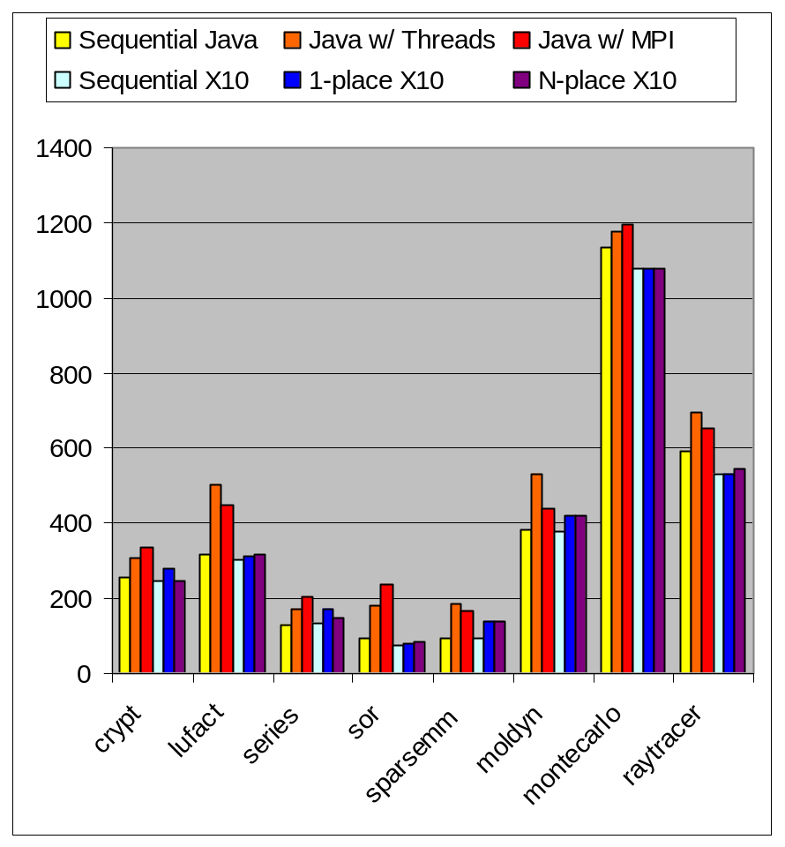
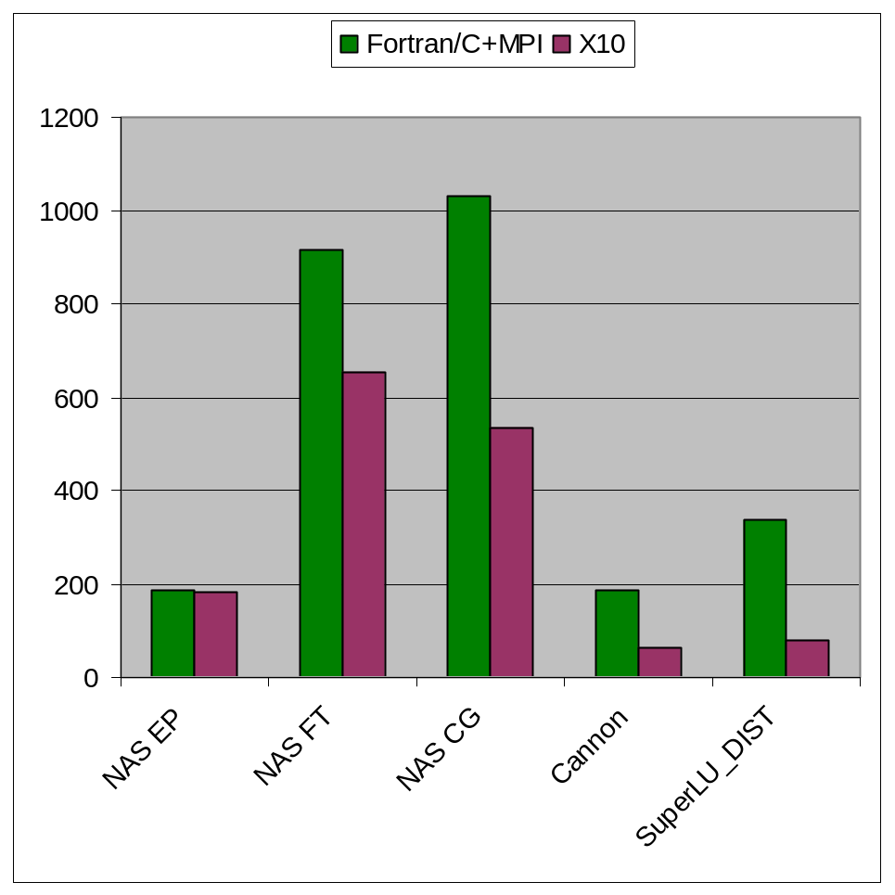
Benchmark SLOC
Poster
OOPSLA 05 Onwards!
Fraguela, et al (UIUC).
Notes:
Its the whole code, without comments

Slide 9
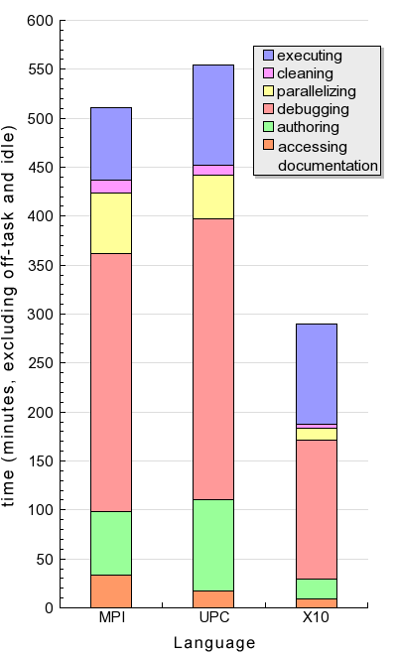
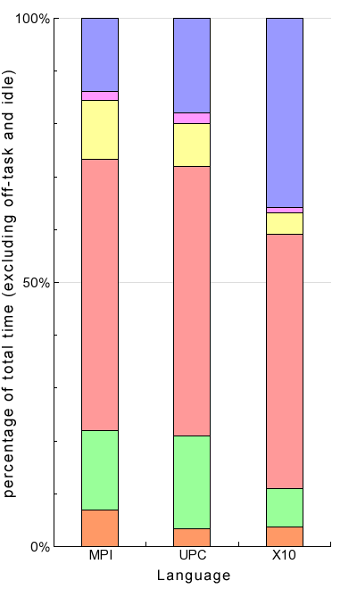
Average Development Time by Language
Absolute Time
Percentage of Total
Comparing average development
times between languages, several
observations are clear:
Average development time for subjects using X10 was significantly lower than that for subjects using UPC and MPI.
The relative time debugging was approximately the same for all languages.
X10 programmers spent relatively more time executing code and relatively less time authoring and tidying code.
Subjects using MPI spent more time accessing documentation (tutorials were online; more documentation is available).
For this experiment, the effect of batch vs. interactive environments was probably significant.

Slide 10
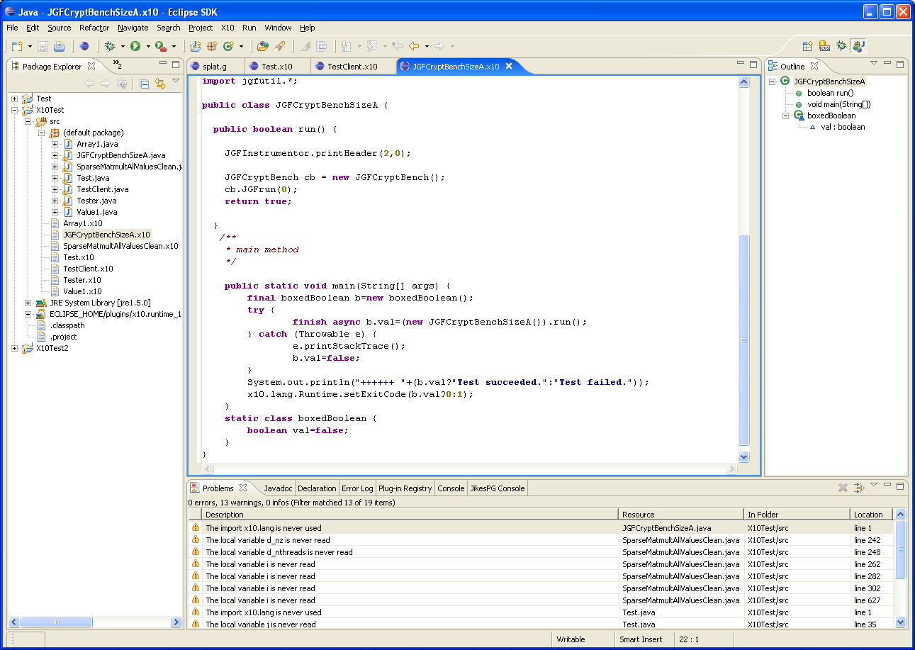
X10DT: Enhancing productivity
Poster
Source editor w/ syntax
highlighting, auto indenting,
some content assist
X10 Launch Configuration
Outline View populated w/
X10 types, members, loops
X10 Incremental Builder;
Problems View populated
w/ X10 compiler messages
Code editing
Refactoring
Code visualization
Data visualization
Debugging
Static performance analysis
Vision: State-of-the-art IDE for a modern OO language for HPC

Slide 11
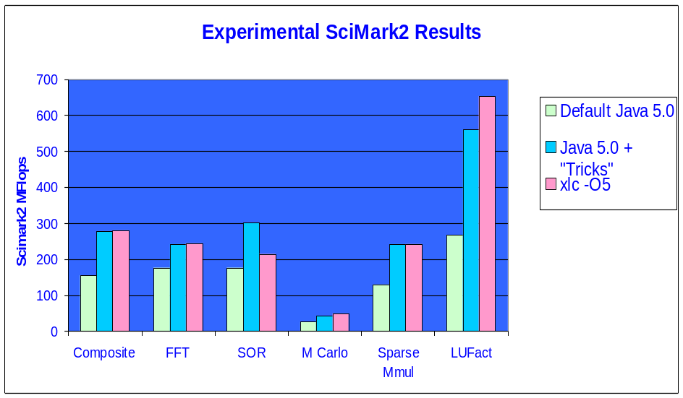
JITed Single thread performance
Poster
Existing JIT has many sophisticated optimizations
  Force them to be activated early.
  Simulate X10 compiler’s ability to remove null- and bounds-check code.
  Exploit X10 compiler’s capability of generating more GC-aware code
    Remove some extra code/constraints on register allocation forced by VM’s GC implementation.
Relatively simple modifications to a production Java JIT yields performance comparable to C.

Slide 12
Multi-node X10 VM design
Poster
X10
program
VM 1
Asyncs marshal needed data in runtime and send via LAPI
In many cases, 0-copy, non-serialized transfer may be used
Each VM knows about all other VMs and transfers data on demand
LAPI communication library handles data transfers and synchronization issues
To run a program each VM:
loads the same program and configuration data.
Establishes LAPI connections
Place 0 runs main
X10 runtime
LAPI
VM0
VM2
VM3
x10
x10
x10
VM 0
VM 2
VM 3
X10 runtime
X10 runtime
X10 runtime
LAPI
LAPI
LAPI

Slide 13
HPLS Phase III Plans (July 2006 – Dec 2007)
VM-based prototype
  Focus on scalable intra-place performance with lightweight threads by extending a state-of-the-art VM implementation
  Full support for garbage collection, dynamic compilation, runtime checking, multi-language support
Scale-out prototype
  Focus on large-scale inter-place performance with lightweight threads by extending a state-of-the-art UPC implementation
  Restricted language, static compilation, lightweight runtime, limited runtime checking
X10DT
  Eclipse-based IDE for X10
  Concurrency-based refactorings
  Tool support for multi-language applications
Static Analysis and compilation
  Build locality analyses
  For bug-detection, re-factoring, (static/dynamic) compilation
  Annotations for application semantics and code transformation.
X10 Applications
  Port challenging apps
  Develop new apps (graph-based? Streaming?)

Slide 14
HPC Landscape: 20K view
Our view!
 | MPI + C/Fortran | C.OMP | ZPL | CAF | UPC | Ti | X10 | HPL 2010?
Convenient? | X+ | √ | √? | √− | √− | √− | √? | √+
Global view? | X | X | √ | √ | √ | √ | √ | √+
Object-oriented? | X | X | X | X | X | √ | √ | √+
Strong-typing? | √? | X | √? | √? | X | √ | √+ | √+
Exceptions? | X | X | X | X | X | √ | √+ | √+
Managed Runtime? | X | X | X | X | X | √− | √+ | √+
Productivity
Perf Transparency | √ | √ | √ | √ | √ | √ | √? | √+
Perf Portability | √ | X | √ | √ | √? | √ | √? | √+
Perf Scalability | √ | X | √ | √ | √ | √? | √? | √+
Perf
Data-structures? | X | √ | X | X | √ | √ | √+ | √+
Explicit parallelism? | √ | √ | X | √ | √ | √ | √+ | √+
Task parallelism? | X | √ |  | X | X | X | √+ | √+
Fork-join parallelism? |  | √ |  |  |  |  | √+ | √+
Expr.

Slide 15
X10 plans w.r.t. HPLS Consortium
Phase III (July 2006 – Dec 2007)
  Will provide X10 prototype implementations and research publications to HPLS team during Phase III, and collaborate on appropriate research topics
  We welcome help from HPLS team:
    Feedback on language definition
    Application studies
    Suggestions for productivity studies
Beyond Phase III (Beyond Jan 2008)
  Play an active role in defining the “consortium” language based on PERCS experiences with X10 and UPC in Phases II and III
  (We are researchers too!)
  We will work closely with the HPLS team and provide leadership in appropriate areas.

Slide 16
Summary
X10 explores a very interesting subspace for HPC designs
  Motivated first by productivity, generality, simplicity.
  Some early validation through ports of several application programs.
X10 can take advantage of modern IDEs
  Concurrency/distribution refactoring support supports productivity.
X10 enables sophisticated static analysis
  Can leverage static analysis for refactorings, annotation-driven transformations
X10 implementations can exploit existing infrastructure
  SMP implementation can leverage Java/JIT infrastructure.
  Scale-out implementation can leverage UPC infrastructure.
We are very excited to be working with you on breakthrough programming languages research!

Slide 17
Backup

Slide 18
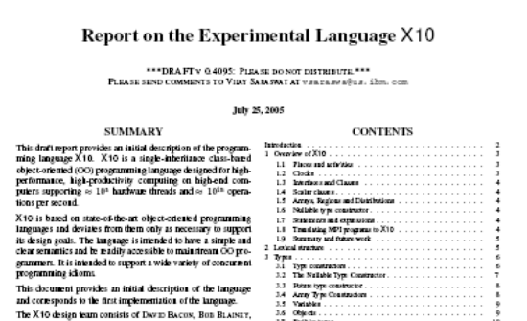
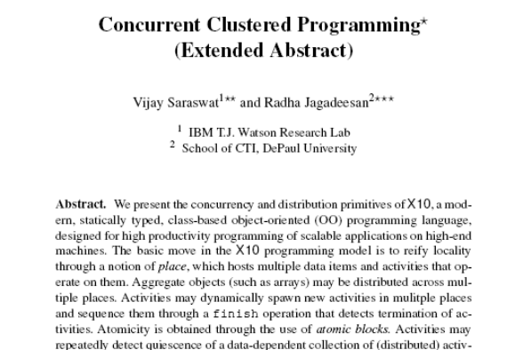
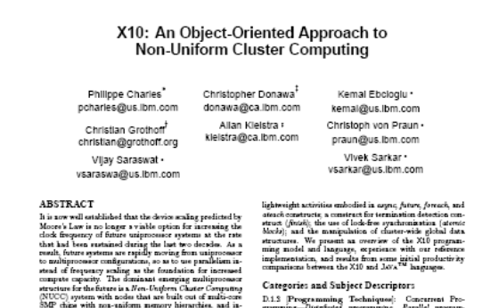
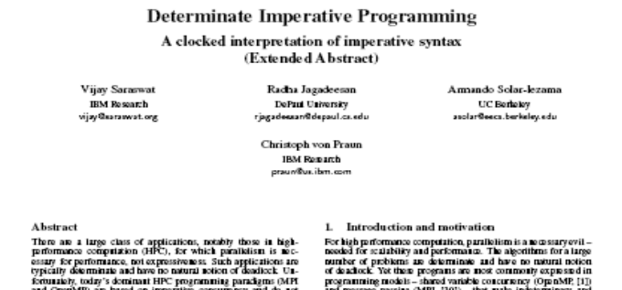
Our results
Language Report
CONCUR 05
OOPSLA 05 Onwards!
X10 Tutorial ➔ User Report
X10 Reference Implementation
Applications
Productivity Study
(Submitted)

Slide 19
Software Architecture - 2010: Vision
Compilers
CPO
DB
SMT Exploitation
Cache injection
Adv. Funcs
Productivity Enhancers
ILM
COE
User Space
APPLICATION
Kernel Space
ESSL
PESSL
SHMEM
GPFS
SOCKETS
Operating Systems
UPC
X10
VSD/NSD
TCP
UDP
CSM, RSCT
IBM’s MPI
LL
LAPI
DD
HYP
IP
HAL
IF_LS
Network Adapter
HMC
Network

Slide 20
PERCS Programming Model, Tools
JavaTM source code
(w/ threads & conc utils)
C/C++ source code
(w/ MPI, OpenMP, UPC)
Fortran source code
(w/ MPI, OpenMP)
. . .
X10 source code
. . .
Productivity Measurements
X10 Development Toolkit
Java Development Toolkit
C/C++
Development Toolkit
+ MPI extensions
Fortran Development Toolkit
. . .
Refactoring for Concurrency
. . .
Performance
Exploration
X10 Compiler
Java
Compiler
C/C++ Compiler
w/ UPC extensions
Fortran Compiler
Parallel Tools Platform (PTP)
Eclipse
platform
Text in blue identifies
exploratory
PERCS
contributions
X10 Components
Java components
C/C++
components
Fortran components
Fast extern
interface
X10 runtime
Java runtime
C/C++ runtime
Fortran runtime
Dynamic Compilation + Continuous Program Optimization
Integrated Parallel Runtime: MPI + LAPI + RDMA + OpenMP + threads

