Slide 1
Computing at Scale
The design of X10
Vijay Saraswat, IBM TJ Watson
vijay@saraswat.org
http://www.saraswat.org/
This work has been supported in part by the Defense Advanced Research Projects Agency (DARPA) under contract No. NBCH30390004.

Slide 2
Acknowledgements
X10 core team
  Philippe Charles
  Chris Donawa (IBM Toronto)
  Kemal Ebcioglu
  Christian Grothoff (UCLA)
  Allan Kielstra (IBM Toronto)
  Douglas Lovell
  Maged Michael
  Christoph von Praun
  Vivek Sarkar
  Armando Solar-Lezama (UC Berkeley)
Additional contributors to X10 ideas:
David Bacon, Bob Blainey, Perry Cheng, Julian Dolby, Guang Gao (U Delaware), Robert O'Callahan, Filip Pizlo (Purdue), Lawrence Rauchwerger (Texas A&M), Mandana Vaziri, Jan Vitek (Purdue), V.T. Rajan, Radha Jagadeesan (DePaul)
X10 Tools
Julian Dolby, Steve Fink, Robert Fuhrer, Matthias Hauswirth, Peter Sweeney, Frank Tip, Mandana Vaziri
University partners:
MIT (StreamIt), Purdue University (X10), UC Berkeley (StreamBit), U. Delaware (Atomic sections), U. Illinois (Fortran plug-in), Vanderbilt University (Productivity metrics), DePaul U (Semantics)
X10 PM+Tools Team Lead:
Kemal Ebcioglu, Vivek Sarkar
PERCS Principal Investigator:
Mootaz Elnozahy

Slide 3
The context
The Challenge of High Performance and High Productivity Computing.
Scalability. 100K hardware threads.
High Productivity. Today, MPI, OpenMP. Low-level APIs oriented towards the hardcore implementer.

Slide 4
Where we are coming from
Concurrency, Semantics (Time, Space), Formal Methods, Types, Symbolic Techniques (Hybrid) CCP
Applications
Scalable IM servers
Constraints
Parsing
Design/Impl of high-productivity, high-performance programming language
Parallelizing compilers
Static Analysis DOMO, Race checking
VM Design
JIT Compilation
LAPI
IBM has researchers in many other related areas

Slide 5
Our response
Design a real, clean, scalable, concurrent, imperative, OO language.
Preserve determinacy, deadlock-freedom wherever possible.

Slide 6
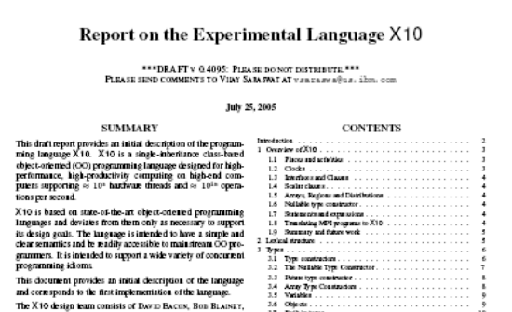
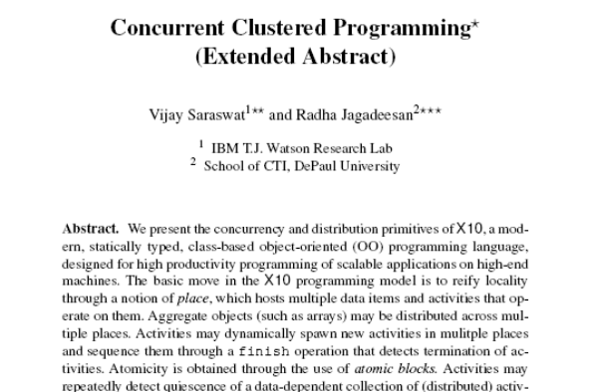
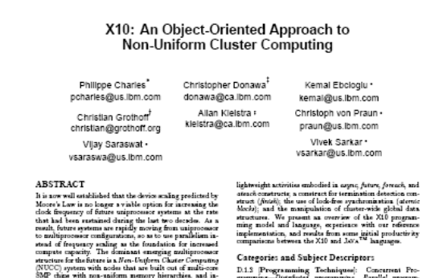
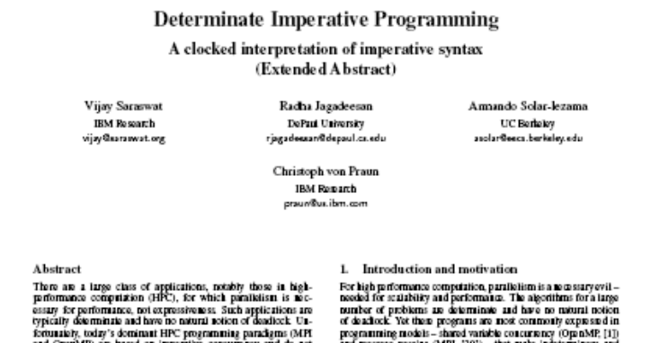
Our results
Language Report
CONCUR 05
OOPSLA 05 Onwards!
X10 Tutorial ➔ User Report
X10 Reference Implementation
Applications
Productivity Study
(Submitted)

Slide 7
The X10 Programming Model
Place
Place
Partitioned Global heap
Outbound activities
Inbound activities
Partitioned Global heap
Place-local heap
Place-local heap
. . .
Activities
Activities
heap
stack
control
heap
stack
control
heap
stack
control
heap
stack
control
. . .
Inbound activity replies
Outbound activity
replies
. . .
Immutable Data
A program is a collection of places, each containing resident data and a dynamic collection of activities.
Program may distribute aggregate data (arrays) across places during allocation.
Program may directly operate only on local data, using atomic blocks.
Program may spawn multiple (local or remote) activities in parallel.
Program must use asynchronous operations to access/update remote data.
Program may repeatedly detect quiescence of a programmer-specified, data-dependent, distributed set of activities.
Cluster Computing: P >= 1
Shared Memory (P=1)
MPI (P > 1)

Slide 8
async, finish
async PlaceExpressionSingleListopt Statement
Statement ::= finish Statement
async (P) S
  Parent activity creates a new child activity at place P, to execute statement S; returns immediately.
  S may reference final variables in enclosing blocks.
finish S
  Execute S, but wait until all (transitively) spawned async’s have terminated.
  Trap all exceptions thrown by spawned activities, throw aggregate exception when all activities terminate.
  double[D] A =…; // Global dist. array
  final int k = …;
  async ( A.distribution[99] ) {
  // Executed at A[99]’s place
  atomic A[99] = k;
  }
finish ateach (point [i]:A) A[i] = i;
finish async (A.distribution[j]) A[j] = 2;
// All A[i]=I will complete before A[j]=2
cf Cilk’s spawn, sync

Slide 9
atomic, when
Statement ::= atomic Statement
MethodModifier ::= atomic
Statement ::= WhenStatement
WhenStatement ::= when ( Expression ) Statement
Atomic blocks are
  Conceptually executed in a single step, while other activities are suspended
An atomic block may not include
  Blocking operations
  Accesses to data at remote places
  Creation of activities at remote places
Activity suspends until a state in which the guard is true; in that state the body is executed atomically.

Slide 10
regions, distributions
Region
  a (multi-dimensional) set of indices
Distribution
  A mapping from indices to places
High level algebraic operations are provided on regions and distributions
region R = 0:100;
region R1 = [0:100, 0:200];
region RInner = [1:99, 1:199];
// a local distribution
dist D1=R-> here;
// a blocked distribution
dist D = block(R);
// union of two distributions
dist D = (0:1) -> P0 || (2:N) -> P1;
dist DBoundary = D – RInner;
Based on ZPL

Slide 11
arrays
Arrays may be
  Multidimensional
  Distributed
  Value types
  Initialized in parallel:
  int [D] A= new int[D]
  (point [i,j]) {return N*i+j;};
Array section
  A[RInner]
High level parallel array, reduction and span operators
  Highly parallel library implementation
  A-B (array subtraction)
  A.reduce(intArray.add,0)
  A.sum()

Slide 12
ateach, foreach
ateach ( FormalParam: Expression ) Statement
foreach ( FormalParam: Expression ) Statement
ateach (point p:A) S
  Creates |region(A)| async statements
  Instance p of statement S is executed at the place where A[p] is located
foreach (point p:R) S
  Creates |R| async statements in parallel at current place
Termination of all activities can be ensured using finish.
public boolean run() {
dist D = dist.factory.block(TABLE_SIZE);
long[.] table = new long[D] (point [i]) { return i; }
long[.] RanStarts = new long[distribution.factory.unique()]
(point [i]) { return starts(i);};
long[.] SmallTable = new long value[TABLE_SIZE]
(point [i]){return i*S_TABLE_INIT;};
finish ateach (point [i] : RanStarts ) {
long ran = nextRandom(RanStarts[i]);
for (int count: 1:N_UPDATES_PER_PLACE) {
int J = f(ran);
long K = SmallTable[g(ran)];
async atomic table[J] ^= K;
ran = nextRandom(ran);
}}
return table.sum() == EXPECTED_RESULT;
}
Notes:
Allocate and initialize RanStarts with one random number seed for each place.
Allocate and initialize table as a block-distributed array.
Everywhere in parallel, repeatedly generate random table indices and atomically read/modify/write table element.
Allocate a small immutable table that can be copied to all places.

Slide 13
Det. dynamic barriers: clocks
Operations
  clock c = new clock();
  c.resume();
    Signals completion of work by activity in this clock phase.
  next;
    Blocks until all clocks it is registered on can advance. Implicitly resumes all clocks.
  c.drop();
    Unregister activity with c.
  async(P)clocked(c₁,…,c_{n})S
    (Clocked async): activity is registered on the clocks (c₁,…,c_{n})
Static Semantics
  An activity may operate only on those clocks it is live on.
  In finish S,S may not contain any (top-level) clocked asyncs.
Dynamic Semantics
  A clock c can advance only when all its registered activities have executed c.resume().
No explicit operation to register a clock.
Supports over-sampling, hierarchical nesting.

Slide 14
NPB – CG in X10
timer.start( t_bench );
for (point [itt] : [1:niter]){
if (timeron )timer.start( t_conj_grad );
finish ateach (point[p]:THREADS) step3();
double rho = rhomaster.sum();
for (point [ii]: [0:cgitmax]){
finish ateach (point [p]:THREADS) step0();
final double rho0 = rho;
final double alpha = rho/dmaster.sum();
finish ateach (point [p]:THREADS) step1(alpha);
rho = rhomaster.sum();
final double beta = rho/rho0;
finish ateach (point [p]:THREADS) step2(beta);
}
finish ateach (point [p]:THREADS) endWork();
rnorm = Math.sqrt( rnormmaster.sum() );
if (timeron) timer.stop(t_conj_grad);
tnorm1 = x.mul(z).sum();
tnorm2 = z.mul(z).sum();
tnorm2 = 1.0 / Math.sqrt(tnorm2);
zeta = shift + 1.0 /tnorm1;
System.out.println( " "+ itt + " " + rnorm +" " + zeta );
final double tnorm2ff = tnorm2;
finish ateach (point[jj] : D) x[jj] = tnorm2ff*z[jj];
}
timer.stop(t_bench);
void step0() {
region Dlocal = (D | here).region;
for (point [j] : Dlocal) {
double sum = 0.0;
for (int k=rowstr[j];k<rowstr[j+1];k++)
sum += a_val[k]*(colidx_val[k]==0? 0 : p[colidx_val[k]]);
q[j] = sum;
}
dmaster[here.id]=(p[Dlocal]).mul(q[Dlocal]).sum();
}
void step1(double alpha) {
region Dlocal = (D | here).region;
for (point [j]:Dlocal){ z[j] += alpha*p[j]; r[j] -= alpha*q[j];}
rhomaster[here.id]=r[Dlocal].mul(r[Dlocal]).sum();
}
void step2(double beta) {
region Dlocal = (D | here).region;
for (point [j]:Dlocal) p[j]=r[j]+beta*p[j];
}
void step3() {
double rho = 0.0;
region Dlocal = (D|here).region;
for (point [j]:Dlocal) { q[j] = z[j] = 0.0; r[j] = p[j] = x[j]; rho += x[j]*x[j]; }
rhomaster[here.id]=rho;
}
void endWork() {
region Dlocal = (D | here).region;
for (point [j]:Dlocal) {
double sum = 0.0;
for (point [k] :[rowstr_val[j]:rowstr_val[j+1]-1])
sum += a_val[k]*(colidx_val[k] == 0 ? 0 : z[colidx_val[k]]);
r[j] = sum;
}
rnormmaster[here.id]=(x[Dlocal]).sub(r[Dlocal]).pow(2).sum();
}

Slide 15
NPB – CG in X10 … array syntax (*)
timer.start( t_bench );
for (point [itt] : [1:niter]){
if (timeron )timer.start( t_conj_grad );
finish ateach (point[p]:THREADS) step3();
double rho = rhomaster.sum();
for (point [ii]: [0:cgitmax]){
finish ateach (point [p]:THREADS) step0();
final double rho0 = rho;
final double alpha = rho/dmaster.sum();
finish ateach (point [p]:THREADS) step1(alpha);
rho = rhomaster.sum();
final double beta = rho/rho0;
finish ateach (point [p]:THREADS) step2(beta);
}
finish ateach (point [p]:THREADS) endWork();
rnorm = Math.sqrt( rnormmaster.sum() );
if (timeron) timer.stop(t_conj_grad);
tnorm1 = x.mul(z).sum();
tnorm2 = z.mul(z).sum();
tnorm2 = 1.0 / Math.sqrt(tnorm2);
zeta = shift + 1.0 /tnorm1;
System.out.println( " "+ itt + " " + rnorm +" " + zeta );
final double tnorm2ff = tnorm2;
finish ateach (point[jj] : D) x[jj] = tnorm2ff*z[jj];
}
timer.stop(t_bench);
void step0() {
region Dl = (D | here).region;
for (point [j] : Dl) {
region R = [rowstr[j]:rowstr[j+1]-1];
q[j] = (a_val[R]*p[colidx[R]]).sum();
}
dmaster[here.id]=(p[Dl] *q[Dl]).sum();
}
void step1(double alpha) {
region Dl= (D | here).region;
z[Dl] += alpha * p[Dl];
r[Dl] -= alpha* q[Dl];
rhomaster[here.id]=(r [Dl] * r [Dl]).sum();
}
void step2(double beta) {
region Dl= (D | here).region;
p[D] = r[Dl] + beta*p[Dl];
}
void step3() {
double rho = 0.0;
region Dl = (D | here).region;
q[D] = z[Dl] = 0.0;
r[D] = p[Dl] = x[Dl];
rhomaster[here.id]= (x[Dl] + x[Dl]).sum();
}
void endWork() {
region Dl = (D | here).region;
for (point [j] : Dl) {
region R = [rowstr[j] : rowstr[j+1] – 1];
r[j] = (a_val[R]*z[colidx[R]]).sum();
}
rnormmaster[here.id]=((x[Dl] – r[Dl])^2).sum();
}
(*) Being implemented

Slide 16
Edmiston
// SPMD computation at each place
finish ateach(point [p]:dist.factory.unique(D.places())) {
// get sub-distribution for this place
final dist myD = D|here;
final int myLow=myD.region.rank(1).low();
final int myHigh=myD.region.rank(1).high();
final int overlapStart=Math.max(0,myLow-overlap);
final dist warmupD=[0:N,overlapStart:myLow]->here;
// Create a local warmup array
final int [.] W= new int[warmupD];
// Compute columns overlapStart+1 .. myLow using column overlapStart
computeMatrix(W, c1, c2, overlapStart+1, myLow);
// Copy column, e[0:N,myLow] = W[0:N,myLow];
finish foreach (point [i] : [0:N]) e[i,myLow] = W[i,myLow];
computeMatrix(e, c1, c2, myLow+1, myHigh);
}
void computeMatrix(int[.] a, final RandCharStr c1, final RandCharStr c2, int firstCol, int lastCol) {
for (point[i,j] : [1:N,firstCol:lastCol] )
a[i,j] = min4(0, a[i-1,j]+iGapPen, a[i,j-1]+iGapPen,
a[i-1,j-1] + (c1.s[i]==c2.s[j] ? iMatch : iMisMatch));
}

Slide 17
Current Status
09/03
PERCS Kickoff
02/04
We have an operational X10 0.41 implementation
X10 Kickoff
07/04
X10 0.32 Spec Draft
Code Templates
X10 Multithreaded RTS
X10 Grammar
Annotated AST
Target Java
Native code
AST
02/05
Parser
Analysis passes
Code emitter
JVM
X10 Prototype #1
X10 source
PEM Events
Structure
  Translator based on Polyglot (Java compiler framework)
  X10 extensions are modular.
  Uses Jikes parser generator.
Code metrics
  Parser: ~45/14K*
  Translator: ~112/9K
  RTS: ~190/10K
  Polyglot base: ~517/80K
  Approx 180 test cases.
  (* classes+interfaces/LOC)
Program output
07/05
Limitations
  Clocked final not yet implemented.
  Type-checking incomplete.
  No type inference.
  Implicit syntax not supported.
X10 ProductivityStudy
12/05
X10 Prototype #2
06/06
Open Source Release?

Slide 18
Formal semantics (FX10)
Based on Middleweight Java (MJ)
Configuration is a tree of located processes
  Tree necessary for finish.
Clocks formalized using short circuits (PODC 88).
Bisimulation semantics.
Basic theorems
  Equational laws
  Clock quiescence is stable.
  Monotonicity of places.
  Deadlock freedom (for language w/out when).
  … Type Safety
  … Memory Safety

Slide 19
MJ syntax
Program p
p ::= cd₁ … cd_{n}; s
Class definition cd
cd ::= class C extends C {fd₁ … fd_{k}
cnd md₁ … md_{n}}
Field definition fd
fd ::= C f;
Constructor definition cnd
Cnd ::= C(C₁ x₁, …, C_{j} x_{j}) {
super(e₁,…, e_{k}); s₁ … s_{n}}
Return type τ
τ ::= C | void
Method definition md
md ::= τ m(C₁ x₁, …, C_{j} x_{j}) {s₁ … s_{k}}
Expression e
e ::= x | null | e.f | (C) e | pe
Promotable expression pe
pe ::= e.m(e1,…,ek)
| new C(e₁,…,e_{k})
Statement s
s ::= ; |pe; | e.f = e; | C x; | x = e;
| if (e == e) {s₁ … s_{k}} else {s_{k+1} … s_{n}}
| return e; | {s₁ … s_{n}}
No visibility, interfaces, exceptions, threads, built-in types,…

Slide 20
MJ Configurations
Heap H
pf from oids to (C, F) where C is classname and F is a finite pf from field names to values
Closed Frame CF
Statement being evaluated
Errors E
E ::= NPE | CCE
Values V
V ::= null | o
Config ::= (H, VS, CF, FS) | E
Variable Stack VS
VS ::= MS o VS | []
MS ::= BS o MS | []
BS a pf from variables to pairs of expression types, values.
Frame Stack FS
FS ::= F o FS | []
F ::= CF | OF
OF ::= if ( *==e) {s} else {s} | …
CF ::= s | {} | return e;
All pfs are finite

Slide 21
X10 syntax
Expression e
e ::= q | MJe
Place Expression q
q ::= here | q.next | v.place
Statement s
s ::= MJs | async (q) clocked (c) s
| finish s | next;
| clock x is new;
| resume c;
| drop c;
p, cd, fd, cnd, τ, md unchanged; arrays, regions, dist out of scope.

Slide 22
X10 Configurations
Errors E
E ::= MJE | BPE
| CUE | FE
Activity tree Δ
A tree with nodes labeled by activities a
a ::= p:(CF,(VS,FS,K)) | E
Values V
V ::= MJV | p
Config ::= (H, σ, Δ) | E
Constraint Store σ
Constraints over clock counters
Clock Map K
pf from clock ids to pairs (X,Y) of clock counters
OF ::= MJOF | async(*) s | when (*) s
CF ::= MJCF | waitn; | waitf;
VS,MS, BS, FS, F as for MJ.

Slide 23
Clocks – Deadlock freedom
For each configuration, define a wait-for graph
  Nodes: clocks; waitf, waitn activities in the configuration.
  Edge from each waitf activity to each waitf/waitn activity in its subtree.
  Edge from each waitn activity to each clock it is registered on.
  Edge from each each clock c to each waitf activity registered on c.
Theorem: There are no cycles in the wait-for graph.

Slide 24
Past work
Java
  Base language
Cilk
  async, finish
PGAS languages
  places
SPMD languages, Synchronous languages
  clocks
Atomic operations
ZPL, Titanium, (HPF…)
  Regions, distributions

Slide 25
Future language extensions
Type system
  semantic annotations
  clocked finals
  aliasing annotations
  dependent types
Determinate programming
  e.g. immutable data
Weaker memory model?
  ordering constructs
First-class functions
Generics
Components?
User-definable primitive types
  Support for operators
Relaxed exception model
Middleware focus
  Persistence?
  Fault tolerance?
  XML support?
Welcome University Partners and other collaborators.

Slide 26
Future Work: Implementation
Type checking/inference
  Clocked types
  Place-aware types
Consistency management
  Lock assignment for atomic sections
  Data-race detection
Activity aggregation
  Batch activities into a single thread.
Message aggregation
  Batch “small” messages.
Load-balancing
  Dynamic, adaptive migration of places from one processor to another.
Continuous optimization
  Efficient implementation of scan/reduce
Efficient invocation of components in foreign languages
  C, Fortran
Garbage collection across multiple places
Welcome University Partners and other collaborators.

Slide 27
Future work: Other topics
Design/Theory
  Atomic blocks
  Structural study of concurrency and distribution
    Clocked types
    Hierarchical places
    Weak memory model
  Persistence/Fault tolerance
  Database integration
Tools
  Refactoring language.
Applications
  Several HPC programs planned currently.
  Also: web-based applications.
Welcome University Partners and other collaborators.

Slide 28
Type system
Value classes
  May only have final fields.
  May only be subclassed by value classes.
Instances of value classes can be copied freely between places.
nullable is a type constructor
  nullable T contains the values of T and null.
Place types: T@P, specify the place at which the data object lives.
Future work: Include generics and dependent types.

Slide 29
X10 v0.409 Cheat Sheet
Stm:
async [ ( Place ) ] [clocked ClockList ] Stm
when ( SimpleExpr ) Stm
finish Stm
next; c.resume() c.drop()
for( i : Region ) Stm
foreach ( i : Region ) Stm
ateach ( I : Distribution ) Stm
Expr:
ArrayExpr
ClassModifier : Kind
MethodModifier: atomic
DataType:
ClassName | InterfaceName | ArrayType
nullable DataType
future DataType
Kind :
value | reference
x10.lang has the following classes (among others)
point, range, region, distribution, clock, array
Some of these are supported by special syntax.

Slide 30
X10 v0.409 Cheat Sheet: Array support
ArrayExpr:
new ArrayType ( Formal ) { Stm }
Distribution Expr -- Lifting
ArrayExpr [ Region ] -- Section
ArrayExpr | Distribution -- Restriction
ArrayExpr || ArrayExpr -- Union
ArrayExpr.overlay(ArrayExpr) -- Update
ArrayExpr. scan( [fun [, ArgList] )
ArrayExpr. reduce( [fun [, ArgList] )
ArrayExpr.lift( [fun [, ArgList] )
ArrayType:
Type [Kind] [ ]
Type [Kind] [ region(N) ]
Type [Kind] [ Region ]
Type [Kind] [ Distribution ]
Region:
Expr : Expr -- 1-D region
[ Range, …, Range ] -- Multidimensional Region
Region && Region -- Intersection
Region || Region -- Union
Region – Region -- Set difference
BuiltinRegion
Distribution:
Region -> Place -- Constant Distribution
Distribution | Place -- Restriction
Distribution | Region -- Restriction
Distribution || Distribution -- Union
Distribution – Distribution -- Set difference
Distribution.overlay ( Distribution )
BuiltinDistribution
Language supports type safety, memory safety, place safety, clock safety

Slide 31
Backup

Slide 32
RandomAccess
public boolean run() {
distribution D = distribution.factory.block(TABLE_SIZE);
long[.] table = new long[D] (point [i]) { return i; }
long[.] RanStarts = new long[distribution.factory.unique()]
(point [i]) { return starts(i);};
long[.] SmallTable = new long value[TABLE_SIZE]
(point [i]) {return i*S_TABLE_INIT;};
finish ateach (point [i] : RanStarts ) {
long ran = nextRandom(RanStarts[i]);
for (int count: 1:N_UPDATES_PER_PLACE) {
int J = f(ran);
long K = SmallTable[g(ran)];
async atomic table[J] ^= K;
ran = nextRandom(ran);
}
}
return table.sum() == EXPECTED_RESULT;
}
Allocate and initialize table as a block-distributed array.
Allocate and initialize RanStarts with one random number seed for each place.
Allocate a small immutable table that can be copied to all places.
Everywhere in parallel, repeatedly generate random table indices and atomically read/modify/write table element.

Slide 33
Example: Latch
public class Latch implements future {
protected boolean forced = false;
protected nullable boxed result = null;
protected nullable exception z = null;
public atomic
boolean setValue( nullable Object val,
nullable exception z ) {
if ( forced ) return false;
// these assignment happens only once.
this.result .val= val;
this.z = z;
this.forced = true;
return true;
public atomic boolean forced() {
return forced;
}
public Object force() {
when ( forced ) {
if (z != null) throw z;
return result;
}
}
}
public interface future {
boolean forced();
Object force();
}
public class boxed {
nullable Object val;
}

Slide 34
Performance and Productivity Challenges
1) Memory wall: Architectures exhibit severe non-uniformities in bandwidth & latency in memory hierarchy
2) Frequency wall: Architectures introduce hierarchical heterogeneous parallelism to compensate for frequency scaling slowdown
Clusters (scale-out)
SMP
Multiple cores on a chip
Coprocessors (SPUs)
SMTs
SIMD
ILP
Proc Cluster
Proc Cluster
. . .
. . .
PEs,
L1 $
PEs,
L1 $
PEs,
L1 $
PEs,
L1 $
. . .
L2 Cache
L2 Cache
. . .
. . .
L3 Cache
. . .
Memory
3) Scalability wall: Software will need to deliver ~ 10⁵-way parallelism to utilize peta-scale parallel systems
Notes:
Unique opportunity for software technologies to help

Slide 35
High Complexity Limits Development Productivity
One billion transistors in a chip
Proc Cluster
Proc Cluster
. . .
. . .
1995: entire chip can be accessed in 1 cycle
PEs,
L1 $
PEs,
L1 $
PEs,
L1 $
PEs,
L1 $
. . .
2010: only small fraction of chip can be accessed in 1 cycle
L2 Cache
L2 Cache
. . .
Major sources of complexity for application developer:
1) Severe non-uniformities in data accesses
2) Applications must exhibit large degrees of parallelism
(up to ~ 10⁵ threads)
\\
. . .
L3 Cache
Complexity leads to increases in all phases of HPC Software Lifecycle related to parallel code
Memory
//
//
Development of Parallel Source Code ---
Design, Code,
Test, Port,
Scale, Optimize
Written
Specification
Production
Runs of
Parallel Code
Maintenance and
Porting of Parallel Code
Requirements
Algorithm
Development
Parallel
Specification
Input Data
Source Code
HPC Software Lifecycle

