Slide 1
CS 267
Unified Parallel C (UPC)
Kathy Yelick
http://www.cs.berkeley.edu/~yelick/cs267
Slides adapted from some by Tarek El-Ghazawi (GWU)

Slide 2
UPC Outline
Background and Philosophy
UPC Execution Model
UPC Memory Model
Data and Pointers
Dynamic Memory Management
Programming Examples
8. Synchronization
9. Performance Tuning and Early Results
10. Concluding Remarks

Slide 3
Context
Most parallel programs are written using either:
  Message passing with a SPMD model
    Usually for scientific applications with C++/Fortran
    Scales easily
  Shared memory with threads in OpenMP, Threads+C/C++/F or Java
    Usually for non-scientific applications
    Easier to program, but less scalable performance
Global Address Space (GAS) Languages take the best of both
  global address space like threads (programmability)
  SPMD parallelism like MPI (performance)
  local/global distinction, i.e., layout matters (performance)

Slide 4
Partitioned Global Address Space Languages
Explicitly-parallel programming model with SPMD parallelism
  Fixed at program start-up, typically 1 thread per processor
Global address space model of memory
  Allows programmer to directly represent distributed data structures
Address space is logically partitioned
  Local vs. remote memory (two-level hierarchy)
Programmer control over performance critical decisions
  Data layout and communication
Performance transparency and tunability are goals
  Initial implementation can use fine-grained shared memory
Base languages differ: UPC (C), CAF (Fortran), Titanium (Java)

Slide 5
Global Address Space Eases Programming
Thread₀ Thread₁ Thread_{n}
X[0]
X[1]
X[P]
Shared
Global address space
ptr:
ptr:
ptr:
Private
The languages share the global address space abstraction
  Shared memory is partitioned by processors
  Remote memory may stay remote: no automatic caching implied
  One-sided communication through reads/writes of shared variables
  Both individual and bulk memory copies
Differ on details
  Some models have a separate private memory area
  Distributed array generality and how they are constructed

Slide 6
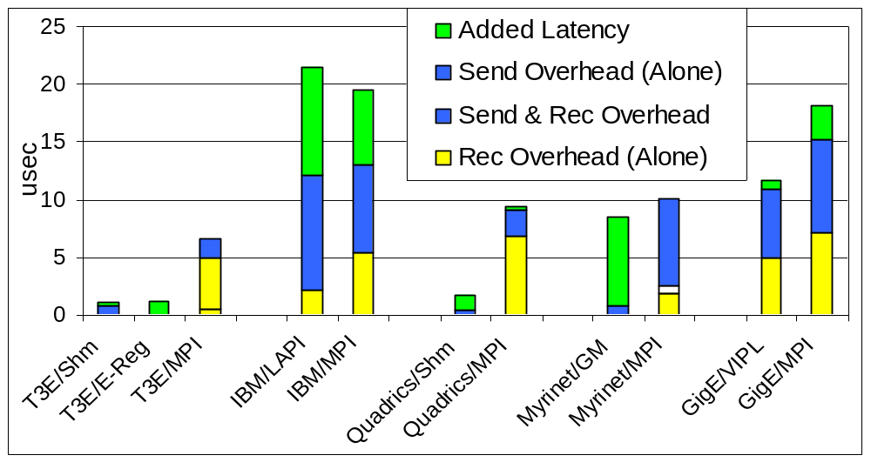
One-Sided Communication May Improve Performance
Potential performance advantage for fine-grained, one-sided programs
Potential productivity advantage for irregular applications

Slide 7
Current Implementations
A successful language/library must run everywhere
UPC
  Commercial compilers available on Cray, SGI, HP machines
  Open source compiler from LBNL/UCB (and another from MTU)
CAF
  Commercial compiler available on Cray machines
  Open source compiler available from Rice
Titanium (Friday)
  Open source compiler from UCB runs on most machines
Common tools
  Open64 open source research compiler infrastructure
  ARMCI, GASNet for distributed memory implementations
  Pthreads, System V shared memory

Slide 8
UPC Overview and Design Philosophy
Unified Parallel C (UPC) is:
  An explicit parallel extension of ANSI C
  A partitioned global address space language
  Sometimes called a GAS language
Similar to the C language philosophy
  Programmers are clever and careful, and may need to get close to hardware
    to get performance, but
    can get in trouble
  Concise and efficient syntax
Common and familiar syntax and semantics for parallel C with simple extensions to ANSI C
Based on ideas in Split-C, AC, and PCP

Slide 9
UPC Execution Model

Slide 10
UPC Execution Model
A number of threads working independently in a SPMD fashion
  Number of threads specified at compile-time or run-time; available as program variable THREADS
  MYTHREAD specifies thread index (0..THREADS-1)
  upc_barrier is a global synchronization: all wait
  There is a form of parallel loop that we will see later
There are two compilation modes
  Static Threads mode:
    Threads is specified at compile time by the user
    The program may is THREADS as a compile-time constant
  Dynamic threads mode:
    Compiled code may be run with varying numbers of threads

Slide 11
Hello World in UPC
Any legal C program is also a legal UPC program
If you compile and run it as UPC with P threads, it will run P copies of the program.
Using this fact, plus the identifiers from the previous slides, we can parallel hello world:
#include <upc.h> /* needed for UPC extensions */
#include <stdio.h>
main() {
printf("Thread %d of %d: hello UPC world\n",
MYTHREAD, THREADS);
}

Slide 12
Example: Monte Carlo Pi Calculation
Estimate Pi by throwing darts at a unit square
Calculate percentage that fall in the unit circle
  Area of square = r² = 1
  Area of circle quadrant = ¼ * π r² = π/4
Randomly throw darts at x,y positions
If x² + y² < 1, then point is inside circle
Compute ratio:
  # points inside / # points total
  π = 4*ratio
r =1

Slide 13
Pi in UPC
Independent estimates of pi:
main(int argc, char **argv) {
int i, hits, trials = 0;
double pi;
if (argc != 2)trials = 1000000;
else trials = atoi(argv[1]);
srand(MYTHREAD*17);
for (i=0; i < trials; i++) hits += hit();
pi = 4.0*hits/trials;
printf("PI estimated to %f.", pi);
}
Each thread gets its own copy of these variables
Each thread can use input arguments
Initialize random in math library
Each thread calls “hit” separately

Slide 14
Helper Code for Pi in UPC
Required includes:
#include <stdio.h>
#include <math.h>
#include <upc.h>
Function to throw dart and calculate where it hits:
int hit(){
int const rand_max = 0xFFFFFF;
double x = (double) (rand()*rand_max) / rand_max;
double y = (double) (rand()*rand_max) / rand_max;
if ((x*x + y*y) <= 1.0) return(1);
else return(0);
}
Hidden slide

Slide 15
UPC Memory Model
Scalar Variables
Distributed Arrays
Pointers to shared data

Slide 16
Private vs. Shared Variables in UPC
Normal C variables and objects are allocated in the private memory space for each thread.
Shared variables are allocated only once, with thread 0
shared int ours;
int mine;
Simple shared variables of this kind may not occur in a within a function definition
Thread₀ Thread₁ Thread_{n}
ours:
Shared
Global address space
mine:
mine:
mine:
Private

Slide 17
Pi in UPC (Cooperative Version)
Parallel computing of pi, but with a race condition
shared int hits;
main(int argc, char **argv) {
int i, my_hits = 0;
int trials = atoi(argv[1]);
my_trials = (trials + THREADS - 1
- MYTHREAD)/THREADS;
srand(MYTHREAD*17);
for (i=0; i < my_trials; i++)
hits += hit();
upc_barrier;
if (MYTHREAD == 0) {
printf("PI estimated to %f.", 4.0*hits/trials);
}
}
shared variable to record hits
divide work up evenly
accumulate hits

Slide 18
Pi in UPC (Cooperative Version)
The race condition can be fixed in several ways:
  Add a lock around the hits increment (later)
  Have each thread update a separate counter:
    Have one thread compute sum
    Use a “collective” to compute sum (recently added to UPC)
shared int all_hits [THREADS];
main(int argc, char **argv) {
… declarations an initialization code omitted
for (i=0; i < my_trials; i++)
all_hits[MYTHREAD] += hit();
upc_barrier;
if (MYTHREAD == 0) {
for (i=0; i < THREADS; i++) hits += all_hits[i];
printf("PI estimated to %f.", 4.0*hits/trials);
}
}
all_hits is shared by all processors, just as hits was
Where does it live?

Slide 19
Shared Arrays Are Cyclic By Default
Shared array elements are spread across the threads
  shared int x[THREADS] /* 1 element per thread */
  shared int y[3][THREADS] /* 3 elements per thread */
  shared int z[3*THREADS] /* 3 elements per thread, cyclic */
In the pictures below
  Assume THREADS = 4
  Elements with affinity to processor 0 are red
As a 2D array, this is logically blocked by columns
x
y
z

Slide 20
Example: Vector Addition
Questions about parallel vector additions:
  How to layout data (here it is cyclic)
  Which processor does what (here it is “owner computes”)
/* vadd.c */
#include <upc_relaxed.h>
#define N 100*THREADS
shared int v1[N], v2[N], sum[N];
void main() {
int i;
for(i=0; i<N; i++)
if (MYTHREAD = = i%THREADS) sum[i]=v1[i]+v2[i];
}
cyclic layout
owner computes

Slide 21
Work Sharing with upc_forall()
The idiom in the previous slide is very common
  Loop over all; work on those owned by this proc
UPC adds a special type of looIteration are independent
  upc_forall(init; test; loop; affinity)
  statement;
Programmer indicates the iterations are independent
  Undefined if there are dependencies across threads
Affinity expression indicates which iterations to run
  Integer: affinity%THREADS is MYTHREAD
  Pointer: upc_threadof(affinity) is MYTHREAD
Semantics are undefined if there are dependencies between iterations
  Programmer has indicated iterations are independent

Slide 22
Vector Addition with upc_forall
The vadd example can be rewritten as follows
  Equivalent code could use “&sum[i]” for affinity
  The code would be correct but slow if the affinity expression were i+1 rather than i.
/* vadd.c */
#include <upc_relaxed.h>
#define N 100*THREADS
shared int v1[N], v2[N], sum[N];
void main() {
int i;
upc_forall(i=0; i<N; i++; i)
sum[i]=v1[i]+v2[i];
}
The cyclic data distribution may perform poorly on a cache-based shared memory machine

Slide 23
UPC Matrix Vector Multiplication Code
The data distribution becomes more interesting in 2D
Here is one possible matrix-vector multiplication
#include <upc_relaxed.h>
shared int a[THREADS][THREADS];
shared int b[THREADS], c[THREADS];
void main (void) {
int i, j , l;
upc_forall( i = 0 ; i < THREADS ; i++; i) {
c[i] = 0;
for ( l= 0 ; l< THREADS ; l++)
c[i] += a[i][l]*b[l];
}
}

Slide 24
Data Distribution
B
Th. 0
Th. 1
Th. 2
Th. 0
*
=
Thread 0
Th. 1
Thread 1
Thread 2
Th. 2
A
B
C

Slide 25
A Better Data Distribution
B
Th. 0
Th. 1
Th. 2
Th. 0
Thread 0
*
=
Th. 1
Thread 1
Th. 2
Thread 2
A
B
C

Slide 26
Layouts in General
All non-array objects have affinity with thread zero.
Array layouts are controlled by layout specifiers.
layout_specifier::
null
layout_specifier [ integer_expression ]
The affinity of an array element is defined in terms of the
block size, a compile-time constant, and THREADS a runtime constant.
Element i has affinity with thread
( i / block_size) % PROCS.

Slide 27
Layout Terminology
Notation is HPF, but terminology is language-independent
  Assume there are 4 processors
(Block, *)
(*, Block)
(Block, Block)
(Cyclic, *)
(Cyclic, Cyclic)
(Cyclic, Block)

Slide 28
2D Array Layouts in UPC
Array a1 has a row layout and array a2 has a block row layout.
shared [m] int a1 [n][m];
shared [k*m] int a2 [n][m];
If (k + m) % THREADS = = 0 them a3 has a row layout
shared int a3 [n][m+k];
To get more general HPF and ScaLAPACK style 2D blocked layouts, one needs to add dimensions.
Assume r*c = THREADS;
shared [b1][b2] int a5 [m][n][r][c][b1][b2];
or equivalently
shared [b1*b2] int a5 [m][n][r][c][b1][b2];

Slide 29
UPC Matrix Vector Multiplication Code
Matrix-vector multiplication with better layout
#include <upc_relaxed.h>
shared [THREADS] int a[THREADS][THREADS];
shared int b[THREADS], c[THREADS];
void main (void) {
int i, j , l;
upc_forall( i = 0 ; i < THREADS ; i++; i) {
c[i] = 0;
for ( l= 0 ; l< THREADS ; l++)
c[i] += a[i][l]*b[l];
}
}

Slide 30
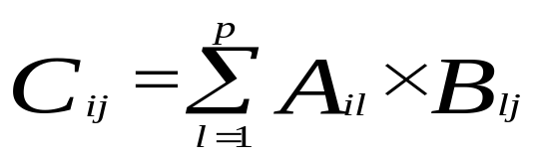
Example: Matrix Multiplication in UPC
Given two integer matrices A(NxP) and B(PxM)
Compute C =A x B.
Entries C_{ij} in C are computed by the formula:

Slide 31
Matrix Multiply in C
#include <stdlib.h>
#include <time.h>
#define N 4
#define P 4
#define M 4
int a[N][P], c[N][M];
int b[P][M];
void main (void) {
int i, j , l;
for (i = 0 ; i<N ; i++) {
for (j=0 ; j<M ;j++) {
c[i][j] = 0;
for (l = 0 ; l<P ; l++) c[i][j] += a[i][l]*b[l][j];
}
}
}

Slide 32
Domain Decomposition for UPC
Exploits locality in matrix multiplication
A (N × P) is decomposed row-wise into blocks of size (N × P) / THREADS as shown below:
B(P × M) is decomposed column wise into M/ THREADS blocks as shown below:
Thread 0
Thread THREADS-1
P
M
0 .. (N*P / THREADS) -1
Thread 0
(N*P / THREADS)..(2*N*P / THREADS)-1
Thread 1
N
P
((THREADS-1)×N*P) / THREADS .. (THREADS*N*P / THREADS)-1
Thread THREADS-1
Note: N and M are assumed to be multiples of THREADS
Columns 0: (M/THREADS)-1
Columns ((THREAD-1) × M)/THREADS:(M-1)

Slide 33
UPC Matrix Multiplication Code
/* mat_mult_1.c */
#include <upc_relaxed.h>
#define N 4
#define P 4
#define M 4
shared [N*P /THREADS] int a[N][P], c[N][M];
// a and c are row-wise blocked shared matrices
shared[M/THREADS] int b[P][M]; //column-wise blocking
void main (void) {
int i, j , l; // private variables
upc_forall(i = 0 ; i<N ; i++; &c[i][0]) {
for (j=0 ; j<M ;j++) {
c[i][j] = 0;
for (l= 0 ; l<P ; l++) c[i][j] += a[i][l]*b[l][j];
}
}
}

Slide 34
Notes on the Matrix Multiplication Example
The UPC code for the matrix multiplication is almost the same size as the sequential code
Shared variable declarations include the keyword shared
Making a private copy of matrix B in each thread might result in better performance since many remote memory operations can be avoided
Can be done with the help of upc_memget

Slide 35
Pointers to Shared vs. Arrays
In the C tradition, array can be access through pointers
Here is the vector addition example using pointers
#include <upc_relaxed.h>
#define N 100*THREADS
shared int v1[N], v2[N], sum[N];
void main() {
int i;
shared int *p1, *p2;
p1=v1; p2=v2;
for (i=0; i<N; i++, p1++, p2++ )
if (i %THREADS= = MYTHREAD)
sum[i]= *p1 + *p2;
}
v1
p1

Slide 36
UPC Pointers
Where does the pointer reside?
 | Private | Shared
Private | PP (p1) | PS (p3)
Shared | SP (p2) | SS (p4)
Where does it point?
int *p1; /* private pointer to local memory */
shared int *p2; /* private pointer to shared space */
int *shared p3; /* shared pointer to local memory */
shared int *shared p4; /* shared pointer to
shared space */
Shared to private is not recommended.

Slide 37
UPC Pointers
Thread₀ Thread₁ Thread_{n}
p3:
p3:
p3:
p4:
p4:
p4:
Shared
Global address space
p1:
p1:
p1:
p2:
p2:
p2:
Private
int *p1; /* private pointer to local memory */
shared int *p2; /* private pointer to shared space */
int *shared p3; /* shared pointer to local memory */
shared int *shared p4; /* shared pointer to
shared space */
Pointers to shared often require more storage and are more costly to dereference; they may refer to local or remote memory.

Slide 38
Common Uses for UPC Pointer Types
int *p1;
These pointers are fast
Use to access private data in part of code performing local work
Often cast a pointer-to-shared to one of these to get faster access to shared data that is local
shared int *p2;
Use to refer to remote data
Larger and slower due to test-for-local + possible communication
int *shared p3;
Not recommended
shared int *shared p4;
Use to build shared linked structures, e.g., a linked list

Slide 39
UPC Pointers
In UPC pointers to shared objects have three fields:
  thread number
  local address of block
  phase (specifies position in the block)
Example: Cray T3E implementation
Virtual Address | Thread | Phase
Phase | Thread | Virtual Address
63
49
48
38
37
0

Slide 40
UPC Pointers
Pointer arithmetic supports blocked and non-blocked array distributions
Casting of shared to private pointers is allowed but not vice versa !
When casting a pointer to shared to a private pointer, the thread number of the pointer to shared may be lost
Casting of shared to private is well defined only if the object pointed to by the pointer to shared has affinity with the thread performing the cast

Slide 41
Special Functions
size_t upc_threadof(shared void *ptr);
returns the thread number that has affinity to the pointer to shared
size_t upc_phaseof(shared void *ptr);
returns the index (position within the block)field of the pointer to shared
size_t upc_addrfield(shared void *ptr);
returns the address of the block which is pointed at by the pointer to shared
shared void *upc_resetphase(shared void *ptr); resets the phase to zero

Slide 42
Synchronization
No implicit synchronization among the threads
UPC provides many synchronization mechanisms:
  Barriers (Blocking)
    upc_barrier
  Split Phase Barriers (Non Blocking)
    upc_notify
    upc_wait
  Optional label allow for
  Locks

Slide 43
Synchronization - Locks
In UPC, shared data can be protected against multiple writers :
  void upc_lock(upc_lock_t *l)
  int upc_lock_attempt(upc_lock_t *l) //returns 1 on success and 0 on failure
  void upc_unlock(upc_lock_t *l)
Locks can be allocated dynamically. Dynamically allocated locks can be freed
Dynamic locks are properly initialized and static locks need initialization

Slide 44
Corrected version Pi Example
Parallel computing of pi, but with a bug
shared int hits;
main(int argc, char **argv) {
int i, my_hits = 0;
int trials = atoi(argv[1]);
my_trials = (trials + THREADS - 1
- MYTHREAD)/THREADS;
srand(MYTHREAD*17);
for (i=0; i < my_trials; i++)
hits += hit();
upc_barrier;
if (MYTHREAD == 0) {
printf("PI estimated to %f.", 4.0*hits/trials);
}
}
shared variable to record hits
accumulate hits

Slide 45
Memory Consistency in UPC
The consistency model of shared memory accesses are controlled by designating accesses as strict, relaxed, or unualified (the default).
There are several ways of designating the ordering type.
A type qualifier, strict or relaxed can be used to affect all variables of that type.
Labels strict or relaxed can be used to control the accesses within a statement.
strict : { x = y ; z = y+1; }
A strict or relaxed cast can be used to override the current label or type qualifier.

Slide 46
Synchronization- Fence
Upc provides a fence construct
  Equivalent to a null strict reference, and has the syntax
    upc_fence;
  UPC ensures that all shared references issued before the upc_fence are complete

Slide 47
Matrix Multiplication with Blocked Matrices
#include <upc_relaxed.h>
shared [N*P/THREADS] int a[N][P], c[N][M];
shared [M/THREADS] int b[P][M];
int b_local[P][M];
void main (void) {
int i, j , l; // private variables
upc_memget(b_local, b, P*M*sizeof(int));
upc_forall(i = 0 ; i<N ; i++; &c[i][0]) {
for (j=0 ; j<M ;j++) {
c[i][j] = 0;
for (l= 0 ; l<P ; l++) c[i][j] += a[i][l]*b_local[l][j];
}
}
}

Slide 48
Shared and Private Data
Assume THREADS = 4
shared [3] int A[4][THREADS];
will result in the following data layout:
Thread 0
Thread 1
Thread 2
Thread 3
A[0][0]
A[0][3]
A[1][2]
A[2][1]
A[0][1]
A[1][0]
A[1][3]
A[2][2]
A[0][2]
A[1][1]
A[2][0]
A[2][3]
A[3][0]
A[3][3]
A[3][1]
A[3][2]

Slide 49
UPC Pointers
Thread 0
Thread 0
Thread 2
Thread 3
X[0]
X[1]
X[2]
X[3]
X[4]
dp
X[5]
dp+1
X[6]
dp+2
X[7]
dp + 3
X[8]
dp + 4
X[9]
dp + 5
X[10]
dp+6
X[11]
dp + 7
X[12]
dp + 8
X[13]
dp + 9
X[14]
X[15]
dp1

Slide 50
UPC Pointers
Thread 0
Thread 1
Thread 2
Thread 3
X[0]
X[3]
dp + 1
X[6]
dp + 4
X[9]
X[1]
X[4]
dp + 2
X[7]
dp + 5
X[10]
X[2]
dp
X[5]
dp + 3
X[8]
dp + 6
X[11]
X[12]
dp + 7
X[15]
X[13]
dp + 8
X[14]
dp+9
dp1

Slide 51
Bulk Copy Operations in UPC
UPC provides standard library functions to move data to/from shared memory
Can be used to move chunks in the shared space or between shared and private spaces
Equivalent of memcpy :
  upc_memcpy(dst, src, size) : copy from shared to shared
  upc_memput(dst, src, size) : copy from private to shared
  upc_memget(dst, src, size) : copy from shared to private
Equivalent of memset:
  upc_memset(dst, char, size) : initialize shared memory with a character

Slide 52
Worksharing with upc_forall
Distributes independent iteration across threads in the way you wish– typically to boost locality exploitation
Simple C-like syntax and semantics
  upc_forall(init; test; loop; expression)
  statement
Expression could be an integer expression or a reference to (address of) a shared object

Slide 53
Work Sharing: upc_forall()
Example 1: Exploiting locality
  shared int a[100],b[100], c[101];
  int i;
  upc_forall (i=0; i<100; i++; &a[i])
    a[i] = b[i] * c[i+1];
Example 2: distribution in a round-robin fashion
  shared int a[100],b[100], c[101];
  int i;
  upc_forall (i=0; i<100; i++; i)
    a[i] = b[i] * c[i+1];
  Note: Examples 1 and 2 happen to result in the same distribution

Slide 54
Work Sharing: upc_forall()
Example 3: distribution by chunks
  shared int a[100],b[100], c[101];
  int i;
  upc_forall (i=0; i<100; i++; (i*THREADS)/100)
    a[i] = b[i] * c[i+1];
i | i*THREADS | i*THREADS/100
0..24 | 0..96 | 0
25..49 | 100..196 | 1
50..74 | 200..296 | 2
75..99 | 300..396 | 3

Slide 55
UPC Outline
Background and Philosophy
UPC Execution Model
UPC Memory Model
UPC: A Quick Intro
Data and Pointers
Dynamic Memory Management
Programming Examples
8. Synchronization
9. Performance Tuning and Early Results
10. Concluding Remarks

Slide 56
Dynamic Memory Allocation in UPC
Dynamic memory allocation of shared memory is available in UPC
Functions can be collective or not
A collective function has to be called by every thread and will return the same value to all of them

Slide 57
Global Memory Allocation
shared void *upc_global_alloc(size_t nblocks, size_t nbytes);
nblocks : number of blocks
nbytes : block size
Non collective, expected to be called by one thread
The calling thread allocates a contiguous memory space in the shared space
If called by more than one thread, multiple regions are allocated and each thread which makes the call gets a different pointer
Space allocated per calling thread is equivalent to :
shared [nbytes] char[nblocks * nbytes]
(Not yet implemented on Cray)

Slide 58
Collective Global Memory Allocation
shared void *upc_all_alloc(size_t nblocks, size_t nbytes);
nblocks: number of blocks
nbytes: block size
This function has the same result as upc_global_alloc. But this is a collective function, which is expected to be called by all threads
All the threads will get the same pointer
Equivalent to :
shared [nbytes] char[nblocks * nbytes]

Slide 59
Memory Freeing
void upc_free(shared void *ptr);
The upc_free function frees the dynamically allocated shared memory pointed to by ptr
upc_free is not collective

Slide 60
UPC Outline
Background and Philosophy
UPC Execution Model
UPC Memory Model
UPC: A Quick Intro
Data and Pointers
Dynamic Memory Management
Programming Examples
8. Synchronization
9. Performance Tuning and Early Results
10. Concluding Remarks

Slide 61
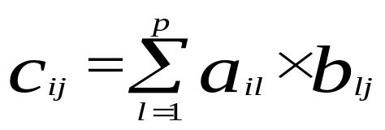
Example: Matrix Multiplication in UPC
Given two integer matrices A(NxP) and B(PxM), we want to compute C =A x B.
Entries c_{ij} in C are computed by the formula:

Slide 62
Doing it in C
#include <stdlib.h>
#include <time.h>
#define N 4
#define P 4
#define M 4
int a[N][P] = {1,2,3,4,5,6,7,8,9,10,11,12,14,14,15,16}, c[N][M];
int b[P][M] = {0,1,0,1,0,1,0,1,0,1,0,1,0,1,0,1};
void main (void) {
int i, j , l;
for (i = 0 ; i<N ; i++) {
for (j=0 ; j<M ;j++) {
c[i][j] = 0;
for (l = 0 ; l<P ; l++) c[i][j] += a[i][l]*b[l][j];
}
}
}
Note: some compiler do not yet support the intialization in declaration statements

Slide 63
Domain Decomposition for UPC
Exploits locality in matrix multiplication
A (N × P) is decomposed row-wise into blocks of size (N × P) / THREADS as shown below:
B(P × M) is decomposed column wise into M/ THREADS blocks as shown below:
Thread 0
Thread THREADS-1
P
M
0 .. (N*P / THREADS) -1
Thread 0
(N*P / THREADS)..(2*N*P / THREADS)-1
Thread 1
N
P
((THREADS-1)×N*P) / THREADS .. (THREADS*N*P / THREADS)-1
Thread THREADS-1
Note: N and M are assumed to be multiples of THREADS
Columns 0: (M/THREADS)-1
Columns ((THREAD-1) × M)/THREADS:(M-1)

Slide 64
UPC Matrix Multiplication Code
#include <upc_relaxed.h>
#define N 4
#define P 4
#define M 4
shared [N*P /THREADS] int a[N][P] = {1,2,3,4,5,6,7,8,9,10,11,12,14,14,15,16}, c[N][M];
// a and c are blocked shared matrices, initialization is not currently implemented
shared[M/THREADS] int b[P][M] = {0,1,0,1,0,1,0,1,0,1,0,1,0,1,0,1};
void main (void) {
int i, j , l; // private variables
upc_forall(i = 0 ; i<N ; i++; &c[i][0]) {
for (j=0 ; j<M ;j++) {
c[i][j] = 0;
for (l= 0 ; l<P ; l++) c[i][j] += a[i][l]*b[l][j];
}
}
}

Slide 65
UPC Matrix Multiplication
Code with block copy
#include <upc_relaxed.h>
shared [N*P /THREADS] int a[N][P], c[N][M];
// a and c are blocked shared matrices, initialization is not currently implemented
shared[M/THREADS] int b[P][M];
int b_local[P][M];
void main (void) {
int i, j , l; // private variables
upc_memget(b_local, b, P*M*sizeof(int));
upc_forall(i = 0 ; i<N ; i++; &c[i][0]) {
for (j=0 ; j<M ;j++) {
c[i][j] = 0;
for (l= 0 ; l<P ; l++) c[i][j] += a[i][l]*b_local[l][j];
}
}
}

Slide 66
UPC Outline
Background and Philosophy
UPC Execution Model
UPC Memory Model
UPC: A Quick Intro
Data and Pointers
Dynamic Memory Management
Programming Examples
8. Synchronization
9. Performance Tuning and Early Results
10. Concluding Remarks

Slide 67
Memory Consistency Models
Has to do with the ordering of shared operations
Under the relaxed consistency model, the shared operations can be reordered by the compiler / runtime system
The strict consistency model enforces sequential ordering of shared operations. (no shared operation can begin before the previously specified one is done)

Slide 68
Memory Consistency Models
User specifies the memory model through:
  declarations
  pragmas for a particular statement or sequence of statements
  use of barriers, and global operations
Consistency can be strict or relaxed
Programmers responsible for using correct consistency model

Slide 69
Memory Consistency
Default behavior can be controlled by the programmer:
  Use strict memory consistency
    #include<upc_strict.h>
  Use relaxed memory consistency
    #include<upc_relaxed.h>

Slide 70
Memory Consistency
Default behavior can be altered for a variable definition using:
  Type qualifiers: strict & relaxed
Default behavior can be altered for a statement or a block of statements using
  #pragma upc strict
  #pragma upc relaxed

Slide 71
UPC Outline
Background and Philosophy
UPC Execution Model
UPC Memory Model
UPC: A Quick Intro
Data and Pointers
Dynamic Memory Management
Programming Examples
8. Synchronization
9. Performance Tuning and Early Results
10. Concluding Remarks

Slide 72
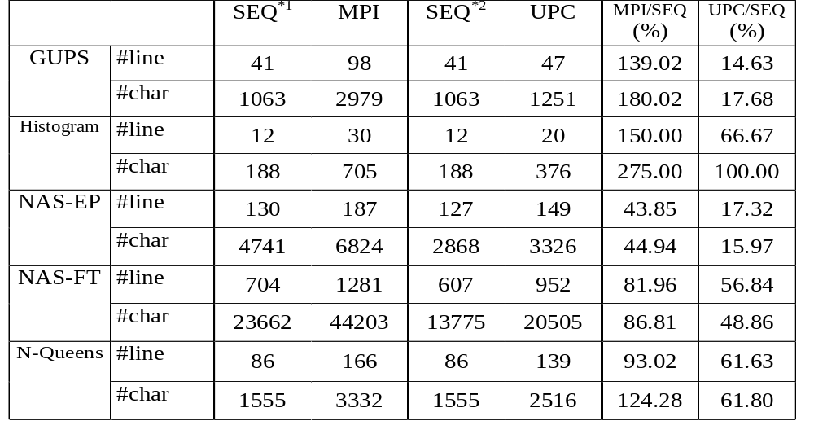
Productivity ~ Code Size
All the line counts are the number of real code lines (no comments, no blocks)
^{*1}: The sequential code is coded in C except for NAS-EP and FT which are coded in Fortran.
^{*2}: The sequential code is always in C.

Slide 73
How to Exploit the Opportunities for Performance Enhancement?
Compiler optimizations
Run-time system
Hand tuning

Slide 74
List of Possible Optimizations for UPC Codes
Space privatization: use private pointers instead of pointer to shareds when dealing with local shared data (through casting and assignments)
Block moves: use block copy instead of copying elements one by one with a loop, through string operations or structures
Latency hiding: For example, overlap remote accesses with local processing using split-phase barriers
Vendors can also help decrease cost for address translation and providing optimized standard libraries

Slide 75
Performance of Shared vs. Private Accesses (Old COMPAQ Measurement)
MB/s | read single elements | write single elements
CC | 640.0 | 400.0
UPC Private | 686.0 | 565.0
UPC local shared | 7.0 | 44.0
UPC remote shared | 0.2 | 0.2
Recent compiler developments have improved some of that

Slide 76
Using Local Pointers Instead of pointer to shared
…
int *pa = (int*) &A[i][0];
int *pc = (int*) &C[i][0];
…
upc_forall(i=0;i<N;i++;&A[i][0]) {
for(j=0;j<P;j++)
pa[j]+=pc[j];
}
Pointer arithmetic is faster using local pointers than pointer to shared
The pointer dereference can be one order of magnitude faster

Slide 77
Performance of UPC
UPC benchmarking results
  Nqueens Problem
  Matrix Multiplication
  Sobel Edge detection
  Stream and GUPS
  NPB
  Splash-2
Compaq AlphaServer SC and Origin 2000/3000
Check the web site for new measurements

Slide 78
Shared vs. Private Accesses (Recent SGI Origin 3000 Measurement)
MB/S | Memcpy | Array Copy | Scale | Sum | Block Get | Block Scale
GCC | 400 | 266 | 266 | 800 | N/A | N/A
UPC Private | 400 | 266 | 266 | 800 | N/A | N/A
UPC Local | N/A | 40 | 44 | 100 | 400 | 400
UPC Shared (SMP) | N/A | 40 | 44 | 88 | 266 | 266
UPC Shared (Remote) | N/A | 34 | 38 | 72 | 200 | 200
STREAM BENCHMARK

Slide 79
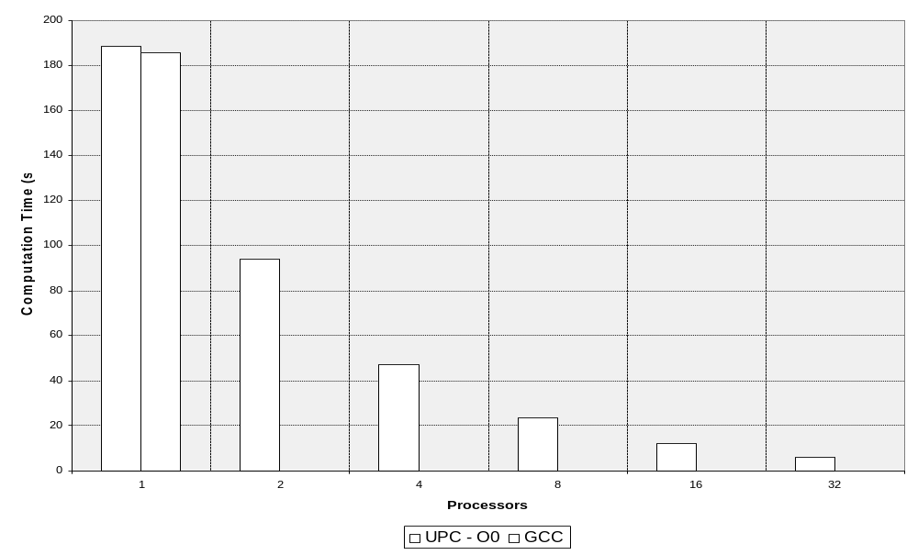
Execution Time over SGI–Origin 2k NAS-EP – Class A

Slide 80
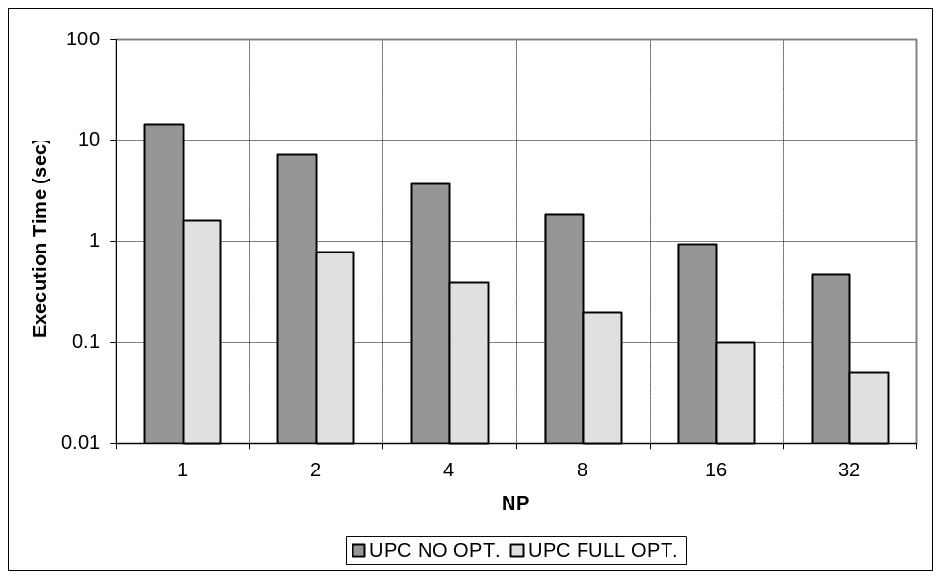
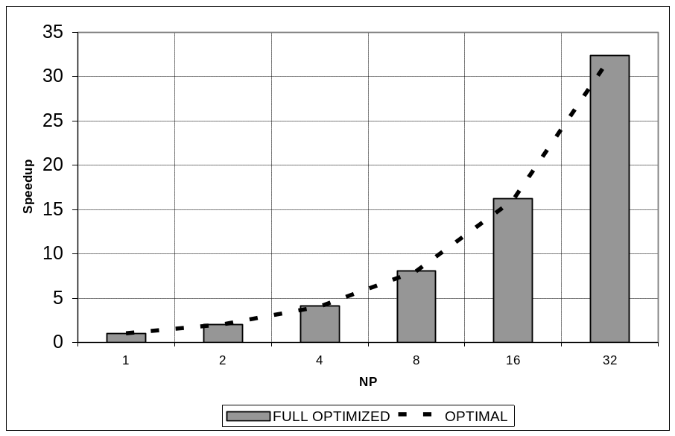
Performance of Edge detection on the Origin 2000
Execution Time
Speedup

Slide 81
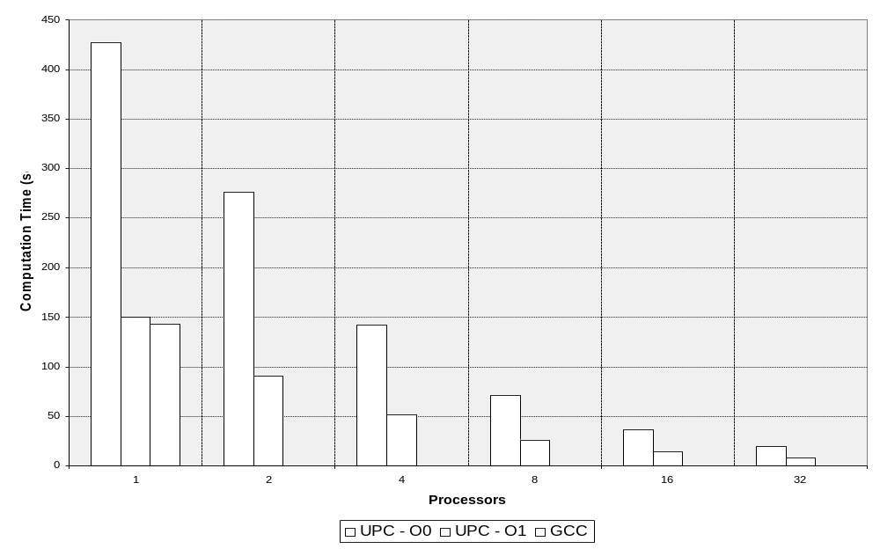
Execution Time over SGI–Origin 2k NAS-FT – Class A

Slide 82
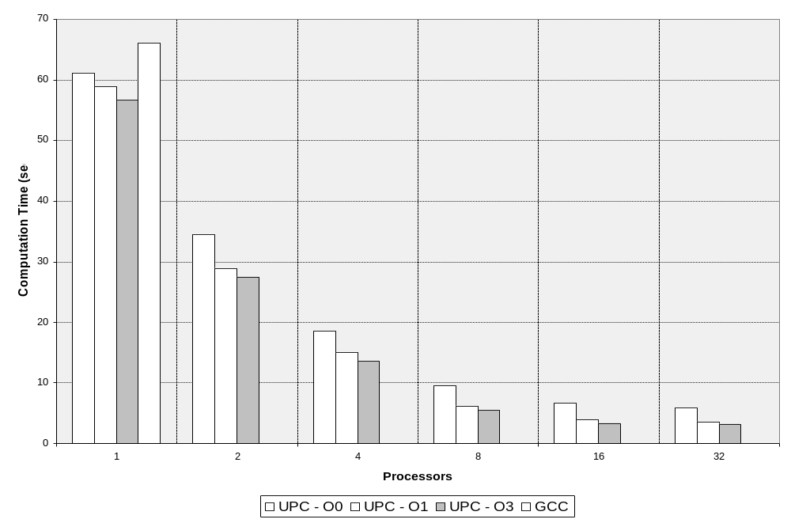
Execution Time over SGI–Origin 2k
NAS-CG – Class A

Slide 83
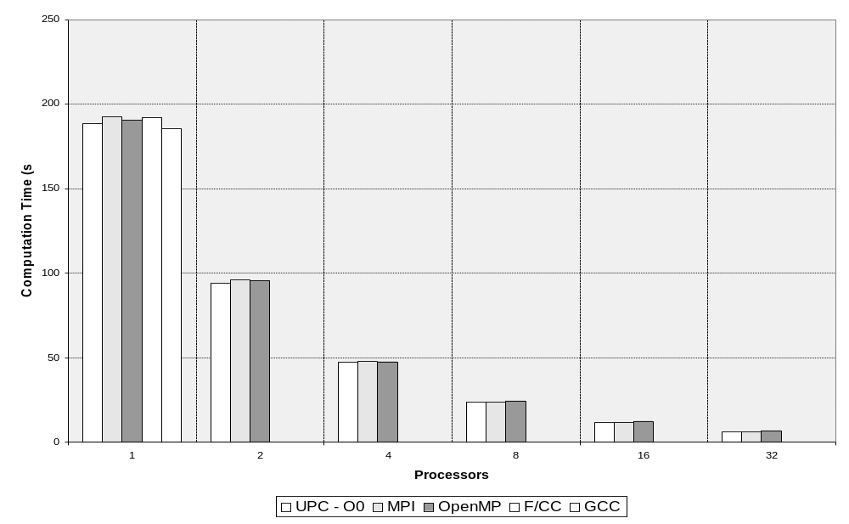
Execution Time over SGI–Origin 2k
NAS-EP – Class A

Slide 84
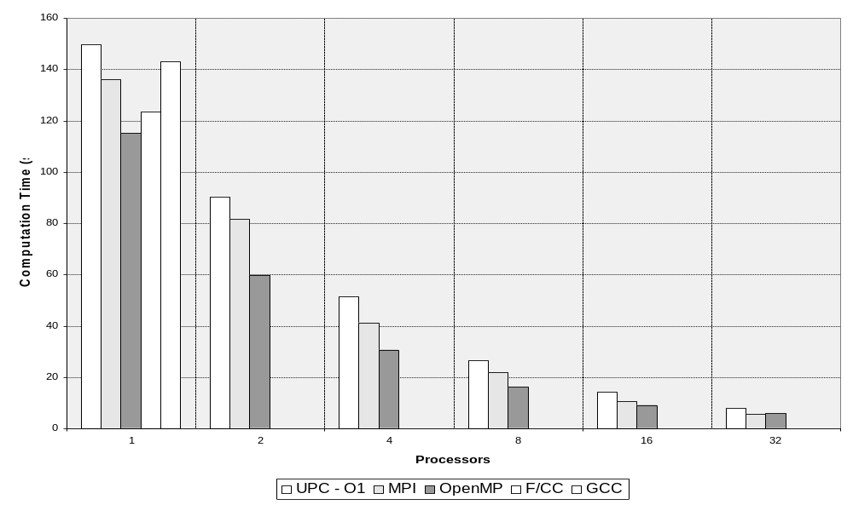
Execution Time over SGI–Origin 2k
NAS-FT – Class A

Slide 85
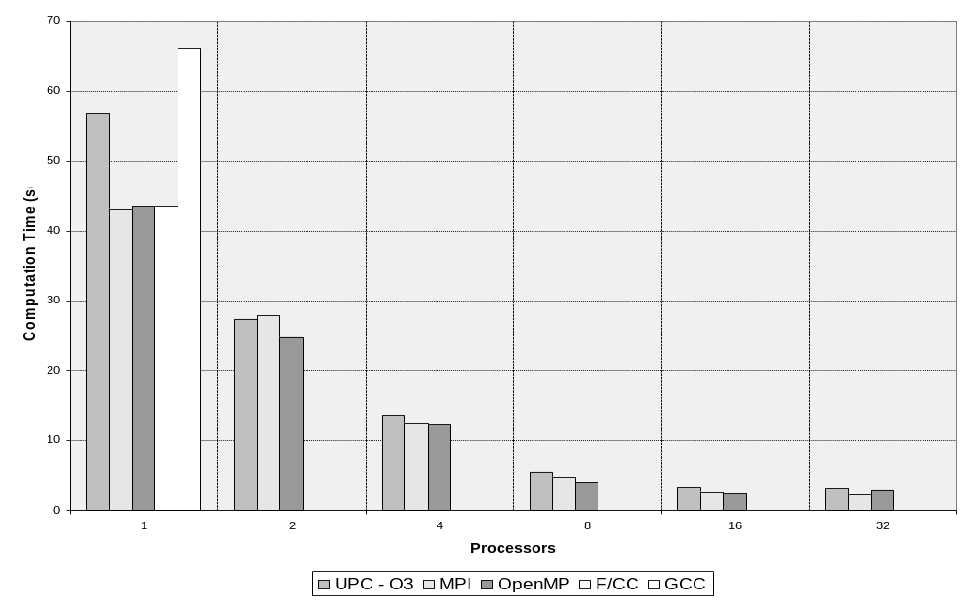
Execution Time over SGI–Origin 2k NAS-CG – Class A

Slide 86
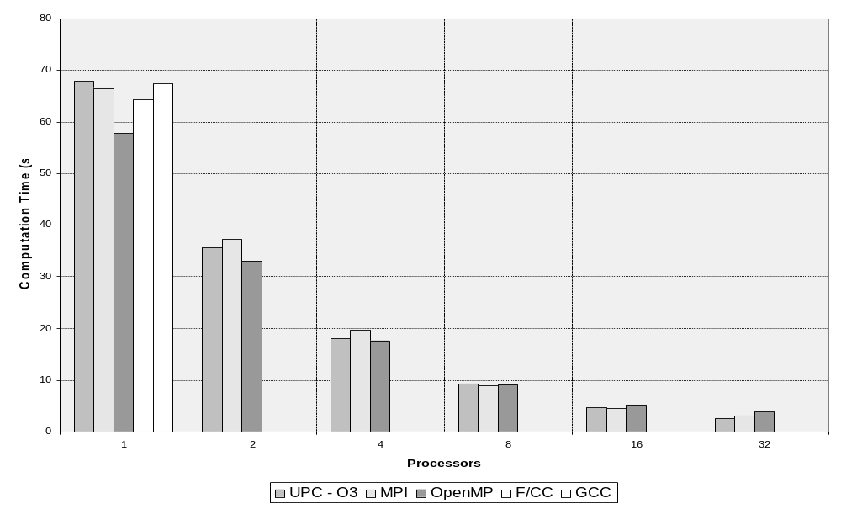
Execution Time over SGI–Origin 2k NAS-MG – Class A

Slide 87
UPC Outline
Background and Philosophy
UPC Execution Model
UPC Memory Model
UPC: A Quick Intro
Data and Pointers
Dynamic Memory Management
Programming Examples
8. Synchronization
9. Performance Tuning and Early Results
10. Concluding Remarks

Slide 88
UPC_{Time-To-Solution}=
UPC_{Programming Time} + UPC_{Execution Time}
Conclusions
Simple and Familiar View
  Domain decomposition maintains global application view
  No function calls
Concise Syntax
  Remote writes with assignment to shared
  Remote reads with expressions involving shared
  Domain decomposition (mainly) implied in declarations (logical place!)
Data locality exploitation
No calls
One-sided communications
Low overhead for short accesses

Slide 89
Conclusions
UPC is easy to program in for C writers, significantly easier than alternative paradigms at times
UPC exhibits very little overhead when compared with MPI for problems that are embarrassingly parallel. No tuning is necessary.
For other problems compiler optimizations are happening but not fully there
With hand-tuning, UPC performance compared favorably with MPI
Hand tuned code, with block moves, is still substantially simpler than message passing code

Slide 90
Conclusions
Automatic compiler optimizations should focus on
  Inexpensive address translation
  Space Privatization for local shared accesses
  Prefetching and aggregation of remote accesses, prediction is easier under the UPC model
More performance help is expected from optimized standard library implementations, specially collective and I/O

Slide 91
References
The official UPC website, http://upc.gwu.edu
T. A.El-Ghazawi, W.W.Carlson, J. M. Draper. UPC Language Specifications V1.1 (http://upc.gwu.edu). May, 2003
François Cantonnet, Yiyi Yao, Smita Annareddy, Ahmed S. Mohamed, Tarek A. El-Ghazawi Performance Monitoring and Evaluation of a UPC Implementation on a NUMA Architecture, International Parallel and Distributed Processing Symposium(IPDPS’03) Nice Acropolis Convention Center, Nice, France, 2003.
Wei-Yu Chen, Dan Bonachea, Jason Duell, Parry Husbands, Costin Iancu, Katherine Yelick, A performance analysis of the Berkeley UPC compiler, International Conference on Supercomputing, Proceedings of the 17th annual international conference on Supercomputing 2003,San Francisco, CA, USA
Tarek A. El-Ghazawi, François Cantonnet, UPC Performance and Potential: A NPB Experimental Study, SuperComputing 2002 (SC2002). IEEE, Baltimore MD, USA, 2002.
Tarek A.El-Ghazawi, Sébastien Chauvin, UPC Benchmarking Issues, Proceedings of the International Conference on Parallel Processing (ICPP’01). IEEE CS Press. Valencia, Spain, September 2001.

Slide 92
CS267 Final Projects
Project proposal
  Teams of 3 students, typically across departments
  Interesting parallel application or system
  Conference-quality paper
  High performance is key:
    Understanding performance, tuning, scaling, etc.
    More important the difficulty of problem
Leverage
  Projects in other classes (but discuss with me first)
  Research projects

Slide 93
Project Ideas
Applications
  Implement existing sequential or shared memory program on distributed memory
  Investigate SMP trade-offs (using only MPI versus MPI and thread based parallelism)
Tools and Systems
  Effects of reordering on sparse matrix factoring and solves
Numerical algorithms
  Improved solver for immersed boundary method
  Use of multiple vectors (blocked algorithms) in iterative solvers

Slide 94
Project Ideas
Novel computational platforms
  Exploiting hierarchy of SMP-clusters in benchmarks
  Computing aggregate operations on ad hoc networks (Culler)
  Push/explore limits of computing on “the grid”
  Performance under failures
Detailed benchmarking and performance analysis, including identification of optimization opportunities
  Titanium
  UPC
  IBM SP (Blue Horizon)

