Slide 1


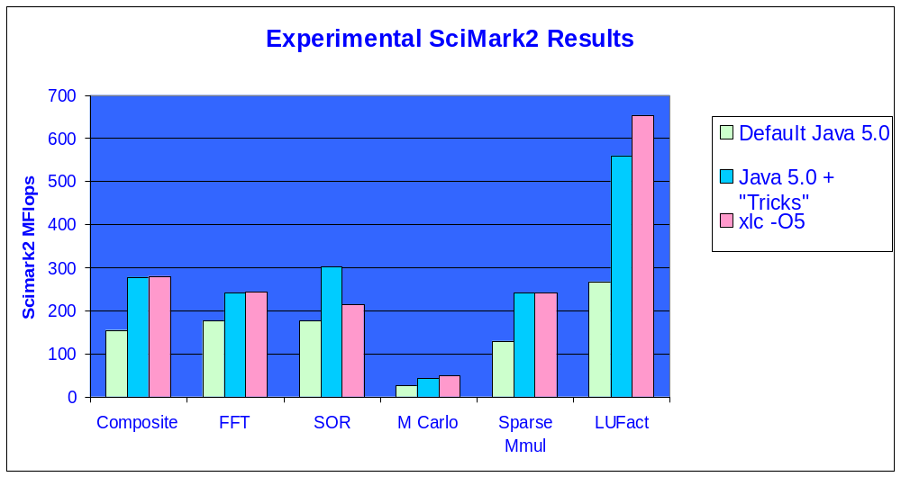
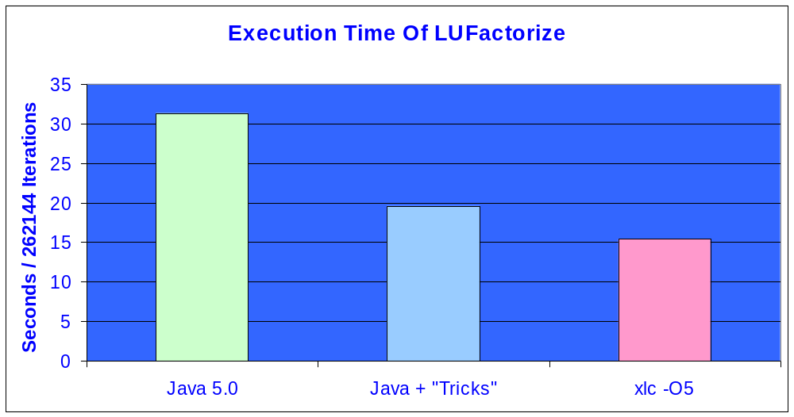
The Role Of An X10 VM In Delivering Productivity And Performance
The PERCS Compilation System For X10
Achieving Static Language Performance In An X10 VM
There are substantial productivity advantages that come from a VM for X10. We want to demonstrate that performance need not suffer as a result.
We Use SciMark2 (http://math.nist.gov/scimark2/)
to compare C and Java on Numeric Codes.
  With some relatively simple modifications to our existing Java product, we show that the VM can execute the Java code virtually as fast as the C code runs.
A Closer Look At LUFactorization: A Kernel In All Benchmark Suites!
A basic Gaussian elimination kernel. Our implementation is inspired by the HPC “hpl” benchmark and differs from SciMark2’s:
We arrange the data in column major order
  Makes better use of data cache
  Makes it suitable for parallelization
When processing column i, find pivot point for column i+1
We manually performed some standard compiler optimizations that can be easily added to the JIT for X10
Expressions involving division by a loop invariant are replaced by multiplication by a reciprocal (which computation is hoisted out of the loop)
“unswitched” a hot loop (create two loops with less control flow in each)
Copied certain instance variables to local automatics to aid in commoning (and other optimizations)
Javac
X10
Static
Analyzer
UPC
C, C++
FTN
library
Machine
Independent
Optimizer
class
class
jar
W-Code
PDF
PERCS VM
Continuous
Program
Optimization
J9 Execution Engine
DLL / a.out
machine code
Testa Rossa
JIT
We Used a simple –O5 flag. No Attempt Was Made To Determine The Best Possible C Options. The C score can likely be improved.
Advantages to a VM Based Execution Environment
VM helps to ensure the safety rules defined by languages such as X10
Automatic system activities such as:
  Storage management
  Dynamic recompilation with profiling information based on current system conditions
Exploit powerful static optimizer in dynamic environment
“Static” languages and X10 (or Java) can inter-operate:
  Exploit legacy libraries (from X10 code)
Maximize performance of older code given deep knowledge of actual executing processor
Great framework for CPO and other analysis tools
Achieving The Best VM-Based Performance: “Tricks”
The existing Just In Time Compiler (JIT) already has a repertoire of sophisticated optimizations.
  Force more of these to be activated early on in program execution
X10’s rules allow the use of Fused- Multiply-Add machine instructions
Simulate X10 Static Analyzer’s ability to remove most null- and bounds-checks by removing all such checks from selected methods.
  Checks cause extra code and act as barriers to optimizations
The VM’s garbage collection mechanism also results in extra code and constraints on register allocation
  Removed many such constraints in selected methods
  X10 executing code will be more GC-aware than Java
Executing scientific code under a VM can be done with static language performance.
The Test Environment
System Model: IBM,7040-671: PowerPC_POWER4
Number Of Processors: 16: Clock Speed: 1100 MHz
Memory Size: 131072 MB
Xlc 7.0.0.1
Compilation Products – SWG Toronto Laboratory – IBM Confidential

Slide 2
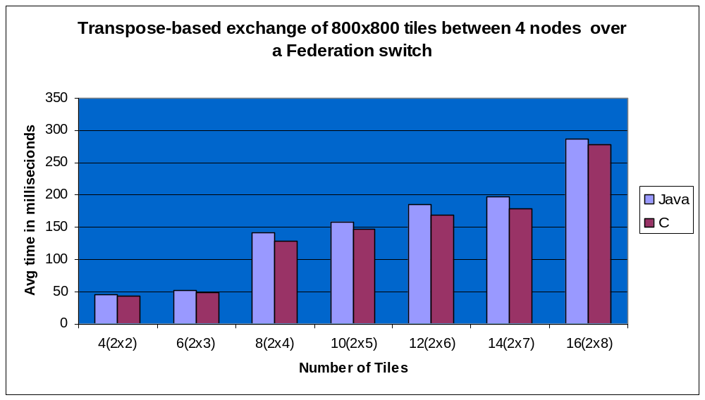
The Role Of An X10 VM In Delivering Productivity And Performance
Phase III Activities To Further Improve Performance of Numeric X10 Code
Aliasing
  Successive rows/columns of X10 arrays are never aliased (and always assumed to be aliased in Java)
  Many optimizations including data-flow based optimizations and scheduling are restricted by imprecise alias information.
X10 multi-dimensioned arrays are not “arrays of arrays”
  Faster element access via a single base address rather than indirect access
  Better opportunity for versioning and other bounds check removal
  Less space wasted by object headers
General Floating Point improvements
  E.g., integer to double conversions on PowerPC
Faster interaction with other languages
Example: Parallel Transpose Across Four VMs
basic algorithm based on ptrans
VM 0
VM 1
Src array
Source
Array tile
Dest array
Partitioned
T
Temp
buffer
Result
Array tile
Source and destination arrays distributed in equal sized tiles among VMs
VMs copy source tile into temporary buffer at destination
Transpose from temp buffer to result tile
VM 2
VM 3
Single program across many VMs: How a multi-node VM works
VM 1
X10
program
Each VM knows about all other VMs and transfers data on demand
Asyncs (remote data manipulation) marshal needed data in runtime and send via LAPI
In many cases, 0-copy, non-serialized transfer may be used
Low-level API (LAPI) communication library handles data transfers and synchronization issues
To run a program each VM:
loads the same program and configuration data.
Establishes LAPI connections
Place 0 runs main
X10 runtime
Performance: VM + Communication Library Is a Viable Option
Two versions of a parallel transpose used: C and Java, both based on the LAPI library.
Run across four machines connected by a Federation switch.
Can co-operating Java processes on different machines exchange data fast enough to be used as a basis for an X10 implementation?
Tile size: 800x800 (640000) 8-byte doubles
System Model: IBM, 9119-575 PowerPC_POWER5
Number Of Processors: 8 Clock Speed: 1902 MHz
Memory Size: 15552Mb
We think that there is a lot of promise.
LAPI
VM0
VM2
VM3
VM 0
x10
VM 2
x10
VM 3
x10
X10 runtime
X10 runtime
X10 runtime
LAPI
LAPI
LAPI
Compilation Products – SWG Toronto Laboratory – IBM Confidential

