Slide 1

X10: Concurrent Programming in the multicore era
Vijay Saraswat, vijay@saraswat.org
July 2007
IBM Research
© Vijay Saraswat

Slide 2
Acknowledgments
X10 Core Team
  Rajkishore Barik, Ganesh Bikshandi, Chris Donawa, Allan Kielstra, Sreedhar Kodali, Nathaniel Nystrom, Igor Peshansky, Christoph von Praun, Vijay Saraswat, Vivek Sarkar, Lex Spoon, Pradeep Varma, Krishna Venkat, Tong Wen
X10 Tools
  Philippe Charles, Julian Dolby, Robert Fuhrer, Frank Tip, Mandana Vaziri
Emeritus
  Kemal Ebcioglu, Christian Grothoff, Vincent Cave
Research colleagues
  Ras Bodik, Guang Gao, Radha Jagadeesan, Jens Palsberg, Rodric Rabbah, Jan Vitek
  Vinod Tipparaju, Jarek Nieplocha (PNNL)
  Kathy Yelick, Dan Bonachea (Berkeley)
Several IBM colleagues
Special thanks to Christoph von Praun and Vivek Sarkar for many slides.

Slide 3
X10 in a Nutshell

Slide 4
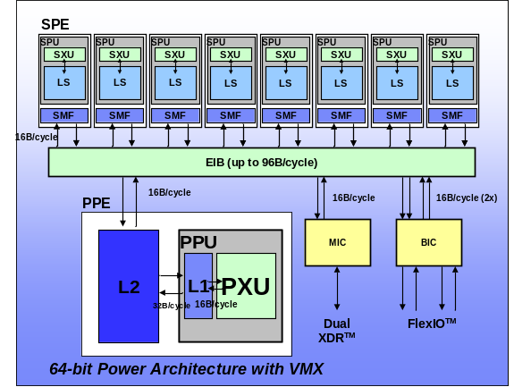
A new era of mainstream parallel processing
The Challenge
Parallelism scaling replaces frequency scaling as foundation for
increased performance ➔ Profound impact on future software
Multi-core chips
Heterogeneous Parallelism
Cluster Parallelism
SMP Node
SMP Node
. . .
. . .
. . .
PEs,
L1 $
PEs,
L1 $
. . .
. . .
PEs,
PEs,
PEs,
PEs,
L2 Cache
. . .
. . .
PEs,
L1 $
PEs,
L1 $
Memory
Memory
L2 Cache
Interconnect
Our response:
Use X10 as a new language for parallel hardware that builds on
existing tools, compilers, runtimes, virtual machines and libraries
Notes:
PPoPP: VIVEK
Parallelism scaling replaces frequency scaling as the foundation for increased performance. Parallelism scaling can be observed at three important levels of the hardware stack:
Multi-core parallelism
Hetreogeneous parallelism (as in the Cell processor)
Cluster parallelism as in Blue Gene or in commodity scale-out clusters
The move towards parallelism as the primary driver for system performance will have a profound software impact on software, because all software will need to be enabled to exploit parallelism. Some areas of commercial software (e.g. transaction systems) are already prepared for this trend from past investments in SMP-enablement. However, a lot of other software is predominantly single-threaded has been riding the frequency scaling curve predicted by Moore’s Law for the last two decades. The goal of the X10 project in IBM Research is to respond to this future software crisis by establishing new foundations for programming models, languages, tools, compilers, runtimes, virtual machines, and libraries for parallel hardware.

Slide 5
Themes
Target productivity, without sacrificing performance.
Build on what we understand – core sequential OO base.
Manage concurrency and distribution explicitly.
Target the “mainstream” programmer; do not ignore the expert.
Rule out large classes of errors by design – statically as far as possible, else dynamically.
Keep the language small, orthogonal.
Make easy things easy, hard things possible.
Address the entire tool chain: development environment, analysis tools, debugging, …

Slide 6
Programming Model -- The Big Picture
Places
  Partition data and activities that operate on the data
  But keep address space global.
  Locality central to heterogeneity, clustering.
Asynchrony
  Express fine-grained parallelism
  Exploit fork-join structure, recursive partitioning.
Atomicity
  Specify granularity of atomicity.
  Focus on the desired property, not the mechanism.
Ordering
  Termination detection
  Quiescence detection

Slide 7
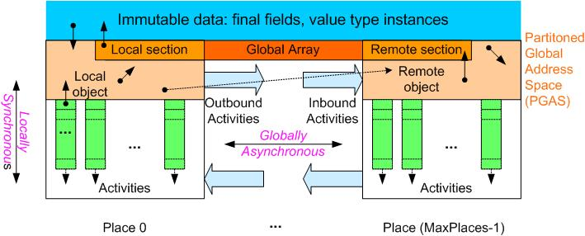
X10 Programming Model – The Big Picture
Storage classes:
Activity-local
Place-local
Partitioned global
Immutable
Dynamic parallelism with a Partitioned Global Address Space
Places encapsulate binding of activities and globally addressable data
  Number of places currently fixed at launch time
All concurrency is expressed as asynchronous activities – subsumes threads, structured parallelism, messaging, DMA transfers, etc.
Atomic sections enforce mutual exclusion of co-located data
  No place-remote accesses permitted in atomic section
Immutable data offers opportunity for single-assignment parallelism
Notes:
This slide summarizes the basic concepts in the X10 programming models. A more detailed technical description can be found in the OOPSLA 2005 paper titled “X10: an object-oriented approach to non-uniform cluster computing”.
All concurrency is expressed as asynchronous activities. Our experience has been that this single notion of an asynchronous activity can subsume many levels of parallelism that a programmer may encounter e.g., threads, structured parallelism (including OpenMP), messaging (including MPI), DMA transfers, etc. In the above slide each vertical green rectangle represents the stack for a single activity.
Places encapsulate an affinity between activities and data. All data that is writeable is assumed to be partitioned across places, thereby resulting in a Partitioned Global Address Space (PGAS). For example, we see a number of activities and local objects in Place 0 above. In addition, Place 0 can hold a local section of a global array. An activity may hold references to remote objects i.e., objects located at places different from the activity’s place. If an activity attempts to operate on a remote object, then it does so by logically creating a new activity at the remote place to perform the operation as indicated by the arrows labeled “Outbound Activities” and “Inbound Activities”. Immutable (readonly) data has a special status because it can be accessed freely from any place.
A place is a virtual concept. While it is natural to think of a place mapping to a single SMP node (say), it may be possible to map multiple places on the same SMP node and even migrate the places within and across SMP’s if it’s advantageous to do so.
3) Atomic blocks are used by multiple activities in the same place to coordinate mutual exclusion in their accesses to shared mutable data. A key benefit of atomic compared to classical acquire/release or monitor-enter/monitor-exit is that the programmer does not need to specify a lock to be used fo reinforcing mutual exclusion.
There are three possible approaches for implementing atomic blocks currently being pursued in the X10 project:
Automatic lock assignment by the system. The approach here is to let the static/dynamic compiler study the data being accessed in each atomic blocks, and assign locks from a compiler-managed set to different atomic blocks so as to guarantee mutual exclusion.
Use of transactional memory. Any transactional memory implementation (hardware, software, or hybrid) can be used to implement atomic blocks.
Use of nonblocking instructions in hardware. In many cases, the body of the atomic block is simple enough that it may be possible to implement the entire atomic block using nonblocking instructions in the target processor.
4) Finish is the X10 operation that is used to detect termination of a set of subactivities created by an X10 activity (the set is determined by the scope of the Finish construct)
5) An important result is that any X10 program written with the above constructs can never deadlock. There are additional constructs in X10 that have not been described here, for the sake of brevity.

Slide 8
X10 v1.01 Cheat sheet
Stm:
async [ ( Place ) ] [clocked ClockList ] Stm
atomic Stm
when ( SimpleExpr ) Stm
finish Stm
next; c.resume() c.drop()
for( i : Region ) Stm
foreach ( i : Region ) Stm
ateach ( I : Distribution ) Stm
Expr:
ArrayExpr
ClassModifier : Kind
MethodModifier:
atomic nonblocking sequential
local safe
Type:
DataType
nullable<Type>
future <Type >
Kind :
value | reference
ClassType , InterfaceType :
TypeName
[ DepParameters ] [ PlaceTypeSpecifier ]
Annotations: @ InterfaceType
Annotations suffix types and prefix almost all other syntactic elements.
x10.lang has the following classes (among others)
point, range, region, distribution, clock, array
Some of these are supported by special syntax.
Notes:
PPoPP: Vijay – upgrade to 1.01 syntax.

Slide 9
X10 v1.01 Cheat sheet: Array support
ArrayExpr:
new ArrayType ( Formal ) { Stm }
Distribution Expr -- Lifting
ArrayExpr [ Region ] -- Section
ArrayExpr | Distribution -- Restriction
ArrayExpr || ArrayExpr -- Union
ArrayExpr.overlay(ArrayExpr) -- Update
ArrayExpr. scan( [fun [, ArgList] )
ArrayExpr. reduce( [fun [, ArgList] )
ArrayExpr.lift( [fun [, ArgList] )
ArrayType:
Type [Kind] [ ]
Type [Kind] [ region(N) ]
Type [Kind] [ Region ]
Type [Kind] [ Distribution ]
Region:
Expr : Expr -- 1-D region
[ Range, …, Range ] -- Multidimensional Region
Region && Region -- Intersection
Region || Region -- Union
Region – Region -- Set difference
BuiltinRegion
Dist:
Region -> Place -- Constant distribution
Distribution | Place -- Restriction
Distribution | Region -- Restriction
Distribution || Distribution -- Union
Distribution – Distribution -- Set difference
Distribution.overlay ( Distribution )
BuiltinDistribution
Language supports type safety, memory safety, place safety, clock safety.
Notes:
: Vijay – upgrade to 1.01 syntax.

Slide 10
A simple example: Fib
class Fib {
int result;
Fib (int n) { result = n;}
void run() {
if (result < 2) { result=1; return; }
final Fib f1 = new Fib(result-1);
final Fib f2 = new Fib(result-2);
finish { async f1.run(); async f2.run();}
result = f1.result + f2.result;
}
public static void main (String[] a) {
int n = java.lang.Integer.parseInt(a[0]);
Fib f = new Fib(n); f.run();
System.out.println("Fib(" + n+ ")=" + f.result);
}
}

Slide 11
Comparison with MPI
Model of parallelism
MPI: data parallel, SPMD
X10: structured multithreading, SPMD is a special case.
Synchronization model
MPI: clear distinction between control synchronization
(barriers) and communication (or combine them in a collective).
  synchronous: send / receive
  asynchronous: put/get
X10: shared memory paradigm
  address space partitioned,
    locality of access visible to the programmer
  remote access are asynchronous (but may be made synchronous)
  Supports “active messages”.
Notes:
PPoPP: Christoph
Expand with high-level comparison with UPC/MPI/Cilk.

Slide 12
Comparison with UPC
X10 is similar to UPC in ...
shared partitioned global address space
barrier synchronization:
  UPC split barrier (upc_notify, upc_wait)
  X10 clocks: resume(), next
parallel loops with affinity
  UPC affinity clause in upc_forall
  X10 distribution in ateach
X10 extends UPC in ...
dynamic structured multithreading (not SPMD)
safety properties (managed runtime)
distributed computation and data, concept of places
array language, multidimensional arrays
critical section synchronization
  simple atomic blocks, not locks
  conditional atomic blocks
type system exposes access locality
multiple, custom distributions

Slide 13
Comparison with CILK
X10 is similar to CILK in ...
structured concurrency
  Cilk: spawn, sync
  X10: async, finish (block scoped, rooted exception model), method body not forced to finish spawned asyncs.
  serial elision only for non-blocking activities in X10
X10 extends CILK in ...
distributed computation and data, concept of places
  intra/inter-place work-stealing scheduler?
array language, multidimensional arrays
critical sections
  simple atomic blocks, not locks
  X10 has condition synchronization
X10 managed runtime and type system: safety properties

Slide 14
Comparison with Java ™
X10 language builds on the Java language
Shared underlying philosophy: shared syntactic and semantic tradition, simple, small, easy to use, efficiently implementable, machine independent
X10 does not have:
Dynamic class loading
Java’s concurrency features
  thread library, volatile, synchronized, wait, notify
X10 restricts:
Class variables and static initialization
X10 adds to Java:
value types, nullable
Array language
  Multi-dimensional arrays, aggregate operations
New concurrency features
  activities (async, future), atomic blocks, clocks
Distribution
  places
  distributed arrays

Slide 15
X10 availability
X10 is an open source project (Eclipse Public License).
Website: http://x10.sf.net
Reference implementation in Java, runs on any Java 5 VM.
  Windows/Intel, Linux/Intel
  AIX/PPC, Linux/PPC
  Runs on multiprocessors
Website contains
  Tutorial material
  Presentations
  Download instructions
  Copies of some papers
  Pointers to mailing list

Slide 16
PERCS Programming Model, Tools
JavaTM source code
(w/ threads & conc utils)
C/C++ source code
(w/ MPI, OpenMP, UPC)
Fortran source code
(w/ MPI, OpenMP)
. . .
X10 source code
. . .
Productivity Measurements
X10 Development Toolkit
Java Development Toolkit
C/C++
Development Toolkit
+ MPI extensions
Fortran Development Toolkit
. . .
Refactoring for Concurrency
. . .
Performance
Exploration
X10 Compiler
Java
Compiler
C/C++ Compiler
w/ UPC extensions
Fortran Compiler
Parallel Tools Platform (PTP)
Eclipse
platform
Text in blue identifies
exploratory
PERCS
contributions
X10 Components
Java components
C/C++
components
Fortran components
Fast extern
interface
X10 runtime
Java runtime
C/C++ runtime
Fortran runtime
Dynamic Compilation + Continuous Program Optimization
Integrated Parallel Runtime: MPI + LAPI + RDMA + OpenMP + threads

Slide 17
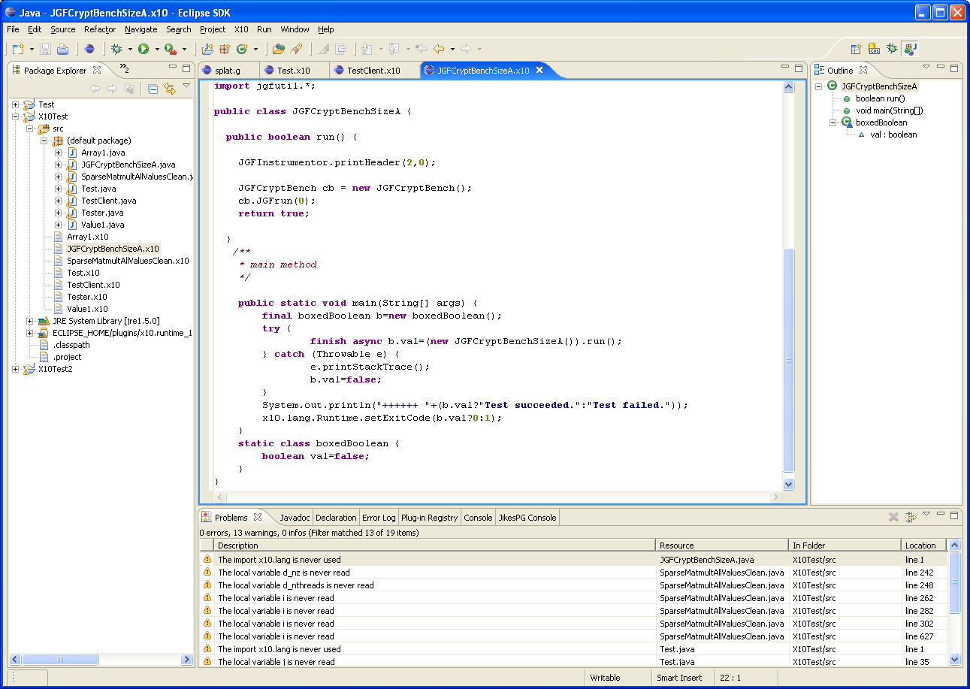
X10DT: Enhancing productivity
X10 Launch Configuration
Source editor w/ syntax
highlighting, auto indenting,
some content assist
Outline View populated w/
X10 types, members, loops
X10 Incremental Builder;
Problems View populated
w/ X10 compiler messages
Code editing
Refactoring
Code visualization
Data visualization
Debugging
Static performance analysis
Vision: State-of-the-art IDE for a modern OO language for HPC

Slide 18
X10 Compiler (06/2007)
09/03
Operational X10 implementation (since 02/2005)
PERCS Kickoff
02/04
Code Templates
X10 Multithreaded RTS
X10 Kickoff
X10 Grammar
Annotated AST
Target Java
AST
07/04
Parser
Analysis passes
Code emitter
JVM
X10 0.32 Spec Draft
X10 source
Native code
02/05
X10 Prototype #1
Program output
07/05
X10 ProductivityStudy
Structure
  Translator based on Polyglot (Java compiler framework)
  X10 extensions are modular.
  Uses Jikes parser generator.
Code metrics
  Parser: ~45/14K*
  Translator: ~112/9K
  RTS: ~190/10K – revised for JUC
  Polyglot base: ~517/80K
  Approx 280 test cases.
  (* classes+interfaces/LOC)
New features 6/07
  Annotations
  X10lib v 0.5
12/05
X10 Prototype #2
12/06
Open Source Release
6/07
Annotations, X10lib v0.5

Slide 19
X10 Runtime (06/2007)
Implemented in Java
Full implementation of X10 v1.5
Concurrent implementation
  Based on Java concurrency utils
  Thread pool used to manage activities in each place
  Asyncs implemented using shared work queue per place
  Atomics implemented with per place lock
Support for native code integration
  Enables development of hybrid X10 applications: manage concurrency in X10, use existing single-threaded C/Fortran kernels.

