Slide 1
X10: Computing at Scale
Vijay Saraswat
http://www.research.ibm.com/x10
This work has been supported in part by the Defense Advanced Research Projects Agency (DARPA) under contract No. NBCH30390004.

Slide 2
Acknowledgements
X10 core team
  Philippe Charles
  Chris Donawa (IBM Toronto)
  Kemal Ebcioglu
  Christian Grothoff (UCLA)
  Allan Kielstra (IBM Toronto)
  Douglas Lovell
  Maged Michael
  Christoph von Praun
  Vivek Sarkar
  Armando Solar-Lezama (UC Berkeley)
Additional contributors to X10 ideas:
David Bacon, Bob Blainey, Perry Cheng, Julian Dolby, Guang Gao (U Delaware), Robert O'Callahan, Filip Pizlo (Purdue), Lawrence Rauchwerger (Texas A&M), Mandana Vaziri, Jan Vitek (Purdue), V.T. Rajan, Radha Jagadeesan (DePaul)
X10 Tools
Julian Dolby, Steve Fink, Robert Fuhrer, Matthias Hauswirth, Peter Sweeney, Frank Tip, Mandana Vaziri
University partners:
MIT (StreamIt), Purdue University (X10), UC Berkeley (StreamBit), U. Delaware (Atomic sections), U. Illinois (Fortran plug-in), Vanderbilt University (Productivity metrics), DePaul U (Semantics)
X10 PM+Tools Team Lead:
Kemal Ebcioglu, Vivek Sarkar
PERCS Principal Investigator:
Mootaz Elnozahy

Slide 3
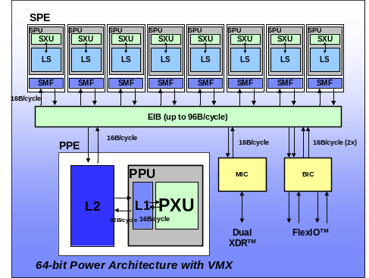
Problem: Post-Moore Programming
Intra-node Parallelism
Heterogeneous Parallelism
Scale-out Parallelism
SMP
Multi-core
SMT’s
SIMD
ILP
Node
Node
. . .
. . .
. . .
PEs,
PEs,
PEs,
PEs,
Memory
Memory
Need: Lightweight parallelism, data affinity
Need: Efficient DMA data transfer
Need: single-program parallelism for scale-out
Java: heavyweight threads, uniform heap, complicated memory model
Java’s I/O model heavyweight, library-based
Java RMI designed for loosely coupled clusters
Common concurrency, distribution framework: from games consoles to supercomputers

Slide 4
Where we are coming from
Concurrency, Semantics (Time, Space), Formal Methods, Types, Symbolic Techniques (Hybrid) CCP
Applications
Scalable IM servers
Constraints
Parsing
Design/Impl of high-productivity, high-performance programming language
Parallelizing compilers
Static Analysis DOMO, Race checking
VM Design
JIT Compilation
LAPI
IBM has researchers in many other related areas

Slide 5
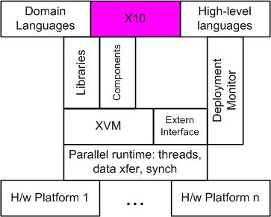
The X10 concept
Our Approach
  Design a clean, scalable, concurrent, imperative Java-based language.
  Reify distribution, emphasize asynchrony.
  Preserve determinacy, deadlock-freedom (where possible)
Focus on concurrency, synchronization, distribution, arrays.
Few things, done well.

Slide 6
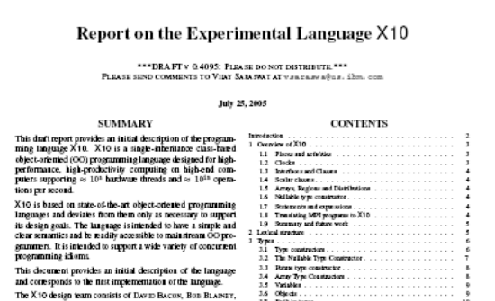
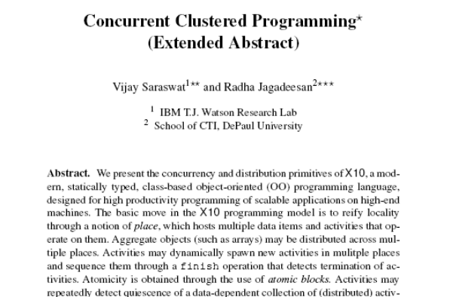
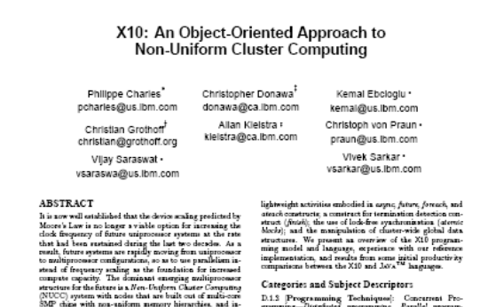
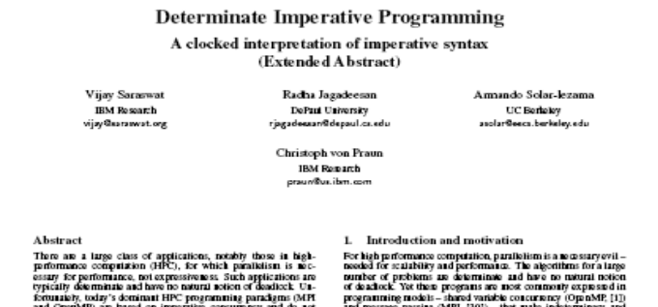
Our results
Language Report
CONCUR 05
OOPSLA 05 Onwards!
X10 Tutorial ➔ User Report
X10 Reference Implementation
Applications
Productivity Study
(Submitted)

Slide 7
The X10 Programming Model
Place
Place
Partitioned Global heap
Outbound activities
Inbound activities
Partitioned Global heap
Place-local heap
Place-local heap
. . .
Activities
Activities
heap
stack
control
heap
stack
control
heap
stack
control
heap
stack
control
. . .
Inbound activity replies
Outbound activity
replies
. . .
Immutable Data
A program is a collection of places, each containing resident data and a dynamic collection of activities.
Program may distribute aggregate data (arrays) across places during allocation.
Program may directly operate only on local data, using atomic blocks.
Program may spawn multiple (local or remote) activities in parallel.
Program must use asynchronous operations to access/update remote data.
Program may repeatedly detect quiescence of a programmer-specified, data-dependent, distributed set of activities.
Cluster Computing: P >= 1
Shared Memory (P=1)
MPI (P > 1)

Slide 8
X10 v0.409 Cheat Sheet
Stm:
async [ ( Place ) ] [clocked ClockList ] Stm
when ( SimpleExpr ) Stm
finish Stm
next; c.resume() c.drop()
for( i : Region ) Stm
foreach ( i : Region ) Stm
ateach ( I : Distribution ) Stm
Expr:
ArrayExpr
ClassModifier : Kind
MethodModifier: atomic
DataType:
ClassName | InterfaceName | ArrayType
nullable DataType
future DataType
Kind :
value | reference
x10.lang has the following classes (among others)
point, range, region, distribution, clock, array
Some of these are supported by special syntax.

Slide 9
X10 v0.409 Cheat Sheet: Array support
ArrayExpr:
new ArrayType ( Formal ) { Stm }
Distribution Expr -- Lifting
ArrayExpr [ Region ] -- Section
ArrayExpr | Distribution -- Restriction
ArrayExpr || ArrayExpr -- Union
ArrayExpr.overlay(ArrayExpr) -- Update
ArrayExpr. scan( [fun [, ArgList] )
ArrayExpr. reduce( [fun [, ArgList] )
ArrayExpr.lift( [fun [, ArgList] )
ArrayType:
Type [Kind] [ ]
Type [Kind] [ region(N) ]
Type [Kind] [ Region ]
Type [Kind] [ Distribution ]
Region:
Expr : Expr -- 1-D region
[ Range, …, Range ] -- Multidimensional Region
Region && Region -- Intersection
Region || Region -- Union
Region – Region -- Set difference
BuiltinRegion
Distribution:
Region -> Place -- Constant Distribution
Distribution | Place -- Restriction
Distribution | Region -- Restriction
Distribution || Distribution -- Union
Distribution – Distribution -- Set difference
Distribution.overlay ( Distribution )
BuiltinDistribution
Language supports type safety, memory safety, place safety, clock safety

Slide 10
async, finish
async PlaceExpressionSingleListopt Statement
Statement ::= finish Statement
async (P) S
  Parent activity creates a new child activity at place P, to execute statement S; returns immediately.
  S may reference final variables in enclosing blocks.
finish S
  Execute S, but wait until all (transitively) spawned async’s have terminated.
  Trap all exceptions thrown by spawned activities, throw aggregate exception when all activities terminate.
  double[D] A =…; // Global dist. array
  final int k = …;
  async ( A.distribution[99] ) {
  // Executed at A[99]’s place
  atomic A[99] = k;
  }
finish ateach (point [i]:A) A[i] = i;
finish async (A.distribution[j]) A[j] = 2;
// All A[i]=I will complete before A[j]=2
cf Cilk’s spawn, sync

Slide 11
atomic, when
Atomic blocks are
  Conceptually executed in a single step, while other activities are suspended
An atomic block may not include
  Blocking operations
  Accesses to data at remote places
  Creation of activities at remote places
Activity suspends until a state in which the guard is true; in that state the body is executed atomically.
Statement ::= atomic Statement
MethodModifier ::= atomic
Statement ::= WhenStatement
WhenStatement ::= when ( Expression ) Statement

Slide 12
regions, distributions
region R = 0:100;
region R1 = [0:100, 0:200];
region RInner = [1:99, 1:199];
// a local distribution
dist D1=R-> here;
// a blocked distribution
dist D = block(R);
// union of two distributions
dist D = (0:1) -> P0 || (2:N) -> P1;
dist DBoundary = D – RInner;
Region
  a (multi-dimensional) set of indices
Distribution
  A mapping from indices to places
High level algebraic operations are provided on regions and distributions
Based on ZPL

Slide 13
arrays
Array section
  A[RInner]
High level parallel array, reduction and span operators
  Highly parallel library implementation
  A-B (array subtraction)
  A.reduce(intArray.add,0)
  A.sum()
Arrays may be
  Multidimensional
  Distributed
  Value types
  Initialized in parallel:
  int [D] A= new int[D]
  (point [i,j]) {return N*i+j;};

Slide 14
ateach, foreach
public boolean run() {
dist D = dist.factory.block(TABLE_SIZE);
long[.] table = new long[D] (point [i]) { return i; }
long[.] RanStarts = new long[distribution.factory.unique()]
(point [i]) { return starts(i);};
long[.] SmallTable = new long value[TABLE_SIZE]
(point [i]){return i*S_TABLE_INIT;};
finish ateach (point [i] : RanStarts ) {
long ran = nextRandom(RanStarts[i]);
for (int count: 1:N_UPDATES_PER_PLACE) {
int J = f(ran);
long K = SmallTable[g(ran)];
async atomic table[J] ^= K;
ran = nextRandom(ran);
}}
return table.sum() == EXPECTED_RESULT;
}
ateach (point p:A) S
  Creates |region(A)| async statements
  Instance p of statement S is executed at the place where A[p] is located
foreach (point p:R) S
  Creates |R| async statements in parallel at current place
Termination of all activities can be ensured using finish.
ateach ( FormalParam: Expression ) Statement
foreach ( FormalParam: Expression ) Statement
Notes:
Allocate and initialize RanStarts with one random number seed for each place.
Allocate and initialize table as a block-distributed array.
Everywhere in parallel, repeatedly generate random table indices and atomically read/modify/write table element.
Allocate a small immutable table that can be copied to all places.

Slide 15
Det. dynamic barriers: clocks
Operations
  clock c = new clock();
  c.resume();
    Signals completion of work by activity in this clock phase.
  next;
    Blocks until all clocks it is registered on can advance. Implicitly resumes all clocks.
  c.drop();
    Unregister activity with c.
  async(P)clocked(c₁,…,c_{n})S
    (Clocked async): activity is registered on the clocks (c₁,…,c_{n})
Static Semantics
  An activity may operate only on those clocks it is live on.
  In finish S,S may not contain any (top-level) clocked asyncs.
Dynamic Semantics
  A clock c can advance only when all its registered activities have executed c.resume().
No explicit operation to register a clock.
Supports over-sampling, hierarchical nesting.

Slide 16
NPB – CG in X10
timer.start( t_bench );
for (point [itt] : [1:niter]){
if (timeron )timer.start( t_conj_grad );
finish ateach (point[p]:THREADS) step3();
double rho = rhomaster.sum();
for (point [ii]: [0:cgitmax]){
finish ateach (point [p]:THREADS) step0();
final double rho0 = rho;
final double alpha = rho/dmaster.sum();
finish ateach (point [p]:THREADS) step1(alpha);
rho = rhomaster.sum();
final double beta = rho/rho0;
finish ateach (point [p]:THREADS) step2(beta);
}
finish ateach (point [p]:THREADS) endWork();
rnorm = Math.sqrt( rnormmaster.sum() );
if (timeron) timer.stop(t_conj_grad);
tnorm1 = x.mul(z).sum();
tnorm2 = z.mul(z).sum();
tnorm2 = 1.0 / Math.sqrt(tnorm2);
zeta = shift + 1.0 /tnorm1;
System.out.println( " "+ itt + " " + rnorm +" " + zeta );
final double tnorm2ff = tnorm2;
finish ateach (point[jj] : D) x[jj] = tnorm2ff*z[jj];
}
timer.stop(t_bench);
void step0() {
region Dlocal = (D | here).region;
for (point [j] : Dlocal) {
double sum = 0.0;
for (int k=rowstr[j];k<rowstr[j+1];k++)
sum += a_val[k]*(colidx_val[k]==0? 0 : p[colidx_val[k]]);
q[j] = sum;
}
dmaster[here.id]=(p[Dlocal]).mul(q[Dlocal]).sum();
}
void step1(double alpha) {
region Dlocal = (D | here).region;
for (point [j]:Dlocal){ z[j] += alpha*p[j]; r[j] -= alpha*q[j];}
rhomaster[here.id]=r[Dlocal].mul(r[Dlocal]).sum();
}
void step2(double beta) {
region Dlocal = (D | here).region;
for (point [j]:Dlocal) p[j]=r[j]+beta*p[j];
}
void step3() {
double rho = 0.0;
region Dlocal = (D|here).region;
for (point [j]:Dlocal) { q[j] = z[j] = 0.0; r[j] = p[j] = x[j]; rho += x[j]*x[j]; }
rhomaster[here.id]=rho;
}
void endWork() {
region Dlocal = (D | here).region;
for (point [j]:Dlocal) {
double sum = 0.0;
for (point [k] :[rowstr_val[j]:rowstr_val[j+1]-1])
sum += a_val[k]*(colidx_val[k] == 0 ? 0 : z[colidx_val[k]]);
r[j] = sum;
}
rnormmaster[here.id]=(x[Dlocal]).sub(r[Dlocal]).pow(2).sum();
}

Slide 17
NPB – CG in X10 … array syntax (*)
for (point [ii]: [0:cgitmax]){
finish ateach (point [p]:THREADS) step0();
final double rho0 = rho;
final double alpha = rho/dmaster.sum();
finish ateach (point [p]:THREADS) step1(alpha);
rho = rhomaster.sum();
final double beta = rho/rho0;
finish ateach (point [p]:THREADS) step2(beta);
}
void step1(double alpha) {
region Dl= (D | here).region;
z[Dl] += alpha * p[Dl];
r[Dl] -= alpha* q[Dl];
rhomaster[here.id]=(r [Dl] * r [Dl]).sum();
}
(*) Being implemented

Slide 18
Current Status (05/11)
09/03
PERCS Kickoff
02/04
We have an operational X10 0.41 implementation
X10 Kickoff
07/04
X10 0.32 Spec Draft
Code Templates
X10 Multithreaded RTS
X10 Grammar
Annotated AST
Target Java
Native code
AST
02/05
Parser
Analysis passes
Code emitter
JVM
X10 Prototype #1
X10 source
PEM Events
Structure
  Translator based on Polyglot (Java compiler framework)
  X10 extensions are modular.
  Uses Jikes parser generator.
Code metrics
  Parser: ~45/14K*
  Translator: ~112/9K
  RTS: ~190/10K
  Polyglot base: ~517/80K
  Approx 180 test cases.
  (* classes+interfaces/LOC)
Program output
07/05
Limitations
  Clocked final not yet implemented.
  Type-checking incomplete.
  No type inference.
  Implicit syntax not supported.
X10 ProductivityStudy
12/05
X10 Prototype #2
06/06
Open Source Release?

Slide 19
Future language extensions
Type system
  semantic annotations
  clocked finals
  aliasing annotations
  dependent types
Determinate programming
  e.g. immutable data
Weaker memory model?
  ordering constructs
First-class functions
Generics
Components?
User-definable primitive types
  Support for operators
Relaxed exception model
Middleware focus
  Persistence?
  Fault tolerance?
  XML support?
Welcome University Partners and other collaborators

Slide 20
Future Work: Implementation
Type checking/inference
  Clocked types
  Place-aware types
Consistency management
  Lock assignment for atomic sections
  Data-race detection
Activity aggregation
  Batch activities into a single thread.
Message aggregation
  Batch “small” messages.
Load-balancing
  Dynamic, adaptive migration of places from one processor to another.
Continuous optimization
  Efficient implementation of scan/reduce
Efficient invocation of components in foreign languages
  C, Fortran
Garbage collection across multiple places
Welcome University Partners and other collaborators.

Slide 21
Backup

Slide 22
PERCS Background
DARPA Program on High Productivity Computing Systems (HPCS)
  Phase 1 (7/02 – 6/03): Concept Phase (~ $3M funding)
    Five vendors selected: Cray, IBM, Intel, SGI, Sun
  Phase 2 (7/03 – 6/06): Design Phase (~ $53M funding)
    Three vendors selected: Cray, IBM, Sun
  Phase 3 (7/06 – 6/10): Productization Phase (~ $250M funding)
    1-2 vendors to be selected
HPCS goals
  Petascale performance
  10X improvement in development productivity
IBM PERCS project (Productive Easy-to-use Reliable Computing Systems)
  Cross-division team: STG, SWG, Research
  System strategy:
    Power/7 processor, Node = 128-way SMP, choice of cluster interconnect determined by price-performance tradeoff, Linux or AIX, with Xen hypervisor
  Productivity strategy:
    New programming model (X10)
    Integrated parallel development tools (Eclipse)
    Static and dynamic compilation (XL compilers, Testarossa)
    Libraries (ESSL, PESSL, OSL, …)
    Productivity assessment methodology

Slide 23
PSC Productivity Study (X10,MPI,UPC)
Goals
  Contrast productivity of X10, UPC, and MPI for a statistically significant subject sample on a programming task relevant to HPCS Mission Partners
  Validate the PERCS Productivity Methodology to obtain quantitative results that, given specific populations and computational domains, will be of immediate and direct relevance to HPCS.
Study design and implementation led by IBM Research Social Computing group
Overview
  4.5 days: May 23-27, 2005 at the Pittsburgh Supercomputing Center (PSC)
  Pool of 27 comparable student subjects
  Programming task: Parallelizing the alignment portion of Smith-Waterman algorithm (SSCA#1)
  3 language programming model combinations (X10, UPC, or C + MPI)
  Equal environment as near as possible (e.g. pick of 3 editors, simple println stmts for debugging)
  Provided expert training and support for each language
  All development occurred on TCS, a 3000-processor AlphaServer SC system at PSC (Tru64 OS, 2-rail Quadrics)

Slide 24
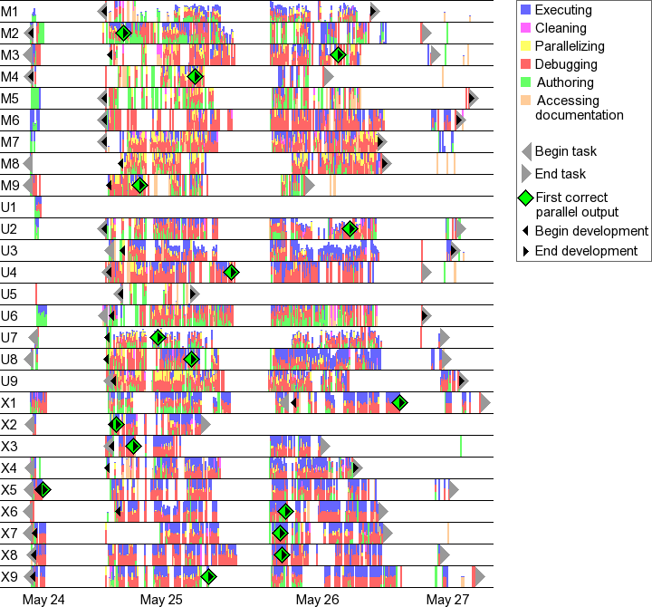
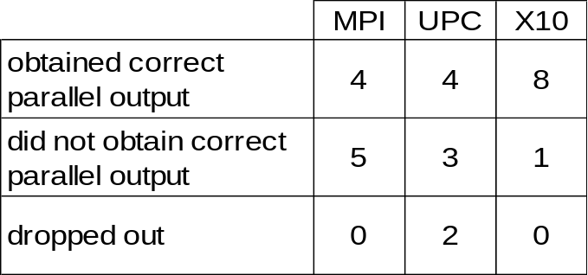
Initial Results: Development Time
Each thin vertical bar depicts
5 minutes of development time, colored by the distribution of activities within the interval.
Development milestones bound intervals for statistical analysis:
  begin/end task
  begin/end development
  first correct parallel output

Slide 25
RandomAccess
public boolean run() {
distribution D = distribution.factory.block(TABLE_SIZE);
long[.] table = new long[D] (point [i]) { return i; }
long[.] RanStarts = new long[distribution.factory.unique()]
(point [i]) { return starts(i);};
long[.] SmallTable = new long value[TABLE_SIZE]
(point [i]) {return i*S_TABLE_INIT;};
finish ateach (point [i] : RanStarts ) {
long ran = nextRandom(RanStarts[i]);
for (int count: 1:N_UPDATES_PER_PLACE) {
int J = f(ran);
long K = SmallTable[g(ran)];
async atomic table[J] ^= K;
ran = nextRandom(ran);
}
}
return table.sum() == EXPECTED_RESULT;
}
Allocate and initialize table as a block-distributed array.
Allocate and initialize RanStarts with one random number seed for each place.
Allocate a small immutable table that can be copied to all places.
Everywhere in parallel, repeatedly generate random table indices and atomically read/modify/write table element.

Slide 26
PERCS Programming Model Architecture Overview
JavaTM source code
(w/ threads & conc utils)
C/C++ source code
(w/ MPI, OpenMP, UPC)
Fortran source code
(w/ MPI, OpenMP)
. . .
X10 source code
. . .
Productivity Measurements
X10 Development Toolkit
Java Development Toolkit
C/C++
Development Toolkit
+ MPI extensions
Fortran Development Toolkit
. . .
Refactoring for Concurrency
. . .
Performance
Exploration
X10 Compiler
Java
Compiler
C/C++ Compiler
w/ UPC extensions
Fortran Compiler
Parallel Tools Platform (PTP)
Eclipse
platform
Text in blue identifies
exploratory
PERCS
contributions
X10 Components
Java components
C/C++
components
Fortran components
Fast extern
interface
X10 runtime
Java runtime
C/C++ runtime
Fortran runtime
Dynamic Compilation + Continuous Program Optimization
Integrated Parallel Runtime: MPI + LAPI + RDMA + OpenMP + threads

Slide 27
X10 vs. JavaTM language
X10 extends sequential Java 1.4 language
  Base language = Java 1.4 language
    Java 5 features (generics, metadata, etc.) will be supported in the future
  Notable features removed from Java language
    Concurrency --- threads, synchronized, etc.
    Java arrays
Notable features added to Java language
  Concurrency – async, finish, atomic, future, force, foreach, ateach, clocks
  Distribution --- points, distributions
  X10 arrays --- multidimensional distributed arrays, array reductions, array initializers
  Serial constructs --- nullable, const, extern, value type

Slide 28
X10 deployment on PERCS HPC system
One of multiple fat-tree networks
Interconnect
One of multiple fat-tree networks
One of multiple fat-tree networks
One of multiple fat-tree networks
One of multiple fat-tree networks
One of multiple fat-tree networks
One of multiple fat-tree networks
One of multiple fat-tree networks
Fat-tree network
Fat-tree network
Fat-tree network
Fat-tree network
Fat-tree network
Fat-tree network
Fat-tree network
Thin
X10 VM
Thick
X10 VM
Storage and I/O
controllers
Other
Storage
Device
I/O
Device
Compute Node
I/O Node

