Slide 1
Higher-order Abstract Syntax with constraints or Testing concurrent systems or 25 Years of Logic Programming Languages
Radha Jagadeesan, De Paul U
Gopalan Nadathur, U of Minnesota
Vijay Saraswat, IBM TJ Watson
This work has been supported in part by DARPA under contract No. NBCH30390004, NSF under contracts 0430175 and CCR-0429572.

Slide 2
Acknowledgements
X10 design -- X10 core team
  Philippe Charles, Chris Donawa, Kemal Ebcioglu, Christian Grothoff, Allan Kielstra, Douglas Lovell, Maged Michael, Christoph von Praun, Vivek Sarkar, Armando Solar-Lezama
X10 Type System
  Christian Grothoff, Jens Palsberg.
X10DT (Eclipse)
  Robert Fuhrer, Mandana Vaziri
Open Compiler
  Martin Odersky, Todd Millstein, Lex Spoon
Scala implementation of RCC
  Lex Spoon, Martin Odersky

Slide 3
The context
The Challenge of High Performance and High Productivity Computing.
Scalability. 100K hardware threads, sustain 10^15 operations/second.
High Productivity. Today, MPI, OpenMP. Low-level APIs oriented towards the hardcore implementer.

Slide 4
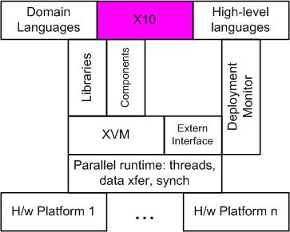
The X10 concept
Our Approach
  Design a clean, scalable, concurrent, imperative Java-based language.
  Reify distribution, emphasize asynchrony.
  Preserve determinacy, deadlock-freedom (where possible)
Focus on concurrency, synchronization, distribution, arrays.
Few things, done well.

Slide 5
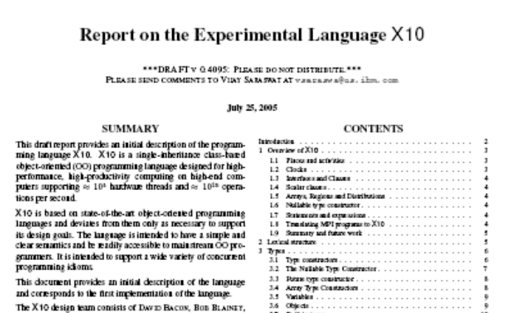
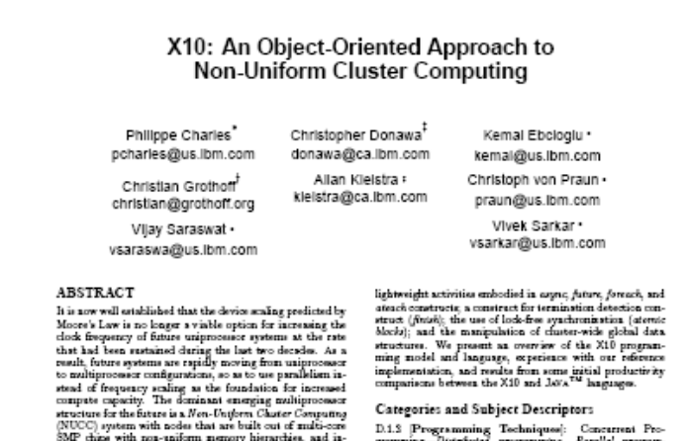
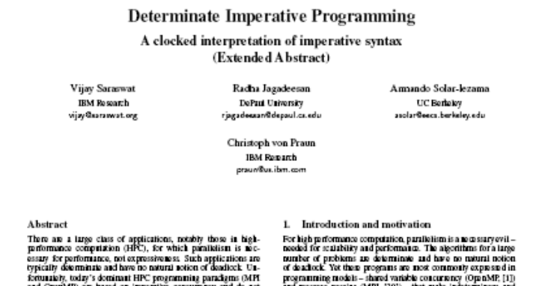
Our results
Language Report
OOPSLA 05 Onwards!
X10 Reference Implementation
Applications
Productivity Study
(Submitted)

Slide 6
Meta-programming
Background:
  Design and prototyping of new programming languages.
Specifying type checkers
Specifying application specific refactorings.
  Specifying compiler analyses
Specifying operational semantics of progg lang
Desiderata.
  Able to represent O-programs as F-data
    Use Higher-order Abstract Syntax?
  Constraint-based
    Constraints are central to program analysis.
    Constraints should be absorbed, not reified.
  Declarative
    View F-programs as logical formulas.

Slide 7
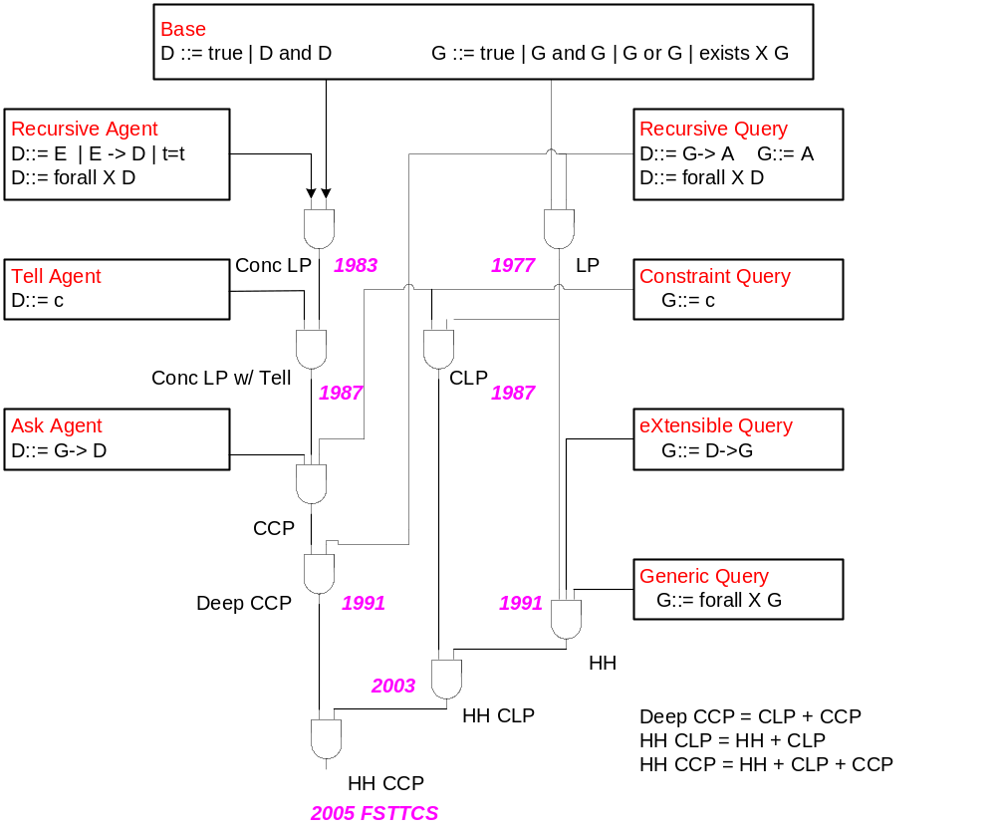
Clark,
Shapiro, Ueda
Kowalski, Colmerauer,…
Jaffar, Lassez, Maher
Maher, Saraswat
Miller, Nadathur
Saraswat, Lincoln
Leach, Nieva, Rodriguez-Artalejo
(Some) Logic Programming Languages 1977-2005

Slide 8
Why LHS recursion?
Conjunction on the Left =/= Conjunction on the Right.
All constraints imposed by LHS are simultaneously available.
Constraints asserted by RHS (c => G) available only for the current goal (G).
Recursions that accumulate constraints in the store must be performed on LHS.
Example: Java type-checking
  Source file must be traversed to obtain signatures of referenced classes.
  Class methods are type-checked in this context.
  LHS recursion, not RHS recursion, must be used to compute signatures.
Example: Operational semantics of X10.
typedClass ClassName :-
parse ClassName Code,
typesOfrefedClasses Code
=> typedCode Code.

Slide 9
Testing interpretation
disjoint
D ::= true | c | E | D and D | G  A | E  D | G  D | Ex.D | Ax.D
G ::= true | c | A | G and G | D  G | G or G | Ex.G | Ax.G
Assume underlying constraint system C.
D and G communicate only through constraints (Disjoint Vocabulary Condition), not through atoms.
  Left recursion segregated from right recursion.
  Use of  is restricted to ensure that it respects polarity (only D’s on the left, only G’s on the right).
  Yet D, G interaction is recursive: G::= D  G and deep guards D::=G  D
Logically, rules of IL are augmented with (CONST):
  ☹,c₀,…, c_{n}  c if c₀,…, c_{n} _{C} c
View D ?- G as a behavioral test G of a concurrently evolving system D.
  D ?- G = Does D have the potential to answer (some recursive simplification of) G?
  i.e. Can execution of D generate constraints c₀,…, c_{n} st c₀,…, c_{n} _{C} c, where c is produced by recursively simplifying G?
  LHS recursion = mechanism for realizing the potential.
  D processes are determinate, potential is not lost on evolution, only realized (May=Must).
  (Could add D ::= D or D.)
Uniform proofs deal only with computation “on the right”.

Slide 10
Operational Semantics of RCC
D ::= true | c | E | D and D | G  A | G  A | G  A | Ex.D | Ax.D
G ::= true | c | A | G and G | D  G | G or G | Ex.G | Ax.G
☹?-true → 
☹?-c →   (if ☹  c)
☹,G  A?-A → ☹,G  A?-G
☹?G and G’ → ☹?G, ☹?G’
☹?-G or G’ → ☹?-G
☹?-G or G’ → ☹?-G’
☹?-D  G → ☹,D?-G
☹?-Ex.G → ☹?-G[t/X]
☹?-Ax.G → ☹?-G[i/X] *
*: i must be “new”
Configurations: Multisets  of predications ☹?-G. (☹ ranges over multisets of D’s.)
Successful termination:  →* 
☹,E,E  D?-G → ☹,E,D?-G
☹,D and D’?-G → ☹,D,D’?-G
☹,Ex.D?-G → ☹, D[i/x]?-G *
☹,Ax.D?-G → ☹, Ax.D,D[t/x]?-G
☹,G  D ?- G’ → ☹, D ?- G’ if ☹,G  D ?- G →*  
,☹?-G → , ’ (if ☹?-G → ’)
Semantics models successful termination, non-deterministically.

Slide 11
Basic Results: Operational proofs
Operational proofs must satisfy chaining conditions.
  BC condition: Every instance of (L) in which the principal formula is G  A must have a conclusion ☹,G  A  A
  FC condition: Similar.
  Constraint condition: Every instance of (L) in which the principal formula is c  D must use (CONST).
The operational semantics produces only operational proofs.
D?-G →  iff D ₀ G
Completeness Theorem:
  D  G  iff D ₀ G
Chaining conditions capture restricted use of L  in RCC

Slide 12
Implementation
An rcc implementation embedded in Scala is being designed.
Absorbs predicate definition (e.g. jcc), uses Scala type system.
Conceptual issues
  Controlling non-determinism (backtracking).
    Use known permutability properties of IL.
  Solving constrained unification problems under a mixed prefix:
    : c₀,…, c_{n} ➔ c
Joint work with Martin Odersky and Lex Spoon.

Slide 13
Conclusion
Rich logical framework for meta-programming.
  Provides a computational interpretation for a large fragment of IL.
Implementation being developed on top of Scala
Intended to be used in open compilers, to prototype new programming languages.

