Slide 1
X10: Computing at Scale
Vijay Saraswat, IBM TJ Watson
http://www.research.ibm.com/x10
This work has been supported in part by the Defense Advanced Research Projects Agency (DARPA) under contract No. NBCH30390004.

Slide 2
X10 Team
X10 core team
  Philippe Charles, Kemal Ebcioglu, Christoph von Praun, Vijay Saraswat, Vivek Sarkar
  Toronto: Chris Donawa, Allan Kielstra
  Interns: Christian Grothoff (UCLA), Armando Solar-Lezama (Berkeley)
X10 analysis
  Julian Dolby, Satish Gupta, Raj Barik, Ras Bodik (Berkeley)
X10 Applications (0.5)
  Douglas Lovell
University partners:
MIT (Rabbah), Purdue University (Vitek), UC Berkeley (Bodik), U. Delaware (Gao), DePaul U (Jagadeesan)
X10 Tools
Philippe Charles, Julian Dolby, Steve Fink, Robert Fuhrer, Matthias Hauswirth, Peter Sweeney, Frank Tip, Mandana Vaziri
Part of DARPA-funded PERCS project.

Slide 3
Problem
Programming high-performance machines is very difficult.
  Shared memory abstractions break down.
  Message-passing very low-level, cumbersome.
Too few people know how to program such machines.
Widely acknowledged in the High Performance community
DARPA sponsored language projects at three “vendors” IBM (X10), Sun (Fortress) and Cray (Chapel).
Build on past work on PGAS languages (Co-Array Fortran, UPC, Titanium).
New DARPA project (Lusk) through 12/07 to evaluate vendor languages.
Desired goal: 10x improvement in productivity by 2010

Slide 4
X10
Strategic Importance
  Multi-processor architectures are becoming mainstream (multi-core chips, Cell, …)
  Clean solutions developed here may have widespread applicability, outside HPC.
  Potentially, next Java.
Strategies: Web programming model
Product Division Contacts: Kevin Stoodley, Bob Blainey, Ram Govindraju
Success criteria
  This milestone: Complete language design and prototype implementation of the X10 programming language. Demonstrate prototype to the Strategist
  6/2006: Open source release
  Adoption: external community of users, developers.

Slide 5
The X10 Concept
Our Approach
  Design a real, clean, scalable, concurrent, imperative Java-based language.
  Reify distribution, emphasize asynchrony.
  Preserve determinacy, deadlock-freedom (wherever possible)
Focus on concurrency, synchronization, distribution, arrays.

Slide 6
The X10 Programming Model
Place
Place
Partitioned Global heap
Outbound activities
Inbound activities
Partitioned Global heap
Place-local heap
Place-local heap
. . .
Activities
Activities
heap
stack
control
heap
stack
control
heap
stack
control
heap
stack
control
. . .
Inbound activity replies
Outbound activity
replies
. . .
Immutable Data
A program is a collection of places, each containing resident data and a dynamic collection of activities.
Program may distribute aggregate data (arrays) across places during allocation.
Program may directly operate only on local data, using atomic blocks.
Program may spawn multiple (local or remote) activities in parallel.
Program must use asynchronous operations to access/update remote data.
Program may repeatedly detect quiescence of a programmer-specified, data-dependent, distributed set of activities.
Cluster Computing: P >= 1
Shared Memory (P=1)
MPI (P > 1)
Notes:
Relate to IBM work on clustered JVMs.

Slide 7
Language constructs
Asynchronous stm
  stm ::= async (p) stm
  stm ::= async (p) clocked (c1,…,cn) stm
Asynchronous expr
  exp ::= future(p) {exp}
Termination
  stm ::= finish stm
Atomicity
  stm ::= atomic stm
  Stm ::= when (c) stm
Phased execution
  clocks, next, c.drop, c.resume
places
  locale for execution
regions
  Multi-dimensional collections of points
distribution
  region with points labeled with places.
Multi-d, distributed arrays
  Defined over a distribution

Slide 8
X10 application code
Java Grande Benchmarks
  raytracer, moldyn, lufact, series, montecarlo,…
SpecJBB
SSCA #1
NAS Parallel Benchmark
  CG translated to X10
  Others in progress
Adaptive Mesh Refinement
  Currently in progress
Notes:
Check OOPSLA paper.

Slide 9
X10 demo screenshot

Slide 10
NPB – CG in X10
To be simplified, compared with Java.
timer.start( t_bench );
for (point [itt] : [1:niter]){
if (timeron )timer.start( t_conj_grad );
finish ateach (point[p]:THREADS) step3();
double rho = rhomaster.sum();
for (point [ii]: [0:cgitmax]){
finish ateach (point [p]:THREADS) step0();
final double rho0 = rho;
final double alpha = rho/dmaster.sum();
finish ateach (point [p]:THREADS) step1(alpha);
rho = rhomaster.sum();
final double beta = rho/rho0;
finish ateach (point [p]:THREADS) step2(beta);
}
finish ateach (point [p]:THREADS) endWork();
rnorm = Math.sqrt( rnormmaster.sum() );
if (timeron) timer.stop(t_conj_grad);
tnorm1 = x.mul(z).sum();
tnorm2 = z.mul(z).sum();
tnorm2 = 1.0 / Math.sqrt(tnorm2);
zeta = shift + 1.0 /tnorm1;
System.out.println( " "+ itt + " " + rnorm +" " + zeta );
final double tnorm2ff = tnorm2;
finish ateach (point[jj] : D) x[jj] = tnorm2ff*z[jj];
}
timer.stop(t_bench);
void step0() {
region Dlocal = (D | here).region;
for (point [j] : Dlocal) {
double sum = 0.0;
for (int k=rowstr[j];k<rowstr[j+1];k++)
sum += a_val[k]*(colidx_val[k]==0? 0 : p[colidx_val[k]]);
q[j] = sum;
}
dmaster[here.id]=(p[Dlocal]).mul(q[Dlocal]).sum();
}
void step1(double alpha) {
region Dlocal = (D | here).region;
for (point [j]:Dlocal){ z[j] += alpha*p[j]; r[j] -= alpha*q[j];}
rhomaster[here.id]=r[Dlocal].mul(r[Dlocal]).sum();
}
void step2(double beta) {
region Dlocal = (D | here).region;
for (point [j]:Dlocal) p[j]=r[j]+beta*p[j];
}
void step3() {
double rho = 0.0;
region Dlocal = (D|here).region;
for (point [j]:Dlocal) { q[j] = z[j] = 0.0; r[j] = p[j] = x[j]; rho += x[j]*x[j]; }
rhomaster[here.id]=rho;
}
void endWork() {
region Dlocal = (D | here).region;
for (point [j]:Dlocal) {
double sum = 0.0;
for (point [k] :[rowstr_val[j]:rowstr_val[j+1]-1])
sum += a_val[k]*(colidx_val[k] == 0 ? 0 : z[colidx_val[k]]);
r[j] = sum;
}
rnormmaster[here.id]=(x[Dlocal]).sub(r[Dlocal]).pow(2).sum();
}

Slide 11
Current Status
09/03
PERCS Kickoff
02/04
We have an operational X10 0.41 implementation
X10 Kickoff
07/04
X10 0.32 Spec Draft
Code Templates
X10 Multithreaded RTS
X10 Grammar
Annotated AST
Target Java
Native code
AST
02/05
Parser
Analysis passes
Code emitter
JVM
X10 Prototype #1
X10 source
PEM Events
Structure
  Translator based on Polyglot (Java compiler framework)
  X10 extensions are modular.
  Uses Jikes parser generator.
Code metrics
  Parser: ~45/14K*
  Translator: ~112/9K
  RTS: ~190/10K
  Polyglot base: ~517/80K
  Approx 180 test cases.
  (* classes+interfaces/LOC)
Program output
07/05
Limitations
  Clocked final not yet implemented.
  Type-checking incomplete.
  No type inference.
  Implicit syntax not supported.
X10 ProductivityStudy
12/05
X10 Prototype #2
06/06
Open Source Release

Slide 12
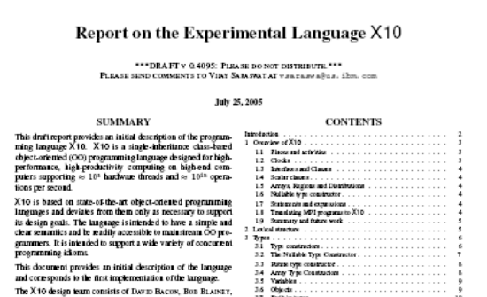
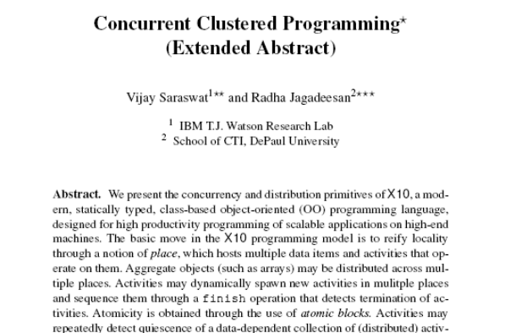
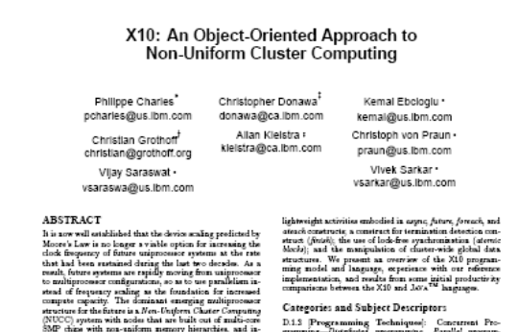
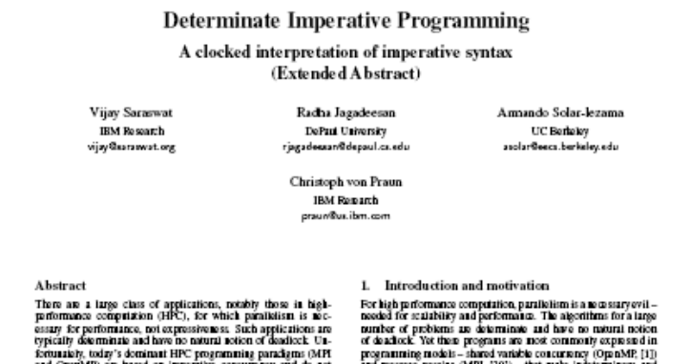
Our results
Language Report
CONCUR 05
OOPSLA 05 Onwards!
X10 Tutorial ➔ User Report
X10 Reference Implementation
Applications
Productivity Study
X10 Memory Model
(Submitted)

Slide 13
Intellectual Property
Ext communication
  Open source release planned 6/06.
  Potentially courses, book.
Standards activities
  Premature
Collaborations
  Purdue (Vitek)
  Berkeley (Bodik)
  UCLA (Palsberg)
  MIT (Rabbah)
  UIUC (Padua)
  Delaware (Gao)?
  IBM STG (Kielstra, Donawa)
  U New Mexico?
  Pittsburgh Supercomputing Center?
Internet: http://www.research.ibm.com/x10

Slide 14
Public Talks
Presentations
  PGAS Conference 09/05
  UC Berkeley 08/05
  CONCUR 08/05
  UCLA 08/05
  ICS Panel 06/05
  PPoPP Panel 06/05
  Pittsburgh SC 05/05
  U Delaware 05/05
  IBM PL Day 04/05
  LCR Wkshp (OOPSLA) 10/05
  MIT 08/04
PERCS Milestones
  08/05 Yorktown Heights
  02/05 Austin
  12/04 DOE Review (ANL)
  07/04 Hawthorne

Slide 15
Opportunities
Engage application developers
  No talent in house?
Engage VM researchers
  Distributed VM design
  Async optimization
  Atomic implementation
  Distributed GC
  Fast implementation of collectives
  Have talent, but prioritization?
Get more committers.

