Slide 1
Ranking News Articles based on Prestige
Paul Horan
04/12/2017

Slide 2
Introduction
Who are you?
What is the context of your project?
Who is your customer (if applicable)?
Which problem did you approach?

Slide 3
Discussions
Advantages, Disadvantages?
Opportunities and Limits?
Future Perspectives?

Slide 4
Goals
How will you solve the problem?
By Ranking Websites/Articles and Authors by Prestige.
What are you trying to achieve?
The end Goal is to eradicate Fake News/Media Outlets from users feeds

Slide 5
System
Description
A Search Engine for News Outlets that will disregard fake news websites.
Analysing the data that comes from the searches, saving search history for each user. Login’s implemented for this.
Research Technologies
Research Technologies:
Python
BeautifulSoup
API Services
Apache Solr
ApacheLucene
Main algorithms
Page Ranking System
Google Algorithm

Slide 6
Design
Overview of the main requirements
Functional
Quality of Search functionality.
Gathering all of the data from the searches and having indexes with all of the scraped data
Data
Will be stored in a Database, either MySQL or Google FireBase
System

Slide 7
Evaluation
How will you evaluate the system?
TREC(Text Retrieval Conference) testing the system against a common database of the documents/Indexes.
Other methods of testing will be looked into during the duration of the project
What will be the results?

Slide 8
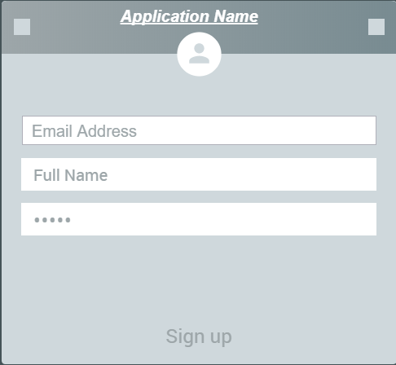
Demonstration
GUI (Screen Shots)

Slide 9
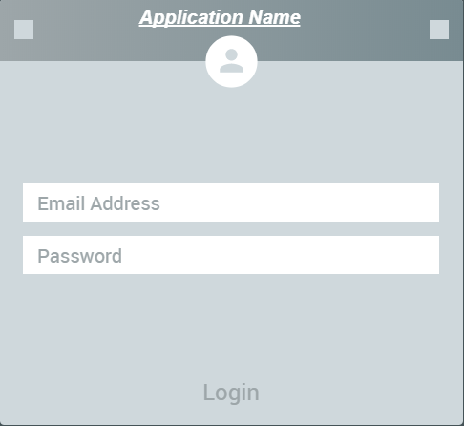
Demonstration
GUI

Slide 10
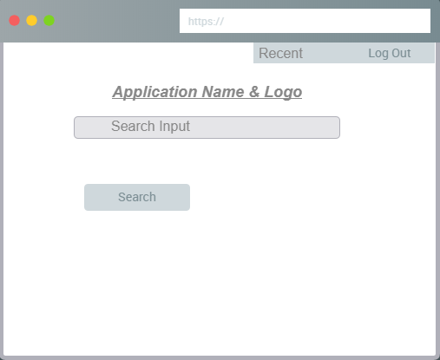
Demonstration
GUI

Slide 11
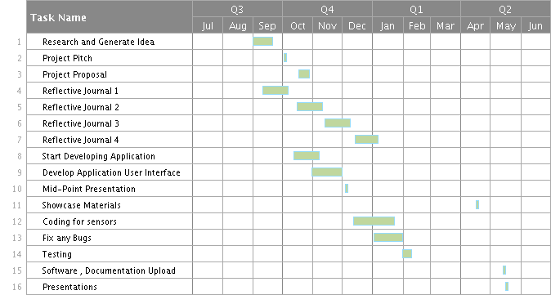
Going Forward
Project Plan
Explain next steps

Slide 12
Discussion
General Discussion
Feedback

