Slide 1

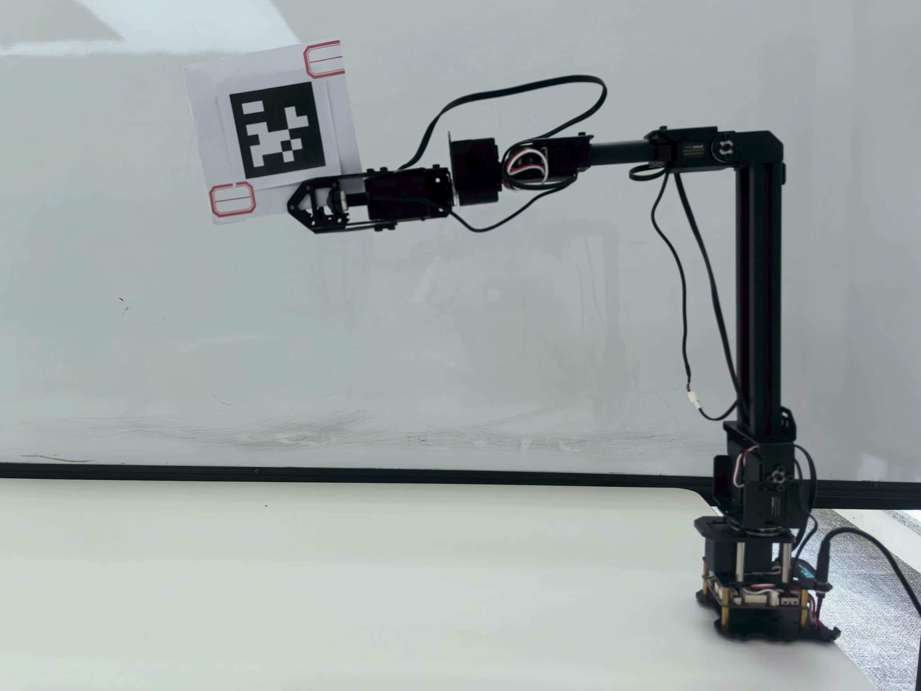
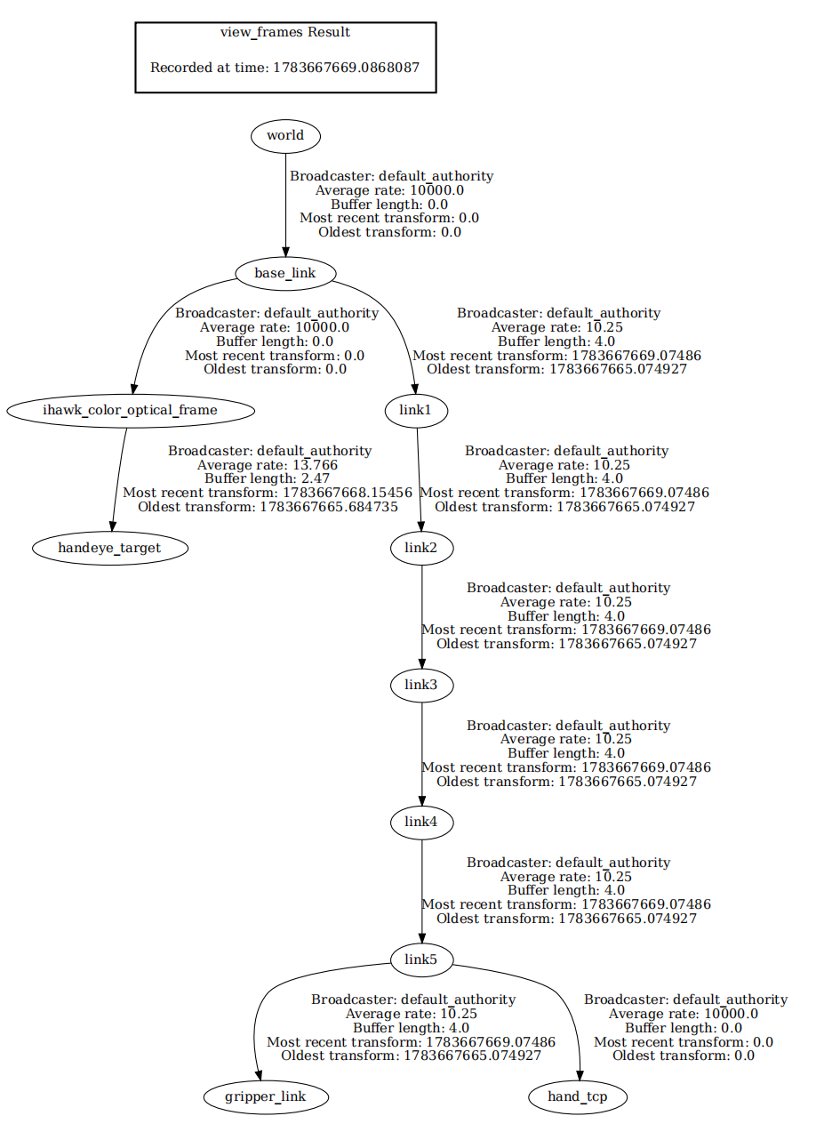
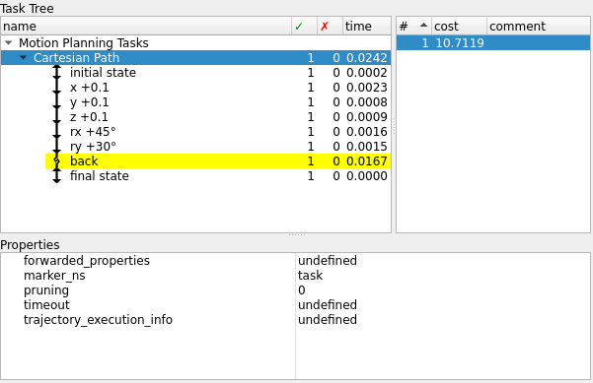
Department of Electrical and Electronic Engineering
Whole-Body Control for a Mobile Manipulator
with QP + Reinforcement Learning
RoArm-M3 demo: MTC planning and camera-guided grasping
Project overview
This poster presents the RoArm-M3 motion-planning and vision-guided grasping components of the wider whole-body control project. A fixed camera provides a target pose; eye-to-hand calibration maps it into the robot base frame. MoveIt Task Constructor (MTC) plans the manipulation stages, while measured joint feedback updates the robot state.
Demo pipeline
01
→
02
→
03
→
04
Camera
Calibration
MTC
RoArm-M3
Target observation
Camera → base
Approach + grasp
Execute + feedback
Control path: MoveIt 2 / MTC → ros2_control → serial driver → RoArm-M3. Measured joint angles → /joint_states → TF.
Existing hardware setup
Complete TF tree
RoArm-M3 with AprilTag at the gripper for eye-to-hand calibration.
MoveIt Task Constructor plan
Provided MTC Task Tree: one displayed Cartesian Path solution. This image does not show grasp execution.
Original ROS view_frames output. The tree shows frame connectivity; calibration accuracy needs separate validation.
Grasp trials
Accuracy
17 / 20
successful trials · 85%
End-effector position: 2.96 mm mean ± 0.57 mm SD (n=6); held-out split unspecified
Camera reprojection: 0.30 px mean (n=25); calibration-set fit
95% exact CI: 62.1–96.8% | an irregularly shaped part; randomized starts; real hardware
Camera-to-robot alignment: 1.18 mm RMS (n=12); correspondence fit
ESP32 LSTM controller; 30 demonstrations; one evaluated checkpoint.
Trajectory tracking: 2.9 mm MAE; sample count not reported
Student Name: Zifan Xu (20719616)
Supervisor: Chiew-Foong Kwong

