Slide 1




Loop 1
Loop 16
Loop 30
Loop 47

Slide 2
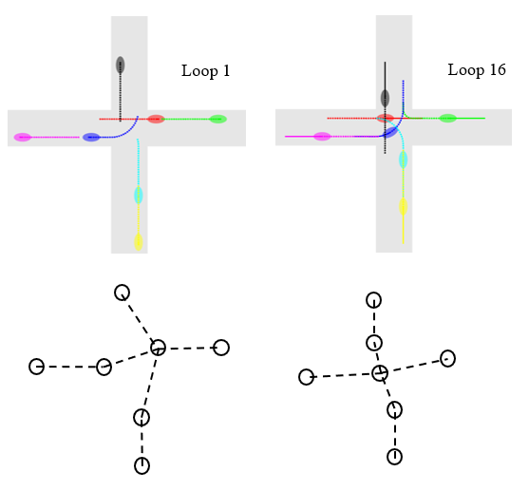
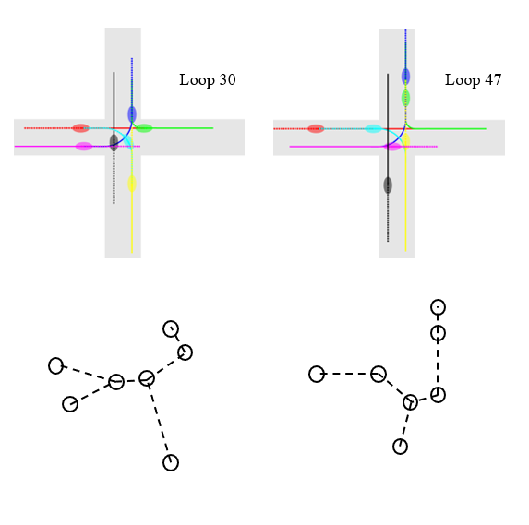

Slide 3
