Slide 1

本科毕业论文答辩
Bachelor Thesis Defense
自动驾驶车辆的分布式协调方案
Tree Structured Traffic Coordination
with Decentralized Optimization
方笑天 Xiaotian Fang
Supervisor: Boris Houska
June 5, 2020

Slide 2

Outline
Ⅰ Motivation and Background
Ⅱ System Model
Ⅲ Collision Avoidance
Ⅳ Problem Formulation
Ⅴ Distributed MPC Scheme
Ⅵ Case Study
Ⅶ Conclusion
0

Slide 3
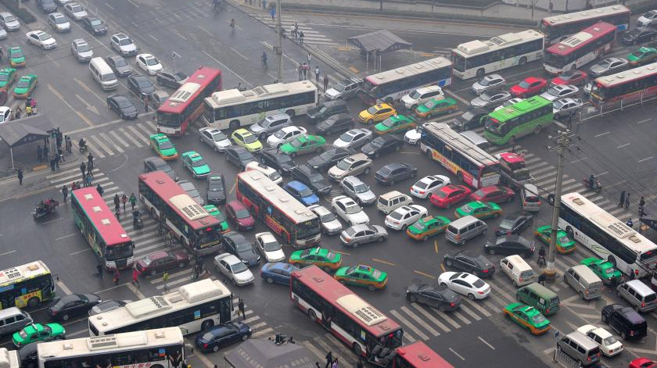
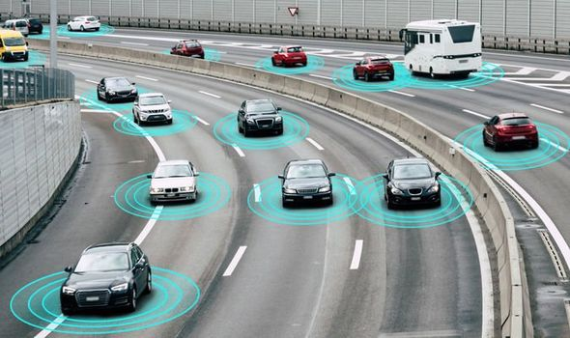
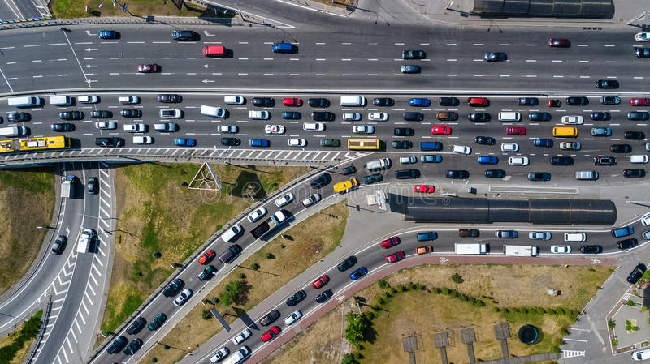
Motivation & Background
coordinate vehicles
Alleviate traffic congestion
Autonomous driving
1

Slide 4
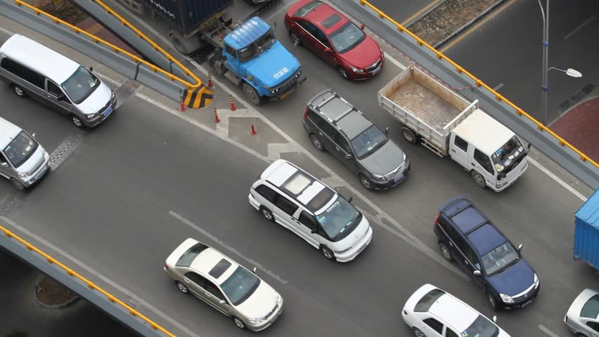
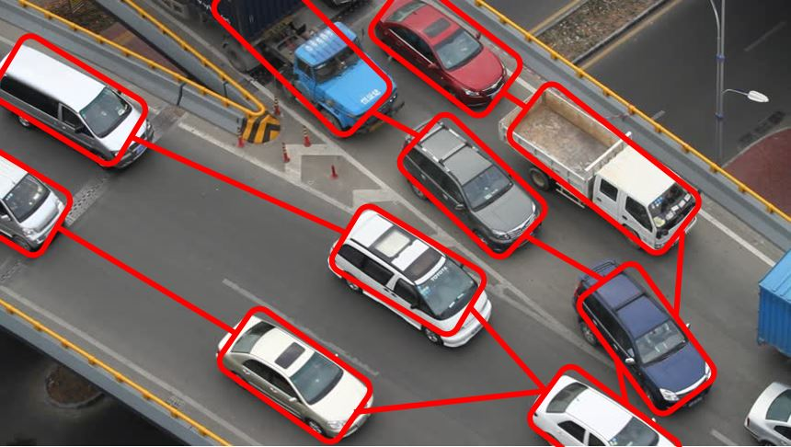
Motivation & Background
Network Structure
Tree-structured Network
Traffic Coordination
2

Slide 5
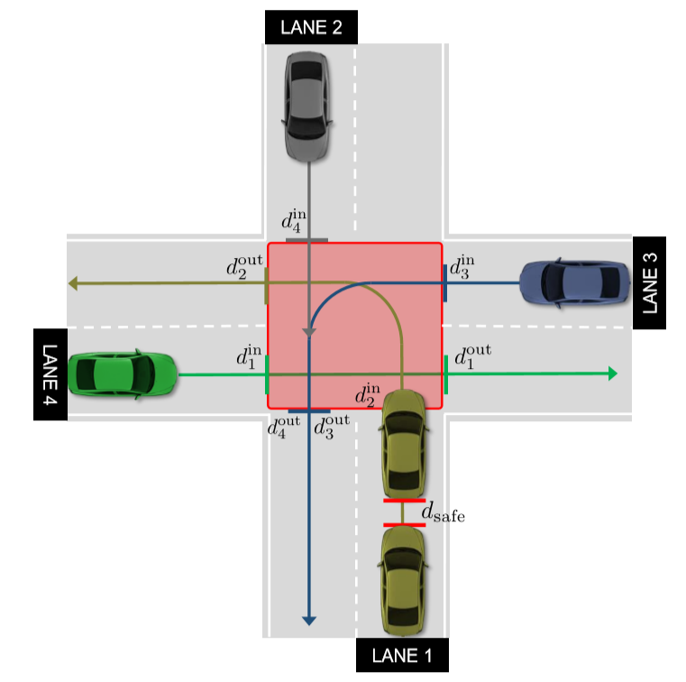
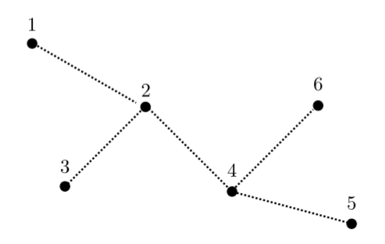
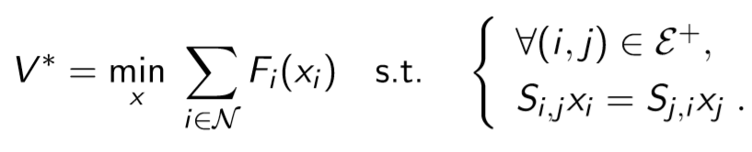
Motivation & Background
[1]Y. Jiang, M. Zanon, R. Hult, and B. Houska. IFAC 2017
Distributed algorithm for optimal vehicle coordination at trafﬁc intersections.
[2]J. Shi, Y. Zheng, Y. Jiang, M. Zanon, R. Hult, and B. Houska. CDC 2018
Distributed control algorithm for vehicle coordination at traffic intersections.
[3]Y. Jiang, D. Kouzoupis, H.Yin, M. Diehl, and B. Houska.
Decentralized Optimization over Tree Graphs.
arXiv preprint arXiv:1910.09206.
3

Slide 6
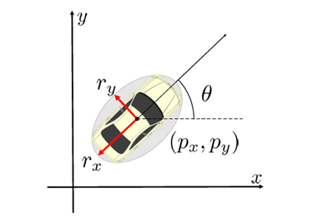

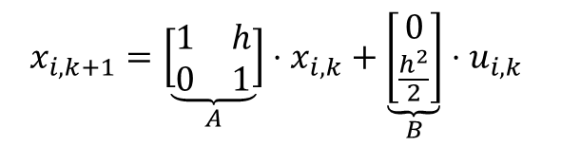
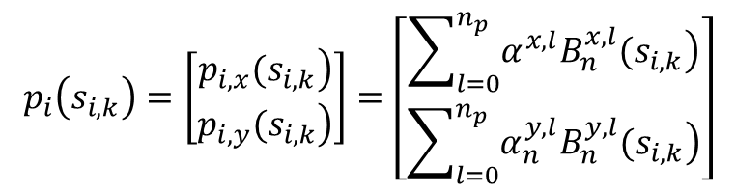
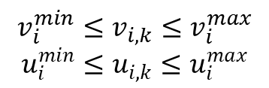

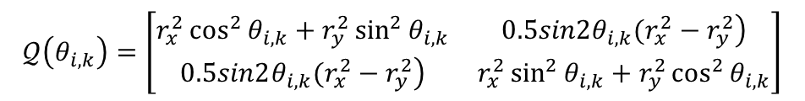
System Model
• Vehicle Kinematics
• Vehicle Shape
$$x_{i,k+1}=\underset{A}{\underbrace{\left[\begin{matrix}1 & h \\ 0 & 1\end{matrix}\right]}}⋅x_{i,k}+\underset{B}{\underbrace{\left[\begin{matrix}0 \\ \frac{h^{2}}{2}\end{matrix}\right]}}⋅u_{i,k}$$
$$x_{i,k}= \left[\begin{matrix}s_{i,k} \\ v_{i,k}\end{matrix}\right]$$
$$v_{i}^{min}≤v_{i,k}≤v_{i}^{max}$$
$$u_{i}^{min}≤u_{i,k}≤u_{i}^{max}$$
• Local to Global Coordinates
Shape ellipse: $ℰ(p_{i,k},𝒬(θ_{i,k}))$
$$p_{i}\left(s_{i,k}\right)=\left[\begin{matrix}\left.p_{i,x}(s_{i,k}\right) \\ \left.p_{i,y}(s_{i,k}\right)\end{matrix}\right]=\left[\begin{matrix}\sum_{l=0}^{n_{p}}{\left.α^{x,l}B_{n}^{x,l}(s_{i,k}\right)} \\ \sum_{l=0}^{n_{p}}{\left.α_{n}^{y,l}B_{n}^{y,l}(s_{i,k}\right)}\end{matrix}\right]$$
$$𝒬\left(θ_{i,k}\right)=\left[\begin{matrix}r_{x}^{2}\cos^{2}{θ_{i,k}+r_{y}^{2}\sin^{2}{θ_{i,k}}} & \left.0.5sin2θ_{i,k}(r_{x}^{2}−r_{y}^{2}\right) \\ \left.0.5sin2θ_{i,k}(r_{x}^{2}−r_{y}^{2}\right) & r_{x}^{2}\sin^{2}{θ_{i,k}+r_{y}^{2}\cos^{2}{θ_{i,k}}}\end{matrix}\right]$$
4

Slide 7
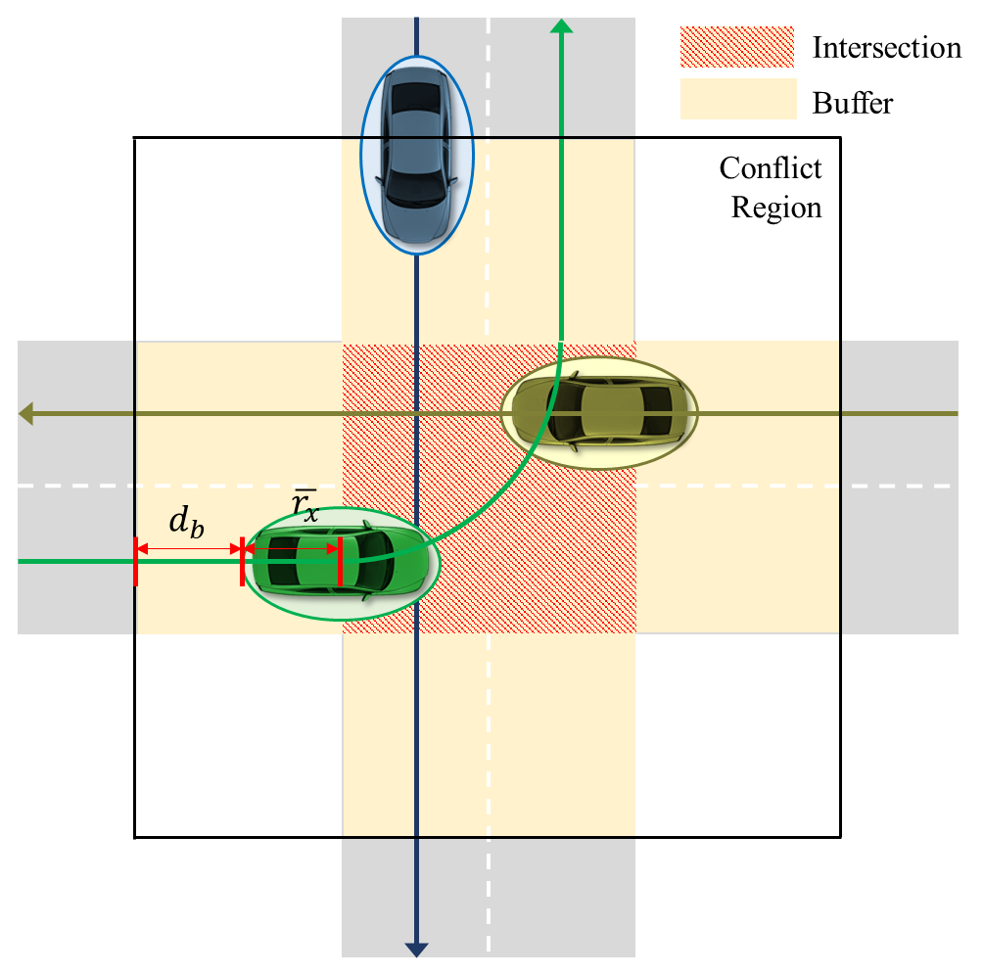
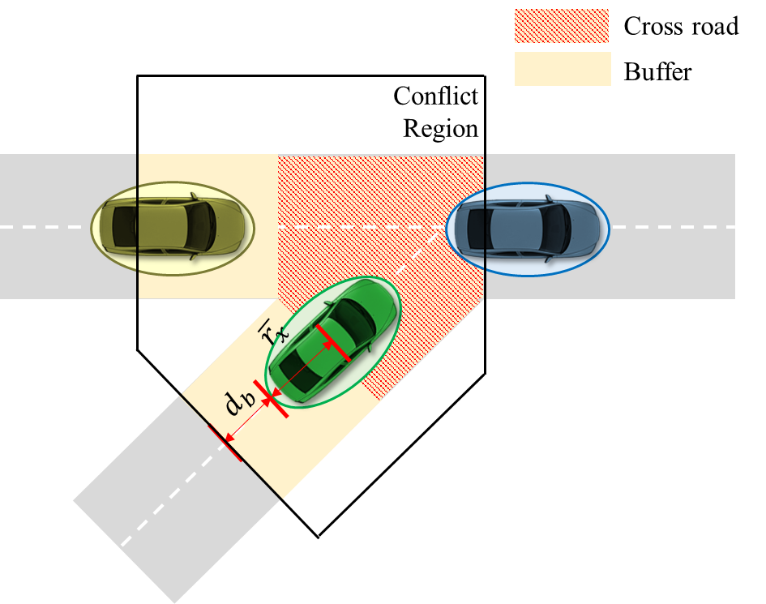
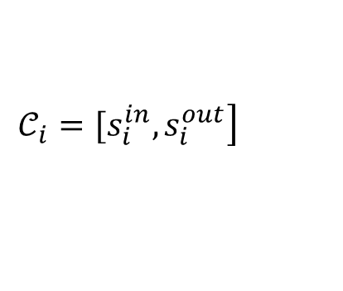
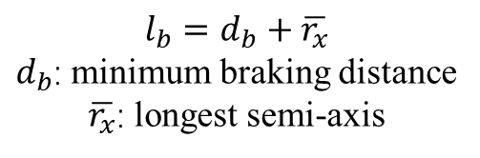
Collision Avoidance
Conflict Region
$$\left.𝒞_{i}=[s_{i}^{in},s_{i}^{out}\right]$$
outside: Rear-end Collision
inside: Rear-end and Side Collision
$$l_{b}=d_{b}+\overline{r_{x}}$$
$d_{b}$: minimum braking distance
$\overline{r_{x}}$: longest semi-axis
5

Slide 8
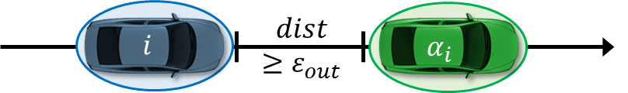
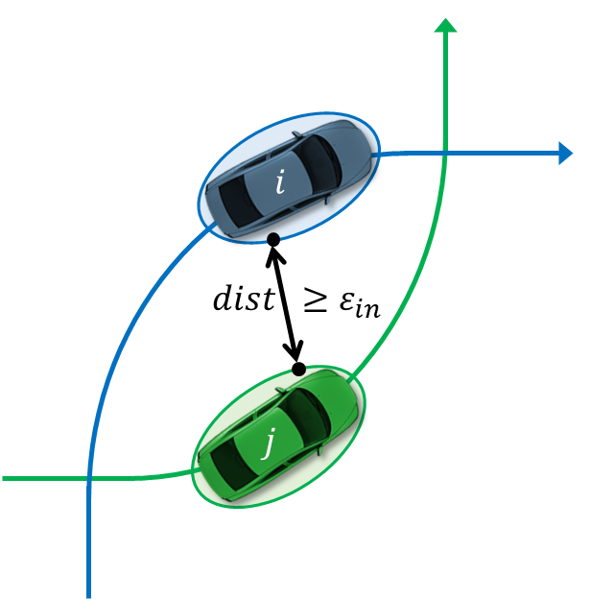
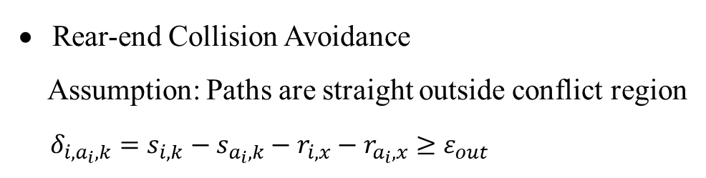
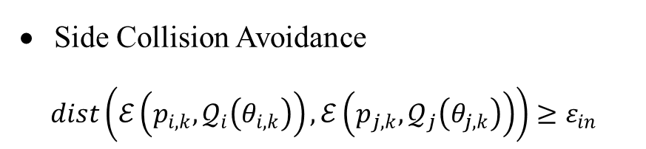
Collision Avoidance
Rear-end and Side Collision Avoidance
Rear-end Collision Avoidance
Assumption: Paths are straight outside conflict region
$δ_{i,a_{i},k}=s_{i,k}−s_{a_{i},k}−r_{i,x}−r_{a_{i},x}≥ε_{out}$
Side Collision Avoidance
$dist\left(ℰ\left(p_{i,k},𝒬_{i}\left(θ_{i,k}\right)\right),ℰ\left(p_{j,k},𝒬_{j}\left(θ_{j,k}\right)\right)\right)≥ε_{in}$
6

Slide 9
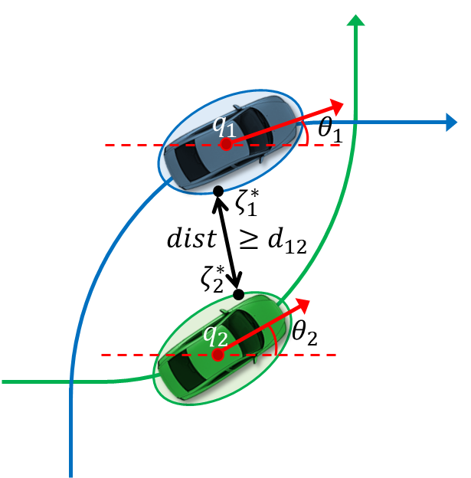

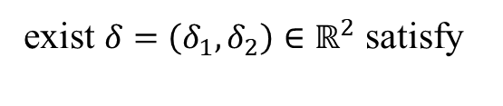
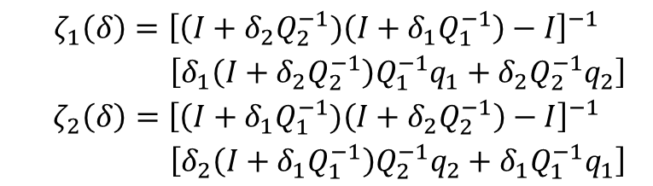
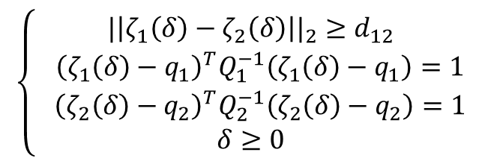
Collision Avoidance
Distance between Ellipses
$$dist\left(ℰ\left(q_{1},Q_{1}\right),ℰ\left(q_{2},Q_{2} \right)\right)≥d_{12}$$
exist $δ=\left(δ_{1},δ_{2}\right)∈ℝ^{2}$ satisfy
$$\left\{\begin{matrix}\begin{matrix}|{\left|ζ_{1}\left(δ\right)−ζ_{2}\left(δ\right)\right||}_{2}≥d_{12} \\ { \left(ζ_{1}\left(δ\right)−q_{1}\right)}^{T}Q_{1}^{−1}\left(ζ_{1}\left(δ\right)−q_{1}\right)=1\end{matrix} \\ \begin{matrix}{ \left(ζ_{2}\left(δ\right)−q_{2}\right)}^{T}Q_{2}^{−1}\left(ζ_{2}\left(δ\right)−q_{2}\right)=1 \\ δ≥0\end{matrix}\end{matrix}\right.$$
where
$$\begin{matrix}\begin{aligned}ζ_{1}\left(δ\right)={\left[\left(I+δ_{2}Q_{2}^{−1})\left(I+δ_{1}Q_{1}^{−1}\right)−I\right.\right]}^{−1} \\ \left[δ_{1}\left(I+δ_{2}Q_{2}^{−1}\right)Q_{1}^{−1}q_{1}+δ_{2}Q_{2}^{−1}q_{2}\right]\end{aligned} \\ \begin{aligned}ζ_{2}\left(δ\right)={\left[\left(I+δ_{1}Q_{1}^{−1})\left(I+δ_{2}Q_{2}^{−1}\right)−I\right.\right]}^{−1} \\ \left[δ_{2}\left(I+δ_{1}Q_{1}^{−1}\right)Q_{2}^{−1}q_{2}+δ_{1}Q_{1}^{−1}q_{1}\right]\end{aligned}\end{matrix}$$
7

Slide 10
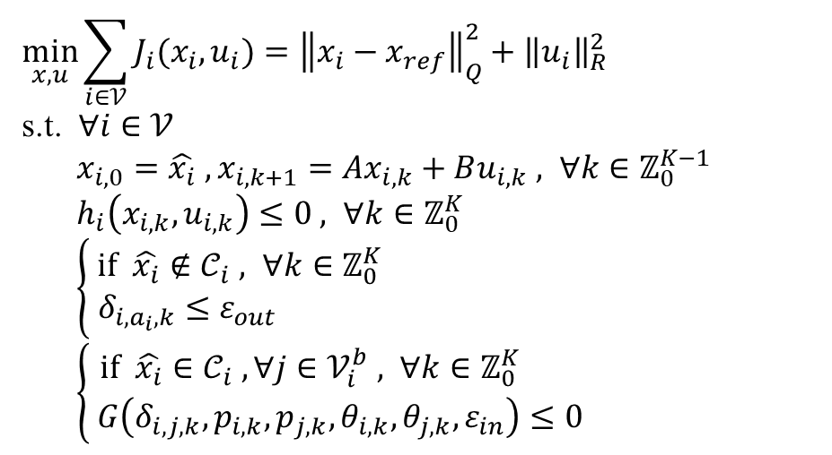
Problem Formulation
Centralized Formulation
$$\min_{x,u}{\sum_{i∈𝒱}{J_{i}(x_{i},u_{i})}}={\left\|x_{i}−x_{ref}\right\|}_{Q}^{2}+{\left\|u_{i}\right\|}_{R}^{2}$$
s.t. $∀i∈𝒱$
$x_{i,0}=\hat{x_{i}} , x_{i,k+1}=Ax_{i,k}+Bu_{i,k} , ∀k∈ℤ_{0}^{K−1}$
$h_{i}\left(x_{i,k},u_{i,k}\right)≤0 , ∀k∈ℤ_{0}^{K}$
$\left\{\begin{matrix} \text{if} \hat{x_{i}}∉𝒞_{i} , ∀k∈ℤ_{0}^{K} \\ δ_{i,a_{i},k}≤ε_{out} \end{matrix}\right.$
$\left\{\begin{matrix} \text{i}\text{f} \hat{x_{i}}∈𝒞_{i} , ∀j∈𝒱_{i}^{b} , ∀k∈ℤ_{0}^{K} \\ G\left(δ_{i,j,k},p_{i,k},p_{j,k},θ_{i,k},θ_{j,k},ε_{in}\right)≤0\end{matrix}\right.$
Objective
Kinematics
State and Control Constraints
Rear-end Collision Avoidance
Inside Conflict Region Collision Avoidance
8

Slide 11
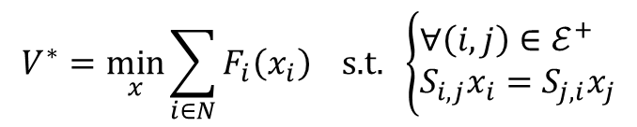
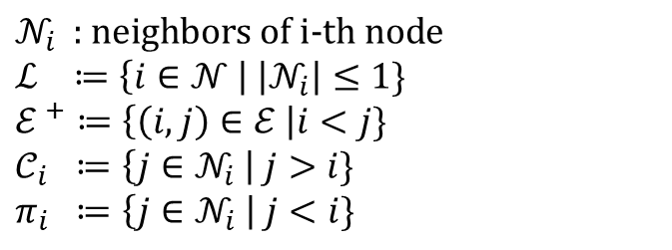
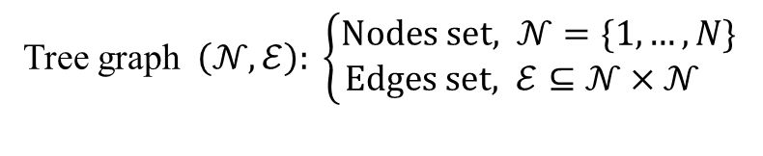
Problem Formulation
Tree-structed Optimization Problem
Tree graph $\left(𝒩,ℰ\right): \left\{\begin{matrix}\text{N}\text{odes} \text{set}, 𝒩=\{1,…,N\} \\ \text{Edges} \text{set}, ℰ⊆𝒩×𝒩 \end{matrix}\right.$
$$𝒩_{i} \text{ : }\text{neighbors} \text{of} \text{i}\text{−}\text{th} \text{node}$$
$$ℒ ≔\left\{i∈𝒩 \right| \left|𝒩_{i}\right|≤1\}$$
$$ℰ^{ +}≔\left\{\left(i,j\right)∈ℰ \right|i<j\}$$
$$𝒞_{i} ≔\left\{j∈𝒩_{i} \right| j>i\}$$
$$π_{i} ≔\left\{j∈𝒩_{i} \right| j<i\}$$
$$V^{∗}=\min_{x}{\sum_{i∈N}{F_{i}\left(x_{i}\right) \text{s}\text{.}\text{t}\text{. }\left\{\begin{aligned}&∀\left(i,j\right)∈ℰ^{+} \\ &S_{i,j}x_{i}=S_{j,i}x_{j}\end{aligned}\right.}}$$
9

Slide 12



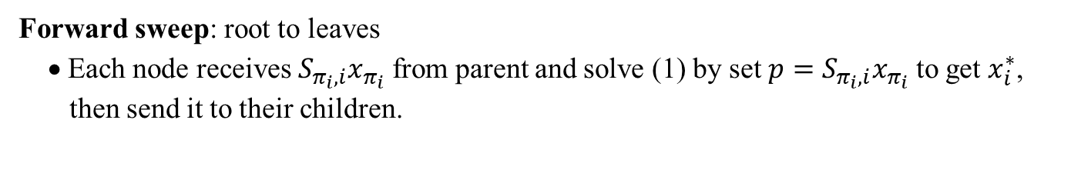
Problem Formulation
Dynamic Programming
Backward sweep: leaves to root
• Each node receives $V_{j}$ from children $𝒞_{i}$. Then, construct $V_{i}$ by
(1)
and sent it to parent $π_{i}$.
• The root solves
$$V_{i}\left(p\right)=\min_{x_{i}}{F_{i}\left(x_{i}\right)+\sum_{j∈𝒞_{i}}{V_{i}(S_{i,j}x_{i})} s.t. S_{i,π_{i}}x_{i}=p}$$
$$V^{∗}=\min_{x_{1}}{F_{1}\left(x_{1}\right)+\sum_{j∈𝒞_{1}}{V_{j}(S_{1,j}x_{1})}}$$
Forward sweep: root to leaves
• Each node receives $S_{π_{i},i}x_{π_{i}}$ from parent and solve (1) by set $p=S_{π_{i},i}x_{π_{i}}$ to get $x_{i}^{∗}$,
then send it to their children.
Disadvantages: • $V_{i}$ required to be constructed explicitly for $p$.
• Greatly affected by curse of dimensionality.
10

Slide 13
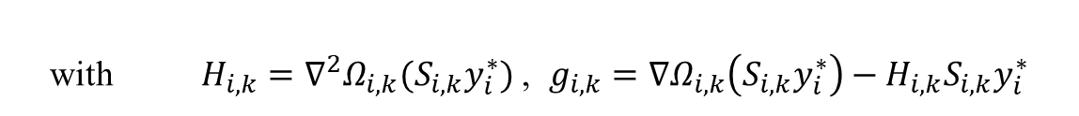
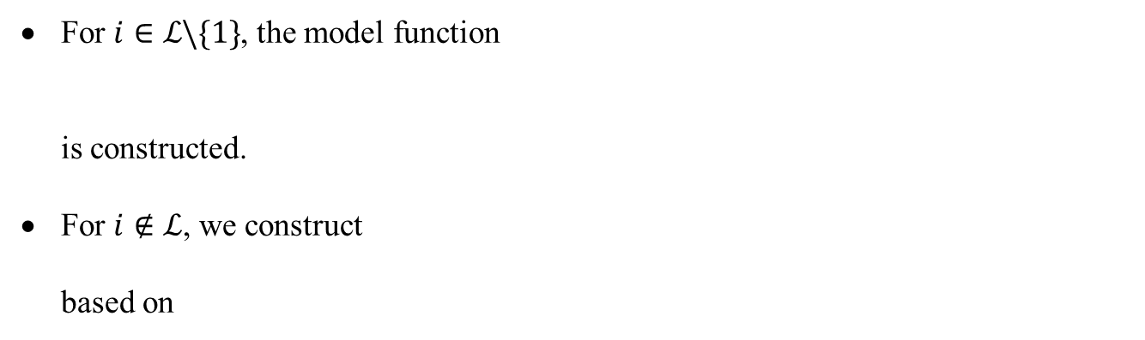
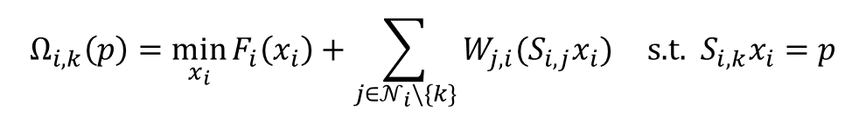
Problem Formulation
Model function
For $i∈ℒ\backslash \{1\}$, the model function
is constructed.
For $i∉ℒ$, we construct
based on
$$W_{i,π_{i}}\left(p\right)≈V_{i}\left(p\right)=\min_{x_{i}}{F_{i}\left(x_{i}\right) \text{s}\text{.}\text{t}\text{. }S_{i,π_{i}}x_{i}=p}$$
$$W_{i,k}(p)≈Ω_{i,k}(p)≈V_{i}(p)$$
$$Ω_{i,k}\left(p\right)=\min_{x_{i}}{F_{i}\left(x_{i}\right)+\sum_{j∈𝒩_{i}\backslash \{k\}}{W_{j,i}(S_{i,j}x_{i})}} \text{s}\text{.}\text{t}\text{. }S_{i,k}x_{i}=p$$
Example (cubic model):
$$W_{i,k}\left(p\right)=\frac{1}{2}p^{T}H_{i,k}p+g_{i,k}^{T}p+σ_{i,k}{\left\|p−S_{i,k}y_{i}^{∗}\right\|}^{3}+\text{const}$$
with $H_{i,k}=∇^{2}Ω_{i,k}(S_{i,k}y_{i}^{∗})$ , $g_{i,k}=∇Ω_{i,k}\left(S_{i,k}y_{i}^{∗}\right)−H_{i,k}S_{i,k}y_{i}^{∗}$
11

Slide 14
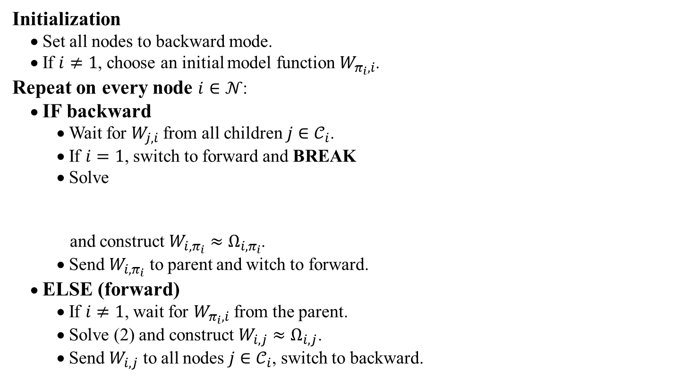
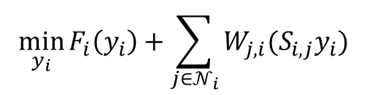
Problem Formulation
Multi-sweep Method
Initialization
• Set all nodes to backward mode.
• If $i≠1$, choose an initial model function $W_{π_{i},i}$.
Repeat on every node $i∈𝒩$:
• IF backward
• Wait for $W_{j,i}$from all children $j∈𝒞_{i}$.
• If $i=1$, switch to forward and BREAK
• Solve
and construct $W_{i,π_{i}}≈Ω_{i,π_{i}}$.
• Send $W_{i,π_{i}}$ to parent and witch to forward.
• ELSE (forward)
• If $i≠1$, wait for $W_{π_{i},i}$ from the parent.
• Solve (2) and construct $W_{i,j}≈Ω_{i,j}$.
• Send $W_{i,j}$ to all nodes $j∈𝒞_{i}$, switch to backward.
$$\min_{y_{i}}{F_{i}\left(y_{i}\right)+\sum_{j∈𝒩_{i}}{W_{j,i}(S_{i,j}y_{i})}}$$
(2)
12

Slide 15
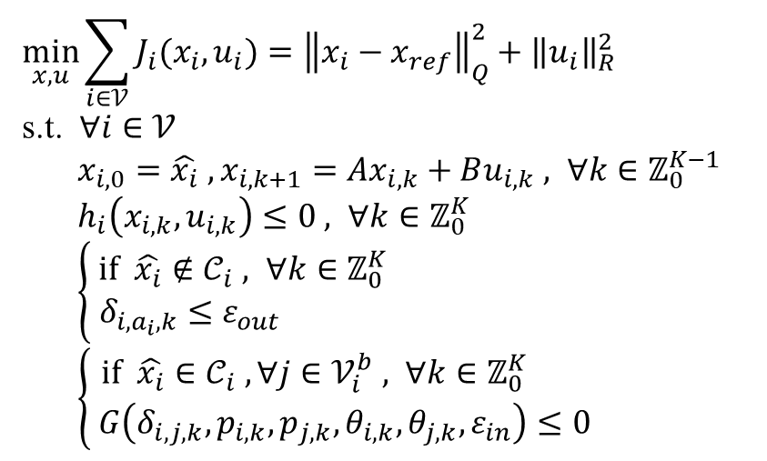
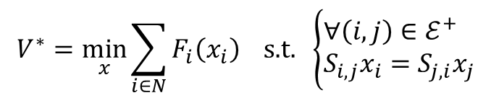
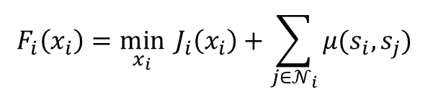
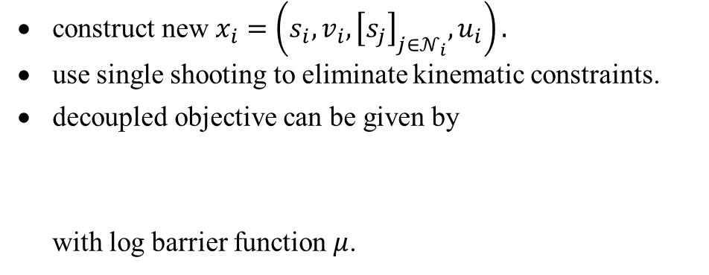
Problem Formulation
Tree-structed Reformulation
construct new $x_{i}=\left(s_{i},v_{i},{\left[s_{j}\right]}_{j∈𝒩_{i}},u_{i}\right).$
use single shooting to eliminate kinematic constraints.
decoupled objective can be given by
with log barrier function $μ$.
$$\min_{x,u}{\sum_{i∈𝒱}{J_{i}(x_{i},u_{i})}}={\left\|x_{i}−x_{ref}\right\|}_{Q}^{2}+{\left\|u_{i}\right\|}_{R}^{2}$$
s.t. $∀i∈𝒱$
$x_{i,0}=\hat{x_{i}} , x_{i,k+1}=Ax_{i,k}+Bu_{i,k} , ∀k∈ℤ_{0}^{K−1}$
$h_{i}\left(x_{i,k},u_{i,k}\right)≤0 , ∀k∈ℤ_{0}^{K}$
$\left\{\begin{matrix} \text{if} \hat{x_{i}}∉𝒞_{i} , ∀k∈ℤ_{0}^{K} \\ δ_{i,a_{i},k}≤ε_{out} \end{matrix}\right.$
$\left\{\begin{matrix} \text{i}\text{f} \hat{x_{i}}∈𝒞_{i} , ∀j∈𝒱_{i}^{b} , ∀k∈ℤ_{0}^{K} \\ G\left(δ_{i,j,k},p_{i,k},p_{j,k},θ_{i,k},θ_{j,k},ε_{in}\right)≤0\end{matrix}\right.$
$$F_{i}\left(x_{i}\right)=\min_{x_{i}}{{ J}_{i}\left(x_{i}\right)+\sum_{j∈𝒩_{i}}{μ(s_{i},s_{j})}}$$
$$V^{∗}=\min_{x}{\sum_{i∈N}{F_{i}\left(x_{i}\right) \text{s}\text{.}\text{t}\text{. }\left\{\begin{aligned}&∀\left(i,j\right)∈ℰ^{+} \\ &S_{i,j}x_{i}=S_{j,i}x_{j}\end{aligned}\right.}}$$
13

Slide 16
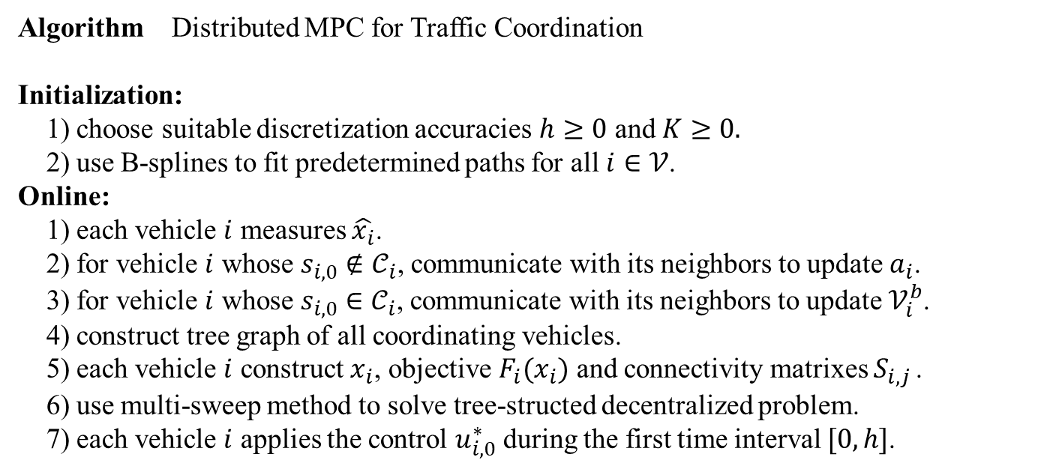
Distributed MPC Scheme
Algorithm Distributed MPC for Traffic Coordination
Initialization:
1) choose suitable discretization accuracies $h≥0$ and $K≥0.$
2) use B-splines to fit predetermined paths for all $i∈𝒱$.
Online:
1) each vehicle $i$ measures $\hat{x_{i}}$.
2) for vehicle $i$ whose $s_{i,0}∉𝒞_{i}$, communicate with its neighbors to update $a_{i}$.
3) for vehicle $i$ whose $s_{i,0}∈𝒞_{i}$, communicate with its neighbors to update $𝒱_{i}^{b}$.
4) construct tree graph of all coordinating vehicles.
5) each vehicle $i$ construct $x_{i}$, objective $F_{i}(x_{i})$ and connectivity matrixes $S_{i,j }$.
6) use multi-sweep method to solve tree-structed decentralized problem.
7) each vehicle $i$ applies the control $u_{i,0}^{∗}$ during the first time interval $[0,h]$.
14

Slide 17
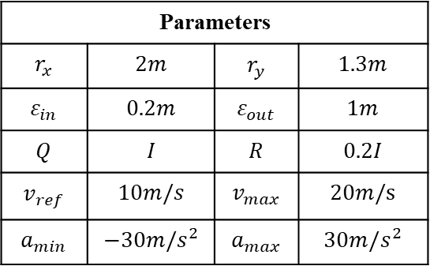
Case Study y
Intersection Scenario
Parameters
$$r_{x}$$ | $$2m$$ | $$r_{y}$$ | $$1.3m$$
$$ε_{in}$$ | $$0.2m$$ | $$ε_{out}$$ | $$1m$$
$$Q$$ | $$I$$ | $$R$$ | $$0.2I$$
$$v_{ref}$$ | $$10m/s$$ | $$v_{max}$$ | $$20m/s$$
$$a_{min}$$ | $$−30m/s^{2}$$ | $$a_{max}$$ | $$30m/s^{2}$$
Relatively complex scenario
Good utilization in space
High cost in computation
15

Slide 18
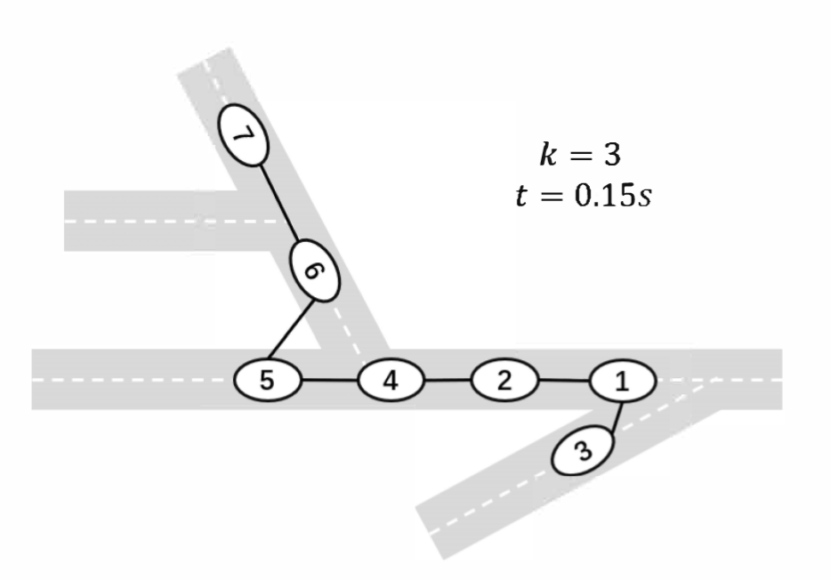
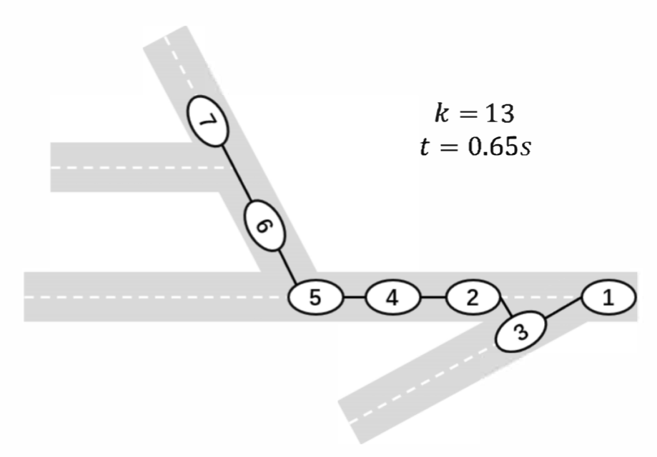
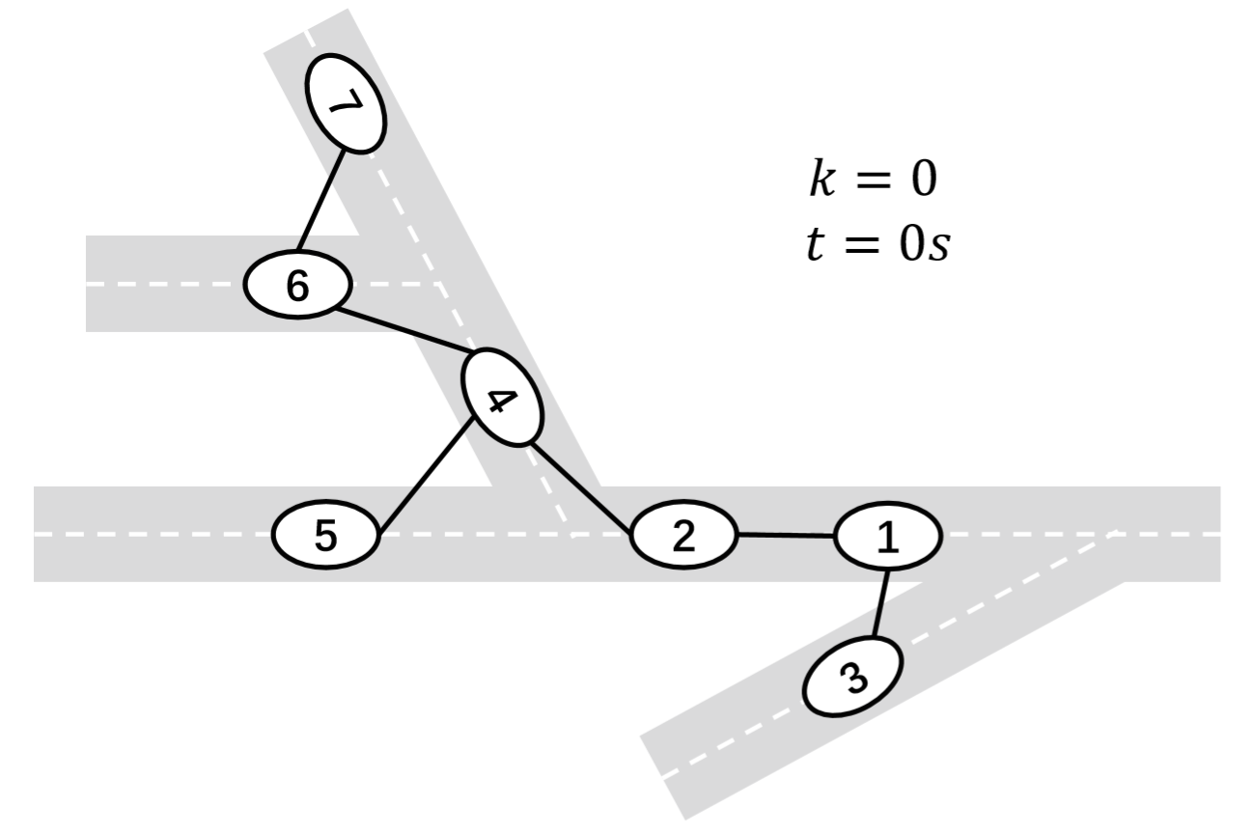
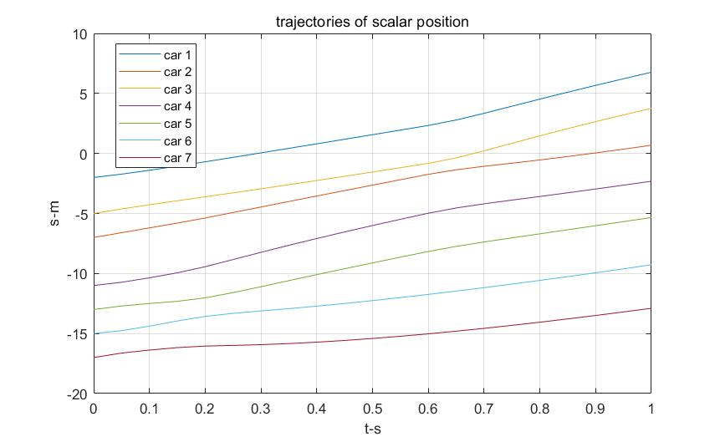
Case Study y
Lanes merge Scenario
No considering the shape of vehicles
Relatively simple scenario
High efficiency in computation
• one backward + forward for QP problem
• computational cost increases in linear rate
16

Slide 19
Conclusion
Balance
01
Space Utilization
#agents per unit area
Efficiency
computational cost
02
Network structed decentralized optimization algorithm is pretty suitable for (traffic) coordination.
03
Feasibility might be the biggest problem for traffic coordination. A complete strategy for the whole traffic system (not some parts) is needed.
17

Slide 20
Thank you for your attention.
Sincere thanks to Prof. Houska,
Dr. Jiang and Jiahe Shi.
Q&A
END

