Slide 1
Contents at a glance about software requirement
GV: ĐỖ TẤN NHÀN

Slide 2
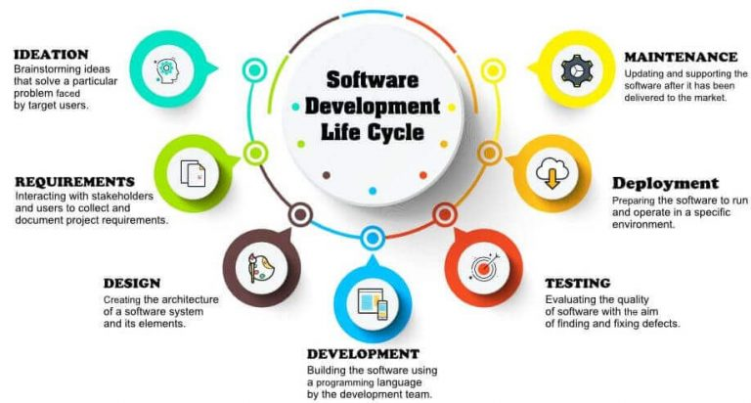
Software Development Life Cycle

Slide 3
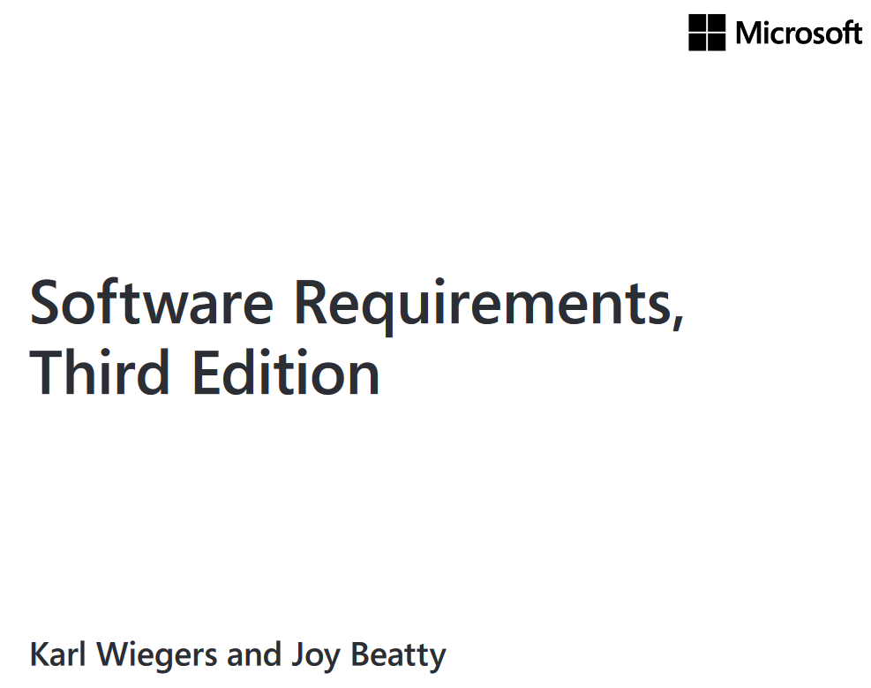
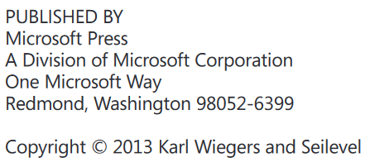
Contents at a glance

Slide 4
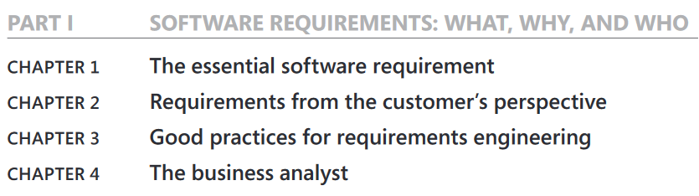
Contents at a glance

Slide 5
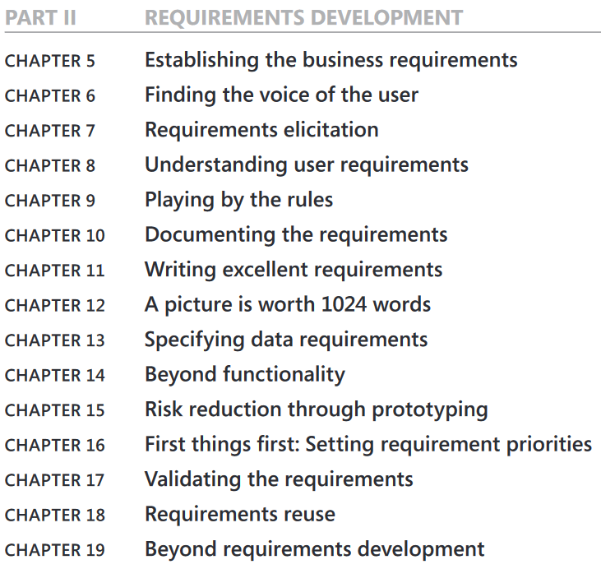
Contents at a glance

Slide 6
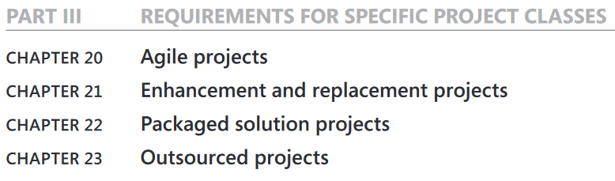
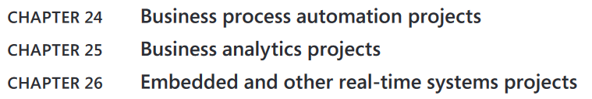
Contents at a glance

Slide 7
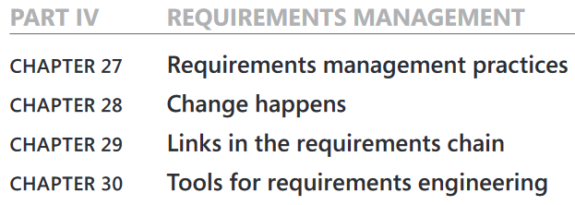
Contents at a glance

Slide 8
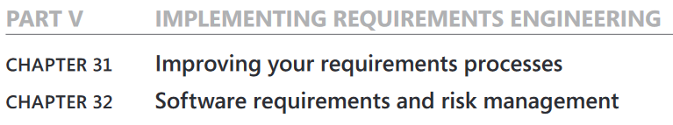
Contents at a glance

