Slide 1
Contents at a glance about software requirement
GV: ĐỖ TẤN NHÀN

Slide 2
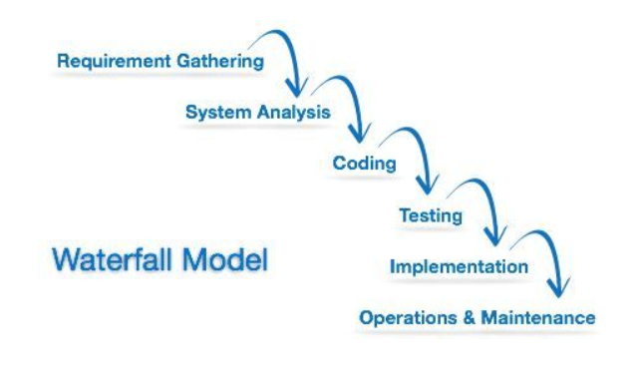
Waterfall Model

Slide 3
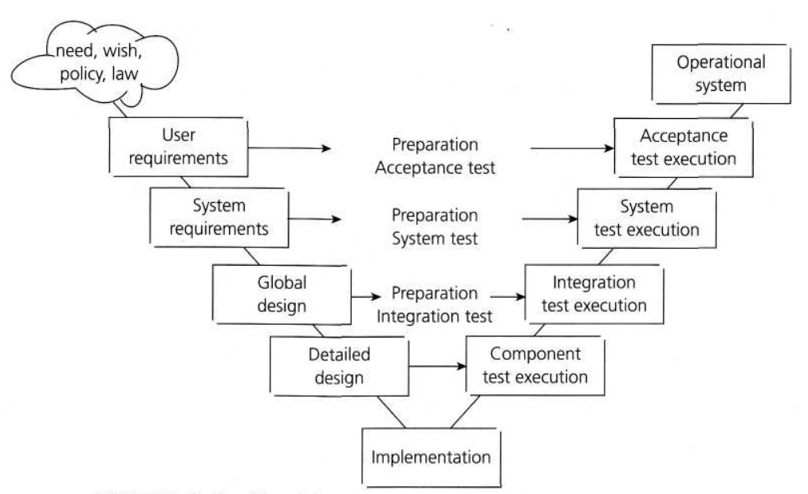
V-Mode Model

Slide 4
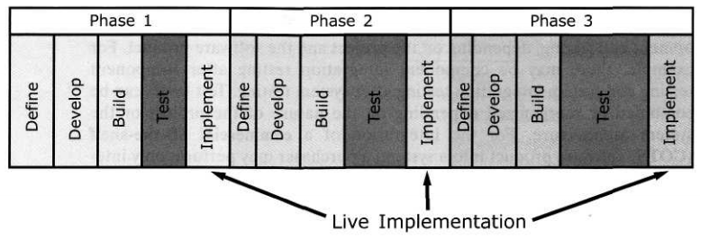
Interative Development Model

Slide 5
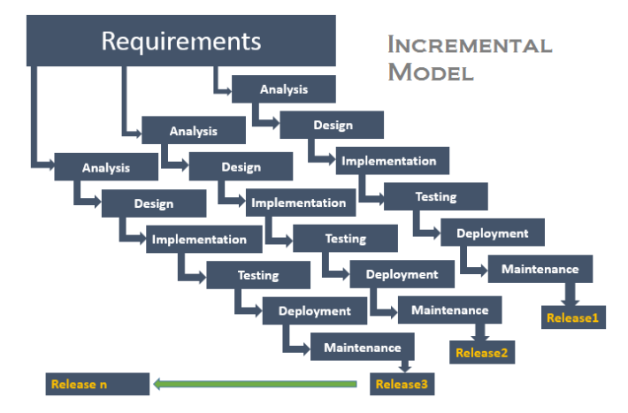
Incremental Model

Slide 6
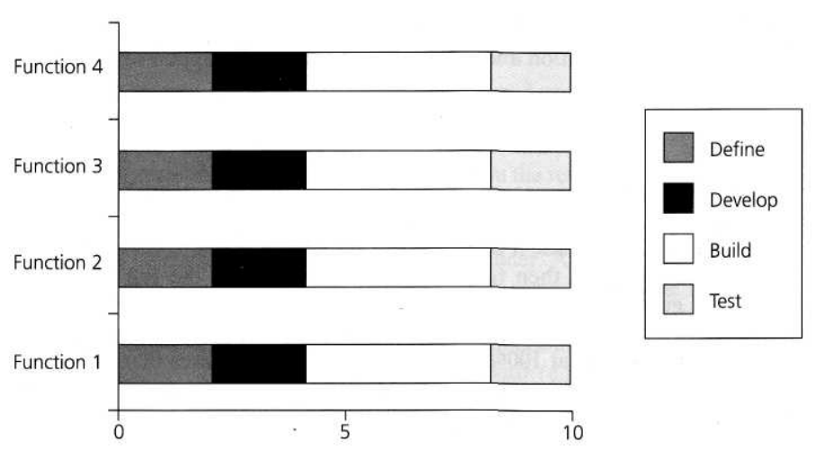
Rapid Application Development Model

Slide 7
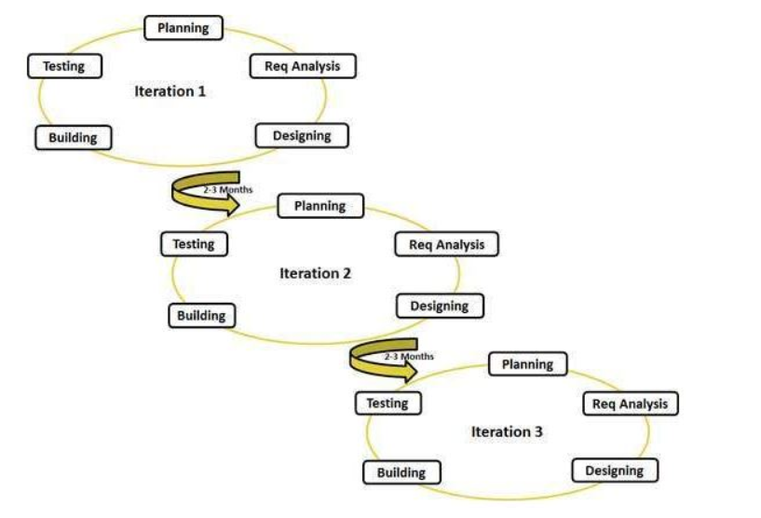
Agile Model

