Slide 1
EVENT LISTENERS

Slide 2
Objectives
Introduction to Event Listeners
+ Understand the purpose of Event Listeners
+ Create, Declaring and Invoking Event Listeners
7/1/2025
‹#›

Slide 3
What is Event Listeners?
Event Listeners is occurrence of something, in web application world an event can be initialization of application, destroying an application, request from client, creating/destroying a session, attribute modification in session etc.
7/1/2025
‹#›

Slide 4
Describe servlet event listeners
Event Categories and Listener Interfaces
Typical Event Listener Scenario
Event Listener Declaration and Invocation
Event Listener Coding and Deployment Guidelines
Event Listener Methods and Related Classes

Slide 5
Event Categories and Listener Interfaces
- There are two levels of servlet events:
Servlet context-level (application-level) event
This event involves resources or state held at the level of the application servlet context object.
Session-level event
This event involves resources or state associated with the series of requests from a single user session; that is, associated with the HTTP session object.

Slide 6
Event Categories and Listener Interfaces
- Each of these two levels has two event categories:
Lifecycle changes
Attribute changes
You can create one or more event listener classes for each of the four event categories. A single listener class can monitor multiple event categories.
Create an event listener class by implementing the appropriate interface or interfaces of the javax.servlet package or javax.servlet.http package
7/1/2025
‹#›

Slide 7
Event Categories and Listener Interfaces
Event Category | Event Descriptions | Java Interface
Servlet context lifecycle changes | Servlet context creation, at which point the first request can be serviced Imminent shutdown of the servlet context | javax.servlet. ServletContextListener
Servlet context attribute changes | Addition of servlet context attributes Removal of servlet context attributes Replacement of servlet context attributes | javax.servlet. ServletContextAttributeListener
Session lifecycle changes | Session creation Session invalidation Session timeout | javax.servlet.http. HttpSessionListener
Session attribute changes | Addition of session attributes Removal of session attributes Replacement of session attributes | javax.servlet.http. HttpSessionAttributeListener
7/1/2025
‹#›

Slide 8
Typical Event Listener Scenario
A typical use of the event listener mechanism would be to create a servlet context lifecycle event listener to manage the database connection. This listener may function as follows:
The listener is notified of application startup.
The application logs in to the database and stores the connection object in the servlet context.
Servlets use the database connection to perform SQL operations.
The listener is notified of imminent application shutdown (shutdown of the Web server or removal of the application from the Web server).
Prior to application shutdown, the listener closes the database connection.
7/1/2025
‹#›

Slide 9
Event Listener Declaration and Invocation
Event listeners are declared in the application web.xml deployment descriptor through <listener> elements under the top-level <web-app> element.
Each listener has its own <listener> element, with a <listener-class> subelement specifying the class name.
Within each event category, event listeners should be specified in the order in which you would like them to be invoked when the application runs.

Slide 10
Event Listener Declaration and Invocation
Here is an example of event listener declarations, from the Sun Microsystems Java Servlet Specification, Version 2.3:
<web-app>
<display-name>MyListeningApplication</display-name>
<listener>
<listenerclass>com.acme.MyConnectionManager</listenerclass>
</listener>
<listener>
<listener-class>com.acme.MyLoggingModule</listener-class>
</listener>
<servlet>
<display-name>RegistrationServlet</display-name>
...
</servlet>
</web-app>

Slide 11
Event Listener Coding and Deployment Guidelines
Be aware of the following rules and guidelines for event listener classes:
In a multithreaded application, attribute changes may occur simultaneously. There is no requirement for the servlet container to synchronize the resulting notifications; the listener classes themselves are responsible for maintaining data integrity in such a situation.
Each listener class must have a public zero-argument constructor.
Each listener class file must be packaged in the application WAR file, either under /WEB-INF/classes or in a JAR file in /WEB-INF/lib.
7/1/2025
‹#›

Slide 12
Event Listener Methods and Related Classes
This section contains event listener methods that are called by the servlet container when a servlet context event or session event occurs.
These methods take different types of event objects as input
ServletContextListener Methods
The ServletContextListener interface specifies the following methods:
void contextInitialized(ServletContextEvent sce)
The servlet container calls this method to notify the listener that the servlet context has been created and the application is ready to process requests.
void contextDestroyed(ServletContextEvent sce)
The servlet container calls this method to notify the listener that the application is about to be shut down.
7/1/2025
‹#›

Slide 13
Event Listener Methods and Related Classes
ServletContextAttributeListener Methods
The ServletContextAttributeListener interface specifies the following methods:
void attributeAdded(ServletContextAttributeEvent scae)
The servlet container calls this method to notify the listener that an attribute was added to the servlet context.
void attributeRemoved(ServletContextAttributeEvent scae)
The servlet container calls this method to notify the listener that an attribute was removed from the servlet context.
void attributeReplaced(ServletContextAttributeEvent scae)
The servlet container calls this method to notify the listener that an attribute was replaced in the servlet context.
7/1/2025
‹#›

Slide 14
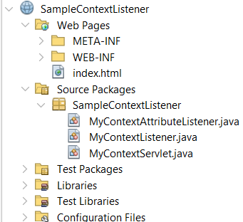
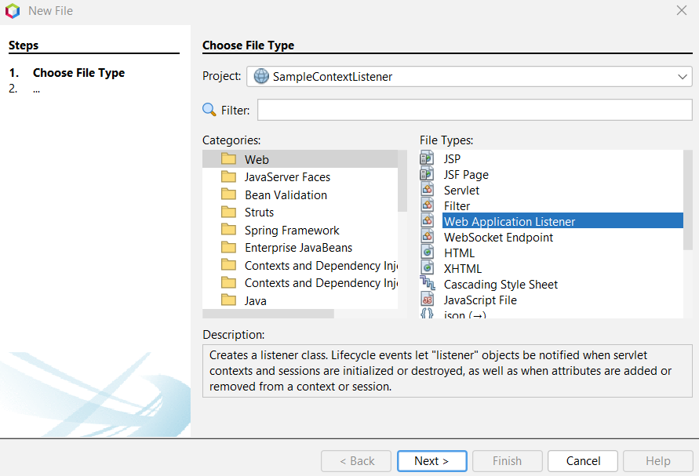
How to Add Listener to Web Project
#1. MyContextListener

Slide 15
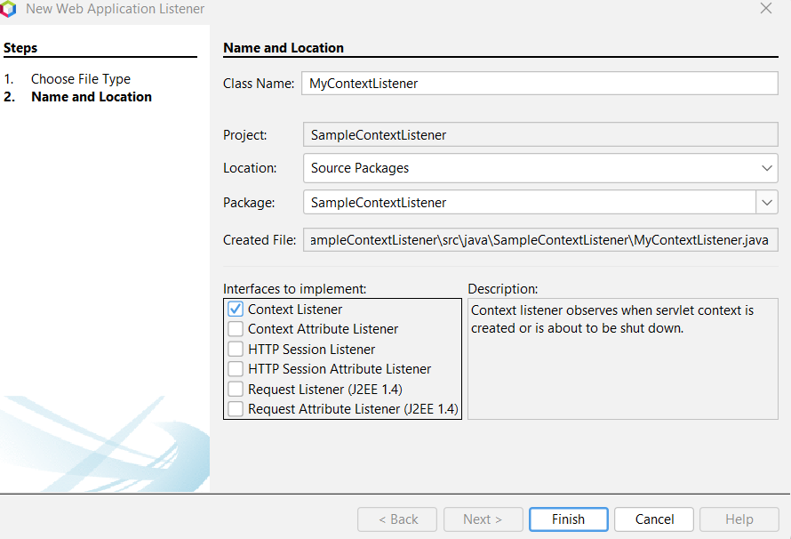
How to Add Listener to Web Project

Slide 16
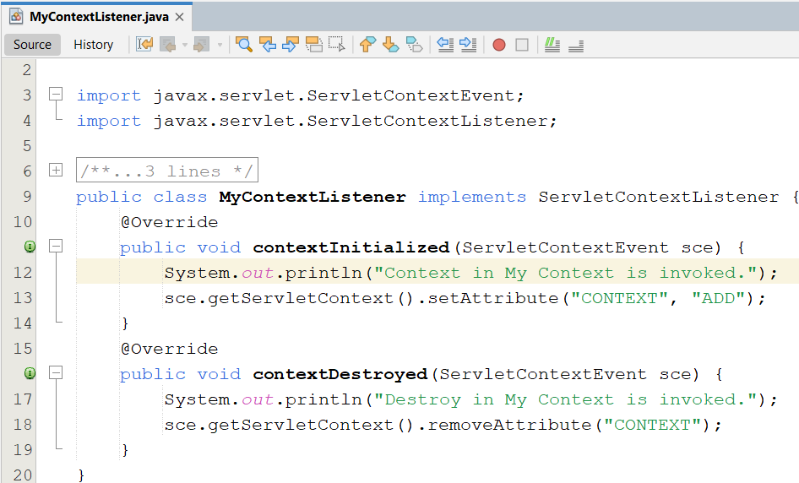
Demo - ServletContextListener

Slide 17
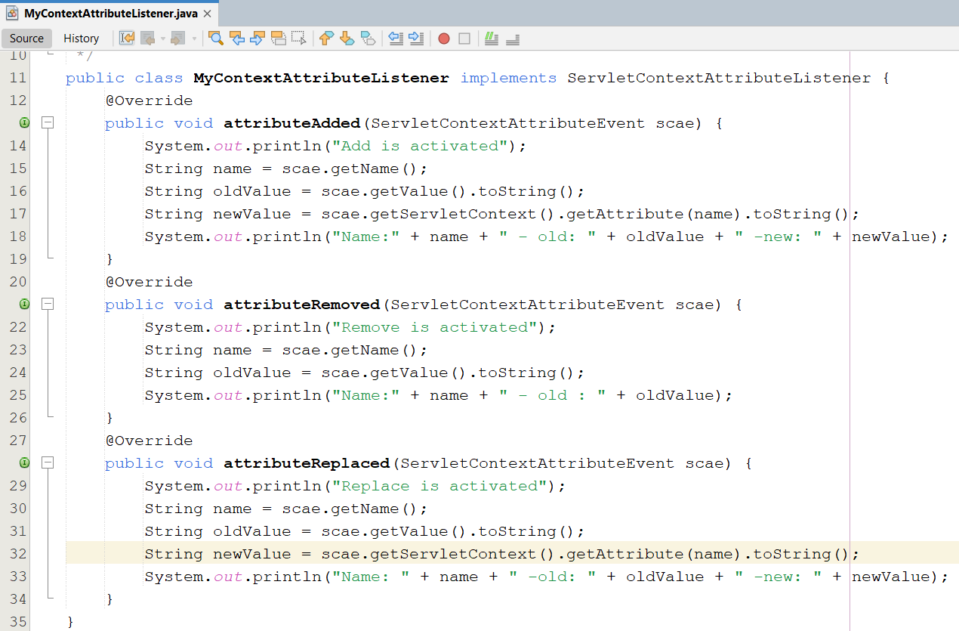
Demo - ServletContextListener
#2. Repeat Step #1 to create a ContextAttributeListener named MyContextAttributeListener

Slide 18
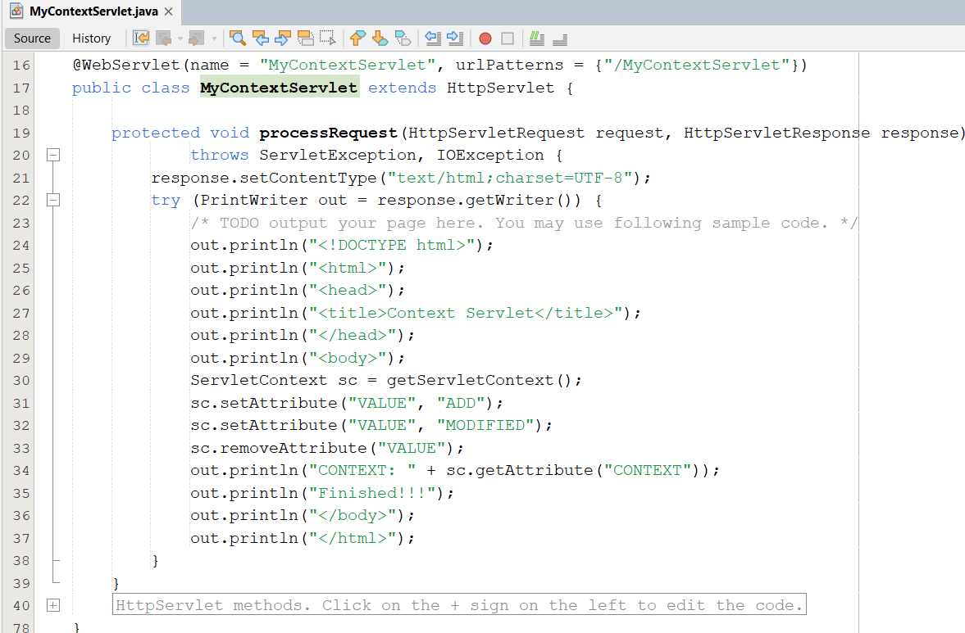
Demo - ServletContextListener
#3. Create MyContextServlet

Slide 19
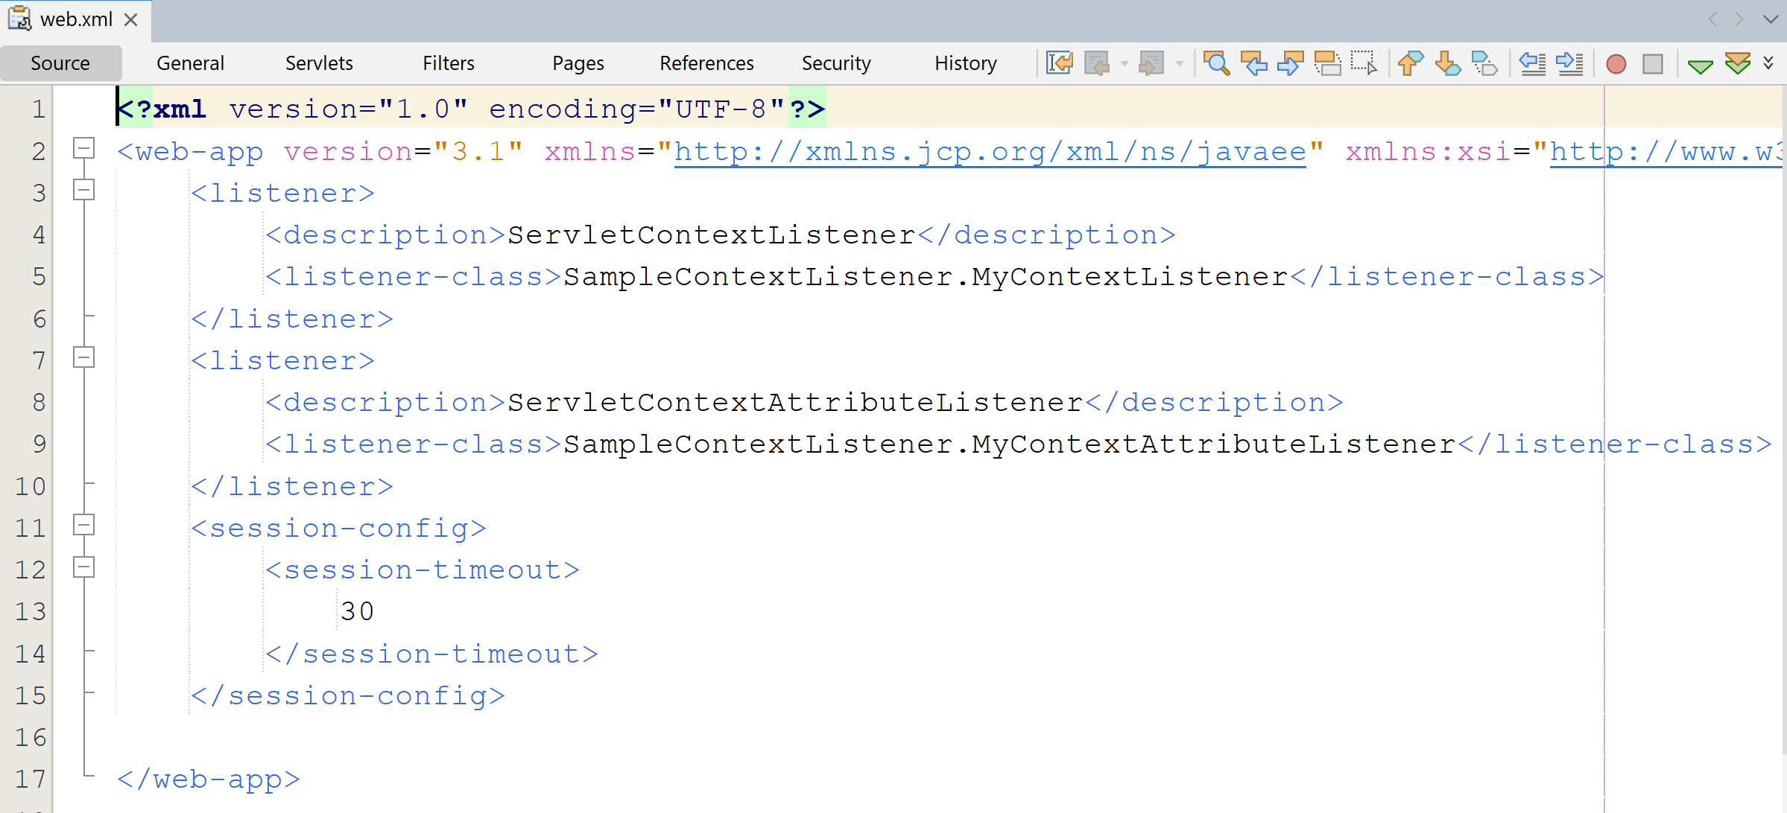
Demo - ServletContextListener
#4. Config in web.xml
<listener>
<description>ServletContextListener</description>
<listener-class>SampleContextListener.MyContextListener</listener-class>
</listener>
<listener>
<description>ServletContextAttributeListener</description>
<listener-class>SampleContextListener.MyContextAttributeListener</listener-class>
</listener>
Notes:
-To view Destroy context message : Must Undeploy Web App from Web Server Tomcat

Slide 20
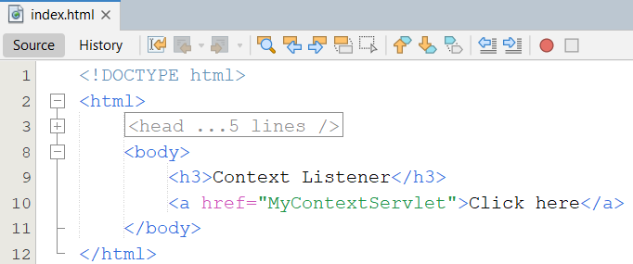
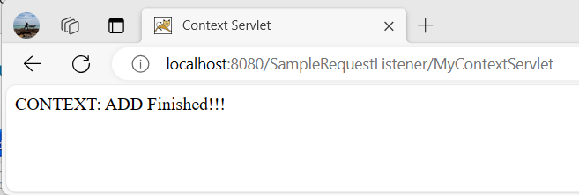
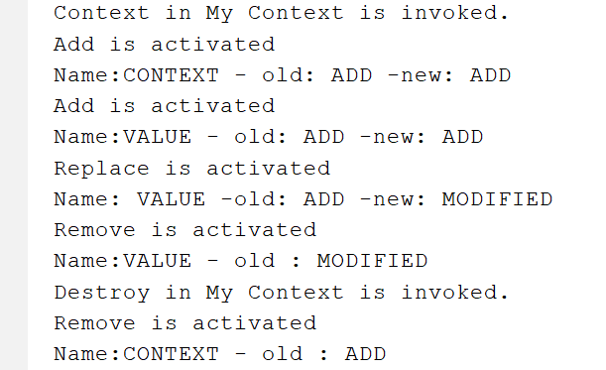
Demo - ServletContextListener
#5. Create Index.html
#6. Run the project
Notes:
-To view Destroy context message : Must Undeploy Web App from Web Server Tomcat

Slide 21
Event Listener Methods and Related Classes
HttpSessionListener Methods, HttpSessionEvent Class
The HttpSessionListener interface specifies the following methods:
void sessionCreated(HttpSessionEvent hse)
The servlet container calls this method to notify the listener that a session was created.
void sessionDestroyed(HttpSessionEvent hse)
The servlet container calls this method to notify the listener that a session was destroyed.
7/1/2025
‹#›

Slide 22
Event Listener Methods and Related Classes
HttpSessionAttributeListener Methods, HttpSessionBindingEvent Class
The HttpSessionAttributeListener interface specifies the following methods:
void attributeAdded(HttpSessionBindingEvent hsbe)
The servlet container calls this method to notify the listener that an attribute was added to the session.
void attributeRemoved(HttpSessionBindingEvent hsbe)
The servlet container calls this method to notify the listener that an attribute was removed from the session.
void attributeReplaced(HttpSessionBindingEvent hsbe)
The servlet container calls this method to notify the listener that an attribute was replaced in the session.
7/1/2025
‹#›

Slide 23
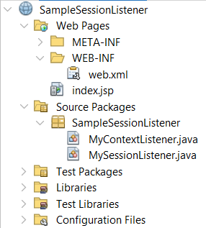
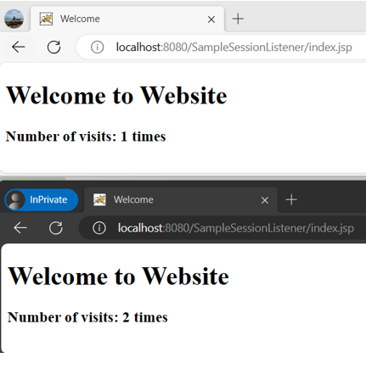
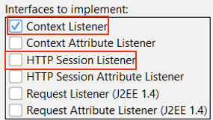
Demo Session Listeners
Reference to Slide 14-15

Slide 24
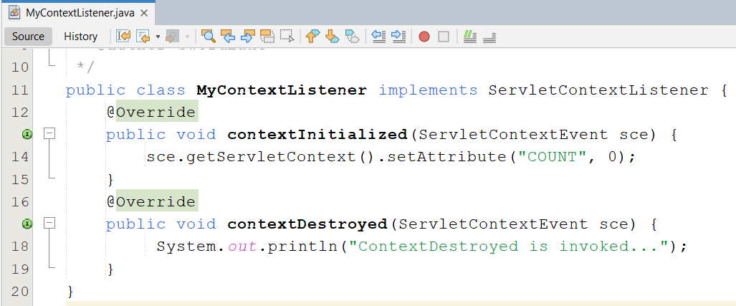
Demo Session Listeners
#1. Create MyContextListener

Slide 25
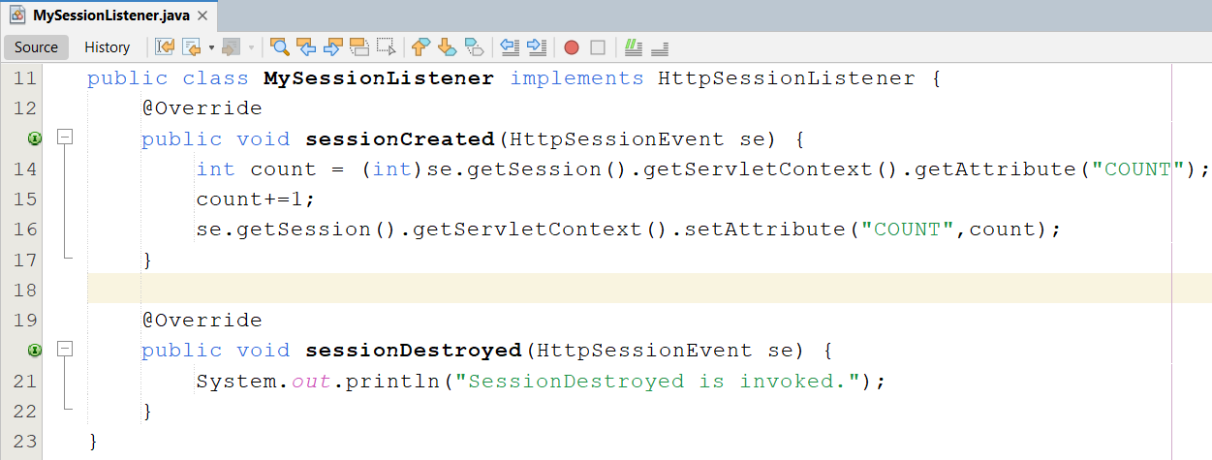
Demo Session Listeners
#2. Create SessionListener

Slide 26
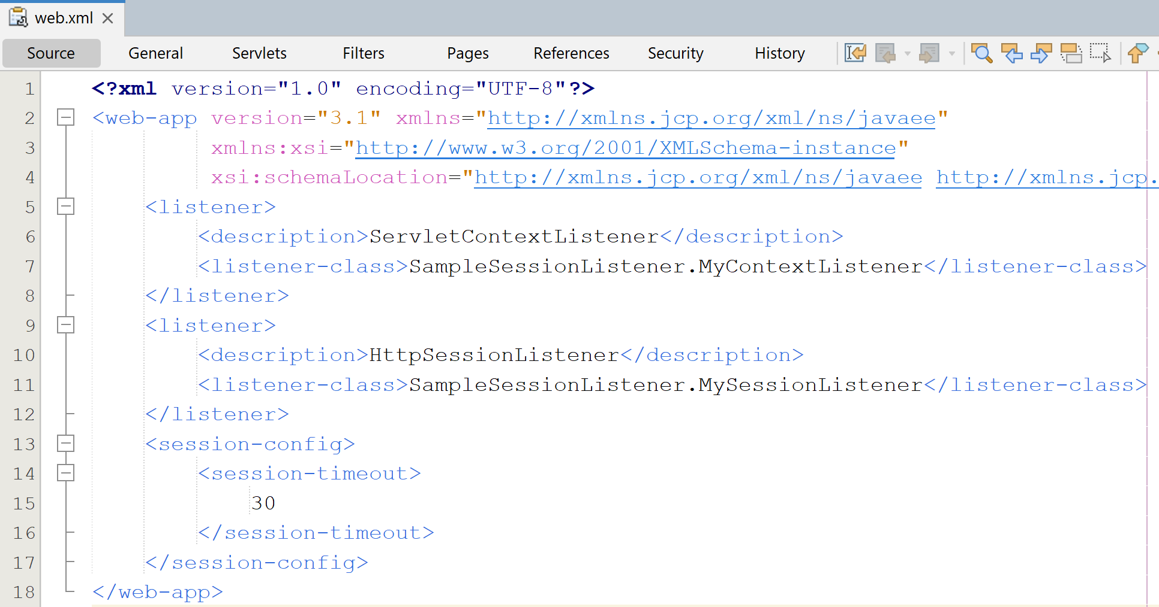
Demo Session Listeners
#3. Config in web.xml
<listener>
<description>ServletContextListener</description>
<listener-class>SampleSessionListener.MyContextListener</listener-class>
</listener>
<listener>
<description>HttpSessionListener</description>
<listener-class>SampleSessionListener.MySessionListener</listener-class>
</listener>

Slide 27
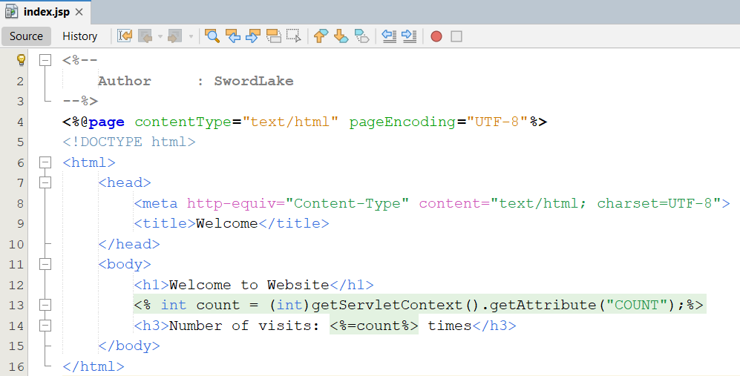
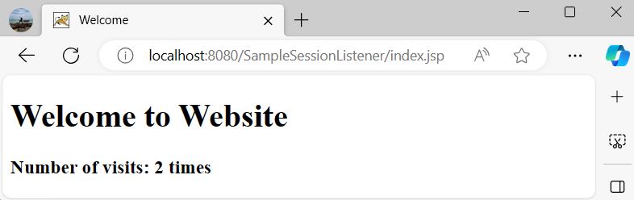
Demo Session Listeners
#4. Create Index.html
#5. Run the project

Slide 28


Summary
What is Event Listeners?
What it can be used for ?
Describe servlet event listeners
Event Categories and Listener Interfaces
Typical Event Listener Scenario
Event Listener Declaration and Invocation
Event Listener Coding and Deployment Guidelines
Event Listener Methods and Related Classes
4. More Details : Appendix – Chapter 05. Session
7/1/2025
‹#›

